Slide 1
Teacher Student Data Link (TSDL)
November 2017

Slide 2
Agenda
Data Uses/Reports
Pipeline Review
Getting Started – What is Required
Timeline
Resources

Slide 3
Data Uses: Reporting and Analysis
Public District Course Directory (public)
Interact tool allows users to view and identify courses a district offers
Released to the public on Nov 1, 2017
Report uses state course code data
http://www2.cde.state.co.us/schoolview/coursedirectory/districtcoursedirectorydata.asp
Educator Preparation Performance Report (development):
Review of teacher preparation programs pursuant to 23-1-121
Report will use TSDL (both course enrollment and course instructor) and state course code

Slide 4
Data Reporting – CRDC on behalf of districts
Since 1968, the U.S. Department of Education (ED) has conducted the Civil Rights Data Collection (CRDC) to collect data on key education and civil rights issues in our nation's public schools
Previously, all data was reported directly from the LEA to ED. Starting for the 2013-14 collection, CDE pre-populates data if possible based on data reported from LEAs to CDE
Collection is completed every other year
TSDL data elements provide 23% of all data elements CDE pre-populates for LEAs

Slide 5
Authority To Collect
Derived from both Colorado Revised Statutes (C.R.S) and the Colorado State Board of Education’s rules:
Concerning Statutory Changes to K-12 Education, House Bill 13-12-19: 22-2-116.5
Course Participation and Student Proficiency Reports, House Bill 14-1376: 22-11-503.5
Monitoring of Written Evaluation System, C.R.S. 22-9-106 (1.5) (a-b)
Rules for administration of a statewide system to evaluate the effectiveness of licensed personnel employed by school districts and boards of cooperative services 1 CCR 301-87(6.04) (i), (A), (C) (2) (b, d, and e), and (C) (3) (a).
Commissioner Duties - reviewing the content of educator preparation programs in Colorado, C.R.S. 22-2-112 (p-q)

Slide 6
Pipeline Review

Slide 7
Glossary of Terms
Term | Definition
Cognos | A type of report in which the user can view applicable reports that are formatted in a user friendly environment
Data Pipeline | A streamlined approach to efficiently move required education information from school districts to the CDE
Interchange | The method of providing data to CDE in which LEA’s may choose from multiple file formats to submit data transactions throughout the year.
LAM | Local Access Manager responsible for assigning the appropriate access to CDE applications
LEA | Local Education Agencies
IdM | Identity Management. A single sign on system, allowing the user to navigate between the applications without entering user ID information a second time.
Snapshot | A date in time when data is pulled from the appropriate interchanges, validated by additional business rules, and approval given that signifies it was accurately reported for a specific point in time by an LEA

Slide 8
Training Opportunities
Town Hall occurs every Thursday from 9 to 10 am
Monthly webinars scheduled to review and discuss the Teacher Student Data Link Interchange and Snapshot:
Every 2nd Tuesday of the month from 1 to 2pm
To join webinar:
https://cdeinfotech.adobeconnect.com/data_services/
Call in number: 1-855-397-4421
Reminders will be sent via email

Slide 9
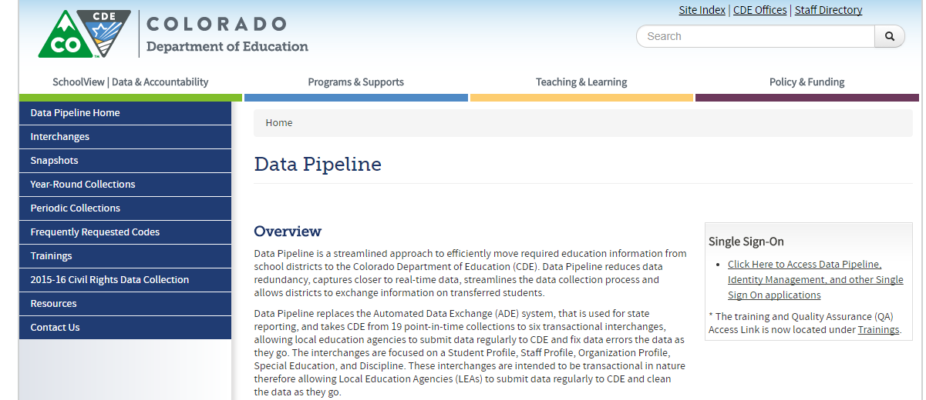
Website Overview
https://www.cde.state.co.us/datapipeline
For Teacher Student Data Link Interchange Information
To Log In Pipeline System:
click here
For Teacher Student Data Link Snapshot Information
Codes – frequently used codes are found here (district codes, school codes, institutes of higher education, etc.)
Collection dates, Mandatory Collections- legislation and uses, converting csv files to excel, etc.

Slide 10
Website Overview - Interchanges
Teacher Student Data Link
Deadlines
File Layouts and Field Definitions with Codes
Training
Templates
Business Rules
Additional Resources

Slide 11
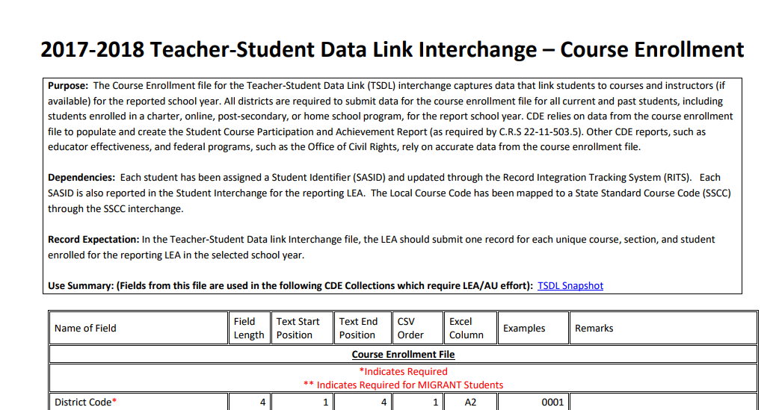
Screenshot of Course Enrollment File Layout
Definitions - Every Field Name included in the File Layout will have a corresponding “Definition” listed under the file layout table
We also include any changes in the document at the bottom of it.

Slide 12
Website Overview – Interchanges (cont.)
Standard Course Codes (SSCC)
Deadlines
File Layouts and Field Definitions with Codes
Training
Templates
Business Rules
Additional Resources

Slide 13
Website Overview – Snapshots
Teacher Student Data Link
Information for 2017-2018 will be updated in December

Slide 14
Getting Started –
What is Required?

Slide 15
Identity Management Roles
Teacher Student Data Link Interchange Roles:
TSL~ LEAUSER – upload and modify TSDL interchange files OR
TSL~LEAVIEWER – view (only) TSDL interchange data
Teacher Student Data Link Snapshot Roles:
TLS~LEAAPPROVER – Approves, creates, views Snapshot OR
TLS~LEAUSER - creates, views Snapshot OR
TLS~LEAVIEWER- views snapshot

Slide 16
Course Codes
ALL Local Course Codes must be mapped to a State Standard Course Code
Use the SSCC (State Standard Course Code) system to map your local course codes
https://www.cde.state.co.us/datapipeline/sscc-details
Available now for update
Option available to roll over courses from 2016-17 to 2017-18
Even if you use the Standard Course Codes as your Local Course Code- they need to be mapped within the system

Slide 17
Required K-12 Courses
Mathematics
Science
Social Studies
English Language Arts
All other courses may be included but are not required to be reported

Slide 18
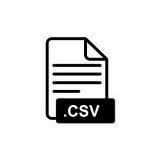
Creating Files
Pull data files from SIS Extract
Create Course Enrollment File and Create Course Instructor File
File Layouts found online at: https://www.cde.state.co.us/datapipeline/inter_teacherstudent
File Requirements:
Excel, CSV or Text File all accepted
Need 2 separate files
1st record of data must be field names/titles

Slide 19
Tips on Files
Excel, CSV, or Text formats are accepted
Simple Excel template for Course Enrollment and Course Instructor Files posted online https://www.cde.state.co.us/datapipeline/inter_teacherstudent under Templates (however, it is not necessary to use a template if your file already extracts in one of the accepted formats)
No spaces in file name
No blank fields
Be sure the file is not open when uploading
Be sure you haven’t lost all your leading zeros on a CSV file or it won’t upload (steps for saving them posted online)

Slide 20
Interchange Files
Course Enrollment
All students enrolled in a required course (mathematics, science, social studies, and English language arts) for at least 4 consecutive weeks
Each record must be unique based on: school code, local course code, section number, SASID , student's grade level and term
Course Instructor
All teachers teaching the required courses reported in the course enrollment file for at least 4 consecutive weeks
Each record must be unique based on: school code, local course code, section number, EDID and term

Slide 21
TSDL Fields
Course Enrollment File
Course Instructor File
Name of Field
School District/BOCES Code
School Code
Local Course Code
Section Number
SASID
Student's Last Name
Student's First Name
Student's Gender
Student's Date of Birth
Roster Start Date
Roster End Date
Student’s Grade Level
Term
Credits Granted
Final Grade/Course Completion Status
Name of Field
School District/BOCES Code
School Code
Local Course Code
Section Number
EDID
Staff's Last Name
Staff's First Name
Staff's Gender
Staff's Date of Birth
Term
Staff Role
Used to link records in the TSDL Snapshot

Slide 22
Interchange Process
Upload files in Data File Upload
Review Batch Maintenance
Review Error Reports in Cognos/Pipeline
Correct Data Files in Source System
Create/Update Data Files
- Continue until all errors are resolved

Slide 23
Timeline

Slide 24
TSDL Interchange Timeline
Prior to TSDL files:
Statewide Standard Course Code Submission
Open year round
Student Interchange Files uploaded
Staff Interchange Files uploaded
Interchange:
Open Wednesday, November 15th 2017
Remains open throughout the year

Slide 25
TSDL Snapshot Timeline
Date | Event
Wednesday, Nov 15th 2017 | Interchange open
Wednesday, Jan 17th 2018 | Snapshot open
Friday, June 1st 2018 | Target: All districts create a TSDL snapshot
Friday, June 15th 2018 | Target: TSDL Interchange files error free
Friday, June 22nd 2018 | Target: TSDL Snapshot error free
Friday, June 29th 2018 | Soft Deadline: Recommended date to finalize the TSDL snapshot. After this date, many school systems roll over to the next school year.
Friday, August 31st 2018 | Deadline: Snapshot must be finalized

Slide 26
Webinar Trainings
Date/Time | Topic
Tuesday, November 14th 1 -2 pm | Getting Started – What is Required?
Tuesday, December 12th 1 -2 pm | TSDL Interchange Updates and Process
Tuesday, January 9th 1 -2 pm | TSDL Interchange Edits Guide
Tuesday, February 13th 1 -2 pm | TSDL Snapshot Process
Tuesday, March 13th 1 -2 pm | Overall Process Review (Interchange and Snapshot)
Tuesday, April 10th 1 -2 pm | TSDL Snapshot Edits and Reports
Tuesday, May 8th 1 -2 pm | TSDL Interchange Review
Tuesday, June 12th 1 -2 pm | Reports Review and Finalizing Steps
Tuesday, July 10th 1 -2 pm | Status Check – Who’s Remaining?
Tuesday, August 14th 1 -2 pm | Final Review

Slide 27
Resources and Contact Information

Slide 28
Thank You for Joining!
Our next TSDL webinar will be December 12th from 1 – 2 pm
2017-18 File Layout Updates and the TSDL Interchange Process

Slide 29
TSDL Interchange Resources
Course Code Documentation found at:
https://www.cde.state.co.us/datapipeline/sscc-details
TSDL Interchange Documentation found at: http://www.cde.state.co.us/datapipeline/inter_teacherstudent
Deadlines
File layouts and definitions
Defects
Business Rules
Trainings
Additional Resources – Frequently Asked Questions
Contact:
Annette Severson: severson_a@cde.state.co.us or 303-866-6824
Please note – I will be unavailable the week of Thanksgiving but can provide assistance upon my return (Monday, November 27th)

