Slide 1
SPECIAL EDUCATION DISCIPLINE REPORT TRAINING
2016-2017

Slide 2
All About Reports (with a little bit of Finalizing Thrown in for good measure)
What Kind of Reports Are Available?
Where Can I Find Reports?
What Reports Require The Special Education Director’s Signature?
What Reports Assist in Validating Signed Reports?
Where and When Do I Send Reports?

Slide 4
Throughout the year schools are tracking discipline events for students with disabilities.
Beginning in April, district respondents begin uploading the “Discipline Action” file containing the discipline events of students with disabilities from the current reporting period to the data pipeline.
By July 12th the districts have worked through any related interchange errors. Ensuring all data that is to be reported has been reported.
Discipline Action File Uploaded Interchange Errors Resolved
07/12/2017

Slide 5
Administrative Units create Snapshots triggering Snapshot level errors ensuring the data is valid and reliable.
By August 15th, a Complete Special Education Discipline Snapshot has been created.
Snapshot Errors Resolved
08/15/2017

Slide 6
Once Interchange and Snapshot errors have been resolved it’s time to dive into reviewing reports.
Report Review
08/16/2017-08/23/2017

Slide 7
What Reports Require Signatures?
When are they due?
Reports Signed & Uploaded to the DMS
08/23/2017

Slide 8
Discipline Action File Uploaded Interchange Errors Resolved
07/12/2017
Snapshot Errors Resolved
08/15/2017
Report Review
08/16/2017-08/23/2017
Reports Signed & Uploaded to the DMS
08/23/2017

Slide 9
SPED Discipline Reports
Resolve Snapshot Errors
Report Review Week
Reports signed and Uploaded to the DMS
8/15/2017
8/16-8/23
8/23/2017

Slide 10
REPORTS AVAILABLE TO RESOLVE SNAPSHOT ERRORS

Slide 11
Reports to Help Identify Snapshot Errors and Warnings
District Activity Report
SPED Error Detail Report (Warnings will stay on the Error Report)
SPED Incident and School Enrollment Date Comparison Report (SD017)
SPED Snapshot Records Excluded Due to Profile Errors

Slide 12
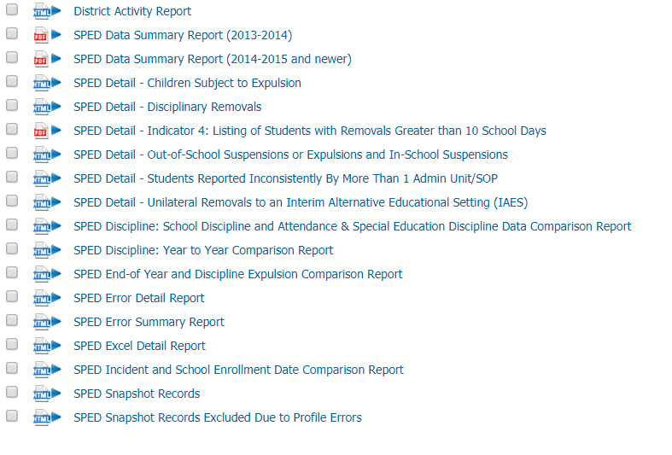
Cognos Reports Available to help resolve Errors

Slide 13
District Activity Report
District | File | BatchID | Submitter | Date Processed | Processed Indicator | # of Records | # of Errors | # of Warnings
1234 | Discipline Action | ##### | Who | Day & Time | Y or N | # | # | #
1234 | Student Demographic | ##### | Who | Day & Time | Y or N | # | # | #
1234 | Student School Association | ##### | Who | Day & Time | Y or N | # | # | #
4321 | Discipline Action | ##### | Who | Day & Time | Y or N | # | # | #
4321 | Student Demographic | ##### | Who | Day & Time | Y or N | # | # | #
4321 | Student School Association | ##### | Who | Day & Time | Y or N | # | # | #
Look for
Submitted By - Not Loaded
Date Processed – how does that coincide with when Snapshot was created?
Processed Indicator N
Processed Indicator Y but Number of Records 0
Number of Errors – if Discipline Errors check Excluded Report. If student errors check with Submitter

Slide 14
August 15, 2017
Error Free
Date by which all Interchange and Snapshot Errors are Resolved and Warnings have been Reviewed.
For Administrative Units – All data records needed for the Special Education Discipline snapshot should be uploaded and passed interchange (level 1) and Snapshot (level 2) edit validations.

Slide 15
WARNINGS
DA025 - Under Colorado statute, a student may not be suspended for more than 25 school days for any disciplinary incident (CRS 22-33-105).
SD021 - Student's age is outside of the expected range for the reported grade.
SD022 - The following record(s) have a duplicate record (discipline, action length, and incident date combination matches)
Please review the data submitted to ensure that it is valid.

Slide 17
Review Week Reports
Report review week is August 16-23.
All changes identified during the report review must be made by August 23, 2017
By August 23rd the director must be ready to sign the AU’s SPED Data Summary Report and the Year to Year Comparison Report, assuring the CDE that the data is valid and reliable.

Slide 18
SNAPSHOT REPORTS
SNAPSHOT
Detail Reports
Signature Reports

Slide 19
COGNOS Reports
Notes:
`

Slide 20
SNAPSHOT RECORDS REPORT
These are all the records recorded in your SPED Discipline Snapshot
You can use this as a reference when questions arise from other reports.
It’s a good idea to download the report in Excel choosing the 2007 Format
Count how many rows of data records there are.

Slide 21
Students Reported Inconsistently by More Than 1 Administrative Unit
This report is for your information to ensure you have reported demographic and primary disability accurately.
The report will provide data that is inconsistent between you and other Administrative Units
The Errors appearing here may be legitimate entries.
For example a student’s disability identification may have changed at a mid-year staffing
A student’s parents may choose to report race differently when they move to a new district (A student is identified “Hispanic,” then “2 or More Races”)
Investigate things that don’t make sense

Slide 22
SIGNATURE REPORTS
DISTRICT
Superintendent Sign-Off Form
(requested by Special Education Directors for data assurance purposes)
ADMINISTRATIVE UNIT
Data Summary Report (14 Pages)
Year to Year Report (13 Pages)
Year to Year Flag Explanation Document (WORD)

Slide 23
Superintendent Sign-Off Form
Report Contains the following data:
Unilateral Removals to an Interim Alternative Educational Setting by School Personnel
(B) Drugs (C) Weapons (D)Serious Bodily Injury
Removals to an Interim Alternative Educational Setting Based on a Hearing Officer Determination Regarding Likely Injury
Out-of-School Suspensions or Expulsions
(A) Number of Children with Out-of-School Suspensions/Expulsions Totaling 10 Days or Less
(B) Number of Children with Out-of-School Suspensions/Expulsions Totaling Greater than 10 Days
In-School Suspensions
(A) Number of Children with In-School Suspensions Totaling 10 Days or Less
(B) Number of Children with In-School Suspensions Totaling Greater than 10 Days
Disciplinary Removals
(A) Total Disciplinary Removals
(B) Number of Children with Disciplinary Removals Totaling 1 Day or Less
(C) Number of Children with Disciplinary Removals Totaling 2-10 Days
(D) Number of Children with Disciplinary Removals Totaling Greater than 10 Days
Children Subject to Expulsion
(A) Received Educational Services During Expulsion
(B) Did Not Receive Education Services During Expulsion

Slide 24
Superintendent Sign-Off Form
This report is DUE to Kristi Gleason by August 23. Districts with Exempt status may send the report in prior to the 23rd.
To reduce paperwork, the superintendent should email or fax the full report directly to Kristi Gleason (it does not have to be collected by the AU and uploaded to the DMS).
Fax # for this report 303-866-6888 – “Attention: Kristi Gleason”

Slide 25
2 Special Education Discipline Director Signed Reports + Flag Explanations
SPED Data Summary Report (2014-2015 and newer)
SPED Year to Year Comparison Report
+ Special Education Discipline Flag Explanations
Notes:
Revenant data for Indicator 4 can be found in the Data Summary Report. The report with the heading “Indicator 4” has been changed to a detail report and does not need to be submitted to the CDE.

Slide 26
SPED Data Summary Report
The report has 5 Sections
Section A: Disciplinary Removal Type by Disability (pp. 1-3)
Section B: Disciplinary Removal Type by Race/Ethnicity (pp. 4-6)
Section C: Disciplinary Removal Type by Gender (pp. 7-9)
Section D: Disciplinary Removal Type by English Language Learner Status(pp. 10-12)
Section E: Children subject to expulsion who did and did not receive educational services by Disability Status (p. 13)

Slide 27
SPED Data Summary Report
Sections A-D contain counts of discipline events and counts of children with disabilities by:
Unilateral removal by school personnel following a drug or weapon offense or serious bodily injury
Removal based on a hearing officer determination regarding likely injury
Suspension (both In-School and Out-of-School totaling less than 10 school days and totaling more than 10 school days
Expulsion with and without educational services.
TIP: The TOTALS for these areas should be the same across Sections A-D

Slide 28
SPED Data Summary Report
The final section, “Section E: Children subject to expulsion who did and did not receive educational services by disability status” is on page 13.
Note: Children with disabilities must receive educational services during an expulsion of more than 10 school days. The only children with disabilities who should be reported as not receiving services are those who were removed for less than 10 school days after an expulsion.
This is very rare, only 13 out of the 155 students expelled did not receive services last year (Section E-6(B)).

Slide 29
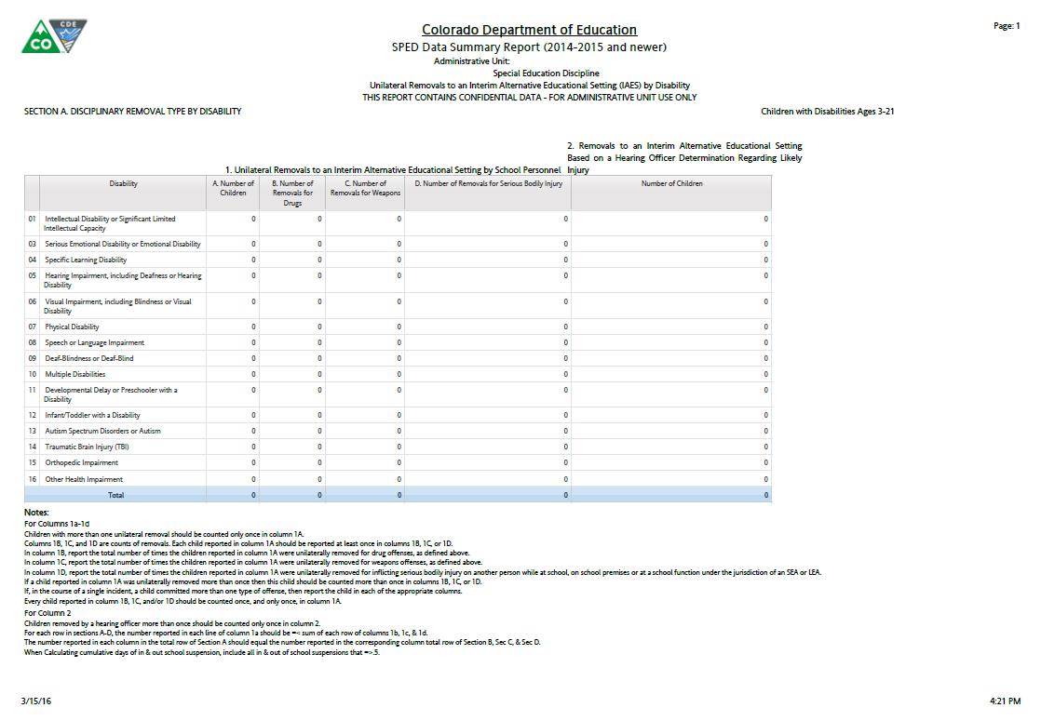
Section A: Disciplinary Removal by Disability.
If a child reported in column 1A was unilaterally removed to an Interim Alternative Educational Setting more than once then this child should be counted more than once in columns 1B,1C,1D. If, in the course of a single incident, a child committed more than one type of offense, then report the child in each of the appropriate columns.
Notes:
This slide provides information related specifically to Removals
Section 1A: Number of Children Unilaterally Removed to an IAES by School Personnel
Section 1B: Number of Times students were Unilaterally Removed to an IAES for Drugs
Section 1C: Number of Times students were Unilaterally Removed to an IAES for Weapons
Section 1D: Number of Times students were Unilaterally Removed to an IAES for Serious Bodily Injury
Section 2: Number of Children Removed to an IAES by a Hearing Officer for Serious Bodily Injury
Sections 1 & 2 are broken out by Primary Disability, Federal Race/Ethnicity Reporting category, Gender, and ELL status

Slide 30
Section A: Disciplinary Removal by Disability.
1A. Report the number of children ages 3-21 who were unilaterally removed for drugs, weapons, serious bodily injury. The child should only be counted once here.
1B. Report the total number of times the children reported in column 1A were unilaterally removed for Drug offenses.
1C. Report the total number of times the children reported in column 1A were unilaterally removed for Weapon offenses.
1D. Report the total number of times the children reported in column 1A were unilaterally removed for Serious Bodily Injury offenses.
Notes:
This slide provides information related specifically to Removals
Section 1A: Number of Children Unilaterally Removed to an IAES by School Personnel
Section 1B: Number of Times students were Unilaterally Removed to an IAES for Drugs
Section 1C: Number of Times students were Unilaterally Removed to an IAES for Weapons
Section 1D: Number of Times students were Unilaterally Removed to an IAES for Serious Bodily Injury
Section 2: Number of Children Removed to an IAES by a Hearing Officer for Serious Bodily Injury
Sections 1 & 2 are broken out by Primary Disability, Federal Race/Ethnicity Reporting category, Gender, and ELL status

Slide 31
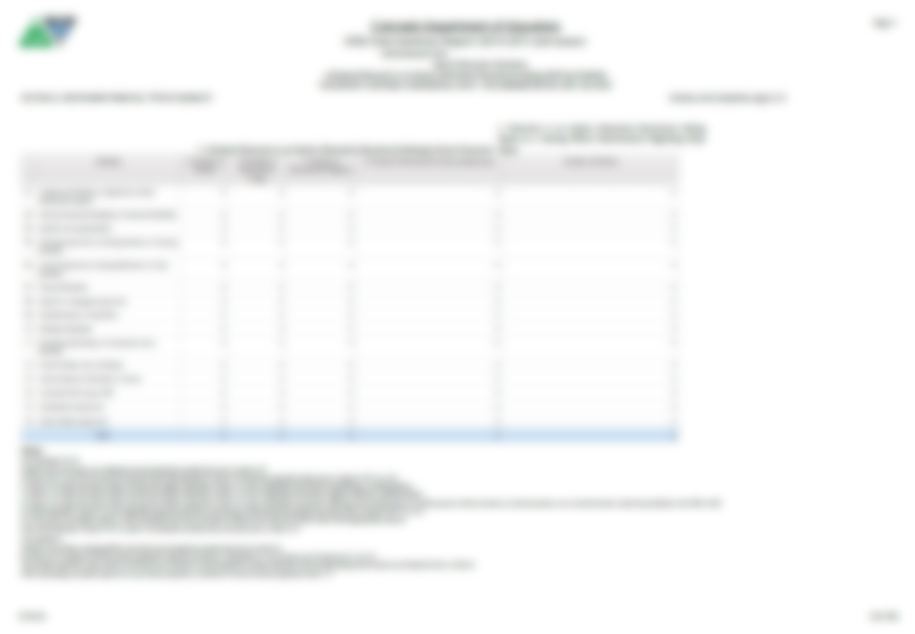
Section A: Disciplinary Removal by Disability.
Report the number of children ages 3-21, who were removed to an IAES based on a Hearing Officer Determination of likely injury to themselves or others. Children removed by a hearing officer more than once should be counted only once in column 2.
Notes:
This slide provides information related specifically to Removals
Section 1A: Number of Children Unilaterally Removed to an IAES by School Personnel
Section 1B: Number of Times students were Unilaterally Removed to an IAES for Drugs
Section 1C: Number of Times students were Unilaterally Removed to an IAES for Weapons
Section 1D: Number of Times students were Unilaterally Removed to an IAES for Serious Bodily Injury
Section 2: Number of Children Removed to an IAES by a Hearing Officer for Serious Bodily Injury
Sections 1 & 2 are broken out by Primary Disability, Federal Race/Ethnicity Reporting category, Gender, and ELL status

Slide 32
Section A: Disciplinary Removal by Disability.
This page, with columns 1A, 1B, 1C, 1D & 2 will repeat for:
Section A: Disability
Section B: Race/ Ethnicity
Section C: Gender and
Section D: ELL Status.
The report will use the Federal Race/
Ethnicity Reporting Category for the Race/Ethnic codes. The totals should match across all 4 pages.
Notes:
This slide provides information related specifically to Removals
Section 1A: Number of Children Unilaterally Removed to an IAES by School Personnel
Section 1B: Number of Times students were Unilaterally Removed to an IAES for Drugs
Section 1C: Number of Times students were Unilaterally Removed to an IAES for Weapons
Section 1D: Number of Times students were Unilaterally Removed to an IAES for Serious Bodily Injury
Section 2: Number of Children Removed to an IAES by a Hearing Officer for Serious Bodily Injury
Sections 1 & 2 are broken out by Primary Disability, Federal Race/Ethnicity Reporting category, Gender, and ELL status

Slide 33
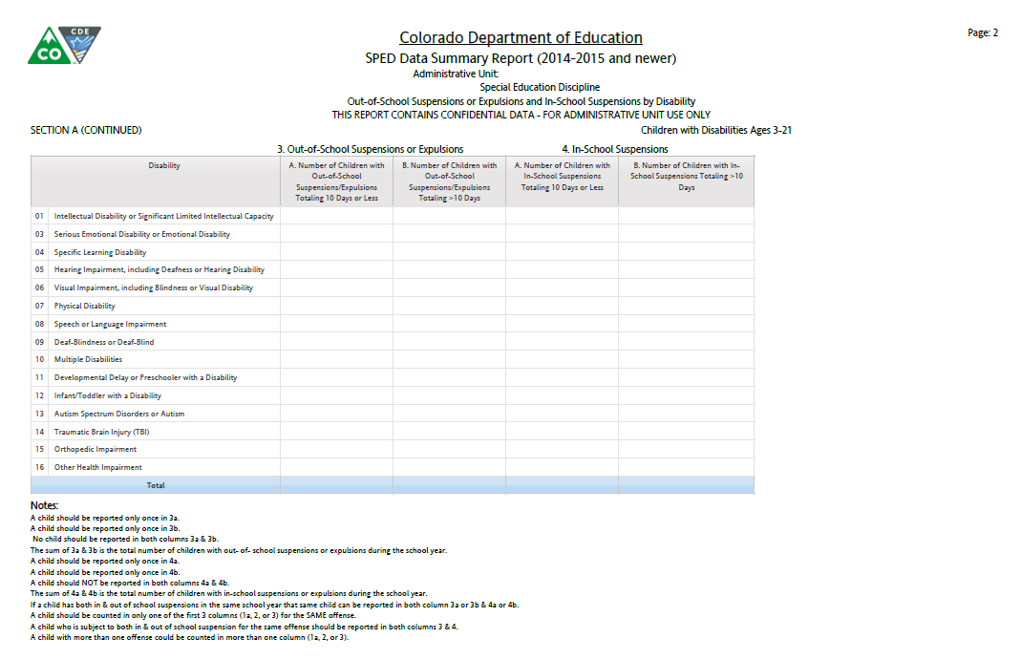
A child who is subject to both an In-School Suspension and an Out-of-School Suspension for the same offense should be reported in both subsections 3 and 4.
Notes:
This slide provides information related specifically to In-School Suspensions Section 4A and 4B as well as Out-of-School Suspensions and Expulsion Section 3A and 3B.
Section 3A: Number of Children with Out-of-School Suspensions and/or Expulsions summing to 10 days or less
Section 3B: Number of Children with Out-of-School and/or Expulsions summing to more than 10 days. (This is the column that is used for Indicator 4 calculations of AU rate and significant discrepancy)
Section 4A: Number of Children with In-School Suspensions summing to 10 days or less
Section 5A: Number of Children with In-School Suspensions summing to more than 10 days
Information related to In-School Suspensions, Out-of-School Suspensions/Expulsions is broken down by Primary Disability, Federal Race Reporting Category, Gender, and ELL Status.

Slide 34
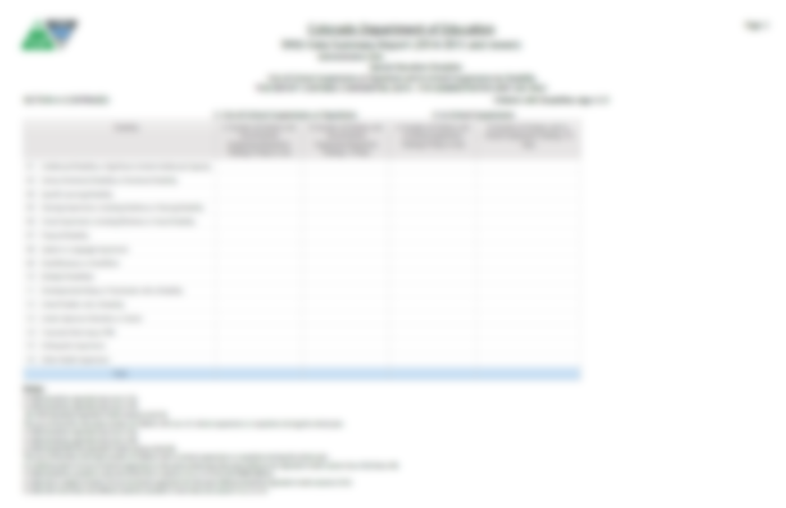
Report the number of children ages 3-21 with Out-of-School Suspensions or Expulsions summing to 10 days or less during the school year for any offense or combination of offenses. No child should be reported more than once in column 3A.
Report the number of children ages 3-21 with Out-of-School Suspensions or Expulsions summing to more than 10 days during the school year for any offense or combination of offenses. No child should be reported more than once in column 3B.
Notes:
This slide provides information related specifically to In-School Suspensions Section 4A and 4B as well as Out-of-School Suspensions and Expulsion Section 3A and 3B.
Section 3A: Number of Children with Out-of-School Suspensions and/or Expulsions summing to 10 days or less
Section 3B: Number of Children with Out-of-School and/or Expulsions summing to more than 10 days. (This is the column that is used for Indicator 4 calculations of AU rate and significant discrepancy)
Section 4A: Number of Children with In-School Suspensions summing to 10 days or less
Section 5A: Number of Children with In-School Suspensions summing to more than 10 days
Information related to In-School Suspensions, Out-of-School Suspensions/Expulsions is broken down by Primary Disability, Federal Race Reporting Category, Gender, and ELL Status.

Slide 35
Report the number of children ages 3-21 with In-School Suspensions summing to 10 days or less during the school year for any offense or combination of offenses. No child should be reported more than once in column 4A.
Report the number of children ages 3-21 with In-School Suspensions summing to more than 10 days during the school year for any offense or combination of offenses. No child should be reported more than once in column 4A.
Notes:
This slide provides information related specifically to In-School Suspensions Section 4A and 4B as well as Out-of-School Suspensions and Expulsion Section 3A and 3B.
Section 3A: Number of Children with Out-of-School Suspensions and/or Expulsions summing to 10 days or less
Section 3B: Number of Children with Out-of-School and/or Expulsions summing to more than 10 days. (This is the column that is used for Indicator 4 calculations of AU rate and significant discrepancy)
Section 4A: Number of Children with In-School Suspensions summing to 10 days or less
Section 5A: Number of Children with In-School Suspensions summing to more than 10 days
Information related to In-School Suspensions, Out-of-School Suspensions/Expulsions is broken down by Primary Disability, Federal Race Reporting Category, Gender, and ELL Status.

Slide 36
This page with columns 3A/B and 4A/B will also repeat for:
Section A: Disability
Section B: Race/ Ethnicity
Section C: Gender and
Section D: ELL Status.
Notes:
This slide provides information related specifically to In-School Suspensions Section 4A and 4B as well as Out-of-School Suspensions and Expulsion Section 3A and 3B.
Section 3A: Number of Children with Out-of-School Suspensions and/or Expulsions summing to 10 days or less
Section 3B: Number of Children with Out-of-School and/or Expulsions summing to more than 10 days. (This is the column that is used for Indicator 4 calculations of AU rate and significant discrepancy)
Section 4A: Number of Children with In-School Suspensions summing to 10 days or less
Section 5A: Number of Children with In-School Suspensions summing to more than 10 days
Information related to In-School Suspensions, Out-of-School Suspensions/Expulsions is broken down by Primary Disability, Federal Race Reporting Category, Gender, and ELL Status.

Slide 37
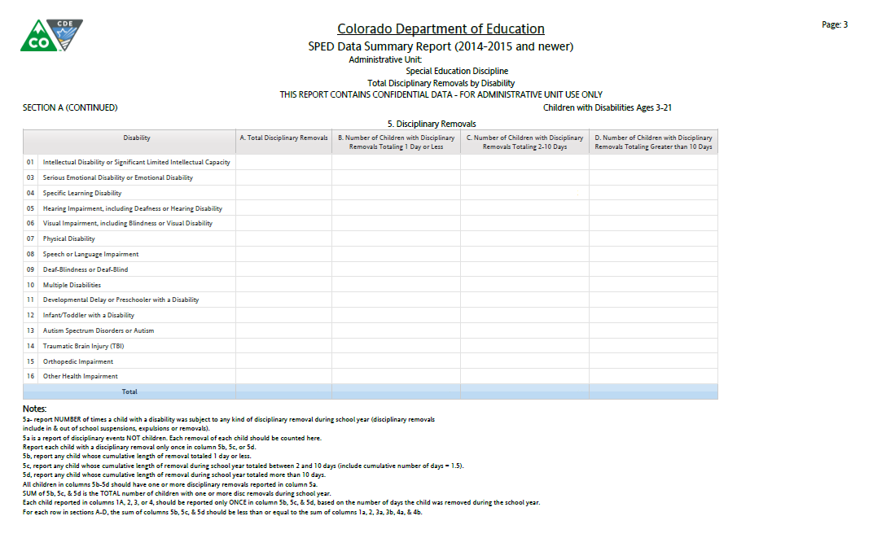
All children reported in columns 5B through 5D should have one or more disciplinary removals reported in column 5A. The sum of 5B, 5C, and 5D is the total number of children with one or more disciplinary removals during the school year. Each child reported in columns 1A, 2,3 or4 should be reported only ONCE in column 5B, 5C, or 5D, based on the cumulative number of days the child was removed during the school year.
Notes:
This slide provides information shows ALL disciplinary incidences including Unilateral Removals by School Personnel, Unilateral Removals by a Hearing Officer, In-School Suspensions, Out-of-School Suspensions and Expulsions and broken down by Primary Disability, Federal Race Reporting Category, Gender, and ELL Status.
Section5A: Number of Times child was subject to any disciplinary action
Section 5B: Report of Children with cumulative length of removal for any disciplinary incident during the reporting period totaling 1 day
Section 5C: Report on Children with cumulative length of removal for any disciplinary incident during the reporting period totaling 2-10 days. (Please pay special attention to Column 5 C = 2-10 days which includes 1.5 cumulative length of removal during the school year).
Section 5D: Report on Children with cumulative length of removal for any disciplinary incident during the reporting period totaling greater than 10 days.

Slide 38
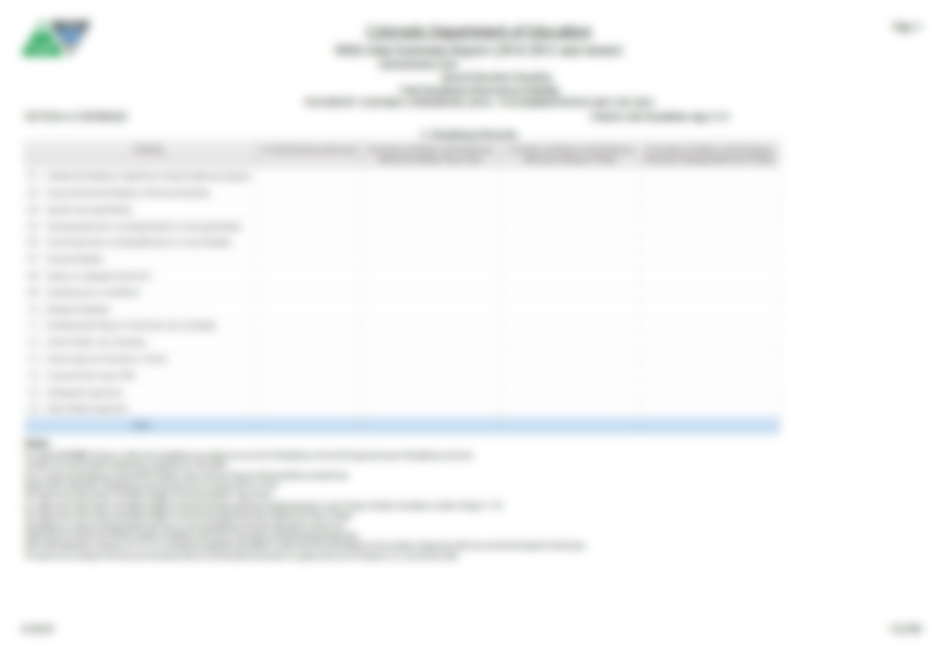
Report the number of times any child with a disability was subject to any of the following disciplinary actions during the school year: In-School or Out-of-School Suspensions, Expulsion, Removals by School Personnel to an IAES or by a Hearing Officer.
Report any child whose cumulative length of removal during the school year totaled 1 day.
Report any child whose cumulative length of removal during the school year totaled between 2 and 10 days.
NOTE: This Includes 1.5 cumulative length of removal during the school year.
Report any child whose cumulative length of removal during the school year totaled more than 10 days.
Remember our little owl back on the Snapshot Records report? Does this number match the record number?
Notes:
This slide provides information shows ALL disciplinary incidences including Unilateral Removals by School Personnel, Unilateral Removals by a Hearing Officer, In-School Suspensions, Out-of-School Suspensions and Expulsions and broken down by Primary Disability, Federal Race Reporting Category, Gender, and ELL Status.
Section5A: Number of Times child was subject to any disciplinary action
Section 5B: Report of Children with cumulative length of removal for any disciplinary incident during the reporting period totaling 1 day
Section 5C: Report on Children with cumulative length of removal for any disciplinary incident during the reporting period totaling 2-10 days. (Please pay special attention to Column 5 C = 2-10 days which includes 1.5 cumulative length of removal during the school year).
Section 5D: Report on Children with cumulative length of removal for any disciplinary incident during the reporting period totaling greater than 10 days.

Slide 39
Section E: Children Subject to Expulsion With and Without Educational Services by Disability Status.
Section 6: Children Subject to Expulsions:
6A: Received Education Services During Expulsion
6B: Did NOT receive Educational Services During Expulsion.
Children with disabilities must receive educational services during any suspension or expulsion of more than 10 school days. The only children with disabilities who should be reported in column 6B are those who were expelled for less than 10 school days (e.g., children with disabilities expelled under the Gun-Free Schools Act whose expulsions were modified to less than 10 school days or who were expelled at the end of a term, like 8 days before school was out for the summer).
If the student was expelled for more than 10 days and did not receive services, they must be reported in column 6B and this removal is non-compliant.
Notes:
This slide provides the data relative to Expulsions with services and without services.
Section 6A: Report of children who were subject to expulsion during the reporting period and received educational services during the expulsion
Section 6B: Report of children who were subject to expulsion during the reporting period and did NOT receive educational services during the expulsion.
CDE will be contacting Aus in regard to discrepancies in reporting’s of expulsions reported in the Special Education Discipline collection as well as the Special Education EOY collection.
Children with disabilities must receive services during any suspension or expulsion of more than 10 school days. The only children with disabilities who should be reported in column 6b are those who were removed for less than 10 school days after an expulsion (e.g. children with disabilities expelled under the Gun-Free Schools Act who expulsions were modified to less than 10 school days).

Slide 40
Incidences of Expulsions where the student did NOT receive services reported in the Discipline collection will be cross referenced with students reported with a Basis of EOY Student Collection. Exit Code 50 – Expulsions in the SPED.
Report the number of children with disabilities ages 3-21 who were subject to expulsion during the school year and who received educational services during the expulsion.
Report the number of children with disabilities ages 3-21 who were subject to expulsion during the school year and did NOT receive educational services during the expulsion.
Notes:
This slide provides the data relative to Expulsions with services and without services.
Section 6A: Report of children who were subject to expulsion during the reporting period and received educational services during the expulsion
Section 6B: Report of children who were subject to expulsion during the reporting period and did NOT receive educational services during the expulsion.
CDE will be contacting Aus in regard to discrepancies in reporting’s of expulsions reported in the Special Education Discipline collection as well as the Special Education EOY collection.
Children with disabilities must receive services during any suspension or expulsion of more than 10 school days. The only children with disabilities who should be reported in column 6b are those who were removed for less than 10 school days after an expulsion (e.g. children with disabilities expelled under the Gun-Free Schools Act who expulsions were modified to less than 10 school days).

Slide 41
By authorizing this report, you are confirming in writing that the data reported is both valid and reliable.
Notes:
By authorizing this report, you are confirming in writing that the data reported is both valid and reliable.
REMINDER: When you send in the Data Summary Report, please send the 14 page report in it’s entirety.

Slide 42
Year to Year Comparison Report
The report totals 13 pages
A section for “Disability: All” (1 page)
A section for Racial/Ethnic groups (6 pages)
A section for Gender groups (2 pages)
A section for ELL Status groups (2 pages)
The signature page

Slide 43
This page will repeat for all Racial, Gender and ELL Categories
You will only see flags - “A” – if both the number of the change is over 20 students AND the Percent of the Change is over 20%
These are the only data points that require explanation on the Flag Explanations sheet

Slide 44
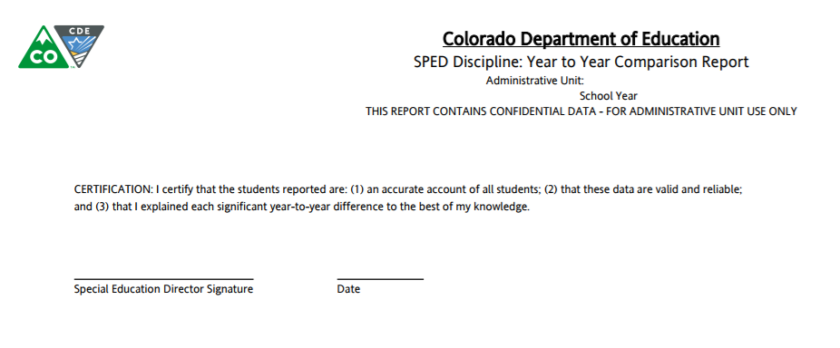
CERTIFICATION: I certify that the students reported are: (1) an accurate account of all students; (2) that these data are valid and reliable; and (3) that I explained each significant year-to-year difference to the best of my knowledge.
By authorizing this report, you are confirming in writing that the data reported is both valid and reliable.
Notes:
By authorizing this report, you are confirming in writing that the data reported is both valid and reliable.
REMINDER: When you send in the Data Summary Report, please send the 14 page report in it’s entirety.

Slide 45
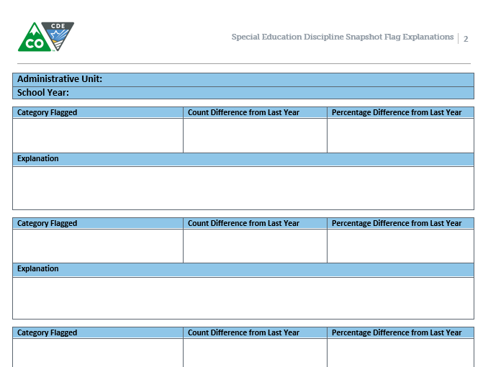
Year to Year Report Flag Explanations
Please remember to provide explanations for the A flags from the Year to Year Report no later than August 23, 2017
The Word Document may be found here under Additional Links http://www.cde.state.co.us/datapipeline/snap_sped-discipline
Remember, you can include multiple flag categories when the same explanation applies
Please remember to upload as

Slide 46
SPED End-of-Year and Discipline Expulsion Comparison Report
SPED Discipline: School Discipline and Attendance (SDA) & Special Education Discipline Data Comparison Report

Slide 47
Special Education EOY/Discipline Expulsion
If you reported an Expulsion Without Services in the Discipline collection (6b) we would expect to see the student with an Exit 50 in the End-of-Year and visa versa.
If you reported an Expulsion with services the student would not have an Exit 50 in the End-of-Year collection.
Data between the two collections is not an Apple to Apple comparison. Please review the report to ensure data is reported accurately.

Slide 48
Special Education EOY/Discipline Expulsion
Type of Suspension/ Expulsion | Action Date | Days Removed
04 | 04282017 | 198 | Too many days removed for an end of year removal. Days removed are from the current reporting period. If expulsion spans two collections only report the number of school days removed in the current reporting period
04 | 04202017 | 175
04 | 09162016 | 7 | The length of removal at the beginning of the year is most likely to short to be an expulsion.

Slide 49
SDA & Discipline Data Comparison

Slide 50
Detail Reports
Unilateral Removals to an Interim Alternative Education Setting (IAES)
1(A), 1(B), 1(C),1(D), 2
Out-of-School Suspensions or Expulsions and In-School Suspensions
3(A), 3(B), 4(A), 4(B)
Disciplinary Removals
5(A), 5(B), 5(C),5(D)
Children Subject to Expulsion
6(A), 6(B)
SPED Excel Detail Report

Slide 51
Detail Reports
Detail Reports were created to assist Districts and Administrative Units validate the Data Summary and Year to Year Comparison Reports
E.G. column 5c – you may have 5 children that are reported with removals from 2-10 days in the Data Summary and Year to Year report but 7 records because a student has more than 1 detail record.
The length of removals for the student meets the criteria and all records are included in the detail report. The student is only reported once in the authorized reports.

Slide 52
SPED Detail – Indicator 4
SPED Detail – Indicator 4
This report is a listing of all student records that appear in the count for Indicator 4.
We do not collect this report as a signed report, it is for your information.
Refer to the SPED Data Summary Report pay special attention to Column 3B
the total for this column is used to determine your Indicator 4A compliance
The data in this column in Section B: Race/Ethnicity is used to determine Indicator 4B compliance

Slide 53
SPECIAL EDUCATION DISCIPLINE REPORT RELATED DEADLINES
Tuesday, August 15, 2017
Date by which you must have generated your complete Special Education Discipline Snapshot dataset by passing all interchange and snapshot validations in preparation for report review.
Wednesday, August 16-August 23, 2017
Report review week.
Review reports in detail and make any data corrections deemed necessary to ensure you are reporting valid and reliable data
All changes must be made by end of day August 23, 2017
Thursday, August 23, 2017
Final report approval, upload signature reports to DMS

Slide 54
August 23, 2017 Deadline
Final report review AND approval.
Date by which the Administrative Unit must approve their completed Special Education Discipline Data Collection Snapshot and;
electronically SUBMIT the data to CDE via the Data Pipeline,
verifying that it’s valid and reliable by uploading the signed Data Summary Report (all 14 pages) and the Year to Year Report (all 13 pages) along with explanations for Flags to the Data Management System.
Districts send in Superintendent Sign-Off Form

Slide 55
Important Dates to Remember
Monday, April 3rd
Discipline Interchange officially open
Monday, May 8th
Date by which the interchanges files must be uploaded: DISCIPLINE/IEP/STUDENT
Thursday, June 8th
Date by which the Admin Unit must generate a snapshot.
Thursday, June 22nd
Date by which 90% of total record count must be included in Discipline Action file
Wednesday, July 12th
Date by which all Discipline Action Interchange errors must be resolved ALL DISTRICTS MET THE DEADLINE!
Tuesday, August 15th
Date by which you must have generated a Complete Snapshot. All data records are included, Interchange & Snapshot Errors resolved
Wednesday, August 16th – Wednesday, August 23rd
Report Review Week. Districts need to be available to make any changes Admin Units deem necessary.
Wednesday, August 23rd
Final Data Approval and Report Submission

Slide 56
Assistance Needed?
If you have ANY questions about the Special Education Discipline Data Collection please feel free to contact us. No question or concern should remain unanswered of unresolved.
We are just a phone call or email away!
Kristi Gleason 303-866-4620 gleason_k@cde.state.co.us Collection Lead
Lindsey Heitman 303-866-5759 heitman_l@cde.state.co.us
Alyssa Ohleyer 303-866-6308 ohleyer_a@cde.state.co.us Exceptional Student Services Unit - Data Management System
Email protocol – please include:
District # and Administrative Unit #
Phone number where you may be reached
Subject of the email
NOTE: Never send files or reports via email – contact us to determine best technical assistance avenue.
Thank you

Slide 57
Thank you for joining us today!

