Slide 1
2015-2016 SPECIAL EDUCATION DISCIPLINE REPORTS

Slide 2
Special Education Discipline Reports

Slide 3
SPED Discipline Reports
Resolve Snapshot Errors
Report Review Week
Reports signed and Uploaded to the DMS
8/16/2016
8/17-8/23
8/24/2016

Slide 4
August 16, 2016
Error Free
Date by which all Interchange and Snapshot Errors are Resolved and Warnings have been Reviewed.
For Administrative Units – All data records needed for the Special Education Discipline snapshot should be uploaded and passed interchange (level 1) and Snapshot (level 2) edit validations.

Slide 5
Reports to Help Identify Snapshot Errors and Warnings
District Activity Report
SPED Error Summary Report – Will show which districts have issues
SPED Error Detail Report – This report should have no errors by August 16, 2016 Review Warnings on this Report
SPED Snapshot Records Excluded Due to Profile Errors – This report should be empty by August 16, 2016.

Slide 6
August 17-23
Review Week
This is your chance to review your reports in detail and make any data corrections you deem necessary to make sure you are reporting valid and reliable data.

Slide 7
Review Week Reports
Report review week is August 17-23.
All changes identified during the report review must be made by August 23, 2016
By August 24 the director must be ready to sign the AU’s SPED Data Summary Report and the Year to Year Comparison Report, assuring the CDE that the data is valid and reliable.

Slide 8
Reports to Review
Notes:
Reports in Blue are Detail Reports, Reports in Green are Signature Reports

Slide 9
SPED Snapshot Records
These are all the records recorded in your SPED Discipline Snapshot
You can use this as a reference when questions arise from other reports.

Slide 10
Students Reported Inconsistently by more than 1 Admin Unit/SOP
The Errors appearing here may be legitimate entries.
For example a student’s disability identification may have changed at a mid-year staffing
A student’s parents may choose to report race differently when they move to a new district (A student is identified “Hispanic,” then “2 or More Races”)
Investigate things that don’t make sense

Slide 11
Detail Reports provide information on the data that makes up the Signature Reports
The SPED Excel Detail Report Combines:
SPED Detail – Unilateral Removals to an Interim alternative Educational Setting (IAES)
SPED Detail – Out-of-School Suspensions or Expulsions and In-School Suspensions
SPED Detail – Disciplinary Removals
SPED Detail – Children Subject to Expulsion
Notes:
The SPED Excel Detail Report contains these 4 other reports, so you have a choice. You can view the reports individually or download all 4 at once in an Excel format. Your Choice!

Slide 12
SPED Detail – Unilateral Removals to an Interim alternative Educational Setting (IAES)
This should not be more than 45 Days
Removal Reason should show 1, 2 or 3 if Removal Type = 1
It should be blank if Removal type = 2
Compare this report to Columns 1A, 1B, 1C, 1D, and 2 in Sections A, B, C, and D in the SPED Data Summary Report
Does this reflect changes you expect to see in the Year-to-Year Comparison Report?
Does the data make sense?
Notes:
1A is the count of students unilaterally removed by staff. 1B, 1C, 1D cover the details of why they were removed. 2 refers to removals by a hearing officer.

Slide 13
SPED Detail – Out-of-School Suspensions or Expulsions and In-School Suspensions
3A = Out-of-School Suspensions/Expulsions = 10 days or less
3B = Out-of-School Suspensions/Expulsions greater than 10 days (Think Indicator 4!)
4A = In-School Suspensions = 10 days or less
4B = In-School Suspensions greater than 10 days
Compare this report to Columns 3A, 3B, 4A, and 4B in Sections A, B, C, and D in the SPED Data Summary Report
Does this reflect changes you expect to see in the Year-to-Year Comparison Report?
Does the data make sense?

Slide 14
SPED Detail – Disciplinary Removals
Compare this report to Column 5A in Sections A, B, C, and D in the SPED Data Summary Report
Does this reflect changes you expect to see in the Year-to-Year Comparison Report?
Does the data in 5B, 5C, and 5D make sense?

Slide 15
SPED Detail – Children Subject to Expulsion
If a student had 2 expulsions you will see them twice in the Detail report but 1 time in the Data Summary Report
6A = Expelled With Services
6B = Expelled Without Services – records in 6B should not be more than 10 days.
Compare this report to Section E in the SPED Data Summary Report
Does this reflect changes you expect to see in the Year-to-Year Comparison Report?
Does the data make sense?

Slide 16
SPED Detail – Children Subject to Expulsion (continued)
This entry does not make much sense. It says that this student was expelled for half a day toward the end of February and services were provided.
Maybe the # of days was supposed to be “0500” (50 days)?
Compare this report to Section E in the SPED Data Summary Report
Does this reflect changes you expect to see in the Year-to-Year Comparison Report?
Does the data make sense?

Slide 17
SPED Detail – Indicator 4
SPED Detail – Indicator 4
This report is a listing of all student records that appear in the count for Indicator 4.
This year we will not collect this report as a signed report.
Refer to the SPED Data Summary Report pay special attention to Column 3B
the total for this column is used to determine your Indicator 4A compliance
The data in this column in Section B: Race/Ethnicity is used to determine Indicator 4B compliance

Slide 18
DETAIL REPORTS
Detail reports provide ALL records related to a student that may fit within the criteria of what is being reported and therefore the number of records may differ from the Data Summary and Year to Year report numbers.
E.G. column 5c – you may have 5 children that are reported with removals from 2-10 days in the Data Summary and Year to Year report but 7 records because a student has more than 1 detail record. The length of removals for the student meets the criteria and all records are included in the detail report. The student is only reported once in the authorized reports.

Slide 19
August 24
Signed Reports
All the reports in the previous section reflect valid and accurate data. These last two reports must be signed and uploaded to the Data Management System by August 24

Slide 20
2 Special Education Discipline Director Signed Reports + Flag Explanations
SPED Data Summary Report (2014-2015 and newer)
SPED Year to Year Comparison Report
+ Special Education Discipline Flag Explanations
Notes:
Revenant data for Indicator 4 can be found in the Data Summary Report. The report with the heading “Indicator 4” has been changed to a detail report and does not need to be submitted to the CDE.

Slide 21
SPED Data Summary Report
The report has 5 Sections
Section A: Disciplinary Removal Type by Disability (pp. 1-3)
Section B: Disciplinary Removal Type by Race/Ethnicity (pp. 4-6)
Section C: Disciplinary Removal Type by Gender (pp. 7-9)
Section D: Disciplinary Removal Type by English Language Learner Status(pp. 10-12)
Section E: Children subject to expulsion who did and did not receive educational services by Disability Status (p. 13)

Slide 22
SPED Data Summary Report
Sections A-D contain counts of discipline events and counts of children with disabilities by:
Unilateral removal by school personnel following a drug or weapon offense or serious bodily injury
Removal based on a hearing officer determination regarding likely injury
Suspension (both In-School and Out-of-School totaling less than 10 school days and totaling more than 10 school days
Expulsion with and without educational services.
TIP: The TOTALS for these areas should be the same across Sections A-D

Slide 23
SPED Data Summary Report
The final section, “Section E: Children subject to expulsion who did and did not receive educational services by disability status” is on page 13.
Note: Children with disabilities must receive educational services during an expulsion of more than 10 school days. The only children with disabilities who should be reported as not receiving services are those who were removed for less than 10 school days after an expulsion.

Slide 24
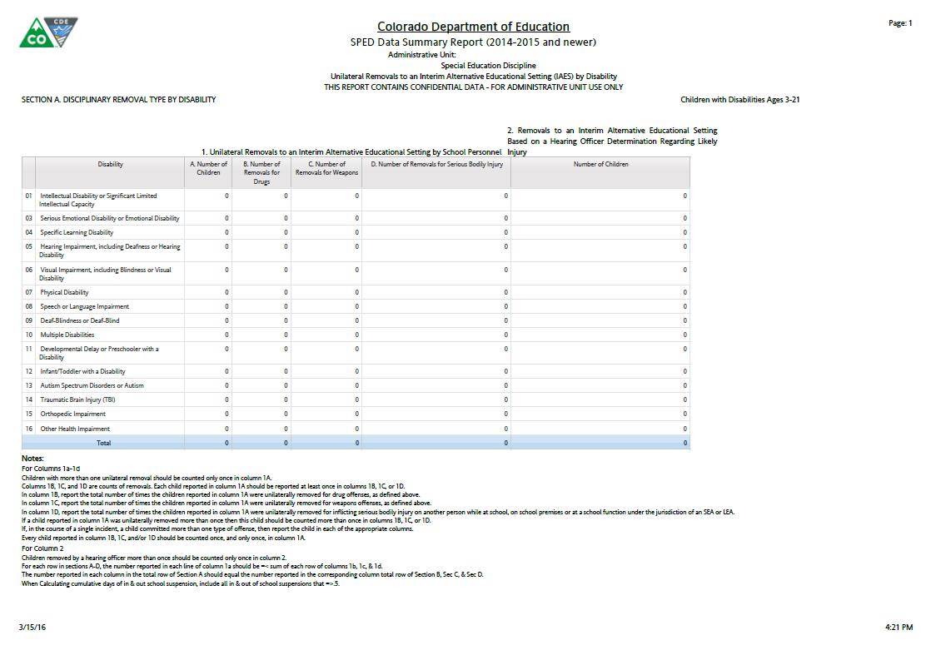
Section A: Disciplinary Removal by Disability.
If a child reported in column 1A was unilaterally removed to an Interim Alternative Educational Setting more than once then this child should be counted more than once in columns 1B,1C,1D. If, in the course of a single incident, a child committed more than one type of offense, then report the child in each of the appropriate columns.
Notes:
This slide provides information related specifically to Removals
Section 1A: Number of Children Unilaterally Removed to an IAES by School Personnel
Section 1B: Number of Times students were Unilaterally Removed to an IAES for Drugs
Section 1C: Number of Times students were Unilaterally Removed to an IAES for Weapons
Section 1D: Number of Times students were Unilaterally Removed to an IAES for Serious Bodily Injury
Section 2: Number of Children Removed to an IAES by a Hearing Officer for Serious Bodily Injury
Sections 1 & 2 are broken out by Primary Disability, Federal Race/Ethnicity Reporting category, Gender, and ELL status

Slide 25
Section A: Disciplinary Removal by Disability.
1A. Report the number of children ages 3-21 who were unilaterally removed for drugs, weapons, serious bodily injury. The child should only be counted once here.
1B. Report the total number of times the children reported in column 1A were unilaterally removed for Drug offenses.
1C. Report the total number of times the children reported in column 1A were unilaterally removed for Weapon offenses.
1D. Report the total number of times the children reported in column 1A were unilaterally removed for Serious Bodily Injury offenses.
Notes:
This slide provides information related specifically to Removals
Section 1A: Number of Children Unilaterally Removed to an IAES by School Personnel
Section 1B: Number of Times students were Unilaterally Removed to an IAES for Drugs
Section 1C: Number of Times students were Unilaterally Removed to an IAES for Weapons
Section 1D: Number of Times students were Unilaterally Removed to an IAES for Serious Bodily Injury
Section 2: Number of Children Removed to an IAES by a Hearing Officer for Serious Bodily Injury
Sections 1 & 2 are broken out by Primary Disability, Federal Race/Ethnicity Reporting category, Gender, and ELL status

Slide 26
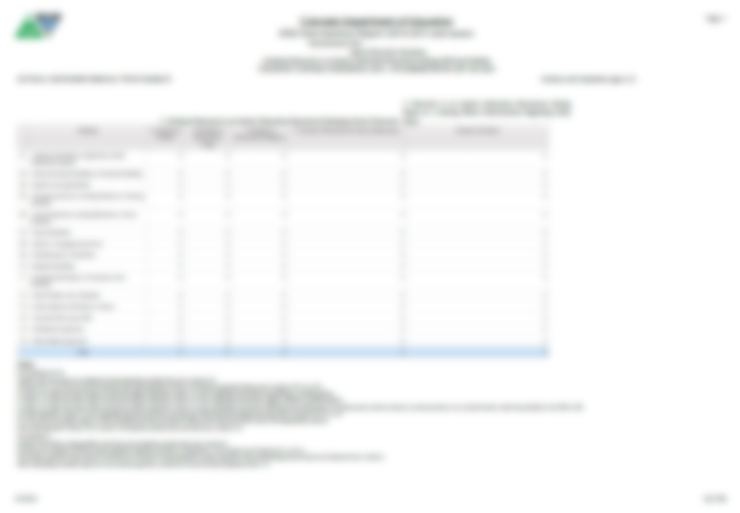
Section A: Disciplinary Removal by Disability.
Report the number of children ages 3-21, who were removed to an IAES based on a Hearing Officer Determination of likely injury to themselves or others. Children removed by a hearing officer more than once should be counted only once in column 2.
Notes:
This slide provides information related specifically to Removals
Section 1A: Number of Children Unilaterally Removed to an IAES by School Personnel
Section 1B: Number of Times students were Unilaterally Removed to an IAES for Drugs
Section 1C: Number of Times students were Unilaterally Removed to an IAES for Weapons
Section 1D: Number of Times students were Unilaterally Removed to an IAES for Serious Bodily Injury
Section 2: Number of Children Removed to an IAES by a Hearing Officer for Serious Bodily Injury
Sections 1 & 2 are broken out by Primary Disability, Federal Race/Ethnicity Reporting category, Gender, and ELL status

Slide 27
Section A: Disciplinary Removal by Disability.
This page, with columns 1A, 1B, 1C, 1D & 2 will repeat for:
Section A: Disability
Section B: Race/ Ethnicity
Section C: Gender and
Section D: ELL Status.
The report will use the Federal Race/
Ethnicity Reporting Category for the Race/Ethnic codes. The totals should match across all 4 pages.
Notes:
This slide provides information related specifically to Removals
Section 1A: Number of Children Unilaterally Removed to an IAES by School Personnel
Section 1B: Number of Times students were Unilaterally Removed to an IAES for Drugs
Section 1C: Number of Times students were Unilaterally Removed to an IAES for Weapons
Section 1D: Number of Times students were Unilaterally Removed to an IAES for Serious Bodily Injury
Section 2: Number of Children Removed to an IAES by a Hearing Officer for Serious Bodily Injury
Sections 1 & 2 are broken out by Primary Disability, Federal Race/Ethnicity Reporting category, Gender, and ELL status

Slide 28
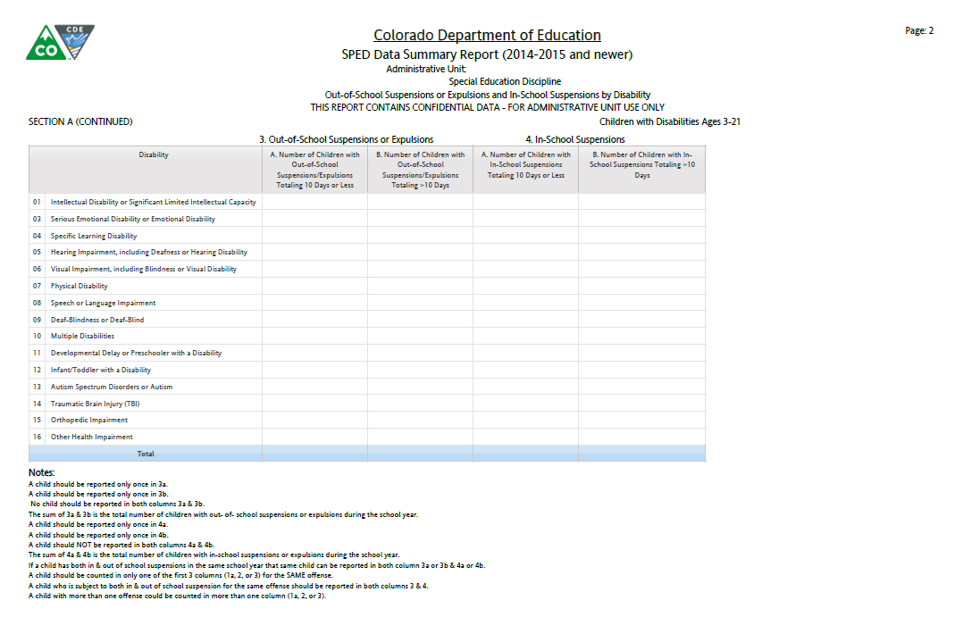
A child who is subject to both an In-School Suspension and an Out-of-School Suspension for the same offense should be reported in both columns 3 and 4.
Notes:
This slide provides information related specifically to In-School Suspensions Section 4A and 4B as well as Out-of-School Suspensions and Expulsion Section 3A and 3B.
Section 3A: Number of Children with Out-of-School Suspensions and/or Expulsions summing to 10 days or less
Section 3B: Number of Children with Out-of-School and/or Expulsions summing to more than 10 days. (This is the column that is used for Indicator 4 calculations of AU rate and significant discrepancy)
Section 4A: Number of Children with In-School Suspensions summing to 10 days or less
Section 5A: Number of Children with In-School Suspensions summing to more than 10 days
Information related to In-School Suspensions, Out-of-School Suspensions/Expulsions is broken down by Primary Disability, Federal Race Reporting Category, Gender, and ELL Status.

Slide 29
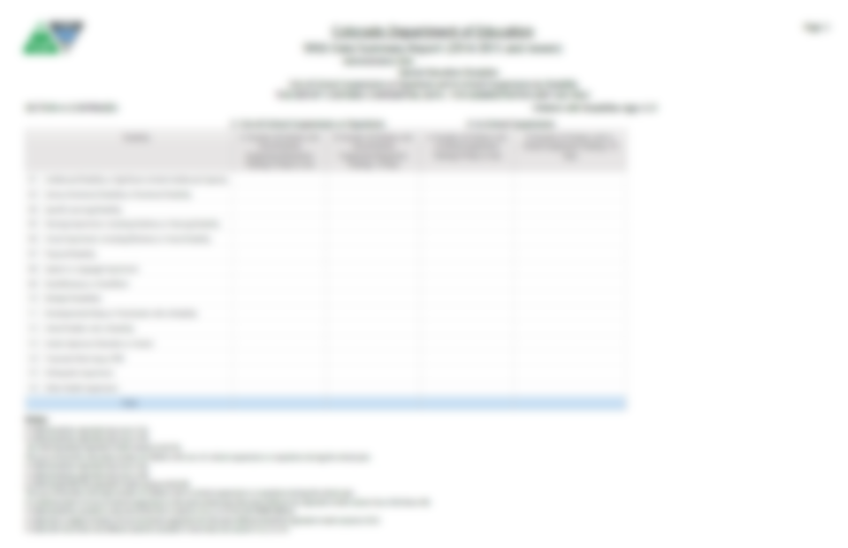
Report the number of children ages 3-21 with Out-of-School Suspensions or Expulsions summing to 10 days or less during the school year for any offense or combination of offenses. No child should be reported more than once in column 3A.
Report the number of children ages 3-21 with Out-of-School Suspensions or Expulsions summing to more than 10 days during the school year for any offense or combination of offenses. No child should be reported more than once in column 3B.
Notes:
This slide provides information related specifically to In-School Suspensions Section 4A and 4B as well as Out-of-School Suspensions and Expulsion Section 3A and 3B.
Section 3A: Number of Children with Out-of-School Suspensions and/or Expulsions summing to 10 days or less
Section 3B: Number of Children with Out-of-School and/or Expulsions summing to more than 10 days. (This is the column that is used for Indicator 4 calculations of AU rate and significant discrepancy)
Section 4A: Number of Children with In-School Suspensions summing to 10 days or less
Section 5A: Number of Children with In-School Suspensions summing to more than 10 days
Information related to In-School Suspensions, Out-of-School Suspensions/Expulsions is broken down by Primary Disability, Federal Race Reporting Category, Gender, and ELL Status.

Slide 30
Report the number of children ages 3-21 with In-School Suspensions summing to 10 days or less during the school year for any offense or combination of offenses. No child should be reported more than once in column 4A.
Report the number of children ages 3-21 with In-School Suspensions summing to more than 10 days during the school year for any offense or combination of offenses. No child should be reported more than once in column 4A.
Notes:
This slide provides information related specifically to In-School Suspensions Section 4A and 4B as well as Out-of-School Suspensions and Expulsion Section 3A and 3B.
Section 3A: Number of Children with Out-of-School Suspensions and/or Expulsions summing to 10 days or less
Section 3B: Number of Children with Out-of-School and/or Expulsions summing to more than 10 days. (This is the column that is used for Indicator 4 calculations of AU rate and significant discrepancy)
Section 4A: Number of Children with In-School Suspensions summing to 10 days or less
Section 5A: Number of Children with In-School Suspensions summing to more than 10 days
Information related to In-School Suspensions, Out-of-School Suspensions/Expulsions is broken down by Primary Disability, Federal Race Reporting Category, Gender, and ELL Status.

Slide 31
This page with columns 3A/B and 4A/B will also repeat for:
Section A: Disability
Section B: Race/ Ethnicity
Section C: Gender and
Section D: ELL Status.
Notes:
This slide provides information related specifically to In-School Suspensions Section 4A and 4B as well as Out-of-School Suspensions and Expulsion Section 3A and 3B.
Section 3A: Number of Children with Out-of-School Suspensions and/or Expulsions summing to 10 days or less
Section 3B: Number of Children with Out-of-School and/or Expulsions summing to more than 10 days. (This is the column that is used for Indicator 4 calculations of AU rate and significant discrepancy)
Section 4A: Number of Children with In-School Suspensions summing to 10 days or less
Section 5A: Number of Children with In-School Suspensions summing to more than 10 days
Information related to In-School Suspensions, Out-of-School Suspensions/Expulsions is broken down by Primary Disability, Federal Race Reporting Category, Gender, and ELL Status.

Slide 32
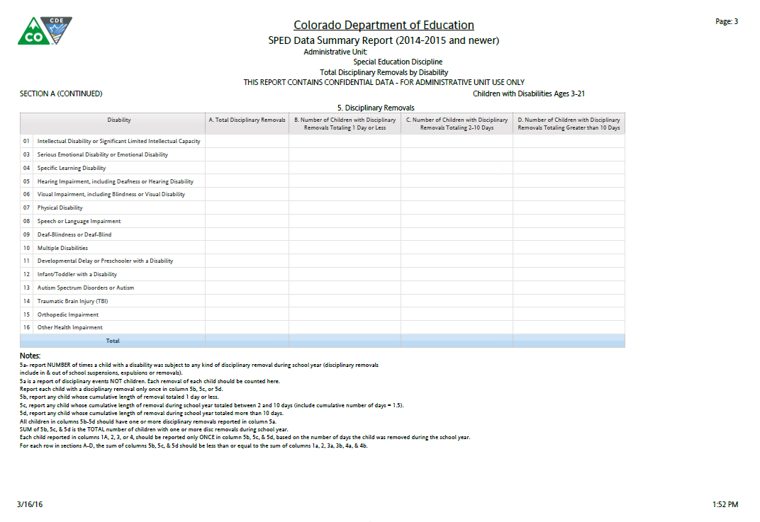
All children reported in columns 5B through 5D should have one or more disciplinary removals reported in column 5A. The sum of 5B, 5C, and 5D is the total number of children with one or more disciplinary removals during the school year. Each child reported in columns 1A, 2,3 or4 should be reported only ONCE in column 5B, 5C, or 5D, based on the cumulative number of days the child was removed during the school year.
Notes:
This slide provides information shows ALL disciplinary incidences including Unilateral Removals by School Personnel, Unilateral Removals by a Hearing Officer, In-School Suspensions, Out-of-School Suspensions and Expulsions and broken down by Primary Disability, Federal Race Reporting Category, Gender, and ELL Status.
Section5A: Number of Times child was subject to any disciplinary action
Section 5B: Report of Children with cumulative length of removal for any disciplinary incident during the reporting period totaling 1 day
Section 5C: Report on Children with cumulative length of removal for any disciplinary incident during the reporting period totaling 2-10 days. (Please pay special attention to Column 5 C = 2-10 days which includes 1.5 cumulative length of removal during the school year).
Section 5D: Report on Children with cumulative length of removal for any disciplinary incident during the reporting period totaling greater than 10 days.

Slide 33
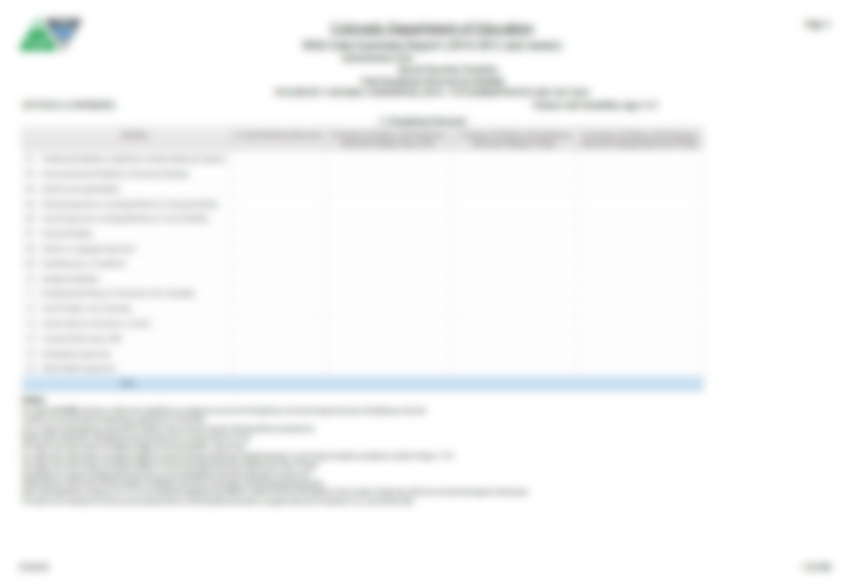
Report the number of times any child with a disability was subject to any of the following disciplinary actions during the school year: In-School or Out-of-School Suspensions, Expulsion, Removals by School Personnel to an IAES or by a Hearing Officer.
Report any child whose cumulative length of removal during the school year totaled 1 day.
Report any child whose cumulative length of removal during the school year totaled between 2 and 10 days.
NOTE: This Includes 1.5 cumulative length of removal during the school year.
Report any child whose cumulative length of removal during the school year totaled more than 10 days.
Notes:
This slide provides information shows ALL disciplinary incidences including Unilateral Removals by School Personnel, Unilateral Removals by a Hearing Officer, In-School Suspensions, Out-of-School Suspensions and Expulsions and broken down by Primary Disability, Federal Race Reporting Category, Gender, and ELL Status.
Section5A: Number of Times child was subject to any disciplinary action
Section 5B: Report of Children with cumulative length of removal for any disciplinary incident during the reporting period totaling 1 day
Section 5C: Report on Children with cumulative length of removal for any disciplinary incident during the reporting period totaling 2-10 days. (Please pay special attention to Column 5 C = 2-10 days which includes 1.5 cumulative length of removal during the school year).
Section 5D: Report on Children with cumulative length of removal for any disciplinary incident during the reporting period totaling greater than 10 days.

Slide 34
This page with Sections 5A , B, C, D will also repeat for:
Section A: Disability
Section B: Race/ Ethnicity
Section C: Gender and
Section D: ELL Status.
Notes:
This slide provides information shows ALL disciplinary incidences including Unilateral Removals by School Personnel, Unilateral Removals by a Hearing Officer, In-School Suspensions, Out-of-School Suspensions and Expulsions and broken down by Primary Disability, Federal Race Reporting Category, Gender, and ELL Status.
Section5A: Number of Times child was subject to any disciplinary action
Section 5B: Report of Children with cumulative length of removal for any disciplinary incident during the reporting period totaling 1 day
Section 5C: Report on Children with cumulative length of removal for any disciplinary incident during the reporting period totaling 2-10 days. (Please pay special attention to Column 5 C = 2-10 days which includes 1.5 cumulative length of removal during the school year).
Section 5D: Report on Children with cumulative length of removal for any disciplinary incident during the reporting period totaling greater than 10 days.

Slide 35
Section E: Children Subject to Expulsion With and Without Educational Services by Disability Status.
Section 6: Children Subject to Expulsions:
6A: Received Education Services During Expulsion
6B: Did NOT receive Educational Services During Expulsion.
Children with disabilities must receive educational services during any suspension or expulsion of more than 10 school days. The only children with disabilities who should be reported in column 6B are those who were expelled for less than 10 school days (e.g., children with disabilities expelled under the Gun-Free Schools Act whose expulsions were modified to less than 10 school days or who were expelled at the end of a term, like 8 days before school was out for the summer).
Notes:
This slide provides the data relative to Expulsions with services and without services.
Section 6A: Report of children who were subject to expulsion during the reporting period and received educational services during the expulsion
Section 6B: Report of children who were subject to expulsion during the reporting period and did NOT receive educational services during the expulsion.
CDE will be contacting Aus in regard to discrepancies in reporting’s of expulsions reported in the Special Education Discipline collection as well as the Special Education EOY collection.
Children with disabilities must receive services during any suspension or expulsion of more than 10 school days. The only children with disabilities who should be reported in column 6b are those who were removed for less than 10 school days after an expulsion (e.g. children with disabilities expelled under the Gun-Free Schools Act who expulsions were modified to less than 10 school days).

Slide 36
Incidences of Expulsions where the student did NOT receive services reported in the Discipline collection will be cross referenced with students reported with a Basis of EOY Student Collection. Exit Code 50 – Expulsions in the SPED.
Report the number of children with disabilities ages 3-21 who were subject to expulsion during the school year and who received educational services during the expulsion.
Report the number of children with disabilities ages 3-21 who were subject to expulsion during the school year and did NOT receive educational services during the expulsion.
Notes:
This slide provides the data relative to Expulsions with services and without services.
Section 6A: Report of children who were subject to expulsion during the reporting period and received educational services during the expulsion
Section 6B: Report of children who were subject to expulsion during the reporting period and did NOT receive educational services during the expulsion.
CDE will be contacting Aus in regard to discrepancies in reporting’s of expulsions reported in the Special Education Discipline collection as well as the Special Education EOY collection.
Children with disabilities must receive services during any suspension or expulsion of more than 10 school days. The only children with disabilities who should be reported in column 6b are those who were removed for less than 10 school days after an expulsion (e.g. children with disabilities expelled under the Gun-Free Schools Act who expulsions were modified to less than 10 school days).

Slide 37
By authorizing this report, you are confirming in writing that the data reported is both valid and reliable.
Notes:
By authorizing this report, you are confirming in writing that the data reported is both valid and reliable.
REMINDER: When you send in the Data Summary Report, please send the 14 page report in it’s entirety.

Slide 38
Year to Year Comparison Report
The report totals 13 pages
A section for “Disability: All” (1 page)
A section for Racial/Ethnic groups (6 pages)
A section for Gender groups (2 pages)
A section for ELL Status groups (2 pages)
The signature page

Slide 39
This page will repeat for all Racial, Gender and ELL Categories
You will only see flags - “A” – if both the number of the change is over 20 students AND the Percent of the Change is over 20%
These are the only data points that require explanation on the Flag Explanations sheet

Slide 40
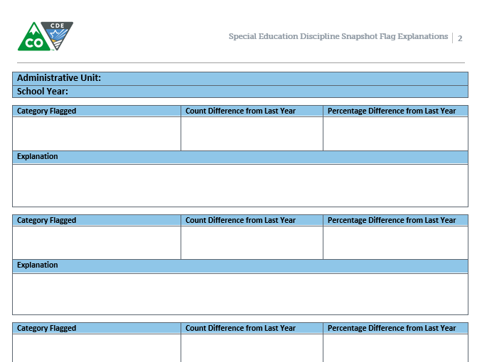
Year to Year Report Flag Explanations
Please remember to provide explanations for the A flags from the Year to Year Report no later than August 24, 2015
Remember, you can include multiple flag categories when the same explanation applies

Slide 41
SPECIAL EDUCATION DISCIPLINE REPORT RELATED DEADLINES
Tuesday, August 16, 2016
Date by which you must have generated your complete Special Education Discipline Snapshot dataset by passing all interchange and snapshot validations in preparation for report review.
Wednesday, August 17-August 23, 2016
Report review week.
Review reports in detail and make any data corrections deemed necessary to ensure you are reporting valid and reliable data
All changes must be made by end of day August 23, 2016
Thursday, August 24, 2016
Final report approval, upload signature reports to DMS

Slide 42
August 24, 2016 Deadline
Final report review AND approval.
Date by which the Administrative Unit must approve their completed Special Education Discipline Data Collection Snapshot and electronically SUBMIT the data to CDE via the Data Pipeline, verifying that it’s valid and reliable by uploading the signed Data Summary Report (all 14 pages) and the Year to Year Report along with explanations for Flags to the Data Management System.

Slide 43
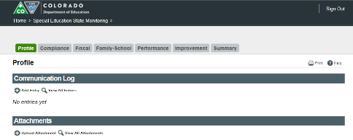
Submitting Final Reports
Both Signature Reports should be signed and submitted by August 24, 2016
2 Signature Reports (+ Flag Report)
Scan signed documents into a PDF or multiple PDFs
Upload the PDFs to the Data Management System/Profile Tab
Upload Flag Explanations separately as a Word File
Notes:
Uploading the Flag Explanations in a Word allows the data team to easily copy the explanations into a searchable file for internal use.

Slide 44
Contact Information
If you have ANY questions about the Special Education Discipline Data Collection please feel free to contact us. We are just a phone call away!
Kristi Gleason 303-866-4620 gleason_k@cde.state.co.us Collection Lead
Lindsey Heitman 303-866-5759 heitman_l@cde.state.co.us
Please include the following team members in your email communications gleason_k@cde.state.co.us; heitman_l@cde.state.co.us
In the subject line of the email if you would please include the following information:
District Number (four digit code)
Administrative Unit Number (5 digit code)
Subject of the email along with any business rules or name of a report if applicable.
In the body of the email:
Please include your phone number!
Thank you
44

Slide 45
GO TEAM DISCIPLINE!

