Slide 1
2015-16 School Discipline and Attendance (SDA)
Annette Severson – severson_a@cde.state.co.us

Slide 2
Agenda
Review
2015-16 File Layout Updates and Changes
File Descriptions with Reporting Examples
No Reportable Incidents
Checklist of Steps
Resources

Slide 3

Review

Slide 4
Why is data required?
22-11-503 (3)(c): The information shall be consistent for each type of report and, at a minimum, shall include the occurrence of each of the following types of incidents, expressed as a number and as a percentage of the total occurrences of all of the incidents:
  Substance abuse-drugs
  Substance abuse- alcohol
  Substance abuse- tobacco
  Felony assaults
  Fights
  Possession of dangerous weapons; and
  Other violations of the code of conduct at the public school

Slide 5
Why is data required? (part 2)
22-32-109.1(2)(b)(IV) The number of conduct and discipline code violations…only in the most serious category that is applicable to that violation including to specific information on the number of and the action taken with respect to the following types of incidents:
  ─ Dangerous Weapon ─ Destruction of Property
  ─ Alcohol ─ Tobacco
  ─ Drug ─ Robbery
  ─ Disobedient/Defiant
  ─ Detrimental Behavior
  ─ 1st, 2nd or Vehicular Assault
  ─ 3rd degree Assault/Disorderly Conduct

Slide 6
Identity Management Roles
To have access to the SDA periodic collection, one of the following 3 roles would need to be assigned to you by your Local Access Manager:
If you plan to ‘do it all’ – you will want the SDA~LEA Approver Role
IdM Role | Enables User to:
SDA~LEAAPPROVER | Finalize, Submit, Modify and View Data
SDA~LEAUSER | Submit, Modify and View Data
SDA~LEAVIEWER | View Data

Slide 7
2015-16 Timeline
Monday, May 9th – Collection Opens
Friday, June 10th – Upload at least 1 file and update ‘No Reportable Incidents’ tab
Thursday, June 16th – All applicable files uploaded
Thursday, June 23rd – All applicable files are error free
Thursday, June 30th – All files are finalized
Timeline is posted online as well
Bold – required
Italicized – goals

Slide 8

SDA Consists of Four Files
Discipline by Action
Discipline by Student Demographic
Firearm (GFSA) Discipline
Attendance Data
1
2
3
4

Slide 9
File Comparison
(part 1)
Discipline by Action
Discipline by Student Demographic
Count of INCIDENTS (Behaviors) per school
Reported by Behavior and Action Taken
1 record per school per behavior type
Count of STUDENTS
Reported by action taken and demographics of the students’ disciplined
1 record per school and student demographic type

Slide 10
File Comparison
(part 2)
Firearm (GFSA) Discipline
Attendance Data
Count of Firearm Possessions per school
Reported by action taken for each firearm possession
Count of Days
1 record per school

Slide 11
What must be Reported?
All students disciplined during the school year
All student attendance info- count of days and partial days
Include the student and incident:
  If the student is disciplined with a Classroom Suspension, In-School Suspension, Out of School Suspension, Expelled, or Referred to Law Enforcement regardless of behavior code
    OR
  If the incident would fit a behavior code other than code 12- Other Violation of Code of Conduct

Slide 12
Quick Review of Process
Update ‘No Reportable Incidents’ Tab
Create and Upload Data files in order:
  Discipline by Action File
  Discipline by Student Demographic File
  Firearm (GFSA) Discipline File
  Attendance File
Review error reports, correct data and re-upload files as needed
Review data reports for accuracy
Finalize data

Slide 13

2015-16 File Layout Updates and SDA Changes

Slide 14
File Layout Updates
Discipline by Action File:
  New/Updated Behavior Codes
  Revised Law Enforcement Referral definition
Discipline by Student Demographic File:
  Removed Habitually Disruptive Students field
Firearm (GFSA) Discipline File:
  Added Grade Level field
Attendance Data File:
  No updates

Slide 15
Discipline by Action File – Behavior Code Updates
01 | Drug Violation | Use, possession, or sale of a drug or controlled substance other than marijuana on school grounds, in school vehicles, or at school activities or sanctioned events.
09 | Detrimental Behavior | Behavior on school property that is detrimental to the welfare or safety of other students or of school personnel, including but not limited to incidents of bullying, as described by subparagraph (X) of paragraph (a) of the subsection (2), and other behavior that creates a threat of physical harm to the student or to other students.
14 | Marijuana Violation | The unlawful use, possession, or sale of marijuana on school grounds, in a school vehicle, or at a school activity or sanctioned event.
15 | Sexual Violence/ Battery (other than Rape) | Acts of sexual violence on school grounds, in a school vehicle, or at a school activity or sanctioned event. Sexual Violence means a physical sexual act perpetrated against a person’s will or where a person is incapable of giving consent. Incidents of sexual violence/battery (other than rape) - An incident that includes threatened rape, fondling, indecent liberties, child molestation, or sodomy. Both male and female students can be victims of sexual battery. Classification of these incidents should take into consideration the age and developmentally appropriate behavior of the offender(s).
16 | Rape or Attempted Rape | Incidents of rape or attempted rape on school grounds, in a school vehicle, or at a school activity or sanctioned event. Rape refers to forced sexual intercourse (vaginal, anal, or oral penetration). This includes penetration from a foreign object. Both male and female students can be victims of rape. Rape is not defined as a physical attack or fight.

Slide 16
Discipline by Action File – Revised Law Enforcement
Law Enforcement Referral Incidents – The total number of incidents (not students) in which the student(s) were referred to law enforcement.
  If the incident was referred to law enforcement, indicate the most serious action taken (e.g., suspension, expulsion) in addition to the referral to law enforcement. Law enforcement referrals will not be counted in the total incident count unless law enforcement referral is the only column checked.
  A communication between a school administrator, teacher, or other school employee and a law enforcement that: agency in which communication:
    (A) Is initiated by the school administrator, teacher, or other school employee; and
    (B) Concerns behavior by a student who the school administrator, teacher, or other school employee believes may constitute a violation of the school conduct and discipline code or a criminal or delinquent offense and for which the school administrator, teacher, or other school employee requests an investigation or other involvement by a law enforcement agency.
  Referral to law enforcement does not include:
    (A) Contact with a law enforcement agency that is made for the purpose of education, prevention, or intervention regarding a student's behavior; or
    (B) Routine or incidental communication between a school administrator, teacher, or other school employee and a law enforcement officer.
    (C) Any Incident or Communication that is initiated by Law Enforcement.
Law Enforcement includes any law enforcement agency, law enforcement officer or school resource officer.

Slide 17
Firearm (GFSA) Discipline File – Added Grade Level
Grade Level is between school code and firearm weapons field in file layout
Grade Level is of the student at the time of the firearm possession incident
004 | Pre-Kindergarten (Preschool) |  | 060 | Grade 6
006 | Half Day Kindergarten (450+ hours) |  | 070 | Grade 7
007 | Full Day Kindergarten (900+ hours) |  | 080 | Grade 8
010 | Grade 1 |  | 090 | Grade 9
020 | Grade 2 |  | 100 | Grade 10
030 | Grade 3 |  | 110 | Grade 11
040 | Grade 4 |  | 120 | Grade 12
050 | Grade 5

Slide 18
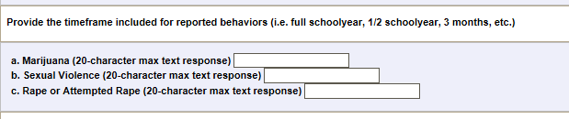
No Reportable Incidents Tab – New Questions
Indicate for the district the timeframe new behaviors were being counted for the files
Each timeframe can be different
Indicator is district – wide
If left blank, it will be assumed to be ‘Full Year’

Slide 19
Process Updates
The data files must be uploaded in the following order:
  Discipline by Action File
  Discipline by Student Demographic File
  Firearm (GFSA) Discipline File
  Attendance File
If a file is not required (based on No Reportable Incidents tab), then it can be skipped and the next file uploaded
This order allows for district to finalize the whole SDA collection once instead of each file individually

Slide 20
Business Rule Updates
Data counts are being compared between the three files:
  Discipline by Action
  Discipline by Student Demographics and
  Firearm (GFSA) Discipline
The Total Number of Incidents must be greater than 0
  If the Total Number of Incidents is 0 for that behavior code, then no record is required for the behavior code
Attendance data fields are all required and cannot be left blank
  If the appropriate response is ‘0’ then report ‘0’

Slide 21
Comparison Business Rule: SR090
(error will be in Demographic File Error Report)
Discipline by Student Demographic
Discipline by Action
Count of Students Disciplined
Count of Incidents
The Sum by School:
  Classroom Suspensions +
  In School Suspensions +
  Total Out of School Suspensions +
  Expulsions without Services +
  Expulsions with services +
  Referred to Law Enforcement +
  School Related Arrests +
  Other Action Taken
Total Number of Incidents per School
>
or
=
Note: > means “Greater Than”
= means “Equals”

Slide 22
Comparison Business Rules
(errors will be in Demographic File Error Report)
Discipline by Student Demographic
Discipline by Action
Count of Students Disciplined
Count of Incidents
Total Number of Classroom Removals by School
Total Number of In School Suspensions by School
Number of Out of School Suspensions by School
(SR091) The Sum by School of Classroom Removals
(SR092) The Sum by School of In School Suspensions
(SR093) The Sum by School
of Total Out of School Suspensions
>
or
=
>
or
=
>
or
=

Slide 23
More Comparison Business Rules
(errors will be in Demographic File Error Report)
Discipline by Student Demographic
Discipline by Action
Count of Students Disciplined
Count of Incidents
Total Number of Expulsions by School
Total Number of Referrals to Law Enforcement by School
Number of Other Action Taken by School
(SR094) The Sum by School Expulsions without Services and Expulsions with Services
(SR095) The Sum by School of Referrals to Law Enforcement
(SR096) The Sum by School of Other Action Taken
>
or
=
>
or
=
>
or
=

Slide 24

Important Note to Remember
Discipline by Student Demographic
>
or
=
Discipline by Action
Count of Students Disciplined
Count of Incidents
Multiple Students may be disciplined for 1 incident
2 students
disciplined
>
1 fight

Slide 25
Comparison Business Rule: SF076
(error will be in Firearm(GFSA) Discipline File Error Report)
Firearm (GFSA) Discipline
Discipline by Action
Count of Students Disciplined for Firearms
Count of Incidents
Total Number of Expulsions by School
The Sum of Students Expelled for firearm possessions by School
<
or
=
Note: < means “Less Than”
= means “Equals”

Slide 26
New Cognos Report:
Comparison Report
Provides the total counts of incidents reported per school
Provides the total count of students disciplined reported by school
These numbers will assist with any comparison error(s) in your data file and to verify accuracy of both reports
Recall, the count of students disciplined should be either more than or equal to the count of incidents reported.

Slide 27

File Descriptions with Reporting Examples

Slide 28
Discipline by Action File
Count of Behaviors per school
  Most severe action taken per behavior
  Only 1 action taken/incident reported
  Referrals to Law Enforcement reported in addition to most severe action taken if applicable
Only report those behaviors which occurred in school during school year
Each Behavior has a code associated with it
  A record will be reported per behavior and school
Discipline by Action

Slide 29
Discipline by Action File: Behaviors (review)
Code | Behavior Type
01 | Drug Violation
02 | Alcohol Violation
03 | Tobacco Violation
04 | 1st, 2nd Degree or Vehicular Assault
05 | Dangerous Weapons
06 | Robbery
07 | Other Felony
08 | Disobedience/Defiant or Repeated Interference
09 | Detrimental Behavior
10 | Destruction of School Property
12 | Other Violation of Code of Conduct
13 | 3rd Degree Assault/Disorderly Conduct
14 | Marijuana Violation
15 | Sexual Violence/Battery (other than Rape)
16 | Rape or Attempted Rape
Discipline by Action
Discipline by Action

Slide 30
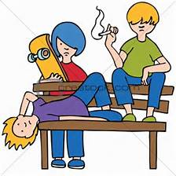
Reporting Incident Example 1
Discipline by Action File
1 Incident of tobacco violation
1 In-School Suspension
Discipline by Student Demographic File
1 White, Male, 7th grader, Non IDEA, Non 504, Non ELL Student with In School Suspension and Referred to Law Enforcement
1 Asian, Female, 7th grader, Non IDEA, Non 504, Non ELL Student with In School Suspension and Referred to Law Enforcement
1 White, Male, 8th grader, Non IDEA, Non 504, Non ELL Student with In School Suspension and Referred to Law Enforcement
1 Referral to Law Enforcement
3 students receive in-school suspensions and are referred to law enforcement for tobacco use (1 incident)
Discipline by Demographics
Discipline by Demographics
Discipline by Action

Slide 31
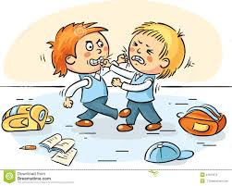
Reporting Incident Example 2
2 students fight and are suspended
(1 out of school and the other in school)
Discipline by Action File
1 Incident of 3rd Degree Assault, Out of School Suspension
Discipline by Student Demographic File
1 White, Male, 10th grader, Non IDEA, Non 504, Non ELL Student, Only 1 Out-of-School Suspended
1 White, Male, 9th grader, Non IDEA, Non 504, Non ELL Student, 1 In-School Suspended
Discipline by Action
Discipline by Action

Slide 32
Discipline by Student Demographic File
One record per subset of students disciplined by school
Detailed information on students disciplined:
  Ethnicity/Race
  Gender
  Grade Level
  IDEA/Special Education status
  Section 504 Status
  ELL Status
Counts of students by action taken
Discipline by Demographics
Discipline by Demographics

Slide 33
Discipline by Student Demographic File: FAQs
Unduplicated count of the students:
  If 1 student receives 3 in-school suspensions and expelled with services once (all for different incidents), he/she would be reported as:
    3 in the in-school suspensions
    1 in the expulsions with educational services
    1 in the unduplicated count of students disciplined
Discipline by Demographics
Discipline by Demographics

Slide 34
Reporting Incident Example 1
Discipline by Action File
1 Incident of tobacco violation
1 In-School Suspension
Discipline by Student Demographic File
1 White, Male, 7th grader, Non IDEA, Non 504, Non ELL Student with In School Suspension and Referred to Law Enforcement
1 Asian, Female, 7th grader, Non IDEA, Non 504, Non ELL Student with In School Suspension and Referred to Law Enforcement
1 White, Male, 8th grader, Non IDEA, Non 504, Non ELL Student with In School Suspension and Referred to Law Enforcement
1 Referral to Law Enforcement
3 students receive in-school suspensions and are referred to law enforcement for tobacco use (1 incident)
Discipline by Demographics
Discipline by Demographics

Slide 35
Reporting Incident Example 2
2 students fight and suspended
(1 out of school and the other in school)
Discipline by Action File
1 Incident of 3rd Degree Assault, Out of School Suspension
Discipline by Student Demographic File
1 White, Male, 10th grader, Non IDEA, Non 504, Non ELL Student, Only 1 Out-of-School Suspended
1 White, Male, 9th grader, Non IDEA, Non 504, Non ELL Student, 1 In-School Suspended
Discipline by Demographics
Discipline by Demographics

Slide 36

Reporting Incident Example 3: Unduplicated Count Focus
Provide an unduplicated count of students involved reported incidents.
Regardless of how many times a student is counted for any category within the Discipline by Student Demographics file, only count the student once in the unduplicated count of students disciplined.
1
Same Student, counted multiple times in Discipline by Student Demographics File
Same Student, counted once in the Unduplicated Count of Students Disciplined field
Discipline by Demographics
Discipline by Demographics

Slide 37
Firearm (GFSA) Discipline File
One record per school and firearm weapon with counts of actions taken.
If there are no firearms to report for a school, no record will be needed in file (based on No Reportable Incidents screen)
3 types of Firearms reported
  Handgun - Rifle/Shotgun - Other Firearm
Expulsions reported are a subset of Dangerous Weapon Expulsions reported
Firearm (GFSA) Discipline
Firearm (GFSA) Discipline

Slide 38
Firearm (GFSA) Discipline File Flowchart
(A) Brought or Possessed at School
(B1) Expelled
(B2) Other Discipline Action (suspensions, etc)
(B3) Remove Other (death, incarcerated, etc)
(B4) No Action Taken
(C1) Less Than Mandatory One Calendar Year
(C2) Full Mandatory One Calendar Year
(D2) Referred to Alternative School/Program
(D1) Referred to Alternative School/Program
Firearm (GFSA) Discipline
Firearm (GFSA) Discipline

Slide 39
Attendance Data File
One record required per school
Decimal point is implied
Same data collected in previous years by school:
  Length of school year
  Total days attended by students
  Total days excused by students
  Total days unexcused by students
  Total possible attendance days
  Number of students truant four or more days in a month
  Number of students truant ten or more days in a school year
  Number of students truant for both conditions listed above
Attendance Data
Attendance

Slide 40
Attendance Data File: Relationship Equation
Student Total Days Attended
Student Total Days Unexcused Absent
Student Total Days Possible
Student Total Days Excused Absent
Decimal point is implied for all of these values.
Example: Student Total Days Attended reported as 5005 is reflected as 500.5 days.
Attendance Data
Attendance

Slide 41
Habitually Truant Definition
22-33-107(3)(I): A child who has attained the age of six years on or before August 1 of the year in question and is under the age of seventeen years and who has four unexcused absences from public school in any one month or ten unexcused absences from public school during any school year. Absences due to suspension or expulsion of a child are considered excused absences for purposes of this subsection.
Attendance Data
Attendance

Slide 42
Habitually Truant Counts
3 fields capture this required data:
  Truancy: Four or more days in any one calendar month
  Truancy: Ten or more days in one school year
  Truancy: Met both conditions
Students are to be reported in only 1 category per school as applicable
Attendance Data
Attendance

Slide 43

Reporting Habitually Truancy Example
1 count of Truancy: 4 or more Days in one calendar month
Unexcused Absences for Sally in March. (Total Unexcused Absences in the School year is less than 10)
Attendance Data
Attendance

Slide 44
Reporting Habitually Truancy Example
Month | # Unexcused Absences for Shirley
Aug | 0
Sept | 1
Oct | 1
Nov | 0
Dec | 1
Jan | 1
Feb | 0
March | 2
April | 0
May | 4
TOTAL | 10
1 count of Truancy: Met Both Conditions
Attendance Data
Attendance

Slide 45

No Reportable Incidents
Reportable
Incidents

Slide 46
No Reportable Incidents
A separate tab in Data Pipeline, under “SDA”
Option to use when a school has no incidents to report to CDE; either
  No Disciplinary Incidents and/or
  No Firearms to report
Can be updated throughout the SDA process.
  If marked as “No” initially, this can be updated to “Yes” for a school if needed and vice versa, until the data is finalized.
Must update each page or select ‘all’ per page to update all schools in one screen

Slide 47
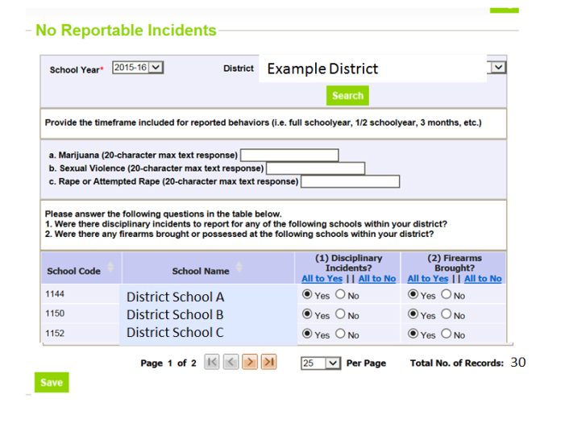
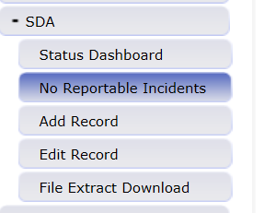
No Reportable Incidents
Screenshot

Slide 48
No Reportable Incidents – Disciplinary Incidents
Disciplinary Incidents column:
  “Yes” indicates:
    the school is included in the Discipline by Action file AND
    The school is included in the Discipline by Student Demographic file
  “No” indicates:
    The school is not included in the Discipline by Action file AND
    The school is not included in the Discipline by Student Demographic file
    If all schools are marked as “No”, then the LEA will not upload either the Discipline by Action file or the Discipline by Student Demographic file.

Slide 49
No Reportable Incidents – Firearm Incidents
Firearms brought column:
  “Yes” indicates:
    The school is included in the Firearm (GFSA) data file uploaded
  “No” indicates:
    The school is not included in the Firearm (GFSA) data file uploaded.
    If all schools in the district have this indication, then the LEA will not upload the Firearm (GFSA) data file.

Slide 50

Checklist of Steps
Quick Step by Step Guide
Detailed Step Process

Slide 51
Quick Step-by-Step
Pipeline Guide
No Reportable Incidents Tab
Answer new questions
Indicate whether schools have firearms to report
Upload Data Files (in order)
Discipline by Action Taken
Finalize
Review, Correct and Re-upload Data Files as needed
Indicate whether schools have disciplinary incidents to report
Firearm (GFSA) Discipline
Attendance Data
Discipline by Student Demographic
Validate Data Reports
Finalize all files

Slide 52
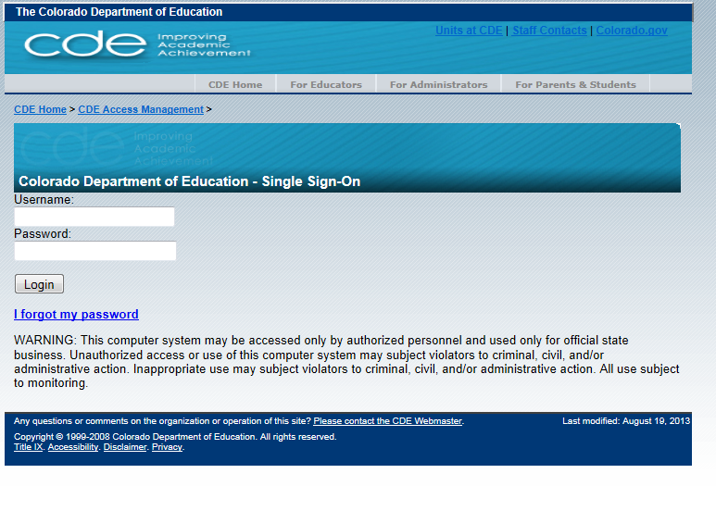
1st - Login to Data Pipeline
https://cdx.cde.state.co.us/pipeline
Username = email address
Password = determined by you. Use the ‘I forgot my password’ if needed.

Slide 53
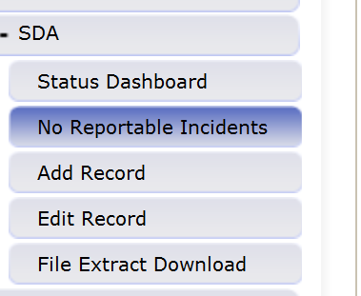
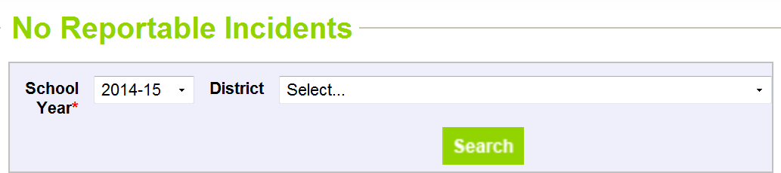
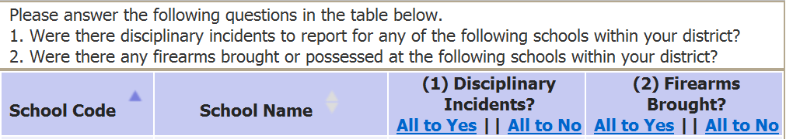
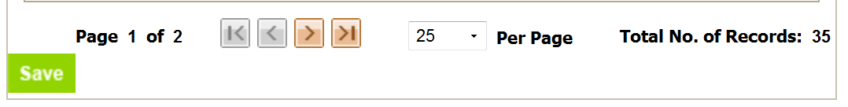
2^{nd*} – No Reportable Incidents
*Note: this step can be performed throughout the process if changes are needed

Slide 54
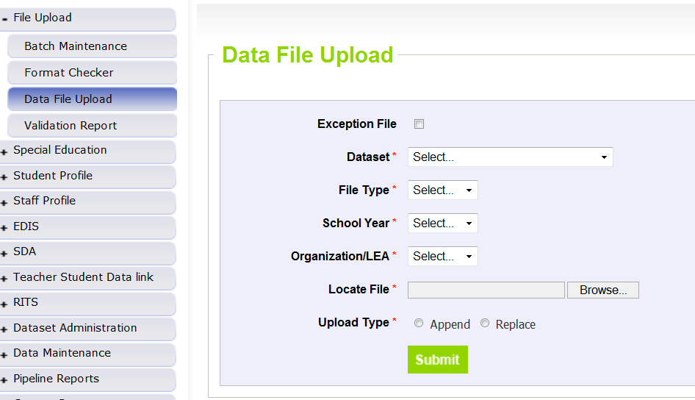
3rd – Upload each File
Dataset | School Discipline Attendance
File Type | Discipline by Action THEN Discipline by Student Demo THEN Firearm Discipline THEN Attendance Data
School Year | 2015-2016
Organization/LEA | Select your District/BOCES
Locate File | Browser and select file to upload
Upload Type | Replace if your file is complete within the one file upload
 | Append if you are adding additional data to what has been previously uploaded
Click “Submit” for each file

Slide 55
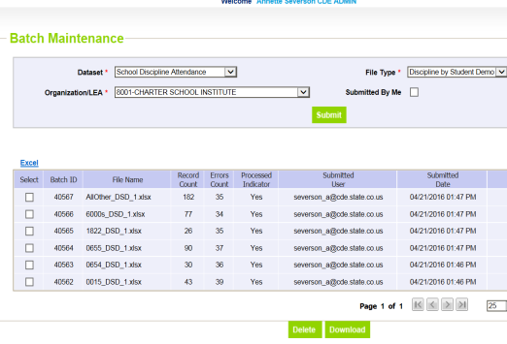
4th - Batch Maintenance Screen
Displays status for files
If using ‘Append’ functionality, error count is incorrect for all except the last file uploaded.

Slide 56
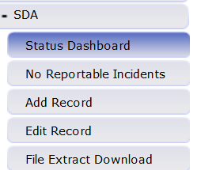
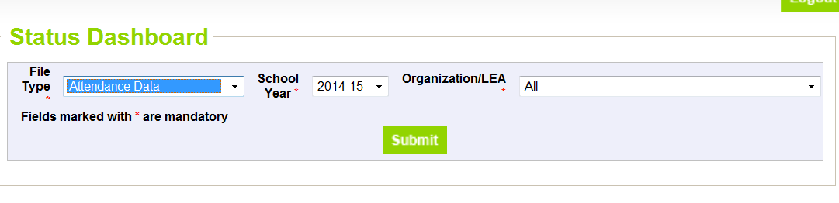
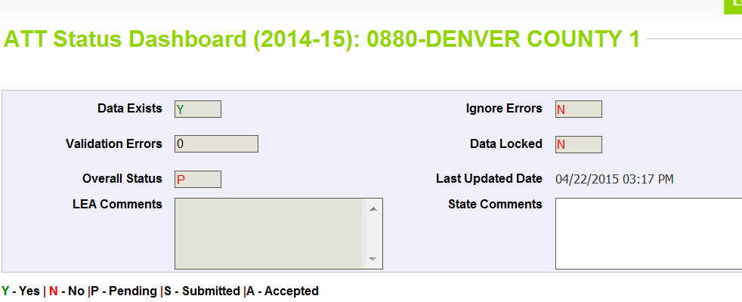
5th – Status Dashboard
Confirms file processed and provides the error count in the file
Data Exists = Y (data processed) or N (data not processed)
Validation Errors = # (# of errors in file)
Overall Status = P (Pending) or N (No data)
Last updated date = last date of upload

Slide 57
Review Errors and Warnings
Two options:
  Using Cognos
  Using Pipeline Error Reports
You may use either option exclusively or both throughout

Slide 58


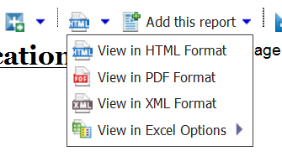
6th –Using Cognos
(Errors and Warnings)
Select the appropriate Error Report to view:
  For Attendance data errors: “Attendance Error Detail Report”
  For Discipline by Student Demographic data errors: “Demographics Error Detail Report”
  For Discipline by Action data errors: “Discipline Action Error Detail Report”
  For Firearm Incident data errors: “Firearm Error Detail Report”
If there are no errors for your district for the file OR the file was not processed for your district yet, there will be no error report available
Error reports can be downloaded into excel

Slide 59

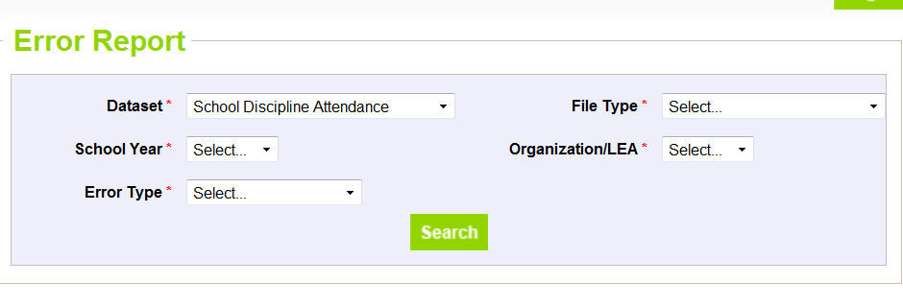
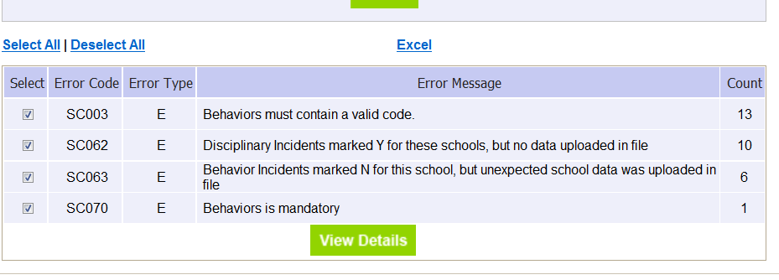
7th – Using Data Pipeline
(Errors and Warnings)
Select file type, year, LEA and Errors and Warnings – then select “Search”
Select Excel to view report

Slide 60
8th - Correct Data
Update data in data files based on errors/warnings and re-upload files as needed.
Repeat steps until all errors in file are resolved

Slide 61
9th –Review Reports

Slide 62
Reports Available
Attendance and Truancy Data
  provides attendance and truancy rate calculated for each school. Data is generated using the Attendance file.
Summary of Behavior by Action
  provides each behavior reported by school with the count of actions taken for each. Data is generated using the Discipline by Action file.
Summary of Discipline by Demographic File
  All incidents reported with all student demographic data provided. Data is generated using the Discipline by Student Demographic file.

Slide 63
Reports Available
(continued)
Summary of Disciplinary Actions by Federal Race/Ethnicity
  Count of Disciplinary Actions reported for all students by Federal Race/Ethnicity and School. Data is generated using the Discipline by Student Demographic file.
Summary of Disciplinary Actions by Gender
  Count of Disciplinary Actions reported for all students by Gender and School. Data is generated using the Discipline by Student Demographic file.
Summary of Disciplinary Actions by Grade
  Count of Disciplinary Actions reported for all students by Grade and School. Data is generated using the Discipline by Student Demographic file.

Slide 64
New Report Available
Comparison of Incidents Reported and Students Disciplined
  Provides total counts of incidents as reported in the Discipline by Action file
  Provides total number of students disciplined as reported in the Discipline by Student Demographic File
Report should assist with new comparison edits (as discussed previously) and validating data reported prior to finalizing

Slide 65
10th -Finalize Uploaded Data
Notes
Still being developed;
Attendance File is only file needed to be “Submitted to CDE”
All files must be uploaded and error free or indicated as No for all schools in No Reportable Incidents tab prior to finalizing
By finalizing the Attendance data file, the other 3 files are also finalized.
Download sign off form will indicate which schools have data reported

Slide 66
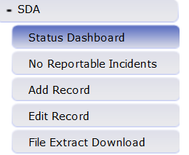
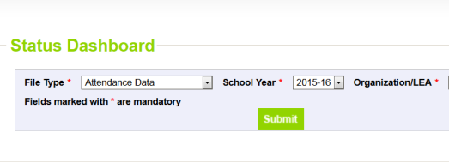
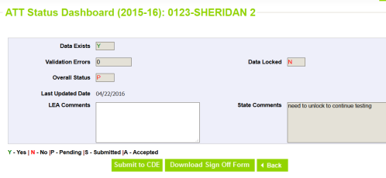
10th -Finalize Uploaded Data
Steps
Only the LEAAPPROVER role can perform this step

Slide 67

Available Resources
All resources made available at: http://www.cde.state.co.us/datapipeline/schooldisciplineattendance

Slide 68
Basic Information
File Layouts – please select 2015-16 documentation
Business Rules
Templates – blank excel files with correct headings
Trainings –
  Current training power point slides (this training) posted soon
  prior year training power point slides posted as well
Available at: http://www.cde.state.co.us/datapipeline/schooldisciplineattendance

Slide 69
Additional Resources
2015-16 Summary of Updates
2015-16 Training Dates and Timeline
Calculating Attendance in Online Schools
SDA Frequently Asked Questions
SDA Process Documentation
Behavior Statutes and Clarifications
Guidance for Determining Most Serious
For assistance please contact Annette Severson at severson_a@cde.state.co.us

Slide 70
In-Depth Review:
Behavior Statutes and Clarifications
Full documentation with statutes and clarifications found at: http://www.cde.state.co.us/datapipeline/sdabehaviorstatutesclarification

Slide 71
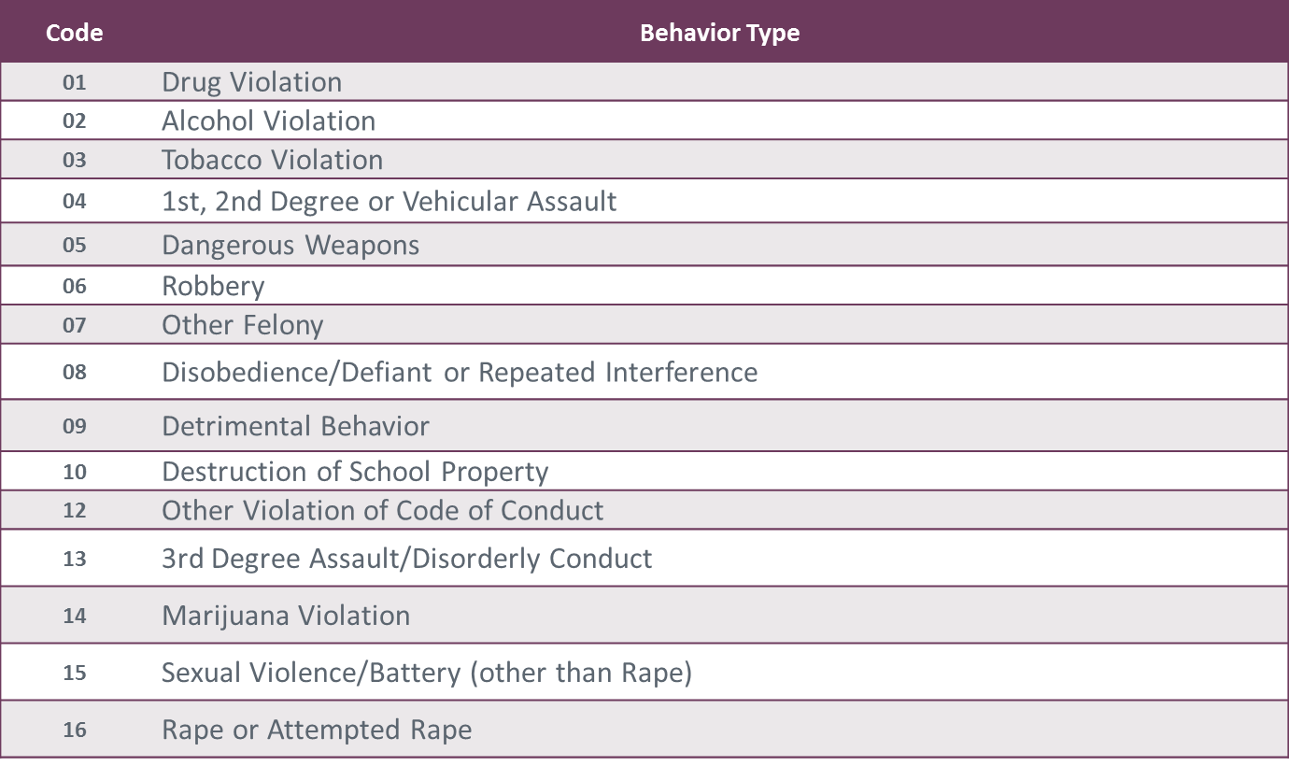
Behavior Codes

Slide 72
Behavior
Statutes and Clarifications
Drug Violations (code 01): Use, possession, or sale of a drug or controlled substance, other than marijuana, on school grounds, in a school vehicle, or at a school activity or sanctioned event.
Alcohol Violations (code 02): Use or possession of alcohol on school grounds, in a school vehicle, or at a school activity or sanctioned event.
Marijuana Violations (code 14): The unlawful use, possession, or sale of marijuana on school grounds, in a school vehicle, or at a school activity or sanctioned event.

Slide 73
Behavior
Statutes and Clarifications
Tobacco Violations (code 03): Use or possession of a tobacco product on school grounds, in a school vehicle, or at a school activity or sanctioned event.
C.R.S. 18-13-121 (5) Tobacco Product; “Tobacco Product” means:
  Any product that contains nicotine or tobacco or is derived from tobacco and is intended to be ingested or inhaled by or applied to the skin of an individual; or
  Any device that can be used to deliver tobacco or nicotine to the person inhaling from the device, including an electronic cigarette, cigar, cigarillo, or pipe.

Slide 74
Behavior
Statutes and Clarifications
Dangerous Weapons (code 05): Possessing a dangerous weapon on school grounds, in a school vehicle, or at a school activity or sanctioned event without the authorization of the school or the school district.
22-33-102(4) Dangerous Weapon; A firearm defined as:
  Any pellet or BB gun or other device, whether operational or not, designed to propel projectiles by spring action or compressed air;
  A fixed-blade knife with a blade that exceeds three inches in length
  A spring-loaded knife or a pocket knife with a blade exceeding three and one-half inches in length
  Any object, device, instrument, material, or substance, whether animate or inanimate, that is used or intended to be used to inflict death or serious bodily injury.

Slide 75
Behavior
Statutes and Clarifications
Robbery (code 06): Commission of an act on school grounds, in a school vehicle, or at a school activity or sanctioned event that, if committed by an adult, would be considered robbery.
Clarifications: Robbery is a class four felony.
  Example: A 12-year old student approaches another student on the playground and in a very threatening manner demands the younger student’s lunch money. When the student refuses to hand over the money, the older student pushes the younger student to the ground and forcefully takes the money from his shirt pocket. This would be considered a robbery because a thing of value (the lunch money) was taken from the person (his shirt pocket) by the use of force (pushing to the ground.)

Slide 76
Behavior
Statutes and Clarifications
1st, 2nd Degree or Vehicular Assault (code 04): Commission of an act on school grounds, in a school vehicle, or at a school activity or sanctioned event that, if committed by an adult, would be considered first degree assault, second degree assault, or vehicular assault.
Clarifications: In keeping with the requirements, this category includes acts considered first and second degree assault, as defined by state statutes or municipal ordinances, but does not include acts considered third degree assault. Fights and other third degree assaults in violation to the local code of conduct should be reported in the "3rd Degree Assaults/Disorderly Conduct" category.

Slide 77
Behavior
Statutes and Clarifications
3rd Degree Assault/Disorderly Conduct (code 13): Commission of an act on school grounds, in a school vehicle, or at a school activity or sanctioned event that, if committed by an adult would be considered third degree assault, as described in section 18-3-204, C.R.S., or disorderly conduct, as described in section 18-9-106 (1) (d), C.R.S.

Slide 78
Behavior
Statutes and Clarifications
Sexual Violence/Battery (other than Rape) (code 15): The number of acts of sexual violence on school grounds, in a school vehicle, or at a school activity or sanctioned event. “Sexual violence” means a physical sexual act perpetrated against a person’s will or where a person is incapable of giving consent.
Clarification: An incident that includes threatened rape, fondling, indecent liberties, child molestation, or sodomy. Both male and female students can be victims of sexual battery. Classification of these incidents should take into consideration the age and developmentally appropriate behavior of the offender(s).

Slide 79
Behavior
Statutes and Clarifications
Rape or Attempted Rape (code 16): Incidents of rape or attempted rape on school grounds, in a school vehicle, or at a school activity or sanctioned event. Rape refers to forced sexual intercourse (vaginal, anal, or oral penetration). This includes penetration from a foreign object. Both male and female students can be victims of rape. Rape is not defined as a physical attack or fight.

Slide 80
Behavior
Statutes and Clarifications
Other Felony (code 07): Commission of an act on school grounds, in a school vehicle, or at a school activity or sanctioned event that, if committed by an adult, would be considered a felony.
Clarification: Any incident for which a student is disciplined which would be considered a felony if committed by an adult, shall be reported in the "other felonies" category except those related to, and already reported under, substance abuse, assault, sexual violence/battery, rape or attempted rape, dangerous weapons or robbery.

Slide 81
Behavior
Statutes and Clarifications
Disobedience/Defiant or Repeated Interference (code 08): Being willfully disobedient or openly and persistently defiant or repeatedly interfering with the schools ability to provide educational opportunities to and a safe environment for, other students.
Destruction of School Property (code 10): Willful destruction or defacement of school property.

Slide 82
Behavior
Statutes and Clarifications
Detrimental Behavior (code 09): Behavior on school grounds, in a school vehicle, or at a school activity or sanctioned event that is detrimental to the welfare or safety of other students or of school personnel, including but not limited to incidents of bullying and other behavior that creates a threat of physical harm to the student or to other students.
“Bullying” means any written or verbal expression, or physical or electronic act or gesture, or a pattern thereof, that is intended to coerce, intimidate, or cause any physical, mental, or emotional harm to any student.

Slide 83
Behavior
Statutes and Clarifications
Other Violations of Code of Conduct (code 12): Other violations of the code of conduct and discipline that resulted in documentation of the conduct in a student’s record.
  Include only if the student received a Suspension (classroom, in school or out of school), Expelled, or Referred to Law Enforcement in relation to this ‘Other Violation of Code of Conduct’
Reminder, the full documentation with statutes and clarifications found at: http://www.cde.state.co.us/datapipeline/sdabehaviorstatutesclarification

Slide 84

Contact Information: Annette Severson
Severson_a@cde.state.co.us
Phone: 303-866-6824
Fax: 303-866-6888

