Slide 1
2015-2016 DISCIPLINE WEBINAR STUDENTS WITH DISABILITIES

Slide 2
TRAINING TOPICS
What is the Special Education Discipline Data Collection?
What’s New for 2015-2016
Resources
Responsibility and Roles
Data Pipeline Access - IdM
Discipline Interchange Process
Exceptions
Important Dates
Cognos Reports
Technical Assistance

Slide 3
PURPOSE and CONTENT
Section 618(a)(I)(A)(vii) of IDEA requires that states report the number of children with disabilities by:
DISABILITY
RACE
GENDER
ELL STATUS
Who were subject to:
Unilateral Removals by School Personnel for one of the following reasons
Drug
Weapons
Serious Bodily Injury
Removal based on a Hearing Officer Determination regarding likely injury
Suspension (DISCIPLINE)
In-School and Out-of-School totaling less than 10 school days and totaling more than 10 school days
Expulsions (DISCIPLINE)
With and without educational services

Slide 4
SPED Discipline Actions
DISCIPLINES
In-School & Out-of-School Suspensions
Expulsions: With and Without Services
REMOVALS
Unilateral Removal By School Personnel for Drugs, Weapons, or Serious Bodily Injury
Unilateral Removal By A Hearing Officer
OR
Record Expectation:
A record will either contain a Discipline or a Removal. Not both

Slide 5
COLLECTION PERIOD
Incidences may span between July 1, 2014 through June 30, 2016
An exception is needed if Incident occurred in prior year. The exception template and instructions may be found here http://www.cde.state.co.us/datapipeline/inter_sped-discipline
Actions must occur in the current collection period of July 1, 2015 and June 30, 2016

Slide 6
What’s New for 2015-2016

Slide 7
Roles and Responsibilities
DISTRICTS
Responsible for submitting valid and reliable data on students with disabilities with discipline incidences and actions.
ADMINISTRATIVE UNITS
Responsible for the Approval and submission of the Special Education Discipline Data Collection.
SPECIAL EDUCATION DIRECTORS
(in conjunction with Superintendents, Principals, Other School Personnel)
Responsible for the overall collection and the authorization of reports.
Collaboration
Notes:
CDE supports the collaborative efforts.

Slide 8
IdM Groups https://cdeapps.cde.state.co.us/faqs.html
DISTRICT
Interchange groups associated with the four digit district code
DIS
District Name PIPELINE -District Number -DIS~LEAUSER Submit and Modify Role
District Name PIPELINE -District Number -DIS~LEAVIEWER Read-Only Role
ADMINSITRATIVE UNIT
Snapshot groups associated with the five digit administrative unit code
SPI
AU Name PIPELINE - AU Number -SPI~LEAVIEWER Read-Only Role
AU Name PIPELINE –AU Number -SPI~LEAUSER Submit and Modify Role
AU Name PIPELINE –AU Number -SPI~LEAAPPROVER Approver Role

Slide 9
RESOURCES
INTERCHANGE
http://www.cde.state.co.us/datapipeline/inter_sped-discipline
Overview
Deadlines
File Layouts and Definitions
Business Rules
Template
Trainings
SNAPSHOT
http://www.cde.state.co.us/datapipeline/snap_sped-discipline
Overview
Deadlines
File Layout
Business Rules
Additional Links

Slide 10
Interchanges that make up the Special Education Discipline Snapshot
INTERCHANGES
Discipline Action
Discipline Data
Student Demographics
Demographics
Student School Association
Grades
IEP Participation
Primary Disability
Special education discipline
http://www.cde.state.co.us/datapipeline/special-education-discipline-file-layout

Slide 11
Discipline
Action Interchange

Slide 12
About the Discipline Interchange
The discipline interchange file contains discipline data for the school year on students with disabilities
July 1, 2015 – June 30, 2016
This information is used in the Special Education Discipline Data Collection.

Slide 13
Data Elements
ACTION
Admin Unit/BOCES Code MUST be a valid code (preferred) or zero-filled
School District/BOCES Code MUST BE A VALID CODE
School Code EITHER A SCHOOL IS REPORTED OR A PROGRAM. NOT BOTH
Program Code EITHER A SCHOOL IS REPORTED OR A PROGRAM. NOT BOTH
Incident Identifier MAY BE DUPLICATED IF MORE THAN 1 STUDENT IS INVOLVED OR MORE THAN 1 ACTION
Date of Incident MOVED FROM THE INCIDENT FILE
SASID CHECKED AGAINST RITS
Student’s First Name CHECKED AGAINST RITS
Student’s Last Name CHECKED AGAINST RITS
Student’s Gender CHECKED AGAINST RITS
Student’s Date of Birth CHECKED AGAINST RITS
Discipline Action Identifier UNIQUE AND UNDUPLICATED. CAN’T MATCH INCIDENT IDENTIFIER
Disciplines SUSPENSIONS AND EXPULSIONS
Discipline Start Date WILL FOLLOW DATE OF INCIDENT
Discipline Action Length – SCHOOL DAYS REPORTED EXCEPT FOR EXPULSIONS WHICH MAY BE CALENDAR
Special Education Removal Type UNILATERAL REMOVALS BY SCHOOL PERSONNEL AND HEARING OFFICER
Special Education Removal Reason REQUIRED ONLY FOR REMOVALS BY SCHOOL PERSONNEL
Received Education Services During Expulsion
Special Education Action Flag MUST be 1

Slide 14
Discipline Action Interchange
The purpose of the Discipline file is to capture and verify the attributes of a student with disabilities who were reported with a disciplinary action which occurred in the current reporting period stemming from a disciplinary incident.
Student has been assigned a SASID and updated in the RITS System
A record for the student exists in the Discipline Incident Interchange File
If an action follows in the following school year do NOT report the incident or action in the 2015-2016 but rather in the 2016-2017 school year for which the action took place.
14

Slide 15
Discipline Action File
Each record represents a single discipline event
Incident Identifier
May be duplicated in cases where a student has more than one action associated with the incident
May be duplicated in cases where more than one student is involved in the incident
If a student gets in trouble in the morning and then in the afternoon for a reportable offense there would be two records with two Incident Identifiers and then the Action associated with the Incident.
School Codes and Dates
Be sure the School Codes and Date of Incident match up with the data reported in the School Association File
Each Action record represents a single action as a result of an Incident.
Action Identifier may not be duplicated
Action Identifier must not match Incident Identifier

Slide 16
Helpful Guidance
Students who were removed by school personnel for drugs, weapons, or serious bodily injury and were NOT sent to an interim alternative educational setting should be reported as having been suspended
Include students who are suspended pending an IEP team meeting in which the student’s IEP placements are changed
In instances in which the IEP team meets to determine the appropriate setting where the student will receive educational services following an expulsion, the removal must be reported as a Suspension or Expulsion and not a Unilateral Removal
Exclude students who were moved from their current educational placement as a result of a decision by the IEP team to change a student’s placement.
e.g. if following a discipline offense, the IEP team meets and determines that the child’s current placement is not the least restrictive environment for that child, and therefore makes a permanent change in the child’s IEP placement, do NOT report the child.
Exclude students who have cumulatively been suspended for less than half a school day (what would half a day be for the individual student)
Exclude parentally-placed in private school students

Slide 17
Interim Alternative Educational Setting (IAES)
Unilateral Removals by School Personnel and
Removed Based on Hearing Officer’s Determination
*Interim Alternative Educational Setting (IAES) – An appropriate setting determined by the child’s IEP team or hearing office in which the child is placed for no more than 45 school days. This setting enables the child to continue to receive educational services and participate in the general education curriculum (although in another setting) and to progress toward meeting the goals set out in the IEP. As appropriate, the setting includes a functional behavioral assessment and behavioral intervention services and a modification to address the behavior violation so that it does not recur.

Slide 18
Creating a file
On April 1st of every year, CDE posts EDAC approved changes to the Discipline Interchange file layout.
Vendors make modifications necessary per the changes in time for submission opening.
Download the Discipline Interchange File Layout to ensure the file follows the layout and byte character lengths and if necessary, work with the vendor to ensure accuracy of the file created.
CDE provides an Excel template if there isn’t a vendor created file.

Slide 19
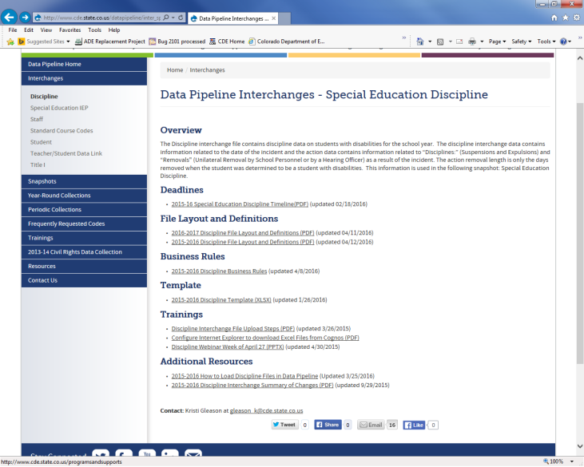
Discipline Template

Slide 20
Tips on files
Be sure there are no spaces in the file name
Be careful with CSV files and losing leading zeros
Be sure the file is not open when you are uploading it to the Data Pipeline website
Establish a naming convention that is easy for you to follow

Slide 21
Accessing the Data Pipeline
https://cdeapps.cde.state.co.us/index.html

Slide 22
Accessing the Data Pipeline
Email address associated with your IdM Group
The password you created in IdM

Slide 23
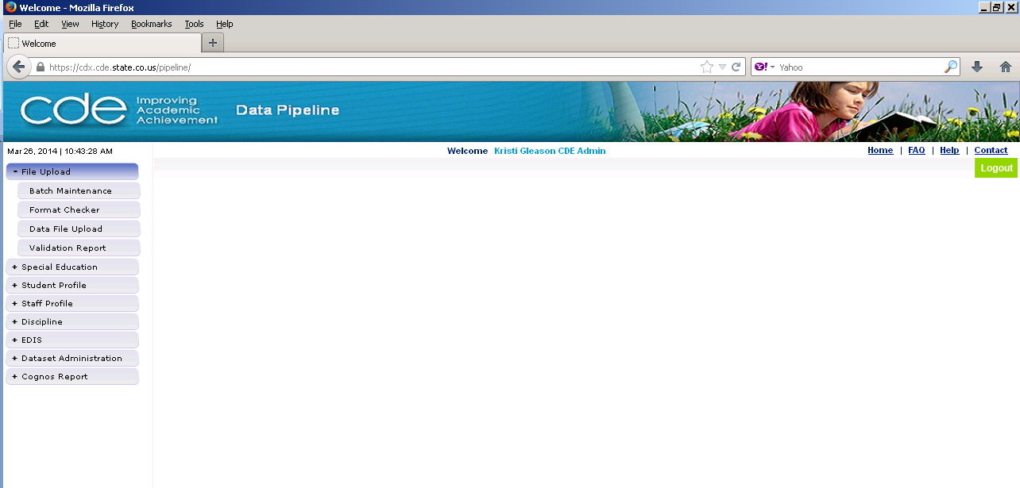
Uploading Discipline Interchange File
The Data Pipeline will accept Excel, CSV, or Text Files.

Slide 24
Format Checker
Steps for uploading the file
Once the file is created, first run it through the Format Checker to ensure all the bytes are correct. The system checks the first row of data. For each field you will either get a Pass or a Fail if the byte length of your data meets the expected byte length.
http://www.cde.state.co.us/displineinterchangefileuploadsteps

Slide 25
Data File Upload
Dataset: Discipline
File Type: Discipline Action
School Year: 2015-16
LEA: District
Locate File:
Upload Type: REPLACE
Submit

Slide 26
Status of Records
If you wish to see the status of the files submitted you’ll want to go to the Batch Maintenance Screen
or the Status Dashboard

Slide 27
Validation Report
Once you uploaded the file you will be able to see a summary of what if any errors you may have by clicking on the Validation Report button on the left hand of the screen.
Dataset: Discipline
File Type: Discipline Action
School Year: 2015-16
LEA: District
Batch Id:
View Report

Slide 28
Reviewing Errors PIPELINE REPORTS

Slide 29
Reviewing Errors in Cognos
If you want to see a detailed list of errors, go to
Cognos at the bottom of the Data Pipeline System Screen
Another window will open
Choose Discipline Interchange Folder and choose one of the following error reports

Slide 30
Reviewing Errors in Cognos
You can choose to
View all Errors and Warnings
Just one Error
Just Warnings
Choose the Finish Button once you’ve made your selection.
If no selection is made all of the errors will be displayed on the report.
If there are no errors you will not see your district in the drop down as there is no report to display

Slide 31
Reviewing Errors in Cognos
You can view the errors and the records receiving the error on-line in the browser or you can download the report as PDF HTML or EXCEL
Be sure to choose the “Format” Option if you choose EXCEL
Remember if you are reviewing the report in the browser to hit page down to see the next set of records and their errors.
Once you know what records have which error, go to the source to make a correction, make a change in the interchange file, and reupload the updated file in the Data Pipeline website.
31

Slide 32
Correcting Errors
Be sure to first make a change in your source system
Once the change is made in the source system, make the change in the file
Reupload the updated file until all Interchange and Snapshot errors are resolved.
32

Slide 33
Common Errors
RITS mismatches – typically first and last name are transposed
Incident Identifier and Action Identifier’s must not match
Discipline Action Length must be between ½ and 365 days
0005 = half day
1000 = 100 days
3650 = 365 days
If the student is removed, Discipline Action Length by law must be between ½ and 45 days
Students may not be suspended for more than 25 school days (warning)
Either a student has a Discipline or a Removal not both.
Only Unilateral Removals by School Personnel require a reason
Received Education Services are only reported during Expulsions
33

Slide 34
EXCEPTIONS
There are a handful of business rules at both the interchange and at the Snapshot that may require an exception request.
You may find the interchange template here http://www.cde.state.co.us/datapipeline/inter_sped-discipline
And the Snapshot Exception Template here http://www.cde.state.co.us/datapipeline/snap_sped-discipline

Slide 35
EXCEPTIONS INTERCHANGE
Business Rule | Description | Steps
DA043 | Date of Incident must be between July 1st and June 30th of the current school year. If Date of Incident is accurate, refer to Exception Request Instructions | Download the Exception template. Follow the instructions for data needed including reason for an exception and send to CDE

Slide 36
EXCEPTIONS SNAPSHOT
Business Rule | Description | Steps
SD020 | Student's age is outside of the valid range for the reported grade.. | Download the Exception template. Follow the instructions for data needed including reason for an exception and send to CDE
SD024 | The discipline date from the discipline action file must be between the start date of special education and the end date of special education.
SD025 | The student associated with this action was reported as expelled without services, please request an exception and provide the reason services were not received.

Slide 37
IMPORTANT DATES TO REMEMBER
Monday, April 11
Discipline Interchange file may be uploaded to the Data Pipeline
Monday, May 9
Date by which the interchanges files must be uploaded
Thursday, June 2
Date by which the Admin Unit must generate a snapshot. Once the Admin Unit creates a snapshot districts will have access to Snapshot errors
Thursday, July 7
Date by which Interchange errors must be resolved
Tuesday, August 16
Date by which Interchange and Snapshot errors must be resolved
Wednesday, August 17 – Tuesday, August 23
Report review week: Districts must be available to make any changes in the interchange
Tuesday, August 23
All interchange and Snapshot errors resolved. No changes after this date.
Wednesday, August 24
Final Data File Approval . Administrative Units Approve and Electronically submit data to the Data Pipeline
http://www.cde.state.co.us/datapipeline/specialeducationdisciplinetimelinedistrictreference

Slide 38
Special Education Discipline Reports

Slide 39
SPED Discipline Reports
Resolve Snapshot Errors
Report Review Week
Reports signed and Uploaded to the DMS
8/16/2016
8/17-8/23
8/24/2016

Slide 40
August 16, 2016
Error Free
Date by which all Interchange and Snapshot Errors are Resolved and Warnings have been Reviewed.
For Administrative Units – All data records needed for the Special Education Discipline snapshot should be uploaded and passed interchange (level 1) and Snapshot (level 2) edit validations.

Slide 41
Reports to Help Identify Snapshot Errors and Warnings
District Activity Report
SPED Error Summary Report – Will show which districts have issues
SPED Error Detail Report – This report should have no errors by August 16, 2016 Review Warnings on this Report
SPED Snapshot Records Excluded Due to Profile Errors – This report should be empty by August 16, 2016.

Slide 42
Reviewing Reports
If you want to see a detailed list of errors, go to
Cognos at the bottom of the Data Pipeline System Screen
Another window will open
Choose Discipline Interchange Folder and choose one of the following error reports
Discipline Action Error Detail Report
Discipline Action Error Summary Report
Discipline Incident Error Detail Report
Discipline Incident Error Summary Report

Slide 43
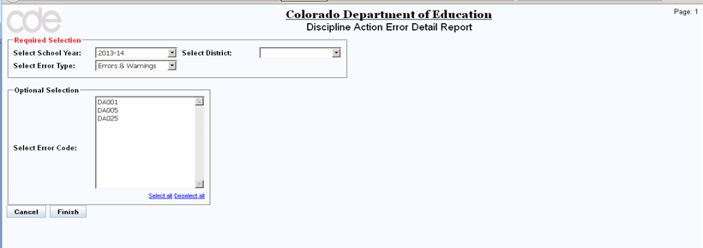
Interchange Errors Reports
You can choose to view all Errors and Warnings
Just one Error or Warning
Choose the Finish Button once you’ve made your selection.
If no selection is made all of the errors will be displayed on the report.
If there are no errors you will not see your district in the drop down as there is no report to display

Slide 44
Reviewing and Downloading Reports
You can view the errors and the records receiving the error on-line in the browser or you can download the report as PDF HTML or EXCEL
Be sure to choose the “Format” Option if you choose EXCEL
Remember if you are reviewing the report in the browser to hit page down to see the next set of records and their errors.
FIXING ERRORS
Once you know what records have which error, go to the source make a correction, make a change in the interchange file, and re-upload the updated file in the Data Pipeline website.

Slide 45
Expulsions – Validity Check
Closer to the end of the Special Education Discipline Collection we will be conducting validity checks around Expulsions between the Special Education Discipline collection and the Special Education End of Year Collection.
An expulsion without services was reported in the SPED EOY collection but not in the Discipline collection
An expulsion without services was reported in the SPED Discipline data collection but not in the SPED EOY collection.
There are inconsistencies in the expulsions being reported between the SPED Discipline and the SPED EOY collections.

Slide 46
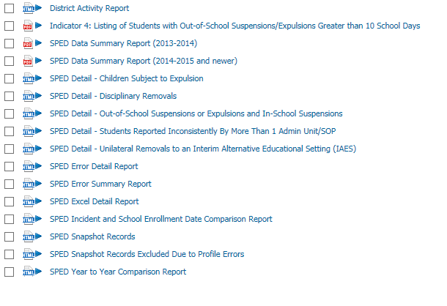
Snapshot Reports For The Administrative Unit Role
Notes:
Slide 51 in last years ppt

Slide 47
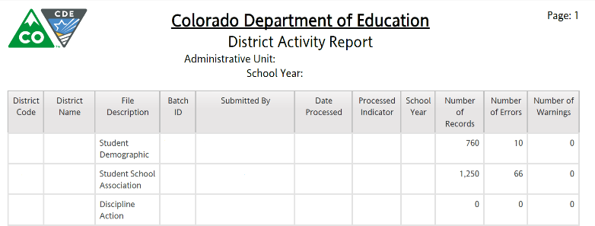
Check your District Activity Report
This report provides the Administrative Unit status on interchanges
If you have snapshot errors, first check if there are interchange errors
Notes:
remove

Slide 48
Common Snapshot Errors
Trying to resolve Snapshot errors when:
A file has not successfully uploaded
There are interchange errors
Records with Interchange errors can be seen in the SPED Snapshot Records Excluded Due to Profile Errors report
Fields where issues occur and why
Birth Date
Calculated age must be >= to 3 and < 22 as of December 1
Age is outside of valid range (send in exception)
A child cannot be reported as a having a Developmental Disability if they were 9 or older as of December 1
http://www.cde.state.co.us/datapipeline/snap_sped-discipline

Slide 49
Common Snapshot Errors (continued)
Discipline Action Length
Cannot Exceed
What happens if a student had an incident earlier in the year and then an expulsion later in the year.
Verify data. If accurate provide an exception
Grade Level
Make sure the Date and School Code in the Discipline file matches the information in the School Association File
Date of Incident
Must be Included
LASID
Check the District Activity Report has a file been successfully uploaded?
Primary Disability
The Date of the Action must come after the Entry Date of Sped and before the Exit Date of Sped.

Slide 50
Common Snapshot Errors
Special Education Suspensions/Expulsions vs Removal Types
Either a student was suspended OR expelled OR they were Unilaterally Removed
Both the “Discipline and the Removal Type cannot have a value nor can they both be zero-filled.
Only if you are reporting a Unilateral Removal by School Personnel should you be reporting a Reason.
See the following example

Slide 51
Common Snapshot Errors
Unilateral Removals and Removal by a H.O. Should never be more than 45 days
“0450” = 45.0 days
 | Disciplines | Discipline Start Date | Discipline Action Length | Special Education Removal Type | Special Education Removal Reason | Received Education Services During Expulsion | Special Education Action Flag
Unilateral Removal | 00 | MMDDYYY | 0450 | 01 | 02 | 0 | 1
Removal by a Hearing Officer | 00 | MMDDYYY | 0450 | 02 | 00 | 0 | 1
In-School Suspension | 01 | MMDDYYY | 0005 | 00 | 00 | 0 | 1
Out-of-School Suspension | 02 | MMDDYYY | 0250 | 00 | 00 | 0 | 1
Expulsion | 03 | MMDDYYY | 1800 | 00 | 00 | 1 | 1
Unilateral Removals and Removal by a H.O. Should have “Discipline” “00” filled
Unilateral Removals by School Personnel should always have a Reason – this is the only instance where a reason is recorded
Notes:
Every entry will have some field “0” filled. Note the highlighted areas.

Slide 52
Common Snapshot Errors
 | Disciplines | Discipline Start Date | Discipline Action Length | Special Education Removal Type | Special Education Removal Reason | Received Education Services During Expulsion | Special Education Action Flag
Unilateral Removal | 00 | MMDDYYY | 0450 | 01 | 02 | 0 | 1
Removal by a Hearing Officer | 00 | MMDDYYY | 0450 | 02 | 00 | 0 | 1
In-School Suspension | 01 | MMDDYYY | 0005 | 00 | 00 | 0 | 1
Out-of-School Suspension | 02 | MMDDYYY | 0250 | 00 | 00 | 0 | 1
Expulsion | 03 | MMDDYYY | 1800 | 00 | 00 | 1 | 1
“0005” = 0.5 days
Suspensions of any type should not exceed 25 days
“0250” = 25 days
Double check Expulsions
>180 days, does this make sense within the school year?
“1800” = 180 days
Notes:
Every entry will have some field “0” filled. Note the highlighted areas.

Slide 53
Common Snapshot Errors
 | Disciplines | Discipline Start Date | Discipline Action Length | Special Education Removal Type | Special Education Removal Reason | Received Education Services During Expulsion | Special Education Action Flag
Unilateral Removal | 00 | MMDDYYY | 0450 | 01 | 02 | 0 | 1
Removal by a Hearing Officer | 00 | MMDDYYY | 0450 | 02 | 00 | 0 | 1
In-School Suspension | 01 | MMDDYYY | 0005 | 00 | 00 | 0 | 1
Out-of-School Suspension | 02 | MMDDYYY | 0250 | 00 | 00 | 0 | 1
Expulsion | 03 | MMDDYYY | 1800 | 00 | 00 | 1 | 1
Provision of services required for removals >10 days, BUT are only REPORTED for Expulsions
Suspensions and Expulsions should have Removal Type and Reason “00”
Special Education Flag should = 1
Notes:
Every entry will have some field “0” filled. Note the highlighted areas.

Slide 54
August 17-23
Review Week
This is your chance to review your reports in detail and make any data corrections you deem necessary to make sure you are reporting valid and reliable data.

Slide 55
Review Week Reports
Report review week is August 17-23.
By August 24 the director must be ready to sign the AU’s SPED Data Summary Report and the Year to Year Comparison Report, assuring the CDE that the data is valid and reliable.
The following is a description of the key reports to review during Review Week.

Slide 56
Reports to Review
Notes:
Reports in Blue are Detail Reports, Reports in Green are Signature Reports

Slide 57
SPED Snapshot Records
These are all the records recorded in your SPED Discipline Snapshot
You can use this as a reference when questions arise from other reports.

Slide 58
Students Reported Inconsistently by more than 1 Admin Unit/SOP
The Errors appearing here may be legitimate entries.
For example a student’s disability identification may have changed at a mid-year staffing
A student’s parents may choose to report race differently when they move to a new district (A student is identified “Hispanic,” then “2 or More Races”)
Investigate things that don’t make sense

Slide 59
Incident and School Enrollment Date Comparison
This report details records where an incident is reported when a student was not enrolled.
This report should be blank.

Slide 60
The Next Reports Deal Directly With Your Signature Reports
The SPED Excel Detail Report Combines:
SPED Detail – Unilateral Removals to an Interim alternative Educational Setting (IAES)
SPED Detail – Out-of-School Suspensions or Expulsions and In-School Suspensions
SPED Detail – Disciplinary Removals
SPED Detail – Children Subject to Expulsion
Notes:
The SPED Excel Detail Report contains these 4 other reports, so you have a choice. You can view the reports individually or download all 4 at once in an Excel format. Your Choice!

Slide 61
SPED Detail – Unilateral Removals to an Interim alternative Educational Setting (IAES)
This should not be more than 45 Days
Removal Reason should show 1, 2 or 3 if Removal Type = 1
It should be blank if Removal type = 2
Compare this report to Columns 1A, 1B, 1C, 1D, and 2 in Sections A, B, C, and D in the SPED Data Summary Report
Does this reflect changes you expect to see in the Year-to-Year Comparison Report?
Does the data make sense?
Notes:
1A is the count of students unilaterally removed by staff. 1B, 1C, 1D cover the details of why they were removed. 2 refers to removals by a hearing officer.

Slide 62
SPED Detail – Out-of-School Suspensions or Expulsions and In-School Suspensions
3A = Out-of-School Suspensions/Expulsions = 10 days or less
3B = Out-of-School Suspensions/Expulsions greater than 10 days (Think Indicator 4!)
4A = In-School Suspensions = 10 days or less
4B = In-School Suspensions greater than 10 days
Compare this report to Columns 3A, 3B, 4A, and 4B in Sections A, B, C, and D in the SPED Data Summary Report
Does this reflect changes you expect to see in the Year-to-Year Comparison Report?
Does the data make sense?

Slide 63
SPED Detail – Disciplinary Removals
Compare this report to Column 5A in Sections A, B, C, and D in the SPED Data Summary Report
Does this reflect changes you expect to see in the Year-to-Year Comparison Report?
Does the data in 5B, 5C, and 5D make sense?

Slide 64
SPED Detail – Children Subject to Expulsion
If a student had 2 expulsions you will see them twice in the Detail report but 1 time in the Data Summary Report
6A = Expelled With Services
6B = Expelled Without Services – records in 6B should not be more than 10 days.
Compare this report to Section E in the SPED Data Summary Report
Does this reflect changes you expect to see in the Year-to-Year Comparison Report?
Does the data make sense?

Slide 65
SPED Detail – Children Subject to Expulsion (continued)
This entry does not make much sense. It says that this student was expelled for half a day toward the end of February and services were provided.
Maybe the # of days was supposed to be “0500” (50 days)?
Compare this report to Section E in the SPED Data Summary Report
Does this reflect changes you expect to see in the Year-to-Year Comparison Report?
Does the data make sense?

Slide 66
SPED Detail – Indicator 4
SPED Detail – Indicator 4
This report is a listing of all student records that appear in the count for Indicator 4.
This year we will not collect this report as a signed report.
Refer to the SPED Data Summary Report pay special attention to Column 3B
the total for this column is used to determine your Indicator 4A compliance
The data in this column in Section B: Race/Ethnicity is used to determine Indicator 4B compliance

Slide 67
August 24
Signed Reports
All the reports in the previous section reflect valid and accurate data. These last two reports must be signed and uploaded to the Data Management System by August 24

Slide 68
2 Special Education Discipline Director Signed Reports + Flag Explanations
SPED Data Summary Report (2014-2015 and newer)
SPED Year to Year Comparison Report
+ Special Education Discipline Flag Explanations
Notes:
Revenant data for Indicator 4 can be found in the Data Summary Report. The report with the heading “Indicator 4” has been changed to a detail report and does not need to be submitted to the CDE.

Slide 69
SPED Data Summary Report
The report has 5 Sections
Section A: Disciplinary Removal Type by Disability (pp. 1-3)
Section B: Disciplinary Removal Type by Race/Ethnicity (pp. 4-6)
Section C: Disciplinary Removal Type by Gender (pp. 7-9)
Section D: Disciplinary Removal Type by English Language Learner Status(pp. 10-12)
Section E: Children subject to expulsion who did and did not receive educational services by Disability Status (p. 13)

Slide 70
SPED Data Summary Report
Sections A-D contain counts of discipline events and counts of children with disabilities by:
Unilateral removal by school personnel following a drug or weapon offense or serious bodily injury
Removal based on a hearing officer determination regarding likely injury
Suspension (both In-School and Out-of-School totaling less than 10 school days and totaling more than 10 school days
Expulsion with and without educational services.
TIP: The TOTALS for these areas should be the same across Sections A-D

Slide 71
SPED Data Summary Report
The final section, “Section E: Children subject to expulsion who did and did not receive educational services by disability status” is on page 13.
Note: Children with disabilities must receive educational services during an expulsion of more than 10 school days. The only children with disabilities who should be reported as not receiving services are those who were removed for less than 10 school days after an expulsion.

Slide 72
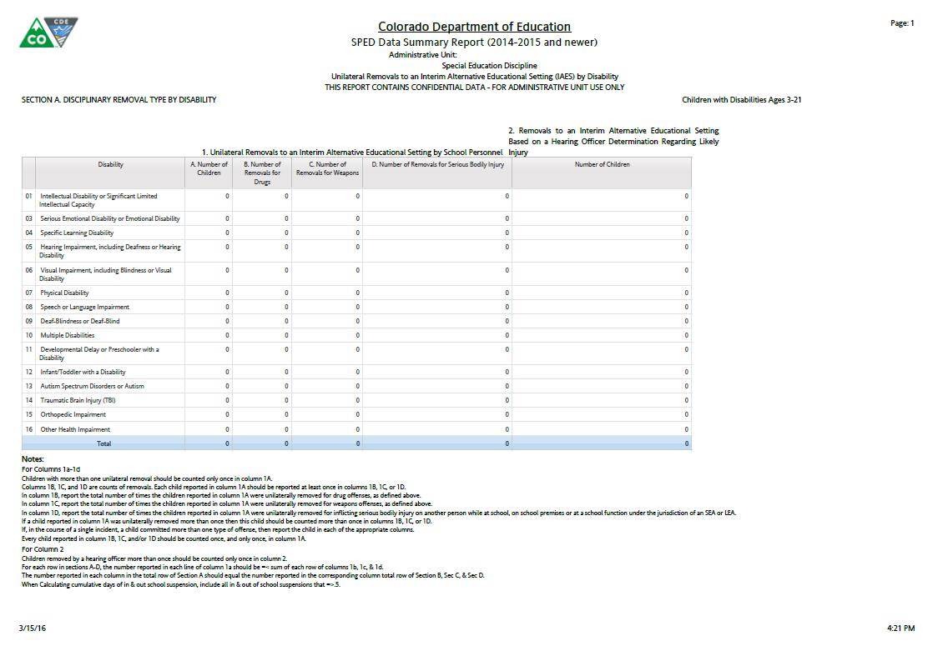
Section A: Disciplinary Removal by Disability.
If a child reported in column 1A was unilaterally removed to an Interim Alternative Educational Setting more than once then this child should be counted more than once in columns 1B,1C,1D. If, in the course of a single incident, a child committed more than one type of offense, then report the child in each of the appropriate columns.
Notes:
This slide provides information related specifically to Removals
Section 1A: Number of Children Unilaterally Removed to an IAES by School Personnel
Section 1B: Number of Times students were Unilaterally Removed to an IAES for Drugs
Section 1C: Number of Times students were Unilaterally Removed to an IAES for Weapons
Section 1D: Number of Times students were Unilaterally Removed to an IAES for Serious Bodily Injury
Section 2: Number of Children Removed to an IAES by a Hearing Officer for Serious Bodily Injury
Sections 1 & 2 are broken out by Primary Disability, Federal Race/Ethnicity Reporting category, Gender, and ELL status

Slide 73
Section A: Disciplinary Removal by Disability.
1A. Report the number of children ages 3-21 who were unilaterally removed for drugs, weapons, serious bodily injury. The child should only be counted once here.
1B. Report the total number of times the children reported in column 1A were unilaterally removed for Drug offenses.
1C. Report the total number of times the children reported in column 1A were unilaterally removed for Weapon offenses.
1D. Report the total number of times the children reported in column 1A were unilaterally removed for Serious Bodily Injury offenses.
Notes:
This slide provides information related specifically to Removals
Section 1A: Number of Children Unilaterally Removed to an IAES by School Personnel
Section 1B: Number of Times students were Unilaterally Removed to an IAES for Drugs
Section 1C: Number of Times students were Unilaterally Removed to an IAES for Weapons
Section 1D: Number of Times students were Unilaterally Removed to an IAES for Serious Bodily Injury
Section 2: Number of Children Removed to an IAES by a Hearing Officer for Serious Bodily Injury
Sections 1 & 2 are broken out by Primary Disability, Federal Race/Ethnicity Reporting category, Gender, and ELL status

Slide 74
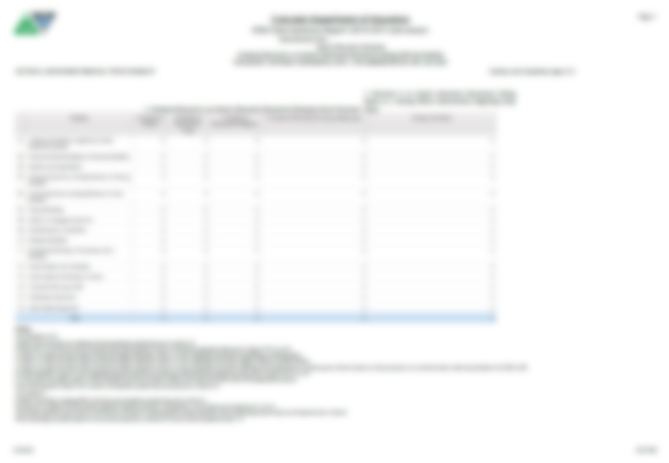
Section A: Disciplinary Removal by Disability.
Report the number of children ages 3-21, who were removed to an IAES based on a Hearing Officer Determination of likely injury to themselves or others. Children removed by a hearing officer more than once should be counted only once in column 2.
Notes:
This slide provides information related specifically to Removals
Section 1A: Number of Children Unilaterally Removed to an IAES by School Personnel
Section 1B: Number of Times students were Unilaterally Removed to an IAES for Drugs
Section 1C: Number of Times students were Unilaterally Removed to an IAES for Weapons
Section 1D: Number of Times students were Unilaterally Removed to an IAES for Serious Bodily Injury
Section 2: Number of Children Removed to an IAES by a Hearing Officer for Serious Bodily Injury
Sections 1 & 2 are broken out by Primary Disability, Federal Race/Ethnicity Reporting category, Gender, and ELL status

Slide 75
Section A: Disciplinary Removal by Disability.
This page, with columns 1A, 1B, 1C, 1D & 2 will repeat for:
Section A: Disability
Section B: Race/ Ethnicity
Section C: Gender and
Section D: ELL Status.
The report will use the Federal Race/
Ethnicity Reporting Category for the Race/Ethnic codes. The totals should match across all 4 pages.
Notes:
This slide provides information related specifically to Removals
Section 1A: Number of Children Unilaterally Removed to an IAES by School Personnel
Section 1B: Number of Times students were Unilaterally Removed to an IAES for Drugs
Section 1C: Number of Times students were Unilaterally Removed to an IAES for Weapons
Section 1D: Number of Times students were Unilaterally Removed to an IAES for Serious Bodily Injury
Section 2: Number of Children Removed to an IAES by a Hearing Officer for Serious Bodily Injury
Sections 1 & 2 are broken out by Primary Disability, Federal Race/Ethnicity Reporting category, Gender, and ELL status

Slide 76
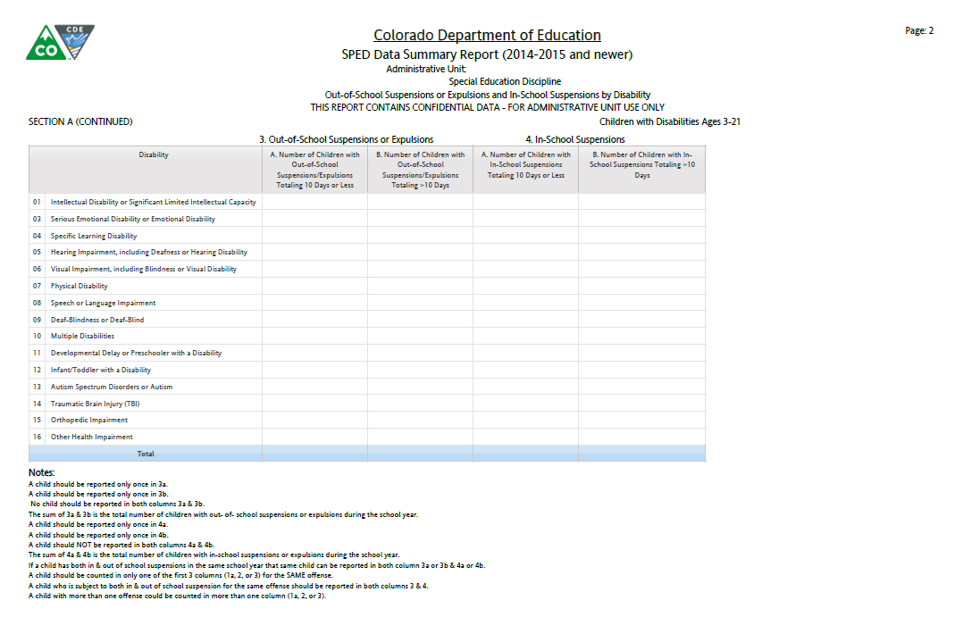
A child who is subject to both an In-School Suspension and an Out-of-School Suspension for the same offense should be reported in both columns 3 and 4.
Notes:
This slide provides information related specifically to In-School Suspensions Section 4A and 4B as well as Out-of-School Suspensions and Expulsion Section 3A and 3B.
Section 3A: Number of Children with Out-of-School Suspensions and/or Expulsions summing to 10 days or less
Section 3B: Number of Children with Out-of-School and/or Expulsions summing to more than 10 days. (This is the column that is used for Indicator 4 calculations of AU rate and significant discrepancy)
Section 4A: Number of Children with In-School Suspensions summing to 10 days or less
Section 5A: Number of Children with In-School Suspensions summing to more than 10 days
Information related to In-School Suspensions, Out-of-School Suspensions/Expulsions is broken down by Primary Disability, Federal Race Reporting Category, Gender, and ELL Status.

Slide 77
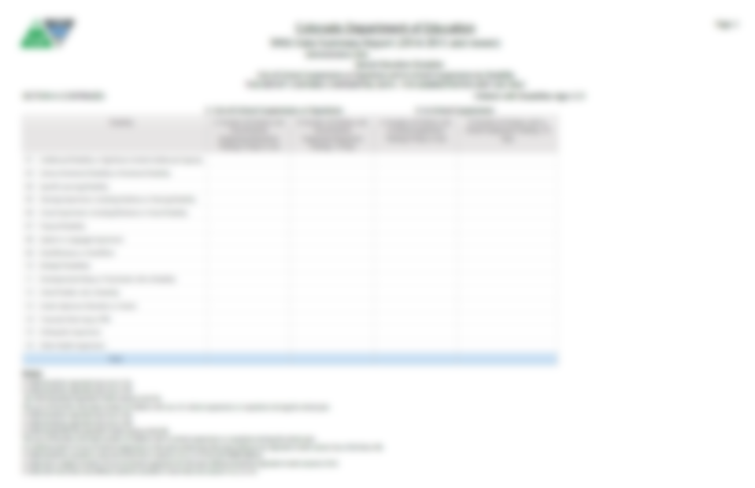
Report the number of children ages 3-21 with Out-of-School Suspensions or Expulsions summing to 10 days or less during the school year for any offense or combination of offenses. No child should be reported more than once in column 3A.
Report the number of children ages 3-21 with Out-of-School Suspensions or Expulsions summing to more than 10 days during the school year for any offense or combination of offenses. No child should be reported more than once in column 3B.
Notes:
This slide provides information related specifically to In-School Suspensions Section 4A and 4B as well as Out-of-School Suspensions and Expulsion Section 3A and 3B.
Section 3A: Number of Children with Out-of-School Suspensions and/or Expulsions summing to 10 days or less
Section 3B: Number of Children with Out-of-School and/or Expulsions summing to more than 10 days. (This is the column that is used for Indicator 4 calculations of AU rate and significant discrepancy)
Section 4A: Number of Children with In-School Suspensions summing to 10 days or less
Section 5A: Number of Children with In-School Suspensions summing to more than 10 days
Information related to In-School Suspensions, Out-of-School Suspensions/Expulsions is broken down by Primary Disability, Federal Race Reporting Category, Gender, and ELL Status.

Slide 78
Report the number of children ages 3-21 with In-School Suspensions summing to 10 days or less during the school year for any offense or combination of offenses. No child should be reported more than once in column 4A.
Report the number of children ages 3-21 with In-School Suspensions summing to more than 10 days during the school year for any offense or combination of offenses. No child should be reported more than once in column 4A.
Notes:
This slide provides information related specifically to In-School Suspensions Section 4A and 4B as well as Out-of-School Suspensions and Expulsion Section 3A and 3B.
Section 3A: Number of Children with Out-of-School Suspensions and/or Expulsions summing to 10 days or less
Section 3B: Number of Children with Out-of-School and/or Expulsions summing to more than 10 days. (This is the column that is used for Indicator 4 calculations of AU rate and significant discrepancy)
Section 4A: Number of Children with In-School Suspensions summing to 10 days or less
Section 5A: Number of Children with In-School Suspensions summing to more than 10 days
Information related to In-School Suspensions, Out-of-School Suspensions/Expulsions is broken down by Primary Disability, Federal Race Reporting Category, Gender, and ELL Status.

Slide 79
This page with columns 3A/B and 4A/B will also repeat for:
Section A: Disability
Section B: Race/ Ethnicity
Section C: Gender and
Section D: ELL Status.
Notes:
This slide provides information related specifically to In-School Suspensions Section 4A and 4B as well as Out-of-School Suspensions and Expulsion Section 3A and 3B.
Section 3A: Number of Children with Out-of-School Suspensions and/or Expulsions summing to 10 days or less
Section 3B: Number of Children with Out-of-School and/or Expulsions summing to more than 10 days. (This is the column that is used for Indicator 4 calculations of AU rate and significant discrepancy)
Section 4A: Number of Children with In-School Suspensions summing to 10 days or less
Section 5A: Number of Children with In-School Suspensions summing to more than 10 days
Information related to In-School Suspensions, Out-of-School Suspensions/Expulsions is broken down by Primary Disability, Federal Race Reporting Category, Gender, and ELL Status.

Slide 80
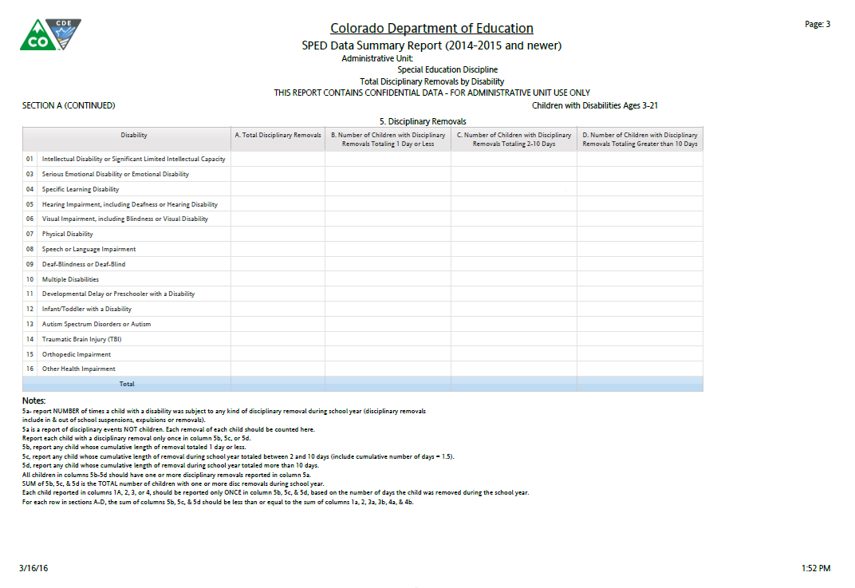
All children reported in columns 5B through 5D should have one or more disciplinary removals reported in column 5A. The sum of 5B, 5C, and 5D is the total number of children with one or more disciplinary removals during the school year. Each child reported in columns 1A, 2,3 or4 should be reported only ONCE in column 5B, 5C, or 5D, based on the cumulative number of days the child was removed during the school year.
Notes:
This slide provides information shows ALL disciplinary incidences including Unilateral Removals by School Personnel, Unilateral Removals by a Hearing Officer, In-School Suspensions, Out-of-School Suspensions and Expulsions and broken down by Primary Disability, Federal Race Reporting Category, Gender, and ELL Status.
Section5A: Number of Times child was subject to any disciplinary action
Section 5B: Report of Children with cumulative length of removal for any disciplinary incident during the reporting period totaling 1 day
Section 5C: Report on Children with cumulative length of removal for any disciplinary incident during the reporting period totaling 2-10 days. (Please pay special attention to Column 5 C = 2-10 days which includes 1.5 cumulative length of removal during the school year).
Section 5D: Report on Children with cumulative length of removal for any disciplinary incident during the reporting period totaling greater than 10 days.

Slide 81
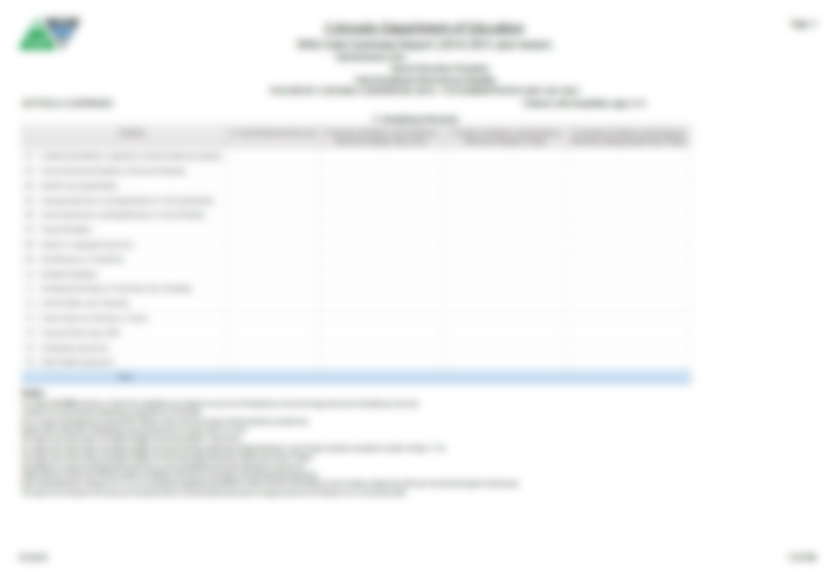
Report the number of times any child with a disability was subject to any of the following disciplinary actions during the school year: In-School or Out-of-School Suspensions, Expulsion, Removals by School Personnel to an IAES or by a Hearing Officer.
Report any child whose cumulative length of removal during the school year totaled 1 day.
Report any child whose cumulative length of removal during the school year totaled between 2 and 10 days.
NOTE: This Includes 1.5 cumulative length of removal during the school year.
Report any child whose cumulative length of removal during the school year totaled more than 10 days.
Notes:
This slide provides information shows ALL disciplinary incidences including Unilateral Removals by School Personnel, Unilateral Removals by a Hearing Officer, In-School Suspensions, Out-of-School Suspensions and Expulsions and broken down by Primary Disability, Federal Race Reporting Category, Gender, and ELL Status.
Section5A: Number of Times child was subject to any disciplinary action
Section 5B: Report of Children with cumulative length of removal for any disciplinary incident during the reporting period totaling 1 day
Section 5C: Report on Children with cumulative length of removal for any disciplinary incident during the reporting period totaling 2-10 days. (Please pay special attention to Column 5 C = 2-10 days which includes 1.5 cumulative length of removal during the school year).
Section 5D: Report on Children with cumulative length of removal for any disciplinary incident during the reporting period totaling greater than 10 days.

Slide 82
This page with Sections 5A , B, C, D will also repeat for:
Section A: Disability
Section B: Race/ Ethnicity
Section C: Gender and
Section D: ELL Status.
Notes:
This slide provides information shows ALL disciplinary incidences including Unilateral Removals by School Personnel, Unilateral Removals by a Hearing Officer, In-School Suspensions, Out-of-School Suspensions and Expulsions and broken down by Primary Disability, Federal Race Reporting Category, Gender, and ELL Status.
Section5A: Number of Times child was subject to any disciplinary action
Section 5B: Report of Children with cumulative length of removal for any disciplinary incident during the reporting period totaling 1 day
Section 5C: Report on Children with cumulative length of removal for any disciplinary incident during the reporting period totaling 2-10 days. (Please pay special attention to Column 5 C = 2-10 days which includes 1.5 cumulative length of removal during the school year).
Section 5D: Report on Children with cumulative length of removal for any disciplinary incident during the reporting period totaling greater than 10 days.

Slide 83
Section E: Children Subject to Expulsion With and Without Educational Services by Disability Status.
Section 6: Children Subject to Expulsions:
6A: Received Education Services During Expulsion
6B: Did NOT receive Educational Services During Expulsion.
Children with disabilities must receive educational services during any suspension or expulsion of more than 10 school days. The only children with disabilities who should be reported in column 6B are those who were expelled for less than 10 school days (e.g., children with disabilities expelled under the Gun-Free Schools Act whose expulsions were modified to less than 10 school days or who were expelled at the end of a term, like 8 days before school was out for the summer).
Notes:
This slide provides the data relative to Expulsions with services and without services.
Section 6A: Report of children who were subject to expulsion during the reporting period and received educational services during the expulsion
Section 6B: Report of children who were subject to expulsion during the reporting period and did NOT receive educational services during the expulsion.
CDE will be contacting Aus in regard to discrepancies in reporting’s of expulsions reported in the Special Education Discipline collection as well as the Special Education EOY collection.
Children with disabilities must receive services during any suspension or expulsion of more than 10 school days. The only children with disabilities who should be reported in column 6b are those who were removed for less than 10 school days after an expulsion (e.g. children with disabilities expelled under the Gun-Free Schools Act who expulsions were modified to less than 10 school days).

Slide 84
Incidences of Expulsions where the student did NOT receive services reported in the Discipline collection will be cross referenced with students reported with a Basis of EOY Student Collection. Exit Code 50 – Expulsions in the SPED.
Report the number of children with disabilities ages 3-21 who were subject to expulsion during the school year and who received educational services during the expulsion.
Report the number of children with disabilities ages 3-21 who were subject to expulsion during the school year and did NOT receive educational services during the expulsion.
Notes:
This slide provides the data relative to Expulsions with services and without services.
Section 6A: Report of children who were subject to expulsion during the reporting period and received educational services during the expulsion
Section 6B: Report of children who were subject to expulsion during the reporting period and did NOT receive educational services during the expulsion.
CDE will be contacting Aus in regard to discrepancies in reporting’s of expulsions reported in the Special Education Discipline collection as well as the Special Education EOY collection.
Children with disabilities must receive services during any suspension or expulsion of more than 10 school days. The only children with disabilities who should be reported in column 6b are those who were removed for less than 10 school days after an expulsion (e.g. children with disabilities expelled under the Gun-Free Schools Act who expulsions were modified to less than 10 school days).

Slide 85
By authorizing this report, you are confirming in writing that the data reported is both valid and reliable.
Notes:
By authorizing this report, you are confirming in writing that the data reported is both valid and reliable.
REMINDER: When you send in the Data Summary Report, please send the 14 page report in it’s entirety.

Slide 86
Year to Year Comparison Report
The report totals 13 pages
A section for “Disability: All” (1 page)
A section for Racial/Ethnic groups (6 pages)
A section for Gender groups (2 pages)
A section for ELL Status groups (2 pages)
The signature page

Slide 87
This page will repeat for all Racial, Gender and ELL Categories
You will only see flags - “A” – if both the number of the change is over 20 students AND the Percent of the Change is over 20%
These are the only data points that require explanation on the Flag Explanations sheet

Slide 88
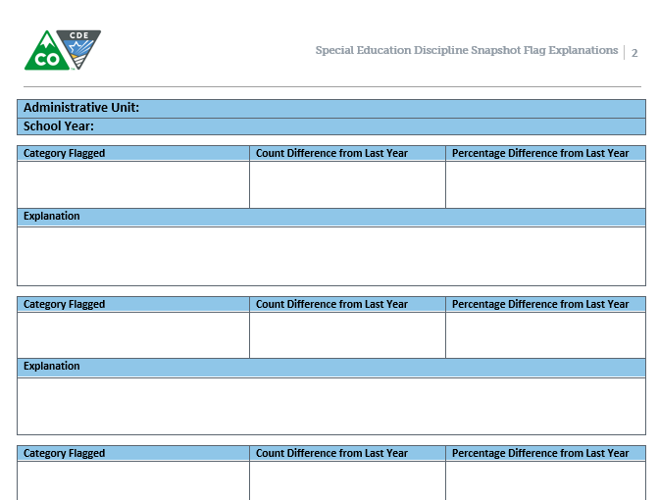
Year to Year Report Flag Explanations
Please remember to provide explanations for the A flags from the Year to Year Report no later than August 24, 2015
Remember, you can include multiple flag categories when the same explanation applies

Slide 89
SPECIAL EDUCATION DISCIPLINE REPORT RELATED DEADLINES
Tuesday, August 16, 2016
Date by which you must have generated your complete Special Education Discipline Snapshot dataset by passing all interchange and snapshot validations in preparation for report review.
Wednesday, August 17-August 23, 2016
Report review week.
Review reports in detail and make any data corrections deemed necessary to ensure you are reporting valid and reliable data
Thursday, August 24, 2016
Final report approval, upload signature reports to DMS

Slide 90
August 24, 2016 Deadline
Final report review AND approval.
Date by which the Administrative Unit must approve their completed Special Education Discipline Data Collection Snapshot and electronically SUBMIT the data to CDE via the Data Pipeline, verifying that it’s valid and reliable by uploading the signed Data Summary Report (all 14 pages) and the Year to Year Report along with explanations for Flags to the Data Management System.

Slide 91
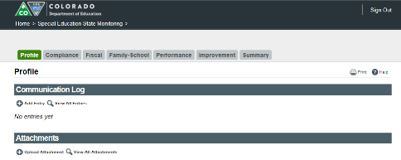
Submitting Final Reports
Both Signature Reports should be signed and submitted by August 24, 2016
2 Signature Reports (+ Flag Report)
Scan signed documents into a PDF or multiple PDFs
Upload the PDFs to the Data Management System/Profile Tab
Upload Flag Explanations separately as a Word File
Notes:
Uploading the Flag Explanations in a Word allows the data team to easily copy the explanations into a searchable file for internal use.

Slide 92
Contact Information
If you have ANY questions about the Special Education Discipline Data Collection please feel free to contact us. We are just a phone call away!
Kristi Gleason 303-866-4620 gleason_k@cde.state.co.us Collection Lead
Lindsey Heitman 303-866-5759 heitman_l@cde.state.co.us
Please include the following team members in your email communications gleason_k@cde.state.co.us; heitman_l@cde.state.co.us
In the subject line of the email if you would please include the following information:
District Number (four digit code)
Administrative Unit Number (5 digit code)
Subject of the email along with any business rules or name of a report if applicable.
In the body of the email:
Please include your phone number!
Thank you
92

Slide 93
GO TEAM DISCIPLINE!

