Slide 1
Human Resources
2014-2015 Snapshot
November 2014

Slide 2
Agenda - LOTS
General Overview
Requirements
Uses
Snapshot Process
Steps
Timeline
Dates
Reports
Support Options
Comparison with Special Ed
Finalizing Data
Poll!
Question Session and Closing Notes too!

Slide 3
General Overview

Slide 4
What requires this data?
Legislation:
  Commissioner – duties statistics required, 22-2-112(k), C.R.S.;
  Board of education – reporting requirements 22-32-109.1(II)(K)(VII), C.R.S.
  Performance reports – contents – rules, 22-11-503(3)(e), C.R.S.;
  Use of aggregate data – educator preparation programs, 22-68.5-102.5 C.R.S.;
  Licensed Personnel Performance Evaluation, 22- 9-101 C.R.S.
US Department of Education reporting requirements

Slide 5
How is the data used?
EDFacts*
SchoolView.org
Performance Reports – staff statistics
Highly Qualified verification
Media and external data requests
Colorado Department of Labor and Employment
Colorado Department of Higher Education
*EDFacts is a U. S. Department of Education (ED) initiative to govern, acquire, validate, and use high-quality, kindergarten through grade 12 (K–12) performance data for education planning, policy-making, and management and budget decision-making to improve outcomes for students. EDFacts data are authorized by an Annual Mandatory Collection of Elementary and Secondary Education Data through EDFacts, OMB 1875-0240, and the Federal Regulations 34 C.F.R. Part 76 published in the Federal Register on January 25, 2007.

Slide 6
Who is/isn’t reported in HR snapshot?
Included:
  All general education staff employed as of December 1st
  Full or part time
  Office/clerical, teachers, principals, administrators, etc.
Excluded
  Substitutes unless they are permanent (90 days or more in the same classroom)
  Temporary workers, such as after school coaches
  Special Education staff – they are reported in separate snapshot
  Staff not employed December 1st

Slide 7
What is the Special Education December Count Snapshot?
Similar to the HR snapshot –
  pulls the Special Education staff employed as of December 1st instead of the general education staff
Stricter deadlines
Administrative Units create snapshot instead of the districts/BOCES
Has a student caseload requirement for staff coded as special education teachers (202) & Speech-Language Pathologists (238)

Slide 8
How does this impact districts/BOCES?
Administrative Units submitting all sped staff data
Districts need to review Special Education staff report in cognos ongoing
  To ensure sped staff correctly reported
  To ensure sped staff are not overly reported in both snapshots
Districts submitting ALL staff data (sped + gen ed)
Prior to Sped deadlines:
  Sped records must be submitted
  Sped records must be error free
Districts must make updates to sped records as needed per AU request to correct snapshot errors

Slide 9
Snapshot Process

Slide 10

Where do we start?
By uploading data into the staff interchange!
  Two files: staff profile & staff assignment files
  STF~LEAUSER role within Identity Management required to upload
Staff interchange files should be error free prior to starting HR snapshot process
File Layouts, File Formatting, Business Rules, Templates, Trainings and Additional Resources for staff interchange found at: http://www.cde.state.co.us/datapipeline/inter_staff

Slide 11
Identity Management Roles
For the Human Resources Snapshot:
HUMAN RESOURCES SNAPSHOT ROLES
VIEW ONLY | HRD~LEAVIEWER
CREATE | HRD~LEAUSER
FINALIZE/SUBMIT TO CDE | HRD~LEAAPPROVER

Slide 12
Overview
Profile
Assignment
No ERRORS
EDIDs in both
Special Ed Flag = 0
Employed on Dec 1st
Human Resources Snapshot
Meets snapshot criteria: add to:

Slide 13
Creating Snapshot Steps
Log into Data Pipeline
Click on Staff Profile tab (on the left)
Select ‘Snapshot’ from the expanded list
Enter appropriate search criteria (Human Resources Snapshot/2014-2015/Org Code)
Click on Search (green button on bottom)
Select ‘Create Snapshot’
New message should appear: “Snapshot creation triggered and processing. A notification email will be sent upon completion.”

Slide 14
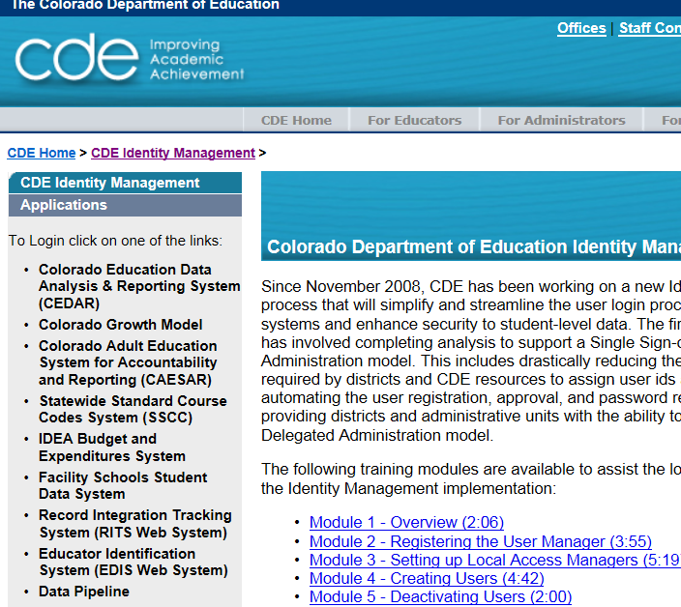
Pre-Step: Getting to Data Pipeline
https://cdeapps.cde.state.co.us/index.html

Slide 15
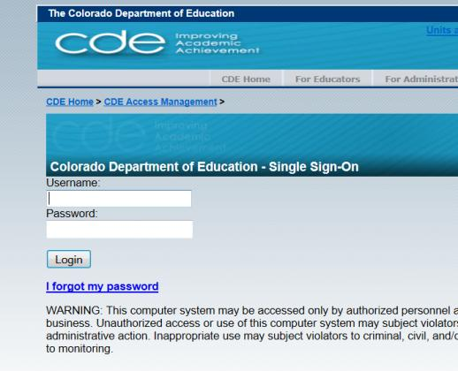
#1: Logging into Data Pipeline
Username = Email Address
Password – you created it
If forgotten password, use ‘I forgot my password’

Slide 16
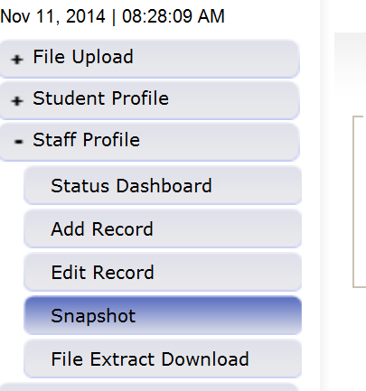
#2 and #3: Selecting Staff -> Snapshot
#2
#3

Slide 17
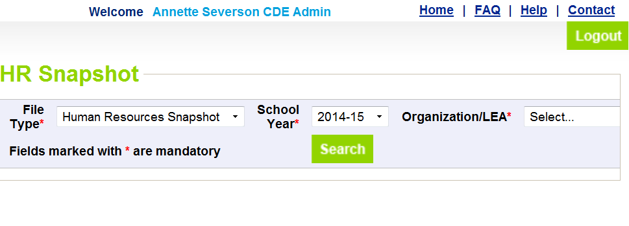
#4 and #5: HR Snapshot Screen
#4
#5

Slide 18
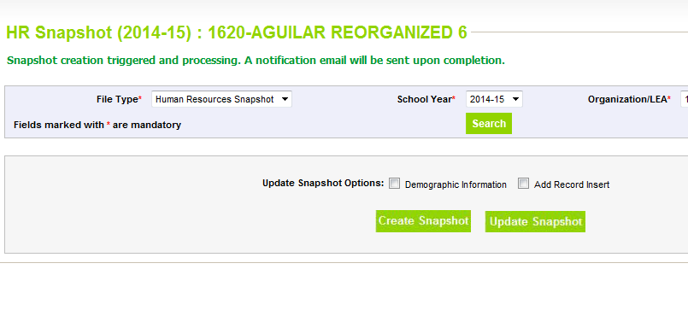
#6 and #7: Creating Snapshot- Screenshot
#7
#6

Slide 19
Next Steps
View Status of HR snapshot
  Email will be sent with status
  Status Dashboard screen –shows if processed and # of errors
View Snapshot errors in Cognos
  Select Human Resources file
  Select the Human Resources Error Detail Report
  View on the web or download into excel
Make corrections to staff interchange files
Upload updated staff interchange files
Re-create HR snapshot

Slide 20
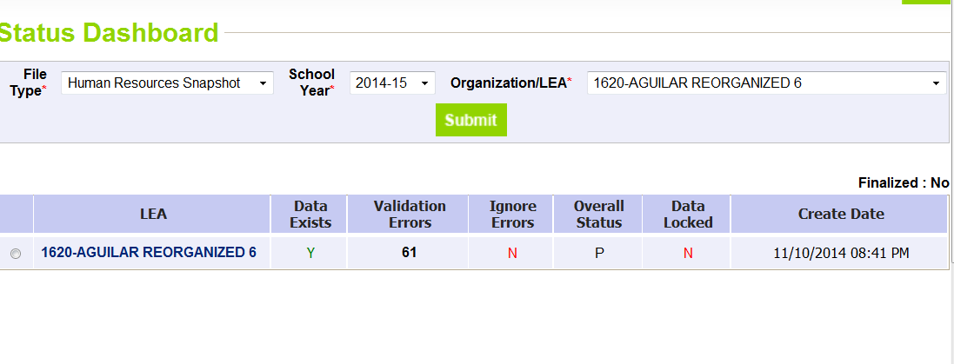
Status Dashboard Screen
# of Snapshot Record Errors
Y = snapshot successful!
N= snapshot wasn’t taken/no data in snapshot
Date/Time of Snapshot created

Slide 21
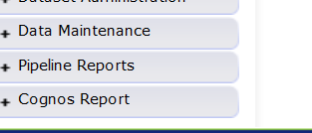
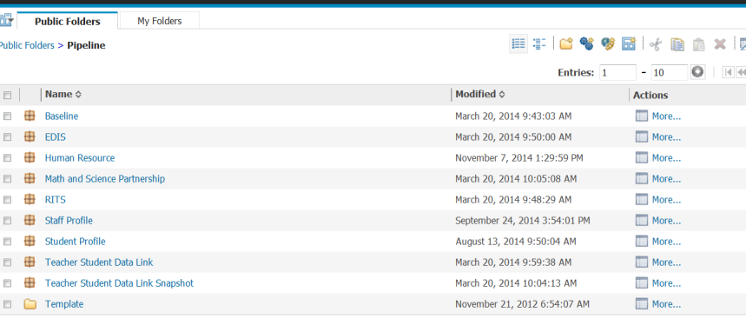
Cognos Report
Opens new window
Human Resources

Slide 22
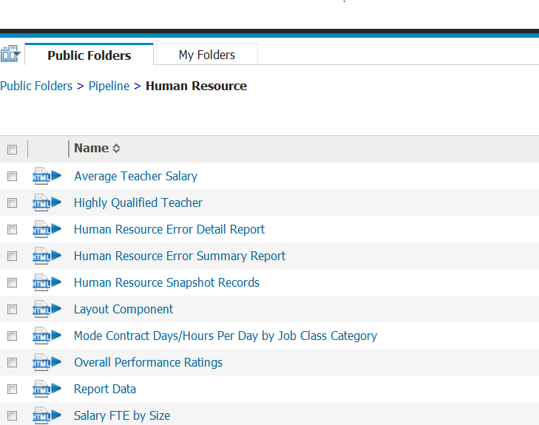
Human Resources Reports

Slide 23
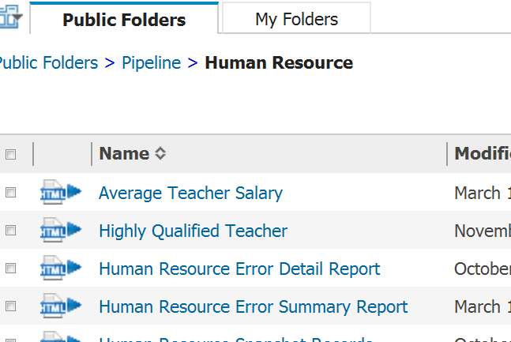
View Errors – Human Resource Error Detail Report

Slide 24
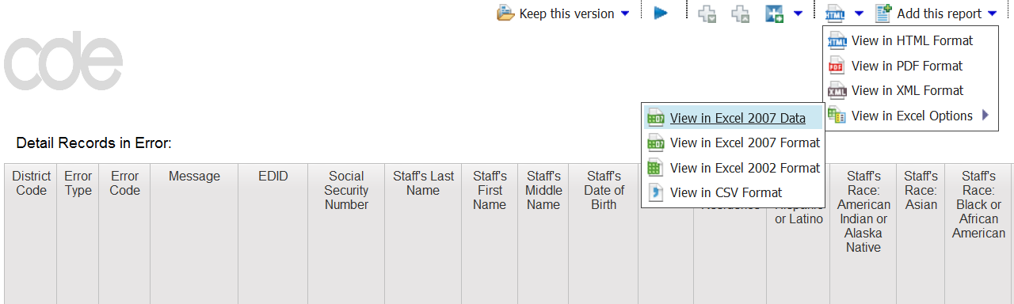
All Reports – Option to View/Open in Excel

Slide 25
Edits
Edits are in place to assist with providing most accurate information to CDE which is published, analyzed and reviewed by legislators, federal government, researchers, etc.
Edits should provide adequate information to assist you with determining corrections needed.
Please contact Annette Severson at severson_a@cde.state.co.us with edit code if further assistance is needed on any edits

Slide 26
Finalizing Steps
Once all Errors are resolved in Snapshot…
Review, review, review data reports for accuracy!
  If mistakes/misreporting is found, correct files again and create new snapshot
  If data reports are all accurate- you may finalize the data by submitting it to CDE (must wait until December 1st or after though)

Slide 27
New fields being captured
Educator Preparation Program
Passed HOUSSE Provision
Highly Qualified in Assignment
  Must be reported as N/A for all staff that are not core content teachers

Slide 28
New fields being calculated
Active Colorado License Type –
  shows if teacher has a current valid license to meet NCLB Highly Qualified requirements
  Provided from CDE licensure data
Teaching Level – shows E for Elementary and S for Secondary level; (E,S) for general middle level
  Calculated based on grade levels selected in record
  (E,S) is for 6th grade only records or if teaching subject area = 0015 for general middle school

Slide 29
Reports Overview
(Slide 1 of 7)
Average Teacher Salary
  District Average Salary for teachers (jobclass code 201-206)
  Includes only HR snapshot teacher records
  Includes FTE, Contract Days and Hours Per Day for teachers
Highly Qualified Teacher
  Provides all information needed to verify HQ status by school and teacher
    Teaching Level ( E or S or E,S)
    Active Valid License
    Classroom HQ status – provided by district in file
    Teacher HQ status- HQ for all teaching subjects? (Y or N)

Slide 30
Reports Overview
(Slide 2 of 7)
Human Resource Error Detail Report – discussed previously
Human Resources Error Summary Report – count of errors
Human Resources Snapshot Records*
  Provides records of all captured from staff interchange files
  Ensures all staff that should be reported in HR are included
  If a record is missing- Verify:
    EDID is in both staff profile and staff assignment file
    No error is in record in either profile or assignment file
    Special Ed flag is reported as 0 in staff assignment file
    Start date is before December 1st 2014 and End date is either blank or after December 1st 2014

Slide 31
Reports Overview
(Slide 3 of 7)
Mode Contract Days/Hours per Day by Job Class Category*
  Provides Mode Contract Days per job classification category
  Provides Mode Hours per Day by job classification category
  Both of these numbers are used to determine FTE
FTE Calculation:
(Contract Days) x (Hours/Day)
(Mode Contract Days) x (Mode Hours/Day)

Slide 32
Reports Overview
(Slide 4 of 7)
Overall Performance Ratings
  Percentages of principals at each rating reported
  Percentages of teachers at each rating reported
Snapshot Records Excluded Due to Profile Errors
  Displays any records that are in the staff interchange but not pulled into the HR snapshot due to interchange errors
  Does not display records that simply do not meet criteria to be pulled in the HR snapshot

Slide 33
Reports Overview
(Slide 5 of 7)
Special Education Staff Report*
  For all Special Education staff reported in your district displays:
    AU Code, District Code, School Code, SSN, EDID, Last Name, First Name, Middle Name, Job Class Code, Teaching Subject Area, Hours Worked Per Day, Number Contract Days, FTE and Grant Project Fund
  Will display records even if errors exist in Special Education December Count snapshot
Staff Summary by School (NEW!)
  Staff Headcounts, FTE and Average Salary by School, Job Category, Job Class Code, Ethnicity/Race, Gender

Slide 34
Reports Overview
(Slide 6 of 7)
Summary of Gender by District
  Number of staff by Assignment*
Summary of Job Classification by District
  Number of staff by Assignment*
Summary of Job Classification by School
  Number of staff by Assignment*
Summary of Race/Ethnicity by District
  Number of staff by Assignment*
*Number of staff by Assignment is not the same as headcount or FTE count For example, if a person has 3 assignments (teacher, principal, bus driver) that person would be counted as 1/3 for each assignment, regardless of FTE at each assignment.

Slide 35
Reports Overview
(Slide 7 of 7)
Teacher Probationary Status
  Provides percentage of teachers reported as probationary and non-probationary in your data file

Slide 36
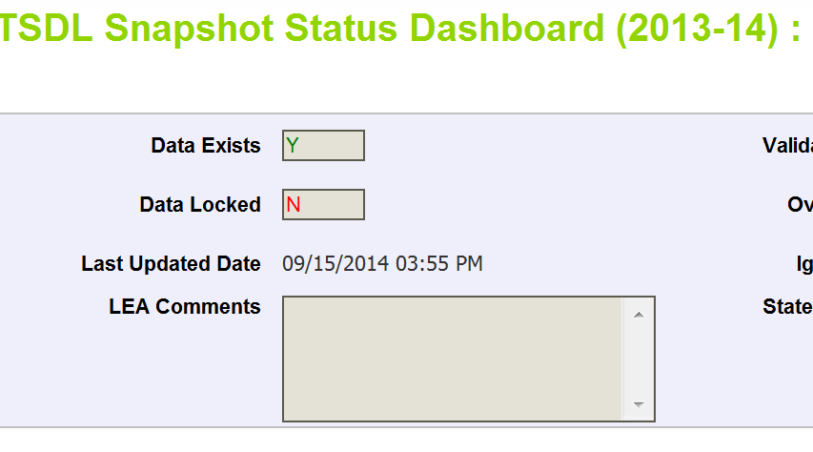
Finalizing Data
Once data is accurate-all reports reviewed and correct…
HR~LEAAPPROVER for district will need to ‘Submit to CDE’
HR Snapshot Status Dashboard (2014-2015):
Submit to CDE

Slide 37
Timeline and Support

Slide 38


Timeline
Snapshot opened November 10th 2014
Snapshot is not due until February 20th 2015
This leaves a lot of time to work on it or to procrastinate!
  How can I best assist you in meeting the deadline
  without being an annoying pest??

Slide 39
Support Options
Reminder emails which will include 1) Current defects; 2) FAQ’s and Tips if available and 3) Next goal date to work towards
Reminder email can be sent:
  Every Monday
  Every other Monday (1st and 3rd of each month)
  3rd Monday of every month
If no option is selected, the default will be every Monday
Will stop once data is finalized for the district
Will become weekly for all not finalized starting January 20th
Complete Survey at: https://www.surveymonkey.com/s/5CQV35H.

Slide 41
Closing Time…

Slide 42

Resources
Staff Interchange: http://www.cde.state.co.us/datapipeline
Highly Qualified: Info under ‘Additional Resources’ or contact Jennifer Phillips Simons at phillips_j@cde.state.co.us
Human Resources: http://www.cde.state.co.us/datapipeline/snap_hr
Special Education December Count Timeline (if you are submitting the special education staff in the staff interchange): http://www.cde.state.co.us/datapipeline/snap_hr

Slide 43
Contact Information
Annette Severson:
  Email: severson_a@cde.state.co.us
  Phone: 303-866-6824
  Fax: 303-866-6888
In emails or voicemail messages, please include:
  District Code
  Error code(s) if applicable
  Where assistance is needed; such as ‘files won’t upload’ or ‘getting error HR### for EDID ######## and I don’t know why’

