Slide 1

2014-15 School Discipline and Attendance (SDA)
Formerly the ADE Safety Discipline Incident (SDI) collection

Slide 2
Agenda
SDA Review
File Descriptions with Reporting Examples
No Reportable Incidents
Checklist of Steps
Resources

Slide 3

Review

Slide 4
General Information
Periodic collection open
Deadline is Friday, June 26th
Periodic collection in Pipeline and 4 files:
  Discipline by Action File
  Firearm (GFSA) Discipline File
  Discipline by Student Demographic File
  Attendance Data File
School Level Data
  count of incidents
  count of students
ALL Students disciplined counted and reported

Slide 5
Why is data required?
22-11-503 (3)(c): The information shall be consistent for each type of report and, at a minimum, shall include the occurrence of each of the following types of incidents, expressed as a number and as a percentage of the total occurrences of all of the incidents:
  Substance abuse-drugs
  Substance abuse- alcohol
  Substance abuse- tobacco
  Felony assaults
  Fights
  Possession of dangerous weapons; and
  Other violations of the code of conduct at the public school

Slide 6
Why is data required? (part 2)
22-32-109.1(2)(b)(IV) The number of conduct and discipline code violations…only in the most serious category that is applicable to that violation including to specific information on the number of and the action taken with respect to the following types of incidents:
  ─ Dangerous Weapon ─ Destruction of Property
  ─ Alcohol ─ Tobacco
  ─ Drug ─ Robbery
  ─ Disobedient/Defiant
  ─ Detrimental Behavior
  ─ 1st, 2nd or Vehicular Assault
  ─ 3rd degree Assault/Disorderly Conduct

Slide 7
Identity Management Roles
Roles have been created and are available for your Local Access Manager to assign:
IdM Role | Enables User to:
SDA~LEAAPPROVER | Finalize, Submit, Modify and View Data
SDA~LEAUSER | Submit, Modify and View Data
SDA~LEAVIEWER | View Data

Slide 8

File Descriptions with Reporting Examples

Slide 9
Discipline by Action File
Count of Behaviors per school
  Most severe action taken per behavior (behavior = incident)
  Only 1 student/incident reported
  Referrals to Law Enforcement reported in addition to most severe action taken if applicable
Only report those behaviors which occurred in school during school year
Each Behavior now has a code associated with it
  A record will be reported per behavior and school
Discipline by Action

Slide 10
Discipline by Action File: Behaviors
Code | Behavior Type
01 | Drug Violation
02 | Alcohol Violation
03 | Tobacco Violation
04 | 1st, 2nd Degree or Vehicular Assault
05 | Dangerous Weapons
06 | Robbery
07 | Other Felony
08 | Disobedience/Defiant or Repeated Interference
09 | Detrimental Behavior
10 | Destruction of School Property
12 | Other Violation of Code of Conduct
13 | 3rd Degree Assault/Disorderly Conduct
Discipline by Action
Discipline by Action

Slide 11
Discipline by Action File
Count of Behaviors per school
  Most severe action taken per incident
  Only 1 student/incident reported
  Referrals to Law Enforcement reported in addition to most severe action taken if applicable
Only report those behaviors which occurred in school during school year
Each Behavior now has a code associated with it
  A record will be reported per behavior and school
Discipline by Action
Discipline by Action
Discipline by Action

Slide 12
Discipline by Action File
Count of Behaviors per school
  Most severe action taken per incident
  Only 1 student/incident reported
  Referrals to Law Enforcement reported in addition to most severe action taken if applicable
Only report those behaviors which occurred in school during school year
Each Behavior now has a code associated with it
  A record will be reported per behavior and school
Discipline by Action
Discipline by Action
Discipline by Action

Slide 13
Discipline by Action File
Count of Behaviors per school
  Most severe action taken per incident
  Only 1 student/incident reported
  Referrals to Law Enforcement reported in addition to most severe action taken if applicable
Only report those behaviors which occurred in school during school year
Each Behavior now has a code associated with it
  A record will be reported per behavior and school
Discipline by Action
Discipline by Action
Discipline by Action

Slide 14
Reporting Incident Example 1
Discipline by Action File
1 Incident
1 Expulsion
1 White, Male, 7th grader, Non IDEA, Non 504, Non ELL Student Expelled with Services
1 Black, Female, 7th grader, Non IDEA, Non 504, Non ELL Student Expelled with Services
1 Hispanic, Female, 7th grader, Non IDEA, Non 504, Non ELL Student Expelled with Services
1 Referral to Law Enforcement
Discipline by Student Demographic File
3 students expelled with Educational Services provided. These students were also referred to law enforcement for drugs
Discipline by Action
Discipline by Action

Slide 15
Reporting Incident Example 2
2 students fight and suspended
(1 out of school and the other in school)
Discipline by Action File
1 Incident of 3rd Degree Assault, Out of School Suspension
Discipline by Student Demographic File
1 White, Male, 10th grader, Non IDEA, Non 504, Non ELL Student, Only 1 Out-of-School Suspended
1 White, Male, 9th grader, Non IDEA, Non 504, Non ELL Student, 1 In-School Suspended
Discipline by Action
Discipline by Action

Slide 16
Discipline by Student Demographic File
One record per subset of students disciplined by school
More detailed information on students disciplined:
  Ethnicity/Race
  Gender
  Grade Level
  IDEA/Special Education status
  Section 504 Status
  ELL Status
Counts of students by action taken
Discipline by Demographics
Discipline by Demographics

Slide 17
Discipline by Student Demographic File – Example Records
LEA | School | Race | Gender | Grade | IDEA | 504 | ELL | Undup | Cls Susp
1111 | 2222 | 01 | 01 | 100 | 1 | 0 | 0 | 5 | 2
1111 | 2222 | 02 | 01 | 090 | 0 | 0 | 0 | 3 | 1
1111 | 3333 | 05 | 02 | 020 | 0 | 0 | 1 | 7 | 3
1111 | 2222 | 07 | 02 | 020 | 0 | 0 | 1 | 2 | 1
Each record represents a different subset of students disciplined during the school year.

Slide 18
Discipline by Student Demographic File: FAQs
Unduplicated count of the students:
  If 1 student receives 3 in-school suspensions and expelled with services once, he/she would be reported as:
    3 in the in-school suspensions
    1 in the expulsions with educational services
    1 in the unduplicated count of students disciplined
Habitually Disruptive:
  No longer required – please report as 0 in all records
Discipline by Demographics
Discipline by Demographics

Slide 19
Reporting Incident Example 1
Discipline by Action File
1 Incident
1 Expulsion
Discipline by Student Demographic File
1 White, Male, 7th grader, Non IDEA, Non 504, Non ELL Student Expelled with Services
1 Black, Female, 7th grader, Non IDEA, Non 504, Non ELL Student Expelled with Services
1 Hispanic, Female, 7th grader, Non IDEA, Non 504, Non ELL Student Expelled with Services
1 Referral to Law Enforcement
3 students expelled with Educational Services provided. These students were also referred to law enforcement for drugs
Discipline by Demographics
Discipline by Demographics

Slide 20
Reporting Incident Example 2
2 students fight and suspended
(1 out of school and the other in school)
Discipline by Action File
1 Incident of 3rd Degree Assault, Out of School Suspension
Discipline by Student Demographic File
1 White, Male, 10th grader, Non IDEA, Non 504, Non ELL Student, Only 1 Out-of-School Suspended
1 White, Male, 9th grader, Non IDEA, Non 504, Non ELL Student, 1 In-School Suspended
Discipline by Demographics
Discipline by Demographics

Slide 21
Reporting Incident Example 3: Unduplicated Count Focus
Provide an unduplicated count of students involved reported incidents.
Regardless of how many times a student is counted for any category within the Discipline by Student Demographics file, only count the student once in the unduplicated count of students disciplined.
Same Student, counted multiple times in Discipline by Student Demographics File
Same Student, counted once in the Unduplicated Count of Students Disciplined field
Discipline by Demographics
Discipline by Demographics

Slide 22
Firearm (GFSA) Discipline File
One record per school and firearm weapon with counts of actions taken.
If there are no firearms to report for a school, no record will be needed in file (based on No Reportable Incidents screen)
3 types of Firearms reported
  Handgun - Rifle/Shotgun - Other Firearm
Expulsions reported are a subset of Dangerous Weapon Expulsions reported
Firearm (GFSA) Discipline
Firearm (GFSA) Discipline

Slide 23
Firearm (GFSA) Discipline File Flowchart
(A) Brought or Possessed at School
(B1) Expelled
(B2) Other Discipline Action (suspensions, etc)
(B3) Remove Other (death, incarcerated, etc)
(B4) No Action Taken
(C1) Less Than Mandatory One Calendar Year
(C2) Full Mandatory One Calendar Year
(D2) Referred to Alternative School/Program
(D1) Referred to Alternative School/Program
Firearm (GFSA) Discipline
Firearm (GFSA) Discipline

Slide 24
Attendance Data File
One record required per school
Decimal point is implied
Same data collected in previous years by school:
  Length of school year
  Total days attended by students
  Total days excused by students
  Total days unexcused by students
  Total possible attendance days
  Number of students truant four or more days in a month
  Number of students truant ten or more days in a school year
  Number of students truant for both conditions listed above
Attendance Data
Attendance

Slide 25
Attendance Data File: Relationship Equation
Student Total Days Attended
Student Total Days Unexcused Absent
Student Total Days Possible
Student Total Days Excused Absent
Decimal point is implied for all of these values.
Example: Student Total Days Attended reported as 5005 is reflected as 500.5 days.
Attendance Data
Attendance

Slide 26
Habitually Truant Definition
A child between 6 and 17 years of age having four unexcused absences from public school in any one month or ten unexcused absences from public school during any school year. Absences due to suspension expulsions is considered excused absences.
Attendance Data
Attendance

Slide 27
Habitually Truant Counts
3 fields capture this required data:
  Truancy: Four or more days in any one calendar month
  Truancy: Ten or more days in one school year
  Truancy: Met both conditions
Students are to be reported in only 1 category per school as applicable
Attendance Data
Attendance

Slide 28

Reporting Habitually Truancy Example
1 count of Truancy: 4 or more Days in one calendar month
Unexcused Absences for Sally in March. (Total Unexcused Absences in the School year is less than 10)
Attendance Data
Attendance

Slide 29
Reporting Habitually Truancy Example
Month | # Unexcused Absences for Shirley
Aug | 0
Sept | 1
Oct | 1
Nov | 0
Dec | 1
Jan | 1
Feb | 0
March | 2
April | 0
May | 4
TOTAL | 10
1 count of Truancy: Met Both Conditions
Attendance Data
Attendance

Slide 30

No Reportable Incidents
Incidents

Slide 31
No Reportable Incidents
Use when a school has no incidents to report to CDE; either
  No Disciplinary Incidents and/or
  No Firearms to report
A separate tab in Data Pipeline, under “SDA”
Can be updated throughout the SDA process.
  If marked as “No” initially, this can be updated to “Yes” for a school if needed and vice versa, until the data is finalized.

Slide 32
No Reportable Incidents – Disciplinary Incidents
Disciplinary Incidents column:
  “Yes” indicates:
    the school is included in the Discipline by Action file AND
    The school is included in the Discipline by Student Demographic file
  “No” indicates:
    The school is not included in the Discipline by Action file AND
    The school is not included in the Discipline by Student Demographic file
    If all schools are marked as “No”, then the LEA will not upload either the Discipline by Action file or the Discipline by Student Demographic file.

Slide 33
No Reportable Incidents – Firearm Incidents
Firearms brought column:
  “Yes” indicates:
    The school is included in the Firearm (GFSA) data file uploaded
  “No” indicates:
    The school is not included in the Firearm (GFSA) data file uploaded.
    If all schools in the district have this indication, then the LEA will not upload the Firearm (GFSA) data file.

Slide 34
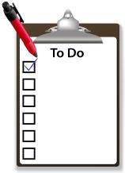
Checklist of Steps

Slide 35
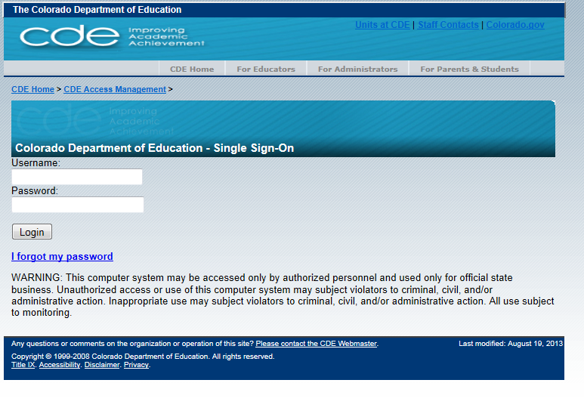
1st - Login to Data Pipeline
https://cdx.cde.state.co.us/pipeline
Username = email address
Password = determined by you. Use the ‘I forgot my password’ if needed.

Slide 36
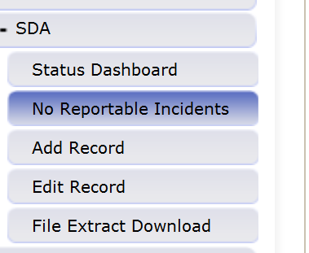
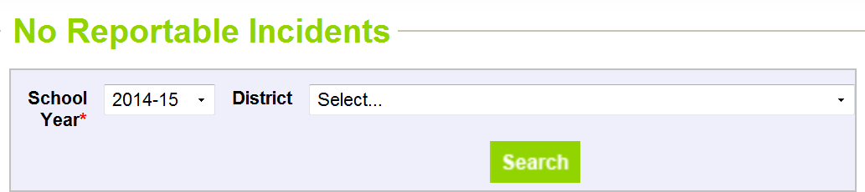
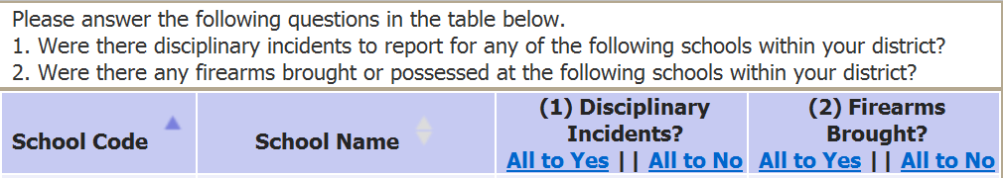
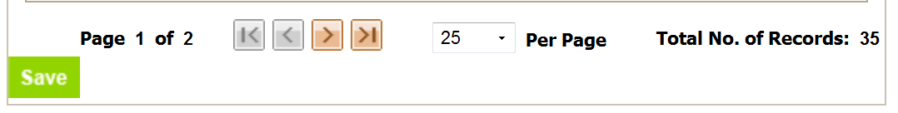
2^{nd*} – No Reportable Incidents
*Note: this step can be performed throughout the process if changes are needed

Slide 37
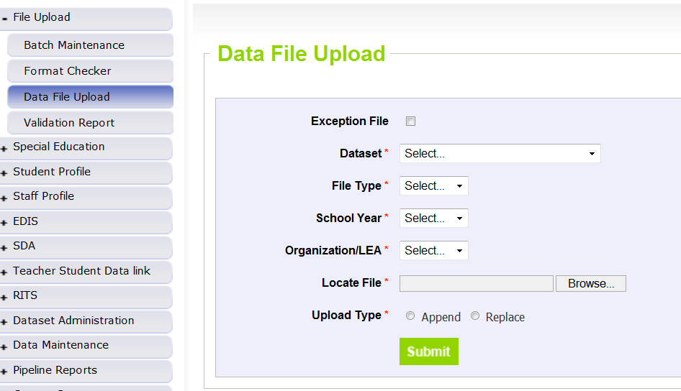
3rd – Upload each File
Dataset | School Discipline Attendance
File Type | Attendance Data OR Discipline by Action OR Discipline by Student Demo OR Firearm Discipline
School Year | 2014-15
Organization/LEA | Select your District/BOCES
Locate File | Browser and select file to upload
Upload Type | Replace if your file is complete within the one file upload
 | Append if you are adding additional data to what has been previously uploaded
Click “Submit” for each file

Slide 38
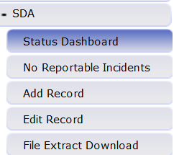
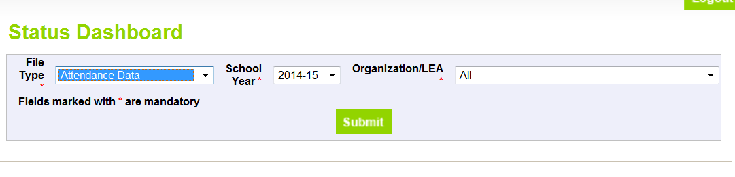
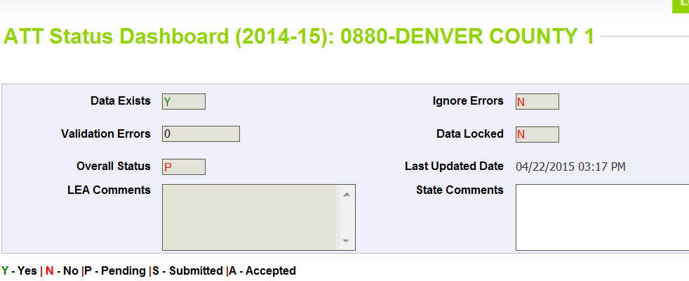
4th – Status Dashboard
Confirms file processed and provides the error count in the file
Data Exists = Y (data processed) or N (data not processed)
Validation Errors = # (# of errors in file)
Overall Status = P (Pending) or N (No data)
Last updated date = last date of upload

Slide 39
Review Errors and Errors
Two options:
  Using Cognos
  Using Pipeline Error Reports
You may use either options exclusively or both options throughout

Slide 40


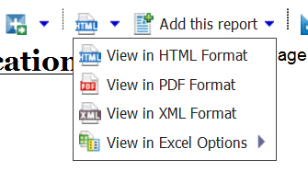
5th –Using Cognos
(Errors and Warnings)
Select the appropriate Error Report to view:
  For Attendance data errors: “Attendance Error Detail Report”
  For Discipline by Student Demographic data errors: “Demographics Error Detail Report”
  For Discipline by Action data errors: “Discipline Action Error Detail Report”
  For Firearm Incident data errors: “Firearm Error Detail Report”
If there are no errors for your district for the file OR the file was not processed for your district yet, there will be no error report available
Error reports can be downloaded into excel

Slide 41

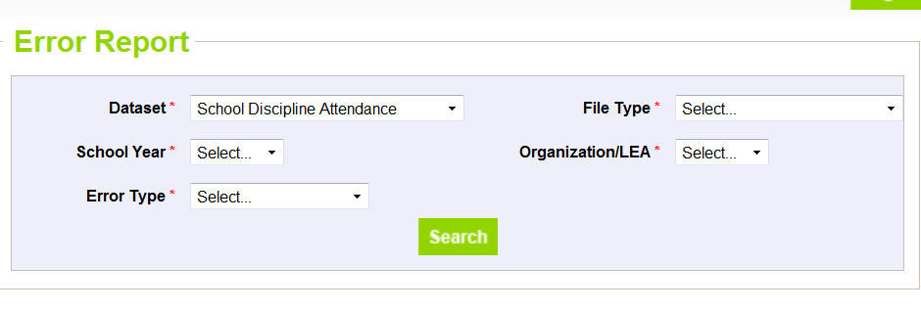
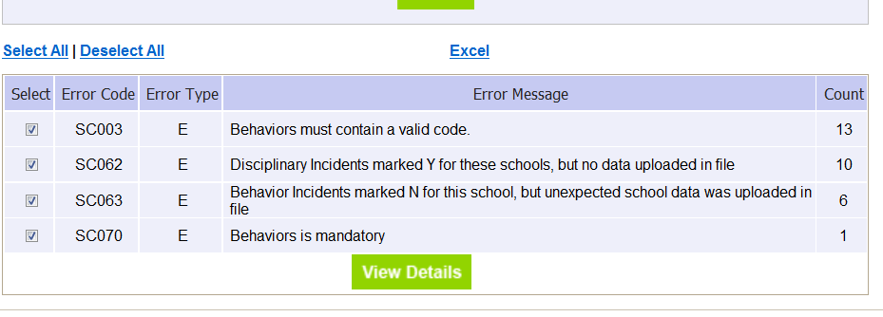
6th – Using Data Pipeline
(Errors and Warnings)
Select file type, year, LEA and Errors and Warnings – then select “Search”
Select Excel to view report

Slide 42
7th - Correct Data
Update data in data files based on errors/warnings and re-upload files as needed.
Repeat steps until all errors in file are resolved

Slide 43
8th –Review Reports

Slide 44
Reports Available
Attendance and Truancy Data
  provides attendance and truancy rate calculated for each school. Data is generated using the Attendance file.
Summary of Behavior by Action
  provides each behavior reported by school with the count of actions taken for each. Data is generated using the Discipline by Action file.
Summary of Discipline by Demographic File
  All incidents reported with all student demographic data provided. Data is generated using the Discipline by Student Demographic file.

Slide 45
Reports Available
(continued)
Summary of Disciplinary Actions by Federal Race/Ethnicity
  Count of Disciplinary Actions reported for all students by Federal Race/Ethnicity and School. Data is generated using the Discipline by Student Demographic file.
Summary of Disciplinary Actions by Gender
  Count of Disciplinary Actions reported for all students by Gender and School. Data is generated using the Discipline by Student Demographic file.
Summary of Disciplinary Actions by Grade
  Count of Disciplinary Actions reported for all students by Grade and School. Data is generated using the Discipline by Student Demographic file.

Slide 46
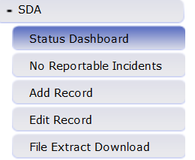
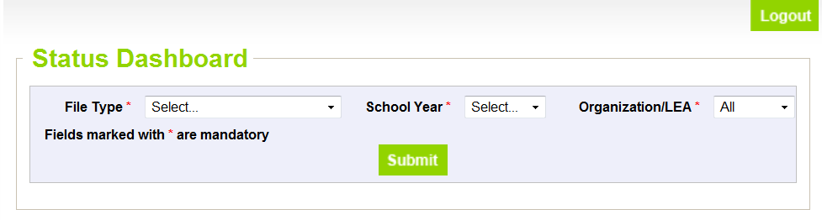
9th -Finalize Uploaded Data
LEAAPPROVER role can perform this step only
Must finalize each SDA File separately
Data Exists = Y (data must be processed)
Validation Errors = 0 (must be 0 in order to finalize)
Overall Status = Will be updated to “S” once finalized
Last updated date = last date of upload
Submit to CDE

Slide 47

Resources

Slide 48
SDA Resources
File Layouts, business rules and templates available at: http://www.cde.state.co.us/datapipeline/schooldisciplineattendance
Opened May 14th
Due Friday, June 26th
  Exceptions may be allowed, if school(s) are in session on or later than due date. Please contact me if this is needed.
For assistance please contact Annette Severson at severson_a@cde.state.co.us

Slide 49

Thank You!

