Slide 1
Teacher Student Data Link (TSDL) Interchange and Snapshot

Slide 2
Agenda
Statewide Standard Course Codes
TSDL Interchange
Overview
2019-2020 Steps
Interchange Process
Data Uses
Populate CRDC
Migrant Student Reporting
Course Participation Reports
Educator Preparation Program Report
General
Authority to Collect
Timeline
Overall Process
Resources
Online
Contacts
Resources

Slide 3
General Information

Slide 4
Authority To Collect
Derived from both Colorado Revised Statutes (C.R.S) and the Colorado State Board of Education’s rules:
Concerning Statutory Changes to K-12 Education, House Bill 13-12-19: 22-2-116.5
Course Participation and Student Proficiency Reports, House Bill 14-1376: 22-11-503.5
Monitoring of Written Evaluation System, C.R.S. 22-9-106 (1.5) (a-b)
Rules for administration of a statewide system to evaluate the effectiveness of licensed personnel employed by school districts and boards of cooperative services 1 CCR 301-87(6.04) (i), (A), (C) (2) (b, d, and e), and (C) (3) (a).
Commissioner Duties - reviewing the content of educator preparation programs in Colorado, C.R.S. 22-2-112 (p-q); Commission directive--approval of educator preparation programs—review, C.R.S. 23-1-121 (6)

Slide 5
Overall Process
SSCC
Map new Courses to SCED Codes
TSDL Interchange
Upload Course Enrollment File
Upload Course Instructor File
TSDL Snapshot
Create Snapshot Linking Instructors to Students by Course
Review Reports
Finalize Data
CDE Reports
Pre-populate CRDC
Migrant Student Reporting
Course Participation Reports
Educator Preparation Program Report
Prior year mapped courses will be rolled over for 2019-2020 automatically

Slide 6
TSDL Timeline
October
16th – SSCC opens
November
13th – TSDL Interchange opens
January
15th – TSDL Snapshot Opens
April
16th – Interchange files uploaded at least once
May
14th – TSDL Snapshot created at least once
July
9th TSDL Interchange files errors resolved
August
13th – Finalize the TSDL Snapshot
1st –12th – Final Snapshot Report Review
30th –Snapshot errors resolved
Enrollment and
Instructor

Slide 7
Statewide Standard Course Codes (SSCC)

Slide 8
Statewide Standard Course Codes (SSCC)
Separate system exists to map local course codes to a course code system that all districts use to provide comparability across the state
Primarily used as a part of the Teacher Student Data Link (TSDL) collection
To access system: https://www.cde.state.co.us/idm -> SSCC (Statewide Standard Course Codes System)

Slide 9
What are Statewide Standard Course Codes ?
Based on the Secondary School Course Classification System:
School for Exchange of Data (SCED)
National Center for Education Statistics (NCES)
U.S. Department of Education
Five digit common codes for all courses PK-12
First two digits indicate the subject area
Last three digits indicate the content

Slide 10
Course Codes
CDE automatically replicated the 2018-2019 course codes mapped for every district when 2018-2019 data was available
CDE automatically replicated the 2017-2018 course codes mapped for every district when 2018-2019 data was not available
New courses for 2019-2020 will still need to be mapped to a SCED Code
Courses no longer offered in 2019-2020 can be removed
Use the SSCC (State Standard Course Code) system to map your local course codes
https://www.cde.state.co.us/datapipeline/sscc-details

Slide 11
Documentation
Documentation can be found at:
http://www.cde.state.co.us/datapipeline/sscc-details
SCED Code documentation under additional resources
http://www.cde.state.co.us/datapipeline/faq-sced
Template and training materials available on this site
http://www.cde.state.co.us/datapipeline/sscc-details
Demo of the course code documentation website
http://www.cde.state.co.us/datapipeline/sscc-details

Slide 12
Interchange Process

Slide 13
Identity Management Roles
Teacher Student Data Link Interchange Roles:
TSL~ LEAUSER – upload and modify TSDL interchange files OR
TSL~LEAVIEWER – view (only) TSDL interchange data
Teacher Student Data Link Snapshot Roles:
TLS~LEAAPPROVER – Approves, creates, views Snapshot OR
TLS~LEAUSER - creates, views Snapshot OR
TLS~LEAVIEWER- views snapshot

Slide 14
Interchange Files
Course Enrollment
All 6th – 12th grade students:
Enrolled in a required course (mathematics, science, social studies, and English language arts)
Enrolled 6 weeks or more for reported course, section, term and school
ALL 8th-12th grade Migrant students enrolled in all classes
Include all Computer Science Courses and ALL AP Courses for CRDC purposes
Each record must be unique based on: school code, local course code, section number, SASID , student's grade level and term
Course Instructor
All Instructors:
Actively employed 6 weeks or more
Instructing a course in mathematics, English language arts/literacy, and/or science
Instructing students in grades 6 through 12
Include Computer Science Courses for CRDC purposes
Each record must be unique based on: school code, local course code, section number, EDID and term

Slide 15
Interchange Process
Upload files in Data File Upload
Review Batch Maintenance
Review Error Reports in Cognos/Pipeline
Correct Data Files in Source System
Create/Update Data Files
- Continue until all errors are resolved

Slide 16
Creating Files
Pull data files from SIS Extract
Create Course Enrollment File and Create Course Instructor File
File Layouts found online at: https://www.cde.state.co.us/datapipeline/inter_teacherstudent
File Requirements:
Excel, CSV or Text File all accepted
Need 2 separate files
1st record of data must be field names/titles

Slide 17
Tips on Files
Excel, CSV, or Text formats are accepted
Simple Excel template for Course Enrollment and Course Instructor Files posted online https://www.cde.state.co.us/datapipeline/inter_teacherstudent under Templates (however, it is not necessary to use a template if your file already extracts in one of the accepted formats)
No spaces in file name
No blank fields
Be sure the file is not open when uploading
Be sure you haven’t lost all your leading zeros on a CSV file or it won’t upload (steps for saving them posted online)

Slide 18
Required 6th - 12th Grade Courses
Mathematics
Science
Social Studies
English Language Arts
Computer Science – to be included in CRDC
ALL AP Courses – to be included in CRDC
All other courses may be included but are not required to be reported in the Course Enrollment or Course Instructor files

Slide 19
TSDL Fields (Interchange and Snapshot Link)
Course Instructor File
Course Enrollment File
Name of Field
School District/BOCES Code
School Code
Local Course Code
Section Number
SASID
Student's Last Name
Student's First Name
Student's Gender
Student's Date of Birth
Roster Start Date
Roster End Date
Student’s Grade Level
Term
Credits Granted
Final Grade/Course Completion Status
Name of Field
School District/BOCES Code
School Code
Local Course Code
Section Number
EDID
Staff's Last Name
Staff's First Name
Staff's Gender
Staff's Date of Birth
Term
Staff Role
Used to link records in the TSDL Snapshot

Slide 20
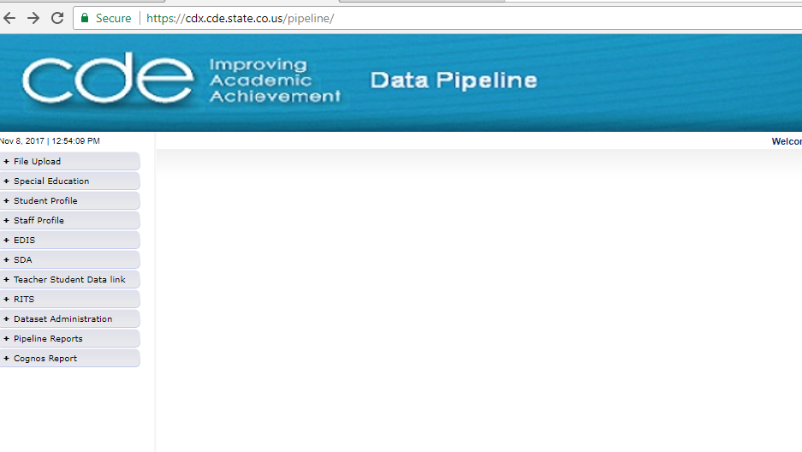
Pipeline Website Review
Batch Maintenance, Format Checker and Data File Upload
Based on your Identity Management Roles
Error reports and other validation reports

Slide 21
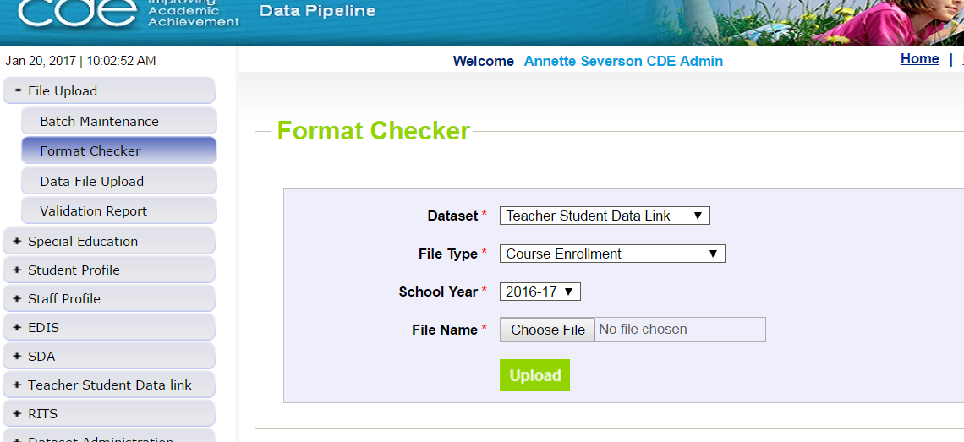
File Upload – Format Checker
Course Enrollment or Course Instructor

Slide 22
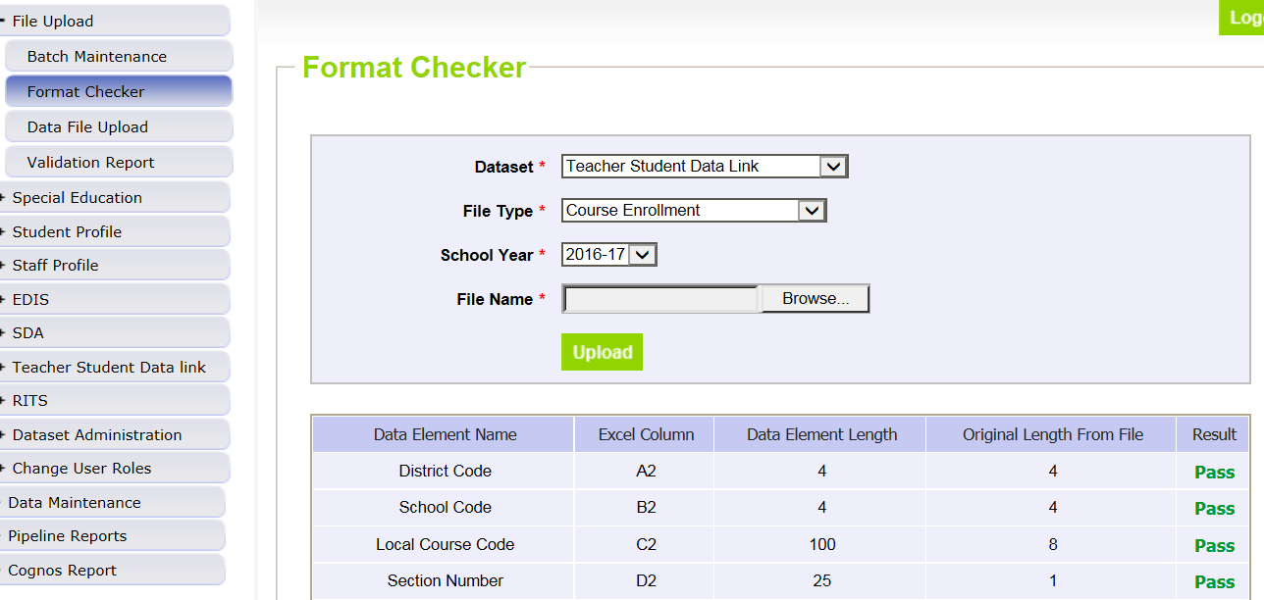
Format Checker – Upload Results

Slide 23
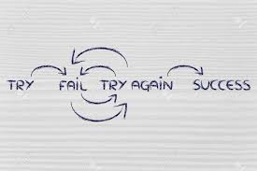
Format Checker Notes
Format Checker will only review the 2nd row in your file
Passing format checker Does Not Equal file will process
Green ‘Pass’ for each field is desired result
Red ‘Fail’ for a field indicates file is not in the correct format- please refer to the 2019-2020 file layout on web

Slide 24
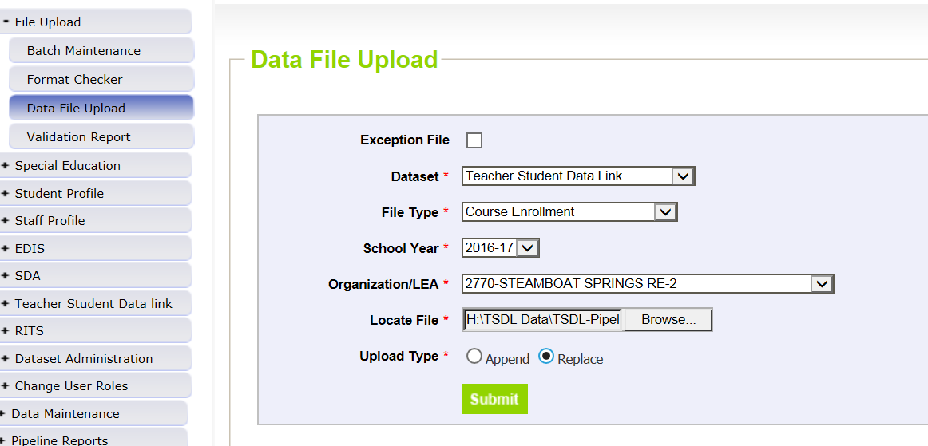
Data File Upload

Slide 25
Data File Upload Types
Append = adds file to existing file, all records from both files included
Can be tricky with fixing errors
Replace = deletes any prior data file and replaces it with the file being uploaded
RECOMMENDED

Slide 26
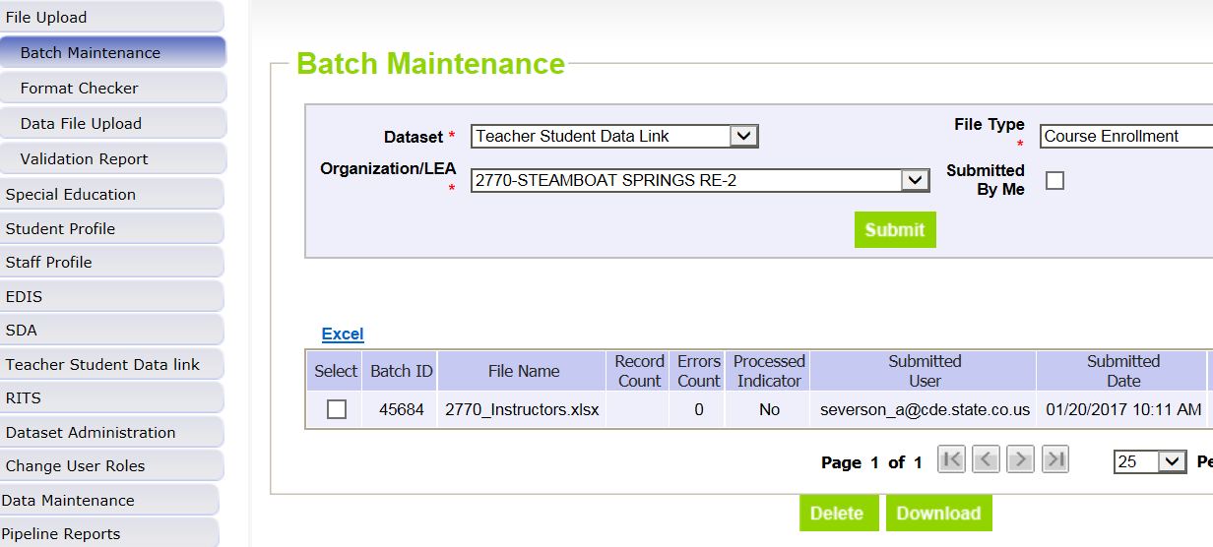
Batch Maintenance Screen – Not Processed

Slide 27
File Not Processed – Next Steps
Ensure file has all green ‘pass’ in format checker
YES?
Open file and review all records are formatted the same as the 2nd row
Be sure all codes and dates have leading zeros included
NO?
Review file layout posted online and re-format the file
For further assistance, contact Annette Severson
DO NOT INCLUDE THE FILE IN ANY EMAILS; instead email for assistance and a syncplicity folder can be created and shared

Slide 28
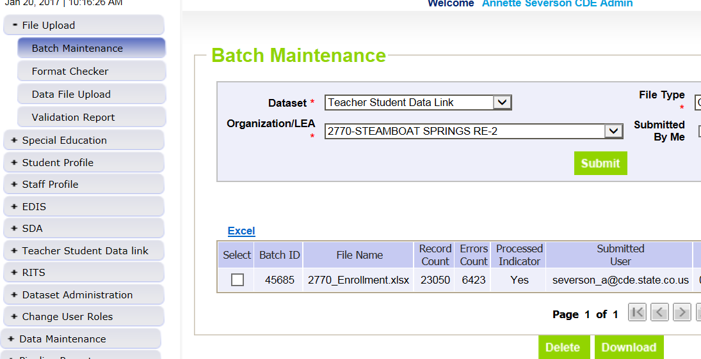
Batch Maintenance – File Processed

Slide 29
File Processed – Next Steps
Use same screen to see the Number of Errors:

Slide 30
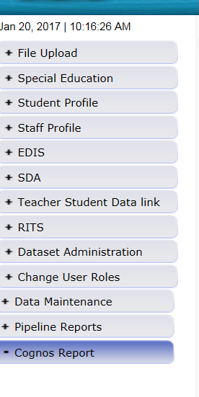
Review Errors in Detail
2 methods available:
Data Pipeline Reports -> Error Reports
Cognos Reports – > Teacher Student Data Link

Slide 31
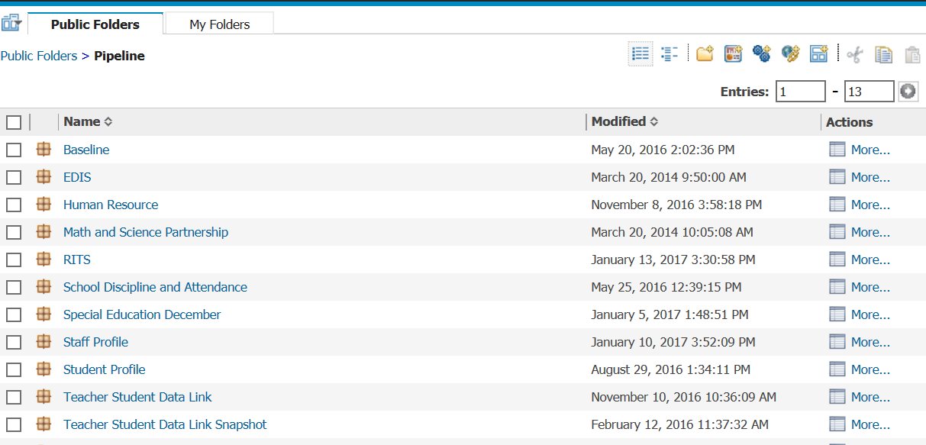
Clicking on Cognos Reports- Opens in a new Screen
These dates are to be ignored

Slide 32
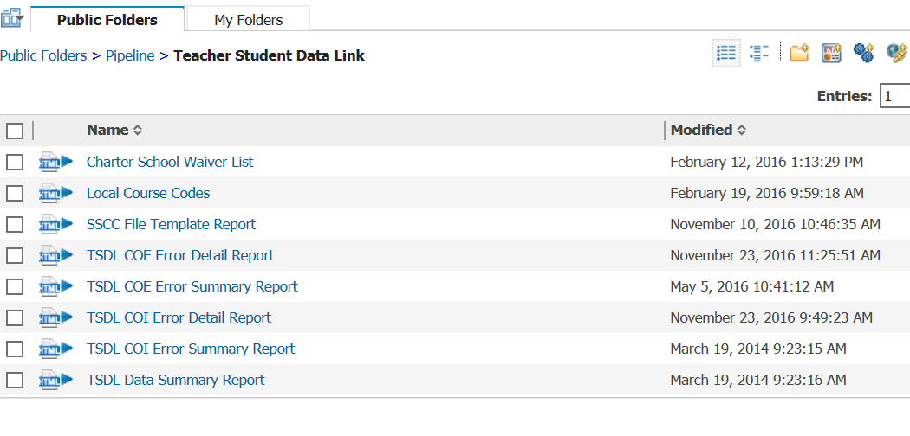
TSDL Interchange Errors
Detail Reports – provides detailed records with descriptions of error
Summary Reports – provides a count of records by type of error
*Do Not Send Error reports via email to CDE for assistance

Slide 33
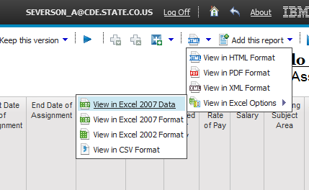
Error Detail Report- Excel

Slide 34
Error Reports
Error Detail Report
Provides specific records causing the error with the error description
Can select to View ALL error records or 1 type of error at a time
Error Summary Report
Provides a count of errors generated per error type and description
Resubmit either file as needed for corrections for all data errors to be resolved
Be sure to update source file with corrections as well

Slide 35
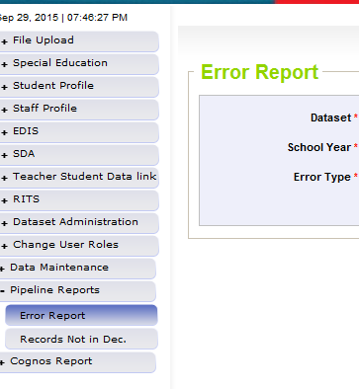
Pipeline Reports
Search:
Dataset = Teacher Student Data Link
School Year = 2019-2020
Error type = Errors and Warnings
File Type: Course Enrollment or Course Instructor
Org/LEA = Code
Click ‘Search’

Slide 36
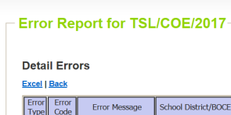
Pipeline Error Reports – Viewing Details
Summary of Errors in File are next provide
Click on ‘View Details’ to view each record with the error
Choose ‘Excel’ to download error report in Excel – recommended

Slide 37
Correcting Errors
Correct the errors in the file:
May have to fix errors in both Course Enrollment and Course Instructor files
Keep file versions – in case updated file causes even more errors, you can re-start using a prior file version
CDE does not maintain these versions, once the file has been replaced, all prior data files have been deleted in pipeline
Resubmit your data records using the same process and replacing your existing data file using the Data File Upload tool
All errors must be corrected, all warnings should be reviewed

Slide 38
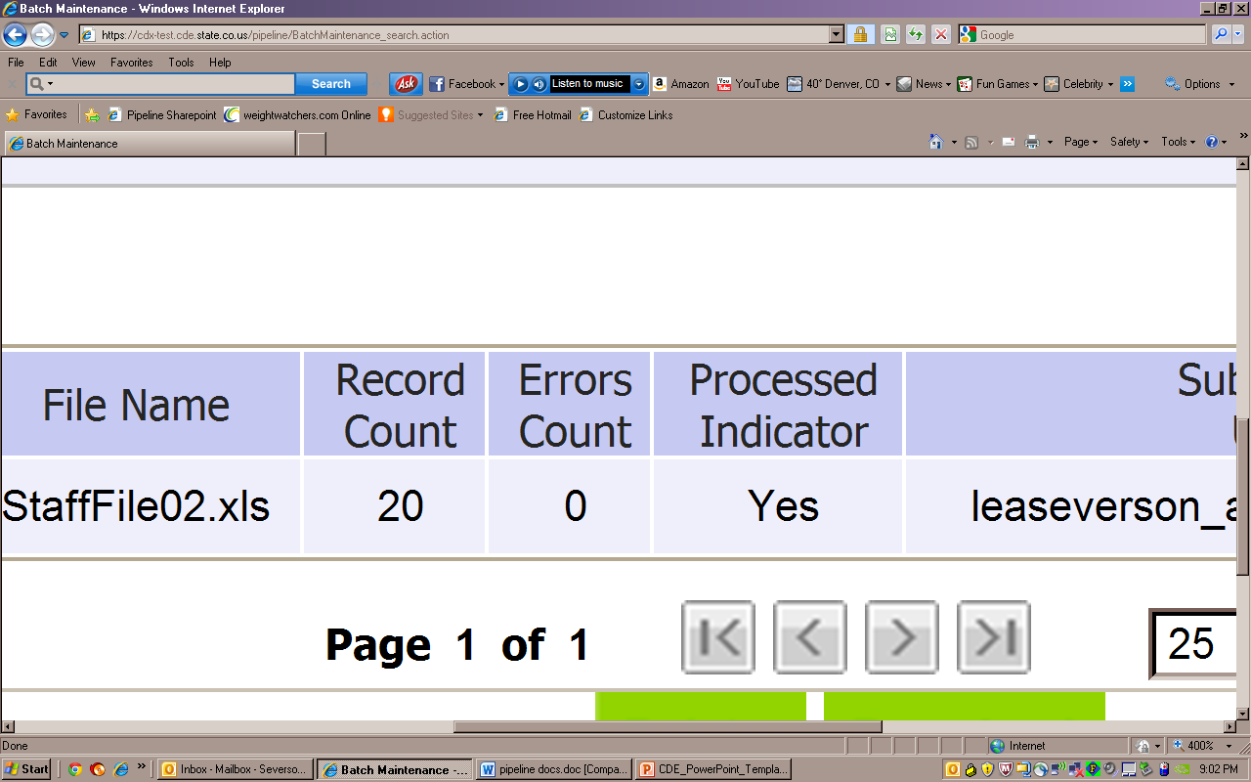
Batch Maintenance: No Errors

Slide 39
Next Steps – TSDL Snapshot
Course Enrollment File= Processed and Zero Error Count
Course Instructor File = Processed and Zero Error Count
Create TSDL Snapshot (opens in January)

Slide 40
TSDL Interchange Resources
TSDL Interchange Documentation found at: http://www.cde.state.co.us/datapipeline/inter_teacherstudent
Contact:
Annette Severson: severson_a@cde.state.co.us or 303-866-6824

Slide 41
Snapshot Process

Slide 42
Snapshot Flowchart
Create TSDL Snapshot
Errors? If Yes, Review Error Reports
Correct Interchange File as Needed
Upload Corrected Error Files
Finalize (Data Reviewed as Accurate)
Create new TSDL Snapshot
Errors? If Not, Review Cognos Reports
Send Signed Verification form to CDE

Slide 43
Teacher Student Data Link Snapshot: Access
Local Access Manager (LAM) will need to assign you prior to logging into Pipeline
TLS_LEAAPPROVER – creates, views and finalizes data
TLS_LEAUSER – create and review snapshot data
TLS_LEAVIEWER – View the data only (not modify or submit)
Can only be assigned one or the other.

Slide 44
Creating Snapshot Steps
Log into Data Pipeline
Click on Teacher Student Data Link tab (on the left)
Select ‘Snapshot’ from the expanded list
Enter appropriate search criteria (Teacher Student Data Link Snapshot/2019-2020/Org Code)
Click on Search (green button on bottom)
Select ‘Create Snapshot’
New message should appear: “Snapshot creation triggered and processing. A notification email will be sent upon completion.”

Slide 45
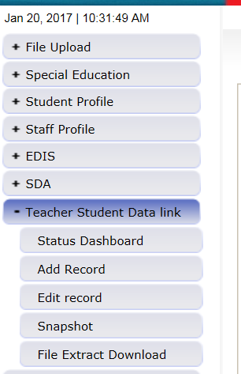
Selecting Teacher Student Data Link -> Snapshot

Slide 46
TSDL Snapshot Screen

Slide 47
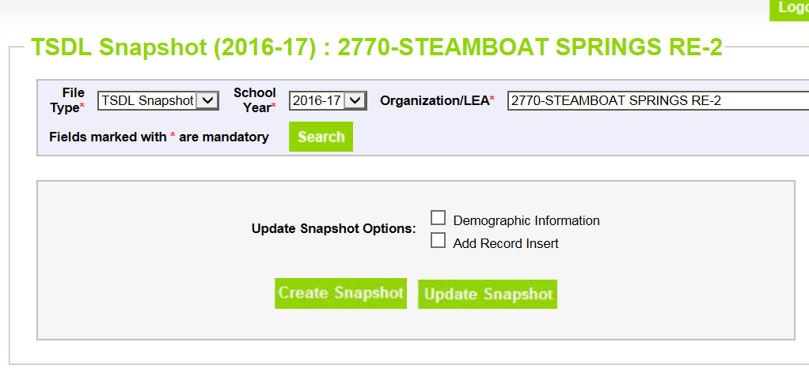
Creating Snapshot- Screenshot

Slide 48
Next Steps
View Status of TSDL snapshot
Email will be sent with status
Status Dashboard screen –shows if processed and # of errors
View Snapshot errors in Cognos or Data Pipeline
Make corrections to Teacher Student Data Link interchange files
Upload updated Teacher Student Data Link interchange files
Re-create Teacher Student Data Link snapshot

Slide 49
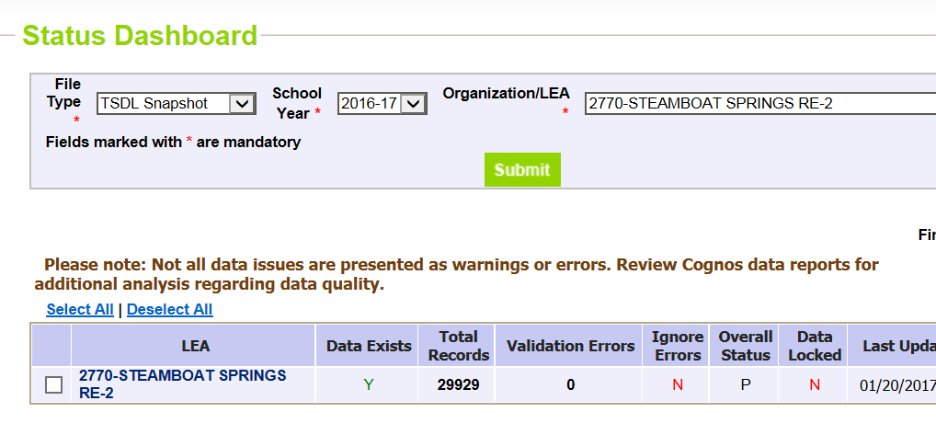
Status Dashboard Screen
Y = snapshot successful!
N= snapshot wasn’t taken/no data in snapshot
# of Snapshot Record Errors
Date/Time of Snapshot created

Slide 50
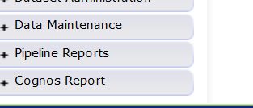
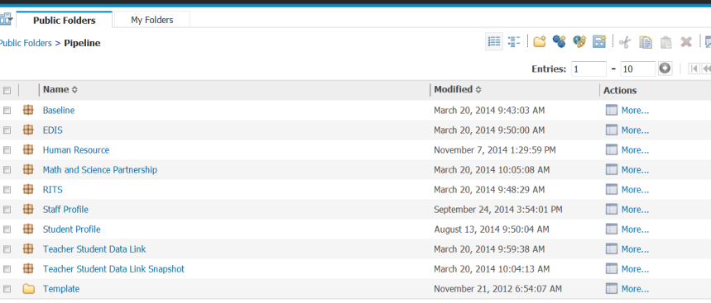
Accessing Cognos Reports
Opens new window
Teacher Student Data Link Snapshot

Slide 51
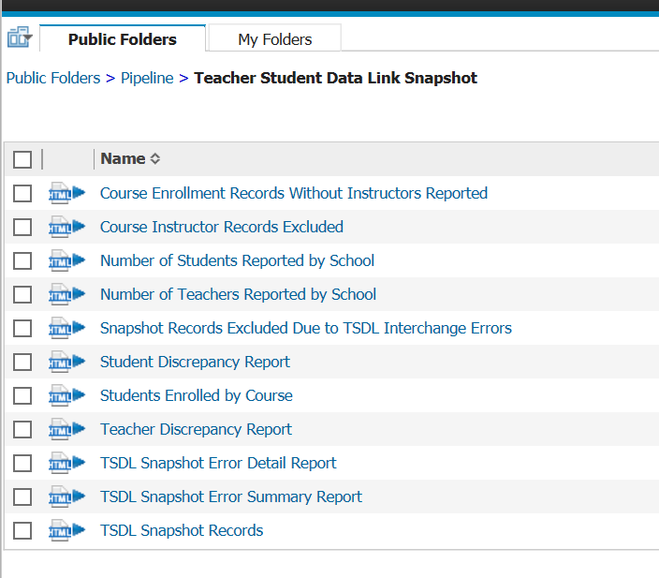
Teacher Student Data Link Cognos Reports

Slide 52
View Errors – Teacher Student Data Link Error Detail Report

Slide 53
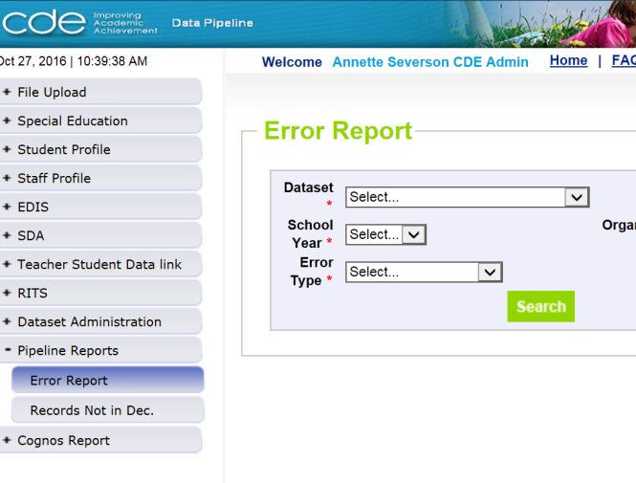
Viewing Errors in Data Pipeline

Slide 54
Edits
Edits are in place to assist with providing most accurate information to CDE which is published, analyzed and reviewed by legislators, federal government, researchers, etc.
Edits should provide adequate information to assist you with determining corrections needed.

Slide 55
Finalizing Steps
Once all Errors are resolved in Snapshot…
Review, review, review data reports for accuracy!
If mistakes/misreporting is found, correct files again and create new snapshot
If data reports are all accurate- you may finalize the data by submitting it to CDE
http://www.cde.state.co.us/datapipeline/tsdl-snap-reports-guide

Slide 56
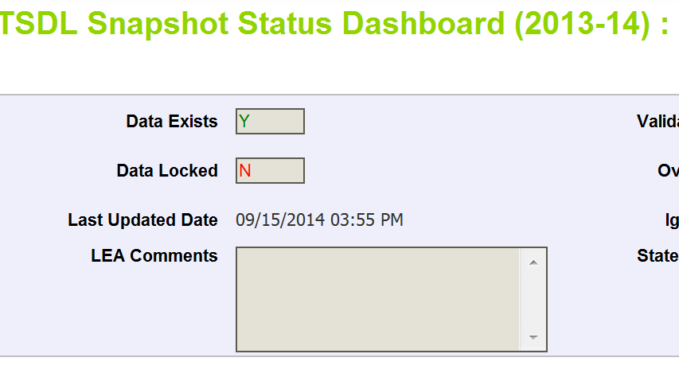
Finalizing Data
Once data is accurate-all reports reviewed and correct…
TLS~LEAAPPROVER for district will need to ‘Submit to CDE’
TSDL Snapshot Status Dashboard (2019-2020):
Star
Submit to CDE

Slide 57
TSDL Snapshot Reports (cognos)

Slide 58
Available Reports
Course Enrollment Records Without Instructors Reported
Course Instructor Records Excluded
Number of Students Reported by School
Number of Teachers Reported by School
Snapshot Records Excluded Due to TSDL Interchange Errors
Student Discrepancy Report
Student Enrolled by Course
Teacher Discrepancy Report
TSDL Snapshot Error Detail Report
TSDL Snapshot Error Summary Report
TSDL Snapshot Records

Slide 59
Course Enrollment Records Without Instructors Reported
Displays All Records from Course Enrollment file where there was no matching record in the Course Instructor file.
Records are matched based on:
School District/BOCES Code
School Code
Local Course Code
Section Number
Term
These records will have no instructor linked to the course/student

Slide 60
Course Instructor Records Excluded
Displays all records in Course Instructor file that are not being included in the snapshot
There is no matching record in the course enrollment file
Snapshots records are created using all Enrollment File records and matching those with the Instructor file based on the fields:
School District/BOCES Code
School Code
Local Course Code
Section Number
Term

Slide 61
Number of Students Reported by School
Provides headcount of students by school code/name
Headcount is counting the unique SASIDs reported for each school

Slide 62
Number of Teachers Reported by School
Provides headcount of teachers by school code/name
Headcount is counting the unique EDIDs reported for each school

Slide 63
Snapshot Records Excluded Due to TSDL Interchange Errors
Due to TSDL Interchange errors (either in Course Enrollment or Course Instructor) the records are not being included in the Snapshot
Next Steps – review and correct TSDL interchange files and create a new TSDL Snapshot

Slide 64
Student Discrepancy Report
Displays ALL students reported in the Student Interchange that are NOT included in the TSDL Snapshot
Also calculates and displays ‘Weeks Enrolled’
Can be used to sort- those enrolled for a long period of time should be included
Can download report into excel to sort as necessary

Slide 65
Students Enrolled by Course
Provides count of students (headcount) by school, final grade/course completion status and local course code
Provides total by school and final grade/course completion status

Slide 66
Teacher Discrepancy Report
Provides list of staff reported in the Staff Assignment file with job class codes 201, 202 and 206 (teachers) that are not included in the TSDL snapshot
Provides the Teaching Subject Area reported in the Staff Assignment file
All 6th- 12th grade mathematics, English language arts, and Sciences teacher MUST be included in the Course Instructor file

Slide 67
Error Reports
TSDL Snapshot Error Detail Report
Displays each error and record in detail
TSDL Snapshot Error Summary Report
Displays a count of records with each error code

Slide 68
TSDL Snapshot Records
Provides the full snapshot records included in your snapshot
Can only provide current year due to size of TSDL snapshot files

Slide 69
TSDL Snapshot Resources
TSDL Snapshot Documentation found at: http://www.cde.state.co.us/datapipeline/tsdl
Contact:
Annette Severson: severson_a@cde.state.co.us or 303-866-6824

Slide 70
Data Uses and Reports

Slide 71
Quick Overview
Course Taking Reports
Educator Preparation Program Report
Migrant Education
Civil Rights Data Collection (CRDC)
Educator Effectiveness Metrics*
*Timeline for incorporating TSDL data into the metrics has not yet been determined.

Slide 72
Course Participation Report

Slide 73
Course Participation Report Requirements
As outlined in legislation (HB 14-1376), the report must include:
Student participation in each core course level (math, English, science and social science) disaggregated by student groups; and
When available, the proficiency levels of students in each core course level as measured on the statewide assessments, disaggregated by student groups.
Schools and districts are required to conduct an analysis of the course enrollment data in their Unified Improvement Plans (UIPs). If disparities are discovered, then actions should be documented in the action plan.

Slide 74
Course Participation Report Components
TSDL
English Language Arts, Math, Science, and Social Studies course only
Student October/EOY
Assess-ment Data
CMAS ELA, CMAS Math, PSAT/SAT EBRW*, PSAT/SAT Math
Course Taking Report
Participation in Courses by Title and Rigor
Assessment Performance by Course (by Title and Rigor)
*EBRW = Evidence-Based Reading and Writing

Slide 75
Course Participation Report Access
http://www.cde.state.co.us/cdegen/studentopportunitygaps
Levels of Course Participation Report
 | District | School
Password-Protected | Includes student level drill-down No suppressions applied Counts/means rolled up to district level Accessible through identity management role permissions | Includes student level drill-down No suppressions applied Counts/means rolled up to school level Accessible through identity management role permissions
Public | N of 16 suppression applied to all data Counts/means rolled up to district level Accessible through report website | N of 16 suppression applied to all data Counts/means rolled up to school level Accessible through report website

Slide 76
Course Participation Report Screenshot
The landing page lets you select your school (or district) and the year
The district reports have a separate landing page

Slide 77
Course Participation Report Review
The Overview/Background Data tab displays enrollment data for context

Slide 78
Course Participation Report Review
The Participation and Achievement Data tab displays counts of students enrolled by subject and course level.
Assessment data is not yet available.

Slide 79
Course Participation Reports Available
2016-2017 and 2017-2018 data is currently available:
Reports include:
Course participation
Enrollment data
Assessment performance by course enrollment
Mean scale score
Assessment participation
2018-2019 data will not be available (year was paused)

Slide 80
Course Participation Report Contact
B Sanders
Accountability Senior Consultant
303.866.2865
Sanders_b@cde.state.co.us

Slide 81
Educator Preparation Program Report

Slide 82
Educator Preparation Program (EPP) Report
First release scheduled for December 2019
A joint agency report co-authored by CDE and Colorado Dept. of Higher Education
To fulfill statutory requirements in CRS titles 22 and 23. To include data on:
Preparation program enrollment & completers
Educator outcomes:
student academic growth
educator placement
educator mobility and retention
educator performance evaluation ratings
Enrollment and completion reported for all educators in a Colorado educator preparation program, but outcomes only reported for new teachers who completed a Colorado educator preparation program.
Reports will be produced annually
Due to TSDL pausing for 2018-2019, student academic growth will not be included in the first report, which will be issued in 2019
TSDL data are necessary because each teacher must be connected to their own students’ growth and achievement

Slide 83
Educator workforce pipeline: Enrollment in preparation program to retention in teaching
Enrollment and Completion
How many candidates enroll each year?
Employment
What is the in-state placement rate for initial licensure completers?
Classroom Performance
Overall, how do teachers perform in the classroom?
How many candidates complete prep program each year? In which endorsement areas?
Where are completers working?
What subject areas do these completers teach?
On average, what is their students’ academic achievement?
On which standard level do teachers excel or struggle?
What is the context in the districts where novice teachers work?
Teacher Retention and Mobility
How frequency are teachers leaving?
Are teachers more likely to leave in certain types of districts?

Slide 84
Statutory Requirements: Educator Preparation Report
22-2-112 and 23-1-121 (Annual Report on Effectiveness of Educator Preparation Programs)
22-2-112(1) Subject to the supervision of the state board, the commissioner has the following duties:
(q) (I) To assist the state board in reviewing the content of educator preparation programs offered by institutions of higher education within the state. In so doing, the commissioner shall direct the department to collaborate with the department of higher education to prepare an annual report on the effectiveness of educator preparation programs.
(II) For purposes of this paragraph (q), the department shall use data collected from an educator in his or her first three years of placement as the educator of record.
(III) … the report required pursuant to this subsection (1)(q) must include, but need not be limited to, the correlation between different educator preparation programs in the state, including alternative educator preparation programs, and student academic growth, educator placement, educator mobility and retention, and educator performance evaluation ratings.
(IV) The department shall work collaboratively with educator preparation programs and the department of higher education and make the report prepared pursuant to this paragraph (q) available to the public on its web site no later than thirty days after its completion. The department shall share the information with educator preparation programs to inform curriculum and program improvements.

Slide 85
Educator Preparation Program Report Contacts
Carolyn Haug
Director, Research & Impact
303-866-6923
Haug_c@cde.state.co.us
Molly Gold
Strategic Data Analyst
303-866-6223
Gold_m@cde.state.co.us

Slide 86
Migrant Education

Slide 87
TSDL and Migrant Education
The Migrant Education Program pulls on the following fields from TSDL to populate its Student Information System.
Migrant children often enroll in multiple schools and school districts for varying amounts of time each year.
Without timely access to the critical information contained in these records, school personnel may not be able to enroll migrant students, make appropriate grade and course placement decisions, and ensure the accrual of secondary school course credits.
District Code
School Code
State Course Code
Local Course Code
Section Number
Term
Course Title
SASID
Student’s Last Name
Student’s First Name
Gender
Student’s DOB
Roster Start Date
Roster End Data
Grade Level
Credits Granted
Course Completion Status

Slide 88
TSDL/Migrant Data Quality Issues
In addition to fields required for all students, districts are required to report the following two fields for students identified as migrant in grades 8-12.
Credits Granted
Final Grade
When reviewing the Migrant data pulled for SY 2018-19:
There were 568 records where Credits Granted field was left blank (null)
There were 82 records where the Roster Start Date field was left blank (null)
There were 567 records where the Roster End Date field was left blank (null)
There were 278 records where the Local Course Title field was left blank (null)

Slide 89
Migrant Contact Information
Brenda Meyer
Migrant Data Senior Consultant
303.866.6744
meyer_b@cde.state.co.us

Slide 90
Civil Rights Data Collection (CRDC)

Slide 91
Data Reporting – CRDC on behalf of districts
Since 1968, the U.S. Department of Education (ED) has conducted the Civil Rights Data Collection (CRDC) to collect data on key education and civil rights issues in our nation's public schools
Collection is completed every other year; 2019-2020 will be a CRDC reporting year
TSDL data elements provide 23% of all data elements CDE pre-populates for LEAs
If data is missing from TSDL, these fields must be completed by the CRDC Contact
Communicate with your district CRDC contact on what is/isn’t being reported in the TSDL files this year

Slide 92
TSDL Data Used for CRDC Student Level Data
Student’s Grade Level (for Course)
Student’s Gender
State Course Codes:
Final Grade/Course Completion Status
Roster Start and End Dates
Algebra I and II
Geometry
Advanced Math
Calculus
Biology
Chemistry
Physics
IB Classes
AP Classes
Computer Science

Slide 93
TSDL Data Used for CRDC Instructor Level Data
Grade Level (for Course)
State Course Codes:
Roster Start and End Dates
Algebra I and II
Geometry
Advanced Math
Calculus
Biology
Chemistry
Physics
IB Classes
AP Classes
Computer Science

Slide 94
Civil Rights Data Collection (CRDC) Contact
Annette Severson
Principal Data Specialist
303-866-6824
Severson_a@cde.state.co.us
Jan Petro
Director, Data Services
303-866-6838
Petro_j@cde.state.co.us

Slide 95
Educator Effectiveness Metrics

Slide 96
Educator Effectiveness (EE) Metrics
Annually released
Provides information regarding educator performance ratings
To fulfill statutory requirements in C.R.S. 22-9-106 (1.5) (a-b) and rule requirements in 1 CCR 301-87 (6.01).
Monitors district and BOCES implementation of the requirements for local licensed personnel evaluation systems. To include data on:
Distribution of overall performance evaluation ratings and standard level ratings
Equitable distribution of effective and highly effective educators
Correlation between student performance outcomes and the assignment of educators to performance evaluation ratings
TSDL data are necessary because each teacher must be connected to their own students’ growth and achievement
Correlation between student performance outcomes and educator effectiveness ratings will be implemented in Phase II of the EE Metrics. The timeline for Phase II has not yet been determined.

Slide 97
Educator Effectiveness Metrics Contacts
Carolyn Haug
Director, Research & Impact
303-866-6923
Haug_c@cde.state.co.us
Molly Gold
Strategic Data Analyst
303-866-6223
Gold_m@cde.state.co.us

Slide 98
Resources

Slide 99
Online Resources
Statewide Standard Course Codes (SSCC):
https://www.cde.state.co.us/datapipeline/sscc-details
Teacher Student Data Link Interchange (TSDL Interchange):
https://www.cde.state.co.us/datapipeline/inter_teacherstudent
Teacher Student Data Link Snapshot (TSDL Snapshot):
https://www.cde.state.co.us/datapipeline/tsdl

Slide 100
CDE Contacts
State Standard Course Codes Teacher Student Data Link Interchange Teacher Student Data Link Snapshot | Annette Severson – severson_a@cde.state.co.us
Educator Preparation Program Report Educator Effectiveness Metrics | Carolyn Haug – haug_c@cde.state.co.us Molly Gold – gold_m@cde.state.co.us
Migrant Education | Brenda Meyer - meyer_b@cde.state.co.us
Course Participation Reports | B Sanders – sanders_b@cde.state.co.us
Civil Rights Data Collection (CRDC) | Annette Severson – severson_a@cde.state.co.us Jan Petro – petro_j@cde.state.co.us

Slide 101
Thank you for Joining!
Contact Annette Severson at severson_a@cde.state.co.us with Questions

