Slide 1

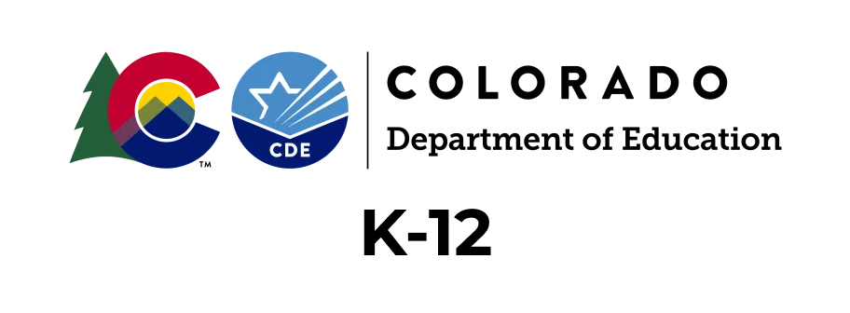
Building a Strong Foundation for Lifelong Literacy Success
Information for K-12 Teachers New to This Course

Slide 2
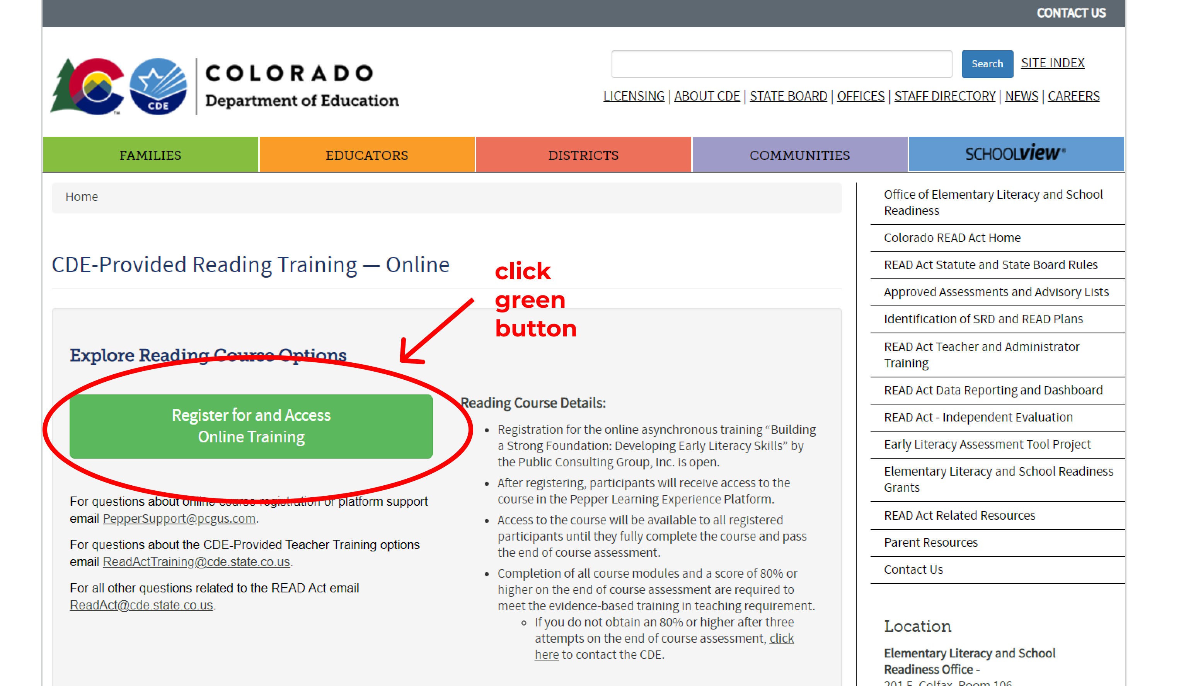
Registering for the CDE Pepper Training
You must register for a Pepper account using the CDE website
https://www.cde.state.co.us/coloradoliteracy/onlinecdetraining
Notes:
Click on the green button – do we need to edit the language to include new groups of learners.
Add more language on this page to describe the K-12 & Leadership tracks?
Add 2nd button Admin learners who have previously taken trainings and want to submit verification.

Slide 3
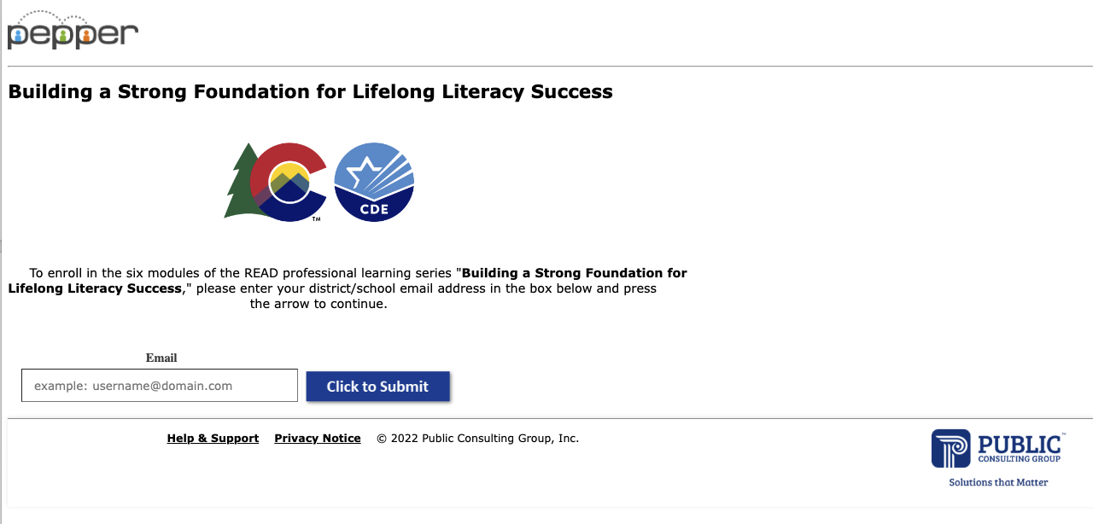
Use the email you will use to access the training in Pepper
Notes:
Production
https://www.pepperpd.com/CDEREADACT/mainloginpage
Pre-production
(https://www-pre.pepperpd.com/CDEREADACT/mainloginpage)

Slide 4
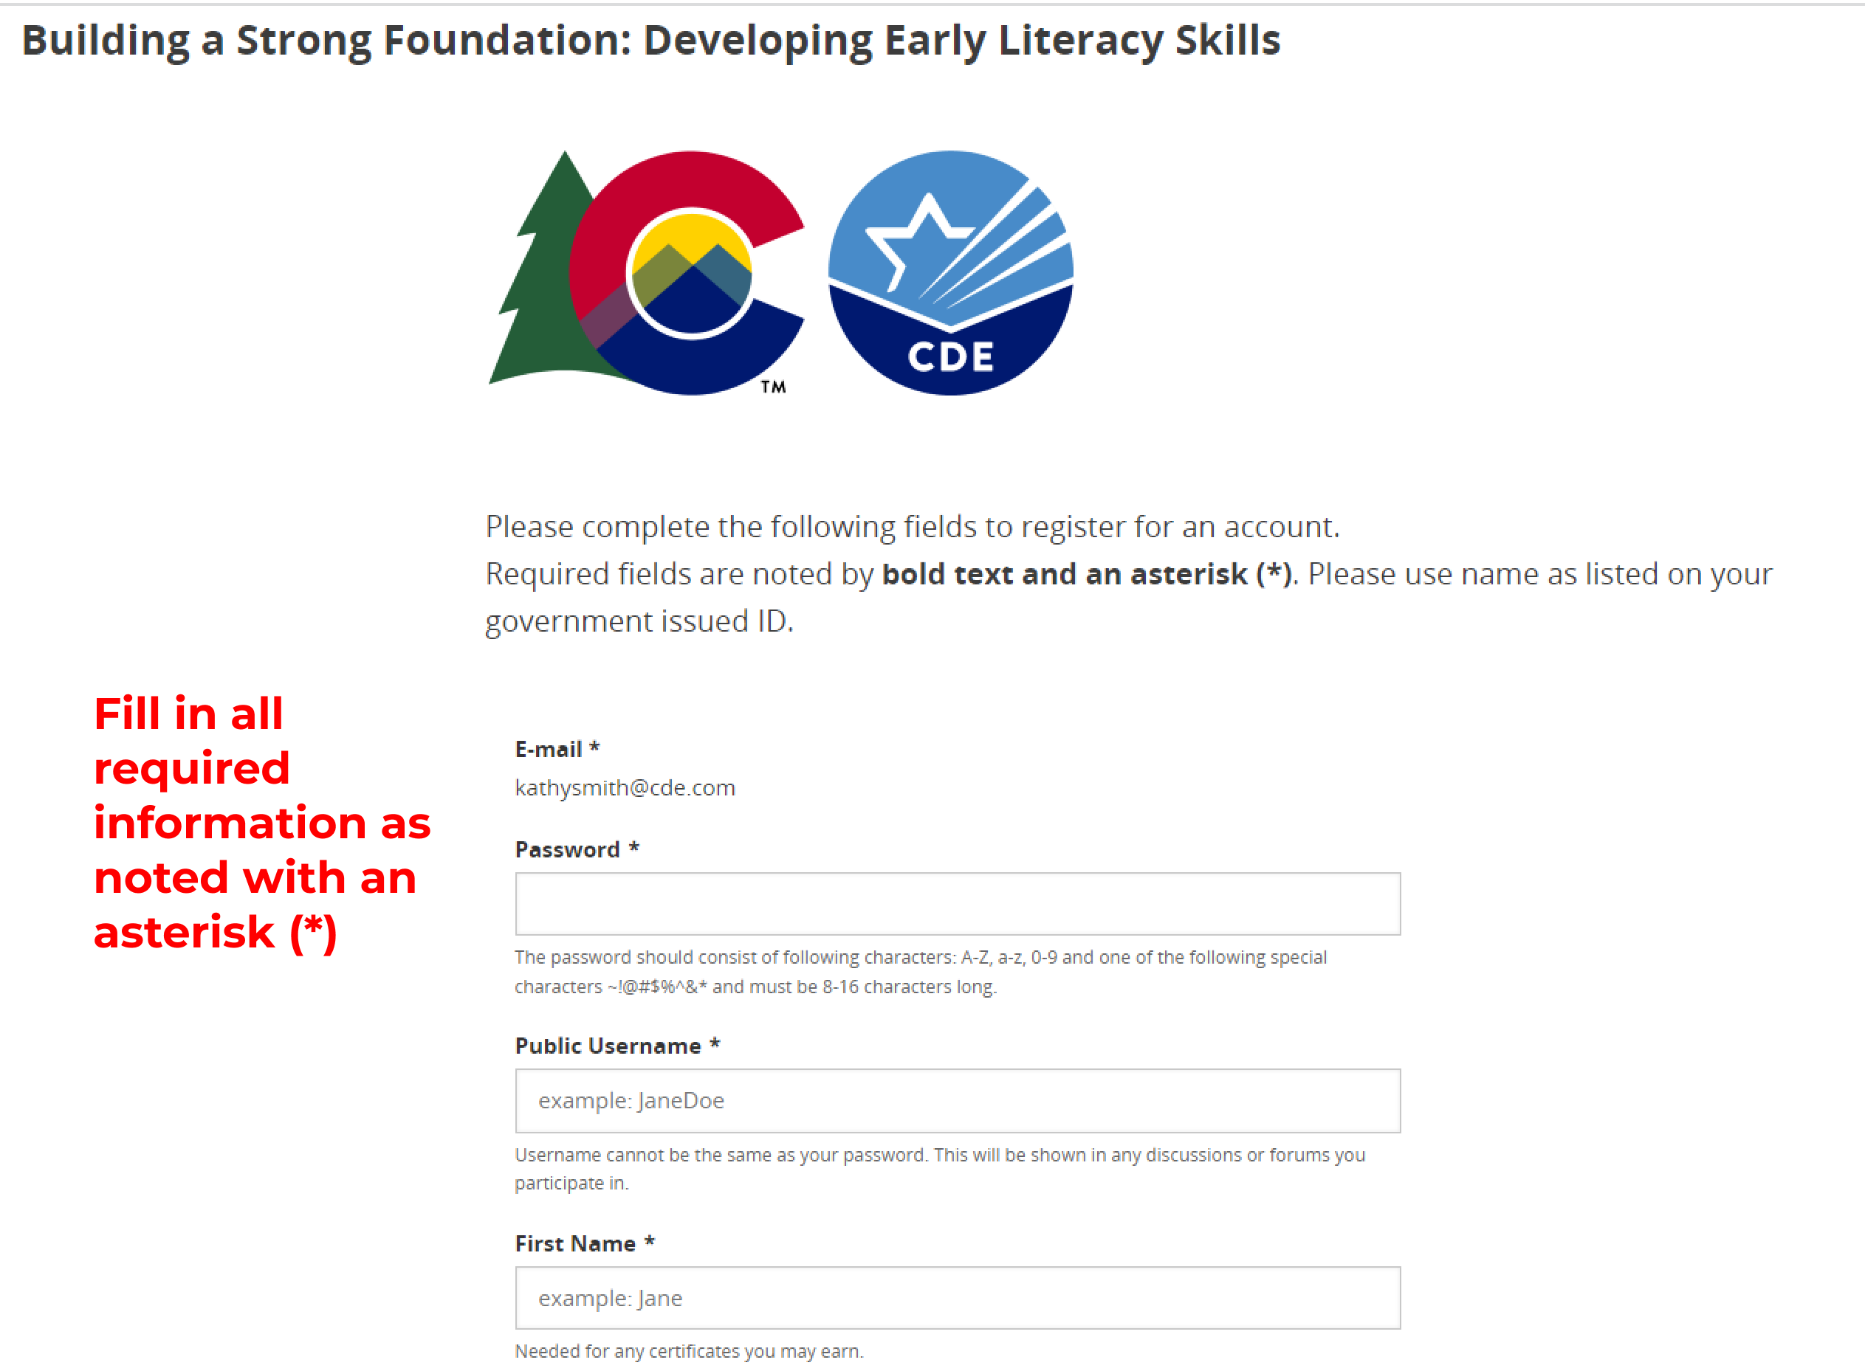
As a new user, fill in all required information in order to create your Pepper account.
Once it is completed, you will automatically be signed into your account on Pepper.

Slide 5
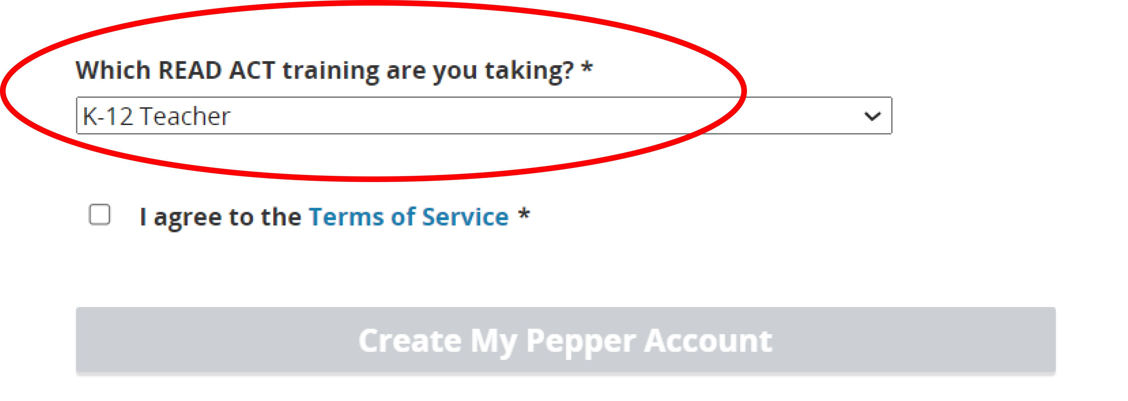
In the registration form, to properly set up your Pepper Account, you must select the correct training.
Select “K-12 Teacher” as your training.
Notes:
Learners will select their role when completing registration form and creating account

Slide 6
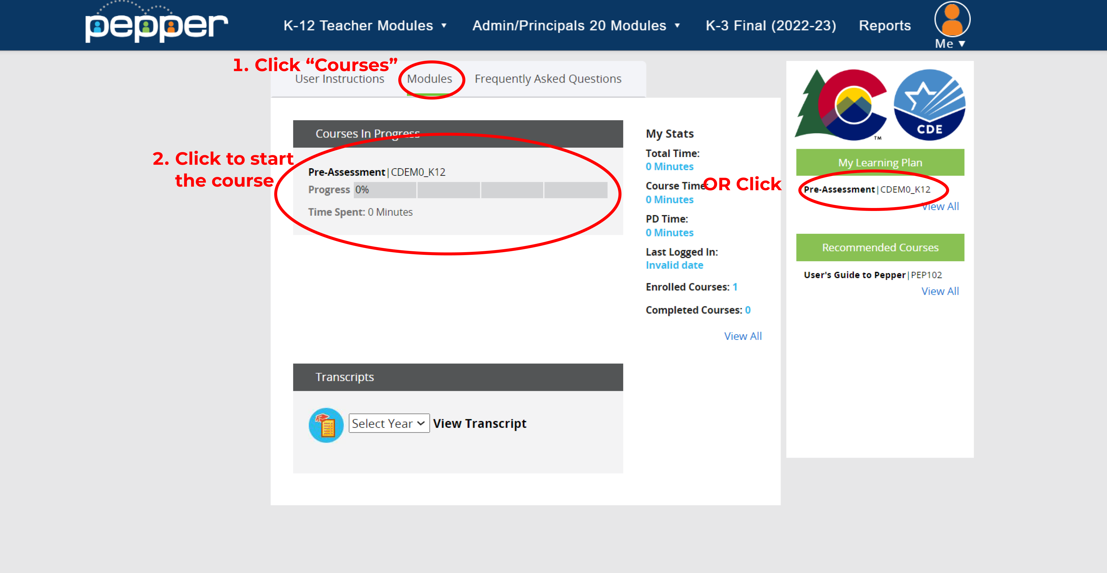
Once registration is completed, learner will be brought to Pepper dashboard
The K-12 pre assessment will automatically be assigned
1. Go to the “Courses” tab
2. Use the “My Learning Plan” on the right column
Notes:
The K-12 pre-assessment will be automatically assigned based on role selection.
Learners can always access Pepper account by going to production: https://www.pepperpd.com/login
or pre-production:
(https://www-pre.pepperpd.com/newdashboard/)

Slide 7
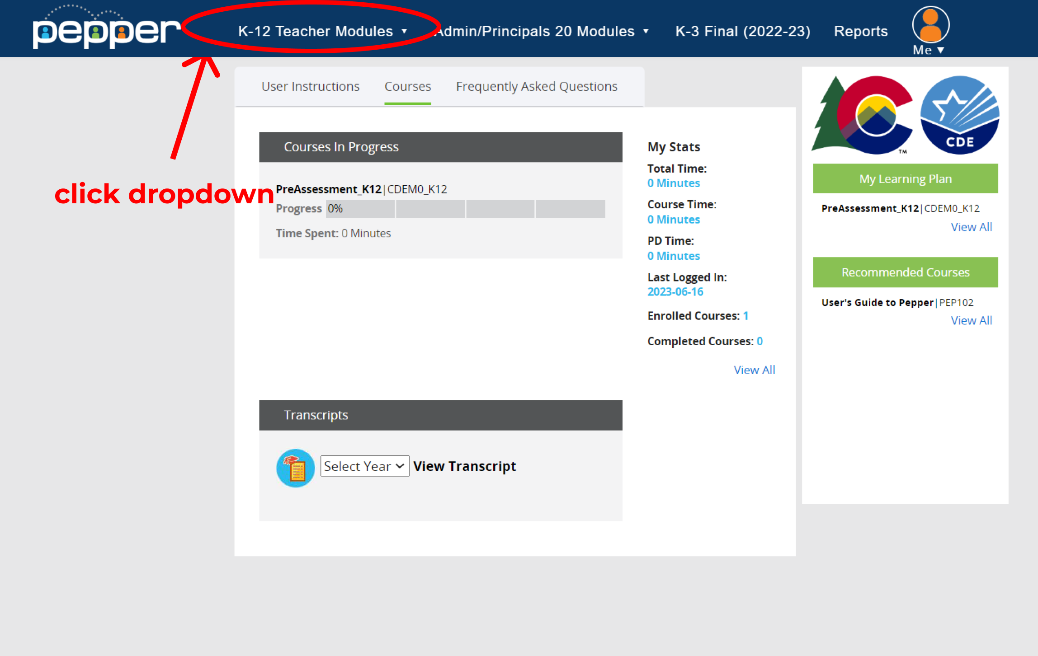
To access all K-12 training modules, click the appropriate tab in blue ribbon
Notes:
All other modules for K-12 will be found in the top blue ribbon. They are not automatically assigned.

Slide 8
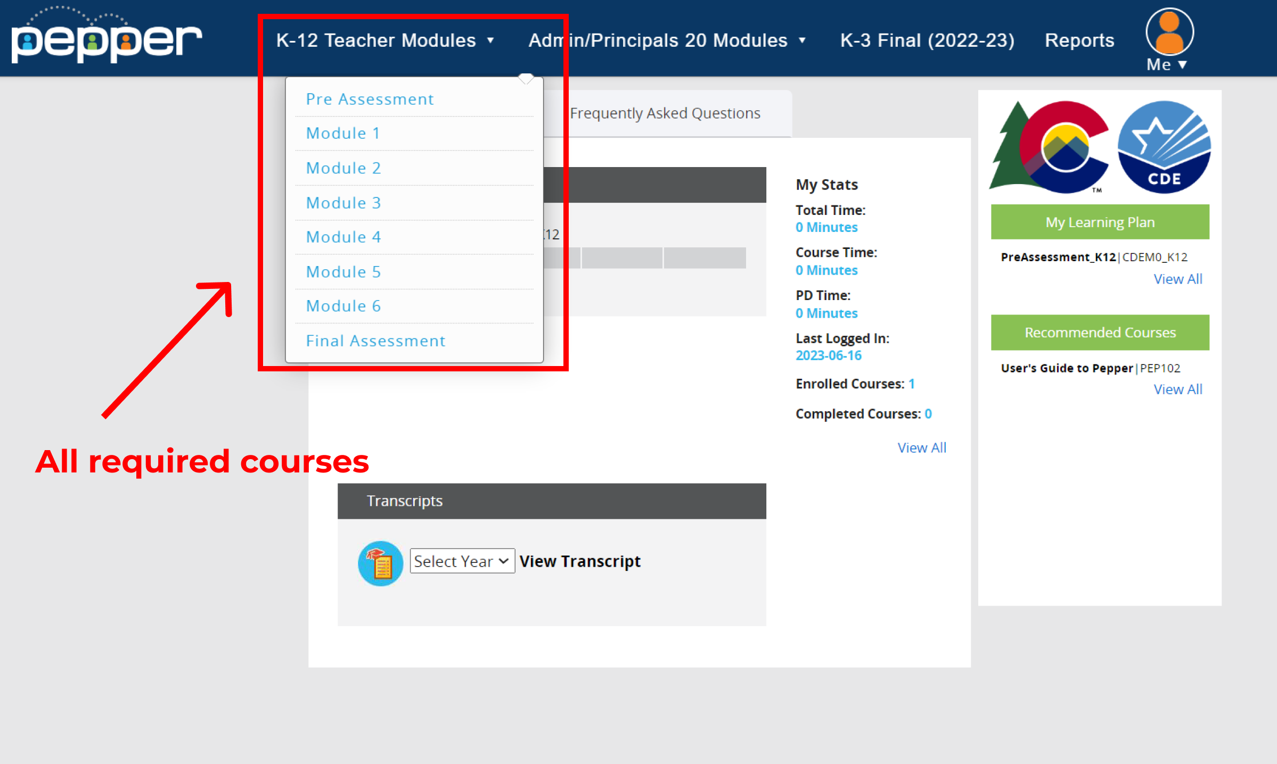
All the K-12 modules will be listed in the dropdown.
The learner can only access Modules 1-6 once the pre assessment pre-requisite is completed
Notes:
Learners will be required to click on each individual module to gain access. They will only be permitted to access once they have completed the pre assessment.
K-12 learners will also not able to access the Literacy Leader or K-3 Final modules when clicking.

Slide 9
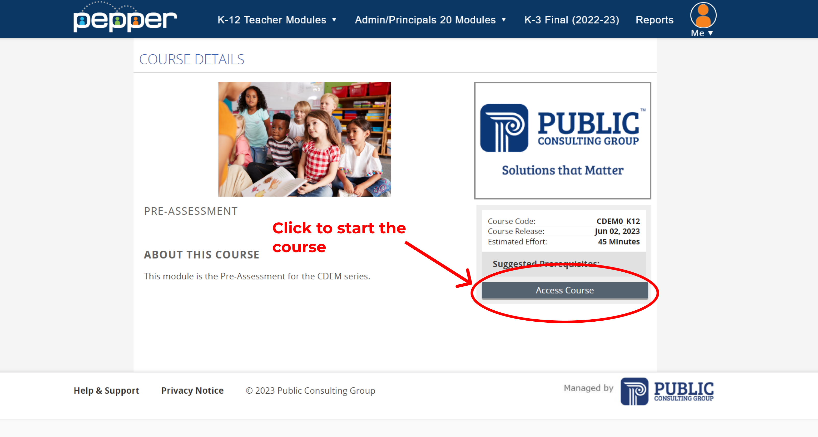
Another way to access is by clicking on the module name in the drop-down
You will then be brought to the information page of the Pre-Assessment
To start, click “Access Course”
Notes:
Learner will only be able to access pre-assessment from the drop-down list.

Slide 10
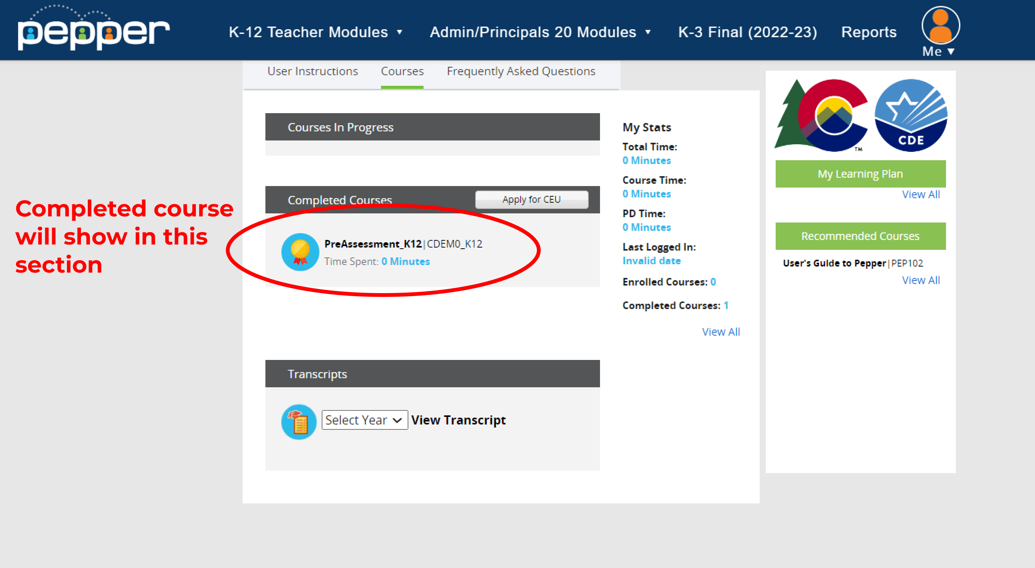
You can confirm completion in the “Courses” tab under “Completed Courses”

Slide 11
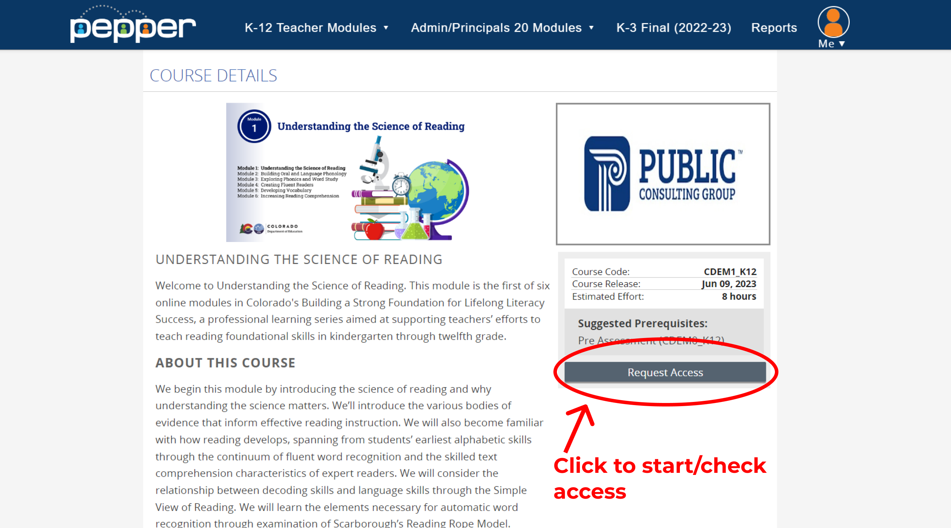
After you complete the Pre-Assessment, you can then access Modules 1-6.
Go to Module 1 from the K-12 dropdown and click “Request Access”

Slide 12
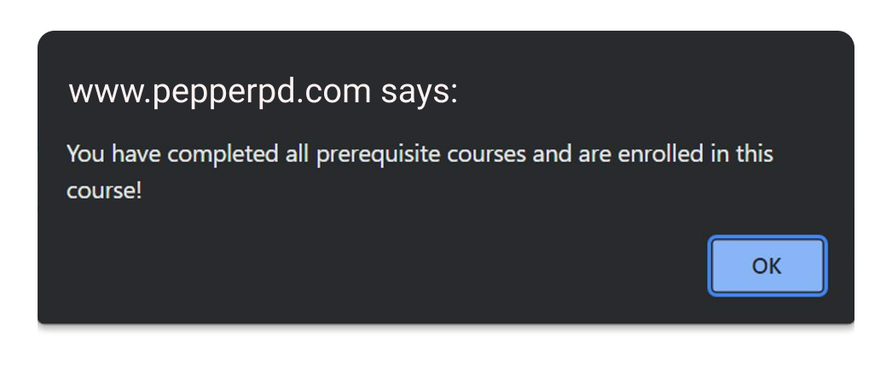
If prerequisite is completed, a pop-up will notify you that you are enrolled

Slide 13
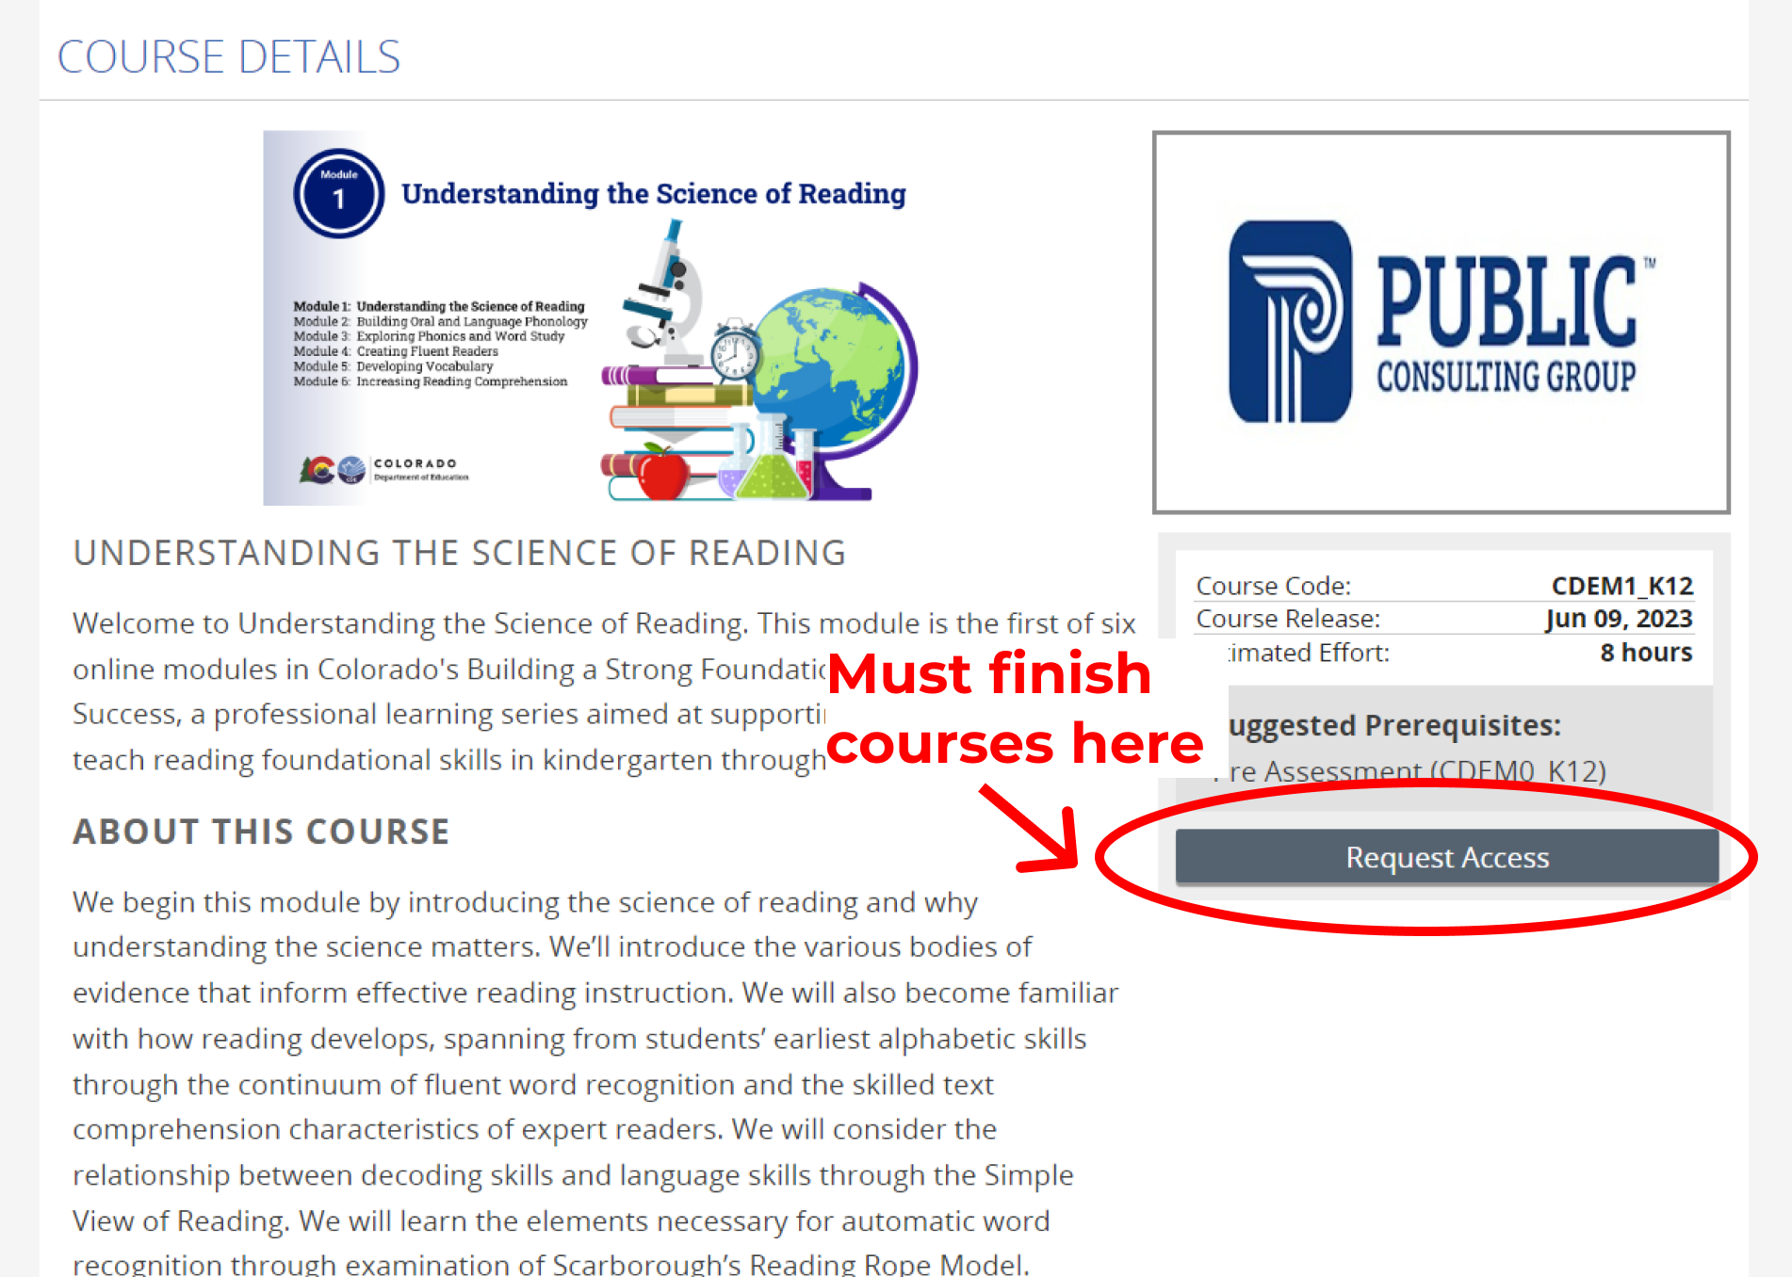
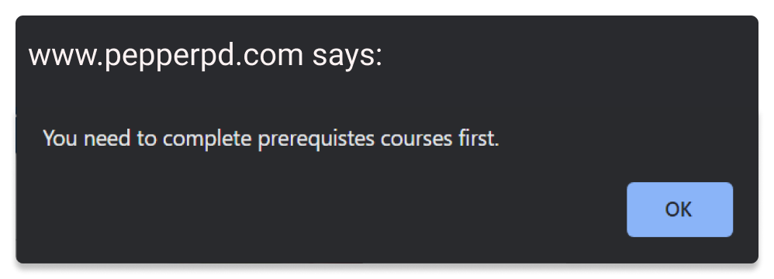
If you did not complete the prerequisite, a pop-up will notify you that you must finish all prerequisites instead. Check the prerequisites on the page to make sure you completed them all.

Slide 14
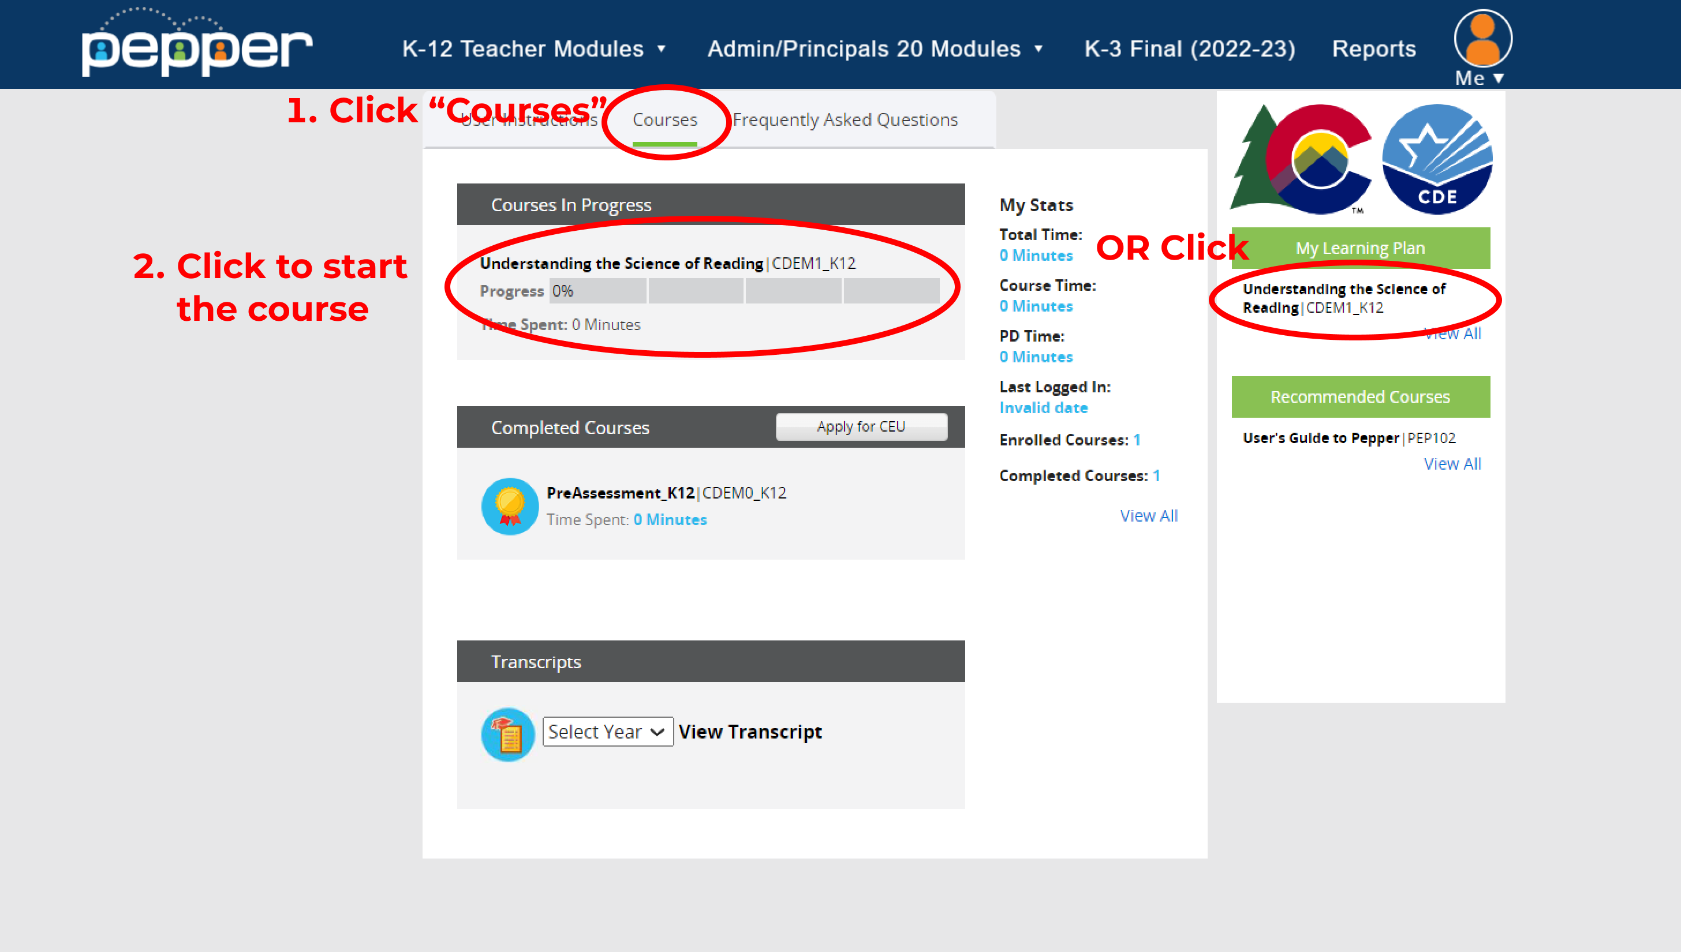
Modules will then be available on dashboard
Complete Modules 1-6
You must complete Modules 1-6 to gain access to the Final Assessment.

Slide 15
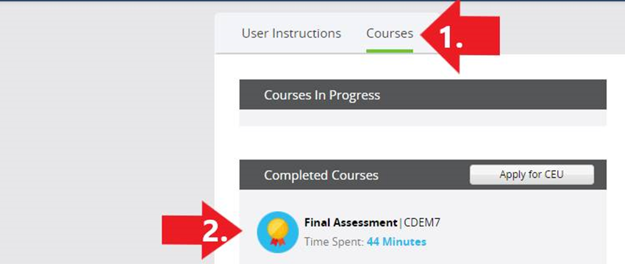
After passing the Final Assessment, you will be awarded a certificate indicating that you have completed the training.
To download your certificate, click the gold medal on the Final Assessment
Congratulations, you have successfully completed your CDE K12 training!
Notes:
You must complete modules 1-6 before obtaining access to Module 7 Final Assessment

