Slide 1
READ Act Office Hours Exiting a Student from a READ Plan
Thursday, April 27, 2023
Notes:
Welcome the READ Act office hours, we’re glad you could join us today to talk about Exiting a Student from a READ Plan.

Slide 2
READ Act Office Hours Introductions
READ Act Office Hours
Scheduled Dates and Times
Exiting Students from a READ Plan
April 27, 2023: 3-4 p.m.
EOY Parent Meeting (READ Act Requirements)
May 11, 2023: 3-4 p.m.
Planning for the Year Ahead
May 25, 2023: 3-4 p.m.
UIP with a READ Lens
July 27, 2023: time TBD
SRD Determination
August 24, 2023: time TBD
Writing READ plans
September 21, 2023, time TBD
Lindsey Beveridge
Senior Literacy Consultant, Elementary Literacy and School Readiness
Melissa Ahlstrand
Literacy Program Supervisor, Elementary Literacy and School Readiness
http://www.cde.state.co.us/coloradoliteracy/elsrliteracyteam-officehours
Notes:
Speaker Notes:
Hosting this session today… (introduce selves)​
​
​
In the box on the right side of the screen you can see the dates, topics for the upcoming office hours sessions for the next several months.
You can register to attend any of these virtual sessions, access related guidance documents and submit topic specific questions on the READ Act website. We will be adjusting and adding new times for upcoming sessions to accommodate for varying needs, so please be on the lookout for those options. The link to the office hours registration page is at the bottom of this slide.​
Put in chat:
http://www.cde.state.co.us/coloradoliteracy/elsrliteracyteam-officehours

Slide 3
READ Act Office Hours Purpose
The purpose of the monthly live READ Act Office Hours is to provide:
Information and guidance on specific topics related to the READ Act and
an opportunity for stakeholders to ask specific questions related to the specific topic

Slide 4
READ Act Office Hours Procedure
Prior to the scheduled office hours, participants will review guidance documents and/or pre-recorded webinar that align with the specific topic that will be discussed.
At least 1 week prior to the scheduled office hours, participants will submit questions they have about the specific topic through the Office Hours Questions Google form linked on the CDE READ Act Office Hours webpage
During the office hours, CDE will:
Introduce the topic being presented and provide a short summary of the topic
Answer questions submitted 1 week prior to the scheduled office hours
Allow for participants to ask questions live during the office hours

Slide 5
READ Act Office Hours Logistics
Each Office Hour is scheduled to address questions related to a specific topic.
The topic today is: Exiting a Student From a READ Plan
First, we will walk through the questions related to this topic submitted via the Google form linked to the Office Hours webpage.
After we walk through the questions submitted prior to the scheduled Office Hours, there will be designated time for participants to enter questions in the Q&A feature that are related to today’s topic.
Some questions will be answered during the webinar and others will be captured for further consideration.
Additionally:
For general questions about the CDE-Provided Teacher or Administrator Training options email: ReadActTraining@cde.state.co.us
For READ Act Data Inquires email READActData@cde.state.co.us
For all other questions related to the READ Act email: ReadAct@cde.state.co.us

Slide 6
READ Act Office Hours Objectives:
Overview of Exiting a Student From a Read Plan guidance
Review and respond to questions submitted prior to today's Office Hours
Respond to topic related questions submitted live
Notes:
Image:
Image from: http://www.picpedia.org/highway-signs/a/agenda.html

Slide 7
READ Act Office Hours Colorado READ Act-It Is About Prevention
READ Act
Passed by the Colorado legislature in 2012
Focuses on early literacy development for all students in kindergarten through 3rd grade
Preventative in nature
Scientifically and evidence-based reading instruction
Assessment
READ plans
Parent communication monitoring
Ensure every student in Colorado Reaches reading proficiency by the end of 3rd grade
Notes:
Speaker notes:
Just a brief overview of the READ Act, which was passed by the Colorado legislature in 2012
The READ Act focuses on literacy development for kindergarteners through third-graders - especially for students at risk for not reading at grade level by the end of third grade.
The READ Act is preventative in nature:
The READ Act requires that all school districts ensure that students in K-3rd grade receive scientifically and evidence-based reading instruction
The READ Act requires teachers to assess the literacy development of K-3rd grade students in order to identify early those student who struggle or may struggle with learning to read.
The READ Act also requires the development and implementation of individual intervention plans (READ Plans) for students who are identified as having a significant reading deficiency.
Parent communication is also apart of the READ Act. Under the READ Act, parents and school personnel should make decisions collaboratively throughout the READ Plan implementation process.
Parents should receive regular, ongoing updates from the student’s teacher concerning results of the intervention instruction and the student’s progress in achieving reading competency
As we know that teacher knowledge and practice are critical and in 2019 the amended the READ Act to require all K-3rd grade teachers receive training in evidence-based practices in teaching reading.
Again, the READ Act is about prevention.

Slide 8
Exiting a READ Plan and the READ Act
22-7-1206 (6) Each local education provider shall ensure that a teacher continues to revise and implement a student's READ plan until the student attains reading competency, regardless of the student's grade level and regardless of whether the student was enrolled with the local education provider when the READ plan was originally created or the student transferred enrollment to the local education provider after the READ plan was created.
Notes:
The Colorado READ Act has specific sections that address READ plans. Section 22-7-12006 states that “each local education provider shall ensure that a teacher continues to revise and implement a student’s READ plan until the student attains reading competency, regardless of the student’s grade level and regardless of whether the student was enrolled with the local education provider when the READ plan was originally created.

Slide 9
Exiting a READ Plan and the READ Act
4.01(B) The LEP shall monitor the ongoing progress of students determined to have a significant reading deficiency by administering the selected state board approved interim assessment periodically throughout the school year and by collecting a body of evidence demonstrating student progress toward the Minimum Reading Competency Skill Levels described below. Once a student demonstrates grade level competency, he or she may be removed from a READ plan.
4.01(C) Beginning in the 2020-21 school year and annually thereafter, the department, in consultation with stakeholders, shall provide guidance on how to determine when a student demonstrates grade level competency and should be removed from a READ plan.
Notes:
The Rules for the administration of the READ Act also state that student progress shall be monitored using the interim assessment and by collecting a body of evidence that demonstrates student progress toward the Minimum Competency Skill levels. Once a student demonstrates grade level competency, he or she may be removed from a READ plan.
READ Act Rule also outlines a requirement for CDE to provide guidance on how to determine when a student demonstrates grade level competency and should be removed from a READ plan. This is the guidance we will be discussing today.

Slide 10
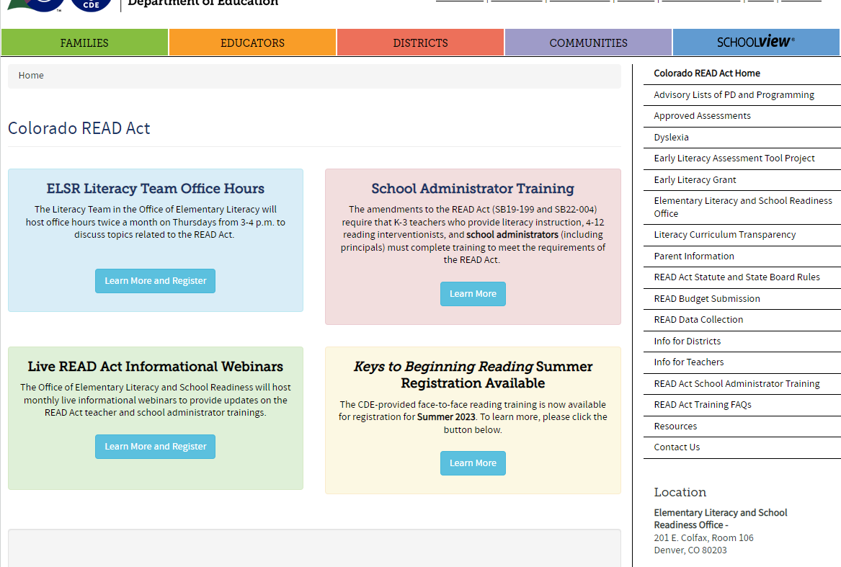
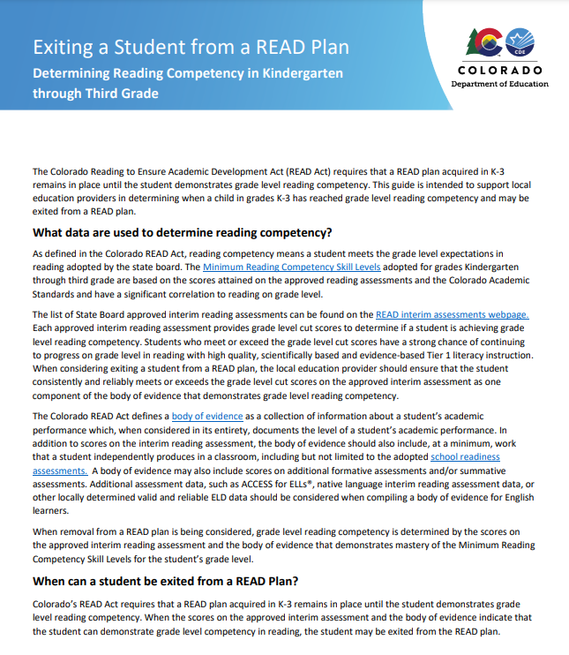
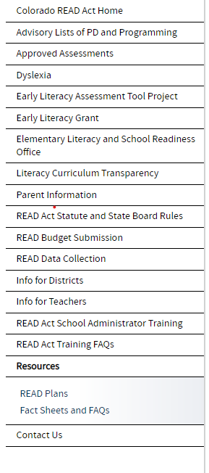
Updated Guidance
https://www.cde.state.co.us/coloradoliteracy/exitingareadplan
Notes:
The guidance document titled “Exiting a Student from a READ Plan” can be found on the READ Act webpage by clicking on “Resources” and then “READ Plans in the drop down menu. This will take you to a page of READ plan resources, including the Exiting a Student from a READ plan document we are highlighting today.
Put link in chat:
https://www.cde.state.co.us/coloradoliteracy/exitingareadplan

Slide 11
Determining Reading Competency Questions
Notes:
We are going to begin by answering some frequently asked questions that arise around Exiting Students from a READ plan. Then we will have time for specific questions you may have that are not addressed in these slides.

Slide 12
Question: How is reading competency determined in grades K-3?
Scores on the approved interim reading assessment
AND
A body of evidence that demonstrates mastery of the Minimum Reading Competency Skill Levels for the student’s grade level
Classroom work and assessments
Adopted school readiness assessments
Additional formative or summative assessments
ACCESS for ELLs; native language reading assessment data
http://www.cde.state.co.us/coloradoliteracy/minimumcompetencylinkedmatrix
Notes:
The first question is: “How is reading competency determined in grades K-3?”
Reading competency is determined by the scores on the approved interim reading assessment and a body of evidence that demonstrates mastery of the Minimum Reading Competency Skill levels for the student’s grade level.
For your reference, I’ll put the link to the Minimum competency skill levels matrix in the chat; it’s also on the bottom of this slide:
http://www.cde.state.co.us/coloradoliteracy/minimumcompetencylinkedmatrix
The body of evidence can include examples of classroom work and assessments, adopted school readiness assessments, additional formative or summative assessments, and for English Learners, the BoE also includes score on Access for ELLs and any native language reading assessment data that may be available.

Slide 13
Question: Can a student be exited from a READ plan based on the body of evidence if the student does not score at/above benchmark on the interim assessment?
The interim assessment is a critical component for determining grade level reading competency. A student must score at/above benchmark on the interim assessment to consider exiting the student from the READ plan.
Notes:
The next question is :
Can a student be exited from a READ plan based on the BoE if the student does not score at/above benchmark on the interim assessment?
The answer to this is no. The interim assessment is a critical component for determining grade level reading competency. The approved assessments are directly aligned to the minimum skill competencies, and student must score at/above benchmark on the interim assessment to consider exiting the student from the READ plan.
Remember, when exiting a student from a READ plan, we want to be confident that student has the skills needed to continue to maintain progress reading at grade level without additional supports.

Slide 14
Considerations for Exiting a READ Plan Questions
Notes:
The next few questions pertain to considerations for exiting a read plan.

Slide 15
Question: What needs to be considered before a child may be exited from a READ plan?
Has the student demonstrated mastery of the minimum competencies consistently, over multiple measures?
Does the student demonstrate reading competency in all subskills measured by the assessment?
Do the assessment data align with the additional body of evidence?
Is the student able to maintain grade level competency through Tier 1 instruction alone?
If the student is an English Learner, are adequate language supports provided to ensure continued progress in reading?
Notes:
Question: What needs to be considered before a child may be exited from a READ plan?
While the interim assessment score is an important factor, we want to think about a variety of considerations before determining that a child is ready to be exited from a READ plan.
(read slide)

Slide 16
Question: Who is responsible for creating and communicating procedures for exiting a READ plan?
The local education provider is responsible for adopting its own procedures that comply with the requirements of the READ Act. This can include specific procedures for exiting a READ plan.
Notes:
Question: Who is responsible for creating and communicating procedures for exiting a READ plan in my district?
The local education provider is responsible for adopting its own procedures that comply with the requirements of the READ Act, and this can include specific procedures for exiting a READ plan. in most cases the Local Education Provider means the District, but can also be a board of cooperative services, a district charter school or an institute charter school, depending on your situation.

Slide 17
Exiting a READ Plan Questions
Notes:
The last few questions pertain directly to the process for exiting a READ plan.

Slide 18
Question: What do we do once it has been determined that a student has reached grade level reading competency?
Document on the READ plan the assessment scores and the body of evidence that supports the student has demonstrated grade level reading competency.
Ensure the READ plan, supporting documentation for the plan, and the body of evidence that demonstrates the student has reached grade level reading competency are included in the permanent academic record.
Communicate with the student’s parent or guardian that the student has reached grade level competency in reading and will be removed from the READ plan.
Notes:
The first question is: What do we do once it has been determined that a student has reached grade level reading competency and will be removed from the READ plan?
(Read bullets)

Slide 19
Question: What if a student is exited from a READ plan and later is determined to have an SRD?
If the student is in grades K-3 and fails to maintain grade level reading competency after being exited from a READ plan, a new READ plan may be initiated.
Notes:
The next question is: What if a student is exited from a READ plan and later is determined to have an SRD?

Slide 20
Question: What is the process for exiting a student from a READ plan beyond 3rd grade?
The process is the same; however, the assessments and the body of evidence used to determine reading competency may differ.
Guidance for exiting students from a READ plan beyond 3rd grade is being finalized.
Notes:
Finally, the last question is: “What is the process for exiting a student from a READ plan beyond 3rd grade?
Its important to know that the process does not change. We still have to be able to demonstrate that a student has reached grade level competency, that they have mastered the Minimum Skill Competencies and that the body of evidence supports that they are reading on grade level.
However, the assessments schools use and some parts of the body of evidence used to determine reading competency may differ.
We are currently finalizing guidance for districts for exiting students from a READ plan beyond 3rd grade.

Slide 21
Breakout
How does the information align to your district’s current procedures for exiting students from a READ plan?
What additional questions do you have on this topic?
Notes:
(Put in breakout room with consultants if there are enough participants. If not, these reflection questions can be presented to the whole group)
We are going to take a moment to break into smaller groups to have some time for discussion. There will be a CDE consultant in each breakout room to facilitate the conversation and gather questions to bring back to the whole group.
We will spend 5 minutes in breakout rooms discussing these questions:

Slide 22
Questions?

Slide 23
Helpful Links
READ Act Main Page:
http://www.cde.state.co.us/coloradoliteracy
Webinar/Office Hours Information: https://www.cde.state.co.us/coloradoliteracy/elsrliteracyteam-officehours
READ Act Statute and Rules: http://www.cde.state.co.us/coloradoliteracy/readactstatuteandstateboardrules
READ Plans:
https://www.cde.state.co.us/coloradoliteracy/readplans
READ and English Learners:
https://www.cde.state.co.us/coloradoliteracy/readandel
Science of Reading Resources: https://www.cde.state.co.us/coloradoliteracy/scienceofreadingresources
Educator Resources: https://www.cde.state.co.us/coloradoliteracy/readacteducatorresources
Notes:
Speaker Notes:

