Slide 1


Slide 2
Corners
Stand up
Get Ready to Move!!
Teacher Will Display 4 Choices assigned to a corner
You Select Your Preference
Discuss choice with shoulder partner
Notes:
15 Minutes
You will play the Corner’s Classbuilder with students. Students will:
Stand Up and move to center of the room to start.
You will display 4 choices using the PowerPoint Slides.
Students will select a choice and move to the appropriate corner.
They should discuss the choice with their shoulder partner for a few seconds.
You can call on a few students to give their own reason or the reason of their partner.
Move fairly quickly with this activity from selection to selection to keep the energy high and kids interested.
You should finish this game in 5-7 minutes.

Slide 3




Corners
My favorite…
Notes:
From top left corner clockwise:
Baseball
Football
Basketball
Soccer

Slide 4




Corners
My favorite…
Notes:
From top left corner clockwise:
Spring
Summer
Winter
Fall

Slide 5




Corners
My favorite…
Notes:
From top left corner clockwise:
Alternative Rock
Rock Music
Classical Music ☺
Hip Hop

Slide 6

Notes:
Have students return to their seat.

Slide 7
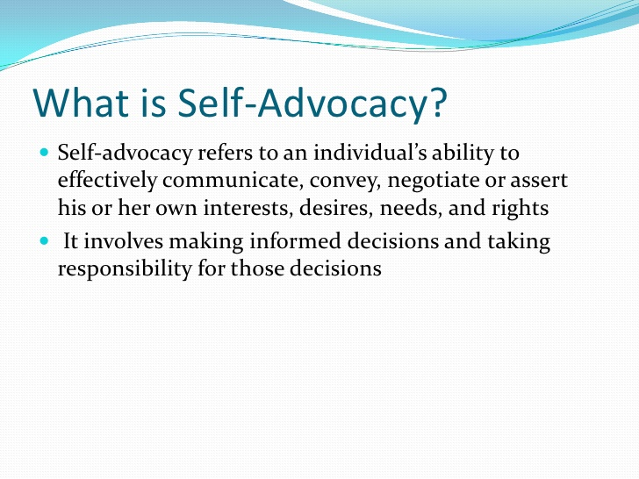

Slide 8

Resisting Pressure
Think clearly and speak in a firm voice to express your choice.
Say NO when you need to.
Make sure your body language matches your words.
Repeat your message firmly.
Provide clear reasons.
Suggest alternative activities.
Communicate consequences of actions.
If your choice is not respected, leave the situation.

Slide 9
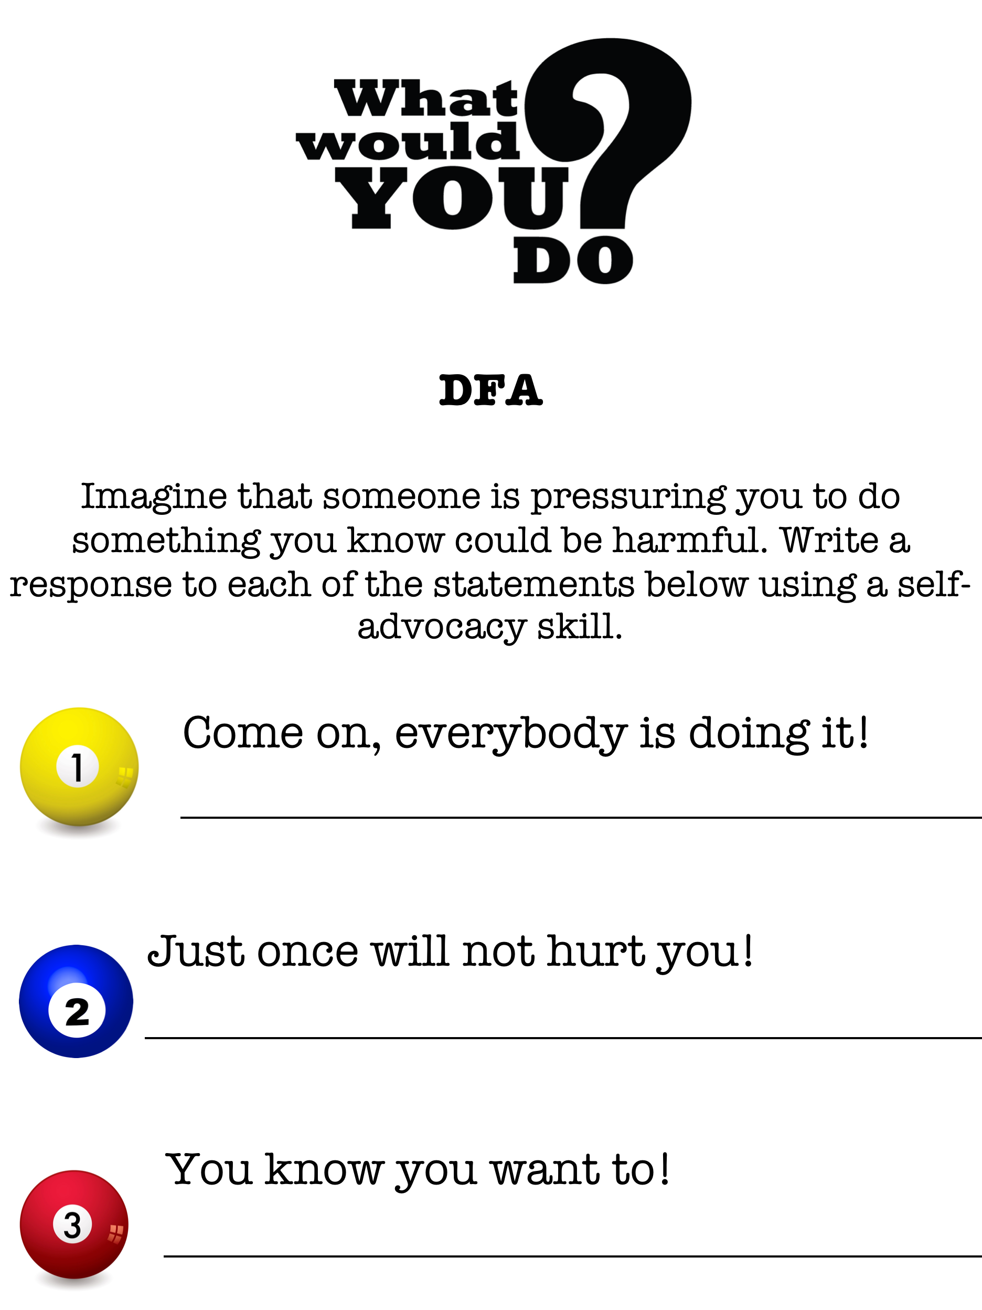

Slide 10




Why do you believe we’re studying this objective?
Were the strategies, skills and procedures used effective for this assignment?
What could the teacher have done differently to help you learn this objective easier?
What’s one thing the teacher did that you really liked?

Slide 11

What did you like about the lesson?
What would you do differently or add?
How can you use this in your content area?

