Slide 1
Standard Record Reviews (SRR) and Transition Age File Reviews: Indicator 13 (I 13) SY2021-2022
Overview, Review Process, Data Submission, and Levels of Support

Slide 2
Today’s Plan
Overview
File review process
Data submission & reporting
Correction of Indicator 13 noncompliance process
Levels of support for Indicator 13

Slide 3
Purpose of IEP Record Reviews
Guide school teams through the examination and comparison of specific components of an IEP to determine if the IEP is reasonably calculated to enable the student to make progress and receive educational benefit.
Outcomes:
Improvement in academic achievement, career and college readiness, and post school outcomes for students with disabilities
Informed decisions about professional development and technical assistance needs in IEP development and implementation
To gather statewide data required for the Colorado State Performance Plan/Annual Performance Review (SPP/APR) submitted annually to the Office of Special Education Programs (OSEP)

Slide 4
Overview

Slide 5
Timeline and samples
Timeline:
Samples are open in the Data Management System (DMS) August 1, 2021 – June 1, 2022
Samples pulled from the 2020 December Count data
Random samples ensure that students in each age group are adequately represented
Sample stratified in 3 age categories:
Preschool: 3- and 4-year-olds
School age: 5- to 14-year-olds
Secondary transition: 15- to 21-year-olds
Sample Size - double the required number – provides flexibility in file selection

Slide 6
Number of reviews
Maximum number of total reviews is 30 (reduced from 50 in SY2020-2021)
Minimum 10
Maximum 30
Transition IEP reviews – used for reporting Colorado’s Indicator 13 data
Minimum 5
Maximum 10
Review active IEPs dated between July 1, 2021 – June 1, 2022
Full record reviews – protocol is built in to the DMS
June 1, 2022 – data collection window closes and DMS files locked

Slide 7
File Review Process – Standard Record Review School Age and Preschool

Slide 8
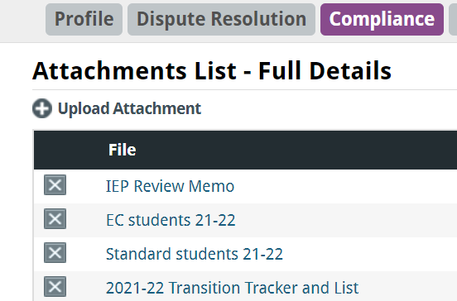
How many files do I have to review?
The CDE uploaded a document to the Attachments List in the DMS Compliance tab that identifies the required number of reviews and the doubled number for each age category.
Required number of reviews
Doubled number
Notes:
The sample size is not doubled if the AU has unusual population (e.g., ,limited or no early childhood, extremely small SPED population). In that case, the sampling is tailored for that AU, so the AU really needs to look at this guidance document.

Slide 9
Student lists
Detailed individual student lists are provided for each age category.

Slide 10
Columns
Separate columns in the Compliance tab of the Data Management System (DMS)

Slide 11
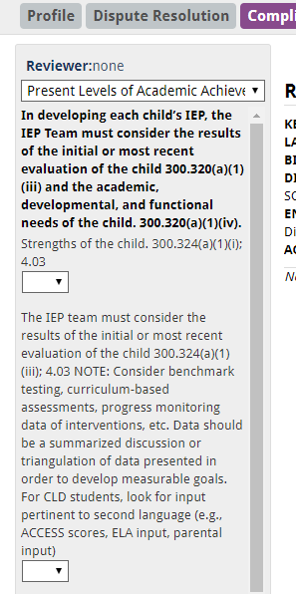
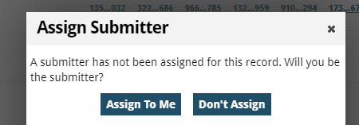
Completing file reviews – Standard School Age and Preschool
Click on the age-range column
Click on the Record Number you want to review
Click on Assign To Me and fill in the reviewer’s name
Complete full record review using the protocol in the DMS
Upload documents to the DMS

Slide 12
Uploading documents to the DMS
Upload the IEP documents for the selected students, including the Notice(s) of Meeting, from your IEP system (e.g. Enrich, Alpine, Infinite Campus) to the DMS.
Instructions for uploading IEPs for Enrich and non-Enrich users can be found under Resources on the Directors' Corner of the CDE website
A one-page checklist for completing the Standard Record Reviews can be found on the General Supervision and Monitoring webpage.
Note: At 5:00 PM on June 1, 2022, the data submission window closes and your access to these files in the DMS will be locked.
By popular demand

Slide 13
File Review Process – Transition Age Indicator 13

Slide 14
Calculating % Compliance for I 13
Target for Indicator 13 = 100% compliance
Indicator 13 is an “all or nothing” indicator - a Transition IEP is considered compliant when ALL 8 required components are evident in the document.
Calculation: % Compliant = (Number of youth age 15 and above with IEPs that contain each of the required components for secondary transition/required number of reviews) * 100.
Example:
Required number of file reviews = 5
Compliant IEPs = 4
% Compliant: 4/5 = 0.8 x 100 = 80%

Slide 15
I 13 Compliance Components
Appropriate measurable postsecondary goals (PSGs) in education/training, career/employment, and, where appropriate, independent living skills
PSGs are updated annually (N/A option if you are reviewing the first Transition Age IEP for the student at age 15)
Age-appropriate transition assessments
Courses of study that will assist the student in reaching the PSGs
Transition services that will reasonably enable the student to meet his or her PSGs
Annual goals related to the student’s transition services
Documentation of student invitation to the IEP
Prior consent of the parent to invite a representative of any participating agency that is likely to be responsible for providing or paying for transition services. (N/A is okay)
Notice of Meeting must indicate a purpose of the meeting will be the consideration of the postsecondary goals and transition services (IDEA required but not part of the I 13 measure)

Slide 16
Transition Age Review Process
Download the pre-populated 2021-22 Transition Tracker and List from the Attachment section of the Compliance tab in the DMS.
Excel spreadsheet – 2 tabs at the bottom
Tracker – used for this process
Full Record – student detail for your use in selection

Slide 17
Transition Tracker
Transition Tracker (this is your friend!)
Identifies required number of reviews
Prepopulated: DMS Record Number, SASID, First Name, Last Name, and Date of Birth
Required - AUs complete: Date of IEP, Compliance Verified (Yes/No drop-down menu)
Optional – AUs complete: Case Manager, Reason not reviewed
Use this required tool to verify your compliance results before the deadline (no surprises)

Slide 18
Completing file reviews – Transition age
Click on the age-range column
Click on the Record Number you want to review
Click on Assign To Me and fill in the reviewer’s name
Complete full record review using the protocol in the DMS
Upload documents to the DMS

Slide 19
Uploading IEP Documents
Select the students you want to include in your review from the Transition Tracker
Remember that your sample includes double the number required for flexibility
Transition Tracker - Excel spreadsheet – 2 tabs at the bottom
Tracker – used to select students and submit data
Full Record – student detail for your use in selection (school, grade level, disability category, etc.)
Upload the IEP documents for the selected students, including the Notice(s) of Meeting, from your IEP system (e.g. Enrich, Alpine, Infinite Campus) to the DMS.
Instructions for uploading IEPs for Enrich and non-Enrich users can be found under Resources on the Directors' Corner of the CDE website

Slide 20
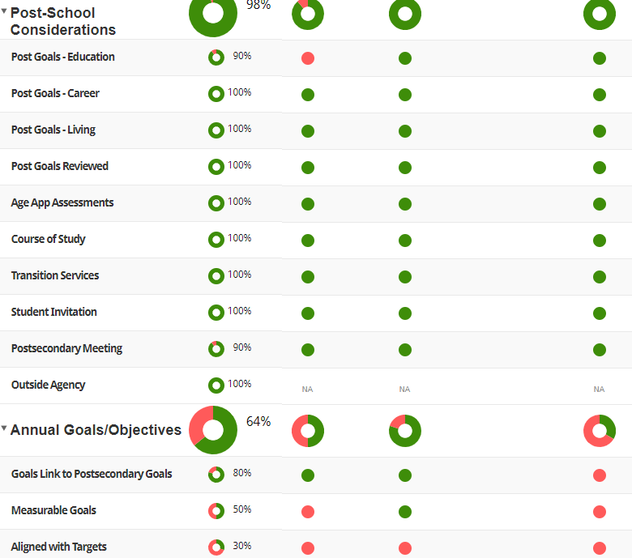
Verification of Data DMS Views (Collapsed & Expanded)
Expand
I 13 Elements Expanded View
IDEA/ECEA

Slide 21
Verification of Data
Please verify your DMS data before the deadline to ensure that any IEP with noncompliant elements have been corrected and amended. There should be no blanks or red indicators in your reviewed IEP protocol on the DMS when the data collection window closes.
No blank spaces
Important: Corrections of any noncompliant sections must be completed, and new IEPs/amendments uploaded to the DMS by June 1, 2022. Remember to change your answers from “No” to “Yes”.

Slide 22
Data Submission & Reporting Indicator 13

Slide 23
Complete and Upload Transition Tracker - Required
For each of the reviewed student files complete the following steps:
Fill in the date of the IEP – IEPs that fall outside of the range will not be accepted
Use the drop-down menu to indicate verification of compliance of the record (Yes/No)
Upload the completed Tracker to the Attachments section: label it “Completed I 13 Tracker 2021-22”
Email Durosko_g@cde.state.co.us to confirm completion of the file reviews
Required
Required

Slide 24
Data Submission Deadline and Reporting
At 5:00 PM on June 1, 2022, the data submission window closes and your access to these files in the DMS will be locked.
Important: Requests to reopen the files after the deadline will result in one point lost for Accurate and Timely Submission of Data on the Compliance Matrix for 2023 AU Determination.
August 2022: CDE will notify AUs that the I 13 results letter is available in the Attachment section of the DMS Compliance tab
February 2023: The CDE reports state-wide Indicator 13 compliance data and evidence to demonstrate correction of any noncompliance to OSEP in the SPP/APR.
Spring 2023: Indicator 13 compliance percentage included in the Compliance Matrix of each AU’s Determination

Slide 25
Checklist
Sign in to the DMS
Go to the Attachment Section in the Compliance Tab
Download Transition Tracker
Select IEPs to review – must be active and dated between July 1, 2021 – June 1, 2022
Upload documents for the selected Transition IEPs to the DMS
Complete full record review in the DMS
Corrections of any non-compliant sections must be completed, and new IEPs/amendments uploaded to the student record by June 1, 2022
On the Transition Tracker, fill in IEP date and compliance outcome
Upload completed Transition Tracker to the Attachment section in Compliance tab
Indicator 13 Checklist and the I 13 Overview Memo are available on the General Supervision and Monitoring webpage.

Slide 26
Reporting Indicator 13 Compliance
Office of Special Education Programs (OSEP) clarification to
State Education Agencies (SEAs) 12/16/19
“while the SEA may provide an LEA the opportunity to correct noncompliance prior to the issuance of a written finding, the percentage reported in the APR must reflect the AU’s actual level of compliance prior to the opportunity to correct any noncompliance.”

Slide 27
What does this mean for CDE/AU reporting?
Once CDE reviews a transition IEP (has eyes on it), and
finds noncompliance in one or more elements required for I 13, then
the IEP must be considered noncompliant for I 13 reporting purposes.
Individual corrections of noncompliance are still required to be completed per OSEP Memo 09-02.

Slide 28
What this means for AUs that participate in CDE/AU collaborative IEP reviews
The AUs reported compliance percentage for Indicator 13 is based on results of the side-by-side file reviews prior to any corrections.
Example: 5 IEPs are reviewed, 1 IEP is determined to be noncompliant, the AU’s Indicator 13 compliance percentage is reported as 80%, 4 out of 5 IEPs compliant.
Correction process remains unchanged:
At the end of these meetings, the Director has access to a list of any individual corrections of noncompliance.
AUs have 45 days following the date of the record reviews to complete any corrections of noncompliance, upload new documents to the DMS, and notify CDE of the completed corrections.
The CDE team reviews the corrections for compliance and advises the Director of the status of the corrections.

Slide 29
Suggestions, tools and resources
Suggestions to lessen the likelihood of noncompliance when the data window closes:
Provide training on the DMS record review process to staff conducting file reviews
Review files for compliance on a regular basis: monthly, bi-monthly, quarterly
Review files prior to a side-by-side collaborative review with CDE
Use the Secondary Transition IEP File Review Checklist
Require the AU’s designated reviewer to submit the completed Transition Tracker to the Director well ahead of the June 1st deadline
Establish a systemic accountability check procedure
Important:
Don’t wait until May to review IEPs

Slide 30
Correction of Noncompliance for I 13

Slide 31
Correction of Noncompliance for I 13 Overview
Demonstrating Correction of Noncompliance for I 13
Per OSEP Memo 09-02
Indicator 13 Compliance Target = 100%
Reported to OSEP every February in the Colorado State Performance Plan (SPP)/Annual Performance Report (APR)
If Colorado reports less than 100% (93% SY2017-18; 88% SY2018-19;)
Then,
The CDE must demonstrate correction of noncompliance for each noncompliant IEP in every AU with less than 100% compliance
OSEP Memo 09-02

Slide 32
Demonstrating correction of noncompliance
Demonstrating Correction of Noncompliance (2 prong process)
Prong 1 “Individual Correction”
The CDE must ensure that each AU has corrected all individual cases of noncompliance unless the child is no longer within the jurisdiction of the AU, and the AU must identify the root cause of the noncompliance.
DMS reported data – AUs must correct all individual IEPs that contain noncompliance for Indicator 13 requirements
Prong 2 “Review of Updated Data”
The CDE must review updated data to determine that the AU is correctly implementing the specific regulatory requirements related to Indicator 13.
CDE/AU collaborative side-by-side reviews of the required number of IEP reviews for secondary transition age youth for the following school year

Slide 33
Levels of Support

Slide 34
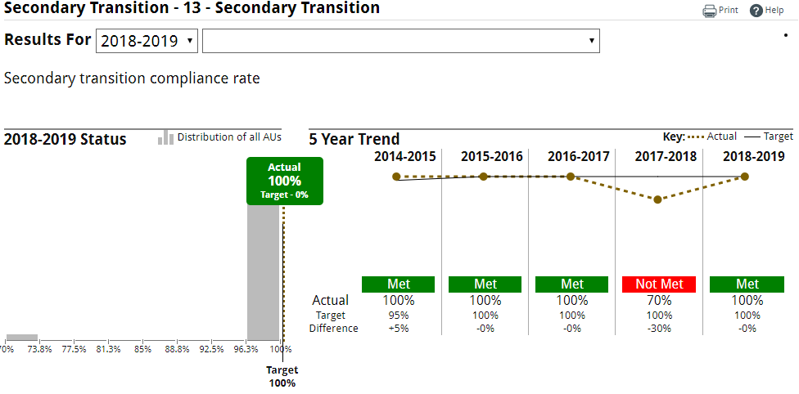
Levels of Support – 3 Levels
Years 2015-16 and 2016-17 were recalibration years. The baseline year for levels of support is 2017-2018.
Directors can find the AU’s trend data used to determine their level of support in the Summary tab in the DMS

Slide 35
Levels of Support - Universal
Universal Support
The following resources are on the General Supervision and Monitoring webpage:
Written communication, “Indicator 13 Overview
The recorded training and PowerPoint which can be used by AUs for staff training.
A checklist of steps to follow in completing the reviews and the certification of data submission process
Various training resources in writing quality Secondary Transition IEPs are on the Secondary Transition webpage.

Slide 36
Levels of Support – New AUs
Targeted Support - Includes all element of Universal Support plus:
Collaborative side-by-side record reviews
August 2022 - AUs will be contacted to set up collaborative record review meetings, either in person or virtually, to be completed by February 15, 2022.
At the end of this meeting, the Director will have access to a list of any individual corrections that need to be made on the Compliance tab of the DMS.
AUs will have 45 days following the record reviews to complete the corrections, upload them to the DMS and notify CDE of the completed corrections.
The CDE team will review the corrections for compliance and advise the Director of the status of the corrections.

Slide 37
Levels of Support - Targeted
Targeted Support - Includes all element of Universal Support plus
Demonstration of Correction:
Prong 1: Individual Correction - AUs must correct the noncompliant section(s) of the individual student’s most recent IEP by November 1, 2022 and identify the root cause of the noncompliance.
AUs will receive a letter with details about this process in August 2022.
Prong 2: Review of Updated Data - Collaborative side-by-side record reviews
August 2022 - AUs will be contacted to set up collaborative record review meetings, either in person or virtually, to be completed by February 15, 2023.
At the end of this meeting, the Director will have access to a list of any individual corrections that need to be made on the Compliance tab of the DMS.
AUs will have 45 days following the record reviews to complete the corrections, upload them to the DMS and notify CDE of the completed corrections.
The CDE team will review the corrections for compliance and advise the Director of the status of the corrections.

Slide 38
Levels of Support - Intensive
Intensive Support – Includes all elements of Universal and Targeted Support plus:
The CDE will provide required individualized professional development in the area(s) of Secondary Transition IEP development based on the AU’s need.
The CDE will conduct a second check of IEPs written 2-3 months after the required professional development.

Slide 39
Questions??

Slide 40
Contact Information Gloria Durosko, Data and General Supervision Liaison General Supervision & Monitoring Exceptional Student Services Unit Durosko_g@cde.state.co.us 303-866-6885

