Slide 1
Standard Record Reviews (SRR) and
Transition Age File Reviews: Indicator 13 (I 13)
SY2024-2025
Overview, Review Process, Data Submission, and Levels of Support

Slide 2
Today’s Plan
Overview
File review process
Data submission & reporting
Correction of Indicator 13 noncompliance process
Levels of support for Indicator 13

Slide 3
Purpose of IEP Record Reviews
Guide school teams through the examination and comparison of specific components of an IEP to determine if the IEP is reasonably calculated to enable the student to make progress and receive educational benefit.
Outcomes:
Improvement in academic achievement, career and college readiness, and post school outcomes for students with disabilities
Informed decisions about professional development and technical assistance needs in IEP development and implementation
To gather statewide data required for the Colorado State Performance Plan/Annual Performance Review (SPP/APR) submitted annually to the Office of Special Education Programs (OSEP)

Slide 4
Overview

Slide 5
Timeline and samples
Timeline:
  Samples are open in the Data Management System (DMS) August 1, 2024 – May 1, 2025
Samples pulled from the 2023 December Count data
Random samples ensure that students in each age group are adequately represented
Sample stratified in 3 age categories:
  Preschool: 3- and 4-year-olds
  School age: 5- to 14-year-olds
  Secondary transition: 15- to 21-year-olds

Slide 6
Number of reviews
Maximum number of total reviews is 30 (reduced from 50 in SY2020-2021)
  Minimum 10
  Maximum 30
Transition IEP reviews – used for reporting Colorado’s Indicator 13 data
  Minimum 5
  Maximum 10
Review active IEPs dated between April 1, 2024 – May 1, 2025
Full record reviews – protocol is built into the DMS
May 1, 2025 – data collection window closes and DMS files locked
Notes:
In order to address your concerns about the challenge of having so many IEPs that are written in the Spring, we are expanding the dates for active IEPs to include those written between May 2023 and May 2024.

Slide 7
Record Review Process

Slide 8
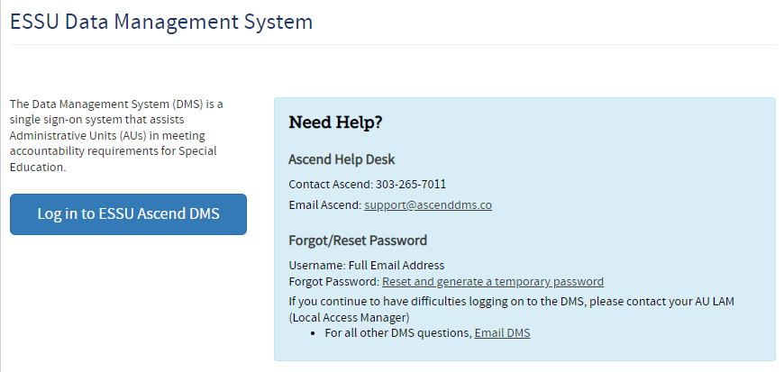
ESSU Data Management System (DMS)
https://www.cde.state.co.us/idm/essu-data

Slide 9
Access to the Ascend DMS
If you do not have access to the new DMS, contact your AU LAM (Local Access Manager).
If you forget your password, there is a “Forgot Password” reset option on the log in page.
The new CDE DMS application in Access Management is ASCDMS. Currently there are 2 roles that grant access to Record Reviews in the DMS:
  MD – For Directors, all access.
  GDnMD – For those who are Gifted and Special Education Directors, all access
  MRR – For Record Review access.
Only one role can be assigned per user. If more than one role is assigned, you will not be able to log in.
If you get a security error message when logging in, have your IT person mark the page as safe, updates to Firewall security may block the page.
Questions about logging in or roles contact Josh Fails at fails_j@cde.state.co.us

Slide 10
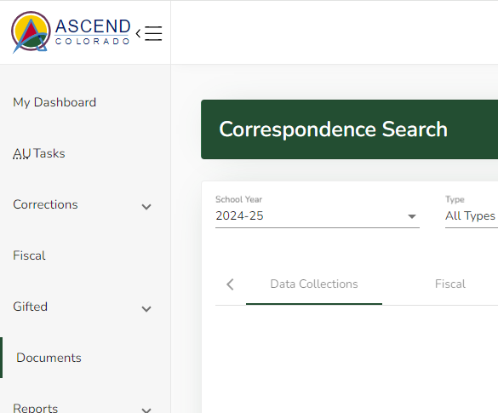
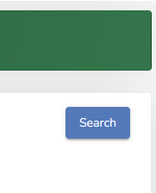
Where to Find Number of Files to Review
CDE uploaded a document to the DMS Documents section that identifies the required number of reviews for each age category. Once logged in the DMS, click “Documents” on the left, change the year to 2024-25, and click the “Search” blue colored button on the right.

Slide 11
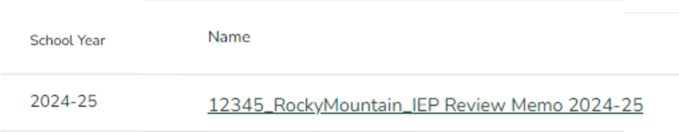
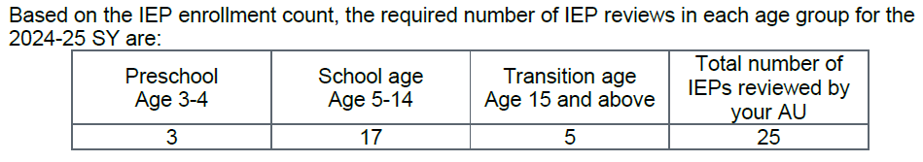
How many files do I have to review?
Click on the document “AUCode_AUName_IEP Review Memo 2024-25”.

Slide 12
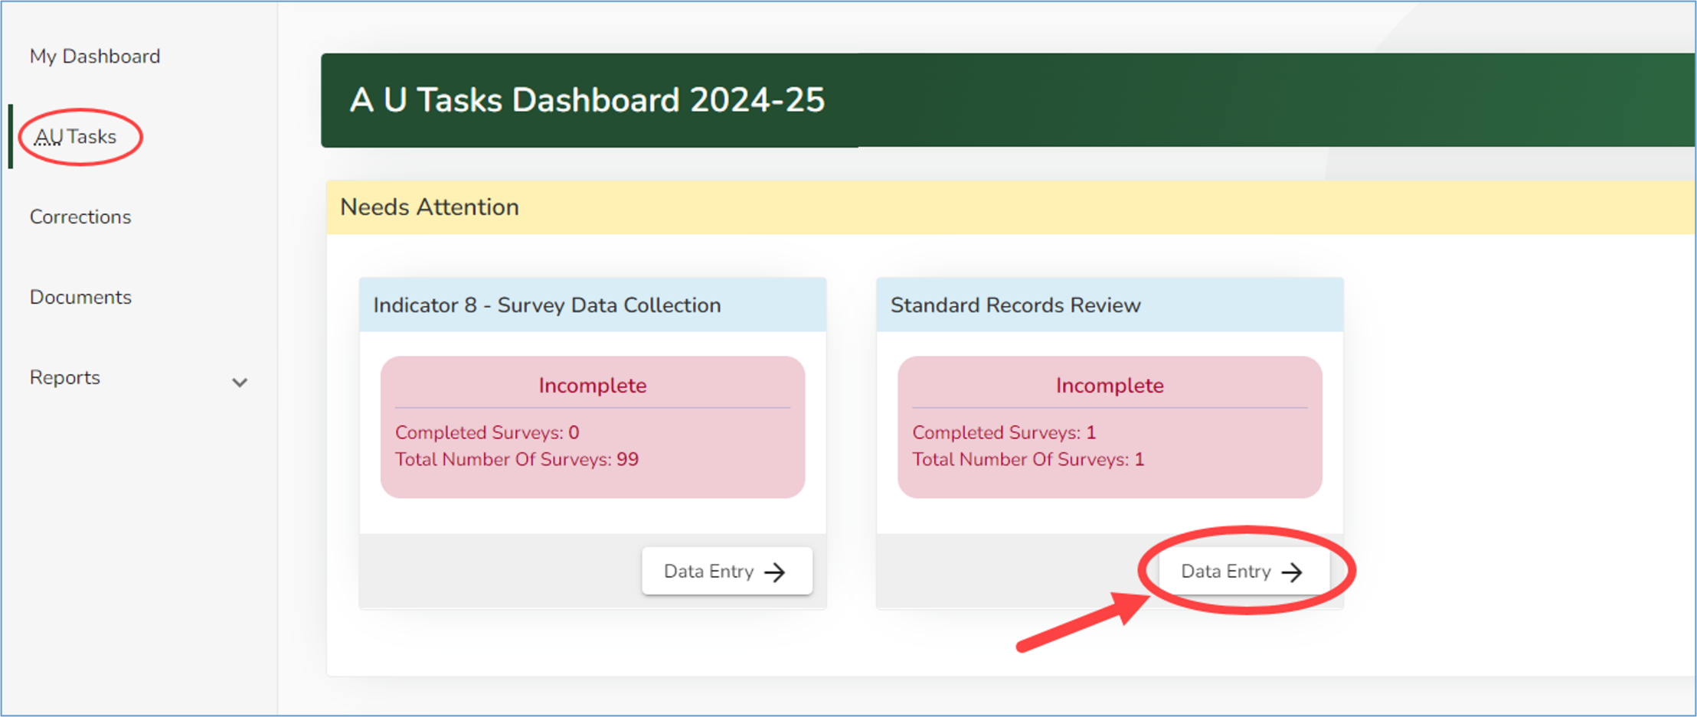
Finding the Reviews
Make sure the school year on your AU Tasks Dashboard shows 2024-25
Click “AU Tasks” on the left of the page.
Click on the “Data Entry” button in the Standard Records Review Tile.

Slide 13
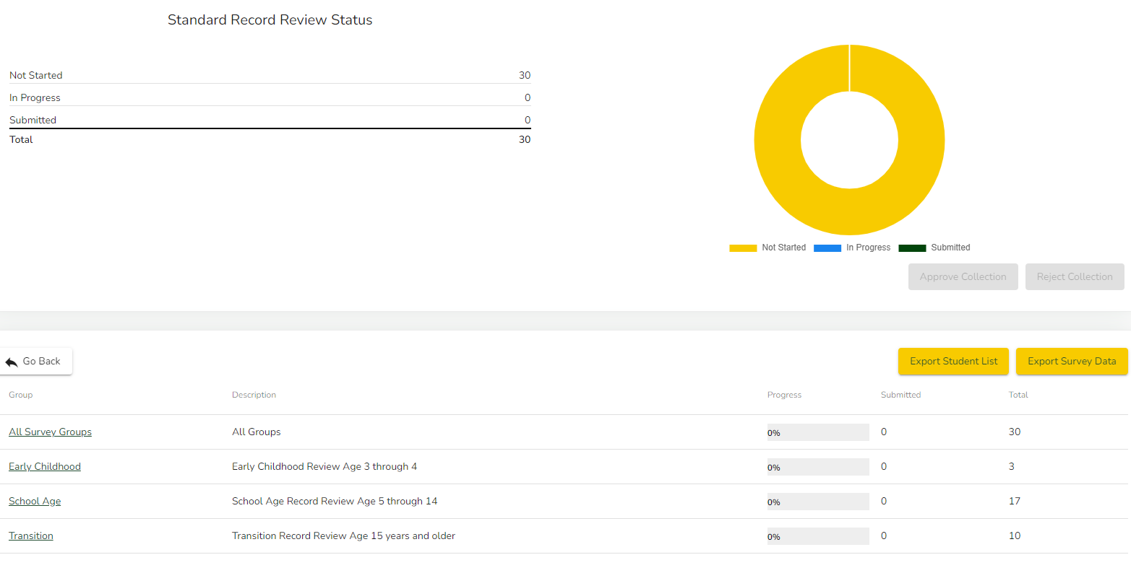
Review Status and Export Student Lists
Select “All Survey Groups” or
Select by age category
Notes:
Export your student list and document the date of the current IEP – you will be reviewing IEPs dated between April 1, 2024 and May 1, 2025.

Slide 14
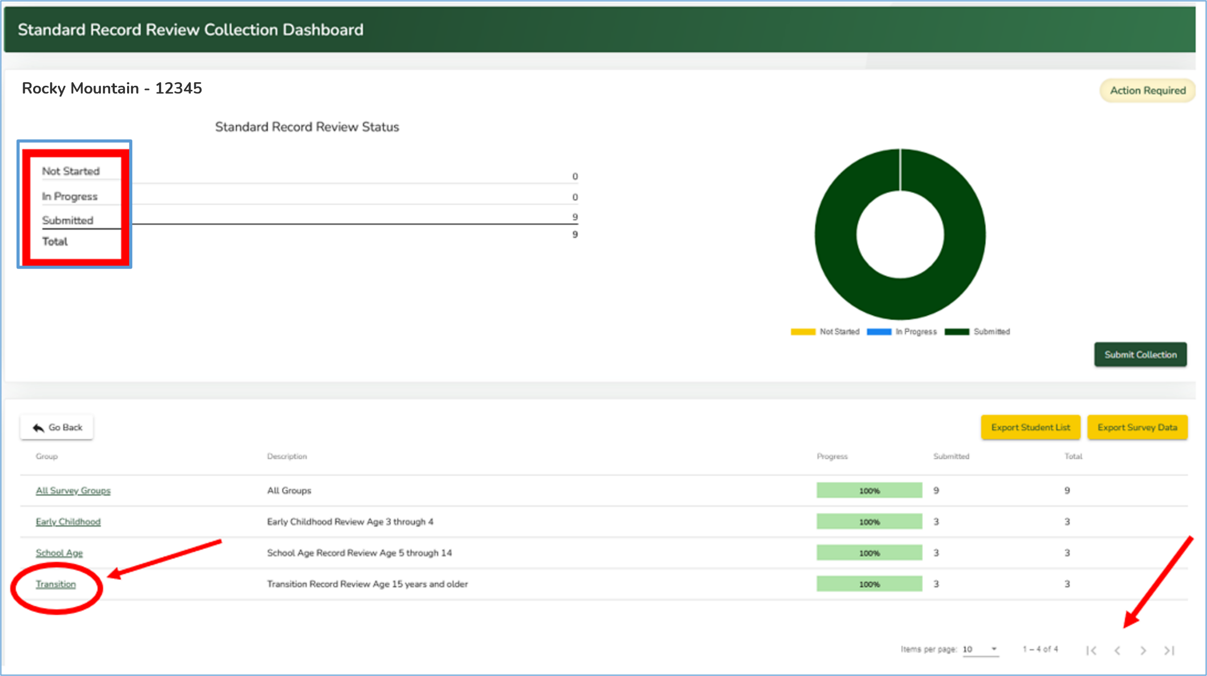
Collection Dashboard & Opening an Age Group Sample
Record review status.
Click on an Age Group in the Group column to view the list of students.

Slide 15
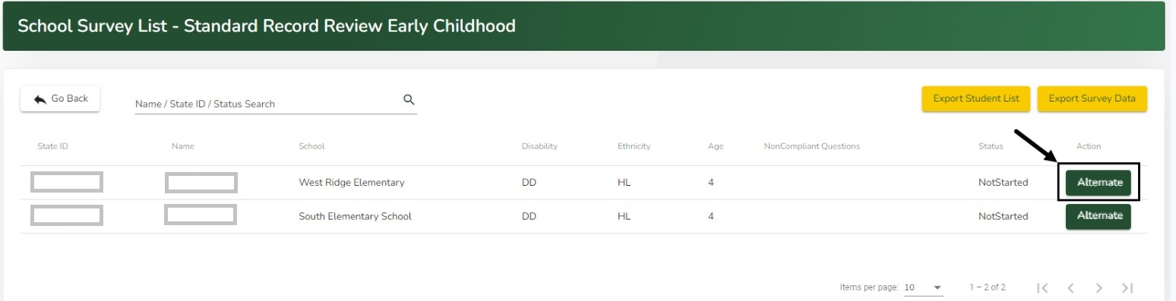
Requesting Alternate Students
You can replace a student with an alternate student for one of four CDE-approved reasons:
  Student is no longer in the AU’s jurisdiction
  Student is no longer receiving special education services
  The IEP meeting will be held after May 1, 2025
  Student no longer has an Early Childhood IEP
Click on the “Alternate” button in the row of the student you wish to replace.

Slide 16
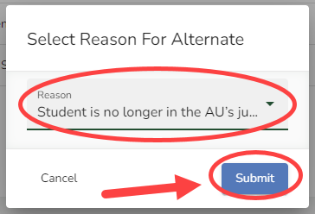
Requesting Alternate Students (cont.)
A Select Reason for Alternate pop-up window will appear.
Click in the Reason field to select the reason
Click the blue “Submit” button.
The student will be replaced with a random student from the sample pool.
If an AU has used all the alternates available for their assigned sample, the system will prompt the user to contact CDE to request additional students be added to their sample. Fails_j@cde.state.co.us

Slide 17
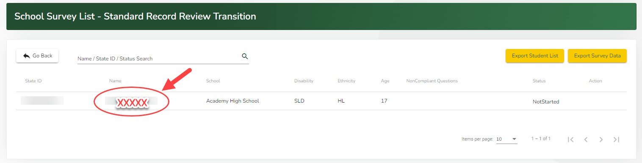
Opening a Student’s Record for Review
Click on the Student’s Name to open that student’s record.
The Standard Record Review protocol for the selected student will open.

Slide 18
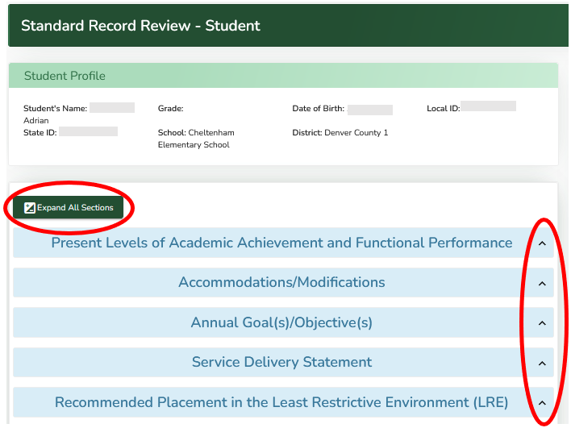
Accessing the Record Review Protocol within a Student Record
Clicking the green “Expand All Sections” button on the left side of the page will open all sections.
Clicking on a caret to the right of the section topic header will open that specific section.

Slide 19
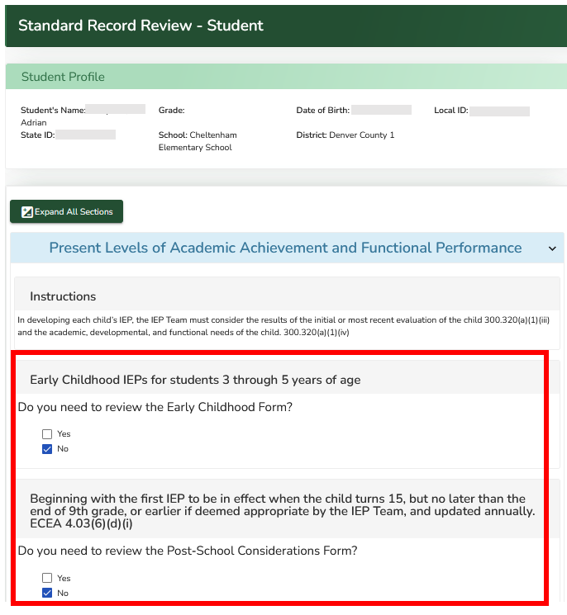
Early Childhood and Transition Questions
Answer the first two questions about Early Childhood and Transition-age students to ensure the required questions for those age groups display.
While previewing the uploaded document, complete the survey in the left side of the screen.
Use the vertical scroll bar on the right side of the page.

Slide 20
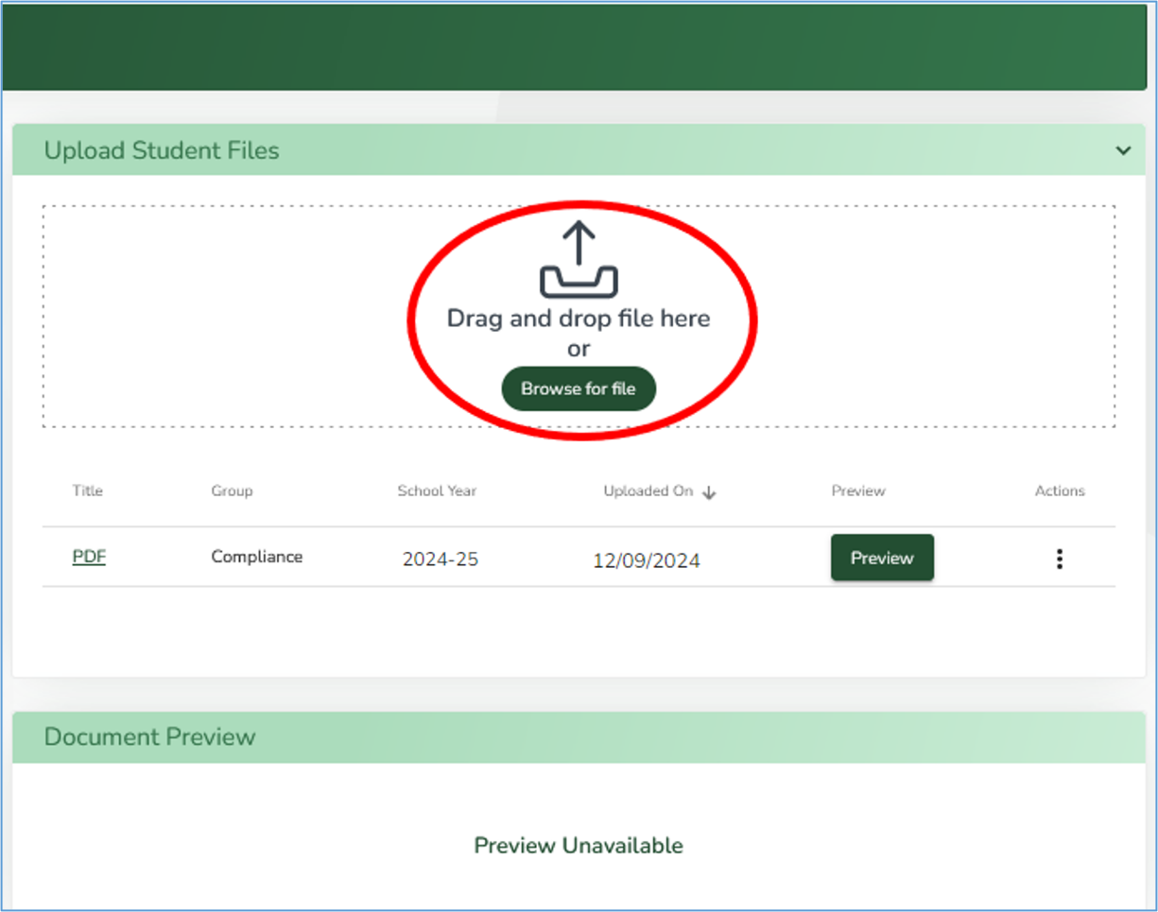
Uploading documents to the Student Record
Upload the IEP documents for the selected students, including the Notice(s) of Meeting (NOM), to the DMS.
To upload the required documentation, click the green Browse for file button OR you can drag and drop files from the computer to the Drag and drop file here box.

Slide 21
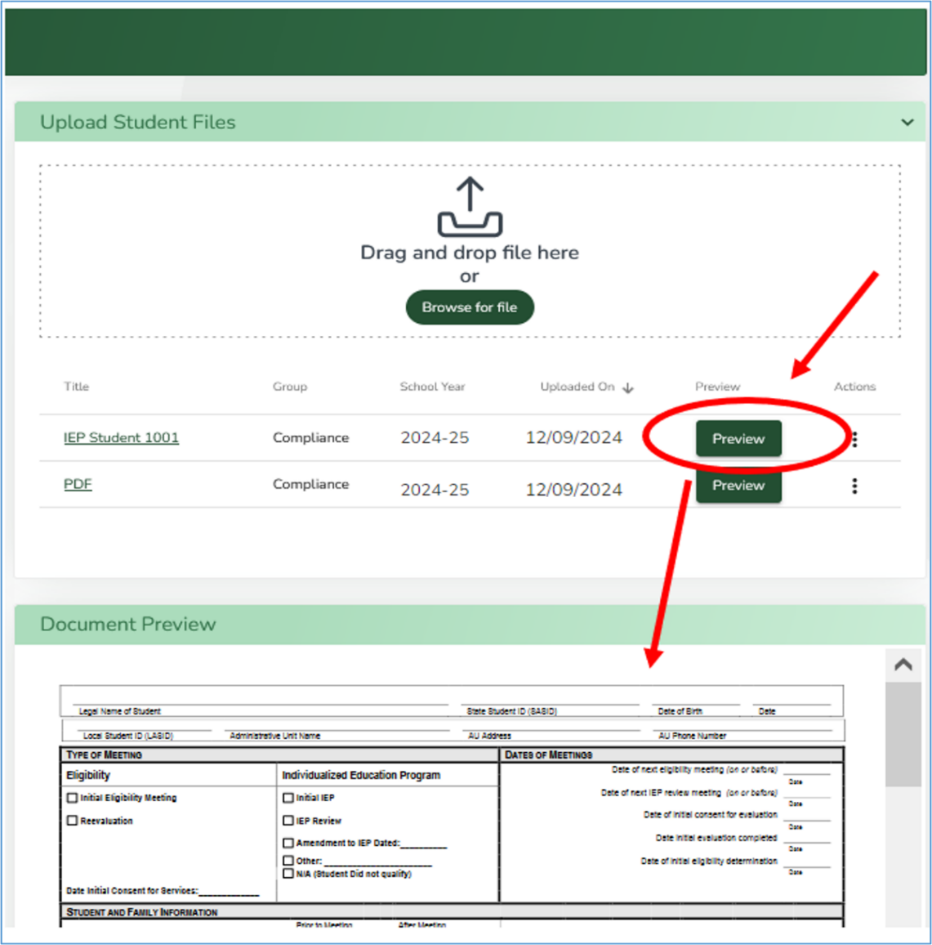
Uploading documents to the Student Record (cont.)
At least one document must be uploaded to submit the survey as complete.
  For Transition Age IEPs, you must upload the NOM and include the NOM to the student.
The uploaded document will appear in the list of documents table in the Upload Student Files section on right side of the page.
PDF documents will show in the Document Preview section when the green Preview button is clicked.
Non-PDF documents will automatically download in your browser to be saved locally on the computer.

Slide 22
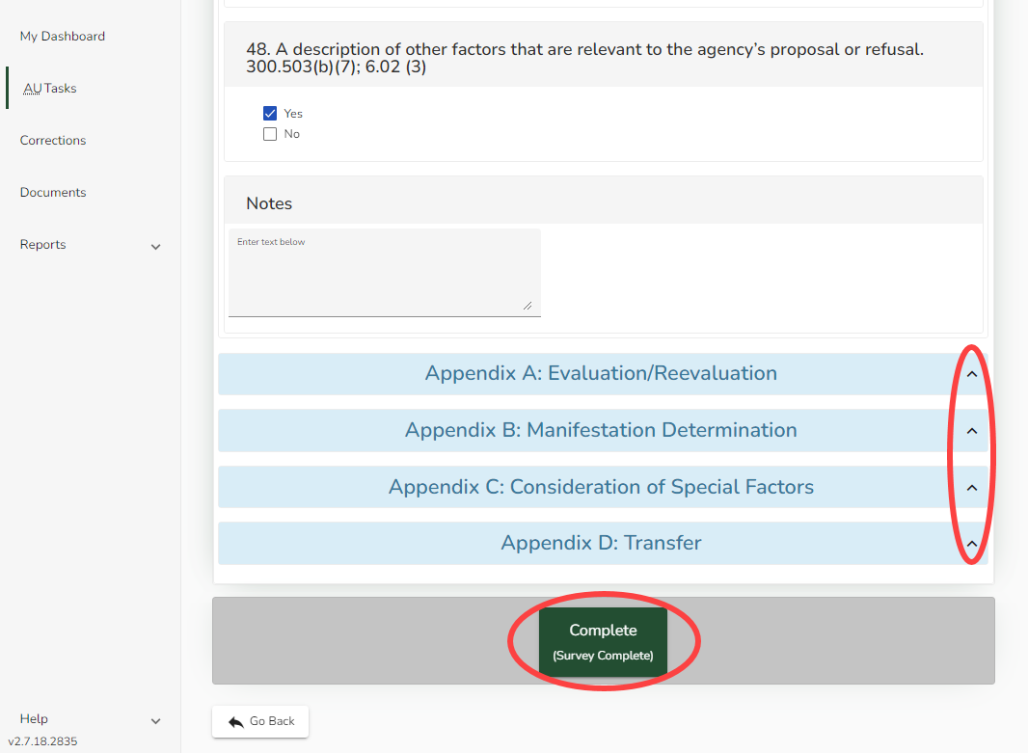
Completing Review
At the end of the survey, there are four appendix sections to be filled out (only if applicable).
To expand a section, click the caret located to the right of each Appendix section header.
Click the “Complete (Survey Completed)” button to complete the survey.

Slide 23
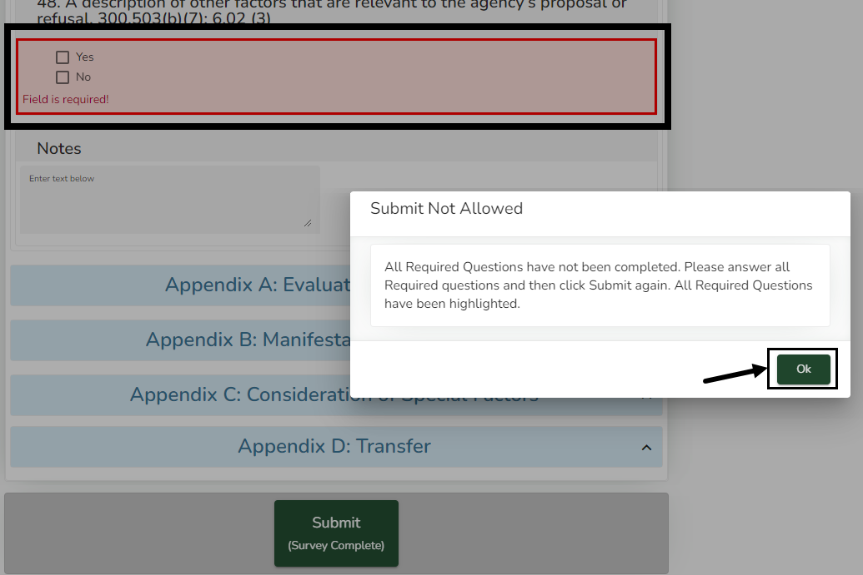
Error Message – Incomplete Review
If the green “Submit” button at the bottom of the survey is clicked and a required question has not been answered, a Submit Not Allowed warning box will appear.
Click the green Ok button to close the Submit Not Allowed warning and return to the survey to address incomplete questions. The unanswered question(s) will be highlighted in red.
After submitting the survey, the status will show as Submitted. Click “Go Back” to return to the Standard Record Review Collection Dashboard page.

Slide 24
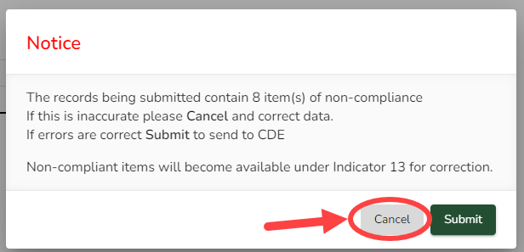
Notice of Noncompliant Indicator 13 Elements for Transition Age IEPs
If there are noncompliant elements for Indicator 13, a Notice warning box will appear displaying the number of noncompliant answers.
To review and verify the noncompliant answers before submission, click the “Cancel” button.

Slide 25
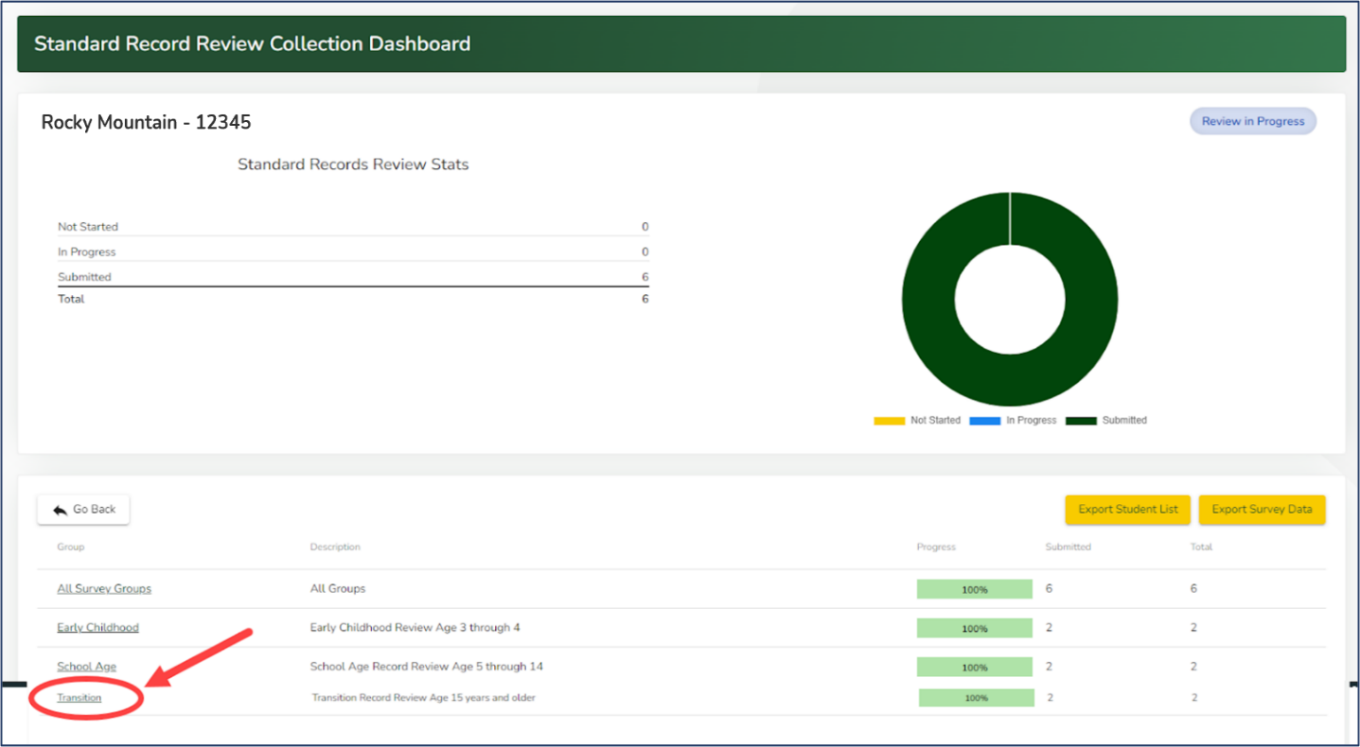
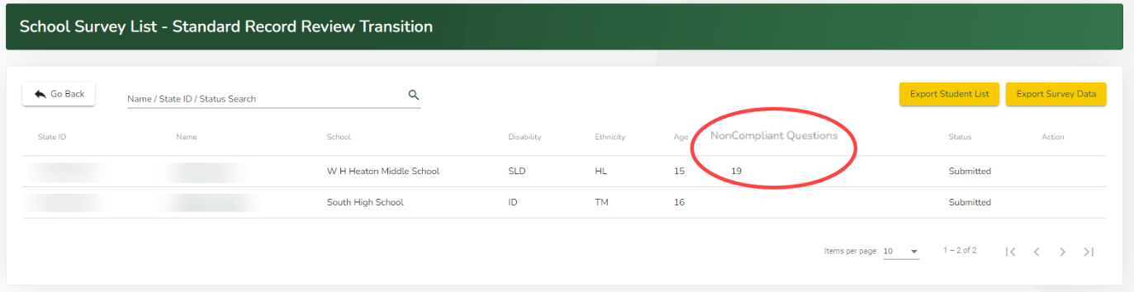
Checking Indicator 13 Noncompliance
In the Group column, click on Transition.
The School Survey List - Standard Record Review Transition page will open. Students with noncompliant record reviews will display the question numbers that were marked “No” under the Noncompliant Questions column.
Record Reviews can be edited up until the user submits the collection to CDE.
Once CDE has approved a collection with noncompliant records for Transition Age youth, those records will require corrections.

Slide 26
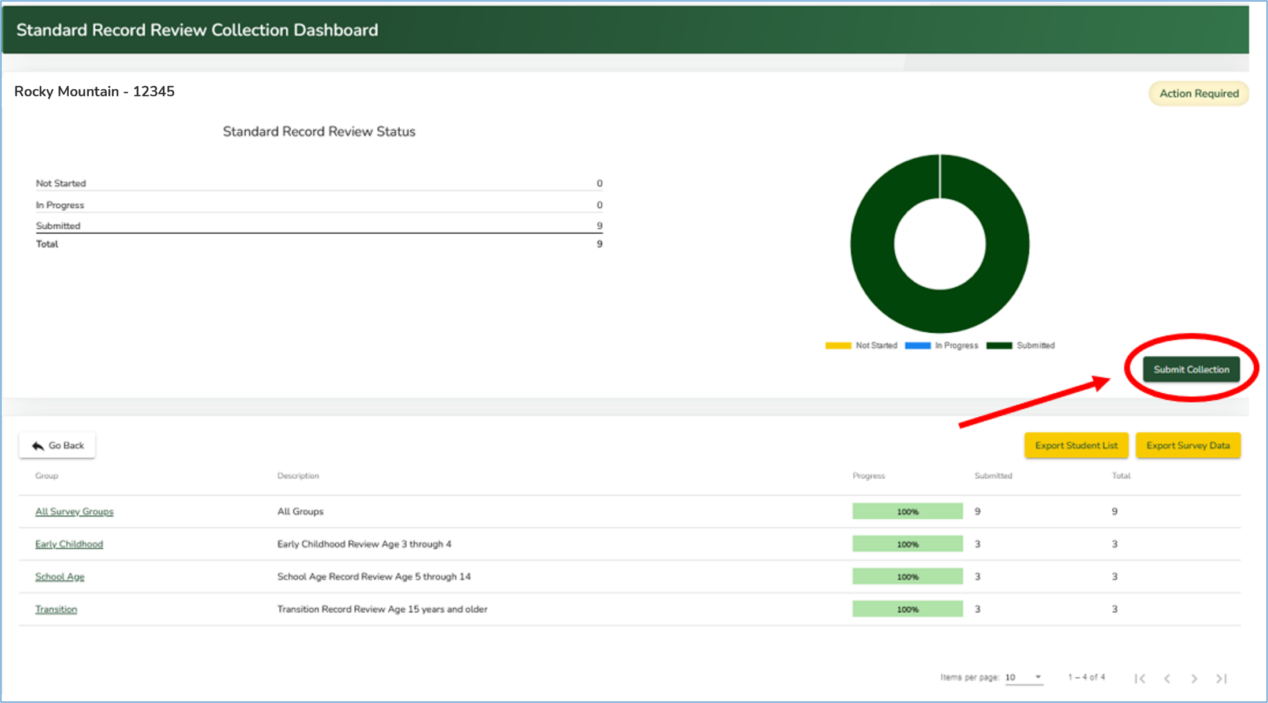
Submitting the Record Review Collection
Once all IEP Record Reviews for all age categories have been completed, click the green “Submit Collection” button on the right side of the Standard Record Review Collection Dashboard page

Slide 27
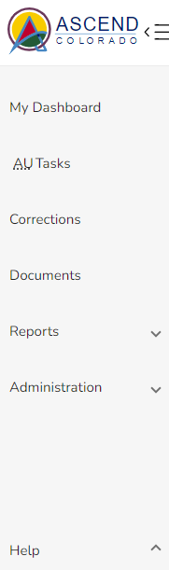
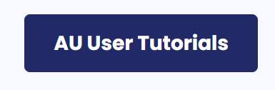
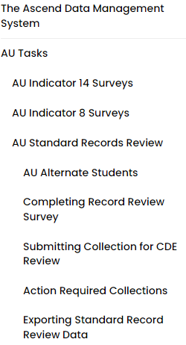
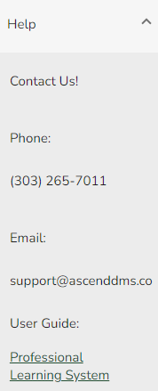
Where to Go For Help
Online tutorial is available in the DMS

Slide 28
Checklist
Sign in to the DMS and select SY 2024-25
Review the 2024-25 IEP Record Reviews Letter from the Documents section
Select IEPs to review – must be active and dated between April 1, 2024 – May 1, 2025
In the DMS, request alternate students for those that:
  Are no longer in the AU’s jurisdiction
  Are no longer receiving special education services
  Have an IEP meeting that will be held after May 1, 2025
  No longer have an Early Childhood IEP

Slide 29
Checklist (cont.)
Select AU Tasks
Select Standard Record Reviews – Data Entry
Upload documents for the selected IEPs to the DMS
Complete full record review in the DMS
Correct any non-compliant Indicator 13(I 13) elements prior to the May 1st deadline. Update section in the protocol and upload new IEPs/amendments to the student record by May 1, 2025.
Submit your collection by May 1, 2025

Slide 30
Resources
Resources will be posted on the General Supervision and Monitoring webpage:
The recorded training
The training PowerPoint
A one-page checklist for completing IEP record reviews
The record review protocol and corresponding record review instruction document

Slide 31
Indicator 13
Transition Age IEP Reviews

Slide 32
Calculating % Compliance for I 13
Target for Indicator 13 = 100% compliance
Indicator 13 is an “all or nothing” indicator - a Transition IEP is considered compliant when ALL 8 required components are evident in the document.
Calculation: % Compliant = (Number of youth age 15 and above with IEPs that contain each of the required components for secondary transition/required number of reviews) * 100.
Example:
  Required number of file reviews = 5
  Compliant IEPs = 4
  % Compliant: 4/5 = 0.8 x 100 = 80%

Slide 33
I 13 Compliance Components
Appropriate measurable postsecondary goals (PSGs) in education/training, career/employment, and, where appropriate, independent living skills
PSGs are updated annually (N/A option if you are reviewing the first Transition Age IEP for the student at age 15)
Age-appropriate transition assessments
Courses of study that will assist the student in reaching the PSGs
Transition services that will reasonably enable the student to meet his or her PSGs

Slide 34
I 13 Compliance Components (cont.)
Annual goals related to the student’s transition services
Documentation of student invitation to the IEP
Prior consent of the parent to invite a representative of any participating agency that is likely to be responsible for providing or paying for transition services. (N/A is okay)
Notice of Meeting must indicate a purpose of the meeting will be the consideration of the postsecondary goals and transition services (IDEA required but not part of the I 13 measure)

Slide 35
Reporting Indicator 13 Compliance
Office of Special Education Programs (OSEP) clarification to
State Education Agencies (SEAs) 12/16/19
“while the SEA may provide an LEA the opportunity to correct noncompliance prior to the issuance of a written finding, the percentage reported in the APR must reflect the AU’s actual level of compliance prior to the opportunity to correct any noncompliance.”

Slide 36

What this means for CDE/AU reporting
Once CDE reviews a transition IEP (has eyes on it), and
finds noncompliance in one or more elements required for I 13, then
the IEP must be considered noncompliant for I 13 reporting purposes.
Individual corrections of noncompliance are still required to be completed.

Slide 37
What this means for AUs that participate in CDE/AU collaborative IEP reviews
  The AUs reported compliance percentage for Indicator 13 is based on results of the side-by-side file reviews prior to any corrections.
  Example: 5 IEPs are reviewed, 1 IEP is determined to be noncompliant, the AU’s Indicator 13 compliance percentage is reported as 80%, 4 out of 5 IEPs compliant.
  Correction process remains unchanged:
  At the end of these meetings, the Director has access to a list of any individual corrections of noncompliance.
  AUs have 45 days following the date of the record reviews to complete any corrections of noncompliance, upload new documents to the DMS, and notify CDE of the completed corrections.
  The CDE team reviews the corrections for compliance and advises the Director of the status of the corrections.

Slide 38

Suggestions
Suggestions to lessen the likelihood of noncompliance when the data window closes:
Provide training on the DMS record review process to staff conducting file reviews
Review files for compliance on a regular basis: monthly, bi-monthly, quarterly
Review files prior to a side-by-side collaborative review with CDE
Establish a systemic accountability check procedure
Important:
Don’t wait until April to review IEPs

Slide 39
Data Submission Deadline and Reporting
At 11:59 PM on May 1, 2025, the data submission window closes and your access to these files in the DMS will be locked.
Requests to reopen the files after the deadline will result in one point lost for Accurate and Timely Submission of Data on the Compliance Matrix for 2026 AU Determination.
AUs who do not complete their Transition Reviews before the deadline will be required to complete these reviews collaboratively with CDE monitoring staff
August 2025: CDE will notify AUs that the I 13 results letter is available in the Attachment section of the DMS Compliance tab
February 2026: The CDE reports state-wide Indicator 13 compliance data and evidence to demonstrate correction of any noncompliance to OSEP in the SPP/APR.
Spring 2026: Indicator 13 compliance percentage included in the Compliance Matrix of each AU’s Determination

Slide 40
Correction of Noncompliance for I 13

Slide 41
Correction of Noncompliance for I 13 Overview
Demonstrating Correction of Noncompliance for I 13
Indicator 13 Compliance Target = 100%
Reported to OSEP every February in the Colorado State Performance Plan (SPP)/Annual Performance Report (APR)
If Colorado reports less than 100%
Then,
The CDE must demonstrate correction of noncompliance for each noncompliant IEP in every AU with less than 100% compliance

Slide 42
Demonstrating Correction of Noncompliance
Prong 1 “Individual Correction”
  The CDE must ensure that each AU has corrected all individual cases of noncompliance unless the child is no longer within the jurisdiction of the AU, and the AU must identify the root cause of the noncompliance.
    DMS reported data – AUs must correct all individual IEPs that contain noncompliance for Indicator 13 requirements
Prong 2 “Review of Updated Data”
  The CDE must review updated data to determine that the AU is correctly implementing the specific regulatory requirements related to Indicator 13.
    CDE/AU collaborative side-by-side reviews of the required number of IEP reviews for secondary transition age youth for the following school year

Slide 43


Correction of Noncompliance
August 2025
AUs who submit noncompliant Transition Age IEPs will be contacted by the ESSU and provided training and information about the correction process
This Photo by Unknown Author is licensed under CC BY

Slide 44
Levels of Support

Slide 45
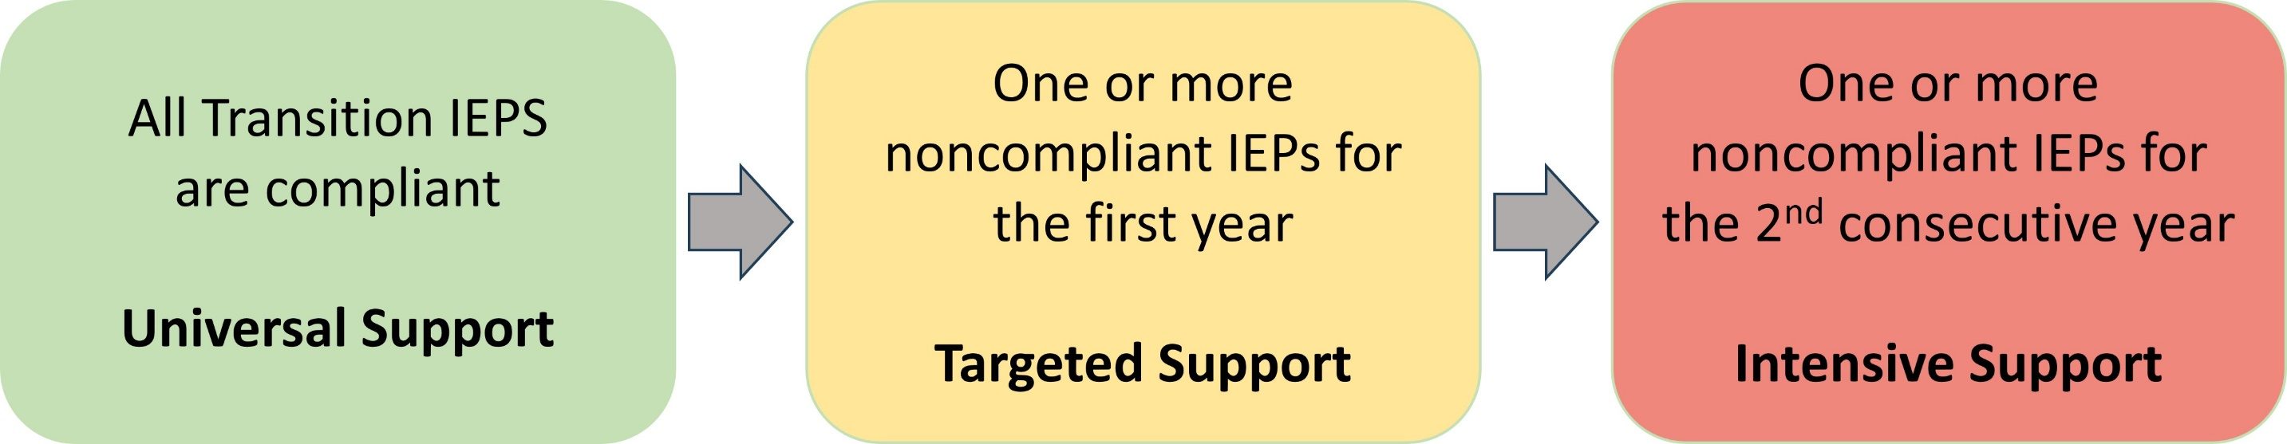
Levels of Support – 3 Levels

Slide 46
Level of Support - Universal
All Transition IEPs
are compliant
Universal Support
Universal Support
Resources can be found on the General Supervision and Monitoring webpage:
This recorded training
The training PowerPoint
A one-page checklist for completing IEP record reviews
Various training resources in writing quality Secondary Transition IEPs are on the Secondary Transition webpage.

Slide 47
Level of Support – New AUs
Includes all elements of Universal Support plus:
Collaborative side-by-side record reviews
  August 2024 - AUs will be contacted to set up collaborative record review meetings, either in person or virtually, to be completed by February 15, 2025.
  At the end of this meeting, the Director will have access to a list of any individual corrections that need to be made in the DMS.
  AUs will have 45 days following the record reviews to complete the corrections, upload them to the DMS and notify CDE of the completed corrections.
  The CDE team will review the corrections for compliance and advise the Director of the status of the corrections.

Slide 48
Level of Support - Targeted
One or more noncompliant IEPs for the first year
Targeted Support
Targeted Support - Includes all elements of Universal Support plus
Demonstration of Correction:
Prong 1: Individual Correction - AUs must correct the noncompliant section(s) of the individual student’s most recent IEP by November 1, 2025, and identify the root cause of the noncompliance.
  AUs will receive a letter with details about training on this process in August 2025.

Slide 49
Level of Support – Targeted continued...
One or more noncompliant IEPs for the first year
Targeted Support
Prong 2: Review of Updated Data - Collaborative side-by-side record reviews
  August 2025 - AUs will be contacted to set up collaborative record review meetings, either in person or virtually, to be completed by February 15, 2026.
  At the end of this meeting, the Director will have access to a list of any individual corrections that need to be made in the DMS.
  AUs will have 45 days following the record reviews to complete the corrections, upload them to the DMS and notify CDE of the completed corrections.
  The CDE team will review the corrections for compliance and advise the Director of the status of the corrections.

Slide 50
Level of Support - Intensive
One or more noncompliant IEPs for the 2nd consecutive year
Targeted Support
Intensive Support – Includes all elements of Universal and Targeted Support plus:
The CDE will provide required individualized professional development in the area(s) of Secondary Transition IEP development based on the AU’s need.
The CDE will conduct a second check of IEPs written 2-3 months after the required professional development.

Slide 51
Resources
Resources will be posted on the General Supervision and Monitoring webpage:
This recorded training
The training PowerPoint
A one-page checklist for completing IEP record reviews
The record review protocol and corresponding record review instruction document
Indicator 13: Overview, Data Collection Process, and Levels of Support document

Slide 52

Questions??

Slide 53
Contact Information
DMS Questions
Josh Fails
Online Project Coordinator and Data Consultant
Fails_J@cde.state.co.us
720-618-0538
IEP Review Questions
Nick Smosna
Special Ed. Monitoring and Technical Assistance Consultant
Smosna_N@cde.state.co.us
303-548-5597
SRR and I 13 Process Questions
Orla Bolger
Supervisor Data and Monitoring Liaison
Bolger_O@cde.state.co.us
720-921-0524

