Slide 1
New Director’s Orientation Data
Colorado Department of Education
Exceptional Student Services Unit
August 2021

Slide 2
Special Education Data Team
ESSU – Data Collection + Reporting
Miki Imura
Supervisor, performance-related data, federal reporting
Orla Bolger
Sped EOY and December Count expert, federal reporting, data requests
Alyssa Ohleyer
Data visualization, creates fabulous reports for internal and external purposes
Melissa Chaffin
Anything with Ascend and Data Management System
Gloria Durosko
AU monitoring based on data
IMS Data Services – Data Collection
Lindsey Heitman
December Count, Sped EOY, Sped Discipline collections
Ascend/DMS
Melissa
Data Collection
Orla & Lindsey
AU Monitoring
Internal & External Data Requests
Federal reporting
Gloria
Alyssa & Orla
Miki
Notes:
Here we have all the members of the Data Team and their specialties!

Slide 3
Data Collections
Notes:
Next, we will look closer at the data collections!

Slide 4
SPED Data Pipeline Collections
December Count
Official Count of Students who receive SPED services and the associated Staff
SPED Discipline Collection
Count of students with IEPs who received disciplinary removals
SPED End of Year Collection
Students’ exit status, Part C-B Transition, Child find
Notes:
The three Data Pipeline Collections are December Count, Sped Discipline and Sped EOY!

Slide 5
Data Collection Flow
AU Directors Must review the snapshots!
IEP/Student Information System
Ascend
Enrich
Alpine
Infinite Campus
PowerSchool
SEAS
Interchange Files
SPED Child (demographic)
SPED Participation (IEP services)
SPED Discipline
Student School Association
Student Demographic
Staff Profile
Staff Assignment
Snapshots
Dec Count Snapshot
SPED EOY Snapshot
SPED Discipline Snapshot
Collections
Finalized
December Count
SPED EOY
SPED Discipline
Pipeline
Click here for a Dec Count timeline as an example: http://www.cde.state.co.us/datapipeline/snap_sped-december
Notes:
The data flows from your IEP and/or SIS system to the Data Pipeline Interchange files which flows to the Snapshots to become finalized data sets!

Slide 6
From Snapshot to Finalization
Snapshot taken
Collection Finalized
AU Directors
AU Directors
1. Duplicate Cleaning
Please work collaboratively with other AUs
2. Report Review Week
Make sure your submission has no errors
Explain the flagged year-to-year differences
3. Upload the signed reports to the Data Management System
Use the reports check list
Notes:
Once AUs have a complete and error free snapshot of data, we clean duplicates statewide, review final reports and upload the final signed reports to the DMS!

Slide 7
Pipeline Data Reports – What to watch out for
Use the report review week! Set aside time to review reports!
1. Look at the totals
Any zeros? Do they look reasonable?
Zero graduates? Zero Child find?
2. Look at the details
Missed entire grades? Missed a disability category? No C-B transition?
Check the data extracts
Were the records finalized to be extracted?
3. Year-to-year reports
Check ALL counts – not only the flagged counts
Make sure the increases and decreases are reasonable
20 count + 20% difference = flag -> submit an explanation form
Notes:
In reviewing the reports please be on the lookout for any counts that do not make sense or do not seem reasonable for your AU. The various summary and detail reports in each collection can really help you see your data in a helpful way.

Slide 8
Data Collection Links
Data Pipeline Link
https://www.cde.state.co.us/datapipeline
Single Sign-On Link
https://www.cde.state.co.us/idm
Notes:
Here is where you can sign on to the Data Pipeline.
From any CDE page you can click on the red Districts Tab and scroll down to the Purple Single Sign On Access tab to get to any CDE system that is a part of the Identity Management System!

Slide 9
Data Collection Resources
Training Videos & Power Points
https://www.cde.state.co.us/datapipeline/snap_snapshots
Notes:
On each Data Pipeline Interchange and Snapshot webpage, there are sections for Trainings and Additional Resources. If you haven’t already be sure to check these out at the beginning of each collection. New this year we have short 10-15 minute training videos about various data collection topics, so be sure to look out for those!

Slide 10
Sources of Indicator Data
CDE gathers data from Administrative Units and State Operated Programs through:
December count
Indicators 5, 6, 9, 10
Indicator 8 (Parent survey) sample
Indicator 13 (Record reviews) sample
Special Education End of Year
Indicators 1, 2, 11, 12
Indicator 14 (Post-school outcomes) sample
Special Education Discipline collection
Indicator 4
State assessments
Indicator 3
Timeliness and accuracy of the data are required for all collections!
Notes:
We rely upon the data collected to fulfill federal and state reporting requirements. Here we have which Indicators are collected in which data collection.

Slide 11
Sources of Funding Data
December Count
ECEA state-level funding
Educational Orphans
Student October
IDEA federal funding
SPED EOY
Part C Evaluation Child Find reimbursement (Funds evaluations, whether or not they qualified)
Notes:
December Count data is used to calculate state level ECEA funding and funding for educational orphans. Sped EOY data is used to determine the Part C Child find evaluation reimbursement.

Slide 12
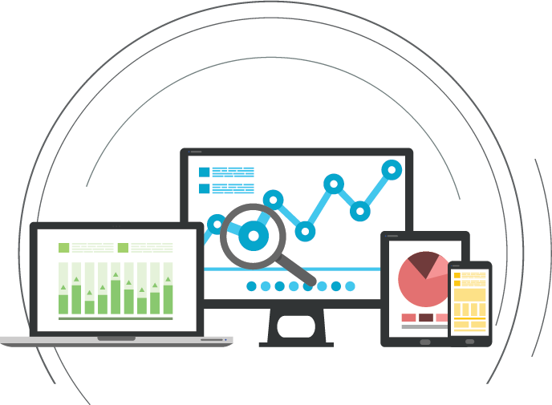
Data Reporting and Requests
GIVE ME DATA!!!!
Notes:
This is Alyssa Ohleyer, I also work on the Data Team with Miki. I work on data reports that you can access on the Data Management system and data requests. Just ask and we will do our best to get you the data you need! We are happy to help you however we can!

Slide 13
Helpful Data Reports Links
District data: https://www.cde.state.co.us/cdereval
Graduation rate: https://www.cde.state.co.us/cdereval/gradratecurrent
Dropout rate: https://www.cde.state.co.us/cdereval/dropoutcurrent
SPED data reports: https://www.cde.state.co.us/cdesped/sped_data
Indicator profiles for AUs: https://www.cde.state.co.us/cdesped/auperformanceprofiles
AU Determination Matrix Page: https://www.cde.state.co.us/cdesped/determinations
Notes:
There are lots of data reports already posted online regularly each year!
The top 3 sites are data for all students, but contain data for special education students data in the instructional group sets.
The last three links are specific to Special education, and you will find information at the State and AU level there.
If you cannot find what you are looking for just ask us and we can direct you to the right webpage or let you know a data request is needed.

Slide 14
Example Data Requests from AU Directors
State Assessments
Differences of proficiency rates between students with IEP and without by school
Median Growth Percentile of students with IEPs by school
Schools’ proficiency level x LRE x Disciplinary Removal
Enrollment
IEP identification by school
IEP identification rates compared to other similar districts/schools
Discipline
Disciplinary removals of students with disabilities by school
Notes:
Examples of data requests from directors that are more detailed than data reports you can find on-line include might include special education data at the school and grade level or that groups students by more than one demographic category like race and grade level. Sometimes publicly available data has been redacted to protect confidentiality because the group of students is so small. You can request the full data set of your own data.

Slide 15
Data Management System (DMS)
Where can you get data? Look in the DMS!
Notes:
Keep in mind we upload AU specific reports to the DMS!

Slide 16
Data Management System (DMS)
Sign in to DMS from https://www.cde.state.co.us/idm/essu-data Using your single sign-on.
Please make sure you have an “AU Director Role.”
Notes:
You can access the Data Management System through the “single-sign-on” site Orla showed you earlier. Log onto the ESSU DMS.

Slide 17
Tabs in the DMS
Indicator summary
Legal stuff
Parent Survey
Collection Uploads and Downloads
IEP reviews
Post-School Outcome Interviews
State Assessment Data Reports
Other academic-related data requests
DMS = Shared workspace for AUs and CDE
Notes:
Here is what you can find in each of the tabs. For example, IEP reviews documents are found in the Compliance tab, while Parent Survey documents are found in the Family-School tab.

Slide 18
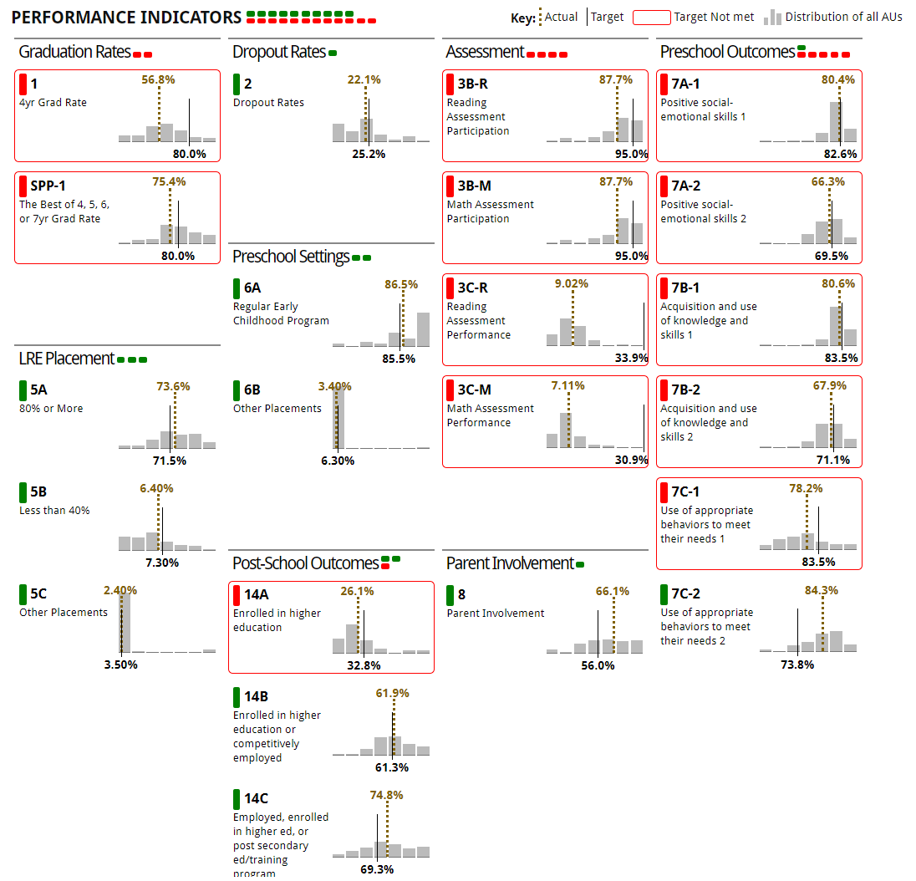
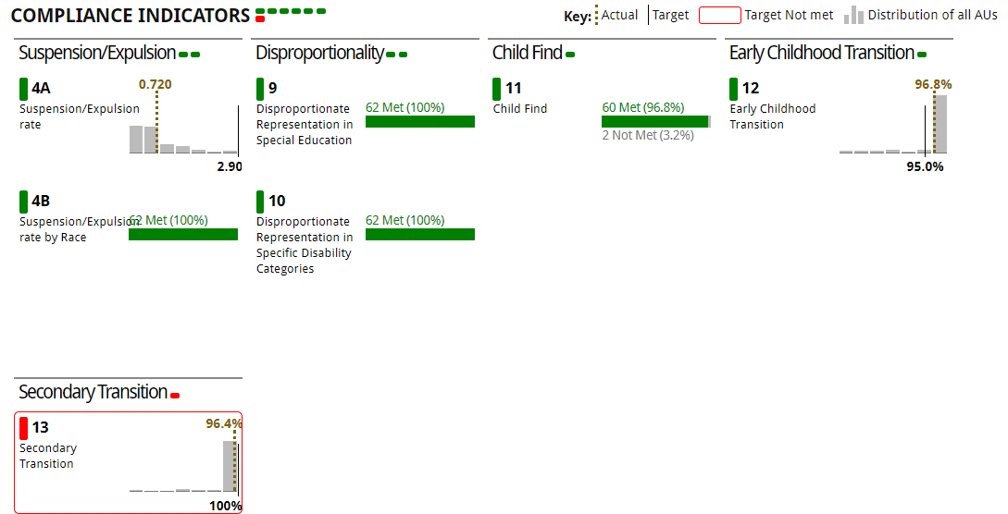
DMS Summary Tab
Shows which SPP indicators your AU is meeting/not meeting the target
Notes:
The summary tab gives you a visual overview of how your AU is doing on the Performance and Compliance indicators! You will need to select the year and wait for the data to populate.

Slide 19
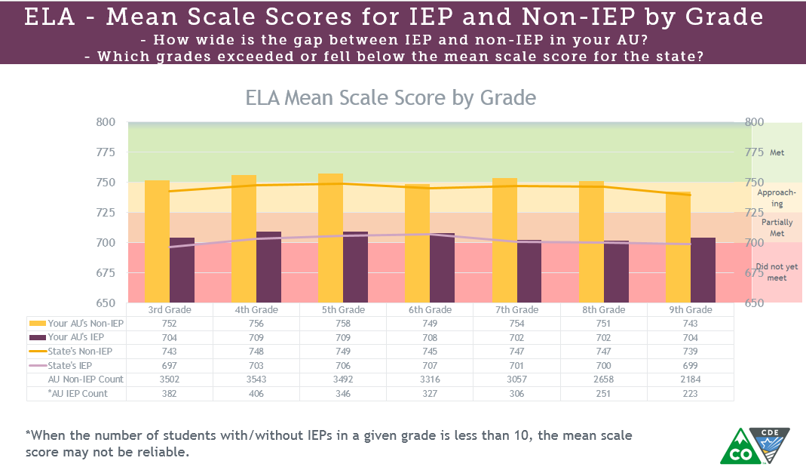
Data Visualization Reports in DMS - Assessment
State Assessment Reports for SWD (Performance)
* Note that the data reported this year will be limited due to the modified State Assessment Report in 2021 due to COVID. There was no report for 2020. Previous reports are still available.
Notes:
We have 4 Data Visualization Reports available at the AU level on the DMS. This first one is the Assessment Report. Of course, the last state Assessment report was in 2019 due to COVID. We will be working out a New Data visualization For the 2021 state assessment this year.

Slide 20
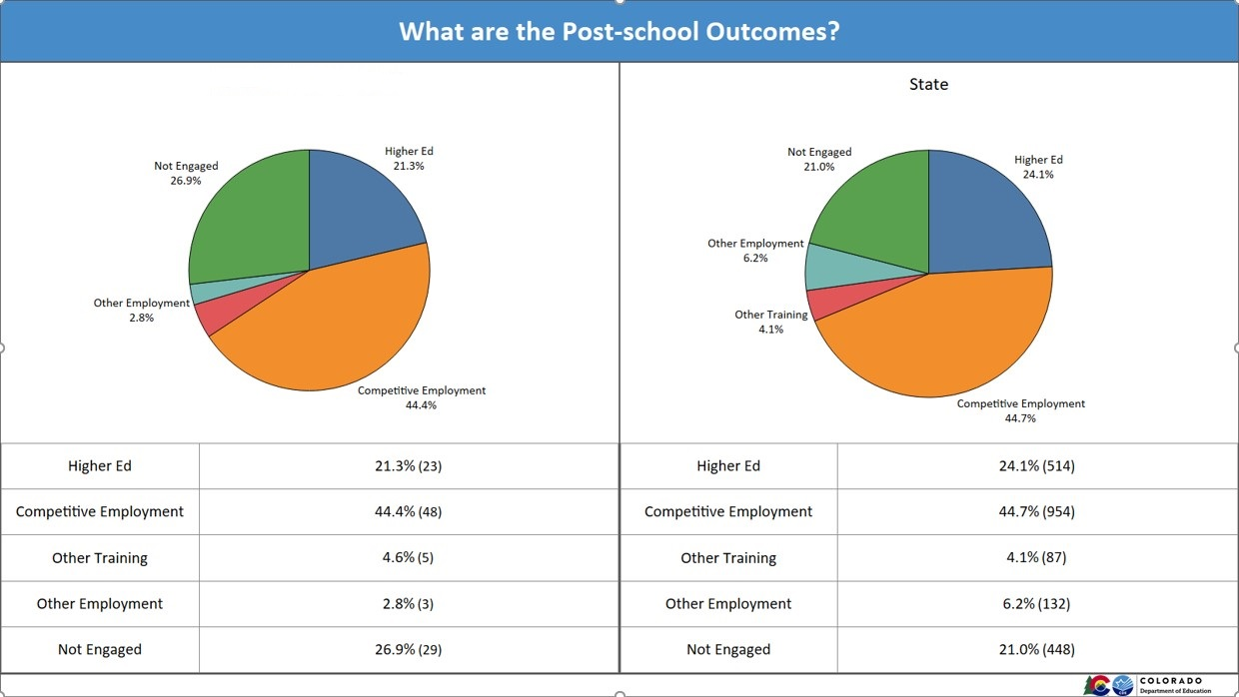
Data Visualization Reports in DMS - PSO
State Assessment Reports for SWD (Performance)
Post-School Outcome Interview Reports (Performance)
Notes:
The Post-School Outcomes Interviews will wrap soon, and I will start working on this visualization next. You will receive the raw data file in October, and I hope to have the Visualization out to you by November or December.

Slide 21
Data Visualization Reports in DMS – Parent Survey
State Assessment Reports for SWD (Performance)
Post-School Outcome Interview Reports (Performance)
Parent Survey Reports (Family-School)
Notes:
The parent survey data Visualization was just completed and posted yesterday. You can find it under the Family-School tab attachments, if your AU had 10 or more surveys returned. The raw data with a guide is posted for all AUs with any number of returns.

Slide 22
Data Visualization Reports in DMS - Discipline
State Assessment Reports for SWD (Performance)
Post-School Outcome Interview Reports (Performance)
Parent Survey Reports (Family-School)
*New* Special Education Discipline (Profile)
Notes:
There is a new Data Visualization on the Profile table. The Special Education Discipline Data Visualization for the 2019-2020 SY is available on the Profile tab. This will be updated with the 2020-2021 data after the collection is finalized. Today is the final day to sign and upload required reports for that collection.

Slide 23
Data Visualization Reports in DMS
State Assessment Reports for SWD (Performance)
Post-School Outcome Interview Reports (Performance)
Parent Survey Reports (Family-School)
*New* Special Education Discipline (Profile)
Indicator 5 – LRE by School Reports (Profile)
Use selected slides for
Strategy meetings with your team
Meeting with superintendents
Board meetings
Working with social workers for family-school partnering
Etc.
You’ve got the data!
Feel free to use them!!
Notes:
You will also find an Indicator 5 report detailing placements by school on the profile tab. Feel free to use these visualization or pieces of them for your needs. I ask that you keep confidentiality in mind if there is a small group count. CDE does not share data on counts of less than 16 with the general public. The reports on the DMS often contain count that are lower, so the reports are considered confidential. Review slides for confidential material and redact it before sharing publicly.

Slide 24
Data Contacts
Questions about Enrich or DMS
Melissa Chaffin 303-866-6819 (Melissa_C@cde.state.co.us )
Data Requests:
Miki Imura 303-866-6976 (Imura_M@cde.state.co.us )
Alyssa Ohleyer 303-866-6308 (Ohleyer_A@cde.state.co.us )
Help with Data Collections/Pipeline
Lindsey Heitman 303-866-5759 (Heitman_L@cde.state.co.us )
Orla Bolger 303-866-6896 (Bolger_O@cde.state.co.us )
Email us and we will call you back!
Notes:
If you have any questions regarding Enrich or the DMS please contact Melissa. For Data Requests, Miki or Alyssa. Help with Data collections and the Data Pipeline email both Lindsey and Orla. It is best to email us because of COVID uncertainty and office time.

