Slide 1
September 26th Town Hall
Welcome to the September 26th Town Hall
We will begin the webinar shortly.
Dial in number is 1-866-764-6750
Please use *# to mute your phone. You can unmute your phone using *#.
Support at: datapipeline.support@cde.state.co.us
Goal: Provide a weekly forum to answer LEA questions on Data Pipeline and inform LEA’s on any upcoming news and updates.
1

Slide 2
Webinar Etiquette
Mute Your Phone (*# Mutes and Un-mutes Individual Phones)
Enter your Name and your District when logging into the webinar (no password will be needed)
For today’s event, we will hold the Q&A session at the end of the presentation:
Type it in the Chat Box for a response OR
Raise Your Hand:
A presenter will call your name
After your name is called, un-mute your phone and speak your question/comment
Please be respectful of others time; we may need to have a separate conversation later to best help you
2

Slide 3
Introductions
CDE Staff Introductions
3

Slide 4
Agenda
Quarterly Readiness Survey
Respondent Users by Collection and Number of LEAs Submitting to Interchange
RITS/EDIS Demo
Special Education Updates
Challenges You Are Having on the Student October Collection
Questions from the September 19th Town Hall Follow-up:
Directory Report Number of Students
Co-Principal Directory
Vendor Concerns
4

Slide 5
Data Pipeline Readiness Survey Summary
5

Slide 6
Data Pipeline Readiness Survey
Total of four surveys have been requested to date:
October 2012
January 2013
April 2013
August 2013
One additional survey is planned for November 2013
First survey was done outside of Survey Monkey
Information from the surveys used to drive communication & training
Survey summaries are and will be posted on the Data Pipeline site for a detailed review.
6

Slide 7
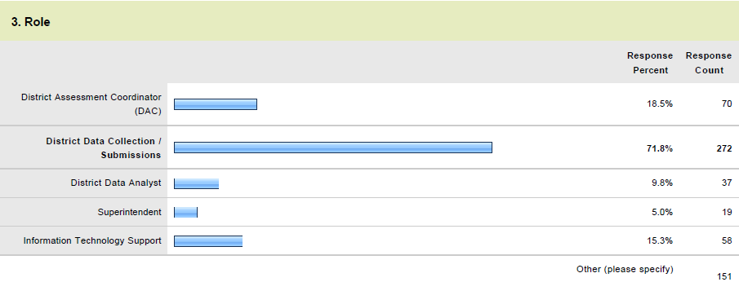
Data Pipeline Readiness Survey
Survey # 2 Respondents
7

Slide 8
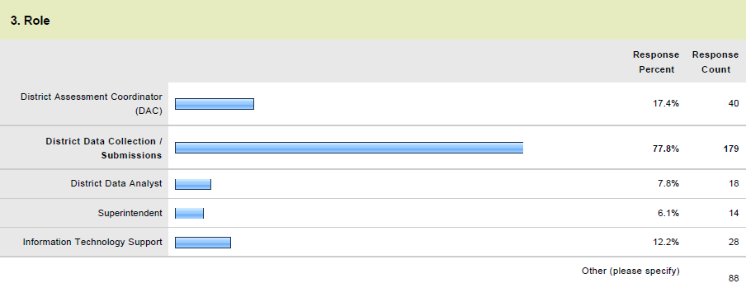
Data Pipeline Readiness Survey
Survey # 3 Respondents
8

Slide 9
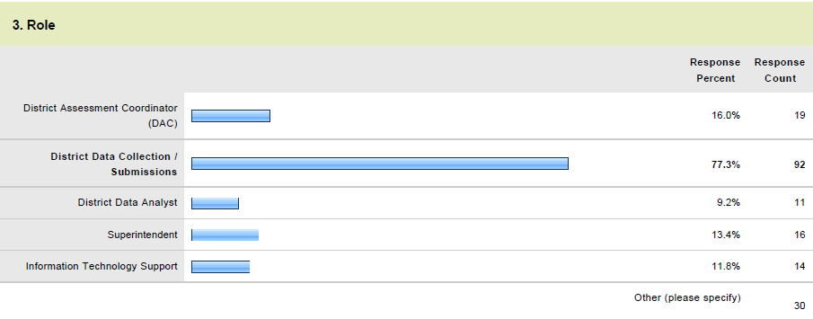
Data Pipeline Readiness Survey
Survey # 4 Respondents
9

Slide 10
Data Pipeline Readiness Survey
Survey # 2 Respondents
10

Slide 11
Data Pipeline Readiness Survey
Survey # 3 Respondents
11

Slide 12
Data Pipeline Readiness Survey
Survey # 4 Respondents
Neutral/Agree increase from 45% to 78% across the surveys
12

Slide 13
Data Pipeline Readiness Survey
Survey # 2 Respondents
13

Slide 14
Data Pipeline Readiness Survey
Survey # 3 Respondents
14

Slide 15
Data Pipeline Readiness Survey
Survey # 4 Respondents
Neutral/agree increase from 52% to 82% across the surveys
15

Slide 16
Data Pipeline Readiness Survey
Survey # 2 Respondents
16

Slide 17
Data Pipeline Readiness Survey
Survey # 3 Respondents
17

Slide 18
Data Pipeline Readiness Survey
Survey # 4 Respondents
Neutral/agree increase from 46% to 78% across the surveys
18

Slide 19
Data Pipeline Readiness Survey
Survey # 2 Respondents
19

Slide 20
Data Pipeline Readiness Survey
Survey # 3 Respondents
20

Slide 21
Data Pipeline Readiness Survey
Survey # 4 Respondents
Neutral/agree increase from 57% to 84% across the surveys
Note: the percentage agreeing or neutral went down 3% between surveys 3 and 4.
21

Slide 22
Data Pipeline Readiness Survey
Again, CDE DSU uses the survey results to:
Adjust communications to the LEAs
Drive Town Hall Topics
Address individual LEA’s needs and requests
CDE understands the Organizational Change Management impacts to the LEAs
Thanks to everyone that has or will take the surveys. The information is invaluable!
22

Slide 23
Interchange Statistics

Slide 24
Number of Respondents and Submissions
 | Sept 19 - LEAs with Respondents | Sept 19 - Number of Respondents | Sept 26 - LEAs with Respondents | Sept 26 - Number of Respondents | LEAs Submitted Files
RITS Web | 196 | 802 | 200 | 851
EDIS Web | 158 | 378 | 167 | 397
RITS Pipeline | 160 | 327 | 165 | 337
EDIS Pipeline | 153 | 267 | 161 | 285
Directory | 152 | 258 | 169 | 278
Student Interchange | 184 | 424 | 185 | 429 | 57
Staff Interchange | 157 | 307 | 178 | 339 | 8
Title I Interchange | 87 | 165 | 106 | 201 | 4
TSDL Interchange | 74 | 141 | 83 | 155 | 0
Student October | 189 | 454 | 190 | 459 | 6
HR December | 161 | 285 | 173 | 302 | 0
24

Slide 25
RITS Overview

Slide 26
RITS Process – New Students
Scenario: Several students enrolling, district needs to obtain SASIDs for the students (they may or may not already have SASIDs assigned)
Be sure to have log in access to both RTS-Pipeline and RITS (web)
Create file with records for each student: file layouts can be found at: http://www.cde.state.co.us/DataPipeline/yr_RITS.asp
Submit the RITS READ file in Data Pipeline: directions can be found at: http://www.cde.state.co.us/datapipeline/yr_rits
Use Edit Record tab in Data Pipeline – correct any errors and then Submit to RITS Match Tool (must use this even if no errors)

Slide 27
RITS Match Tool
RITS Match Tool shows all submitted records and possible matches currently in the RITS system
There are 2 choices:
Use Submitted Record – indicating the student is new to the system
Use Possible Match- indicating the submitted student and the possible match are in fact the same student
You can research as needed and submit partial batches
If you take advantage of the Partial Batches, PLEASE use the Submitted Indicator within the search criteria tool to keep track of those submitted and not yet submitted
Submit the records to RITS

Slide 28
RITS Process – Update Existing Students
Scenario: Update existing student data within district that already have SASIDs
Be sure to have log in access to both RTS-Pipeline and RITS (web)
Create file with records for each student: file layouts can be found at: http://www.cde.state.co.us/DataPipeline/yr_RITS.asp
Submit the RITS Batch file in Data Pipeline: directions can be found at: http://www.cde.state.co.us/datapipeline/yr_rits
Use Edit Record tab in Data Pipeline – correct any errors (must go through this even if no errors)
Submit to RITS

Slide 29
For Either Process: SASID Download Report
Go to the RITS Web Application: https://edx.cde.state.co.us/rits/ (Please note this is not under Pipeline)
Under Reports, choose the SASID Download Report
Select your submitted batch, and your preferred download file format
Your report with the assigned SASIDs will become available for your use
Some of the submitted records will go into Case Management at CDE before having a SASID assigned.

Slide 30
RITS Web –Other Uses
Able to search or update for a single student’s SASID
Able to submit up to 20 students for a SASID (manually entering the student’s data online)
Available Reports
SASID Download Report (as mentioned earlier)
Student Activity Report – the students added or updated to district within defined date range
Taken Student Report – list of students updated by another district away from your district within a date range
Student History Report – search for a student’s history for the last two years as it pertains to your district

Slide 31
RITS Help
Issues logging in to RITS or EDIS?
Be sure you are set up with the correct roles in the RTS-Pipeline (EDS-Pipeline) for submitting files and/or RITS (EDIS) for the RITS Web application by your LAM
Contact datapipeline.support@cde.state.co.us if still an issue
Questions on case management, duplicates, file, etc.?
Contact Debbie Pulscher
pulscher_d@cde.state.co.us
(303) 866-6212

Slide 32
Special Education Updates

Slide 33
AU Access to Student Interchange
Multi-district AUs
Assign BOCES code roles carefully
Only applicable to 9030, 9035, 9050, 9130, 9170
AUs will be able to see all school data
BOCES policy question
Should special education be able to access data for every student?
AUs will not be able to see member district data
Student Interchange
Student October Snapshot
Student End of Year Snapshot

Slide 34
AU Access to Student Interchange
Single-district AUs
Assign district code roles carefully
AUs will be able to see all district data
Student Interchange
Student October Snapshot
Student End of Year Snapshot
District policy question
Should special education be able to access data for every student?
Note: applies to BOCES with schools as well.

Slide 35
IdM Checklist for AU Respondents
Please complete the following steps by Oct. 1, 2013
Assign a User Manager for your AU
Assign at least one AU LAM
For December Count Data Respondents:
Assign the IEP Interchange role: SPE LEA VIEWER
Assign the December Count Snapshot Approver role to whomever is going to submit the approved data to CDE. DEC LEA APPROVER
Assign any December Count Snapshot Users or Viewers that you need.
*Once your roles are assigned, try logging into the ESSU IEP Interchange & Data Pipeline

Slide 36
AU Roles
Special Education data roles:
Only 1 role per dataset. 2 will not allow you to login.
A dataset is an Interchange or Snapshot.
Steps for assigning AU roles are posted here: http://www.cde.state.co.us/datapipeline/resources

Slide 37
AU Interchange Roles
Special Education IEP Interchange:
PIPELINE-00000-SPE~LEAVIEWER
(read-only on Pipeline side and able to submit and modify in the ESSU Statewide IEP system.)
Example: DENVER_1 PIPELINE-16010-SPE~LEAVIEWER Read-Only Role
Staff Interchange:
PIPELINE-00000-STF~LEAVIEWER
PIPELINE-00000-STF~LEAUSER
Example: DENVER_1 PIPELINE-16010-STF~LEAUSER Submit and Modify Role

Slide 38
AU IdM Groups for Snapshots
Snapshot roles: Choose only 1 role per snapshot
Special Education EOY Snapshot:
Pipeline-00000-EOY~LEAUSER
Pipeline-00000-EOY~LEAVIEWER
Pipeline-00000-EOY~LEAAPPROVER
Example: DENVER_1 PIPELINE-16010-EOY~LEAAPPROVER Approver Role
Special Education December Count Snapshot:
Pipeline-00000-DEC~LEAUSER
Pipeline-00000-DEC~LEAVIEWER
Pipeline-00000-DEC~LEAAPPROVER
Example: DENVER_1 PIPELINE-16010-DEC~LEAAPPROVER Approver Role
DEC LEA USER (USERS for snapshots are optional). They can view the snapshots, errors, and cognos reports but can’t submit to CDE.

Slide 39
AU IdM Groups for Snapshots
Special Education Discipline Snapshot:
Pipeline-00000-SPI~LEAUSER
Pipeline-00000-SPI~LEAVIEWER
Pipeline-00000-SPI~LEAAPPROVER
Example: DENVER_1 PIPELINE-16010-SPI~LEAUSER Submit and Modify Role

Slide 40
Logging into the ESSU IEP Interchange
Enter your Single Sign-On “Username”. Enter you Single Sign-On “Password”.
Click “Login”

Slide 41
ESSU IEP Interchange: home screen

Slide 42
IEP Interchange in the Data Pipeline: home screen
You need the SPE LEA VIEWER role in order to see the Special Education IEP Interchange.

Slide 43
Training Dates
Eagle, Wednesday, Oct 16: https://www.surveymonkey.com/s/DataPipelineEagle Alamosa on Monday, Oct. 21: https://www.surveymonkey.com/s/DataPipelineAlamosa Greeley, Wednesday, Oct 23: https://www.surveymonkey.com/s/DataPipelineGreeley Colorado Springs, Tuesday, Oct. 29: https://www.surveymonkey.com/s/DataPipelineColoradoSprings Lamar, Thursday, Nov. 7: https://www.surveymonkey.com/s/DataPipelineLamar
Metro training: November ???

Slide 44
Regional Trainings Content
9:30-12:45
Special Education IEP Interchange
Special Education December Count Snapshot
Special Education Staff HQ
1:00-4:00 (district respondents welcome in this session)
Staff Interchange
HQ

Slide 45
Challenges

Slide 46
Student Interchange concerns
Student Interchange
Contains records for all students between age of 0 and 23
Even students who enrolled at the beginning of the year and have since withdrawn
Students enrolled last year who moved over the summer.
Students required in End of Year and not in Student October
Students required in Student October and not in End of Year
Student October Snapshot
Only pulls primary schools
Only pulls students enrolled on the pupil enrollment date
Only pulls error free interchange records

Slide 47
Common Issues
Duplicate groups error on login
Please report this if you do not have duplicate groups assigned
Unable to access application
Need local access manager to assign privileges
Oracle Access Manager error when attempting to login
This is caused by incorrect bookmark.
Must start at the Identity Management screen

Slide 48
Common Issues
All files require a header record
The load will ignore the first record in the file.
Performance issue on large snapshots
We will continue to monitor
Only one record per student is allowed for student demographic file
Cognos folder is not visible

Slide 49
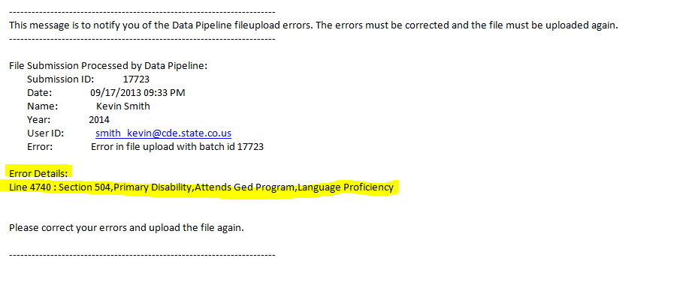
Common Issues
Commas in comma delimited file
Example 1234 39th St., #123 (Notice comma after St.)
System will treat the comma as field separator
Receive email – File is not processed

Slide 50
Common Issues
Cognos Performance issues
Delays in selecting options and report creation takes significant time
We are working on this
Student enrolled in two schools on the same date
SP373 – we are investigating this issue
Student load must complete before loading school association
Order of the files is important

Slide 51
Common Issues
Invalid characters in sasid stops load
Date most recently enrolled in US cannot be all zeros
Duplicate enrollment date and exit date issue with secondary schools
Problem with infants being reported with a funding code of 86
Incorrect warning on CPP students

Slide 52
Follow Up From Last Week

Slide 53
Directory
The pupil counts are incorrect and CDE has a bug request. We will keep you informed when the fix goes live.
Co-Principal – This is only for those instances where the responsibility of the principal is being shared by more than one person. Please do not list assistant principals in this field.
53

Slide 54
September 26th Town Hall
Thanks for joining us today!
Have a great day!
Next Town Hall: October 3rd
54

