Slide 1
Special Education IEP Interchange September 24th, 2013

Slide 2
September 24th Special Education “Huddle”
Welcome to the third in a series of Special Education Data
Reporting weekly “Huddles”
Dial in number is 1-866-764-6750
Please use *# to mute your phone. You can unmute your phone using *#.
Support at: datapipeline.support@cde.state.co.us
Goal: Provide a weekly forum to answer LEA questions on Special Education Data Reporting.

Slide 3
Webinar Etiquette
Mute Your Phone (*# Mutes and Un-mutes Individual Phones)
Enter your Name and your District when logging into the webinar (no password will be needed)
If you have questions during the presentation you can
Type it in the Chat Box for a response OR
Raise Your Hand:
A presenter will call your name
After your name is called, un-mute your phone and speak your question/comment
We will open the lines up for on air questions
Please be respectful of others time; we may need to have a separate conversation later to best help you

Slide 4
Introductions
The purpose of the Special Education Weekly
“Huddle” will be to provide a forum to answer
LEA questions on the new data reporting
processes specific to Special Education and to
inform LEA’s on any upcoming news and
updates.

Slide 5
Topics for Discussion
Identity Management
User Manager
LAMS
User Groups
Accessing and logging in to the ESSU IEP Interchange
New data fields for 2013-14
Regional Trainings
Q & A

Slide 6
IDENTITY MANAGEMENT

Slide 7
AU User Manager
Each AU needs one User Manager designated in Access Management.
Why the need for a User Manager? So that someone of authority is overseeing the role assigning process and making sure data respondents get setup with the appropriate user roles.
The User Manager will then assign the first LAM.
Example: UM-64053 or UM-9140
BOCES -Executive Director or Special Education Director
Administrative Units- Special Education Director

Slide 8
AU User Manager
How? Ask either your Special Education Director or BOCES Executive Director to register as the User Manager in IdM Access Management. They need to register with the AU or BOCES code.
***If they’re already registered in the system, they won’t be able to proceed. In that case, please email us to assign User Manager to their account. ***

Slide 9
Executive Director Registration:
Go to the IdM home page : https://cdeapps.cde.state.co.us/index.html : please bookmark this link. You can use it to get to every CDE application, including Access Management.
Click “Executive Director Registration”
If you’re already registered in the IdM system you won’t be able to proceed. Please contact us and we will assign UM to your account.
Fill out personal information
Organization code should be AU code or BOCES code
(If you register with the BOCES code you won’t be able to see your AU users unless you also have AU LAM access assigned.)

Slide 10
AU LAM
What is a LAM (local access manager)? This person is responsible for assigning data respondents the appropriate user roles and making sure they can access the applications they need in order to submit data to CDE.
Must have at least 1 AU LAM, but there is no limit on how many LAMs you can have.
The AU LAM should be familiar with the Sped collections and have an understanding of which roles are needed.
Example: LAM-64053
Why an AU LAM too? So you can see and or assign the AU special education roles which have 5 digit codes. Without an AU LAM, you will not be able to assign the sped roles.

Slide 11
AU Roles
Special Education data roles:
Only 1 role per dataset. 2 will not allow you to login.
A dataset is an Interchange or Snapshot.
Steps for assigning AU roles are posted here: http://www.cde.state.co.us/datapipeline/resources

Slide 12
AU Interchange Roles
Special Education IEP Interchange:
PIPELINE-00000-SPE~LEAVIEWER
(read-only on Pipeline side and able to submit and modify in the ESSU Statewide IEP system.)
Example: DENVER_1 PIPELINE-16010-SPE~LEAVIEWER Read-Only Role
Staff Interchange:
PIPELINE-00000-STF~LEAVIEWER
PIPELINE-00000-STF~LEAUSER
Example: DENVER_1 PIPELINE-16010-STF~LEAUSER Submit and Modify Role

Slide 13
AU IdM Groups for Snapshots
Snapshot roles: Choose only 1 role per snapshot
Special Education EOY Snapshot:
Pipeline-00000-EOY~LEAUSER
Pipeline-00000-EOY~LEAVIEWER
Pipeline-00000-EOY~LEAAPPROVER
Example: DENVER_1 PIPELINE-16010-EOY~LEAAPPROVER Approver Role
Special Education December Count Snapshot:
Pipeline-00000-DEC~LEAUSER
Pipeline-00000-DEC~LEAVIEWER
Pipeline-00000-DEC~LEAAPPROVER
Example: DENVER_1 PIPELINE-16010-DEC~LEAAPPROVER Approver Role
DEC LEA USER (USERS for snapshots are optional). They can view the snapshots, errors, and cognos reports but can’t submit to CDE.

Slide 14
AU IdM Groups for Snapshots
Special Education Discipline Snapshot:
Pipeline-00000-SPI~LEAUSER
Pipeline-00000-SPI~LEAVIEWER
Pipeline-00000-SPI~LEAAPPROVER
Example: DENVER_1 PIPELINE-16010-SPI~LEAUSER Submit and Modify Role

Slide 15
AU RITS ROLES
AU RITS ROLE:
1 option: RITS Web “View Only Role”
Use dummy code 9993
Ex: ADMIN_UNIT_ACCESS RITS-9993-4 View Only Role
Ex: CMHI_PUEBLO RITS-8102-4 View Only Role (State Operated Program)
There are no RITS Pipeline roles for an AU User

Slide 16
AU EDIS ROLES
AU EDIS ROLES:
4 options available for AU Users
EDIS Web system role must have a 4 digit code. Use BOCES code.
Example:
SANTA_FE_TRAIL_BOCES EDIS-9150-2 Admin Role Add and Update
SANTA_FE_TRAIL_BOCES EDIS-9150-4 View Only Role
EDIS Pipeline role can have a 5 digit code. Use AU code.
Example:
NORTHEAST_BOCES PIPELINE-64103-EDS~LEAVIEWER Read-Only Role
NORTHEAST_BOCES PIPELINE-64103-EDS~LEAUSER Submit and Modify Role

Slide 17
IdM Checklist for AU Respondents
Please complete the following steps by Oct. 1, 2013
Assign a User Manager for your AU
Assign at least one AU LAM
For December Count Data Respondents:
Assign the IEP Interchange role: SPE LEA VIEWER
Assign the December Count Snapshot Approver role to whomever is going to submit the approved data to CDE. DEC LEA APPROVER
Assign any December Count Snapshot Users or Viewers that you need.

Slide 18
IDENTITY MANAGEMENT FAQ
Below is a link to the Colorado Department of Education Identity
Management Frequently Asked Questions where you will find
information about its benefit, what Single Sign-On is, who is
responsible for what, and collection/group mappings.
https://cdeapps.cde.state.co.us/faqs.html

Slide 19
Special Education IEP Interchange

Slide 20
About ESSU Statewide Data Management System…
The ESSU Statewide Data Management system serves as the entry portal for the Data Pipeline Individualized Education Program (IEP) Interchange.
ESSU Statewide Data Management System
ESSU
IEP
Interchange
Data Pipeline

Slide 21
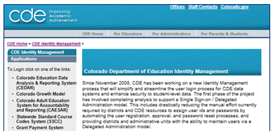
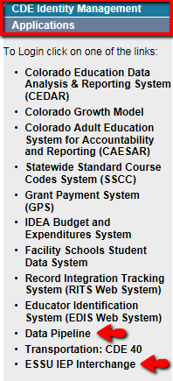
Logging onto ESSU IEP Interchange and Data Pipeline
The left side menu, lists the CDE Applications. Click on ESSU IEP Interchange or Data Pipeline and logon using your Single Sign On User ID and password that you received from your LAM.
https://cdeapps.cde.state.co.us/faqs.html

Slide 22
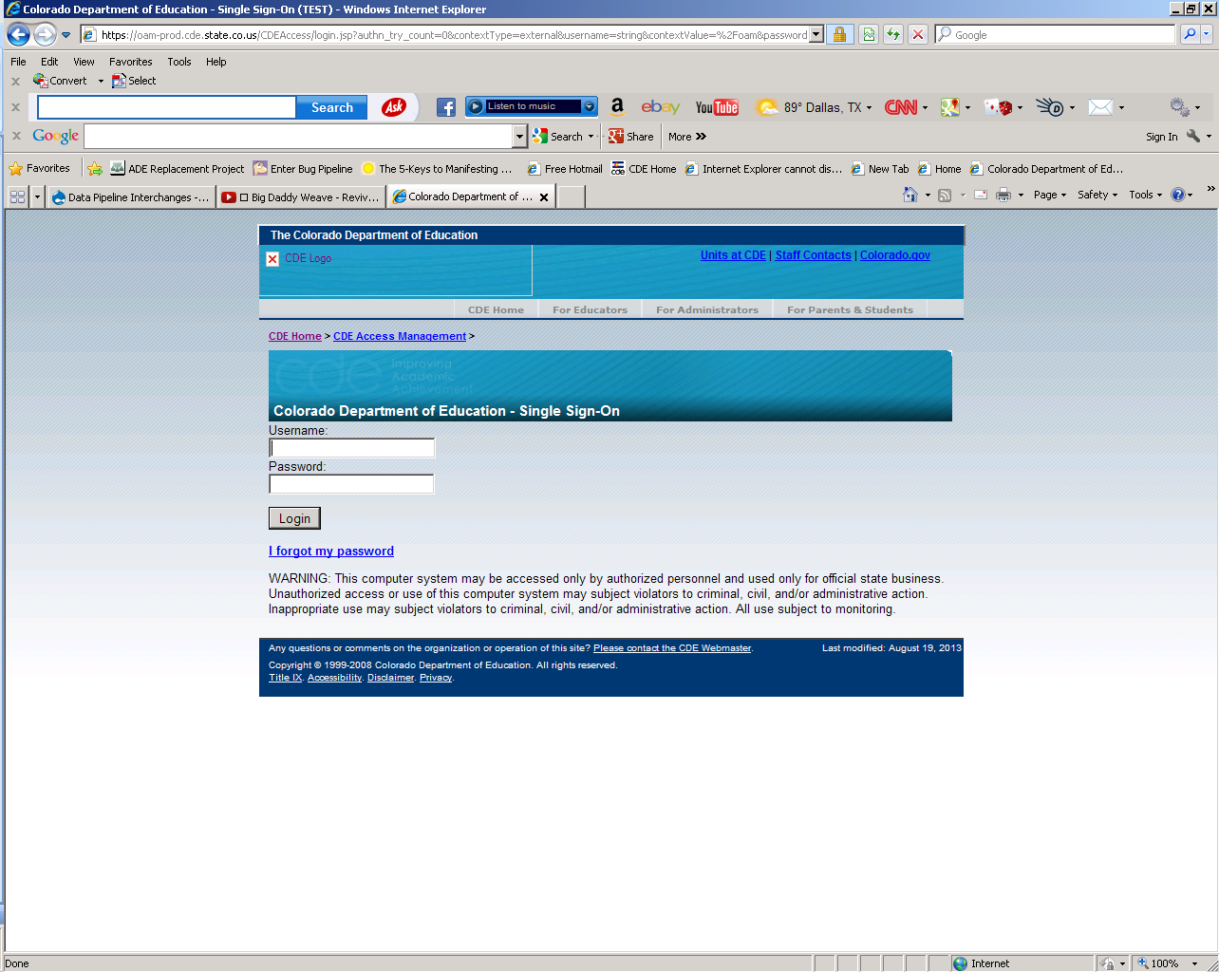
Logging into the ESSU IEP Interchange
Enter your Single Sign-On “Username”. Enter you Single Sign-On “Password”.
Click “Login”

Slide 23
ESSU IEP Interchange: home screen

Slide 24
IEP Interchange in the Data Pipeline: home screen
You need the SPE LEA VIEWER role in order to see the Special Education IEP Interchange.

Slide 25
Practice logging in to both systems now, if possible. Any questions?

Slide 26
Special Education IEP Files

Slide 27
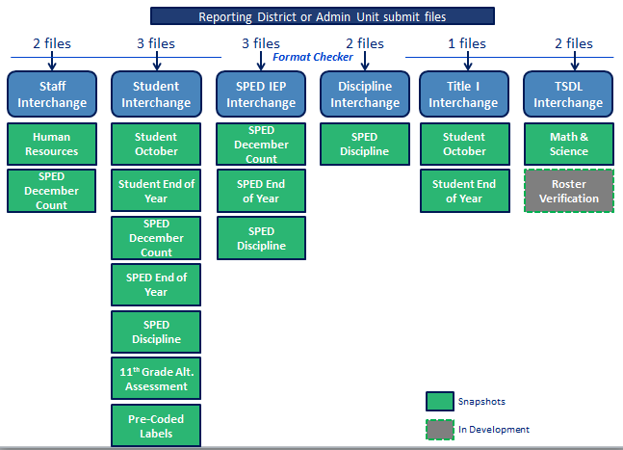
Special Education IEP Interchange Files
Six Interchanges and associated files
Staff - Profile file Staff - Assignment file Student - Demographics file Student - School Association file Student - Advanced Course Completion file SPED IEP - SPED Child file SPED IEP - SPED Participation file SPED IEP - Student Parent Association file Discipline - Incident file Discipline - Action file Title I - Assistance Funding file TSDL - Course Enrollment file TSDL - Course Instructor file

Slide 28
Special Education IEP Interchange
3 Files
Special Education Child
Special ed. student demographic information
Student Special Education Participation
Special ed. services information
Student Parent Association (not required unless in the sample plan)
Parent or guardian contact information

Slide 29
Special Education Child
Special Education Child File
Special Education Child File
Admin Unit/SOP Code | Student's Race: American Indian or Alaska Native | Student's Address City
Student's State ID (SASID) | Student's Race: Asian | Student's Address State
Local ID (LASID) | Student's Race: Black or African American | Student's Address Zip
Student's First Name | Student's Race: White | Student's Primary Telephone Number
Student's Middle Name | Student's Race: Native Hawaiian or Other Pacific Islander | Student's Secondary Telephone Number
Student's Last Name | Grade Level | Student's Email Address
Student's Gender | Student's District of Residence
Student's Date of Birth | State of Parent's Residence for Non-Residence Students
ELL Status | District of Parent's Residence for Non-Residence Students

Slide 30
Child file- new fields for 2013-14
State of Parent’s Residence for Non-Residence Students - State code where the parent/guardian resides, if the student attends a district other than the school district of residence.
District of Parent’s Residence for Non-Residence Students - School district where the parent/guardian resides, if the student attends a district other than the school district of residence and resides in CO.

Slide 31
Special Education Participation File
Student Special Education Participation File
Admin Unit/SOP Code | Pupil's Attendance Information | Secondary Service Provider EDID 3 | Reason for Delay in Completing Evaluation Part C | Reason for Delay in IEP Implementation C to B
Student's State ID (SASID) | State of Attendance | Secondary Service Provider EDID 4 | Eligibility and Services Path 1 | Eligibility and Services Path 2
Local ID (LASID) | Educational Orphan | Hours of Special Education Services per Week | Date Child is Referred to the Part C System | Date of Parental Consent to Evaluate Part B
Student's First Name | Parentally Placed in a Private School | Total School Hours per Week | Date Child is Found Eligible for Part C Services | Date Evaluation Completed Part B
Student's Last Name | Special Education Funding Status | Extended School Year Services | Date of Referral to Administrative Unit from the Local Community Centered Board | Reason for Delay in Completing the Evaluation Part B
Student's Gender | Date of Entry to Special Education | Basis of Exit | Date of Parental Consent to Evaluate C to B | Date of Initial Eligibility Meeting Part B
Student's Date of Birth | Date of Exit from Special Education | Special Education/Part C Referral | Date Evaluation Completed C to B | Date Initial IEP was Finalized Part B
Primary Disability | Educational Environment | Current Eligibility and Services | Reason for Delay in Completing Evaluation C to B | Reason for Delay in Finalizing the Initial IEP Part B
School Code | Primary Service Provider's EDID | Date Referred for Part C Evaluation | Date of Initial Eligibility Meeting C to B | Date IEP was Implemented Part B
Program Code | Secondary Service Provider EDID 1 | Date of Parental Consent To Evaluate Part C | Reason for Delay in Initial Eligibility Meeting C to B | Reason the IEP was Never Implemented Part B
District of Attendance | Secondary Service Provider EDID 2 | Date Evaluation Completed Part C | Date IEP was Implemented C to B | Eligibility and Services Path 3
Notes:
When we switch to the IEP Interchange, there will be a few additional fields. Students attending programs will be reported at that program via a 4 digit code and not through a program exception as done in the past. Additionally, eligibility and services will also be collected for each individual path in addition to the most recent determination as you have reported in the past.

Slide 32
Sped Participation File –new fields
Date of Entry to Special Education – The month, day, year (mmddyyyy) the student started Special Education services in the current school year. This is the date the IEP was implemented in the current school year. If the IEP was implemented in a previous school year, use the first day of school or the first day of the collection period.
For transfer students, use the date the child started services (or school) in your AU
Date of Exit From Special Education – – The month, day, year (mmddyyyy) the student was exited from Special Education services. If student is still active, this field must be zero-filled. This is the date the student last received Special Education and related services in your Administrative Unit prior to leaving the district, being staffed out, etc.

Slide 33
Sped Participation File –new fields
Program Code : (4 digits) for students attending programs, private facilities, or being home-schooled. Exception requests will not be needed for these students!
Link to Program Codes: http://www.cde.state.co.us/datapipeline/org_sped_program_codes
Eligibility and Services field in each path now:
Eligibility and Services Path 1
Eligibility and Services Path 2
Eligibility and Services Path 3

Slide 34
Sped Participation File –new fields
Primary Service Provider’s EDID – Enter the EDID Number for the student’s Primary Provider/Service Coordinator and up to four Secondary Service Providers if the student is receiving his/her educational services from the staff of the reporting administrative unit.
Secondary Service Provider’s EDID 1,2,3,4 – Enter the EDID for student’s secondary service providers.

Slide 35
Student Parent Association File
Student Parent Association File
Admin Unit/SOP Code | Adult Contact's Middle Name
Student's State ID (SASID) | Adult Contact's Last Name
Local ID (LASID) | Adult Contact's Address
Student's First Name | Adult Contact's Address City
Student's Last Name | Adult Contact's Address State
Student's Gender | Adult Contact's Address Zip
Student's Date of Birth | Adult Contact's Primary Telephone Number
Primary Contact Status | Adult Contact's Secondary Telephone Number
Adult Contact ID | Adult Contact's Email Address
Adult Contact's First Name

Slide 36
Student Parent Association file-new fields
Primary Contact Status – Indicates this parent is the primary contact for this student. (Flag) 0 No 1 Yes
Adult Contact ID – This is a Unique 10 digit identifier for each parent or guardian. Each AU will create and control their own list of IDs, and IDs can duplicate across AUs, but cannot duplicate within the same AU.

Slide 37
Special Education IEP Interchange
The following information related to the Special Education IEP
Interchanges may be found at the following location
http://www.cde.state.co.us/datapipeline/inter_sped-iep
Overview
File Layout and Definitions
Business Rules
Templates
Trainings
Additional Links

Slide 38
REGIONAL TRAININGS

Slide 39
Training Dates
Eagle, Wednesday, Oct 16: https://www.surveymonkey.com/s/DataPipelineEagle Alamosa on Monday, Oct. 21: https://www.surveymonkey.com/s/DataPipelineAlamosa Greeley, Wednesday, Oct 23: https://www.surveymonkey.com/s/DataPipelineGreeley Colorado Springs, Tuesday, Oct. 29: https://www.surveymonkey.com/s/DataPipelineColoradoSprings Lamar, Thursday, Nov. 7: https://www.surveymonkey.com/s/DataPipelineLamar
Aurora: November ?

Slide 40
Regional Trainings Content
9:30-12:45
Special Education IEP Interchange
Special Education December Count Snapshot
Special Education Staff HQ
1:00-4:00 (district respondents welcome in this session)
Staff Interchange
HQ

Slide 41
Contact Information
Today’s Presenters:
Kristi Gleason (303) 866-4620 gleason_k@cde.state.co.us
Lindsey Heitman (303) 866-5759 heitman_l@cde.state.co.us

Slide 42
September 24th Huddle
Thanks for joining us today!
Have a great day!
Next Huddle:
October 1st, 2013 11:00 a.m.

