Slide 1
Data Pipeline Town Hall January 10, 2019
The goal of the webinar is to provide updates on the Data Pipeline and current and upcoming collections. These webinars also provide a forum for districts, BOCES, and Administrative Units to have questions answered about Data Pipeline.
We will begin the webinar shortly
Dial in number is 1-866-764-6750
Data Pipeline support email is datapipeline.support@cde.state.co.us

Slide 2
Webinar Etiquette
Mute Your Phone (*# Mutes and Un-mutes Individual Phones); many phones have a mute button on them.
If you receive a call and need to pick up, please disconnect from the webinar. Otherwise, all town hall participants hear your hold music!
We will hold the Q&A session at the end of the presentation:
Type it in the Chat Box for a response OR
Raise Your Hand:
A presenter will call your name
After your name is called, un-mute your phone and speak your question/comment
Please be respectful of others time; we may need to have a separate conversation later to best help you

Slide 3
Colorado Department of Education Identity Management
Access Management
https://cdeapps.cde.state.co.us/faqs.html
Frequently Asked Questions 1-12
#12 Where can I find the Identity Management role mappings for Data Pipeline and other applications?
https://cdeapps.cde.state.co.us/IdentityManagementGroups.xls

Slide 4
What is PII?
Student Personally Identifiable Information (PII) is defined by state and federal laws as information that, alone or in combination, personally identifies an individual
This includes direct identifiers (i.e. name, SASID, etc.)
Includes information that when combined is identifiable
Colorado’s Student Data Transparency and Security Act introduces a number of new requirements for how Student PII is collected, used and shared
CDE has prepared guidance on how to comply with this and other privacy laws which can be found here: http://www.cde.state.co.us/dataprivacyandsecurity

Slide 5
How to Share Data
Check local policies for restrictions, requirements, etc.
Ensure that you are following local policies when transmitting PII to any third party
Use secure methods to transfer any PII to CDE
Call CDE (303-866-6395) with questions about how to transmit PII securely
Use Syncplicity to encrypt emails to CDE
Avoid sending PII via unencrypted email or to unsecured faxes when sharing data between or within districts
Do not use PII in trainings, presentations, etc.
Do not share PII with unauthorized individuals
Do not share passwords

Slide 6
Introductions

Slide 7
Today’s Agenda
Open Collections in Data Pipeline
Assessments Pre-ID Labels
Directory
Special Education December Count
Human Resources
Student End of Year

Slide 8
Open Collections in Data Pipeline

Slide 9
Open Data Pipeline Collections
Year Round
Directory
RITS
EDIS
Periodic
December Finance
Designated Agency
Pre-id Labels
Interchanges
Student
Special Education IEP
Staff

Slide 10
Open Data Pipeline Collections
Snapshots
Special Education December Count
Human Resources
Coming Soon

Slide 11
Assessment Pre-ID Labels

Slide 12
Pre-ID Data Pull
Pre-ID data is demographic data pulled by CDE and sent to the assessment vendors
Data is pulled from the October Count collection, there is no data collection for Pre-ID
Pulling from October count prevents data issues caused by trying to create an additional data collection (missing participants) or pull directly from the interchange (bad data, duplicate records)
All vendors require the data far in advance of testing so they can provide paper materials where required
WIDA ACCESS is sent in November for January testing
All others are sent in January for testing starting in March/April

Slide 13
Data Review
Pre-ID can be reviewed in the vendor systems for the following assessments:
WIDA ACCESS
WIDA AMS student management portal
Data has been available for review and editing since November
Contact: Heather Villalobos-Pavia (villalobos-pavia_h@cde.state.co.us)
CMAS All Subjects/CoAlt Science and Social Studies
Pearson Access Next system
Data will be available on January 7th for review and editing
Contact: Sara Loerzel (loerzel_s@cde.state.co.us)
CoAlt ELA and Math (DLM)
DLM Educator Portal
Data will be available on January 10th for review and editing
Contact: Mindy Roden (roden_m@cde.state.co.us)
Access to these systems are provided by the DAC to other district level users

Slide 14
SAT Data Review
The College Board system does not have a student data portal where the data can be reviewed and edited
The Pre-ID data that is sent to College Board will be available through Data Pipeline
You will need an SAT SBD user role
Go to File Extract Download under the SAT SBD collection
Choose File Type -> Vendor and Extract Type -> Pre Coded Labels
The collection will be available in production starting January 8th after the file is loaded to College Board
No edits can be made to the file but this will provide a baseline for which students you will receive labels for and to help prepare for SBD
The file will remain available until SBD closes

Slide 15
Assessment Contacts
General Data Questions:
Jasmine Carey
Carey_j@cde.state.co.us
303-866-6634
Shangte Shen
Shen_s@cde.state.co.us
303-866-6877

Slide 16
Directory

Slide 17
Data Pipeline Directory
Reminder of the need to keep the Data Pipeline Directory up to date. We are getting ready for our submission to the US Department of Education.
Check and make sure that the Addresses and Phone numbers are correct for the District and Schools.
Make sure that Principal Name and Email address is correct.
Make sure the Virtual Type is correct for the school.

Slide 18
Data Pipeline Directory

Slide 19
Data Pipeline Directory
Make sure that the Board Membership is up to date in the directory.
Make sure the Vendor Information is up to date – This assists Data Collection owners to assist districts with different vendors – Especially if there are issues surrounding a collection.

Slide 20
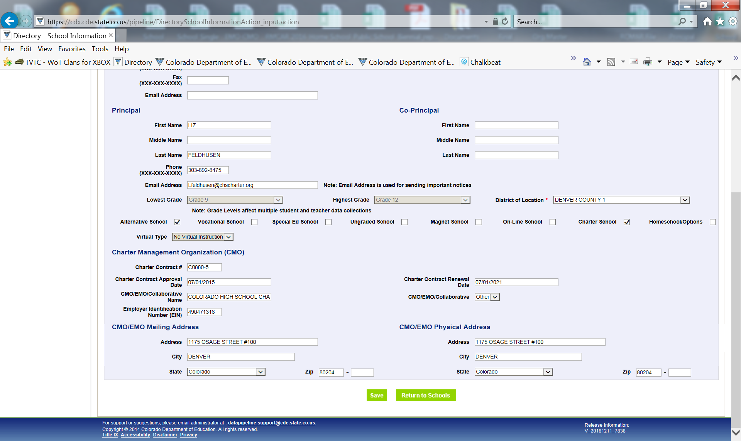
Data Pipeline Directory
Make sure that if you have a charter school in your district that the Charter Management Organization is up to date on the school tab.

Slide 21
Data Pipeline Non-Public Pupil Count/Directory Dennis St. Hilaire st.Hilaire_d@cde.state.co.us
Reminder to make sure you put in your Non-Public school data.
What is the Data Pipeline Non-Public Pupil Count/Directory?
Collects Pupil counts of non-public school students by grade
Identifies non-public schools that are used for funding, nutrition, federal programs and special education. The codes in the non-public directory are used throughout CDE. For most districts this collection should not take much time to complete.
Non-Public Pupil Count/Directory Documentation
http://www.cde.state.co.us/datapipeline/non-public_schools

Slide 22
Data Pipeline Non-Public Pupil Count/Directory Dennis St. Hilaire st.Hilaire_d@cde.state.co.us
Important: Since the non-public school pupil membership counts become a significant component in computing allocations for federal programs. Please make sure that you enter as many non-public school students as possible into the non-public schools collection. If you do not put the counts in it will impact funding from the grants fiscal unit. Do not miss out on these funds because you did not enter in the non-public school counts!

Slide 23
Data Pipeline Non-Public Pupil Count/Directory Dennis St. Hilaire st.Hilaire_d@cde.state.co.us

Slide 24
Data Pipeline Non-Public Schools and Directory Dennis St. Hilaire st.Hilaire_d@cde.state.co.us
Questions
Dennis St. Hilaire
st.Hilaire_d@cde.state.co.us
Phone 303-866-6840

Slide 25
Special Education December Count

Slide 26
Special Education December Count Bug Update
Bugs
1. DC157 and DC017 (bug applies to staff with Job Class Code 224)
DC157: FTE total for each individual must be between 0.005 and 1.71
DC017: Base Salary/FTE does not meet minimum wage requirements.
Fix was moved to production 01/08
Will need to have created snapshot after that date to see these dissolve
2. DC015: Teacher Probationary Status is required and not zero-filled for all teachers, except Purchased Service staff.
Fix was moved to production 01/08
You should be able to zero-fill the Teacher Probationary Status on purchased service staff (Employment Status Code=23)
Create snapshot after 01/08
Special Education December Count - Lindsey Heitman - heitman_l@cde.state.co.us (303) 866-5759

Slide 27
Special Education December Count – Grade Level
Reminder:
District is the authoritative source of grade level and demographic information
Grade Level is pulled primarily from the Student Interchange – School Association file – Untagged or DEC tagged file
If student is not submitted by the district (i.e. private school or facility students) the grade will pull from the Participation file
If no untagged or DEC tagged file, grade will also pull from Participation file, not the OCT tagged file
Special Education December Count - Lindsey Heitman - heitman_l@cde.state.co.us (303) 866-5759

Slide 28
Special Education December Count – DC158
Warning DC158:
The following SASIDs are included in the December Count Student Snapshot, but no record was found in the Student interchange- Untagged or DEC tagged file. This may be accurate for students in Non-Public Schools or Approved Facility Schools, however, if any of these students are in a Public School, please check with your Student Interchange contact to see why they are not reporting the student.
Compares the students in the December Count Student snapshot to the Student Interchange Untagged or DEC tagged file
This warning will stand for students not submitted by the districts
Be sure district has an untagged for DEC tagged file uploaded before looking into these
Special Education December Count - Lindsey Heitman - heitman_l@cde.state.co.us (303) 866-5759

Slide 29
Special Education December Count Important Dates
January
Wednesday January 23rd: All errors resolved – complete snapshot
January 24 – 31 : Report Review
February
February 4 – 14: Resolving duplicates
February 14 - 21: Final Report Review
February 21st : Final Deadline
Special Education December Count - Lindsey Heitman - heitman_l@cde.state.co.us (303) 866-5759

Slide 30
Special Education December Count - Tips
Staff Interchange Users and Viewers are able to see the December Count snapshot errors by downloading this report under:
Cognos Reports- Staff Profile- Special Education December Snapshot Error Detail Report
Special Education December Count - Lindsey Heitman - heitman_l@cde.state.co.us (303) 866-5759

Slide 31
Special Education December Count Contact Info
Special Education December Count contact information
Lindsey Heitman – heitman_l@cde.state.co.us 303-866-5759 (Primary contact)
Orla Bolger – bolger_o@cde.state.co.us 303-866-6896
*Please include your AU #, District #, Error code # (if applicable), and phone number in emails ☺
Resources
Special Education IEP Interchange: http://www.cde.state.co.us/datapipeline/inter_sped-iep
Staff Interchange:
http://www.cde.state.co.us/datapipeline/inter_staff
Special Education December Count Snapshot:
http://www.cde.state.co.us/datapipeline/snap_sped-december

Slide 32
Human Resources

Slide 33
Human Resources Timeline
December
January
Wednesday, January 23rd: HR Snapshot Created
Thursday, January 24th – 31st : Special Education Report Review
Thursday, December 20th: All Interchange errors resolved
Saturday, December 1st: Official Count Date
February
Thursday, February 14th: Snapshot Error Free
Thursday, February 14th – 21st: Snapshot Report Review
Thursday, February 21st: Final Deadline
Human Resources– Annette Severson – severson_a@cde.state.co.us

Slide 34
ESSA Crosswalk Update
Elementary Endorsements will be linked with additional content areas for elementary level:
English Language Arts
Mathematics
Natural Science
Art
Foreign Languages
Physical Curriculum
Music
Social Sciences
Updates should be made by next week. Notification will be sent once completed.
Human Resources– Annette Severson – severson_a@cde.state.co.us

Slide 35
Resources and Contact Information
Human Resources Snapshot information:
http://www.cde.state.co.us/datapipeline/snap_hr
Annette Severson: severson_a@cde.state.co.us
Staff Interchange information:
http://www.cde.state.co.us/datapipeline/inter_staff
Annette Severson: severson_a@cde.state.co.us
Lindsey Heitman: heitman_l@cde.state.co.us
Human Resources– Annette Severson – severson_a@cde.state.co.us

Slide 36
Student End of Year

Slide 37
New Mobility Rate Calculation
Reminder of Mobility Rate definition change:
Starting October 1st rather than the beginning of the school year
All entry types are included if the student is enrolled on or after the October Count date.
All exit types are included (unless they are the graduating or completing exit types of 90, 92, 93, 94, and 95 or the exit type of ‘00’).
A student must have a gap in attendance of more than 10 days in order to be considered mobile.
The 2017-18 End-of-Year collection is the first year of this new calculation method.

Slide 38
Thank You
Next Town Hall:
Thursday, January 17th, 2019 9 a.m.-10 a.m.

