Slide 1
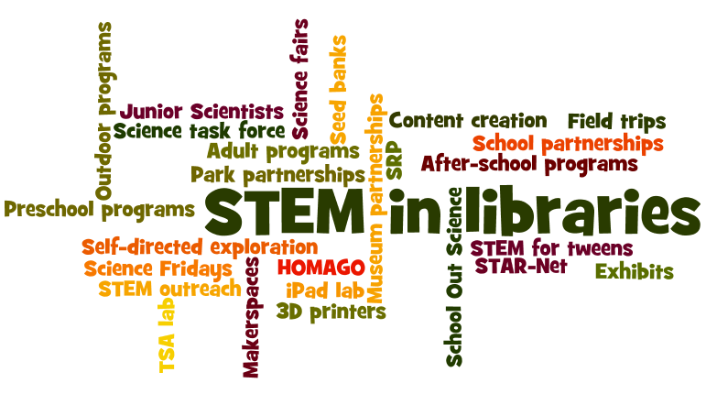
Notes:
Please complete evaluation

Slide 2
Agenda
SRP 2014
Alternative SRPs
STEM
STEAM
STEM in libraries
Outreach
Other?

Slide 3
Workshop Outcomes
Discover innovative approaches to SRPs
Delve into STEM and STEAM
Why’s and how’s of outreach
Create ideas—and plans!—for your library
Connect with colleagues
Have fun & feel energized

Slide 4
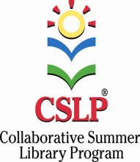
CSLP
47 states + US territories
Grassroots
Collaborative
Manuals, artwork, Highsmith products
Manual content & artwork are proprietary
Notes:
CSLP window clings
Show DVDs
New this year in catalog—generic age items
New this year—catalogs for school partner
Shipping—orders under $55--$6 shipping. Orders between $55 and $450—add 11%. Orders over $450--$50 shipping.
Will be able to order books through the catalog again starting in Nov. Fiction and nonfiction. All under $2. some titles in Spanish

Slide 5
2014 SRP Artists
Early literacy and children’s artwork: Dan Santat
Teen artwork: Tim O’Brien
Adult artwork: Larry Jones

Slide 6
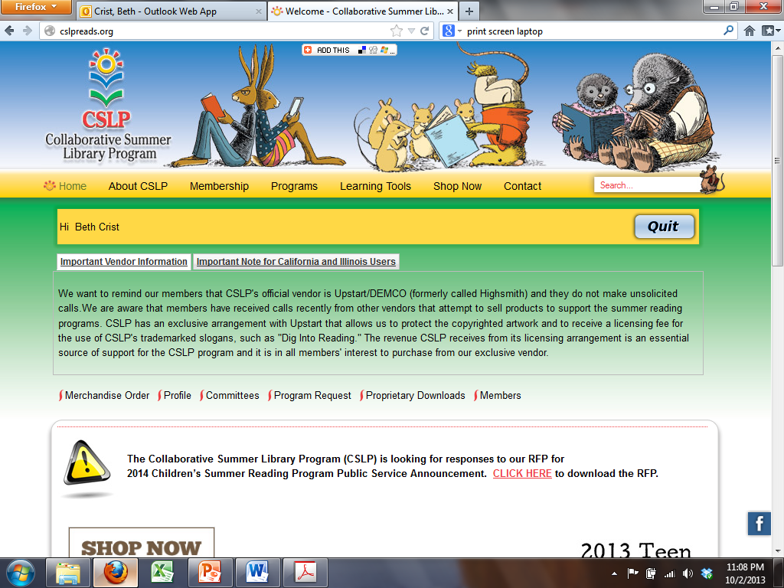
Order from Highsmith

Slide 7
Get promos, etc., here

Slide 8
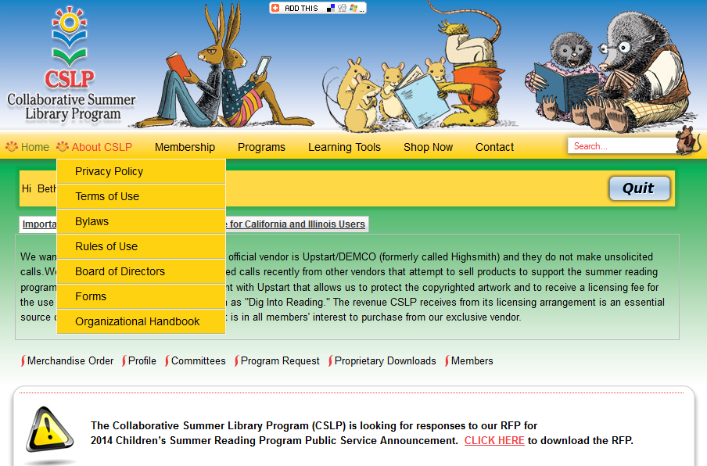
Click here for copyright info

Slide 9
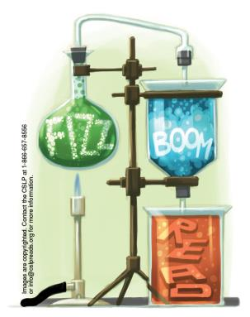
2014 Colorado SRP
Children’s kits:
2 small early literacy posters
5 small kids’ posters
1 pack bookmarks (200)
1 pack stickers (250)
1 rubber stamp
Notes:
When you complete your 2013 SRP report you’re automatically registered for the 2014 program

Slide 10
2014 Colorado SRP cont.
Teen kits:
5 small posters
1 pack bookmarks (200)
1 rubber stamp
1 pack mini-buttons (5)

Slide 11
2014 Mini-Grants
2014 focus: STEM
Purchase STEM-related books for any age
and/or
Purchase STEM-related equipment for in-library use and/or to circulate
Notes:
What kind of equipment? Telescopes, medical models, microscopes, chemistry kits, what else?

Slide 12
2014 SRP Evaluations
Library evaluation
New: Parent evaluation (optional)

Slide 13
Thinking Ahead?
2015 SRP Theme: Heroes
Slogans:
Children: Every Hero Has a Story
Teens: Unmask!
Adult: Escape the Ordinary
2016 SRP Theme: Wellness/Fitness/Sports

Slide 14
Why SRPs?
Parents read, talk, sing, play & write with young kids
Kids & teens select own reading materials
Kids & teens see adults reading
Kids & teens have fun reading
Kids & teens read more, do well in school, succeed
Notes:
Research has shown that reading over the summer unmistakably helps prevent summer slide But little research has proven that traditional srp’s have specific characteristics that help. Here are the proven activities:

Slide 15
Notes:
So, let’s take a cue from the teen SRP here to take a spin in the Imaginator and imagine different ways to do SRPs.

Slide 16
6 Standards of SRPs:
Register participants at the beginning
Track reading by reading log
Have 2-4 levels of completion
Notes:
Examples:
Small changes: family reading logs—Mesa and Pine River,
Medium: Jeffco (all Bingo), Poudre (not registering at the start), letting kids create own goals (reading and/or otherwise), Trinidad—donating to charity instead of incentives, La Veta (offer family programs rather than separate ones for each age group)
Major: Montrose, Anythink, scrap incentives

Slide 17
6 Standards of SRPs:
Have SRPs for different age groups
Give items, books, gift certificates, or passes as incentives
Must be done the same way each year
Notes:
Examples:
Small changes: family reading logs—Mesa and Pine River,
Medium: Jeffco (all Bingo), Poudre (not registering at the start), letting kids create own goals (reading and/or otherwise), Trinidad—donating to charity instead of incentives, La Veta (offer family programs rather than separate ones for each age group)
Major: Montrose, Anythink, scrap incentives

Slide 18
Notes:
What is stem? Different parts—discuss, define.
Steam, steam+m, stream

Slide 19
What is STEM?
National Science Foundation coined the term STEM in 2001.
The following 4 definitions for kids are from Boston Children’s Museum, STEM Sprouts Teaching Guide
www.bostonchildrensmuseum.org/sites/default/files/pdfs/STEMGuide.pdf

Slide 20
Science & Technology
Science is a way of thinking. Science is observing and experimenting, making predictions, sharing discoveries, asking questions, and wondering how things work.
Technology is a way of doing. Technology is using tools, being inventive, identifying problems, and making things work.

Slide 21
Engineering & Math
Engineering is a way of doing. Engineering is solving problems, using a variety of materials, designing and creating, and building things that work.
Math is a way of measuring. Math is sequencing (1, 2, 3, 4…), patterning (1, 2, 1, 2, 1, 2…), and exploring shapes (triangle, square, circle), volume (holds more or less), and size (bigger, less than).

Slide 22
Science
Engineering
Math
Technology
provides tools to deepen & provide context
Prepares us to do
Relies on
Leads to the development of
Prepares us to do
provides tools to deepen & provide context

Slide 23
Why STEM in libraries?
Public libraries have had a tremendous effect on some scientists:
Interviews with Jane Goodall:
www.achievement.org/autodoc/page/goo1int-5
Article about Jack Horner, paleontologist:
articles.chicagotribune.com/2003-01-23/news/0301230350_1_fossilized-dinosaur-embryos-paleontology-science-academy
Notes:
Increase community partnerships
Work with schools
Common Core
Grant opportunities
Libraries strengthen their role in the community as partners in education. This also can show library stakeholders that youth programs have a value beyond entertainment, which can be important in deciding issues like funding and other requests for support.
Opportunity for parents to become more involved with their children through programs that hold universal appeal
STEM is in the national spotlight, so promoting it in your libraries will keep you at pace with the national dialogue on education.
The White House’s STEM coalition writes on its website: “In 2009, President Obama set an ambitious goal: to move U.S. students from the middle to the top of the pack in math and science achievement over the next decade.” because the United States currently faces a shortage of skilled workers in the science, engineering and technology sectors.
As a recent article in Scientific American points out, “[y]oung children think like researchers but lose the feel for the scientific method as they age.”2 Bridging the gap between STEM in the classroom and everyday experiences remains a significant challenge. Overcoming this challenge has never been more important
PLs as centers of lifelong learning
Critical thinking skills, teamwork
http://www.npr.org/player/v2/mediaPlayer.html?action=1&t=1&islist=false&id=165599717&m=165599706 (2.56-3.51)
http://www.achievement.org/autodoc/page/goo1int-5
John “Jack” Horner:
Plagued by undiagnosed dyslexia as a child, Horner couldn't read at all until 4th grade. He graduated from high school with a D-minus grade-point average and flunked out of college seven times before he launched his career in paleontology without a degree.
Horner said his learning disability, which he discovered by accident as a 33-year-old curator at Princeton University, was a blessing in disguise.
It forced him, he said, to invent alternate learning techniques and enabled him to pursue unorthodox scientific research.
I did most of my learning in the library, where I could go at my own pace. I learned that I really could be a scientist and that I could take risks that other students couldn’t because nobody had any expectations of me.
I was outdoors most of the time, summer or winter, but I did occasion the library where I could “read” the books at my own speed. I also checked out a lot of books (all of the science books in our library), and looked at the pictures, or read what I could read.
The key to becoming a successful scientist, Horner told the students, is to embrace the risk of being wrong. "You're going to be wrong a lot in science, especially if you're doing cutting-edge work," he said.
"When you're the first person to discover something, you have the least amount of information about it that will ever be known because the people coming after you will learn new things, some of which will disprove your original findings. If you want to be right all the time, you'd be better off being a lawyer."
http://articles.chicagotribune.com/2003-01-23/news/0301230350_1_fossilized-dinosaur-embryos-paleontology-science-academy

Slide 24
STEM in Libraries
After school programs
Family events
Monthly programs
Summer reading program
Makerspaces
Exhibits
Ongoing services

Slide 25
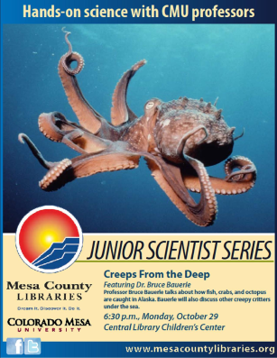
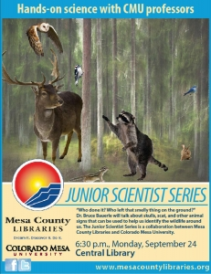
Junior Scientist Program
Mesa County Public Library
Notes:
Great partnership between Mesa County Public Library and CO Mesa University. University professors in science fields give a monthly talk at the library on what they do, including a hands-on science activity for the kids. aimed at kids 8-12. program started January 2012.

Slide 26
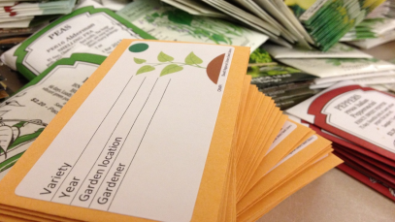
Seed Banks
Basalt Public Library & West Custer County Library District
Notes:
Basalt Public Library has started a seed bank. Seeds are available for local gardeners and farmers to “check out” with the agreement that they grow them out and collect some of the seed to return to the library. The seed of each new generation we will better adapted to the climate in the Roaring Fork Valley. They also offer gardening/horticulture related programming to go with the seed bank.

Slide 27
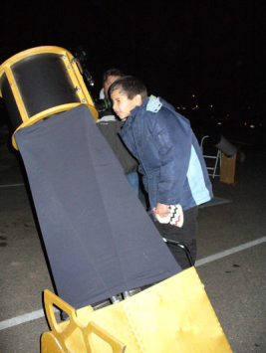
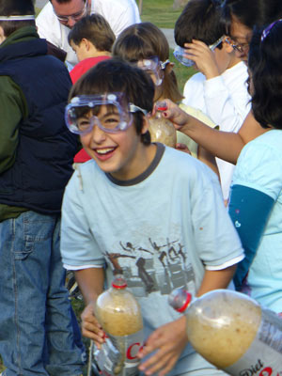
Science Task Force
Mamie Doud Eisenhower Public Library, Broomfield
Notes:
Mamie Doud Eisenhower Public Library offers hands-on science programs for kids using expert community volunteers. A volunteer science task force of these volunteers leads the program, coordinating ideas, programming and volunteers. By involving the community, the library is able to offer a very diverse array of science programming from scientists themselves.

Slide 28
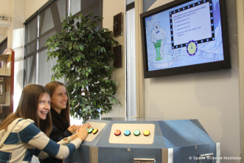
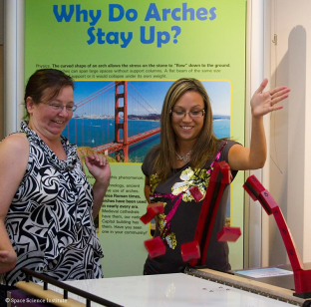
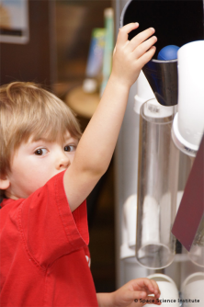
STAR-Net Libraries
Louisville Public Library
Notes:
Louisville Public Library is part of the STAR-Net (Science-Technology Activities and Resources for Libraries) network. It’s a national program led by the Space Science Institute’s National Center for Interactive Learning. ALA is a partner. It includes 2 traveling exhibits, hands-on and outreach activities for kids, and training for library staff.

Slide 29
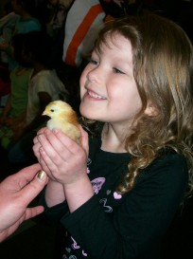
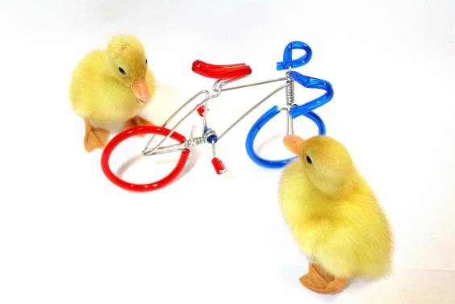
Embryology Program
Anythink Libraries

Slide 30
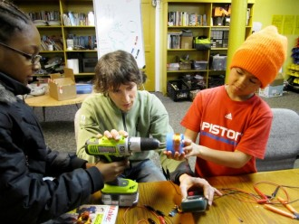
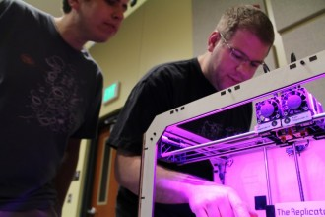
Makerspaces
Multiple Libraries
Notes:
Makerspaces are collaborative spaces in libraries where people interact, engage, and create. Libraries across the country are adding makerspaces, including in CO. here at the Anythink Wright Farms library in Thornton, teens at the makerspace (called “The Studio”) are partnered with creative community members to further the possibilities.

Slide 31
Colorado Teen Video Contest
Multiple Libraries

Slide 32
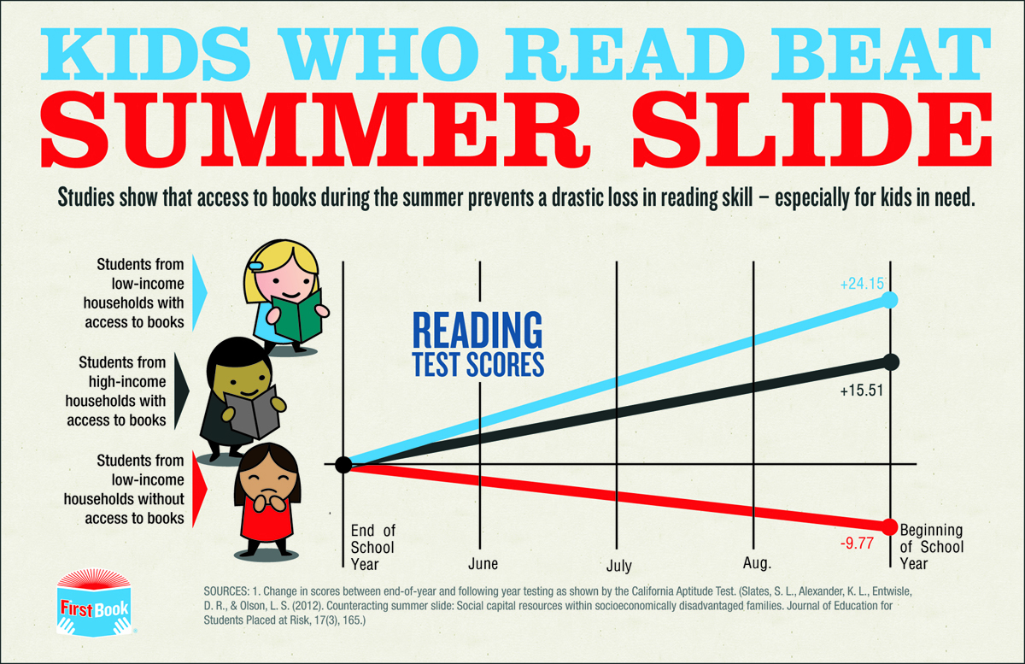
Outreach: Why?
From First Book
Notes:
http://blog.firstbook.org/wp-content/uploads/2013/05/summer-slide-infographic-BLOG.jpg
research studies have shown that summer reading participants tend to be regular library users and/or children and teens who tend to be motivated toward reading and capable readers

Slide 33
/From Summer Matters
Notes:
http://summermatters2you.net/why-summer-matters/

Slide 34
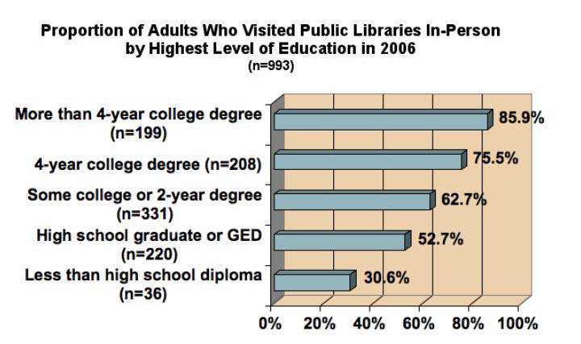
From InterConnections: The IMLS National Study on the use of libraries, museums and the Internet. January 2008.
Notes:
Children from low-income homes have increased summer slide; fewer low-income and less-educated people use public libraries
Conejos, Dacono—SFSP
Nederland--We had a separate reading program for kiddos who would not be able to attend programming called Reading Reward Program. This was a very popular program with our community.
School visits
interconnectionsreport.org/reports/PublicLibraryReport030308.pdf

Slide 35
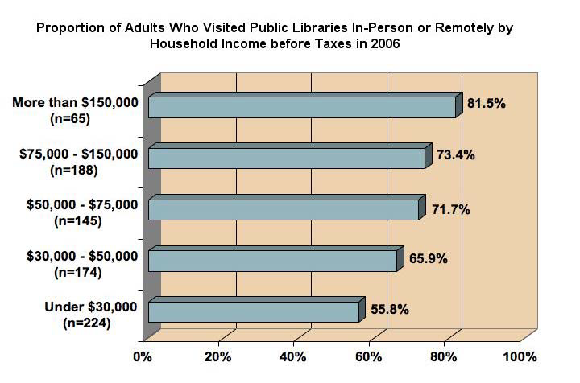
From InterConnections: The IMLS National Study on the use of libraries, museums and the Internet. January 2008.
Notes:
Focusing on outreach efforts helps libraries (a) identify target groups of underserved children, teens, adults or families who have not traditionally participated in the library’s summer reading program, and (b) devise strategies for bringing them into the library—or for bringing the
library to them.
By reaching out to underserved groups who do not traditionally participate in the summer reading program, and by engaging community members who are not regular libraries users and who are not capable readers, libraries can help ensure that their summer reading programs reach their potential, and remain relevant and impactful
To set a goal of reaching nonlibrary users--identify both the groups you wish to target and the number of people you hope to reach within those groups.

Slide 36
How to Reach Out: APPROACH
Assess
Partner
Promote to target audience
Reach Out into the community
Address what’s needed and wanted
Conduct evaluation
Have another look

