Slide 1
2017 Student October At-Risk/Free Lunch Count Office of School Finance Field Analyst Support Team (FAST)
September 2017

Slide 2
Agenda
Student October Count Data Submission
Field Analyst Support Team (FAST)
At-Risk/ Free Lunch Count Audit
Audit Documentation
Direct Certification
Application for Free and Reduced Price School Meals
Family Economic Data Survey (FEDS) Form
Categorical Designations
Special Assistance Certification and Reimbursement Alternatives
FAST Contact Information
Questions

Slide 3
Student October Count Data Submission
The Student October Count is a one-day membership count in which districts report all students who are actively enrolled and attending classes as of the pupil enrollment count date.
For 2017/2018, the pupil enrollment count date is:
Monday, October 2, 2017
Districts report their Student October Count data through the CDE Data Pipeline. Reported data is used to determine both the districts per-pupil and at-risk funding.

Slide 4
Student October Count Data Submission
While several factors come into play when determining a district’s at-risk funding, a student’s free and reduced lunch status as reported in the Student October Count data submission is the primary determination.
Valid lunch eligibility codes for the data submission include:
0 = Not eligible/ Paid
1 = Free lunch eligible
2 = Reduced priced lunch eligible
Only funded students (in grades K-12) reported as free lunch eligible are included when determining at-risk funding.

Slide 5
Field Analyst Support Team (FAST)
In an effort to ensure accurate reporting of those data fields associated with at-risk funding, the Field Analyst Support Team (FAST) of the Office of School Finance at CDE conducts periodic compliance audits of each district’s Student October Count data.
For purposes of the at-risk count audit, districts must be prepared to provide documentation to support any funded student’s free lunch eligibility status as reported in the data submission. Failure to provide documentation may result in the district losing at-risk funds previously received.
Districts must retain all required documentation until audited by CDE or until five years from the certification due date (November 10), whichever comes first.

Slide 6
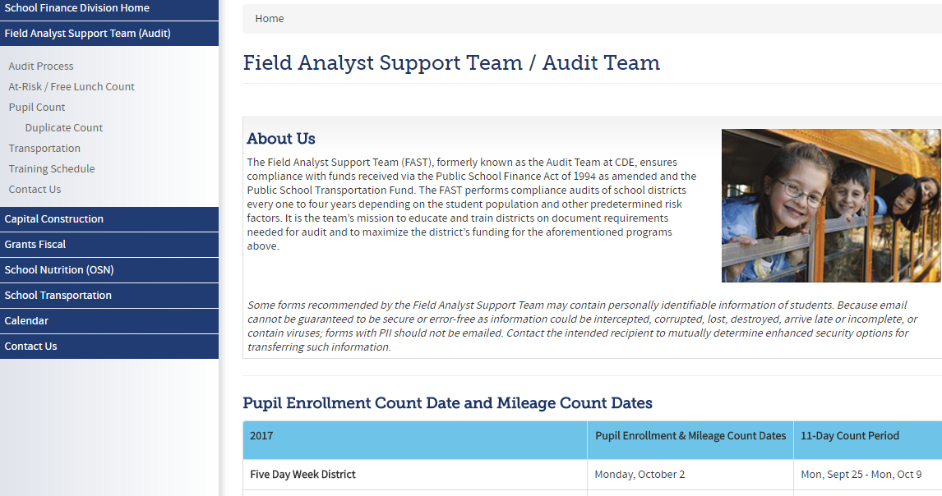
FAST Main Webpage

Slide 7
FAST At-Risk/Free Lunch Count Webpage

Slide 8
Audit Documentation
All current year documentation evidencing lunch eligibility must be dated or received by the district on or before the pupil enrollment count date in order to be used for determining lunch eligibility for the Student October Count data submission.
In the absence of current year documentation, the district may utilize carryover documentation evidencing free lunch eligibility if the pupil enrollment count date falls within the first 30 school days of the current school year.

Slide 9
Carryover Provision
Carryover Variance Waiver
In the event a district is unable to use the carryover provision to evidence free lunch eligibility because the pupil enrollment count date does NOT fall within the first 30 school days, the district may request a variance waiver to extend the 30 day requirement as it relates to the at-risk count only. These requests must be addressed to, and received by Aaron Oberg, School Finance Director (oberg_a@cde.state.co.us) no later than September 15. Requests must outline the reason for the waiver.

Slide 10
Audit Documentation
Free lunch eligibility may be evidenced by one of the following types of documents:
Direct Certification Lists
Applications for Free and Reduced Price School Meals
Family Economic Data Survey (FEDS) forms
Categorical Eligibility Determinations (migrant, homeless, runaway and/or foster child lists)

Slide 11
Direct Certification
Any student who appears on a district direct certification list ran between July 1 and the pupil enrollment count date for the current school year, may be reported as free lunch eligibility in the Student October Count data submission. A copy of the direct certification list must be made available at the time of the at-risk/free lunch count audit in order to evidence free lunch eligibility.
It is recommended that district nutrition services units run direct certification uploads monthly after each new file is available, and that in addition to the required nutrition uploads, districts should also run a direct certification list on the pupil enrollment count date (10/2/2017).

Slide 12
Direct Certification- Extended Eligibility
For students who were not listed on the direct certification list but who reside or belong to the same household as a student who was listed, eligibility may be extended to the student. The district must have documentation evidencing the following:
The date extended eligibility was granted
The initials/name of the district staff member who granted the extended eligibility
The name of the household member who appears on the direct certification list
The date of direct certification list was ran
A copy of the direct certification list

Slide 13
Applications for Free and Reduced Price School Meals
If a student is identified as free lunch eligible through the completion of an Application for Free and Reduced Price School Meals, the student may be reported as such in the data submission. The district will need to be prepared to provide a copy of this application at the time of audit.
For online applications, the district will need to provide a copy of the data submitted in the online application including appropriate evidence of signature and the date the application was submitted/received.

Slide 14
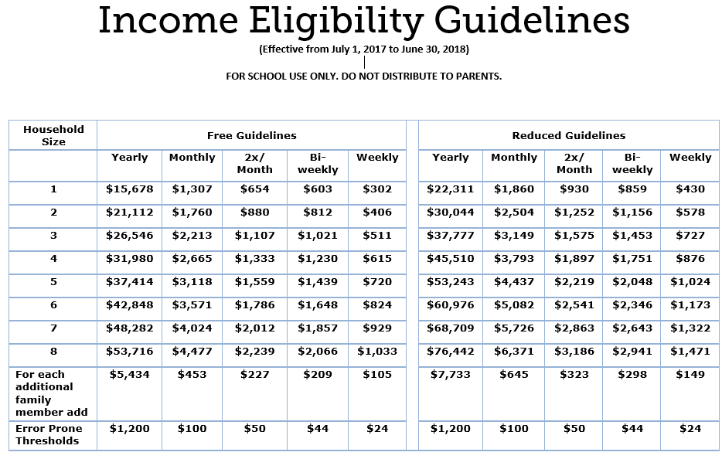
Income Guidelines

Slide 15
Family Economic Data Survey (FEDS) Form
The state FEDS form should be used to document free lunch eligibility for at-risk funding for districts or schools who meet one of the following criteria:
Are NOT participating in the child nutrition program
Who ARE participating in CEP
Who ARE participating in the Provision 2 program following their base year
If a student is identified as free lunch eligible through the completion of a FEDS form, the student may be reported as such in the data submission. The district must be prepared to provide a copy of the document at the time of the audit.
Income guidelines used in evaluating Applications for Free and Reduced Price School Meals should also be used to evaluate the FEDS form.
District cannot use funds received from the National School Lunch and School Breakfast programs to process FEDS forms, however they can reimburse this fund in the event district nutrition staff are used to process these forms.

Slide 16
Categorical Eligibility Determinations
If a student is identified as any of the following on or before the pupil enrollment count date, then the student may be reported as free lunch eligible in the data submission:
Foster Children
Migrant Students
Homeless or Runaway Students
Students may be identified as such on the Application for Free and Reduced Priced School Meals, the FEDS form, or on a district list. The district must be prepared to provide the applicable documentation evidencing the determination at the time of audit to support the student’s free lunch status.
New for 2017/2018: Districts will no longer be providing migrant status in Student October- If CDE identifies a student as migrant, the district will be notified. Districts will also be notified of known foster children who have not been reported as free lunch eligible in the Student October Count.

Slide 17
Special Assistance Certification and Reimbursement Alternatives
The USDA has developed alternative approaches for certification and reimbursement for the Child Nutrition Programs, including:
Community Eligibility Provision (CEP)
Provision 2
These provisions eliminate or reduce the administrative burden of collecting eligibility documentation and simplify the counting and claiming procedures for reimbursement of school meals.

Slide 18
Special Assistance Certification and Reimbursement Alternatives
In order to align with the goal for Special Assistance Certification and Reimbursement Alternatives, which is to reduce/eliminate the administrative burden of collecting household applications/documentation, the following is true for students reported at participating CEP and Provision 2 districts and schools in the Student October Count data submission ONLY:
If a student is reported at a participating CEP or Provision 2 district or school in the Student October Count data submission, the district can report the student as free lunch eligible if it has documentation for the student evidencing free lunch eligibility at any time between, and including, the base year through the pupil enrollment count date of the current Student October Count data submission (usually 7/1 of the base year through 10/1 of the current school year) not to exceed the 4-year cycle.
In the event the CEP or Provision 2 district or school resets its base year, new documentation will be needed.

Slide 19
Audit Documentation (Matrix)

Slide 20
FAST Contact Information
Field Analyst Support Team (FAST)
Email: audit@cde.state.co.us
Website: http://www.cde.state.co.us/cdefinance/auditunit
Aaron Oberg, Director of School Finance, oberg_a@cde.state.co.us
Rebecca McRee, Operations Lead, mcree_r@cde.state.co.us
Melea Bauerle, Field Analyst, bauerle_m@cde.state.co.us
Mary Bello, Field Analyst, bello_m@cde.state.co.us
Travis Noon, Field Analyst, noon_t@cde.state.co.us
Alan Shimmin, Field Analyst, shimmin_a@cde.state.co.us

Slide 21
Questions
Please feel free to type any questions into the chat box
Or
Contact FAST with any additional questions

