Slide 1

Grants Management 101

Slide 2
Grant Life Cycle
These items are a collaboration across several units at CDE and are not the focus of this training.
Pre-Award
Request for Application (RFA), Planning and development of program, budget, final approval
Award
Award
Grant Award Letter (GAL), Terms and Conditions
Post Award
Grant Management,
Monitoring, Reporting, Closeout
These items are the focus of this training.
Notes:
JEN: Think about it this way: preaward is everything you do up until you receive a notice of award and your GAL, when you do, that is the AWARD phase (get your staff and books ready). Post is everything from the date you receive your GAL through CLOSEOUT.

Slide 3
FEDERAL Applicable Requirements and Order of Precedence
Authorizing Statute - The federal statute authorizing the grant program and any other federal statute directly affecting performance of the award.
Program Regulations - Federal program specific guidance related to the specific program under which the funds were awarded.
National Policy Requirements - additional requirements, i.e., FAR, FFATA
Administrative Regulations - cost principles, and audit requirements, e.g., agency implementation of the Uniform Grant Guidance (UGG - which includes 2CFR200)
Pass-through Requirements – Pass through entity's applicable laws and/or regulations that are not in conflict with federal law.
Note, the awardee's internal policies or procedures cannot conflict with the guidance above and must be followed even if they are MORE restrictive than that guidance. During monitoring, activity and internal controls are tested against Federal Regulation AND the awardee’s internal policy.
Authorizing Statute
Program Regulations
ALWAYS follow what is MOST restrictive, even if that is State Fiscal Policy or Awardee Internal Policy
National policy requirements
Administrative regulations
Pass-through entities laws, regulations, and policies
Notes:
JEN: FAR - Federal Acquisition Reporting
FFATA - Federal Funding Accountability and Transparency Act

Slide 4
STATE Applicable Requirements and Order of Precedence
Authorizing Statute/Bill - The state statute or bill authorizing the grant program and any other statute directly affecting performance of the award.
Program Rule - Rule as approved by program or SBE, program rules as defined in the RFA.
GAAP/GASB Requirements - requirements related to standard accounting and internal control practices.
GAL- Terms and Conditions of the CDE Grant Award Letter.
Pass-through Requirements – Pass through entity's applicable laws and/or regulations that are not in conflict with federal law.
Note, the awardee's internal policies or procedures cannot conflict with the guidance above and must be followed even if they are MORE restrictive than that guidance. During monitoring, activity and internal controls are tested against program rules and requirements AND the awardee’s internal policy.
Authorizing Statute/Bill
Program Rules
ALWAYS follow what is MOST restrictive, even if that is State Fiscal Policy or Awardee Internal Policy
GAAP/GASB
GAL Terms and Conditions
Pass-through entities laws, regulations, and policies/procedures
Notes:
JEN: SBE-state board of education
GAL-grant award letter
GAAP/GASB: generally accepted accounting principles or governmental accounting standards board
BEst Practice - treat state as you would federal - be safe

Slide 5
Differences between Federal and State Grants
For both State and Federal awards from CDE, subawarding beyond the LEA or BOCES, is unallowable.
Federal grants
Created and appropriated through an act of U.S. Congress.
Codified in federal law.
Governed by Uniform Grant Guidance (UGG)
  2 CFR 200
  Education Department General Administrative Regulations (EDGAR)
  Funding Program non-regulatory guidance
Funded via reimbursement (funds provided after expenditures incurred).
Indirect Cost Recovery is allowed dependent upon an approved Indirect Cost Rate and possible CAP by federal awarding agency (ie training grants).
Subject to monitoring from CDE as required by the UGG.
State grants
Created and appropriated through an act of state legislation.
Codified in Colorado Revised Statutes (C.R.S.).
Governed by state fiscal rules, State Board of Ed Rules (if applicable), Program Rules, etc.
Typically funded in advance (forward funded).
Does NOT allow Indirect Cost Recovery (MAY require an admin cap).
May be subject to monitoring from CDE in the future.
Best Practice - ALWAYS treat your state as you would federal awards (internal process, policy, requirements, etc).
For both State and Federal awards from CDE, CDE has the authority to be more restrictive if it does not impede the delivery of services or intent and if it does not conflict with any other rule or statute.
Notes:
JEN: Highlight - CDE DOES NOT ALLOW subawarding of any funds CDE awards. NEVER HAS
Admin - instead of receiving ICR, any admin function, per program rules, are budgeted as direct costs. Some STate award (as do federal) have a CAP on the amount of Admin in relation to overall award
Process/policy is being developed at the OSC begin monitoring State awards, more to come

Slide 6
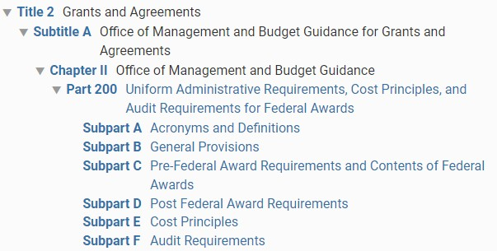
Navigating The Uniform Grant Guidance (UGG)
Title 2 – Code of Federal Regulations –Part 200 (link on Additional Grant Resources slide)
Provides and establishes uniform administrative requirements, cost principles, and audit requirements.
IN GENERAL: if it does not appear as a rule in a specific piece of legislation, CDE Fiscal rules defer to 2 CFR 200 (UGG) & 34 CFR (EDGAR).
Notes:
Jen: This is the bible for federal awards. This should be followed, wherever practicable for state awards. It gets very difficult handling awards in different ways and can result in mistakes, it isn’t worth it and it is just the best practice.
CDE must also comply with 34 PART 75, 76, 81 (EDGAR) where applicable, and may of its’ provisions flow down. Most are related to eligibility, how the STATE must handle direct grants, or how the State requires state administered grant programs to be handled. Good to review.
GEPA is part of EDGAR as well, and should be reviewed ( 34.81)

Slide 7
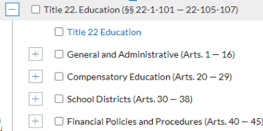
Navigating the Colorado Revised Statutes
The Colorado Revised Statutes (C.R.S.) are the laws passed by the Colorado General Assembly. Every law is assigned an alphanumeric identifier you can use to view the program intent and requirements.
The C.R.S. can be found on the Colorado General Assembly via LexisNexis in publication or online. See link at Additional Grant Resources slide.
This may be useful to review the actual statute or bill for state awards. Please note, however, CDE defers to those requirements listed in the RFA (application) of state awards and has the authority to be more restrictive.
Notes:
JEN this is interesting in terms of what the bill actually intends, however, most times it does leave some room for programs to make decisions on how to carry out the program etc. Always rely on the RFA, the program rules and requirements, etc.

Slide 8
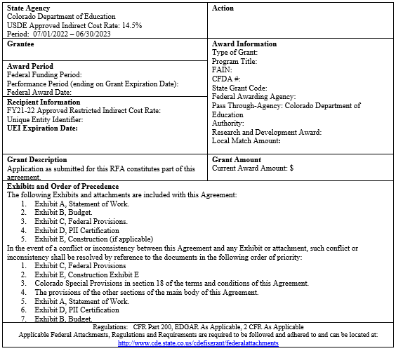
Federal Grant Award Letter (GAL) - What does it look like?
Awarding Agency
Action
Grantee
Award Period
Recipient Information
Award Information
Grant Description
Grant Amount
Exhibits and Order of Precedence
Regulations-link to CDE’s website where all the regulations are posted and are required to be reviewed and adhered to.
Notes:
jen

Slide 9
Federal Grant Award Letter (GAL) - What does it mean?
State Agency (typically known as the pass through entity)
  CDE indirect cost rate; this is not the rate your organization uses if you are claiming indirect costs. Your organization should have its own rate (see Recipient Information below).
Action
  Initial or supplemental or amendment to award (if the statement of work changes or funding changes)
Award Information
  CRS/State Award Name, Federal Program/Grant name
  Federal SEFA information (ALN, FAIN, etc)
  The 4-digit code and name of your organization as registered for your Unique Entity Identifier (UEI)
  Funding Period (period of time in which funds can be expended / drawn down by PTE)
  Performance Period (Period of expenditure and obligation allowed)
  Performance period does not commit funding beyond the current approved budget period.
Recipient Information:
  The approved indirect cost rate for your
organization
  Your organization’s UEI
PAY ATTENTION AND READ THIS - awardees are bound to these requirements.
Notes:
JEN Just showing some of the highlights of the GAL. Reach out if you have any specific questions on your GAL.
Federa award period - GAN to us
Performance period - GAL spending terms within the performance period - allocability discussed on the other slide
Unique Entity Identifier & its expiration

Slide 10
Obligations
§ 76.707 When obligations are made.
The following table shows when a State or a subgrantee makes obligations for various kinds of property and services.
If the obligation is for - | The obligation is made -
(a) Acquisition of real or personal property | On the date on which the State or subgrantee makes a binding written commitment to acquire the property.
(b) Personal services by an employee of the State or subgrantee | When the services are performed.
(c) Personal services by a contractor who is not an employee of the State or subgrantee | On the date on which the State or subgrantee makes a binding written commitment to obtain the services.
(d) Performance of work other than personal services | On the date on which the State or subgrantee makes a binding written commitment to obtain the work.
(e) Public utility services | When the State or subgrantee receives the services.
(f) Travel | When the travel is taken.
(g) Rental of real or personal property | When the State or subgrantee uses the property.
(h) A pre-agreement cost that was properly approved by the Secretary under the cost principles in 2 CFR part 200, Subpart E - Cost Principles | On the first day of the grant or subgrant performance period.
Notes:
JEn Make a distinction on travel between the travel costs, and the conference fees, etc which can be posted as of the purchase date

Slide 11
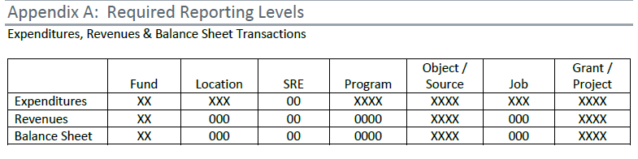
Chart of Accounts (COA) Chart Fields
See CDE Chart of Accounts - Appendix A: Required Reporting Levels for a detailed listing of all the required codes (the “bold” codes).
See CDE Chart of Accounts - Appendix N: Rolling to the Bold for a discussion on the roll to the bold concept.
Notes:
Sondra: This is the fundamentals of CDE Chart of Accounts and required reporting levels. Districts have the option of using fund 10 or fund 22 for grant projects. Anything with the X would be a required field. Bolded accounts within the CDE COA are required and there are sublevels that will roll to the bold allowing districts to further isolate accounts.

Slide 12
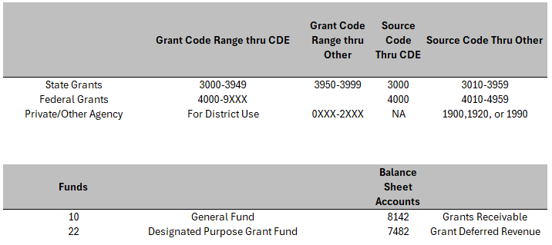
Chart of Accounts – Deciphering Grant Codes
Notes:
Sondra: The coding for grants is important because if there is a problem in the coding it will flag on the data pipeline. State grants passed through CDE will have a project code in the range of 3000 to 3949. Any state funding that is received must have a corresponding source code of 3000, which is state revenue from CDE. 3950-3999 are state grants codes that are available for district use. These codes would be for state grants outside of CDE and must be used with a corresponding source code of 3010. The charter school will need to utilize flow through coding and the corresponding source codes for the charters. Federal grant codes must be assigned by CDE to stay in compliance with Uniform Grant Guidance (UGG). Federal grants from CDE must be used with the corresponding source code 4000, which is federal revenue from CDE. Federal source code 4010 is for federal revenue outside of CDE.

Slide 13

Important Requirements and Distinctions
Notes:
These can be applied to all funding sources

Slide 14
Time and Effort
Support and Documentation Requirements
    Tracking time and EFFORT is required on any federal award. (State Best Practice)
Who needs to track time (in some way)?
  Anyone charging ANY portion of their time to any federal award.
How should time be tracked?
  Guidance indicates:
  If an individual is 100% chargeable to a federal award, awardee should have documentation to support their effort is 100% applicable to the award. Could be a semi-annual Personal Activity Report (PAR) or contract documenting their activity.
  Their activity on the award should be represented in their job description/contract. (Effort)
  Extra duty pay should be reflective of additional hours ABOVE their regular duties for the activity and should be documented, and handled in the same manner for all staff, not just federally funded staff.
  If an individual is split funded on any other funding streams, then entity must have a system in place to track and allocate appropriate percentage of time worked on each funding stream and should be documentable and supportable.
  For split funded individuals, the allocation of expenses may NOT be based on a budget, but are allowed to be ‘trued up’ throughout the award period.
Notes:
Sondra: Note that it doesn’t have to be a paper timesheet, but there must be a system of internal controls and of RECORD indicating that the allocable % of time applied to a federal award is directly related to the effort (activity) the individual had on the award. This must also be incorporated into their records and auditable.
Personal Activity Form - PAR can be used for someone working 100% on an award meaning one cost objective, which would be done semi annually. A contract can be used but there should be a corresponding job description that documents their activity.
Extra duty pay should be above and beyond their duties outside of their regular contract.
Split funded employees need a system in place to track 100 percent of their effort. You cannot base the distribution/allocation on a budget but you can true up actuals through the award period.

Slide 15
Time and Effort
Support and Documentation Requirements
    Tracking Time and Effort - Supporting Documentation
Always review and reconcile your labor costs against your budget, in case there are budget revisions or unintended individuals charging to the award.
Contracts and PARs should be reviewed and reflective of the actual activity performed as compared to budget line. Budget revision may be necessary.
During monitoring, labor costs will be reviewed and supporting allocation methodologies and internal controls will be reviewed.
For split funded individuals, a review/calculation will be done on 100% of individuals’ labor costs/time allocation to ensure that time and effort records for ALL funding streams tie and the appropriate allocable percentage of work is allocated to federal award.
The recording method for time and effort can vary. However, it must comply with your internal procedures, reflect internal controls and provide a reasonable assurance of accuracy. (2 CFR 200.430(g))
https://www.ecfr.gov/current/title-2/section-200.430
https://www.cde.state.co.us/cdefisgrant/faq
Notes:
Sondra:
You want to ensure you are reconciling your payroll ledger, to supporting documentation, and ensuring the correct people are charged to your grant. During this process you want to verify payroll expenditures versus the budget to ensure you do not need to submit a budget revision on your award.
Ensure your contracts/pars are being reviewing and reflect of the actual activity.
During monitoring they will review methodology, internal controls, documentation ties to the allocation in the financial system. Also, make sure that your practices are following your internal procedures or policies.
Note, if implemented properly, timesheets and semi-annual certifications from the days of old (OMB circular) will always meet the requirements

Slide 16
Indirect Cost Guidance
The indirect cost rate (ICR) is calculated by CDE based on financial data pipeline.
The ICR represents the ratio between the total indirect costs and benefiting direct costs, after excluding and or reclassifying unallowable costs, and extraordinary or distorting expenditures (i.e., capital expenditures and major contracts and subgrants).
USDE federal grants specific to training cap ICR at 8%.
Cannot be charged to a grant UNTIL the direct expenditures are incurred.
May not collect ICR on equipment and capital expenditures, or the amount ABOVE the first $25k of professional service contracts. Threshold has increased to $50k for all awards starting on or after 10/1/24.
IS ALLOWED on full contract amount for services contracted to AUGMENT staffing positions that would normally be a staff member (e.g., lack of available skill set in community).
NO ICR allowed on ANY state award.
ICR loses its ‘strings’ when reimbursed. Once the LEA receives reimbursement for its indirect costs, those funds can be used for any propose; they do not have to be spent on the award on which they were earned.
Should be reviewed and reconciled quarterly.
Booking Indirects – Appendix G in the chart of accounts
  Expenditure/Revenue Method
  Abatement Method
    https://www.cde.state.co.us/cdefisgrant/idcusesrequirements
Notes:
Sondra: Reasonableness - how much input/work does LEA actually require for Charters?
Indirect cost rates are determined based of the data pipeline. CDE releases preliminary indirect costs and then they will issue the final indirect costs.
The indirect cost rate (ICR) represents the ratio between the total indirect costs and benefiting direct costs after excluding unallowable costs and distorting expenditures. USDE caps ICR for training grants at 8%.
When booking your indirect costs you must exclude capital expenditures and only charge to the first 25k of professional service contracts. This will increase to 50k under the revised guidance. You will have to determine which set of guidance applies to the grants you have prior to booking indirects.
You can book indirects on full contract amounts if it is a service contracted to augment the staffing positions that would normally be a staff member. Threshold has increased to $50K for all awards starting on or after 10/1/24.
State awards do not have indirect costs.
The best practice would be to review, reconcile, and book indirects at minimum quarterly.
There are two methods listed in the chart of accounts to book indirects, one is the expenditure/revenue method and the other is the abatement method which can be found in appendix G of the chart of accounts.
Charters - indirects can be charged on charters, however the LEA is responsible for ensuring the above practices are applied at the charter level as well.

Slide 17
Procurement Requirements
    Procurement regulations required to be followed for Federal Funds:
    Ensure your internal procurement policy reflects the minimum requirements of federal procurement competition and thresholds.
Take great care of any capital equipment and/or contracted projects. (see Capital Equipment and Contracted Projects slide).
Follow the 2 CFR 200 Procurement Standards:
  Requirement for Conflict of Interest
  Requirement for Competition at certain thresholds (FAR for simplified acquisition threshold)
  SAM.gov check should be done for exclusions
https://www.ecfr.gov/current/title-2/section-200.318
Follow the 2 CFR 200 Competition Standards:
https://www.ecfr.gov/current/title-2/section-200.319
Ensure your internal policy around Federal Funds reflects at a minimum:
  2 CFR 200.320 Methods of Procurement
https://www.ecfr.gov/current/title-2/section-200.320
Requirements to include on Contracts/POs with Federal Funds:
  https://www.ecfr.gov/current/title-2/part-200/appendix-Appendix II to Part 200
    CDE Procurement Guidance Summarizing these requirements can be found here: https://www.cde.state.co.us/cdefisgrant/gfmufpg1223
Notes:
Jen Internal process and thresholds should support the federal thresholds for federal award. In procurement process there must be a segregation of duties, authorization, etc defined. For federal awards, subrecipient needs to make sure that the federal procurement contract additions are included in the PO or contract.
Note, the CDE Procurement Guidance document is in the process of getting updated.

Slide 18
Monitoring
WHY - CDE must monitor all of our grant award subrecipients. The UGG, the US Department of Education and the Office of the State Controller all have authoritative guidance as well as helpful guidelines around implementing this requirement.
WHAT - A tiered review for compliance with general fiscal requirements required when accepting any federal funds as well as award specific requirements around allowability.
WHO - Fiscal monitoring is managed by the CDE Fiscal Monitoring Team as part of GFMU and in collaboration with various program units across CDE.
WHEN - Fiscal monitoring is conducted each fiscal year (looking at the prior fiscal year’s data) on a subset of LEAs. As monitoring is on a cyclical basis, different LEAs are typically monitored each year until the entire population has been reviewed at which point the cycle starts over.
Notes:
JEN

Slide 19
Monitoring Cont’d
WHERE - Fiscal monitoring is currently conducted as desk reviews utilizing email communications, web based document submission dashboards (Syncplicity) and Teams meetings.
HOW - The Fiscal Monitoring Team has a defined process including:
A risk assessment to separate the subset of LEAs into tiers.
Monitoring questionnaires aimed at gathering an initial set of data.
A review of the policies and procedures provided by the LEA which serves as a roadmap to their specific process.
A sample selection of actual expenditures that help CDE document the effectiveness of an LEA’s process.
A final report detailing noncompliant items as well as CDE recommendations.
Ongoing technical assistance in collaboration with other CDE units throughout the year as well as helpful resources posted to the GFMU website.
Notes:
JEn: mention OSC is working on State fiscal monitoring requirements

Slide 20
Capital Equipment and Contracted Projects
    Equipment (2 CFR 200.313)
Documented procedures to manage/track equipment (e.g., equipment definition, who tags equipment, who adjusts records for disposals, etc.)
Property records must include information such as equipment identification number, FAIN#, and federal ownership percentage
Physical inventory and reconciliation at least every two years
    Contracted Projects
Federal contracts - review 2 CFR 200, Appendix II for applicable provisions
ESSER-funded construction subject to requirements of 34 CFR 75.600-617 (except 75.601 and 75.605) including filing a notice of federal interest (ED’s $1M filing threshold)
Davis-Bacon and Related Acts (DBRA)
  Four DBRA criteria
    Exceptions (e.g., employees, sole proprietors, and maintenance)
    Equipment installation costs need to be included in $2,000 threshold assessment (equipment + installation costs regardless of installation funding source). Note, this is also applicable to BEST projects.
  Requirements include contract provisions, review of certified payrolls for prevailing wages, job site visits to ensure DBRA posters and wage determinations are visible
Notes:
JEN
Federally funded (in whole or in part)
Exceed $2,000 (see last bullet regarding federally funded equipment)
Are for the construction, alteration, or repair (including painting and decorating) of public buildings and public works, and
Include employment of laborers or mechanics (work is manual or physical in nature as distinguished from mental or managerial duties)
Note, guidance above may affect BEST funded projects if there is an associated federal funding (e.g. - ESSER used for match)

Slide 21
Determination of Allowable Costs
Applies to State AND Federal Awards
    ANY dollar of state (best practice) or federal funds MUST meet the following requirements:
Is it Allowable (200.403)
  Necessary and reasonable for the performance of the award.
  Conform to specific exclusions or limitations (award specific as well).
  Consistent treatment in process (federal and nonfederal) and application (direct or indirect).
  Conform to GAAP/GASB.
  Not used as cost share or match for another federal award OR duplication of reimbursement (no double dipping).
  Adequately documented.
  Incurred during approved budget period (obligation).
Is it Reasonable AND Necessary (200.404)
  The cost does NOT exceed that which the entity would NORMALLY pay for the service/product.
  Is necessary for the delivery of services under the specific project.
  Complies with requirements and restraints of the award, state law, and INTERNAL POLICY!
Is it Allocable (200.405)
  Example - Labor Costs!
  Incurred for the particular project and is necessary to carry out the project.
  Expense is NOT part of the indirect cost base being claimed.
  If labor costs (activity benefit more than one program, entity can apply costs proportionally and documented.
ALL EXPENSES CHARGED TO A STATE OR FEDERAL AWARD, ARE REQUIRED TO BE NET OF ANY CREDITS.
These requirements are applicable to Cost Share/Matching expenses as well!
Notes:
JEN - every expenditure must meet these three pillars of criteria, but in addition the expenditures must NOT conflict with internal rules and requirements and most especially the GRANT agreement, intent or rules also.

Slide 22
Cost Share, Cost Matching and Program Income
    Cost Matching or Cost Sharing - Funds required from other awardee sources (non-federal) to Match, $1 for $1 of grant funding received, in the delivery of project services and requirements (matching) or up to a specific dollar amount (cost share).
Will be identified in the RFF and Terms and Conditions of GAL if required.
May not be funds or contributions from any other federal award. (except ESSER)
Must be funds used in the accomplishment of the specific project and during the specific performance period.
Are allowable, reasonable, allocable and consistent application within entities business practices.
Be documented/tracked, SEPARATELY of all other general and/or grant funds.
ICR Recovery may be utilized, depending on program allowability.
Program Income: Income earned by awardee directly generated from a supported program or activity, or earned as a result of the federal award, during the performance period.
Must be funds used in the accomplishment of the specific project and during the specific performance period.
Two Methods: Addition and Deduction (should be identified in the Program Guidance or GAL)
  Deduction-income earned should be reduced from the Federal Program Costs, not to increase total program cost. Always used unless the USDE provides guidance.
  Addition-With Prior Approval - program income earned can be ADDED TO the total federal award in the delivery of program objectives.
Notes:
JEN - not many grants from CDE require cost share/match. You will be informed first on the grant application and subsequently upon receipt of award. COST SHARE/MATCH needs to be tracked separately, as it will be required ot be reported on. And CANNOT provide the match $$ from another federal source.
Program income when the awardee ‘makes $’ on the program the award is supporting (paying for). All awards are the deduction method, unless a prior approval from the Feds is received for addition method.
Explain 2 methods.
Tracked separately, be prepared to report on and $$ earned must be in the support of the grant

Slide 23
Internal Processes and Procedures
Federal fiscal compliance is based mainly on the requirements outlined in the Uniform Grant Guidance (UGG)
  Fiscal compliance is generally consistent across all federal funds
  Fiscally compliant procedures under one federal award are typically compliant under most federal awards
Start with documenting how a process works at your LEA
  Handbook for the recently employed
  Satisfy the Must’s and Should’s on the next slide
  Internal processes and procedures MUST be documented and require at a minimum, the federal UGG requirements (e.g., time and effort, procurement, etc)
Monitors and auditors look to how things are done as part of the review
  CDE fiscal monitoring will look at process around four main areas of activity: time and effort, procurement, capital property & equipment, and contracted projects
CDE Guidance on creating internal process regarding Federal funds
  https://www.cde.state.co.us/cdefisgrant/cderefcrepro
Notes:
JEN - this is what, during a monitoring and in some audit level activities, the awardee are ‘tested against’

Slide 24
Internal Processes and Procedures-continued
Must (required in UGG)
Time and effort (200.430)
Employee benefits (200.431)
Procurement (200.318-320)
Equipment management (200.313)
Cost Allowability (200.403-405)
Cash management & Internal Controls (200.302, 303 and 200.305)
Fraud Waste and Abuse (200.113)
Travel (200.475)
Conflicts of interest (200.318(c)), (200.112)
Accounting Policies (200.400(a)), (200.302, 303)
Should (best practice)
Record retention (200.334)
Internal monitoring (e.g., risk assessments, sub-recipient review, etc.)
Program specific requirements (e.g., eligibility, matching, etc.)
Internal processes and policies will be reviewed during monitoring to ensure that they reflect federal requirements AND that the entity is following its internal policies and/or procedures.
Notes:
JEN

Slide 25
Best Practices
Notes:
These can be applied to all funding sources

Slide 26
Best Practices and
Some Useful Tools
Communication (internal and external)
Current grant list with project codes
Overall Grant Tracking - Virtual or Hard Copy
Budget to Actual Spreadsheet
Review your expenditures monthly
Indirects (Process)
    Calculate your indirects (if allowed) monthly or at least quarterly
    Make sure indirects are calculated on the correct expenditure categories
Request for Funds
Quarterly Check Ins
End of Year Grant Closeout Process
RECONCILE!
Notes:
Sondra:
Communication is key whether it is internal or external. The communication with stakeholders should begin way before implementation.
Grant lists - with employee turnover consider what practices you can implement to make things easy. A grant list, with CDE project codes, when are programmatic and fiscal reports due, does the grant allow indirects, what rate was budgeted, when are request for funds due?
Documentation virtual or hard copies
Budget to actual spreadsheet - a lot of financial systems do not let you encumber payroll. On the CDE website there is a budget to actual spreadsheet available. This spreadsheet should be reconciled back monthly or quarterly depending on activity to the general ledger.
Keeping a process for your indirects.
When do you calculate and book indirects?
How do you ensure the right cost categories - especially when you have the 25k which will soon be 50k
Have quarterly check ins with stakeholders, have a process to close of grants, and reconcile.

Slide 27
Best Practices – Things to Know
Name of Grant and Fund Type
Performance Period
Project Code
What is required to submit an RFF (GAINS)
Last day to request funds or how often (do you know the REQUIREMENT in your Terms and Conditions?)
Know the Closeout Process
Understand when/how to do a budget revision
What grant has indirect (not on state grants)
Grant Contacts (funder, program person, fiscal)
Notes:
Sondra:
These items are things you need to know about your grant and should any of these items be included on a grants list that anyone could walk in and understand?
Name of Grant and Fund Type
Performance Period
Project Code
What is required to submit an RFF (GAINS)
Last day to request funds or how often (do you know the REQUIREMENT in your Terms and Conditions?) - EXHIBIT A has a ton of useful information
Know the Closeout Process
Understand when/how to do a budget revision
What grant has indirect (not on state grants)
Grant Contacts (funder, program person, fiscal)

Slide 28
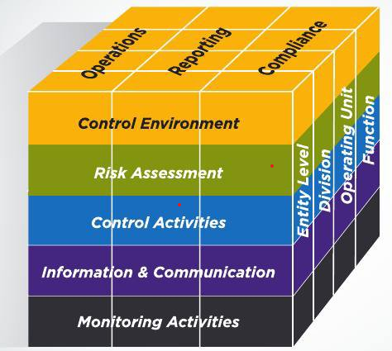
Best Practices - Source Documentation
Time and effort (must meet criteria at 200.430(g))
  Requirements triggered once federal funds used for compensation to any degree
Personnel Contracts
Extra Pay Timesheets
Stipend Memos
Purchase Orders/Receiving
Contracts
Pcard Statements
Invoices
Travel Reimbursement Forms
  For indicating the purpose for travel
  Per Diem Rates
  Hotel Confirmations
  MapQuest or Google Maps for Mileage
  Uber Receipts
  Car Rental Receipts
Record Retention
  Federal Awards: Records should be retained for a minimum of 3 years beyond the final financial disposition of the award.
Notes:
Sondra:
We talked about time and effort but we wanted to list some source documentation items and record retention requirements.
Time and effort (must meet criteria at 200.430(g))
Requirements triggered once federal funds used for compensation to any degree
If you use a PAR for 100% funded people or time and effort for split funded employees make sure you are retaining the documentation.
Personnel Contracts
Extra Pay Timesheets
Stipend Memos
Purchase Orders/Receiving - what are your procurement policies?
Contracts
Pcard Statements
Invoices
Travel Reimbursement Forms - is there a policy for travel?
For indicating the purpose for travel
Per Diem Rates
Hotel Confirmations
MapQuest or Google Maps for Mileage
Uber Receipts
Car Rental Receipts
Record Retention
Federal Awards: Records should be retained for a minimum of 3 years beyond the final financial disposition of the award.

Slide 29
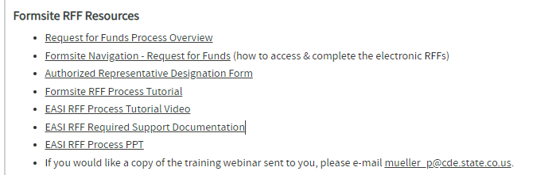
Best Practices - Request for Funds
Request for Funds should be done monthly, at a minimum they are required to be done quarterly per the terms and conditions in the GAL.
There are various trainings and where to request funds at the link below. (This is for the Formsite System, GAINS is coming soon!)
Failure to draw funds down per the terms and conditions can risk your award. Risk assessment for monitoring may look at drawdown frequency when developing risk scores.
  https://www.cde.state.co.us/cdefisgrant/requestforfundsforms
Notes:
Sondra: distinction of GAINs and Formsite
CDE is rolling all grants over into a new platform. The request for funds process will be slightly different depending on the system. Formsite is basically revenue (payments requested) minus expenditures then you get the total amount of what should be requested. This should match your GL.
In GAINs you will be requesting by expense line and you will only be able to go over the object code by 10%. When you reach that 10% you will not be able to request and you will have to do a post award revision.
You still need to follow the terms and conditions of your GAL and make sure you are requesting on time in either system so that you are not out of compliance.
Also, failure to request funds can result in cash flow issues. Larger LEAs have the ability to float grants, where other entities need to reimburse their bank accounts. Please keep this in consideration. It is best to request monthly and at minimum quarterly.

Slide 30
Common Audit Findings – Allocability
FINDING: Grantees/sub-recipients charge salaries to a grant based on budgeted amounts instead of actual after-the-fact time reported on personnel activity reports. For example, the grantee budgets for 20% of a staff member, claims 20% of the staff time, but effort supported only 18%. The auditors question the entire claimed salary for all staff. During audit resolution, the grantee has to go back and recalculate time spent for all staff based on the timesheets. Some disallowances will occur if the claimed costs are not supported by the timesheets. | CORRECTIVE ACTION: Ensure accounting staff are reporting payroll expenditures based on actual hours or percentages by grant or activity and not using budgeted time entered into the accounting system at the beginning of the year as the allocation method when completing expenditure reports. Develop a system to compare actual time against budgeted time and document the process in writing.
FINDING: Grantees charge costs in one grant that are actually carried out in a succeeding budget period in a new grant. For example, a grantee issues a contract late in the budget year for activities the contractor will complete in the succeeding year under a new grant. Contractor payments span both grants. Auditors question the costs as unallocable to the grant and the Federal agency would typically disallow them during audit resolution. | CORRECTIVE ACTION: Review budget to actual expenditures on a monthly basis. Ensure you charge the costs to the correct grant or budget period. Ensure you seek approval from the Federal agency to use funds from a previous budget period in the succeeding new grant budget period or through a no-cost extension. Do not assume the Federal agency will approve the request. In many cases, it may not be approved.
Notes:
Sondra:
We wanted to give you some example of common audit findings. The first finding was directly related to a staff members time being allocable to the grant. Remember the charge to the grant needs to represent the actual effort worked on the grant. If you have a system that is set up to distribute a split portion of salary then you need to review the actual effort the employee has been working on the grant.
The second finding is based on allocability. You want to make sure you are spending in the appropriate performance period.

Slide 31

Compliance - Review and Resources

Slide 32
Compliance - Allowability, an Equation
Allowable = reasonable + necessary + allocable
Necessary
Required for the proper performance of the award
Reasonable (200.404)
Would a prudent person consider the cost and nature of the item to be ordinary and necessary?
Allocable (200.405)
Cost assignable in accordance with relative benefit received
Notes:
Sondra:
The top is the equation required for things to be allowable under the regs. Remember just because a cost is allocable does not mean it is allowable. Each piece of the equation must be met before it is considered allowable.
Is it reasonable? Would a prudent person consider the cost and nature of the item to be ordinary and necessary.
It it necessary to complete the objective of the award?
Is it allocable to the award? Cost assigned is in accordance with the benefits.
There are factors that should be considered with in regard to reasonableness but you need to be able to justify your decision. Was the cost higher because you needed it by a certain time? Things like that play into what a prudent person would consider reasonable.

Slide 33
Compliance - Common Issues Related to Allowable Costs
Food - very specific scenarios in which ED sees food as an allowable use of federal funds
Taxes - make use of available tax exemptions (200.470)
Personal benefit - be careful with perceived benefits (e.g., incentives/gifts)
Conflict with internal policies (e.g., travel normally charged to non federal funds?)
Notes:
Sondra:
There are various scenarios when it comes to food and what is considered an allowable use of funds. Please review them because typically there needs to be justification.
Taxes always use your tax exempt status when available. There are sometimes when it is not, however the regs read if it is available it must be used.
Obviously no swag but also be careful with purchases like these and justification.
Make sure policies are consistent and that they do not conflict with one another.

Slide 34
Compliance - What Needs to Be Documented?
How does the process work? What are the steps from start to finish to accomplish a task? Most likely a combination of policy and procedure.
Policy
A guiding principle used to set direction in an organization.
Changes infrequently
States generally who, what, when, or why
Is broad and general
CDE has compiled some rules and guidance
Procedure
A series of steps to be followed as a consistent and repetitive approach to accomplish a result.
Continuously changes and improves
States specifically who, what, when, and how
  CDE recommends using titles rather than names when documenting the “Who”
Offers a detailed description of activities
Notes:
Jen in the absence of a policy, a procedure is acceptable. Will be tested against. Note, a policy alone (e.g. - CASB policies) is typically insufficient as a fully documented process

Slide 35
Compliance - Overall Financial Management
Documented Processes + Proper Allowability Considerations = Compliant Financial Management (200.302)
Financial systems sufficient to show expenditures used in accordance with UGG and the award
Awards identified in accounting system to a level showing, at a minimum; ALN number and title, Federal award number and year, name of Federal agency, and name of pass-thru entity (accomplished through the proper use of the CDE Chart of Accounts)
Effective control and accountability over all expenditures posted to the award
Ability to show comparison of budgeted expenditures to actual
Adequate source documentation (must tell the story and not complex)
Follow established and documented process
Notes:
Sondra:
Documented Processes + Proper Allowability Considerations = Compliant Financial Management (200.302)
Financial systems sufficient to show expenditures used in accordance with UGG and the award
Awards identified in accounting system to a level showing, at a minimum; ALN number and title, Federal award number and year, name of Federal agency, and name of pass-thru entity (accomplished through the proper use of the CDE Chart of Accounts)
Effective control and accountability over all expenditures posted to the award
Ability to show comparison of budgeted expenditures to actual
Adequate source documentation
Follow established and documented process

Slide 36
Common Audit Findings – Financial Management / Policies / Procedures
FINDING: Grantees do not have good fiscal monitoring policies and procedures in place to ensure subrecipient financial systems are set up to manage Federal funds. For example, the grantee fiscal monitoring tool does not include a process to check amounts recorded in the accounting system to amounts claimed on expense reports. | CORRECTIVE ACTION: Review and strengthen fiscal monitoring policies and procedures of subrecipient's financial systems. Develop a written tool, and set-up regular on-site or desk monitoring visits.
FINDING: Grantees/subrecipients are not reconciling expenditures in their accounting systems/general ledger to amounts claimed on their Federal Financial Reports (FFR). The amount claimed on the FFR does not match the accounting records. Auditors question the difference between what the account system demonstrates as expended and what the FFR reports. The Federal agency must disallow the cost if the grantee cannot reconcile the difference. | CORRECTIVE ACTION: Create and implement procedures to conduct a regular reconciliation between the new FFR and the accounting system and document the process in written procedures. If different offices or individuals prepare the reports, ensure they communicate with one another and reconcile differences.
Notes:
SONDRA
Finding on procedures
not reconciling there are not fiscal monitoring tools - training, monitoring desk audits
Reconciling to the system if you use the tools ad cde and recon to the system.

Slide 37
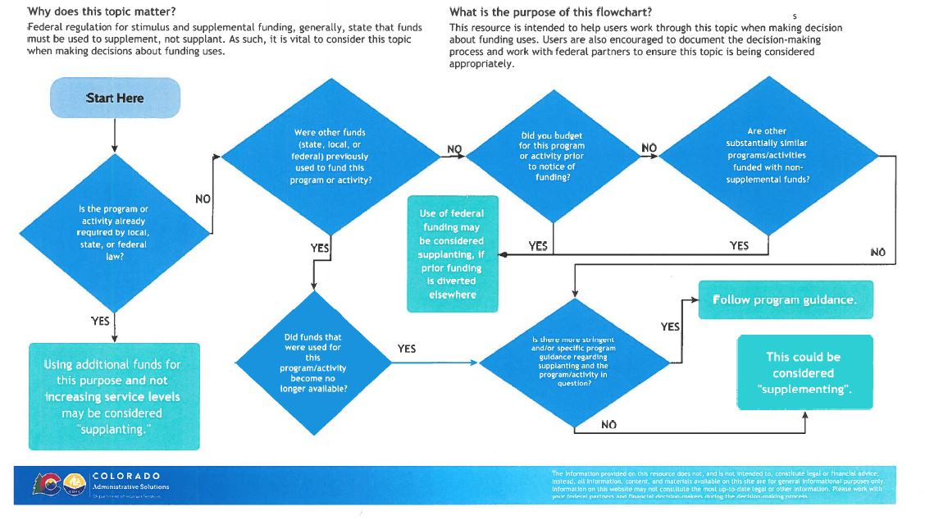
Supplement, Not Supplant
Notes:
Sondra: , while the SNS philosophy is the same, the specific tests may vary across the awards. Note, ESSER does not have SNS but most other ED grants do.

Slide 38


Question
Are there any questions?

Slide 39
Additional Grant Resources
Chart of Accounts: http://www.cde.state.co.us/cdefinance/sfcoa
Grants Fiscal: https://www.cde.state.co.us/cdefisgrant
Indirect Rates: https://www.cde.state.co.us/cdefinance/icrc
Request for Funds: https://www.cde.state.co.us/cdefisgrant/requestforfundsforms (GAINS coming soon)
Federal Regulation 2 CFR 200: https://www.ecfr.gov/current/title-2/subtitle-A/chapter-II/part-200?toc=1
EDGAR Regulation: https://www.ecfr.gov/current/title-34
Related School Finance Trainings: http://www.cde.state.co.us/cdefinance/upcomingschoolfinancetownhallsandtrainings
Management Concepts: https://www.managementconcepts.com/ (for additional staff training if necessary)
Colorado Revised Statutes: https://leg.colorado.gov/agencies/office-legislative-legal-services/colorado-revised-statutes
Colorado Office of the State Controller Fiscal Rules: https://osc.colorado.gov/financial-operations/fiscal-rules-procedures/fiscal-rules
CDE Grants Fiscal Resources: https://www.cde.state.co.us/cdefisgrant/webinarstrainingsguidance
GAINS: https://www.cde.state.co.us/idm/gains
Indirect Cost Guidance: https://www.cde.state.co.us/cdefisgrant/idcusesrequirements and 2 CFR 200.1 Modified Total Direct Cost (MTDC)
Federal GAL Additional Regulations to review: http://www.cde.state.co.us/cdefisgrant/federalattachments
Jennifer Austin, Director of Grants Fiscal Management (CDE): austin_j@cde.state.co.us
Hilery Morris, Fiscal Monitor (CDE): morris_h@cde.state.co.us
Bill Parsley, Monitoring Supervisor (CDE): parsley_b@cde.state.co.us

