Slide 1
Data Pipeline
Cognos Reports
Fiscal Year 2024-25
August 21, 2025

Slide 2
Overview

Slide 3
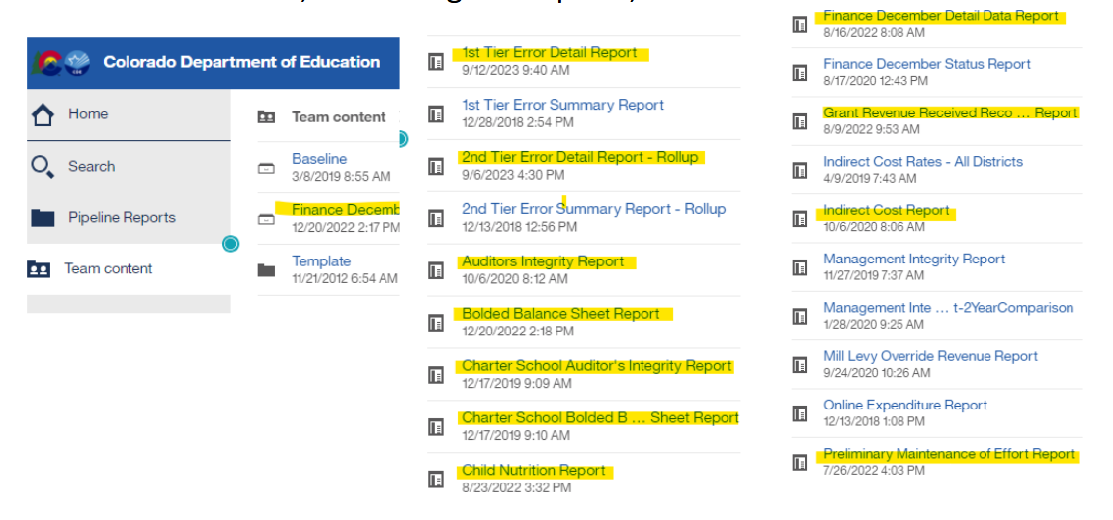
Accessing the Reports - In Data Pipeline
From the Main Menu, Select Cognos Reports, then Select Finance December:
You must be logged into Data Pipeline

Slide 4
Reports Used in the Data Submission
The following Cognos reports are used to verify that all
information in Data Pipeline matches the district’s audit:
Auditors Integrity Report
Including Charter Report if applicable
The FINAL version must be included in bound audit
Bolded Balance Sheet
Including Charter Report if applicable
1st Tier Error Detail Report**
2nd Tier Error Detail Report - Rollup**
Grant Revenue Received Reconciliation Report **
** Reconciliation Reports - Verified & submitted to CDE
Note that you must be on Tier 2 before the Auditors Integrity and Bolded Balance Sheet reports populate.

Slide 5
Reports Used in the Data Submission
provided to other departments
The following Cognos reports are shared with other departments as part of their reviews and/or Calculations
Child Nutrition Report
Child Nutrition Report (Net Cash Resources calculation) and for Nutrition Service Administrative reviews
Preliminary Maintenance of Effort Report
Prelim Maintenance of Effort
(ECEA MOE - Grant #s 3130/3131/3896/3897)
Data Pipeline Data is consolidated by Administrative Unit and completed in spring by Grants Fiscal
Indirect Cost Rate Repot
Used in various grant applications & food service calculations

Slide 6
Auditors Integrity Report

Slide 7
Auditors Integrity Report
Required in the Final Audit
The Final Auditors Integrity Report must match the audited financial statements for each fund and in total (all funds combined).
It must be marked ‘Final’ and bound in the audit*
(FPP Handbook, p. 68).
Financial Audit Law and Submission:
Report will be labeled as ‘Final’ at the bottom when data is submitted to CDE.
Notes:
Kelly - Some auditors might combine the funds into the statements (example funds 20 & 22)

Slide 8
Auditors Integrity Report
Statement of Revenues, Expenditures & Changes in Fund Balance
Each line on the report represents a specific fund (or group of similar funds)
For every fund the report lists the following in columns from left to right:
Beginning Fund Balance (last year’s reported Ending Fund Balance)
Revenues*
Expenditures
Ending Fund Balance
Each of these totals must match the Statement of Revenues, Expenditures and Changes in Fund Balance (income statement) for all governmental funds in the district/charter school audit.
* The Revenues total should match Revenues plus/minus transfers & other sources
This includes all ‘Major’ and ‘Nonmajor’ Governmental Funds in the audit, including Foundations and Internal Service Funds (depends on the classification the district & auditor are using for their funds).

Slide 9
Auditors Integrity Report
Major and Nonmajor Fund Statements
Major Funds
Financial Statements for Major Funds are found toward the top of the audit, following the Statement of Net Position and before the Notes section.
This generally includes the General Fund, Bond Redemption Fund, Building Fund, etc
Nonmajor Funds: Combining Statements of Revenues, Expenditures & Changes in Fund Balance
Financial Statements for Nonmajor Funds are found toward the bottom of the audit, after the Notes & Budgetary Comparison tables for the General Fund
This general includes the Food Service, Pupil Activity and other, smaller funds
The totals from the Combining statements will be included (as a column) in the ‘Total Governmental Funds’ with the other, Major funds.
In addition to the individual fund totals, these overall totals must match the totals on the Auditors Integrity Report.

Slide 10
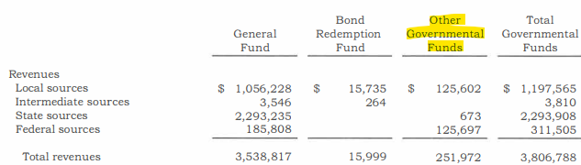
Auditors Integrity Report
Major and Nonmajor Fund Statements in Audit

Slide 11
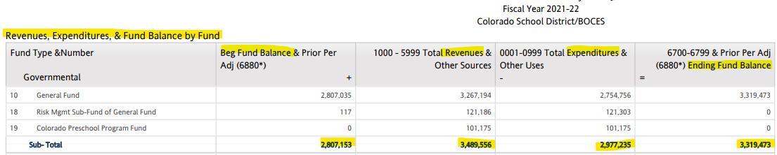
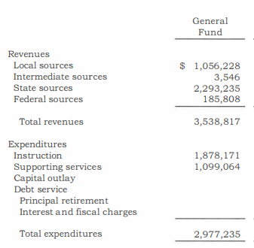
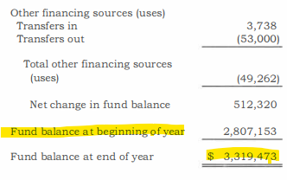
Auditors Integrity Report:
Statement of Revenues, Expenditures & Fund Balance
Revenues +/- Transfers (Other finance sources/uses)

Slide 12
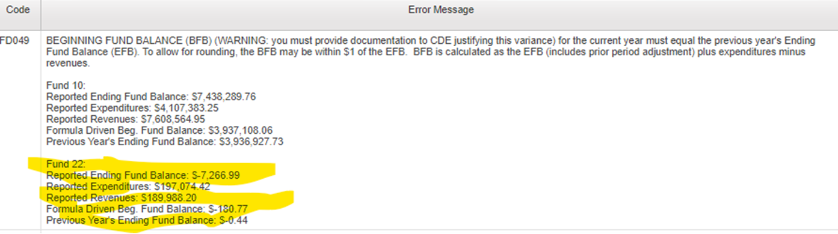
Auditors Integrity Report
Beginning Fund Balance - Formula FD049
Formula-Driven Beginning Fund Balance - (Tier 2 Warning FD049):
Formula-Driven Beg Fund Balance (BFB):
CY End Fund Balance (EFB) - CY Revenues + CY Expenditures = BFB
Does the calculated BFB agree with last year’s reported EFB?
‘If the EFB is $1000, revenues were $500 and Expenditures were $400, then BFB must be $900’. Does this match last year’s reported EFB?

Slide 13
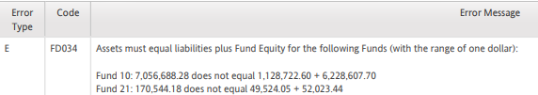
Auditors Integrity Report
Beginning Fund Balance - Formula FD034
Note: This BFB warning is often related to the ‘Assets must equal Liabilities plus Fund Equity’ error FD034

Slide 14
Bolded Balance Sheet

Slide 15
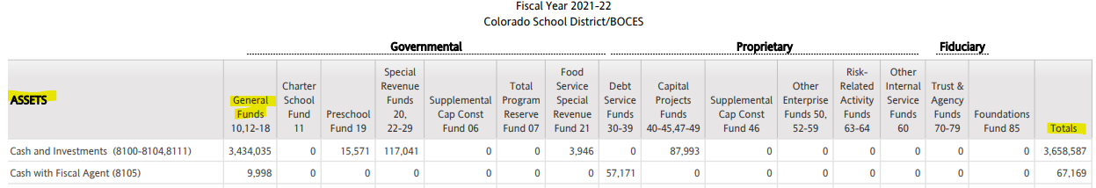
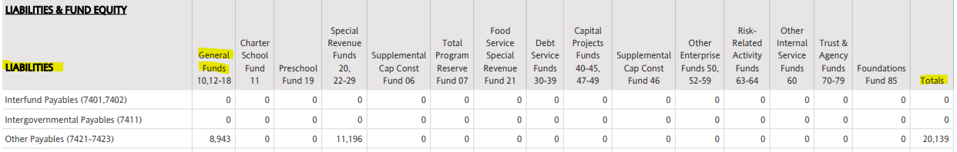
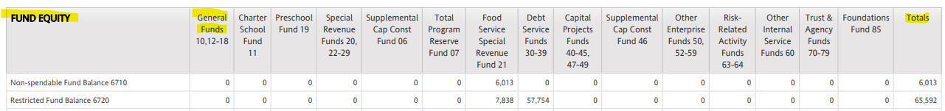
Bolded Balance Sheet
Assets, Liabilities & Fund Equity

Slide 16
Bolded Balance Sheet
Fund Equity Must Mirror the Audit!
The Assets, Liabilities must match the overall audit total, depending on classification of some accounts, which might be combined in the audit.
Fund Equity account balances must mirror the audit. This is driven by statue and by GASB Statement #54.
Differences may require corrections to be made to the data, so verify coding and amounts match the audit:
TABOR (6721)
Restricted (6720)
BEST Capital Reserve (6727)
CPP Reserve (6724)
UPK Reserve (6725)
Committed (6750)
Assigned (6760)
Unassigned (6770)
etc.

Slide 17
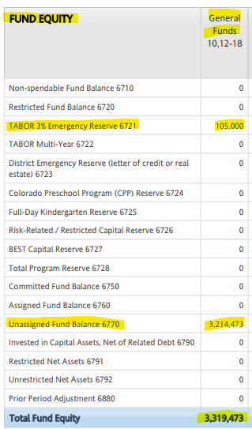
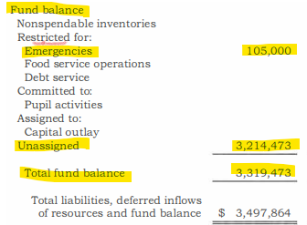
Bolded Balance Sheet
Fund Equity Must Mirror the Audit! example

Slide 18
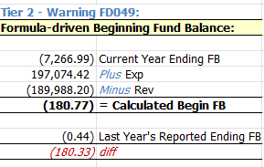
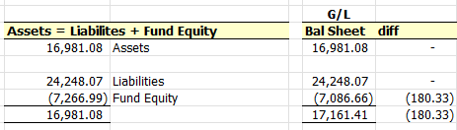
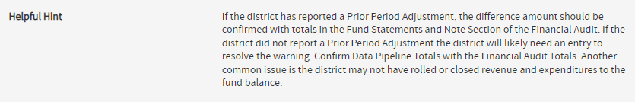
Auditors Integrity Report
Beginning Fund Balance - Formula
Formula-Driven Beginning Fund Balance - Tier 2 Warning FD049:
Formula-Driven Beg Fund Balance (BFB):
CY End Fund Balance (EFB) - CY Revenues + CY Expenditures = BFB
Does the BFB, EFB, Revenues & Expenditures for that fund match the G/L and the Draft Audit?
Helpful Hints - (tips & guidance for how to resolve errors & warnings)

Slide 19

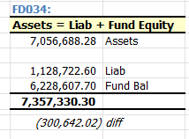
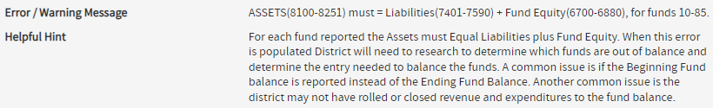
Bolded Balance Sheet
FD034: Assets = Liabilities + Fund Balance
All funds must be in balance - Tier 2 Error FD034
Assets = Liabilities plus Fund Balance
Basic* Accounting Equation: A = L + FB
Duplicating the totals in the data:
Helpful Hints - (tips & guidance for how to resolve errors & warnings)
* (debits = credits)

Slide 20
Grant Revenue Received Reconciliation Report

Slide 21
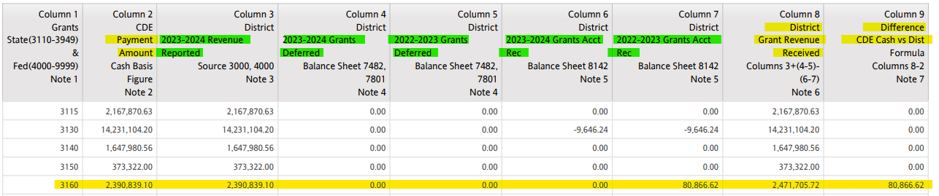
Grant Revenue Received Reconciliation Report
Grant Revenue Received Reconciliation Report (GRRR)
The GRRR is one of three ‘reconciliation reports’ that must be submitted with the district audit files to CDE (along with the Tier 1 and Tier 2 Detail Error Reports, with comments if needed).
Compares the Revenues reported by the district/BOCES to the (cash-basis) Payments sent by CDE per the FDW report* (Column 2)
Adjusting for the CY & PY Deferred Revenue (7482) & Grants A/R (8142) entries for each grant. Remember to include the grant code in those entries/data lines!
This total is then compared to the CDE payment amount (Col 9). Any differences must be reconciled & explained (usually a timing difference)
Related to Grant Warning FD094 (next slide)
*Financial Data Warehouse Report

Slide 22
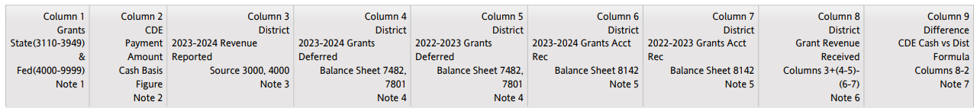
Grant Revenue Received Reconciliation Report
Related to FD094 Grant Revenue Receipts
Column 2 = Payments sent by CDE (FDW Report)
Column 3 = District data w/ Source 3000 or 4000 (only CDE funds). If coded to 3010 in error, it won’t align.
Columns 4-7 = CY & PY Grants A/R & Deferred Rev (8142, 7482)
Column 8 = Calc of Grant Rev Received
Column 9 = Difference between CDE Cash (Col 2) vs Grant Revenue Received (must be explained)
FD094 - Lists grants with variances in District Receipts vs CDE Cash Payments
in this case, district recorded revenues using grant 5555 that should have been grant 4555
FD094 is a Tier 2 Warning that must be reconciled/commented on (reconciliation reports to CDE)
The GRRR and FD094 will help you reconcile your grants & grant revenues!

Slide 23
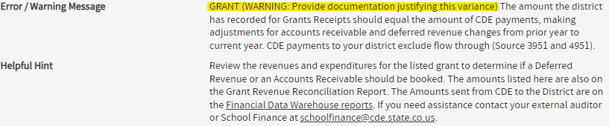
Grant Revenue Received Reconciliation Report
Helpful Hint: FD094
Helpful Hint:
The GRRR and FD094 will help you reconcile your grants & grant revenues!

Slide 24
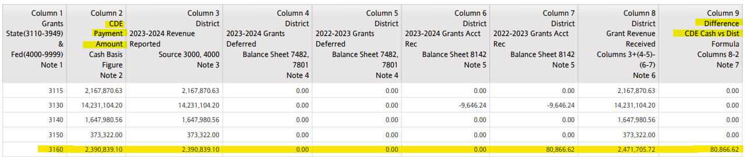
Grant Revenue Received Reconciliation Report
Example
Any differences in Column 9 must be reconciled & commented on - must be submitted with the reconciliations/comments (along with Tier 1 & Tier 2 comments/reconciliations)
From the notes (last page) of the GRRR:
6. District Grant Revenue Received Calculation:
FY24-25 Grant Revenue Reported + (FY24-25 Deferred Grant Revenue - FY23-24 Deferred Grant Revenue) - (FY24-25 Grants Accounts Rec - FY23-24 Grants Accounts Rec)
7. The CDE Payment Figure is compared to the calculated District Grant Received Figure
If the difference between the two can be attributed to a timing issue, grants deferred reported or grant accounts receivables reported, the difference is acceptable.
If the difference is a result of incorrect revenue reported by the District or incorrect grants deferred revenue or grants accounts receivables reported, this is not acceptable.

Slide 25
Child Nutrition Report
(Net Cash Resources in the
Food Service Fund)

Slide 26
Child Nutrition Report - Net Cash Resources
What It Is
Tables in the report displaying Fund 21 account balances:
Revenues
Expenditures (including indirect costs, if any)
Balance Sheet Accounts within Fund 21.
Short Term Balance Sheet accounts are used to calculate Net Cash Resources (short term, liquid assets - minus short term liabilities).
Federal Regulations Test:
Not allowed to have more more than 3 months of Net Cash Resources on hand
The calculation indicates whether or not there is excess Net Cash Resources (> 3 months worth)
Three month Net Cash Resources: Total Expenditures Divided by 9, times 3
Does the District have more than 3 months net cash resources on hand, based on a 9-month operating year?
If yes, a Net Cash Resources Spending Plan must be submitted to the School Nutrition Unit (Lyza Shaw)
Nutrition Program - Financial Management (next slides)

Slide 27
Child Nutrition Report - Net Cash Resources
6-months average expenditures
Excess net cash guidance
Federal regulations require that the net cash resources of the food service fund shall not exceed three months average expenditures.
However, CDE has recently adopted the flexibility of only requiring a spending plan if net cash is in excess of six months average expenditures.
Sponsors with net cash resources in excess of six months average expenditure will be notified and must submit a spending plan to CDE for approval within 30 days of receiving the notification.
Nutrition Program - Financial Management (next slides)

Slide 28
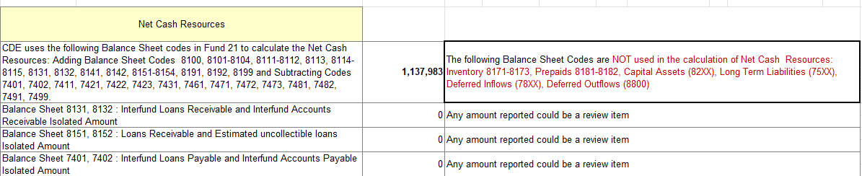
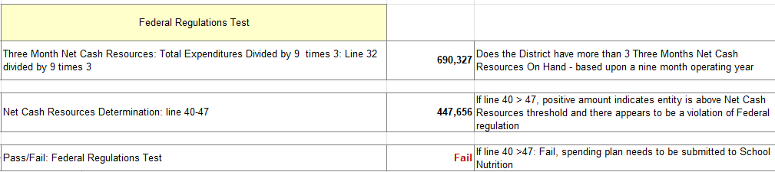
Child Nutrition Report - Net Cash Resources
A table with all of the reported Revenues, Expenditures (including indirect costs, if any), Balance Sheet Accounts within Fund 21

Slide 29
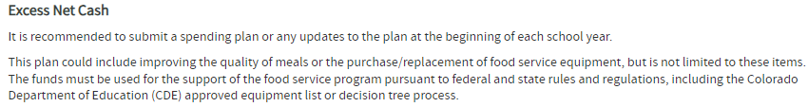
Child Nutrition Report - Net Cash Resources
Must get an approved spending plan if FAIL
Manage (Nutrition) Program Finances
Federal regulations (7 CFR 210.14 (b) and 7 CFR 210.19(a)(1)) require that the net cash resources of the food service fund shall not exceed 3 months average expenditures. Based on the data pipeline figures, the district’s food service fund has been found to have net cash resources (current operating resources) that exceeds this threshold and has triggered a spending plan to be submitted to the State Agency for approval.
Spending Plan Form
The spending plan should reflect expenditures that are reinvesting back into the food service program. Responses have included but not limited to the following: wage increases, equipment purchases, smallwares, technology upgrades, food transportation vehicles, rise in food cost, and indirect costs plan. Please keep in mind the process for purchasing capital equipment. You can find the steps here, Procurement | CDE (state.co.us). Unpaid meal charge and/or bad debt cannot be covered with funds from the nonprofit food service account.
*The citation is in response to FY 2024-25, please include current activity and/or future activity in FY 2025-26 plan. If a multi-year plan needs to be considered, please indicate this in the spending plan template.

Slide 30
Nutrition - Fund 21
Other Items
Manage (Nutrition) Program Finances
Commodities [row 14] (expenditures in object 0633 and matching revenues) - Tier 2 Warning FD249 & FD250
Object 0633 only in Fund 21 - Tier 1 Error FD124*
Transfers Out [row 9] (not allowed in Fund 21 per statute) - Tier 1 Error FD290
Indirect costs [row 27-28] (object 0869 in Fund 21)
Does the District have an Indirect Cost Plan (IDC) approved by the School Nutrition Unit?
Indirect Cost Rate (ICR)
Review guidance, indirect cost rates, indirect cost calculator, here: Financial Management
Fund 21 data is shared with the School Nutrition Unit who also uses it for the Administrative reviews.

Slide 31
Preliminary Maintenance of Effort
Expenditures for Grants
3130/3131/3896/3897

Slide 32

Preliminary Maintenance of Effort Report
Preliminary Maintenance of Effort Report - Grant Codes 3130, 3131, 3896, 3897
Local Maintenance of Effort (MOE) provision, per 34 CFR § 300.203, prohibits the use of Part B funds to reduce the level of local fund expenditures for the education of children with disabilities below the preceding fiscal year level.
A preliminary calculation (at the district level) to determine if the district expenditures tied to 3130, 3131, 3896 & 3897 meet or exceed the prior year expenditures for the district
The compliance with MOE is done at the BOCES level (by Grants Fiscal Unit in March)
Be sure that your SpEd expenditure data correctly reflects the grant codes 3130/3131*
The report reflects expenditures for each of the grants (3130, 3131, 3896, 3897) by each program area (regular, SpEd 1700, Support, etc) less any ‘offset’ accounts such as flow-through accounts (such as 0591, 3951)
*New: If the program code is 1700, 2170, 2231 or 2270 with a grant code or 3896 or 3897 it will be accounted for in the MOE calculation.
Total for these grants, less offset accounts = Expenditure Total (CY and PY)
Did the the CY Expenditure Total Less Offsets meet or exceed the PY Expenditure total Less Offsets?
PASS = CY expenditures were equal to or greater than PY
FAIL = CY expenditures were less than PY (we will comment on this as part of our FinDec & Audit Review)

Slide 33
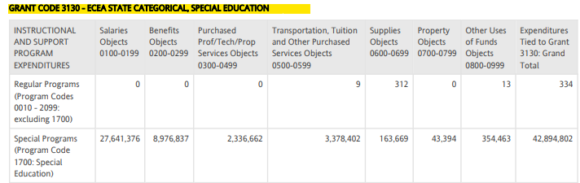

Preliminary Maintenance of Effort Report
Example 3130/3131
Preliminary Maintenance of Effort Report - Grant Codes 3130 and 3131

Slide 34
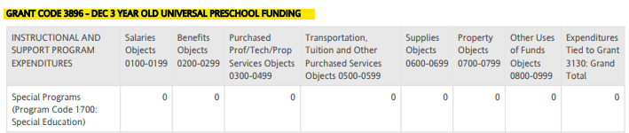
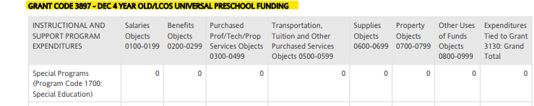

Preliminary Maintenance of Effort Report
Example 3896/3897
Preliminary Maintenance of Effort Report - Grant Codes 3896 and 3897

Slide 35
Finance December Detail Data Report
(The Data)

Slide 36
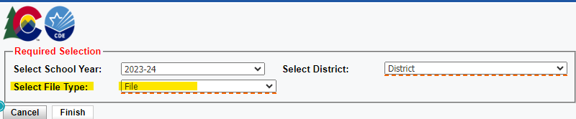
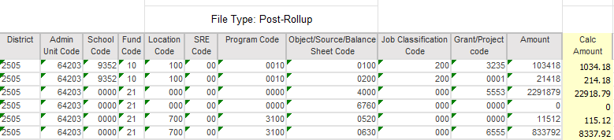
Finance December Detail Data Report
Detail Data Report includes all data lines currently in Data Pipeline - you can run it in two ways:
Pre-Roll Up (Detail - Tier 1 data as uploaded by the district)
Post-Roll Up (Rolled - Tier 2 data)
A tool to help identify datalines associated with errors & warnings;
can also be used for Financial Transparency webpage (pre-rolled data file)

Slide 37

Finance December Detail Data Report
Example 1
Not part of the data file - multiply *100 = $ amount
* Amount field has no decimal (ie 100.00 would be 10000 in data file)
Negative amounts are preceded by a negative sign
Used mainly to extract data for specific errors

Slide 38

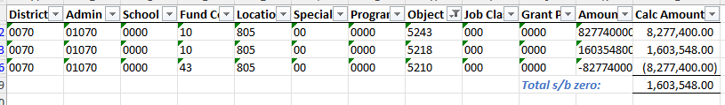
Finance December Detail Data Report
Example 2
Filter the data using information provided in the error message:

Slide 39

Finance December Detail Data Report
Example 3
Another Example:

Slide 40
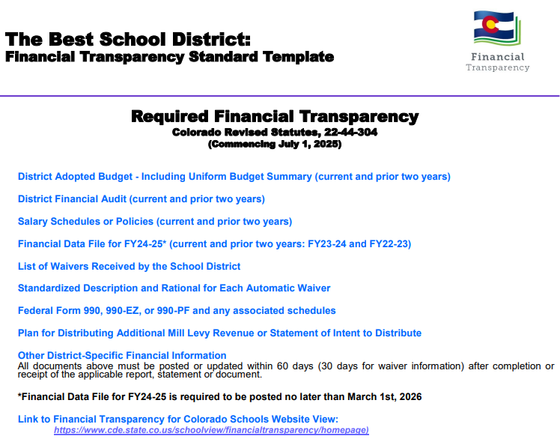
Finance December Detail Data Report
Financial Data File - Financial Transparency
Run the Detail Data Report - then export to excel & post on your Financial Transparency webpage
http://www.cde.state.co.us/cdefinance/sffinancialtransparency

Slide 41
Finance December Tier 1
Detail Error Report
(Pre-rolled, Detail Data)

Slide 42
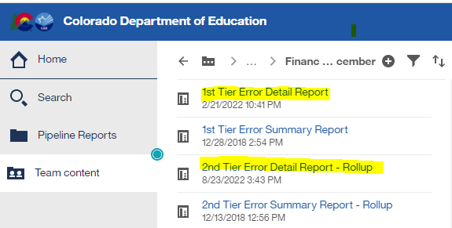
1st Tier Error Detail Report
1st Tier - Business Rules primarily related to account/coding issues
1st Tier = Pre-Rolled (detail) data. Auditors Integrity and Bolded Balance Sheet Reports are NOT available yet
Types of errors
E-type errors: prevent you from moving forward - they are must fix errors
Warnings: indicate something might be incorrect in the data
Must be verified as correct (i.e. reconciliation reports submitted with final audited financial statements)
Can’t move to 2nd Tier until all 1st Tier E-type errors are cleared
Reminder - You can submit data as many times as needed
Run reports in data pipeline:
Several days / weeks to clear errors!
The system automatically rolls to Tier 2 when
Tier 1 Errors are cleared

Slide 43

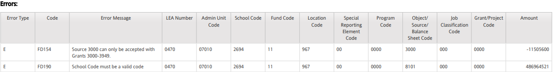
Tier 1 Error Detail Report
Example of Errors
1st Tier - Business Rules primarily related to account/coding issues

Slide 44
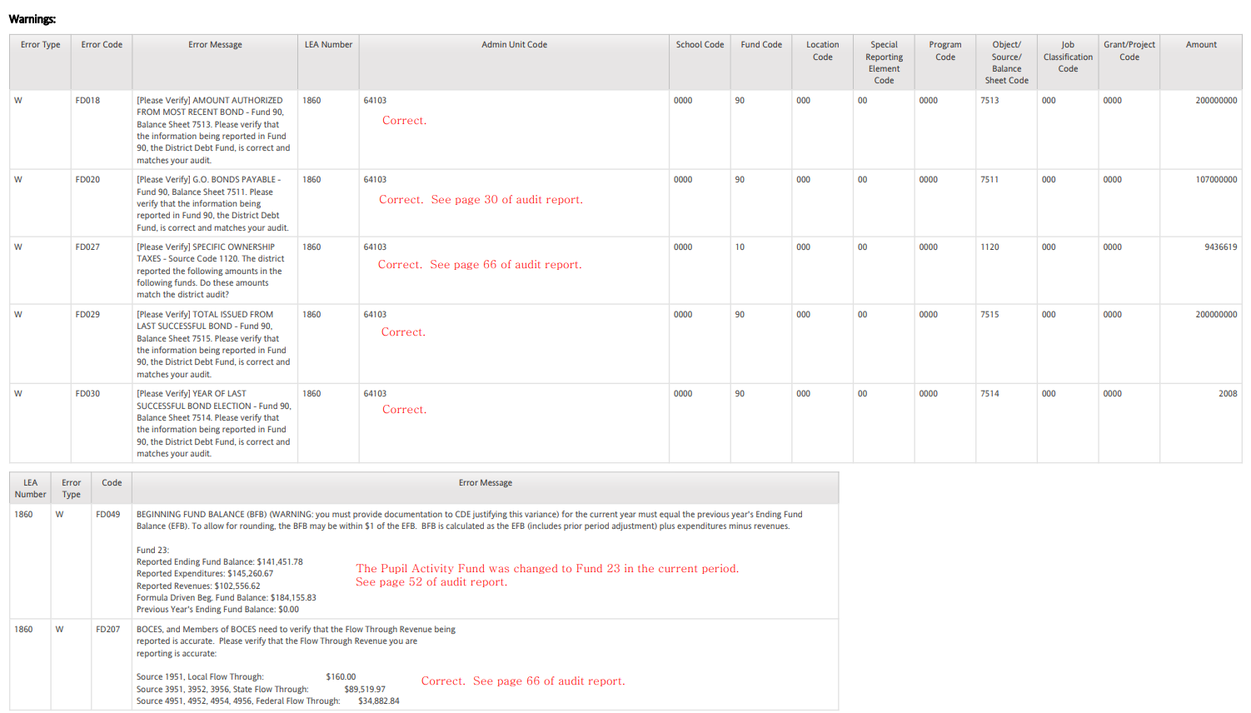
Tier 1 Error Detail Report
Example of Reconciliations/Comments

Slide 45
Finance December Tier 2
Detail Error Report
(Rolled up, BOLD Data)

Slide 46
2nd Tier Error Detail Report
2nd Tier - Business Rules primarily related to dollar amounts
2nd Tier = Post-Rolled (BOLD) data. Auditors Integrity and Bolded Balance Sheet Reports are available
Types of errors
E-type errors: prevent you from moving forward - they are must fix errors
Warnings: indicate something might be incorrect in the data
Must be verified as correct (i.e. reconciliation reports submitted with final audited financial statements)
Can’t move to 2nd Tier until all 1st Tier E-type errors are cleared
Reminder - You can submit data as many times as needed
Run reports in data pipeline:
Several days / weeks to clear errors!

Slide 47

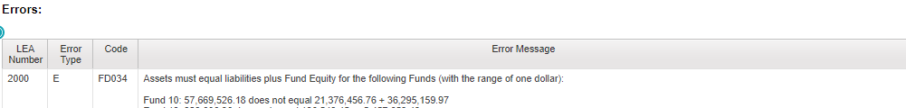
2nd Tier Error Detail Report
Examples
After all Tier 2 Errors are cleared, the data is ready to be submitted, if all other reconciliations are done and the data matches the audit!

Slide 48
Indirect Cost Rate Report

Slide 49
Indirect Cost Report
Indirect Cost Report - calculation to determine the district/BOCES Indirect Cost Rates
Based on Finance December data submission from 2 years ago
FY2024-2025 data will be used to calculate FY2026-2027 rates
Used in ConsApp and various other Grant Applications where indirect costs are allowed / budgeted
Used to determine indirect costs, if charged, in Food Service Fund
Restricted & Unrestricted Rates are calculated

Slide 50
Indirect Costs, Explained
Indirect Cost accounts are considered Internal Charge Reimbursement Accounts. The recording of transactions to allow for charging of internal services from one department within a district to another department.
Expenditure Account
0869 Indirect Costs. Used with federal grants/projects.
Revenue Account
1972 Indirect Cost Revenue. Revenue internal to the district which is generated by charging for costs of a general nature that cannot be readily or accurately identified with specific services.

Slide 51
Indirect Costs, Explained
(continued)
Unrestricted Rate - An indirect cost rate calculated for use on programs without limitations on indirect costs.
Examples:
ESSER
Local Grants
Nutrition - Fund 21 (with an approved plan)
Restricted Rate - Certain ED grant programs have statutory requirements prohibiting the use of federal funds to supplant non-federal funds. These programs require the use of a restricted indirect cost rate. Adjustments to the unrestricted rate calculation are made and result in a lower rate to claim indirect reimbursement on restricted rate programs.
Examples:
Title I
Title II
Title III
IDEA Part B

Slide 52
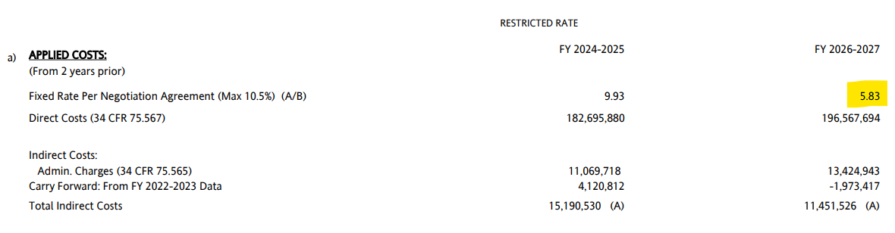
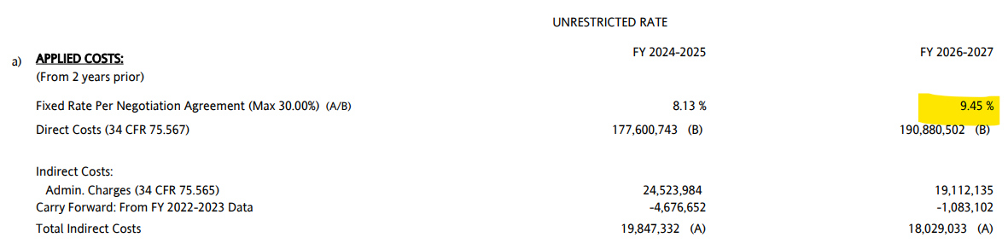
Indirect Cost Report
Rates

Slide 53
Data Pipeline
Single Sign-on

Slide 54
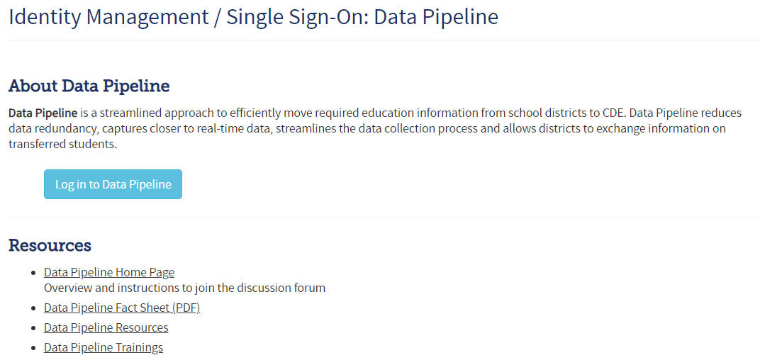
Data Pipeline: Single Sign-on
log-in
http://www.cde.state.co.us/idm/datapipeline

Slide 55
Data Pipeline: Single Sign-on
Roles
CDE does not maintain users/passwords
The Local Access Manager (LAM) at the district assigns roles for individuals to log-in to the system for the submission.
An individual can only be assigned to one role
FIN LEA Approver: Has the ability to upload data files, review cognos reports and finalize the data submission.
FIN LEA User: Has the ability to upload data files and review cognos reports. Is not able to Finalize the data submission.

Slide 56
Data Pipeline: Single Sign-on
LAMs
CDE does not maintain users/passwords
Webpage with information for the LAM process. https://www.cde.state.co.us/idm
In the Password Assistance section there is a "Request for Assistance" and a "Contact Us" link.
The "Request for Assistance" link will forward the question entered to the LAM assigned at the District/BOCES.
The "Contact Us" link provides a CDE email address to ask the CDE contact a question.

Slide 57
Data Pipeline
Reminders

Slide 58
Data Pipeline Submission
FY2024-2025 Due Dates - per statute
FY 2024-2025 Audit and Financial December Pipeline Deadlines
December 31st for districts that do not require an extension
Additional 60 days for districts that have an approved OSA extension
Several districts missed the deadline this year
We recognize that this has been a challenging year in many aspects
Now is the time to proactively work to ensure deadlines are met next year
Districts should work with their auditor to ensure statutory submission deadlines are met
The contract between the district and auditor should articulate statutory deadlines
Consideration should be given to include interim deadlines, e.g. draft for review by district
Contract could include expectations for support with Financial December Data Pipeline submissions
Consideration should be given to include consequences for late submission by the auditor
Communicate with your Auditor journal entries made to pass 1st Tier and 2nd Tier errors, these may change the trial balance.
Any changes should be initiated in the general ledger, for the data pipeline file to be recreated.

Slide 59
Request for 60-day extension
A District may request a 60-day extension from the Office of the State Auditor.
Note, extension request must be submitted by December 31, 2025
Request an Extension Form: https://apps.leg.co.gov/osa/lg
CDE honors extensions granted by OSA; send CDE a copy of the approved extension request: schoolfinance@cde.state.co.us

Slide 60
About PSFU
Sheldon Rosenkrance - Chief District Operations Officer
Jennifer Okes - Special Advisor District Operations
Corey Evans - School Finance Executive Director
Tim Kahle - School Finance Program Director
Yolanda Lucero - Fiscal Data Coordinator
Kelly Wiedemer - Fiscal Data Analyst
Kim Reeves - Government Finance Analyst
Tabitha Tyree - School Finance Senior Analyst
Katherine Proctor - School Finance Program Manager
Glenn Gustafson, CPA - Part-Time School Finance Program Manager
Ack! Who do I contact about what?!
Visit the PSFU Contacts page and see “Contact for questions about….”

Slide 61
Any Questions?

