Slide 1
Mill Levy Correction
Overview Fall 2021

Slide 2
Instructions to Districts
** This slide deck is provided to Colorado school districts to assist you with communicating to local stakeholders about Mill Levy Correction. **
INSTRUCTIONS: Feel free to adapt these slides to your uses. However, if you adapt any content in this slide deck, it is your responsibility to share with your audience that the content is yours, not CDE’s.
Everywhere you see a yellow highlight, insert the correct information for your district. Then delete this Instructions slide.

Slide 3

Summary
… school districts in Colorado, based on an interpretation of statute by CDE and others, began collecting less local property tax for education than their voters had authorized, in some cases for years. How this came to pass is a complicated story that we will try to tell succinctly. Mill Levy Correction is a legislative and legal directive to fix this undercollection of local property taxes for education.

Slide 4
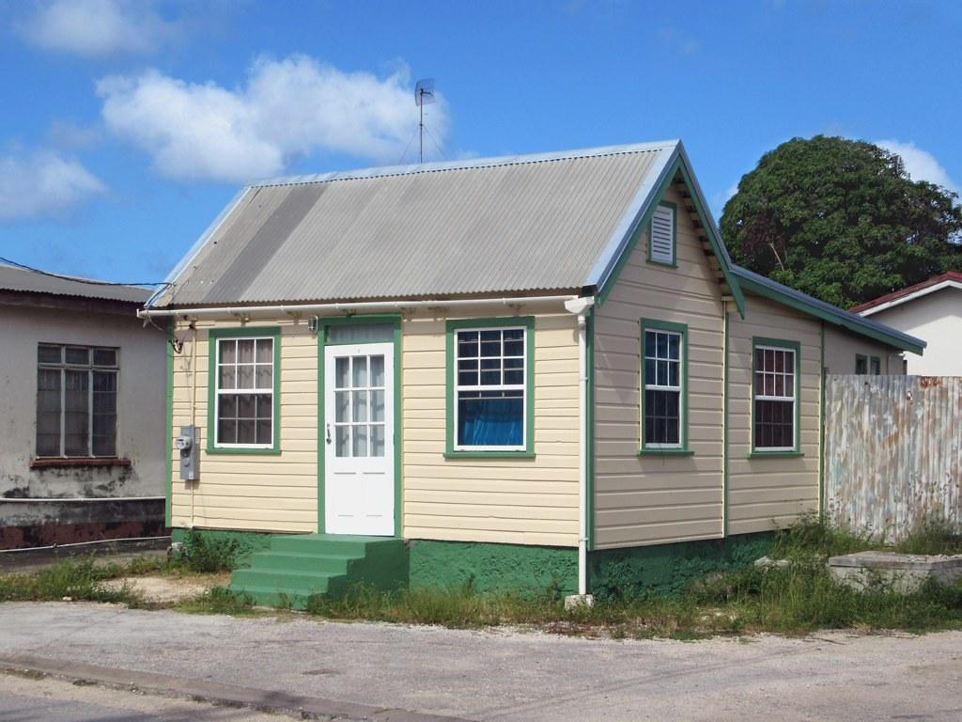
Terminology
Mill: One mill is equal to one tenth of one penny or one 1/1000 of a dollar. Mills are used to calculate property taxes using a formula of mills x assessed property value = property tax. The assessed property value is the actual property value x the assessment rate. Currently, the residential assessment rate in Colorado is 7.15%.
If you live in an area where the total mills levied on all homes is 27 mills, and the assessed property value of your $200,000 home is $14,300 (7.15%), your property tax is .027 x $14,300 = $386.
Total Program Mill Levy: The mill levy is the total number of mills the school district collects from local property taxpayers to fund the local share of Total Program.
Residential Assessment Rate:
7.15%
Assessed Property Value:
$14,300
Mill Levy:
.027
Property Tax Bill for Education:
$386
X
=
X
=
$200,000

Slide 5
Terminology
Assessed Valuation (AV): The taxable portion of property value in the school district. As an index of property wealth, AV varies significantly between districts and can vary a lot from year to year (particularly for oil and gas districts).
Total Program: Refers to the total amount required by the formula to fund the school district on an annual basis. Typically has two portions: local share (property taxes) and state share (state funds appropriated by the Legislature). Some districts can fully fund Total Program with only local share (property taxes).
Districts have different ratios of local to state share in their Total Program. Some are totally funded by local share; others receive most revenue from state share. The ratio depends on multiple factors, including the district’s Assessed Valuation.
Districts may have Mill Levy Overrides and/or bonds that allow them to collect property taxes above and beyond the amount required for Total Program.

Slide 6
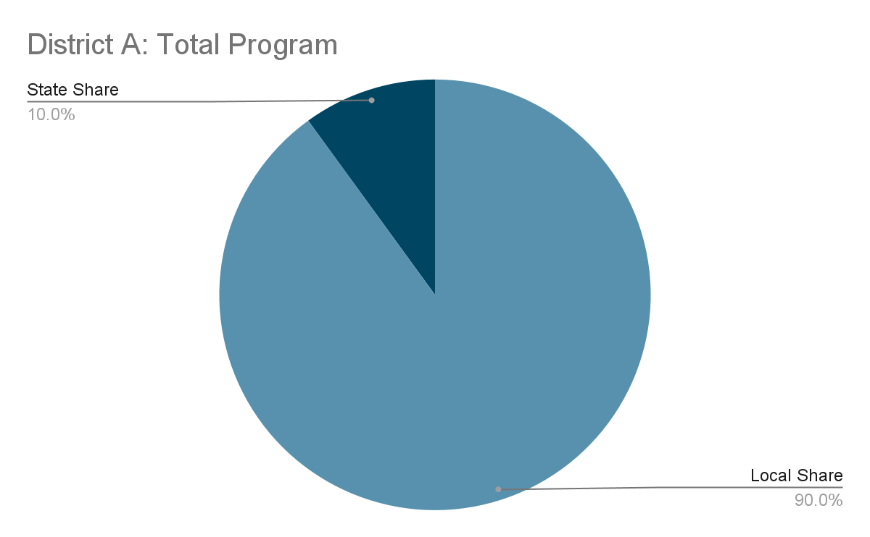
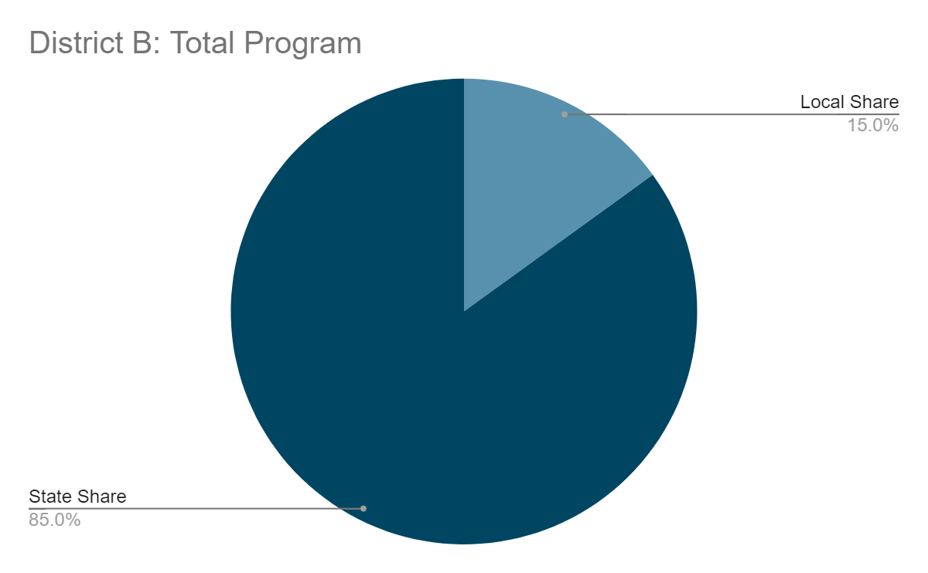
Example
District A includes a large, active mine. The district’s Assessed Valuation is very high.
District B is a district without a lot of industry. The district’s Assessed Valuation is very low.
The district funds the local share by levying the mills determined by CDE and required by statute.
The size of the pie is fixed per the school finance formula. The size of the slices is dependent on local factors.

Slide 7
Our District
Use this slide to explain what the split is between local and state share for your district

Slide 8
Background: How did we get here?
In the 1990s and 2000s, many school districts obtained voter approval to retain and spend revenue in excess of the property tax revenue limitation imposed on the district by TABOR.
You may hear this referred to as “de-Brucing” or “de-TABORing”
Our district passed a de-TABOR vote in XXXX.
Districts that de-TABORed had permission from the voters to keep their local property tax mill levies (their local share) at the level in place at the time of the de-TABOR vote.
Without de-TABORing, districts would not have been able to retain revenues above their TABOR limitation due to interactions of various factors unique to Colorado.
Rapid and significant growth in residential property value;
TABOR, which prevents taxes from increasing without voter approval;
And Gallagher, which has driven the residential assessment rate down in order to preserve the required ratio of residential/commercial property tax rates.

Slide 9
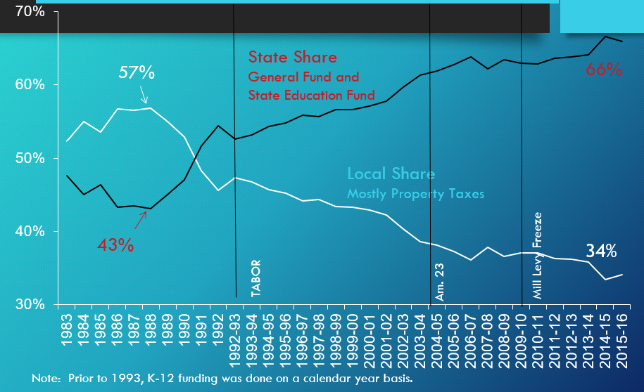
Background: How did we get here?
Notes:
This slide shows the impact of these factors in driving state share up, and local share down, over time

Slide 10
Background: How did we get here?
CDE and others interpreted the statute such that some de-TABORed districts should reduce their local share through 2007.
However, because de-TABORed districts had permission from the voters to keep their mill levies at a higher level, it is now clear that local share should not have been reduced.
In 2007, school district mills were frozen through legislation, then litigated in a debate about how local school districts should have treated their local mills per statute.
Because of the reduction to mill levies made between the early 1990s and 2007, the local share collected by those districts went down, and state share went up.

Slide 11
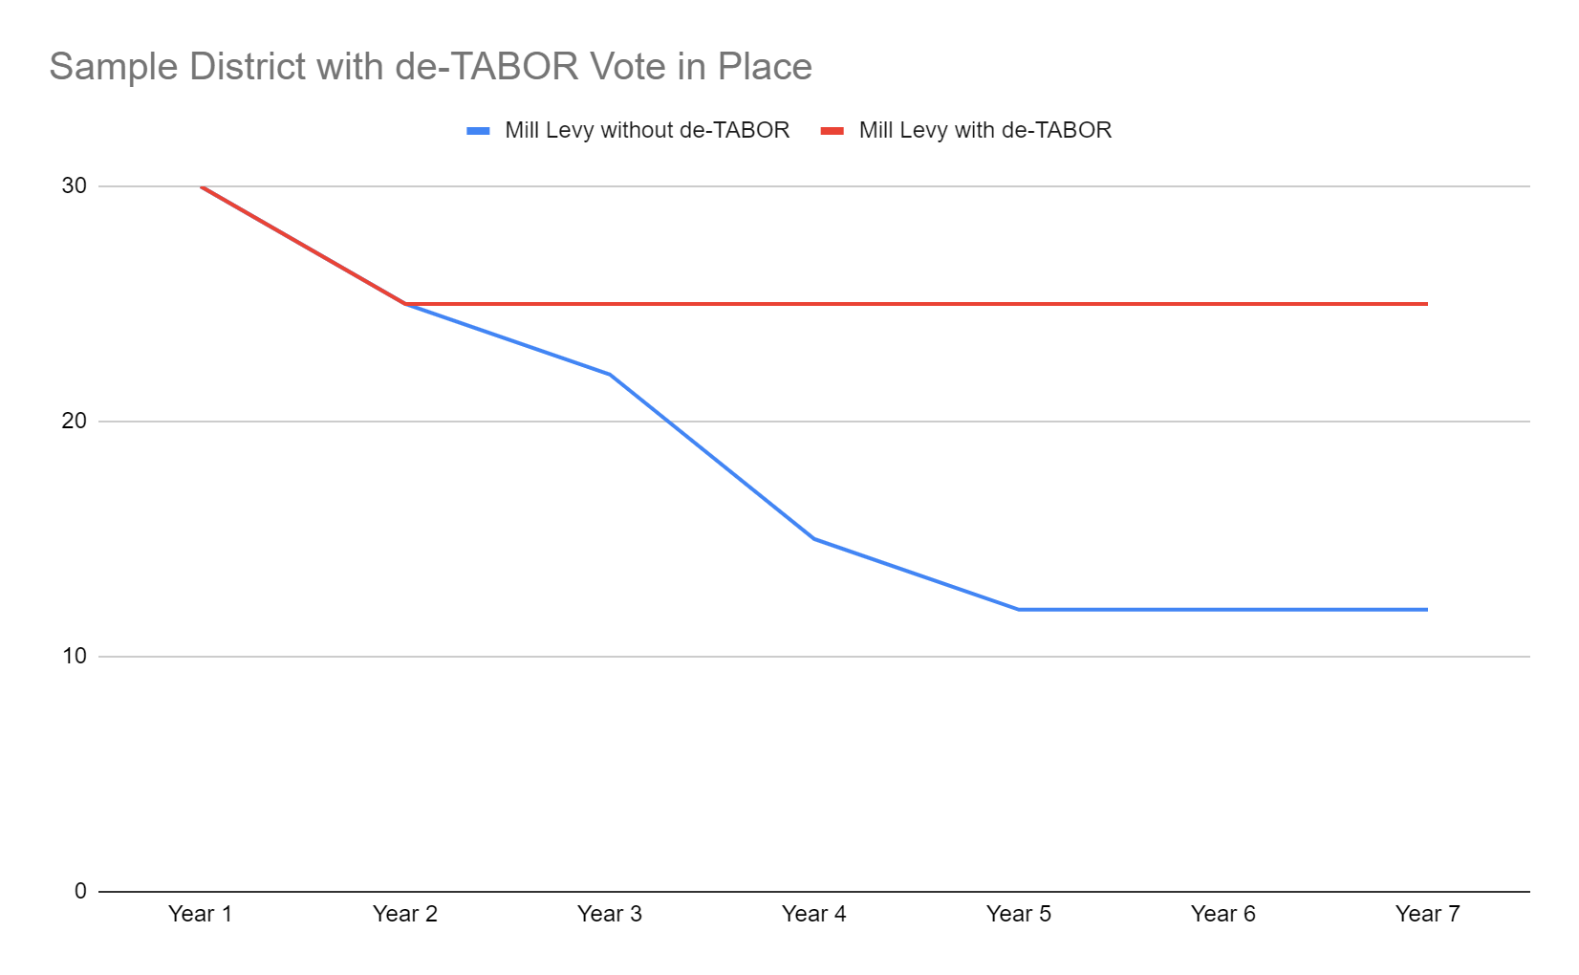
Background: How did we get here?
De-TABOR vote gave district permission to keep mill levy here
Year of de-TABOR vote
Gap in property tax collections that was then covered by state share
District followed “normal” mill levy ratchet down due to interaction of factors in the state Constitution.
2007 “freeze” of mill levies

Slide 12
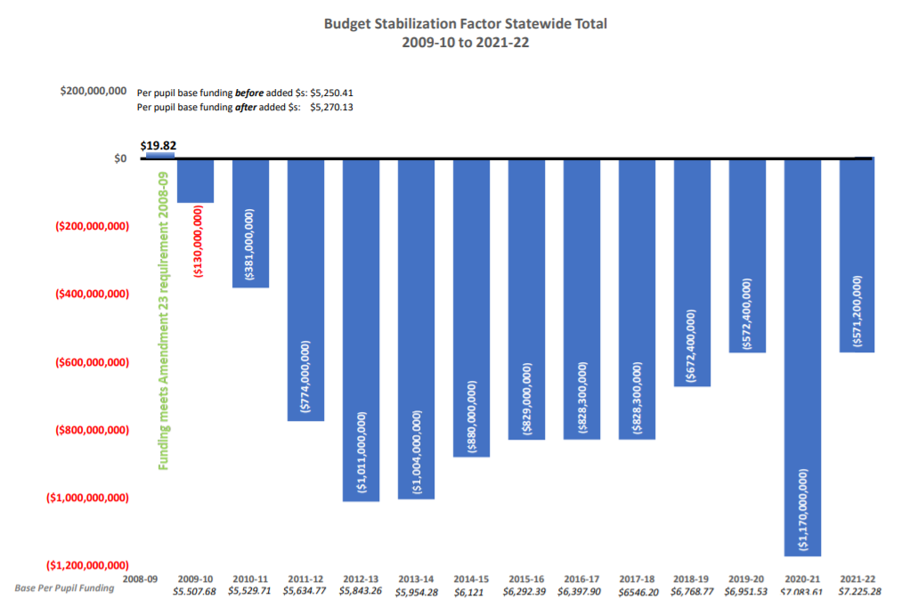
Background: How did we get here?
Beginning in 2008-2009 with the Great Recession, the state’s budget was under increasing pressure. As state share went up, and the economy went through ups and downs, the state was forced to implement the Budget Stabilization Factor.

Slide 13
Background: How do we fix it?
The legislature has now taken steps to restore, going forward, the local share that was erroneously reduced.
This created a reduction in local share and resulted in the non-collection of local property taxes that were already authorized by voters.
The legislature is only seeking to fix this issue going forward--it is NOT seeking to recover local tax property revenue that should have been collected in the past.
Mill Levy Correction is a state law. While the responsibility for setting the mill levy lies with the local school board, the local school board must set the Total Program levy in accordance with state law.

Slide 14
Background: How do we fix it?
Step 1: Passage of HB20-1418
June 2020: HB20-1418 signed (see Section 33). The 2020-2021 School Finance Act required districts to levy the number of mills specified by the requirements in the bill, including the establishment of temporary tax credits, if necessary, to correct historical errors. The bill required districts to set a mill levy target equal to the lowest of:
The mills required to fully fund the district with local property taxes;
The mills in place at the time the district obtained voter approval to retain and spend revenue in excess of the property tax revenue limitation imposed on the district by TABOR (de-Bruce); or
27.000 mills.

Slide 15
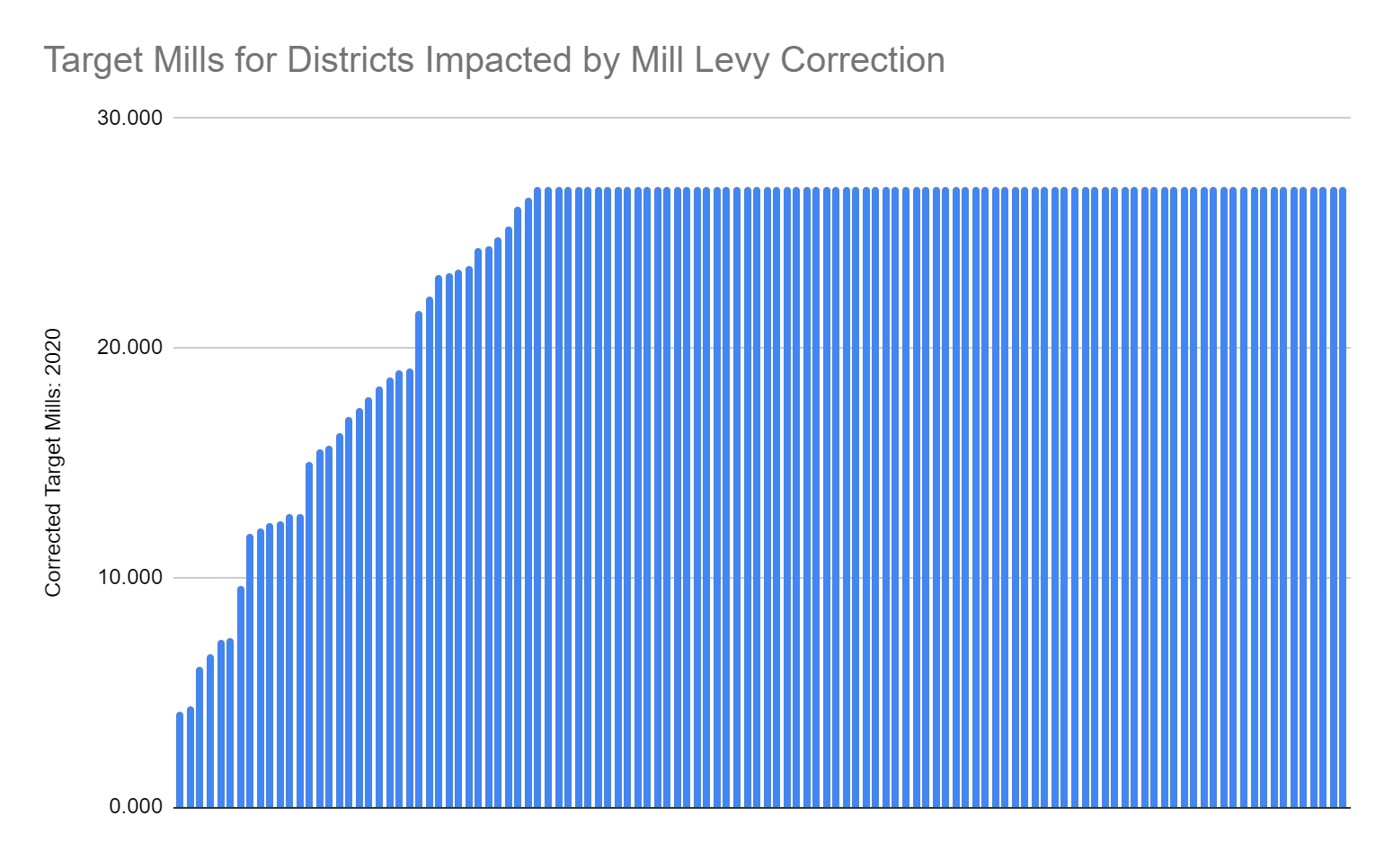
Background: How do we fix it?
81 out of 118 districts (69%) have target mills of 27. This means that the mills required to fully fund the district, and the mills in place at the time of deTABOR, are both greater than 27.
37 out of 118 districts (31%) have target mills under 27. This means that either the mills required to fully fund the district, or the mills in place at the time of deTABOR, are less than 27.

Slide 16
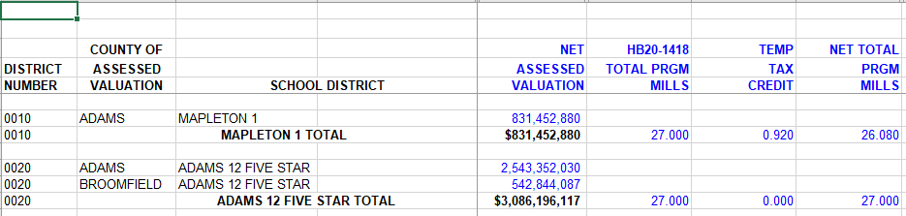
Background: How do we fix it?
Step 2: District certification of Temporary Tax Credits
December 2020: If required, districts included temporary tax credits when certifying property tax mills related to the local share of total program for the 2020 tax year. The temporary tax credits were equal to the difference between the district’s current total program mill and the mill levy target established by HB20-1418. For example, if the district’s current total program mill was 25, and its mill levy target is 27, the district implemented a temporary tax credit of 2 mills.

Slide 17
Our District
Our district’s current total program mill levy: XX mills
Our district’s target mill levy per 20-1418: XX mills
Our district’s temporary tax credits (B - A): XX mills

Slide 18
Background: How do we fix it?
Step 3: Introduction, challenge to, and passage of HB21-1164
March 2021: HB21-1164 introduced. The bill requires CDE to implement a correction plan for districts with temporary tax credits. Specifically, the plan must ensure that districts incrementally reduce temporary tax credits “as quickly as possible but by no more than one mill each property tax year,” beginning in the 2021 tax year.
May 2021: Colorado Supreme Court ruled in an interrogatory that HB21-1164 is constitutional.
June 2021: HB21-1164 signed into law.

Slide 19
Next Steps: What happens now?
HB21-1164 requires CDE to implement a correction plan that:
Reduces a district’s temporary tax credits “as quickly as possible,”
But by no more than 1 mill per year.
Our district has a mill levy target of XX mills based on the requirements of HB20-1418. In 2020, it was levying XX mills. Taxpayers in our district will see the following changes in their property taxes for the local share of Total Program:
2020 Tax Year (certified December 2020): XX.0 mills, XX temporary tax credits
2021 Tax Year (certified December 2021): XX.0 mills, XX temporary tax credit
2022 Tax Year (certified December 2022): ETC

Slide 20
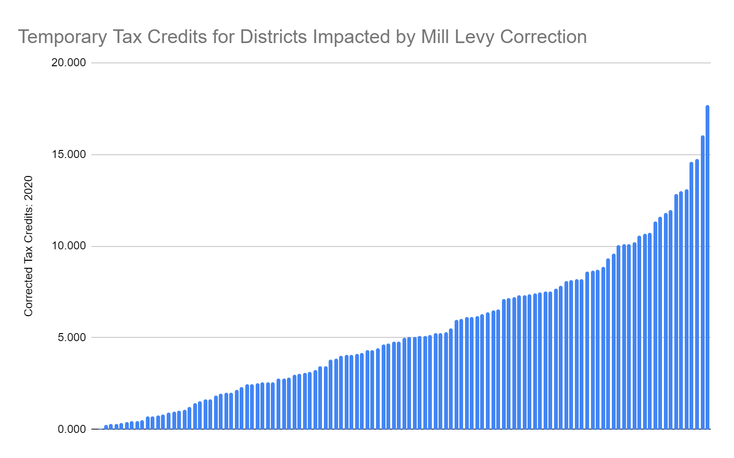
Background: How do we fix it?
Tax credits range from .004 to 17.695.
This means that districts will be implementing Mill Levy Correction for anywhere from 1 to 18 years.
100 out of 118 districts (85%) have fewer than 10 temporary tax credits

Slide 21
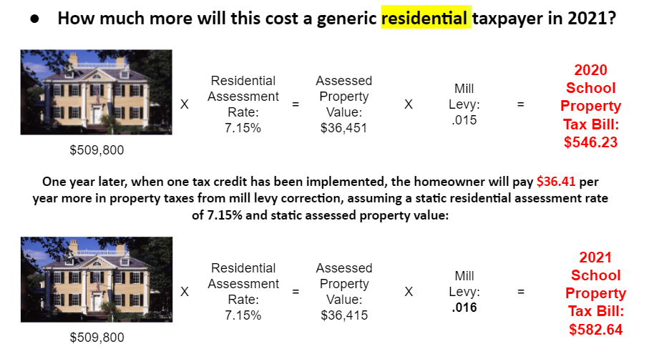
Taxpayer Impact: Example of adding one additional mill for 2021

Slide 22


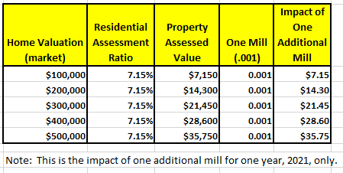
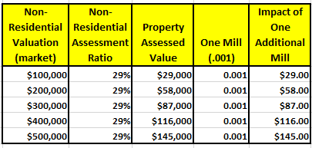
Taxpayer Impact: Example of adding one additional mill for 2021

Slide 23
Next Steps: What happens now?
Where will the money go?
The estimate for the 2021-2022 school year was that Mill Levy Correction would generate ~$90M in additional local share
These are funds that won’t need to be paid from state sources
Therefore, the funds may be redirected, for example to the new factor changes in the finance formula:
“...THE GENERAL ASSEMBLY FURTHER DECLARES THAT THE REMAINING COSTS OF THE SCHOOL FINANCE FORMULA CHANGES ARE OFFSET BY THE SAVINGS TO THE STATE SHARE OF TOTAL PROGRAM THAT OCCUR AS A RESULT OF CORRECTING THE UNAUTHORIZED REDUCTIONS IN DISTRICT PROPERTY TAX MILL LEVIES AS PROVIDED IN SECTION 22-54-106 (2.1).”
Ultimately, use of these state funds is the legislature’s decision.

Slide 24
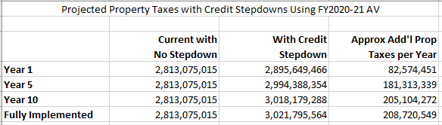
Next Steps: What happens now?
How much might Mill Levy Correction raise in additional property taxes over time?
The following chart provides an estimate of the impact of Mill Levy Correction on property tax collection, all else being equal.*
*Note: the estimates above assume static Assessed Valuations and assessment rates.

Slide 25
Review: Main takeaways
Mill Levy Correction is a legislative and legal directive to correct a historical undercollection of local property taxes.
The historical undercollection resulted in districts collecting less in property taxes for education than their voters had approved by de-TABORing.
Mill Levy Correction is in law, dictated by state statute; it is not a local decision to raise property taxes.
Mill Levy Correction is a phased approach to restoring local property taxes to the levels voters authorized.
Mill Levy Correction will result in local taxpayers increasing their taxes to previously approved levels, or to an appropriate level as defined by HB20-1418.
There are no retroactive payments or penalties--the law only applies to future years.
Funds generated through Mill Levy Correction will result in more fiscal resources overall being available for education.

Slide 26
Questions?
https://www.cde.state.co.us/cdefinance/milllevycorrection

