Slide 1
FPP Updates – 1-30-2020
School Finance and Operations Division

Slide 2
“Grants Bubble” – scope of work for FY18-19 website
Is there a need for some type of Grants revenue and expenditures breakdown bubble on the Financial Transparency for Colorado Schools website?
Potentially under “Explore More”
Potentially similar to the “Gifts, Grants and Donations” breakout box we currently have:

Slide 3
Grants Bubble Continued

Slide 4
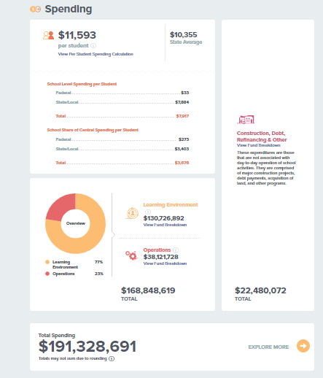
Per Pupil Expenditures Update

Slide 5
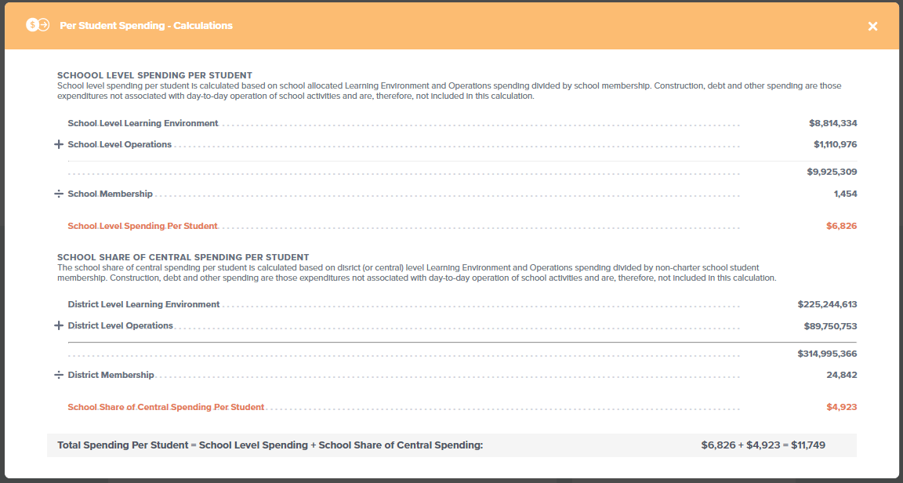
Per Pupil Expenditures Update

Slide 6
Data Pipeline Update
Year End Review Letters
Same tone
Same basic process
CDE staff reaches out to primary school district business officials via email regarding review issues
Letter to Superintendent and BOE are approached to be congratulatory and address only the most pertinent of review items identified
Financial Transparency webpages….

Slide 7
Data Pipeline Update – Financial Transparency Webpages
Significant non-compliance issues being identified
Please follow the FPP-approved webpage template
District’s main page = Icon or words “Financial Transparency”
Don’t bury
Financial Transparency webpages
Follow template as closely as possible
Don’t get too creative
Why is this important?
State BOE Members are looking at this information
Interim Finance Committee
Mandated by State and Federal Legislation

Slide 8
Data Pipeline Update – Financial Transparency Webpages
Please take a moment to ensure your district’s financial transparency webpage follows the template, presents all documents in the correct order
If an item is not applicable, show the bulleted item and indicate “N/A”
Templates are on CDE website:
http://www.cde.state.co.us/cdefinance/ftwebdistricts
Financial Transparency District webpage issues will be addressed in the year end letters to the Superintendent and BOE.

Slide 9
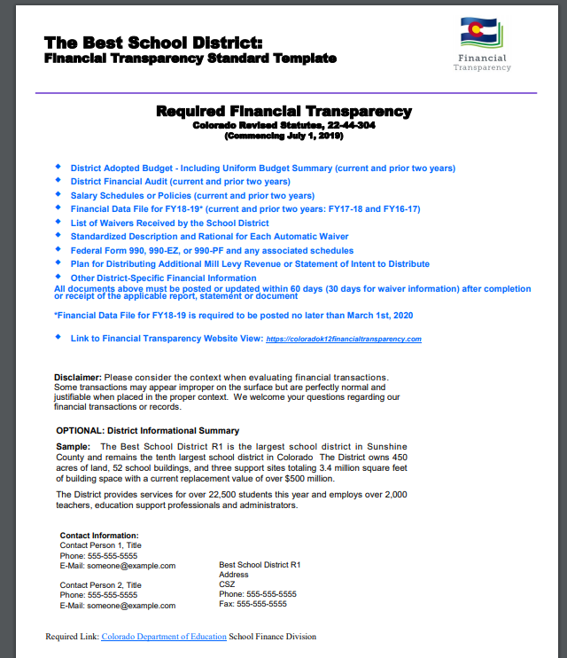

Slide 10
Data Pipeline – Looking Ahead to FY19-20 Transmissions
Edit Cleanup – “Please Verify”
Remove or present elsewhere
PSFU will review all edits to ensure they are relevant, and functioning as intended
New Cognos Report – FY17-18 Management Integrity Two-Year Comparison Report

Slide 11
Job Class Codes: FY19-20
►103 Non-Instructional Administrator. Directs individuals and manages a function, program or supporting service in a senior leadership role. Other management positions include 335, 342 and 357
►104 Instructional Administrator. Performs professional management, administrative, research, and/or analytical services in a senior leadership role. This may include personnel responsible for services such as evaluation, teacher development, dissemination, curriculum development and assistant directors of special education.
►107 Instructional Program Coordinator/Supervisor. No longer used. Reclassify (e.g., 104, 336, etc.).
►108 Non-Instructional Program Coordinator/Supervisor. No longer used. Reclassify (e.g., 103, 335, 342, 357, etc.).
►336 Instructional Program Consultant/Coordinator/Supervisor. Coordinates, manages (including supervising other certified individuals) or directs services (e.g., vocational education and special education) within an instructional program or areas of instruction.
►342 Specialized Professional Manager/Supervisor. Performs professional activities, generally assisting an executive officer, in directing and supervising the functions of professional and support staff. Functions may include budget, finance, human resources, payroll, personnel, purchasing, risk management, etc.
►425 Temporary/Part-time Worker (As needed). An hourly employee who works on an “as needed” or “on call” basis. This employee is not required to be reported to CDE as part of the human resources data collection. This code is invalid, and will not be accepted for SPED and HR data collections
►426 Temporary/Part-time Worker (As needed). An hourly employee who works on an “as needed” or “on call” basis. This employee is not required to be reported to CDE as part of the human resources data collection.

Slide 12
Contacts
School Finance
Kirk Weber, Financial Accounting Technical Advisor
Phone: 303-866-6610
weber_k@cde.state.co.us
Adam Williams, Fiscal Data Coordinator
Phone: 303-866-6843
williams_a@cde.state.co.us

