Slide 1
CDE-40 Transportation Training
Friday, June 19, 2015
Presented by:
Adam Williams- CDE School Finance Unit
Rebecca McRee- CDE Field Analyst Support Team

Slide 2
CDE-40 Transportation Training
Training Overview
School Finance Unit- Adam Williams
CDE-40 General Information
Preparing and Submitting CDE-40 data
Field Analyst Support Team- Rebecca McRee
Audit Process Overview
CDE-40 Audit Specific Details

Slide 3
What is the CDE-40?
Under the “Rules for the Administration of the Public School Transportation Fund 1CCR 301-4-R-2.00”, all public school districts, BOCES, and facilities that provide directly, or contract for, pupil transportation are eligible to receive reimbursement from this fund. In order to determine the amount that districts/BOCES/facilities are entitled, they must complete and submit a Pupil Transportation Reimbursement Claim (Form CDE-40) to the School Finance Division.

Slide 4
CDE-40 Important Dates for FY2014-15
The on-line submission process for submitting the CDE-40 form opens mid-July 2015.
This form will cover the July 1, 2014 – June 30, 2015 reimbursement period (C.R.S. 22-51-105(1)).
Deadline for completing and submitted the CDE-40 form is on or before August 14th, 2015
CDE-40 and Instructions can be found on the CDE website:
http://www.cde.state.co.us/cdefinance/sftransp

Slide 5
CDE-40 Form is Submitted On-Line
The CDE-40 Form is submitted on the CDE website
https://cdeapps.cde.state.co.us/CDEAccess/login.jsp
Do not mail or fax forms
Only authorized district personnel can submit the form – this is typically the District Business Manager
Local Access Managers (LAMs) are able to assign and change authorizations to complete the form

Slide 6
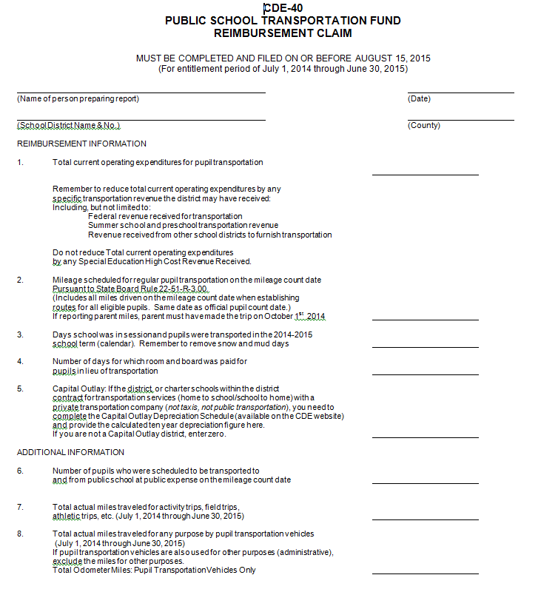
CDE-40 On-Line Form: Eight Items to Complete

Slide 7
Item #1: Current Operating Expenditures
Total current operating expenditures for pupil transportation
Actual Expenditures that have been incurred by the district to transport students from home to school, school to school and school to home
Reimbursable Expenditures - Allowable expenditures to transport students from home to school, school to school and school to home

Slide 8
Item #1: Current Operating Expenditures cont.
Total current operating expenditure for pupil transportation
Remember to reduce total current operating expenditures by specific transportation revenue that the district received: federal grants for transportation, revenue received from other districts to furnish transportation etc.
Do not reduce total current operating expenditures by any Special Education High Cost revenue received

Slide 9
Item #1: Current Operating Expenditures cont.
General Reimbursable Expenditures
salary and benefits for drivers
parent mileage
fuel
percentage of employment costs for personnel with non-student and specific transportation responsibilities
training directly related to student transportation
insurance for vehicles directly related to student transportation

Slide 10
Item #1: Current Operating Expenditures cont.
General Reimbursable Expenditures cont.
cost of furnishing transportation for another district
reimbursements to students who use public transportation services
payments to other school districts for furnishing student transportation
costs of supplies, materials, and other expendable non-capital outlay items utilized by the district
certain repair and maintenance costs that restore facilities and equipment to their original condition

Slide 11
Item #1: Current Operating Expenditures cont.
General Reimbursable Expenditures cont.
Districts shall request and receive from the department PRIOR written approval of additions or alterations to a pupil transportation vehicle not listed in rule 4.01 (16) in order for the cost to be reimbursable
District must own the vehicle for a minimum of 3 years
The Department shall inform a district in writing of approvals and disapprovals of reimbursable additions and alterations to vehicles
The district shall retain the written approval provided by the Department with the other transportation records for five years or until an audit is done by the Department, whichever occurs first
Not intended to be an exhaustive list of allowable costs

Slide 12
Item #1: Current Operating Expenditures cont.
General Reimbursable Expenditures cont.
If a district has owned a pupil transportation vehicle for at least 3 years, it may include the cost of the following types of additions or alterations to those vehicles:
1. manual transmission to automatic transmission
2. gas engine to diesel engine or alternative fuel
3. reflective tape on the outside of vehicle
4. electro-magnetic or hydraulic retarder
5. heated mirrors
6. engine compartment noise reduction package (diesel engine in front engine transit only)
7. driver seat belt to current standards (locking retractor type)

Slide 13
Item #1: Current Operating Expenditures cont.
General Reimbursable Expenditures (cont.)
If a district has owned a pupil transportation vehicle for at least 3 years, it may include the cost of the following types of additions or alterations to those vehicles:
8. air brake drying system
9. mirror system to provide a seated driver an unobstructed view of the front and front sides of a bus
10. wheelchair lifts and other special modifications which are necessary to equip a school bus in order to transport children with disabilities
11. automatic tire chains
12. video surveillance cameras
13. other additions or alterations with prior written approval by the department which increase efficiency and safety or are necessary to meet minimum standards.

Slide 14
Item #1: Current Operating Expenditures cont.
Non-Reimbursable Expenditures
Examples of expenditures that are NOT allowable (and should not be included in total operating expenditures include:
awards, banquets, ceremonies or any employee recognition
advertising
workshops or conferences related to advertising or other non-pupil transportation topics
rent, lease or lease purchase (for all capital outlay items except those additions and alternations to vehicles listed in rule)
school field trips, extracurricular trips, or athletic trips
liability claims
any district vehicle not used for the specific purpose of student transportation
elderly transportation services
recreational transportation services

Slide 15
Item #1: Current Operating Expenditures cont.
Non-Reimbursable Expenditures
Capital Outlay
Refers to any expenditure in excess of $1,000, and with a useful life of more than one year, for pupil transportation vehicles or facilities.
Example: A hydraulic jack that was $2,000 is not reimbursable, however $10,000 worth of fuel is reimbursable
Repairs to a bus garage door that was $1,200 is not reimbursable.
*Please contact CDE if you are unsure

Slide 16
Item #2: Mileage Scheduled
Mileage scheduled for regular pupil transportation on the official mileage count date
Beginning in the 2015/2016 year, district should use a split calendar calculation to determine scheduled count day miles when appropriate.

Slide 17
Item #2: Mileage Scheduled
A district shall not include miles traveled for the purpose of providing pupil transportation for:
the pupils of another district.
school field trips, extracurricular trips, or athletic trips.
purposes not for transporting pupils from home to school, school to school, or school to home.
pupil transportation support and service vehicles.
miles traveled at other times during the year which were not scheduled to be traveled on the mileage count date.

Slide 18
Item #3: Days School was in Session
The number of days that school was in session and pupils were transported
This should be the same as the district calendar, less any cancelled student days
Examples of cancelled student days included snow days, mud days, etc.

Slide 19
Item #4: Number of days for which room and board was paid for in lieu of transportation
Number of days for which room and board was paid for in lieu of transportation
Currently this does NOT apply to any districts
All district should enter zero (0.0) on their CDE-40 form
This is in law, and is kept on the CDE-40 form in the event that a situation like this happens in the future

Slide 20
Item #5: Capital Outlay: Vehicle Depreciation
If the district, or charter schools within the district, contracts for transportation services (home to school/school to home) with a private transportation company (not taxis, not public transportation), you need to complete the Capital Outlay Depreciation Schedule (available on the CDE website) and provide the calculated ten year depreciation figure here.
If you are not a Capital Outlay district, enter zero (0.0) on your CDE-40 form.

Slide 21
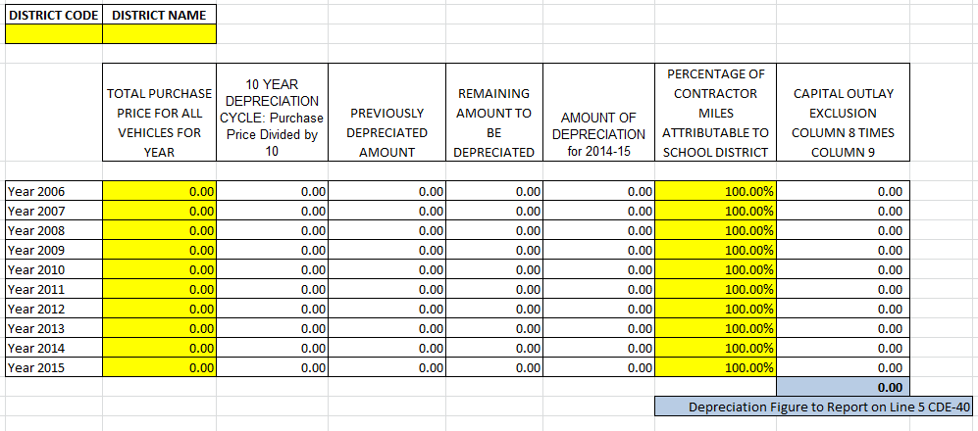
Item #5: Capital Outlay Vehicle Depreciation

Slide 22
Item #6: Number of Pupils Scheduled to be Transported
Number of pupils scheduled to be transported to and from public school at public expense on the mileage count date
The key word is “scheduled” – if you have students who drive to school, they are still scheduled to be transported, and should be included in this figure

Slide 23
Item #7: Total Actual Miles for Activity and Field Trips
All districts must submit the total actual miles traveled for activity trips, field trips, athletic trips etc. during the entitlement period (July 1, 2014 through June 30, 2015).

Slide 24
Item #8: Total Actual Miles for any Purpose
All district’s must submit the total actual miles traveled for any purpose by pupil transportation vehicles during the entitlement period (July 1, 2014 trough June 30, 2015).
These miles are determined by subtracting the ending year odometer readings from the beginning year odometer readings for all pupil transportation vehicles.

Slide 25
CDE-40 Form: Considerations
Transportation is not a fully funded program
You will not be reimbursed for 100% of your current operating expenditures
FY13-14: if transportation were fully funded, the statewide distribution would have been $88,212,754
The state was only able to reimburse $54,454,896

Slide 26
CDE-40 Form: Considerations
Summer School Mileage
Summer school mileage and expenditures can be reported.
Mileage should be reported on line 8 of the CDE-40.(Total Miles)

Slide 27
CDE-40 Form: Web Resources
All transportation material is located on the CDE Website:
http://www.cde.state.co.us/cdefinance/sftransp
Link to the CDE-40 Form
General Instructions and Rules
Payments Information
Reimbursement Claim and Procedures Information
Mileage Calculation Worksheet
Entitlement and Payment Worksheets

Slide 28
CDE-40 Form Preparation and Submission Contacts
School Finance Unit
Adam Williams: 303-866-6843: williams_a@cde.state.co.us
Yolanda Lucero: 303-866-6847: lucero_y@cde.state.co.us
Kirk Weber: 303-866-6610: weber_k@cde.state.co.us
Paul Reynolds: 303-866-6137: reynolds_p@cde.state.co.us

Slide 29
Audit Process Overview
All districts, BOCES, and facilities that receive public school transportation funds are subject to audit.
Who is the Field Analyst Support Team?
How often are Districts Audited?
What is the audit process- what can be expected?

Slide 30
Audited Information
All information submitted on a CDE-40 form is subject to audit. All documentation used in the completion of the CDE-40 should be set aside until the audit is complete.
Current Operating Expenditures
Official Mileage Count Day Miles (Scheduled Route Miles)
Number of School Days Students Actually Transported
Activity Miles
Total Miles

Slide 31
Audit- Current Operating Expenditures
“Current Operating Expenditures are actual expenditures, not including encumbrances, incurred during the entitlement period by a district in transporting students from home to school, school to school, and school to home…”

Slide 32
Audit- Current Operating Expenditures
Entitlement Period:
July 1, 2014 through June 30, 2015
District general ledger
vs
Expenditures reported on CDE-40 form
vs
District Financial data submitted through the Pipeline

Slide 33
Audit- Current Operating Expenditures
Allowable vs Non-Allowable Expenditures
Allowable Expenditures- any expenditure incurred in order to transport students from home to school, school to school, and school to home.
Non-allowable Expenditures- any expenditure that was specifically identified as non-allowable or that was NOT incurred in order to transport students from home to school, school to school, and school to home.

Slide 34
Audit- Current Operating Expenditures
Non-Allowable Expenditures
These are any expenditures that are NOT attributed to transporting students from home to school, school to school, or school to home (in any manner).
These are also expenditures that are not allowed per Rule such as capital outlay (including tools and facility/building repairs greater than $1,000 with a useful life of more than one year).

Slide 35
Audit- Current Operating Expenditures
Allowable Expenditures
Direct Costs (allowed at 100%)
vs
Prorated Expenditures (allowed at the reimbursable percentage)

Slide 36
Audit- Current Operating Expenditures
Allowable Expenditures
Direct Costs- expenditures that are 100% incurred/associated with transporting students from home to school, school to school, and school to home (ONLY).
Examples include:
Route driver salaries/benefits, parent mileage reimbursement, contracted transportation services, public transportation bus passes for students, etc.

Slide 37
Audit- Current Operating Expenditures
Allowable Expenditures
Prorated Expenditures- expenditures that are incurred to transport students (for any purpose).
The vast majority of allowable expenditures are subject to the reimbursable percentage.
Examples include: supplies, maintenance, repairs, fuel, etc.
Any expenditure attributed to the bus garage/facility should be prorated (if it is an allowable expenditure)

Slide 38
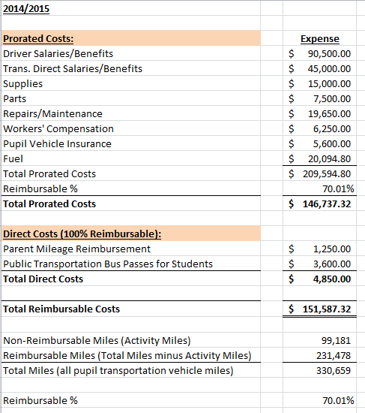
Audit- Current Operating Expenditures

Slide 39
Audit- Current Operating Expenditures
Allowable current operating expenditures may be listed under a district’s:
Transportation Funds
General Funds
Utilities
Insurances (vehicle, property, umbrella)
Workers’ Compensation
Or calculated
Support Costs
Non-transportation employees who assist in pupil transportation related functions (ex. business manager, payroll technician, etc.)

Slide 40
Audit- Current Operating Expenditures
Calculated Expenditures- Support Costs
In situation where a district has non-transportation employees supporting pupil transportation functions, the district can determine the percentage of the non-pupil transportation employee’s time that is spent on pupil transportation, and then apply that percentage to the employee’s total salary and benefits to determine the amount that can then be claimed at the reimbursable percentage.

Slide 41
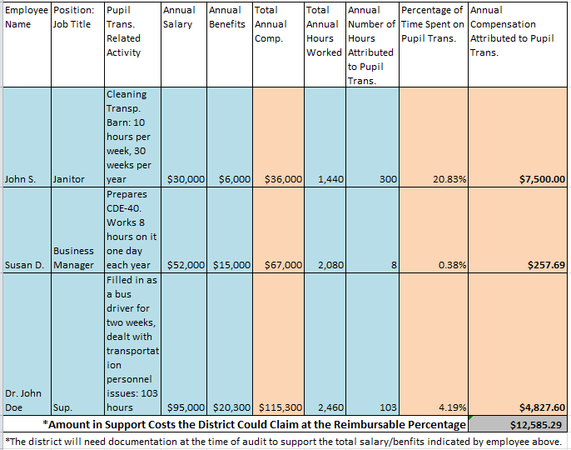
Audit- Current Operating Expenditures
Support Cost Calculation Example

Slide 42
Audit- Current Operating Expenditures
Expenditures attributed to non-pupil transportation vehicles
Yellow Fleet Expenditures (pupil transportation)
vs
White Fleet Expenditures (administrative/non-pupil transportation)
In the event the district does not separate out expenditures attributed to their white fleet from their yellow fleet, the district will need a mechanism by which to reduce these shared expenditures before applying the reimbursable percentage.
Examples of mechanisms that the district may consider include, but are not limited to:
Determining the percentage of district miles that are attributed to non-pupil transportation (aka. “Admin Miles”)
Reducing expenditures (as appropriate) by this percentage before applying the reimbursable percentage.
Applying a reasonable cost per mile and reducing that total prorated expenditures by that amount
This would be appropriate in cases where the district does not separate out any white fleet expenditures from the yellow fleet expenditures.
The Field Analyst Support Team recommends using a reasonable cost per mile of 32.6 cents per mile in such cases.

Slide 43
Audit- Current Operating Expenditures
Expenditures attributed to non-pupil transportation vehicles
Example of one district account that includes both pupil and non-pupil transportation vehicle expenditures:
A district tracks all fuel expenditures (regardless of vehicle type) in the same account.
The district has 4 buses (all log both route and activity miles), two (2) suburbans (both log pupil and non-pupil miles), and a maintenance truck (logs only non-pupil transportation mileage).
The total fuel expenditure for all seven (7) vehicles for the year was $22,000.
In this example, the district would not be able to include the entire $22,000 as a prorated expenditure in their total current operating expenditure.
The district would need to determine what percentage of the fuel was attributed to pupil transportation and then apply the reimbursable percentage to that amount to determine the total fuel expenditure that could be claimed in the reported total current operating expenditures.

Slide 44
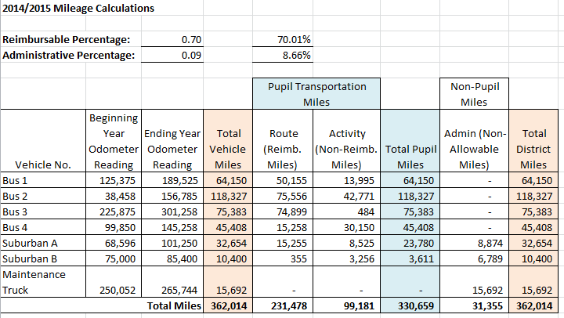
Audit- Current Operating Expenditures
Expenditures attributed to non-pupil transportation vehicles

Slide 45
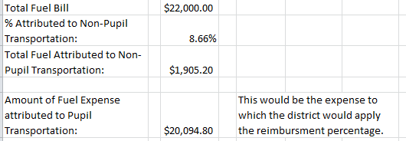
Audit- Current Operating Expenditures
Expenditures attributed to non-pupil transportation vehicles

Slide 46
Audit- Current Operating Expenditures
Audit Documentation- Current Operating Expenditures
At the time of audit, districts must be prepared to provide any documentation used that evidences the amounts claimed on their CDE-40 form including, but not limited to:
District work paper(s) explaining amounts claimed
Summary general ledger YTD report balances (transportation)
Detail Account Ledgers (supplies, repairs, etc.)
Other pertinent documentation included in the calculation of reimbursement expenditures (e.g. insurance, support costs, utilities, risk management documentation, etc.)

Slide 47
Audit- Scheduled Count Day Mileage
The official mileage count date is the same date as the pupil enrollment count date which is October 1 unless that date is a Saturday, Sunday, or major religious holiday.
The official mileage count date for 2014-2015 was
Wednesday, October 1, 2014.
The official mileage count date for 2015-2016
will be Thursday, October 1, 2015.

Slide 48
Audit- Scheduled Count Day Mileage
Districts must report their total mileage scheduled to be traveled by pupil transportation vehicles on the official mileage count date in transporting all pupils enrolled in its schools.
Pupil transportation vehicles are any vehicle used in whole or in part for the purpose of providing pupil transportation. This includes school buses, small vehicles, and multifunction buses. Examples of small vehicles may include vans, suburbans, and expeditions.

Slide 49
Audit- Scheduled Count Day Mileage
Scheduled mileage DOES include:
Scheduled mileage to and from a pupil’s legal residence and school in which the pupil is enrolled, including mileage for loaded and unloaded pupil transportation vehicles.
Scheduled mileage between two or more schools in which pupils are regularly enrolled and which pupils are required to attend as part of their scheduled programs.
In other words, “Scheduled mileage” refers to miles traveled for scheduled routes as of the official mileage count date (i.e. home to school, school to school, and school to home)

Slide 50
Audit- Scheduled Count Day Mileage
Scheduled mileage does NOT include:
Miles traveled for the purpose of providing transportation for pupils of another district.
Miles traveled for school field trips, extracurricular trips, athletic trips, etc.
Miles traveled in trips which are NOT for the purpose of transporting pupils from home to school, school to school, and school to home.

Slide 51
Audit- Scheduled Count Day Mileage
Examples of Types of Scheduled Routes
Regular routes
Mid-Day routes
Late routes
Vocational/Technical routes
Tuition Out/Facility routes
Shuttle routes
Contracted Transportation
Examples: 3rd Party Entities (such as First Student), BOCES, Other Districts, Mobile Taxi Services

Slide 52
Audit- Scheduled Count Day Mileage
Question- What if the district has a scheduled route that does not run every day- including on the official mileage count date?
You can still include these routes in your scheduled count day mileage, however you will need utilize the split calendar calculation in order to adjust for the number of days in which the route is ran.
Districts will still need to provide route descriptions, documentation evidencing the total number of miles the route was scheduled to run, and a copy of the calendar showing the total number of days the route ran.

Slide 53
Audit- Scheduled Count Day Mileage
Parent Mileage
In cases where the district is reimbursing parents to transport their students from home to school, school to school, and school to home, the district can:
Include these miles in the scheduled count day miles
The district will need to utilize a split calendar calculation. Total number of days for this “route” would be the total number of actual days in which the parent transported the student (as evidenced by the student’s attendance records or invoices for which the parent was reimbursed)
Claim the total expenditures attributed to parent mileage reimbursement at 100%

Slide 54
Audit- Scheduled Count Day Mileage
Contracted Mileage
In cases where the district is contracting for transportation services, the district may be able to include these miles in the scheduled count day miles.
If the contracted transportation services are for district routes only, then the regularly scheduled route miles can be included in the district’s reported count day mileage.
If the contracted transportation services include both district routes and student activities, the district can only report the regularly scheduled route mileage.
Be sure NOT to include activity miles ran on the official mileage count date.
If the district contracts transportation services to transport students for activity trips on the official mileage count date, the district can NOT include these miles in their reported scheduled count day mileage.

Slide 55
Audit- Scheduled Count Day Mileage
Contracted Mileage
Depending on the type of student transportation the district contracts, the district may be able to claim the expenditure at either 100% or at the prorated amount.

Slide 56
Audit- Scheduled Count Day Mileage
Split Calendar Calculation
A split calendar calculation needs to be used if a district has regularly scheduled route(s) that follow different calendars that vary by more than 3 days from the district calendar.

Slide 57
Audit- Scheduled Count Day Mileage
Split Calendar Calculation
Example 1: The district has 6 routes, and all 6 routes follow the district calendar. In this case, a split calendar calculation is not needed.
Example 2: The district has 6 routes. Four (4) routes follow the district calendar, and transport students a total of 170 days. One (1) route transports students a total of 168 days, and the last route transports students 172 days. In this case, a split calendar calculation is not necessary because the number of days the other two routes transported students was not more or less than 3 days from the district calendar.

Slide 58
Audit- Scheduled Count Day Mileage
Split Calendar Calculation
Example 3: The district has 6 routes. Four (4) routes follow the district calendar, and are transported 170 days. One (1) route transports students 180 days, and one (1) route transports students a total of 165 days. In this case, a split calendar calculation should be used.

Slide 59
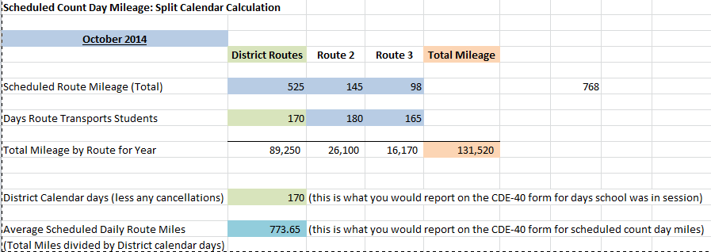
Audit- Scheduled Count Day Mileage
Split Calendar Calculation: Example 3

Slide 60
Audit- Scheduled Count Day Mileage
Scheduled Count Day Mileage Audit Documentation
Districts must be prepared to provide documentation evidencing the following at the time of the audit:
Official mileage count day route descriptions
Documentation evidencing total scheduled miles for each route
Route descriptions that show the mileage between stops OR
Count day route beginning and ending odometer readings
Split calendar calculation work sheet with accompanying calendars (if applicable

Slide 61
Audit- Days School was in Session and students were transported
Every district is required to report the total number of days school was in session and students were actually transported. This total should reflect the total number of days evidenced by the district calendar, less any cancelled school days.
Example: District calendar shows that students are scheduled to attend 170 days. However the district canceled 2 school days in February due to weather, and 1 school day in March because the district high school made it to the final state basketball tournament. In this case, the district would report 167 days on their CDE-40 form (170-3= 167).

Slide 62
Audit- Total Miles Traveled by Pupil Transportation Vehicles
Every district is required to report the total actual miles traveled for any purpose by all pupil transportation vehicles. In addition, of the total actual miles traveled, the district must also report how many of them were traveled for school field trips, extracurricular trips, and athletic trips by pupil transportation vehicles (aka “activity” miles).

Slide 63
Audit- Total Miles Traveled by Pupil Transportation Vehicles
Reimbursable Percentage
The purpose of reporting both the total actual miles traveled and total activity miles is to determine the reimbursable percentage that will be applied to those expenditures attributed to both route and activity miles (prorated expenditures).

Slide 64
Audit- Total Miles Traveled by Pupil Transportation Vehicles
Reimbursable Percentage
Example: If a district had a total of 50,000 miles traveled for any purpose by all pupil transportation vehicles, and of those miles, 12,500 were traveled for school field trips, extracurricular trips, and athletic trips, then the district would determine its reimbursable percentage as follows:
(Total Miles minus Activity Miles) divided by Total Miles
(50,000-12,500)/50,000 = 37,500/50,000 = .75 or 75%
This means that approximately 75% of all miles traveled by pupil transportation vehicles were attributed to transporting students from home to school, school to school, and school to home.
As such, for those expenditures attributed to pupil transportation for any purpose, and were allowed at the reimbursable percentage, the district could claim 75% of those expenditures.

Slide 65
Audit- Total Miles Traveled by Pupil Transportation Vehicles
In order to determine the total actual miles traveled for any purpose for all pupil transportation vehicles, the district must track the beginning year odometer readings (taken on July 1) and the end of year odometer readings (taken on June 30) for each pupil transportation vehicle.
Once the ending year odometer reading is taken, the district can subtract the beginning year reading from the end of year reading for each pupil transportation vehicle to determine the total number of actual miles traveled by that vehicle.
The district must be prepared to provide all odometer readings (beginning and end of year) for all pupil transportation vehicles at the time of audit.

Slide 66
Audit- Total Miles Traveled by Pupil Transportation Vehicles
Helpful Hints:
When reporting total actual miles traveled for any purpose, districts must use the total mileage as evidenced by the odometer readings.
The district should ensure that the current year’s beginning odometer reading for each vehicle matches the prior year’s end of year odometer readings. If these odometer readings do not match, adjustments to total miles will likely be taken at the time of audit.
The district should NOT use any system generated reports to determine total actual miles traveled for any purpose by pupil transportation vehicles.
The district should NOT determine total actual miles traveled for any purpose by pupil transportation vehicles by taking the total scheduled mileage for the year for all route types and then adding total activity miles.

Slide 67
Audit- Total Miles Traveled by Pupil Transportation Vehicles
Helpful Hints:
The district can NOT include parent miles in “Total Miles” as reported on the CDE-40 form (because expenditures attributed to this mileage type are allowed at 100%).
The district may be able to include contracted miles in “Total Miles” depending on how the district claims expenditures associated with these contracted miles.
If the contracted transportation services are for district routes only, then these miles can NOT be included in total miles (because expenditures attributed to this mileage type are allowed as 100%)
If the contracted transportation services include both district routes and student activities, the district should include all mileage (route and activity) in “Total Miles” and reported “Activity Miles” as appropriate.
If the district contracts transportation services to transport students for activity trips at any time during the school year, the district does not have to include these miles in the reported “Total Miles” or “Activity Miles”, as long as the district has not included any expenditures attributed to these contracted miles in their total current operating expenditures.

Slide 68
Audit- Total Actual Miles Traveled for Activity, Field Trip Etc.
Districts are required to report the total actual miles traveled for school field trips, extracurricular trips, and athletic trips by pupil transportation vehicles.
This mileage total is a sub-set of the total miles traveled for any purpose by all pupil-transportation vehicles
Districts should be prepared to provide documentation at the time of audit that evidences this total mileage type. In addition, it should include all activity miles ran during the entire entitlement period.

Slide 69
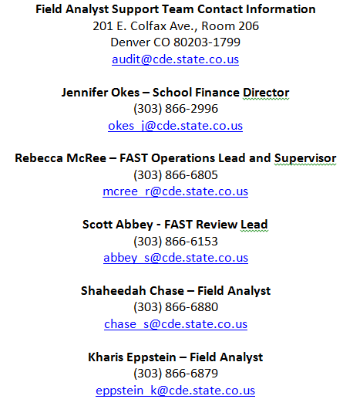
Field Analyst Support Team

