Slide 1
School Finance Update CASE February 4, 2016
Leanne Emm, Associate Commissioner
Emm_l@cde.state.co.us – 303-866-6202
September 2015

Slide 2
Agenda
Total Program Funding
Constitutional Constraints
2015-16 Supplemental Funding Request
2016-17 REVISED Budget Request
Financial Transparency & Related

Slide 3
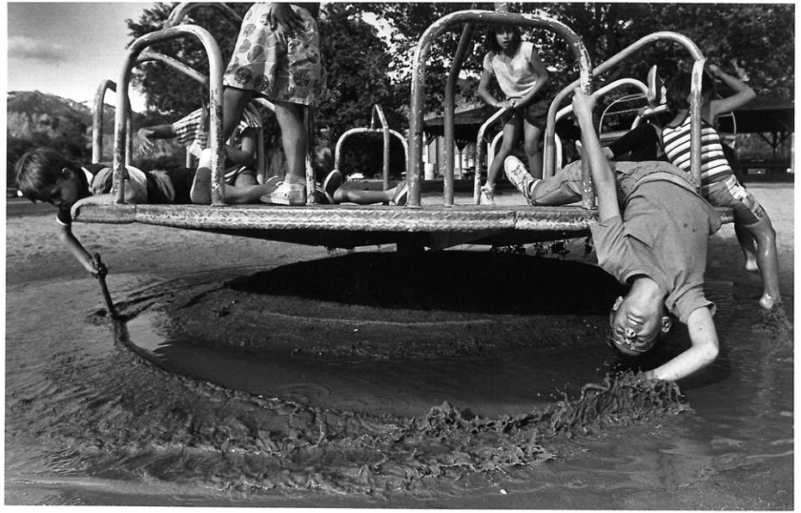

Slide 4
School Finance Total Program Funding

Slide 5
School Funding – Total Program
The vast majority of money for schools comes through the Public School Finance Act of 1994
Total Program Funding = Local Funding + State Funding
(total amount of funding received by districts for operations)
This formula attempts to equalize funding to districts across the state.
Local Funding always applied first.
Notes:
School districts within the state of Colorado receive the majority of their funding through the Public School Finance Act of 1994 as amended. The sources of revenue to fund the School Finance Act are made up of state and local funding. These two revenue streams make up “Total Program Funding” which is the total amount of funding received by districts for general operating expenditures.
The School Finance Act formula attempts to equalize funding to districts across the state. This ensures that districts with lower property tax values have an equal ability to “. . . provide for the establishment and maintenance of a thorough and uniform system of free public schools throughout the state” as stated in Colorado’s constitution. Without this equalization, districts with higher property tax bases would be able to outpace districts with lower property tax values in the ability to provide funding for schools.
There are other sources of revenue that become available to school districts and we will touch on these in a later slide.

Slide 6
Total Program Funding Formula
Total Program Funding equals:
=(funded pupil count x
formula per pupil funding)
+ at-risk funding + online & ASCENT funding
After Total Program is calculated, the Negative Factor is Applied

Slide 7
Base Per Pupil Funding
2015-16
Base Funding - $6,292.39
Increase of $171.39
Inflation of 2.8%
2016-17
Base Funding - $6,367.90
Increase of $75.51
Inflation of 1.2% - Actual
Increase of 1.5% (OSPB) – Budget Request

Slide 8
Formula Per Pupil Funding - Factors
Base per pupil funding is adjusted by factors
Cost of Living
Personnel & Non-personnel costs
Size of district
Determine At-Risk Funding, On-line and ASCENT Funding
Once Total Program is determined, the negative factor is applied
2015-16 – 11.83% - with supplemental
Notes:
Once the base funding has been set, the base has factors applied. These factors determine the per pupil funding amount by district and each district is different.
Cost of living – factor that attempts to reflect the differences between districts for the cost of housing, goods and services. Aspen has a higher cost of living factor than a small rural district.
Personnel costs factor – based on enrollment and incorporates cost of living for personnel.
Size factor – driven by enrollment and attempts to reflect purchasing power within districts. Small districts have greater size factor adjustments.
At-risk funding – based on the numbers of students qualifying for free lunches
On-Line funding – based on the number of students enrolled in an online program within the district. There are various rules that make a student eligible to be counted.
Once these factors are applied to the base, a total per pupil funding amount is determined for district. This amount is then multiplied by the districts funded pupil count to arrive at total program funding.

Slide 9
Local Funding Sources
Local Funding
Property Taxes – mill levies
Specific Ownership Taxes – vehicle registration fees
This funding provides approximately 34% of total program funding statewide
The percentage split in specific districts varies
Notes:
The second piece of Total Program Funding comes from local sources of funds. These local sources include property taxes and specific ownership taxes or vehicle registration fees. In a district with a higher property tax valuation, total program funding is provided with larger amounts of property tax than state funds. The opposite occurs in districts with lower valuations of property taxes.

Slide 10
Illustration of Two Districts

Slide 11
Gallagher Amendment - 1982
Intended to set the ratio of property taxes raised from both residential vs. business properties
Split – 45% residential vs. 55% business – statewide
Residential assessment rate – resets every two years potentially
7.96% since 2003
Under TABOR, this rate cannot rise without a vote of the people
Has had the impact of lower property taxes contributing to School Funding – the Total Program
State share for K-12 education has increased to 65% from 44% while the local share has decreased from 56% to 35%

Slide 12
TABOR Amendment - 1992
Impact of the TABOR amendment on school finance
Sets limits on the amounts of revenues that can be collected and retained by state and local governments including schools districts
Limits local property tax revenue growth
Requires voter approval for an increase in mill levies, or assessment rates
Most districts have received voter approval to retain excess revenues – the State has not
When revenues exceed the limit, refunds must be given

Slide 13
TABOR Amendment - 1992
Between 1994 and 2006, school district mill levies were decreasing since assessed values were increasing at a rate greater than what TABOR allowed – inflation plus student growth
This continued to cause the state portion of school funding to increase putting even greater pressure on the state budget
Senate Bill 07-199 froze mill levies for districts at the 2006-07 levels
Total program mill levies cannot go higher than 27 mills – some districts may have levies lower than this

Slide 14
Amendment 23 - 2000
Requires base per pupil funding to increase by inflation each year in addition to categorical funding
Categorical fund is provided for programs such as exceptional students, transportation and English language learners
An additional one percent was included for 10 years to attempt to make up losses in funding in prior years
The State Education Fund was created which transfers one-third of one percent of federal taxable income from the State’s General Fund
Creates additional pressures on the state budget with these requirements

Slide 15
State Perspective
The following slides were provided by the Office of State Planning and Budgeting
They are not updated with the most current revenue forecast, however still give an illustration of the issues facing the state

Slide 16
A TABOR Simile
TABOR Limit
Income and Sales taxes
General Fund
Fees
Cash Funds
TABOR Refund
Notes:
Talk about refunding cash funds in terms of both Constitutional and practical limitations.

Slide 17
Hospital Provider Fee, Severance Tax, and other TABOR Revenue and Referendum C
Source: OSPB June 2015 Forecast
Notes:
HPF is a creative mechanism that allows the State to draw down additional federal funds, allowing hospitals to be compensated for providing care to individuals for whom they had not previously been fully paid.
Revenue from the Hospital Provider Fee has also paid for the State’s ACA expansion, limiting the direct General Fund cost of expanding Medicaid eligibility

Slide 18
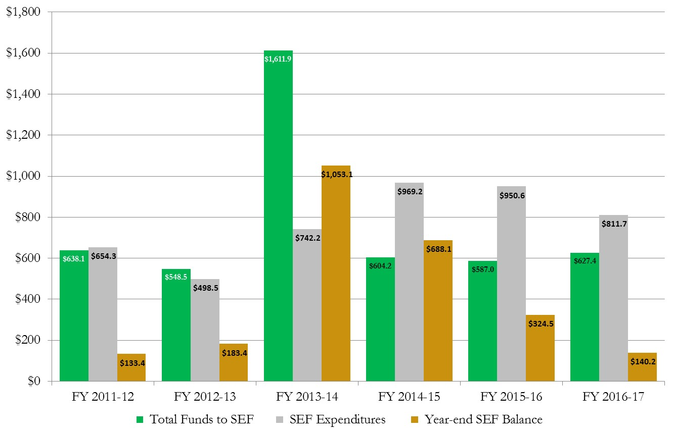
State Education Fund Money, Spending, and Reserves
Under Governor’s Budget Request
FY 2011-12 through FY 2016-17 Projected ($ in Millions)
Notes:
Normal SEF activity in FY12 and FY13 (Green is revenue, gray is expenditures, orange is balance)
Note the big increase in FY14, with a $1 billion balance at the end of the year
Last year, we were faced with a choice of what to do with this balance – we could spend slowly on base-building programs and aim for a soft landing, or we could spend aggressively. The Capitol building chose to spend aggressively.
Total program spending was propped up with one-time SEF revenues, dropping the negative factor from over $1 billion to about $850 million

Slide 19
Negative Factor
The great recession and pressures on the state budget caused the General Assembly to adopt the “negative factor” in 2010-2011
In 2015, the Colorado Supreme Court ruled this was a legal
It has reduced the amount of funding that would be required under the School Finance Act without the negative factor
It was a budget balancing mechanism as the entire state budget was being reduced

Slide 20
Supplemental Funding Request 2015-16

Slide 21
Supplemental Request – 2015-16
 | Original Appropriation | Actual 2015-16* | Change (with Supplemental)*
Funded Pupils | 855,391 | 853,251 | (2,140)
At-Risk Pupils | 309,985 | 308,140 | (1,845)
Total Program Prior to Negative Factor | $7,094,740,921 | $7,070,267,168 | ($24,473,753)
Negative Factor | ($855,176,146) | ($830,702,393) | $24,473,753
Total Program After Negative Factor | $6,239,564,775 | $6,239,564,775 | $0
Average Per Pupil Funding | $7,294.41 | $7,312.69 | $18.28
*Subject to Legislative Approval
Notes:
Sources
Colorado Department of Education

Slide 22
Notes:
The School Finance Act is funded with a combination of State General Fund; local funds including property tax and specific ownership tax and other state funds which include the State Education Fund and the Public School Fund.

Slide 23
Local vs. State Share 2015-16
 | FY 2015-16 Original Appropriation | FY 2015-16 Total Revised Request | FY 2015-16 Requested Supplemental Appropriation
State Share | $4,113,321,146 | $3,979,778,973 | ($133,542,173)
Local Property Tax | 1,976,565,021 | 2,104,957,889 | 128,392,868
Specific Ownership Tax | 149,678,608 | 154,827,913 | 5,149,305
TOTAL | $6,239,564,775 | $6,239,564,775 | $0

Slide 24
Supplemental Request
Accounts for actual October student counts and changes in assessed values and reported specific ownership tax (SOT)
Student counts and at-risk counts lower - $24 million less
Property taxes and SOT higher - $133 million
Total potential “savings” to state - $157 million – legislature must decide on final numbers
Reason why no change in state equalization distributions until legislature takes action
Governor’s request does not change the General Fund
State Ed Fund - $105 million & State Public School Fund - $28 million
Allows for State Ed Fund balance to maintain higher balance for use in 2016-17

Slide 25
REVISED Governor’s Budget Request 2016-17

Slide 26
Revised Assumptions FY2016-17 Budget Request
 | Original Estimate | Revised Estimate | Change
Pupil Growth | 865,454 | 861,442 | (4,012)
At-Risk Growth | 314,418 | 311,413 | (3,005)
Inflation Estimate | 1.8% | 1.5% 1.2% Actual | (0.3%) (0.6%)
Base Per Pupil Funding | $6,405.65 | $6,386.78 $6,367.90 Actual | ($18.87) ($37.75)
Notes:
Sources
Colorado Department of Education

Slide 27
Assumptions FY2016-17 Governor’s Budget Request
Fund growth and inflation
Increase in local share
Negative factor increase from $830.7 million to $871.5 million
Inflation Rate – illustrations assume 1.2% final CPI vs. 1.5%
Joint Budget Committee – Supplemental Hearing
Fund supplemental as presented
FY2016-17 - CURRENT LAW - starting point with same negative factor
Adjustments through School Finance Act
MOVING PARTS – LONG WAY TO GO!

Slide 28
Compare Supplemental FY2015-16 to Budget Request* FY2016-17
 | Actual 2015-16 with Supplemental Funding* | 2016-17 Budget Request** | Change
Total Program prior to Negative Factor (Growth & Inflation) | $7,070,267,168 | $7,223,145,566 | $152,878,398
Negative Factor | (830,702,393) | (871,466,681) | (40,764,288)
Revised Total Program | $6,239,564,775 | $6,351,678,885 | $112,114,110
Negative Factor Percentage | -11.83% | -12.08% | .25%
Average Per Pupil Funding | $7,312.69 | $7,373.31 | $60.62
*Subject to Legislative Approval
**Utilizes the 1.2% Actual Inflation Rate – Governor’s Request
Notes:
Sources
Colorado Department of Education

Slide 29
Compare Supplemental FY2015-16 to Current Law – FY2016-17 (keep negative factor the same)
 | Actual 2015-16 with Supplemental Funding* | 2016-17 Under Current Law* (negative factor the same) | Total
Total Program prior to Negative Factor (Growth & Inflation) | $7,070,267,168 | $7,223,145,566 | $152,878,398
Negative Factor | (830,702,393) | (830,702,393) | -0-
Revised Total Program | $6,239,564,775 | $6,392,443,173 | $152,878,398
Negative Factor Percentage | -11.83% | -11.51% | 0.32%
Average Per Pupil Funding | $7,312.69 | $7,420.63 | $107.94
*Subject to Legislative Approval
Notes:
Sources
Colorado Department of Education

Slide 30
Range of Options – 2016-17 (not all inclusive)
 | 2016-17 Budget Request* | 2016-17 Under Current Law* (negative factor the same) | Variation
Total Program prior to Negative Factor (Growth & Inflation) | $7,223,145,566 | $7,223,145,566 | -0-
Negative Factor | (871,466,681) | (830,702,393) | $40,764,288
Revised Total Program | $6,351,678,885 | $6,392,443,173 | $40,764,288
Negative Factor Percentage | -12.08% | -11.51% | 0.57%
Average Per Pupil Funding | $7,373.31 | $7,420.63 | $47.32

Slide 31
Compare Funding Scenarios for 2016-17
 | Actual 2015-16 with Supplemental Funding* | 2016-17 Budget Request** | 2016-17 Under Current Law* (negative factor the same)
State Share | $3,979,778,973 | $4,076,199,960 | $4,116,964,248
Local Property Tax | 2,104,957,889 | 2,121,309,958 | 2,121,309,958
Specific Ownership Tax | 154,827,913 | 154,168,966 | 154,168,966
Total | $6,239,564,775 | $6,351,678,885 | $6,392,443,173
Statewide Average Per Pupil Funding | $7,312.69 | $7,373.31 | $7,420.63
*Subject to Legislative Approval
**Assumes 1.2% CPI

Slide 32
State of Colorado Total Program Funding
*Subject to Legislative Approval
In millions

Slide 33
State of Colorado Average Per Pupil Funding
Similar to Total Program, the gaps in the bars represents the effect of the negative factor.
For 2015-16, the effect is $973 in the statewide average per pupil funding.
*Subject to Legislative Approval

Slide 34
2016 Legislative Session
November, 2015 | Governor Submits Budget Request for 2016-17 THIS IS ONLY A PROPOSAL!
January 2016 | Joint Budget Committee Hearing with Department The JBC hears about the 2016-17 Budget Request from the Department and seeks any information
January 2016 | Governor Submits Supplemental Budget Request for 2015-16 Adjusts the Current Year Budget for actual Pupil Counts, AVs, etc. HB/SB16-XXX – Mid-Year Adjustments - Supplemental Governor Submits Budget Amendments for next budget year Revised estimates for next year’s students, AVs, etc based on actual
Spring 2016 | JBC Develops State Budget – Figure Setting & Long Bill – pass by GA
Spring 2016 | School Finance Bill Introduced and passed Adjusts the Long Bill numbers

Slide 35
HB14-1292 –Student Success Act Reporting of Local Revenues
2014-15 reporting requirement – additional local property tax revenue – mill levy overrides
How much is distributed to schools of the district
Department will compile the report
Districts and charter schools review report prior to publication
District or charter school may request an addendum
Overall distribution by district to charter schools
Capital construction and facilities
Funding for technology
Other funding
Financial Policies and Procedures Committee
Report information through Fund 90 – informational items

Slide 36
BEST Funding
SB16-072
Would raise state contribution cap to $60 million for Certificate of Participation (COP) payments
Staggered over the years - $5 million per year
Modeling could finance about $300 million over 5 years
Could potentially mean maybe two-three new schools a cycle with additional COPs
Moving ahead with revamp of priority assessment
Assessments will begin on rolling basis in July

Slide 37
Sources and Further Reading
Herriod, Todd. "Memorandum: The State Constitution and School Finance." (n.d.): n. pag. Colorado.gov. Legislative Council. Web. 8 Jan. 2016. <https://www.colorado.gov/pacific/cga-legislativecouncil/tabor-referendum-c-and-gallagher>.
Building a Better Colorado - https://betterco.org/

Slide 38
Contact Information
Leanne Emm
Emm_L@cde.state.co.us
303-866-6202
Jennifer Okes
Okes_J@cde.state.co.us
303-866-2996
Mary Lynn Christel
Christel_M@cde.state.co.us
303-866-6818

