Slide 1

Urban Institute
Colorado At-Risk Working Group

Slide 2
Four Sessions
Sessions are held remotely, on the second or third Monday of the month.
Session Date | Session Topic
August 15, 2022 | Prioritizing SES variables
September 12, 2022 | Understanding estimated values of SES Index by neighborhood, and implementation of the Index
October 17, 2022 | Implementing SES Index with the ISP measure
November 14, 2022 | Finalize the SES index and ISP measure, and any hold harmless recommendations to facilitate transition

Slide 3
Overview
Results from Survey #3
Implementing SES data with ISP
  Weighting of direct certification
  Use of Medicaid data
  Hold Harmless
Discussion and Consensus

Slide 4
Survey Results

Slide 5
Consensus on Index Components?
Same residence, BA or higher, median HH income, child living with non-biological parents, living in more crowded conditions, income to rent/mortgage, non-English language at home
  Yes: 13
  No: 5
  Missing: 2
    Exclude 'adopted' and 'foster' - keep 'living with relatives not their biological parent’
    The measures are fine but I am concerned with the size of "neighborhoods" in rural areas where district boundaries may bring very different results.

Slide 6
Consensus on Index Components?
    Ideally, we would support striking “share of those in the same residence last year” and replace with home ownership rates. We appreciate the inclusion of some housing-related indicators (crowded housing, housing cost burden, etc.), but they don’t capture wealth in the way that home ownership rates do. We understand that it may not make much of a difference to include home ownership in the index since there are so many measures included, and that the group may be moving towards consensus on this list, in which case we would support the group's recommendation - but we do think it's worthy of more discussion.
    Share of adults age 25 or older with a bachelor's degree or higher
    Could the first measure (moved households within the last year) be expanded to something like moved households more than x times in the past y years? A single move doesn’t constitute mobility.

Slide 7
Consensus on At-Risk Measure Weighting?
75% ISP and 25% neighborhood SES: 11
50% ISP and 50% neighborhood SES: 4
Other: 3
Missing: 2
  A 60/40 might generate the most fairness
  There should be flexibility to maximize the percentage i.e. the formula would take the greater of 100/0, 75/25, 50/50, 25/75, 0/100.
  The issue isn't the proposed proportions and ratios, but rather the fact that they don't work for all districts. In general, Model A works for larger districts with fewer historical at-risk students. Model D tends to be best for smaller, rural, larger at-risk percentage districts.

Slide 8
Consensus on Quintiles
Yes: 14
No: 4
Missing: 2
  I am concerned about the accuracy of the neighborhood SES scores as it relates to actual school districts. The two do not necessarily correlate. Additionally, it is hard to have faith in what is being presented when the IES data does not include Medicaid data.
  Since we are an advisory group I would make the recommendation to make the 5 quintiles a range that best fits neighborhood characteristics
  I was initially worried about the unpredictability of funding if you were a district on a quintile boundary every year. I would support it if the financial impact of moving one quintile was not dramatic for districts.

Slide 9
Consensus on Equal Weight Among Quintiles
Yes: 13
No: 4
Missing: 3
  Higher weight for low SES quintiles
  Open to more weight for lower SES
  It should be more front loaded to place a higher value on districts with a larger historical at-risk percentage otherwise you will be potentially significantly overfunding some districts
  If more equitable funding outcomes is a goal of our group, we would support heavier weighting for the lowest SES quartiles, as was modeled on slide 25 of the deck shared in the last meeting (or Model B on slide 26). Especially if SES is only 25% of the weight overall in the factor, it seems important to place additional weight on students who face the most economic barriers.

Slide 10
Should the committee offer specific recommendations around provision of mitigation or harmless measures?
Yes: 18
No: 0
Missing: 2

Slide 11
Should the committee offer specific recommendations around provision of mitigation or harmless measures?
A measure that provides a permanent “floor” of base at-risk funding for districts based on funding in 2022-23, so that districts don’t see any declines relative to current funding
  13
An approach that phases in the new measure over time (for example, using a blend of counts from FRPL and from at-risk, which would require districts to continue collecting school lunch or income forms)
  2
An approach that provides mitigation or alternative calculation for districts with a large difference between the new and old At-Risk measures
  5
Other
  4

Slide 12
Should the committee offer specific recommendations around provision of mitigation or harmless measures?
Maybe a temporary "floor" that would be phased out over time. I'm not sure the Interim Committee would stick with the permanent floor, so I think a phasing would be more appealing to them.
Potential If/then scenarios where certain demographic districts defer to one calculation while other demographic districts are calculated differently.
Gain understanding of what factors within FRPL form are not captured with ISP or SES to help clarify the significant discrepancies some districts are seeing in the estimates and whether any additional calculation/measures would be a more accurate reflection of at-risk for some / all districts.
It would help to have more information about which districts are expected to see their at-risk counts change substantially under the new measure. If they are primarily districts with ample mill levy override funding and/or capacity to raise local resources, we would approach the hold harmless conversation differently than if they are districts where a significant decline in at-risk funding would be more difficult to absorb. An index of local capacity was developed for SB 22-202 (the MLO match fund bill that passed last session) that might be useful here.
We would caution against relying on continued submission of FRPL forms since we are moving away from that for both school funding and school lunch purposes (because of Prop FF's passage).

Slide 13
Other Comments or Questions?

Slide 14
Implementing in Funding Formula

Slide 15
Implementing New At-Risk Measure With Funding Formula
Direct certification is a partial measure of the share of students eligible for free lunch
Even when combined with an SES measure, in most cases, districts had fewer identified at-risk students than the previous FRPL at-risk measure.
Two options:
  Increase percentage of funding each student brings
  Add a multiplicative factor on direct certification

Slide 16
Implementing New At-Risk Measure With Funding Formula
Add a multiplicative factor on direct certification:
  Goal is that total number of at-risk students in the state under the new measure is approximately equal to the total number of at-risk students (FRPL) in the state under the old measure.
  No district gets an at-risk allocation greater than total funded membership.

Slide 17
Implementing New At-Risk Measure With Funding Formula
Model A: 75% ISP (x 1.83) , 25% SES.
  Quintile weights, lowest to highest: 1,0.8, 0.6, 0.4, 0.2 (equal)
Model B: 75% ISP (x 1.58), 25% SES.
  Quintile weights, lowest to highest: 1,0.9, 0.8, 0.6, 0.3 (more weight for lower SES)
Model C: 50% ISP, 50% SES.
  Quintile weights, lowest to highest: 1,0.8, 0.6, 0.4, 0.2 (equal)
Model D: 50% ISP, 50% SES.
  Quintile weights, lowest to highest: 1,0.9, 0.8, 0.6, 0.3 (more weight for lower SES)

Slide 18
Implementing New At-Risk Measure With Funding Formula
Model | At-Risk Count | Multiplication Factor | Total At-Risk Formula Funding | Delta from June 2022 | Hold Harmless | Net New Investment to Implement | Percentage Increase
June 2022 | 327,175 | N/A | $406,344,211 | N/A | N/A | N/A | N/A
Model A | 234,321 | N/A | $270,478,226 | -$135,865,985 | -$140,188,242 | $4,322,257 | 1%
Model A Weighted | 323,182 | 1.83 | $391,141,537 | -$15,202,674 | -$51,198,944 | $35,996,270 | 13%
Model B | 261,125 | N/A | $297,897,810 | -$108,446,401 | -$120,178,148 | $11,731,747 | 3%
Model B Weighted | 323,263 | 1.58 | $380,410,809 | -$25,933,401 | -$60,915,980 | $34,982,579 | 12%
Model C | 325,758 | N/A | $373,295,450 | -$33,048,760 | -$70,260,381 | $37,211,621 | 10%
Model D | 379,354 | N/A | $427,711,065 | $21,366,854 | -$58,655,704 | $80,022,558 | 21%

Slide 19
Characterizing Changes In Funding (Model A Weighted)
11 districts receive funding increases of between $200 and $550 per student
  Average of 4% increase in per-pupil allocation
  Average 2020 ISP decile of 9, FRPL decile of 7, enrollment ~2,800
27 receive funding increases of between $100 and $200 per student
  Average of 1% increase in per-pupil allocation
  Average 2020 ISP decile of 6, FRPL decile of 5, enrollment ~1,800
48 receive funding increases of between $0 and $100 per student
  Average of 0.4% increase in per-pupil allocation
  Average 2020 ISP decile of 5, FRPL decile of 4, enrollment ~5,900
91 districts held harmless at previous allocation (inflation adjusted)
  Average 2020 ISP decile of 5, FRPL decile of 6, enrollment ~5,100

Slide 20
Forecasting Medicaid Changes

Slide 21
A Link to Medicaid will Likely Increase Direct Certification
Increase in share of students eligible for free meals via direct certification based on Medicaid in SY 2017-18 ranged from 0.6 percent to 10.5 percent of all students, depending on the state.
Increase in share of students eligible for free meals via direct certification based on Medicaid in SY 2019-20 ranged from 2.1 percent to 17.1 percent of all students, depending on the state.
Typical overall increase in direct certification is ranges from 2-6 percent.

Slide 22
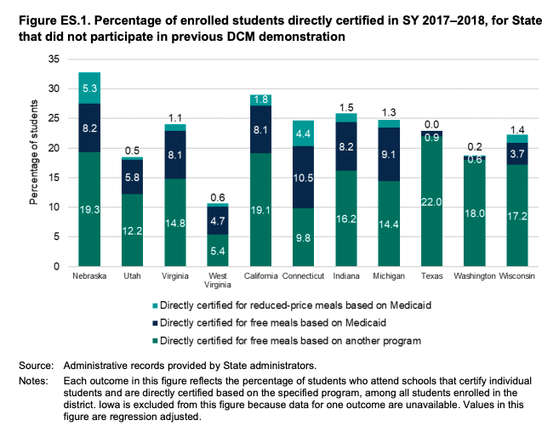
A Link to Medicaid will Likely Increase Direct Certification

Slide 23
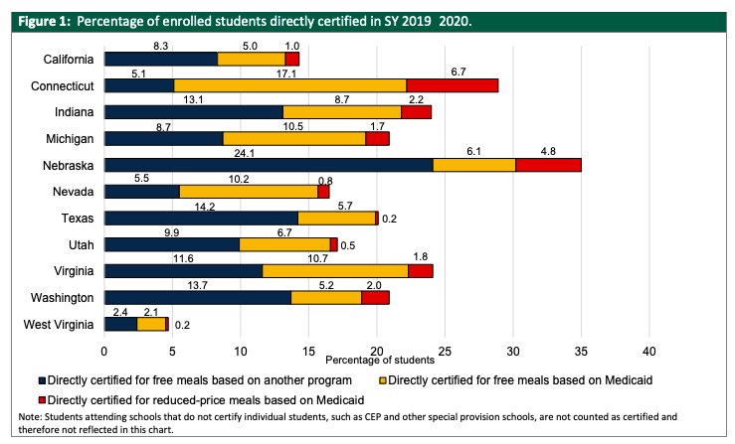
A Link to Medicaid will Likely Increase Direct Certification

Slide 24
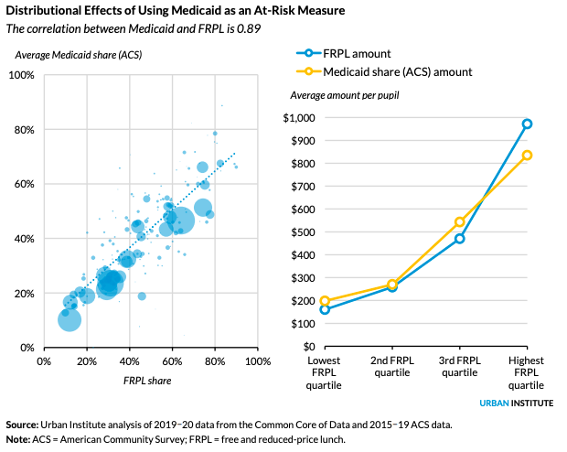

Slide 25
Hold Harmless

Slide 26
Should the committee offer specific recommendations around provision of mitigation or harmless measures?
Yes: 18
No: 0
Missing: 2

Slide 27
Should the committee offer specific recommendations around provision of mitigation or harmless measures?
A measure that provides a permanent “floor” of base at-risk funding for districts based on funding in 2022-23, so that districts don’t see any declines relative to current funding
  13
An approach that phases in the new measure over time (for example, using a blend of counts from FRPL and from at-risk, which would require districts to continue collecting school lunch or income forms)
  2
An approach that provides mitigation or alternative calculation for districts with a large difference between the new and old At-Risk measures
  5
Other
  4

Slide 28
Use of a Floor For Hold Harmless
Precedent in the funding formula for a floor that increases with the rate of inflation each year
  Hold harmless would mitigate concerns around loss of funding for rural districts, and around any changes to neighborhood quintile rank (increase in measured neighborhood SES).
Question of whether and when hold harmless should be re-examined?

Slide 29
Consensus

Slide 30
At-Risk Committee’s Charge
Committee is made up of representatives who are all invested in improving education and food security for Colorado students.
The Committee has been charged with recommending which SES Index measures shall be used, and how they should be incorporated with the direct certification measure.
The Committee may ask legislators to make additional considerations in implementation of the new At-Risk measure.

Slide 31
Consensus Process
Each voting committee member will be asked to provide a score of 0, 1, or 2 on elements of the At-Risk formulation
  2: Agree with element
  1: Neutral
  0: Disagreement (respondent will be given opportunity to explain disagreement)
Vote will occur in chat – will have an opportunity for any final questions before each section.
Discussion of additional considerations already slotted for inclusion in memo will follow before whole-group consensus.

Slide 32
Line-Up
Index Components: Same residence, BA or higher, median HH income, child living with non-biological parents, living in more crowded conditions, income to rent/mortgage, non-English language at home
Use of Quintiles for SES
Weight Among Quintiles: Equal (1, 0.8, 0.6, 0.4, 0.2)
At-Risk Measure Weighting: 75% ISP and 25% neighborhood SES
Count Equalization: Equal to the total number of students identified as eligible for FRPL in 2022-23.
Recommend Hold Harmless: Consist of a floor of funding based on 2022-2023 allocation

Slide 33
Preview: Final Consensus
After voting on each component, members will be asked to give final approval or disapproval on this statement:
  Given any noted differences expressed in the consensus vote, and the opportunity to put forward additional considerations in the final memo to legislators, are there any At-Risk voting committee members who will not approve the committee’s recommendations?
Those who disapprove on the whole will be given an opportunity to state the reasons for their dissention in the memo.

Slide 34
For Consensus:
The at-risk socio-economic status (SES) measure shall be a composite of the following data points from the American Community Survey:
  Share of those in the same residence as last year
  Share of adults age 25 or older with a bachelor’s degree or higher
  Share of children under 18 who are adopted, foster, or living with relatives that are not their biological parents
  Median household income
  Share of occupied housing units with more than 0.5 occupants per room
  Average ratio of income to rent/ownership costs
  Share of children age 5 to 17 who speak non-English language at home

Slide 35
For Consensus:
These data points shall be averaged into an index, which divides each Census block group into one of five socio-economic status quintiles.

Slide 36
For Consensus:
Weights for each student living in an SES quintile shall be distributed in the following way:
SES Quintile | Weight
1 (Lowest SES) | 1
2 | 0.8
3 | 0.6
4 | 0.4
5 (Highest SES) | 0.2

Slide 37
For Consensus:
The SES Index shall make up 25 percent of the At-Risk calculation, with the share of students directly certified, multiplied by a count equalization factor, making up the other 75 percent.

Slide 38
For Consensus:
The count equalization factor shall be a number such that the total number of students identified in the new state-wide at-risk measure is equal to the total number of students identified as eligible for FRPL in 2022-23.
If the count equalization factor results in a count higher that the total funded membership for a district, the at-risk count shall be equal to total funded membership.

Slide 39
For Consensus:
The committee also recommends that the legislature implement a hold-harmless, such that districts do not receive less At-Risk funding than they did in the 2022-23 school year (i.e., a funding floor). The committee recommends that this hold harmless, as well as the factors used for the SES index, should be reconsidered every five years.

Slide 40
Additional Considerations

Slide 41
Additional Considerations
1) Use of American Community Survey (ACS) data to represent socioeconomic conditions in rural communities: The working group noted that the ACS data for rural communities is more widely dispersed than in urban areas, and may not fully represent very small districts.
2) Timing of Medicaid/CHP student count availability: CDE estimates that it will not have initial counts of Medicaid/CHP students to include in each district’s Identified Student Percentage (ISP) until July or August of 2023. This timing presents a challenge for providing districts with accurate forecasts for their at-risk funding for the 2023-24 school year.

Slide 42
Additional Considerations
3) Large swings in ISP versus Free and Reduced Lunch percentages: In producing estimates for the new model, the working group noted several (~20) districts whose ISP percentages are markedly different from their free and reduced lunch percentages as measured by deciles.
These are generally small, rural districts whose ISP deciles indicate a much lower level of socioeconomic need than is represented by their free and reduced lunch percentage deciles. The working group hypothesizes that there may be barriers of one sort or another that prevent families from enrolling in social safety net programs to the same extent they are able to enroll in free and reduced lunch programs. Without a mitigating solution for these districts, such as the proposed hold harmless, these districts could see reductions in their at-risk funding.

Slide 43
Additional Considerations
Others?

Slide 44
Final Consensus

Slide 45
For Final Consensus:
Given any noted differences expressed in the consensus vote, and the opportunity to put forward additional considerations in the final memo to legislators, are there any At-Risk voting committee members who will not approve the totality of the committee’s recommendations?

Slide 46
Thank You And Next Steps

