Slide 1

Urban Institute
Colorado At-Risk Working Group

Slide 2
Introductions

Slide 3
Four Sessions
Sessions are held remotely, on the second or third Monday of the month.
Session Date | Session Topic
August 15, 2022 | Prioritizing SES variables
September 12, 2022 | Understanding estimated values of SES Index by neighborhood, and implementation of the Index
October 17, 2022 | Implementing SES Index with the ISP measure
November 14, 2022 | Finalize the SES index and ISP measure, and any hold harmless recommendations to facilitate transition

Slide 4
Overview
Results from survey
Answering additional questions
Examination of SES Index Variables
Initial SES Census block group results
Implementing SES data with direct certification/identified student percentage data

Slide 5
Survey Results

Slide 6
Rank Variables for Inclusion
Variable | Weighted* Rank (Lower is Better) | Cumulative Ranking (Higher number earlier in ranking is better)
 |  | 1st | 2nd | 3rd | 4th | 5th | 6th | 7th | 8th | 9th | 10th | 11th
Monthly mortgage/rent as share of income | 131 | 1 | 1 | 1 | 1 | 2 | 4 | 7 | 16 | 17 | 17 | 18
Education level/training | 82 | 5 | 7 | 7 | 7 | 8 | 12 | 16 | 18 | 18 | 18 | 18
Occupation type and military employment | 78 | 2 | 6 | 7 | 9 | 12 | 15 | 16 | 17 | 18 | 18 | 18
Household mobility | 91 | 1 | 5 | 6 | 9 | 9 | 13 | 13 | 15 | 18 | 18 | 18
Occupants per room in household | 113 | 2 | 4 | 4 | 5 | 7 | 10 | 11 | 11 | 15 | 16 | 18
Non-English language spoken at home | 118 | 2 | 3 | 4 | 5 | 8 | 8 | 11 | 11 | 14 | 14 | 18
Median income per capita | 122 | 1 | 2 | 3 | 4 | 8 | 8 | 9 | 11 | 13 | 17 | 18
Median household income | 97 | 2 | 3 | 5 | 8 | 10 | 11 | 13 | 14 | 17 | 18 | 18
Share foster children/relatives other than parents | 107 | 1 | 4 | 5 | 9 | 10 | 10 | 11 | 12 | 13 | 16 | 18
Having a computer and/or internet | 114 | 1 | 1 | 7 | 8 | 9 | 10 | 11 | 11 | 11 | 15 | 18
Homeownership share | 135 | 0 | 0 | 5 | 7 | 7 | 7 | 8 | 8 | 8 | 13 | 18

Slide 7
Variables Selected By Survey
Occupation type and military employment
Education level/training
Median household income
Household mobility
Share foster children/relatives other than parents
Occupants per room in household

Slide 8
Answering Additional Questions

Slide 9
Additional Comments: Other Data
Could Special Education share be included?
“Some of the measures might be more telling, in correlation with others. For instance, if "child raised by relatives other than parents" is indicated, it should be weighted "lower" if they own their home than if they don’t.”
“We believe it is critical that the index includes measures that reflect both the social *and* economic conditions Colorado kids experience in their communities. […]. Income is certainly one important factor that influences academic outcomes, but research shows that other factors like family wealth, housing stability, and parental educational attainment are critical factors, too.”
“I was thinking about the possibility of a menu of measures (7 -10) that could then be calculated for each district/neighborhood to include the top 5 measures for that area to give each district a more fair representation.”

Slide 10
Additional Comments
“For any of the income-based measures, what are the thresholds / cutoffs for eligibility? Same as FRL qualifiers? Are additional funds being added to the at-risk weight or do any hold harmless provisions come at the expense of other factors?”
“Do we have flexibility to adjust the weighting of variables within the SES Neighborhood Index once we see updated modeling on the selected variables? Are there certain variables on the list that seem to be duplicative where a 'pick one or the other' should be determined? For median household income, is there a rationale for using the median vs. using the percentage under a certain cut point? Will this also impact accountability?”
“We touched on this at the first meeting, but I think we need to further discuss how we can capture those who don't have a physical address (i.e. trailer parks, etc). Can we build in a way to assign a census block vs. an actual physical address?”

Slide 11
About American Community Survey
Respondents are contacted by mail and can respond online or by returning the form. After three months of non-response to mail contacts, address is visited for personal interview.
The Census Bureau selects a random sample of addresses to be included in the ACS. About 1 in 38 U.S. households per year receives an invitation to participate in the American Community Survey (ACS).
https://www.census.gov/content/dam/Census/programs-surveys/acs/about/ACS_Information_Guide.pdf

Slide 12
Guidance From Texas and Chicago Public Schools
Original Chicago model: household income, home ownership, household composition, educational attainment, English proficiency, and school performance.
Texas model: household income, home ownership, household composition, educational attainment (education score, higher attainment=higher weight)
Texas creates five SES tiers using Census block group data (each with 20 percent of school-age population), with each variable assigned a 0-100 percentile.
If block group cannot be assigned, student is assumed into lowest funded tier. Homeless students are assigned school neighborhood SES.
https://tea.texas.gov/sites/default/files/Socioeconomic%20Tiers%20Report%2020180522%20-%20Accessible.pdf
https://tea.texas.gov/sites/default/files/State%20Comp%20Ed%20HB3%20Powerpoint%20-%20accessible.pdf

Slide 13
SES Variable Values for Colorado

Slide 14
Education level/training: Share With Associate’s Or Higher

Slide 15
Education level/training: Share With Bachelor’s or Higher

Slide 16
Unemployment rate

Slide 17
Number of occupants per room

Slide 18
Median household income

Slide 19
Household mobility: Share Move in Last Year

Slide 20
Share foster children/relatives other than parents

Slide 21
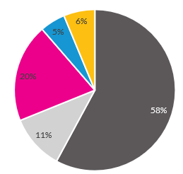
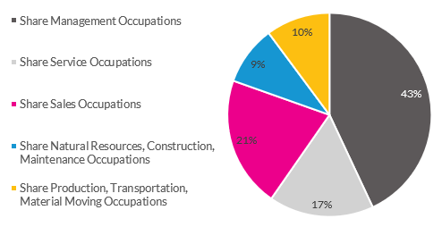
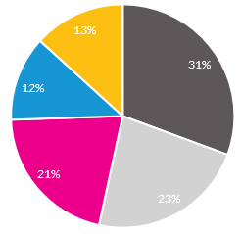
Occupations
Top Quartile HH Income
Bottom Quartile HH Income

Slide 22
Creating a Draft Index Using 2016-2020 Data

Slide 23
SES Index
Correlation to Median Household Income
Share with Bachelors + | 0.62
Unemployment Rate | -0.21
Share of Households With Occupancy of 0.5+ Per Room | -0.35
Share Same Residence Last Year | 0.24
Share Households With Non-Parental Caregivers | -0.14
Share Management Occupations | 0.59
Share Service Occupations | -0.44
Share Sales Occupations | -0.06
Share Natural Resources, Construction, Maintenance Occupations | -0.35
Share Production, Transportation, Material Moving Occupations | -0.34

Slide 24
Occupations and SES Status
Including occupation data in the SES index would require assigning a value or scale to different occupations.
The occupational categories are broad and can incorporate many different kinds of jobs or roles.
Other data (such as median household income or unemployment rates) might also reflect what the group is trying to capture with occupation shares.

Slide 25
SES Index
Share with Bachelors +
Unemployment Rate
Share of Households With Occupancy of 0.5+ Per Room
Share Same Residence Last Year
Share Households With Non-Parental Caregivers
Median HH Income
Each block group is assigned a percentile on the six factors (0-100), with 100 being higher SES.
All six factors are averaged to create a scale score.
If a factor is missing (rare), the block group gets the average of all available data.

Slide 26
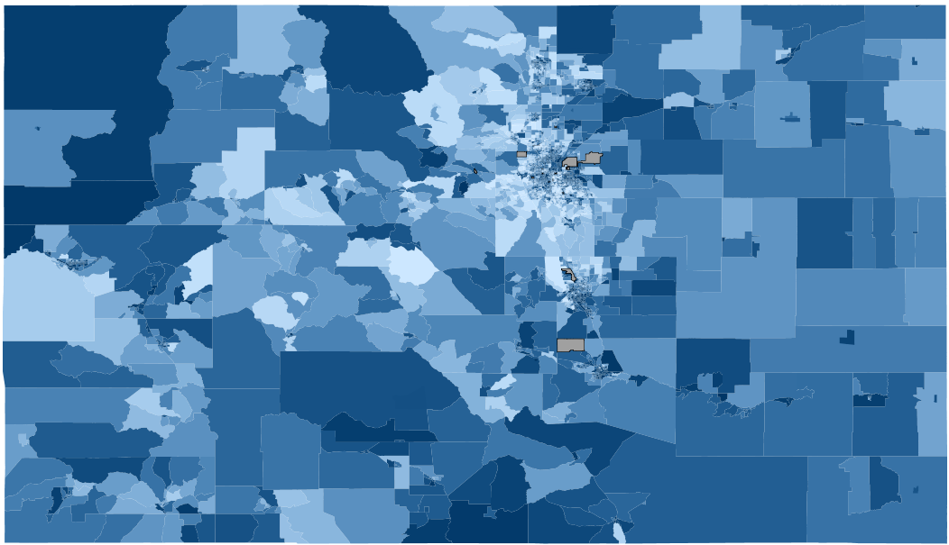

Colorado Census Block Results

Slide 27
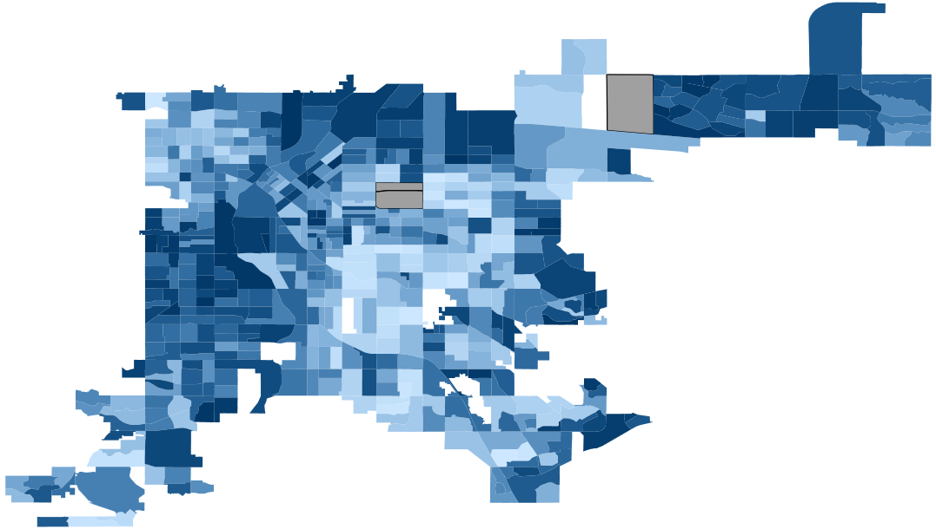
Denver County

Slide 28

El Paso County

Slide 29

Arapahoe County

Slide 30
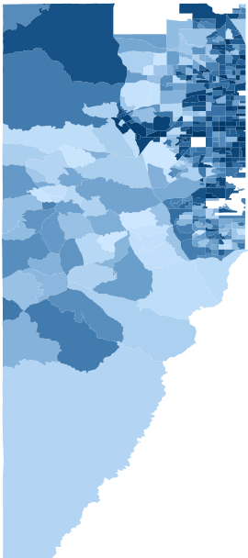
Jefferson County

Slide 31
District Data
To provide a sense of district-level data, Census block group data have been aggregated up into geographic districts.
The actual scores may vary depending on where students that are enrolled in the district live.
2019 SES data are from the initial analysis and use 2010 Census blocks and data from 2015-2019. SES scores for districts range from 21 to 66.
2020 SES data are from the group’s input and use 2020 Census blocks and data from 2016-2020. SES scores for districts range from 28 to 64.

Slide 32
Questions?

Slide 33
Implementing SES Index With ISP Data

Slide 34
New At-Risk Measure
Neighborhood Socioeconomic Status (SES) Indicator
Identified Student Percentage (ISP)
+

Slide 35
Identified Student Percentage
ISP = Directly Certified Students + Categorically Eligible Students
  Directly Certified Students: Students who are administratively linked to their household’s participation in SNAP or TANF (typically, 130% FPL or less), or Migrant Education Program.
  Categorically Eligible Students: Students who experience homelessness (lack a fixed, regular, or adequate nighttime residence), participate in the Head Start program, or are determined to be a runaway, in foster care, or a migrant student.
Eligible children may also be certified for free meals through their household’s participation in Medicaid/CHIP+
This means that submission of a FRPL form will no longer make a student eligible for at-risk

Slide 36
Options For Implementing SES Variables
Use of Values vs. Quintiles:
  Should we categorize Census block groups (e.g., Texas into five categories) or use average scale score?
Weighting of SES relative to ISP:
  How much weight should a direct measure of ISP carry vs. indirect neighborhood measure? E.g. 90-10, 75-25?
Weighting of SES:
  Should there be any weighting of very low SES districts?

Slide 37
Discussion

Slide 38
Breakout Groups
We’re going to divide into small teams for discussion
Reintroduce yourself, and then discuss:
  What is your reaction to the SES data? Is it what you would expect? Are there components you would like to remove or include (i.e. from 2019 run)?
  What would be your initial preferences for weighting of the SES Index vs. ISP data?
  Would you prefer using a raw scale score (0-100) for SES Index or categories?
  What additional data or estimates would you like to see?
An individual from CDE or the Urban Institute will report out your discussion.

Slide 39
Return to Full Group

Slide 40
Breakout Groups
Questions:
  What is your reaction to the SES data? Is it what you would expect? Are there components you would like to remove or include (i.e. from 2019 run)?
  What would be your initial preferences for weighting of the SES Index vs. ISP data?
  Would you prefer using a raw scale score (0-100) for SES Index or categories?
  What additional data or estimates would you like to see?

Slide 41
Next Steps
You will receive a survey via email to follow up on your preferences and capture additional questions

