Slide 1

Urban Institute
Colorado At-Risk Working Group

Slide 2
Introductions

Slide 3

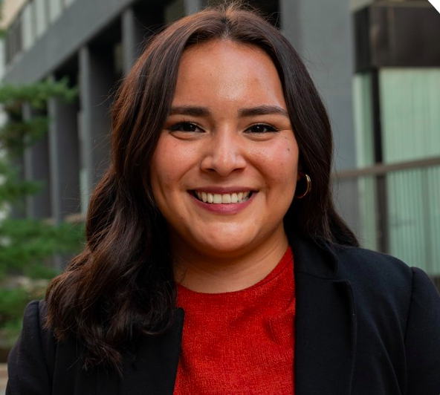
Introductions
Kate Bartlett, CDE
Richard Hull, CDE
Jennifer Okes, CDE
Tim Kahle, CDE
Kristin Blagg and Fanny Terrones, Urban Institute
The Urban Institute is a non-partisan non-profit research organization based in Washington D.C.

Slide 4
Overview
Background on at-risk study
Overview of four sessions
Data available for an SES Index
Selecting and prioritizing SES index variables

Slide 5
Background

Slide 6
Current At-Risk Measure
Colorado currently defines at-risk students as those who are eligible for free and reduced-price lunch (FRPL) and allocates additional dollars for their education.
Adoption of universal free meal programs (like the Community Eligibility Provision, or CEP) weakens this measure as an accurate count of low-income students.
  Families are less likely to return income forms when their students already receive free meals.
  Districts may have concerns about transitioning to CEP and at-risk status

Slide 7
Research Methods
The Urban Institute interviewed more than 30 stakeholders and organizations and received more than 100 survey responses.
Participants included several Colorado organizations with interest in the at-risk measure and organizations outside Colorado with key knowledge about potential alternative measures.
We used 2019-20 data to assess distributional impact of changes to the at-risk measure

Slide 8
New At-Risk Measure
The development of a new at-risk measure yields new opportunities:
  Allow more districts to take up universal free meals after the pandemic.
  Reduce the paperwork burden on CEP schools.
  Render a more accurate and robust count of at-risk students.
  Capture aspects of socioeconomic status beyond household income, such as parent/guardian education level and/or broader household resources.

Slide 9
New At-Risk Measure
Neighborhood Socioeconomic Status (SES) Indicator
Identified Student Percentage (ISP)
+

Slide 10
Four Sessions
Sessions are held remotely, on the second or third Monday of the month.
Session Date | Session Topic
August 15, 2022 | Prioritizing SES variables
September 12, 2022 | Understanding estimated values of SES Index by neighborhood, and implementation of the Index
October 17, 2022 | Implementing SES Index with the ISP measure
November 14, 2022 | Finalize the SES index and ISP measure, and any hold harmless recommendations to facilitate transition

Slide 11
Identified Student Percentage
ISP = Directly Certified Students + Categorically Eligible Students
  Directly Certified Students: Students who are administratively linked to their household’s participation in SNAP or TANF (typically, 130% FPL or less), or Migrant Education Program.
  Categorically Eligible Students: Students who experience homelessness (lack a fixed, regular, or adequate nighttime residence), participate in the Head Start program, or are determined to be a runaway, in foster care, or a migrant student.
Eligible children may also be certified for free meals through their household’s participation in Medicaid/CHIP+
This means that submission of a FRPL form will no longer make a student eligible for at-risk

Slide 12
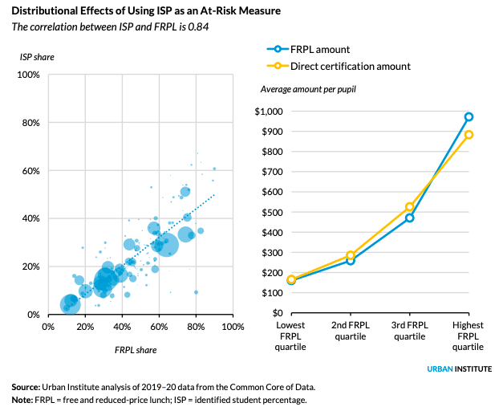
Identified Student Percentage (ISP)

Slide 13
Census-Based Colorado Neighborhood Data
Students are linked through their address to a census block group
  Neighborhood Index using American Community Survey data
    Non-English Language spoken at home
    Foster/raised by relative
    Median HH income
    Home ownership
    Bachelor’s degree attainment

Slide 14
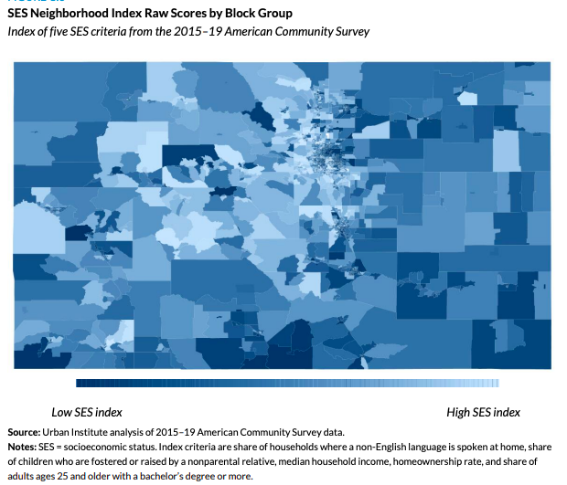
Census-Based Colorado Neighborhood Data

Slide 15
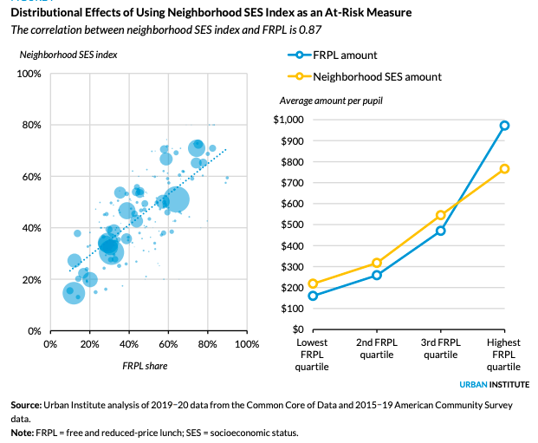
Census-Based Colorado Neighborhood Data

Slide 16
Combining Measures – ISP and Neighborhood
To show how a combination of these measures can best capture at-risk students, we built a model based on 2019–20 direct certification data (our best proxy for ISP) and student-centered SES neighborhood quintiles.
We weight the model so that 75 percent of the measure is informed by the direct certification share and 25 percent is informed by the SES of the student’s neighborhood.

Slide 17
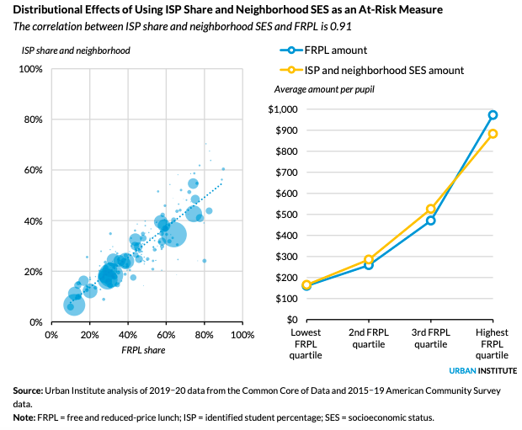
Combining Measures – ISP and Neighborhood

Slide 18
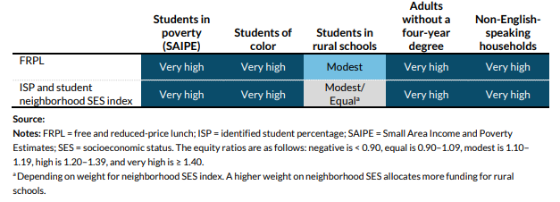
Understanding Equity

Slide 19
Questions?

Slide 20
Data Available For SES Index
  Legislation requires the selection of at least five variables from the American Community Survey for inclusion in the SES Index.
  Inclusion of at least five mitigates concern about mis-measurement or error in a single datapoint.
  Data also covers five years (2015-2019).
  We present data for Census block groups, but could broaden to tract levels for some measures, if needed. We can also scope out availability of other measures.

Slide 21

Recommended variables for SES Index
  Non-English Language spoken at home
  Foster/raised relative
  Median HH income
  Home ownership
  Educational attainment

Slide 22
Recommended variables for SES Index
  English language proficiency is an important economic asset that is associated with increased workforce participation, significantly higher earnings, and economic mobility. (Skinner et. al, 2010)
  Foster kids and children living with grandparents have higher odds of living in poverty (Pac et. al, 2017)
  Household income is most indicative of a standard of living and of life chances household members experience through sharing goods and services. (Duncan et. al, 2002)
  Homeownership offers financial gains and a way to build wealth (Goodman and Mayer, 2018)
  Lower levels of education attainment are associated with higher unemployment rates and lower earnings (NCES, 2015)

Slide 23
Data Available For SES Index
  Median age
  Race and ethnicity
  Geographic mobility (vs. prior year)
  Means of transportation to work
  Number of workers in family
  Work full-time, year-round
  Median HH earnings
  Per-capita income
  Have computer and/or internet
  Number of occupants per room
  Value of owner-occupied housing
  Mortgage/rent as percent of HH income

Slide 24
Data Available For SES Index
  Important not only to pick what variables, but also the cut-offs.
  For example, an education variable could look at the share of adult residents with:
    HS diploma or higher
    Some college or higher
    Bachelor’s degree or higher

Slide 25
Discussion

Slide 26
Breakout Groups
We’re going to divide into small teams for discussion
Reintroduce yourself, and then answer the following questions:
  What SES data, or factors are most important, from your perspective, for the at-risk measure?
  Are there any data or factors you think should not be used, or should be included only with some caution?
An individual from CDE or the Urban Institute will report out your discussion.

Slide 27
Return to Full Group

Slide 28
Breakout Groups
Questions:
  What SES data, or factors are most important, from your perspective, for the at-risk measure?
  Are there any data or factors you think should not be used, or should be included only with some caution?

Slide 29
Next Steps
You will receive a survey via email.
The survey will ask for you to prioritize SES measures proposed in this session.
There will also be space for general feedback, or for ideas that you think haven’t been captured here.

