Slide 1
ASCENT Program 2020 October Count Student Coding

Slide 2
Mary Anne Hunter Postsecondary Pathways Coordinator Office of Postsecondary Readiness (303) 866-6598 Hunter_Mary@cde.state.co.us
Rebecca McRee Audit Supervisor School Finance and Operations Division mcree_r@cde.state.co.us
Brooke Robinson Data Specialist IMS- Data Services robinson_b@cde.state.co.us

Slide 3
Funding & Documentation

Slide 4
Carry Forward ASCENT Slot Timeline
January 2020: CDE determines whether all current year ASCENT slots were used during previous October Count
By April 2020: CDE notifies districts with carry forward slots for the upcoming budget year
January 2021: CDE determines the number of ASCENT carry forward slots from the prior budget year must be repaid
April 2021 CDE notifies districts the amount they must repay for unused carry forward ASCENT slots from the prior budget year

Slide 5
Funding/Documentation Requirements
ASCENT Cooperative Agreement
For the corresponding school year between the district and the IHE
Enrollment
Student must be enrolled with the district as of the pupil enrollment count date
Credit Hour Verification
Funding eligibility for ASCENT students is determined by the number of college credit hours into which the student is enrolled (and for which the district has paid) as of the pupil enrollment count date
Part-Time Funding: 3-11 semester credit hours
Full-Time Funding: 12+ semester credit hours
Homeschool students enrolled in the ASCENT program are only eligible for a maximum of part-time funding
Tuition Payment Verification
Documentation that shows the district paid the tuition cost for all ASCENT semester credit hours directly to the IHE

Slide 6
Funding/Documentation Requirements
High School Transcript
Transcript should be generated during the semester of the pupil enrollment count date
Student cannot have already graduated
Student should have previously completed at least 12 semester credit hours at an IHE (and these should be reflected on the transcript)
Student should be in his/her 5th year of high school

Slide 7
Funding/Documentation Requirements
REMINDER: Beginning with the 2019-20 school years, districts and charter schools are no longer required to provide attendance verification for postsecondary courses taken off-site at the IHE .
Section 22-54-103(10)(h) (as amended by SB 19 -176)
(I) For the 2019-20 budget year and each budget year thereafter, with regard to a pupil who is simultaneously enrolled in a district or institute charter school and in one or more postsecondary courses, a district or institute charter school must submit evidence of:
Enrollment in the district or institute charter school and evidence, as provided in state board rule, of attendance for any secondary courses the pupil is enrolled in; and
Enrollment in one or more postsecondary courses, by submitting evidence, as described in state board rule, only of the district’s or institute charter school’s nonrefundable obligation to pay the student share of tuition for the postsecondary course on behalf of the pupil.
(II) The state board by rule shall specify the number of secondary and postsecondary course credit hours that constitute full-time and part-time membership.

Slide 8
Question from the Field
We have a student who is signed up to complete a concurrent enrollment course in the semester of the pupil enrollment count date, but the course is not scheduled to start until after the pupil enrollment count date. Is the student eligible for funding?
Enrollment
Student must be enrolled w/district as of the pupil enrollment count date.
Scheduled Hours/Credits
As long as the student is scheduled into a course as of the pupil enrollment count date, and that course is scheduled to be completed during the semester of the pupil enrollment count date, it can be used when determining funding eligibility for the student.
Tuition Payment Verification
District must pay the non-refundable obligation of student’s share of tuition.

Slide 9
Question from the Field
We have students who are taking concurrent enrollment courses through the Institution of Higher Education that follow an online and/or hybrid class structure. Is the student eligible for funding, and if so, what type of documentation do we need?
Qualifying concurrent enrollment courses will be evaluated based on credit hours, regardless of the mode of instruction (i.e., in-person, hybrid or online). As with any concurrent enrollment course, the district must be able to provide tuition payment and credit hour verification (at the student level), as well as a cooperative agreement (at the district/IHE level) at the time of audit.
Full-time funding = 12+ college credit hours
Part-time funding = 3-11 college credit hours

Slide 10
Question from the Field
Can ASCENT funding be used to pay for concurrent enrollment courses taken by ASCENT students during the summer term?
Districts receive ASCENT funding based on what a student’s schedule was as of the pupil enrollment count date FOR the semester of the pupil enrollment count date. Therefore, if a district allows an ASCENT student to take courses during the summer, the district should be aware that the credit hours taken by the student during the summer cannot be used to evidence scheduled credit hours in the semester of the pupil enrollment count date.

Slide 11
Data Reporting

Slide 12
Data Reporting for ASCENT
Data Reporting for ASCENT students can be tricky
Requires coordination between Student End of Year and Student October Reporting.
Student End of Year 2019-2020
Students planning to participate in ASCENT the following year:
Student End of Year 2019-2020
Student School Association File:
Student Demographic File
Entry Grade Level = 120 (12th grade)
Retention Code = 2
Post Secondary Enrollment = 00
Student End of Year
Student October

Slide 13
Data Reporting for ASCENT
Student October Data Reporting 2020-2021
If district is using a ½ carry forward and ½ current year slots to fund a student full-time:
RETENTION CODE = 0
NON-SCHOOL PROGRAM = 04 (Third Party Contract w/ IHE)
POSTSECONDARY ENROLLMENT = 10
PUBLIC SCHOOL FINANCE STATUS = 82
Student Demographic File:
Student School Association File
Postsecondary Enrollment = 01, 09, 10
Retention Code = 0
Non-School Program = 04 (Third Party Contract with IHE)
Public School Finance Status
Carryforward = 87 (Non-Eligible, Tuition)
Current Year = 80, 82 (Full-time and Part-time)
Current Year students should be coded to receive funding
01 – ASCENT Current Year
09 – ASCENT Carryforward Full-time
10 – ASCENT Carryforward Part-time
1
Student October Snapshot Due:
November 10, 2020

Slide 14
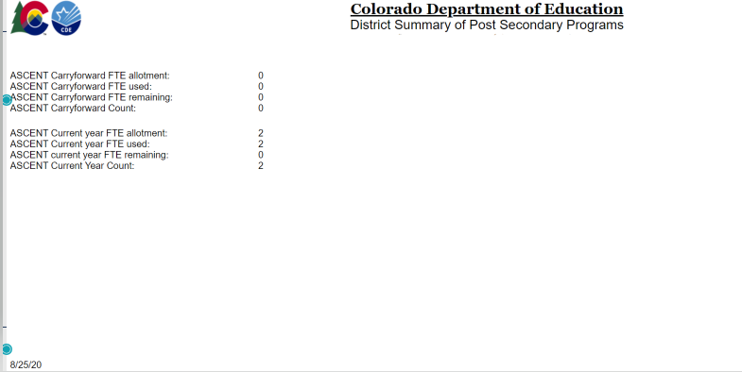
Data Reporting for ASCENT
Student October Cognos Reports
District Summary of Postsecondary Programs
This report will show the number of ASCENT slots and ASCENT Carryforward slots assigned by CDE
The number of slots used and the difference
Can only be created once a Student October snapshot has been created

Slide 15
ASCENT Student Graduation Rate Reporting HB17-1294
… a qualified student who is an ASCENT program participant shall be counted in the enrolling school district's or institute charter school's graduation rate in the school year in which the student completes the school district's or institute charter school's minimum high school graduation requirements.
Effective with the 2017-18 school year
Will not change the existing ASCENT requirements re HS diploma:
cannot be dated until student has completed the ASCENT(5th) year;
cannot be conferred to student until 5th year has been completed;
Transcript grad date must reflect when 5th year was completed.
Districts/Institute Charter Schools can decide to allow ASCENT student to participate in regular grad ceremonies without receiving an official diploma
ASCENT appropriations are made to CDE for grade levels K-12; therefore ASCENT student must still be classified as high school student in 5th year to be eligible to receive ASCENT funding.

Slide 16
ASCENT Student Graduation Rate Reporting HB17-1294
Student Completing their 4th year of High School?
Met district’s graduation requirements
Retained for a 5th year to participate in approved postsecondary program (ASCENT/PTECH)
Student End of Year Data 2019-2020
Exit Code of 90
Retention Code of 2
Please refer to page 12 of the 2020-21 Student Interchange File Layout – Student School Association for more details.

Slide 17
Dividing ASCENT Slots
Guidance document link:
http://www.cde.state.co.us/postsecondary/dividing-ascent-slots
LEPs can offer ASCENT opportunities to more students than it has allocated slots
i.e. dividing a full-time slot into two part-time slots for two separate students
LEP’s must assure that:
All students meet credit hour funding levels & are coded accurately in October Count and End-of-Year:
3-11 credits = part-time
12+ credits = full-time
All required audit documentation is collected and retained
LEPs will only be eligible for a maximum ASCENT funding equal to the number of allocated ASCENT slots.
Contact Mary Anne Hunter if you are considering dividing your slots to a dollar amount that covers less than part-time enrollment

Slide 18
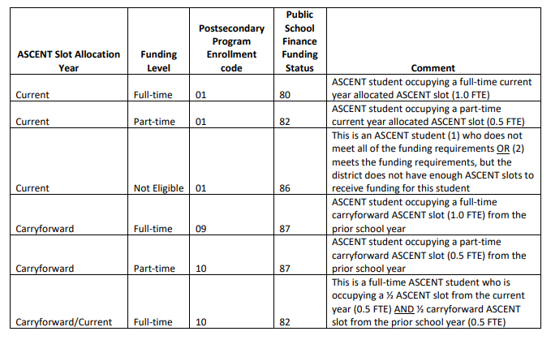

Slide 19
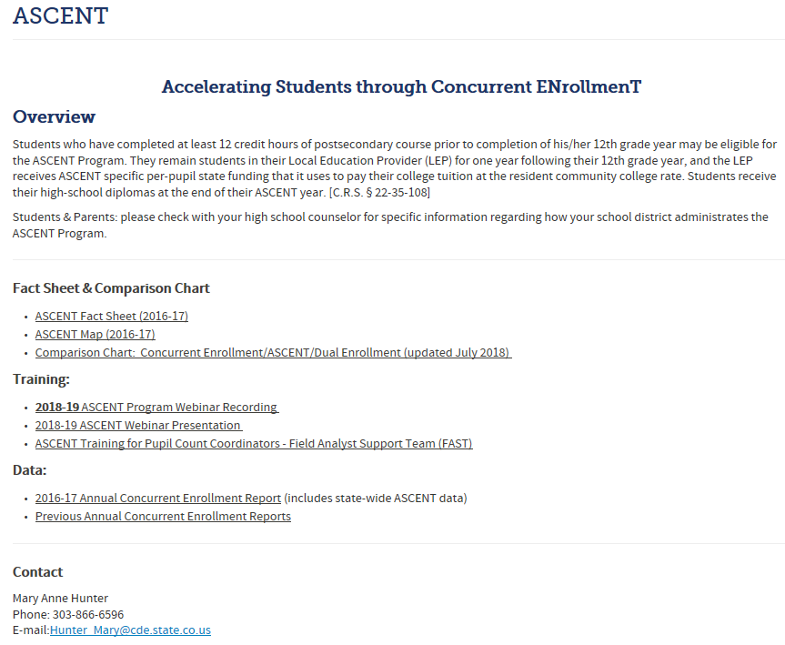
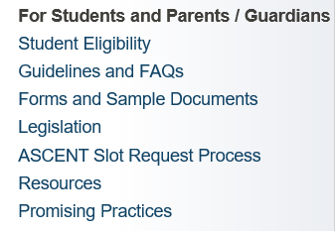
http://www.cde.state.co.us/postsecondary/ce_ascent

Slide 20
Website for Students/Parents http://www.cde.state.co.us/concurrentenrollment/options-ascent

Slide 21
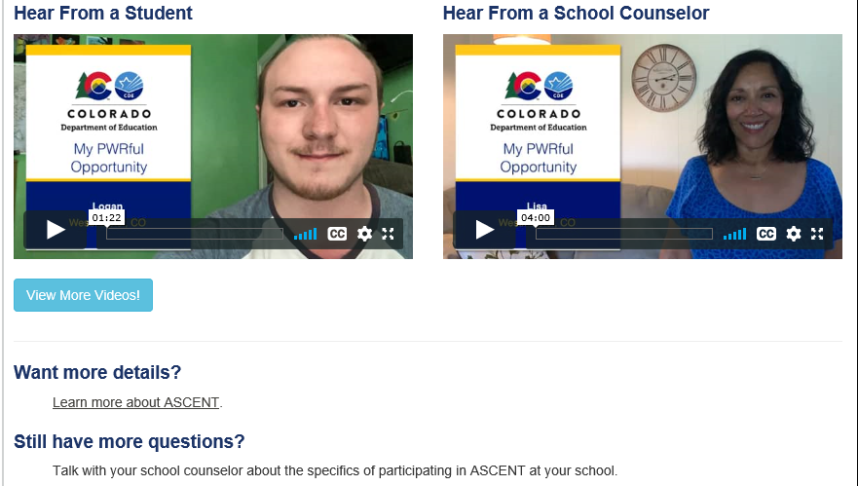

Slide 22
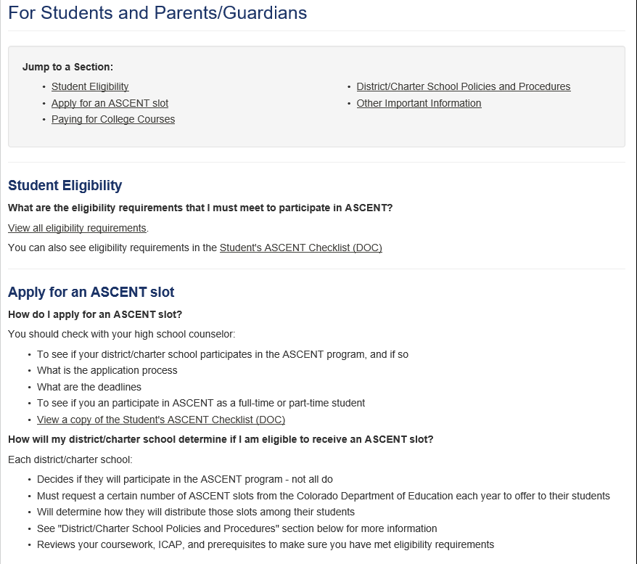

Slide 23
QUESTIONS?

Slide 24
Thank You!

