Slide 1
Colorado Teacher of the Year Application Access Instructions

Slide 2
Introduction to GAINS
Teacher of the Year Applicants will complete their responses in CDE's new Grant Administration Implementation and Navigation System (GAINS).
CDE will use the information collected in the CTOY application access form to provide your access. If you have any trouble, please let us know either by emailing CompetitiveGrants@cde.state.co.us or filling out a Help Desk Ticket.

Slide 3
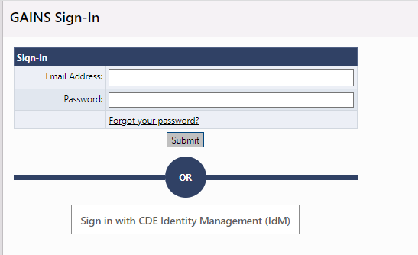
Logging In
Before you can login, CDE will need to provide you with access to GAINS. Please fill out the Application Access Form.
Step 1: Once CDE creates the user in GAINS, the applicant will be notified via email to create a password. Once the password is setup, applicants will access GAINS through the native login (Sign-In).

Slide 4
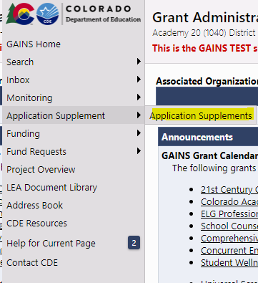
Navigate to Application Supplement
Step 2: Hover over “Application Supplement” in the left navigation bar and select “Application Supplements.”

Slide 5
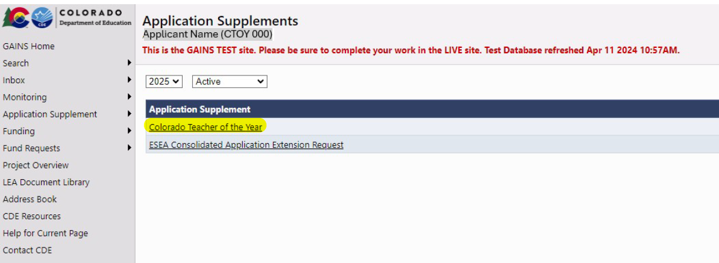
Find the Colorado Teacher of the Year Application
Step 3a: Select 2025 from the dropdown list
Step 3b: Select “Colorado Teacher of the Year”

Slide 6
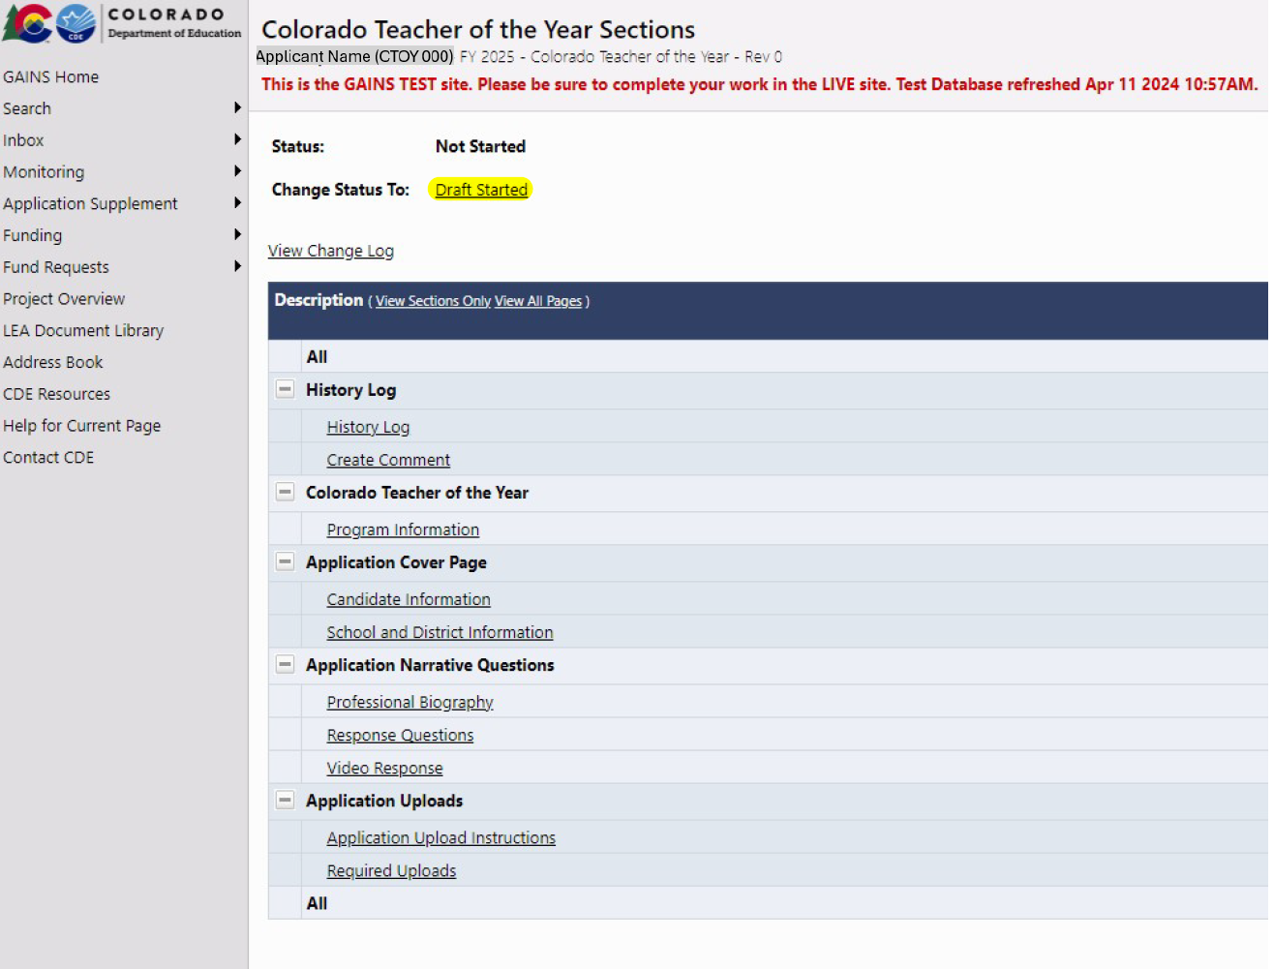
Draft Started
Step 4: Once in the application, be sure to change the application status to by clicking on “DRAFT STARTED”
Please note: Applicants will not be able to any answer application questions until the status is changed to “Draft Started”

Slide 7
Start the CTOY Application in GAINS
Because this is important and the #1 question we receive...
The application will not be open to edit until you click on “DRAFT STARTED”
After clicking a page will appear where you must confirm your selection.

Slide 8
Application Navigation

Slide 9
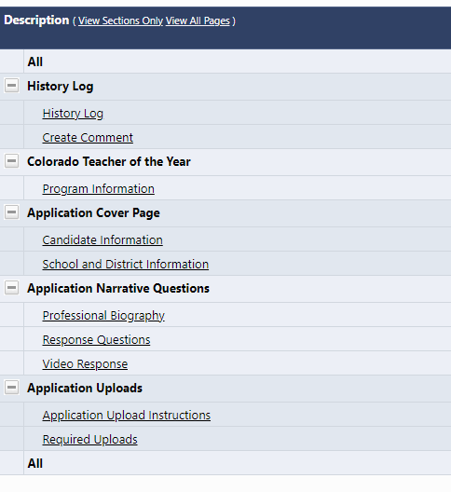
Navigating Basics- Sections Overview
The Sections Page is your Teacher of the Year Application home page and main navigation center.
From here you can access a number of features related to your application. The following pages are required for submission:
Candidate Information
School and District Information
Professional Biography
Response Questions
Video Response
Required Uploads

Slide 10
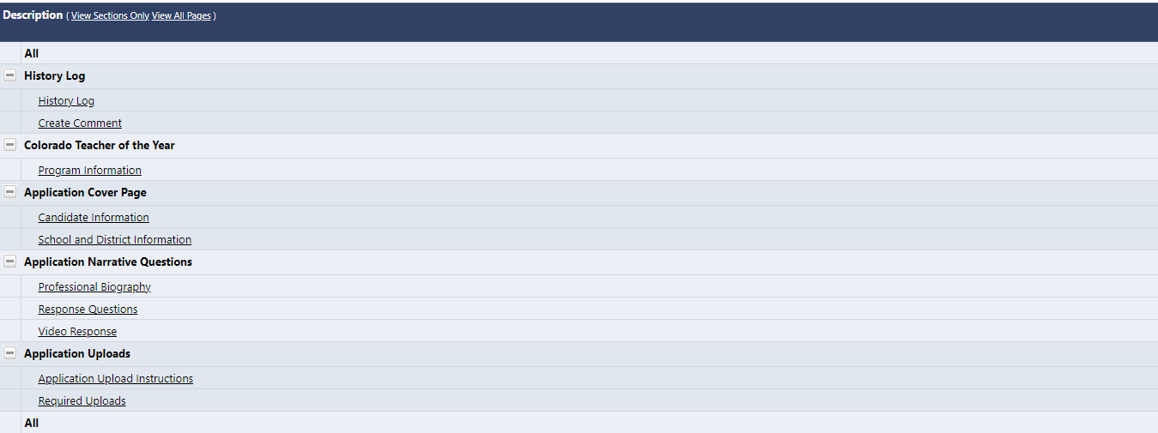
Navigating Basics – Sections Overview (cont.)
In addition to the Sections, you will have a Validation column which will let you know when a section has errors that would prevent you from submitting or warnings to check before submitting.

Slide 11
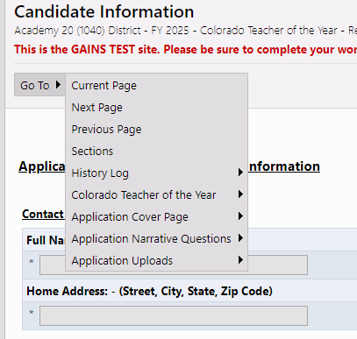
Navigating Basics- Moving Through Sections
For easiest navigation, DO NOT USE your browser’s back/forward buttons; use GAINS menus and links to navigate.
On section pages, use “Save and Go To” or “Go To” buttons:
Saves data on current page; moves to selected page.
Clicking on "Sections" here will take back to the Home Sections Page

Slide 12
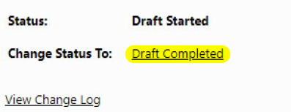
Application Submission
Application due on June 19, 2024
Application status must be changed to “Draft Completed” on June 19, 2024, to be considered for Colorado Teacher of the Year.

Slide 13
Resources & Additional Support

Slide 14
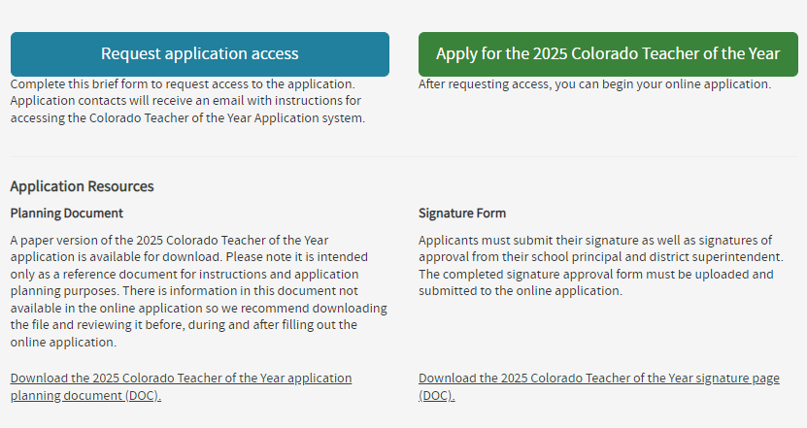
Resources
Learn more about the program and application process on the Colorado Teacher of the Year Website.
Be sure to download the 2025 Colorado Teacher of the Year Application Planning Document for additional information and the questions asked in the online application!
Download the signature page to get your principal and district sign-off, then upload in your online application.

Slide 15
Additional Support
Colorado Teacher of the Year Application Office Hours
Hosted by CDE’s Teacher of the Year Team - Register for Office Hours!
Wednesday, April 24, from 3:30-4:30 pm
Wednesday, May 8, from 3:30-4:30 pm
Guest: 2020 Colorado Teacher of the Year, Hilary Wimmer
Wednesday, May 22, from 3:30-4:30 pm
Wednesday, June 5, from 3:30-4:30 pm
Guest: 2022 Colorado Teacher of the Year, Autumn Rivera
One on One Support
Please fill out the Help Desk Ticket for assistance!
In addition, you can always reach out to Kim Burnham at Burnham_K@cde.state.co.us or Patty Gleason at Gleason_P@cde.state.co.us.

