Slide 1
Reporting on LEA Participation in ESSER Activities

Slide 2
ESSER Data Reporting
The U.S. Department of Education has been authorized by Congress to collect data from all ESSER I, II, and III grantees, including but not limited to the uses and impact of funds. CDE is able to use the ESSER I, II, and III applications to provide the vast majority of the requested data on behalf of our grantees, with the exception of the following data points:
How students with poor attendance or participation have been re-engaged;
How school level allocations were determined; and
LEA participation in ESSER activities.
Notes:
Today we’ll be walking you through the third data point and how you’ll be reporting on it to CDE.

Slide 3
LEA Participation in ESSER Activities
All LEAs that received ESSER I, II, or III funds must report on how ESSER funds were used to support learning recovery or acceleration for student groups who were disproportionately impacted by the COVID-19 pandemic.
Includes all grantees of ESSER I, II, or III funds, including districts, BOCES, Administrative Units (AUs), facility schools, and tribal nations.
Data collection template to be submitted via Syncplicity.
SY 2022-23 template will be due September 30, 2023.

Slide 4
Reporting Question Overview
How did this LEA use ESSER (ESSER I, ESSER II and/or ARP ESSER) funds to support learning recovery or acceleration for student groups who were disproportionately impacted by the COVID-19 pandemic?
Evidence-based summer learning or summer enrichment programs
Evidence-based afterschool programs
Extended instructional time (including extended school day, week, or year)
Evidence-based high dosage tutoring
Early childhood education program expansion or enhancement
Full-service community schools
Purchasing educational technology
For each of these programs, LEAs will have to report the number of students who participated in the programs and the total number eligible to participate.
Notes:
The USDE has created an annotated reporting form providing some definitions, and CDE will be working to provide more definitions on our webpage, which we’ll talk about more later.

Slide 5
Reporting Question Disaggregated Groups
For each of the programs on the previous slide, LEAs will have to report on student participation and eligibility for each of the following student groups:
Students with one or more disabilities
Low-income students
English learners
Students in foster care
Migratory students
Students experiencing homelessness
American Indian or Alaska Native
Asian
Black or African American
Hispanic/Latino
White
Two or more races
Other student group (please specify)

Slide 6
Different Templates
Stakeholders indicated that, for some LEAs, reporting student level data would be more convenient, while for others it would be easier to report aggregated data. To best meet the needs of all LEAs and create options that meet varying needs, LEAs can choose to submit either LEA-level or student-level data. LEAs should submit one of the following templates:
LEA-Level Survey
Student-Level (Combined) Survey
  Single spreadsheet for reporting each student’s participation in a variety of programs.
Student-Level (Separate) Survey
  Multiple spreadsheets to report student participation for each program separately.
Notes:
(Educational Data Advisory Council) LEA-Level survey allows LEAs to report aggregate data for each student group. The Student-level surveys allow LEAs to provide a list of students that were eligible and participated in each activity. CDE will use that information to run the student group aggregations on the LEA’s behalf. Please fill out whichever template best fits your district’s needs.

Slide 7
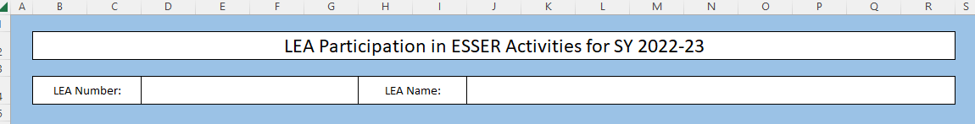
Instructions Tab
Each template begins with the same Instructions tab that includes the list of all ESSER funding codes to be reported on. Please fill out the LEA number and LEA name fields in this tab.

Slide 8
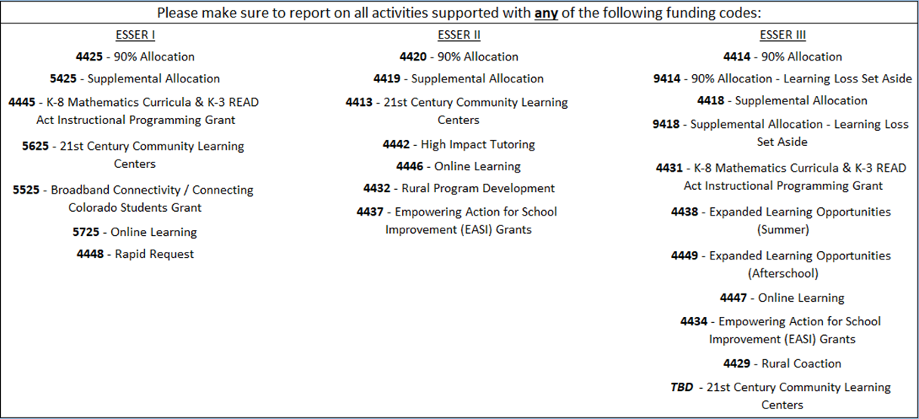
ESSER Funding Codes
Inclusive of all ESSER I, II, and III funds, including state reserve activities:
Notes:
On the Instructions tab you’ll also see this list of funding codes. The survey is inclusive of all ESSER funds, including state reserve activities, so please ensure you report on activities across all ESSER funding codes.

Slide 9
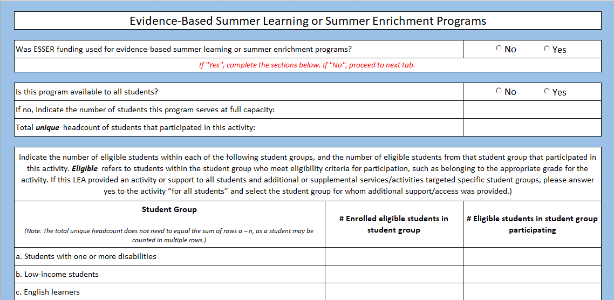
LEA-Level Survey - Summer, Afterschool, Tutoring
Notes:
If the LEA chooses to fill out the LEA-Level Survey, LEAs will provide the number of students that participated in each activity and the number of students eligible to participate in each activity, disaggregated by student groups.
On the Summer, Afterschool and Tutoring tabs, LEAs will give answers to the questions on this slide for each program. If your LEA did not use ESSER funding for these programs, you can skip these tabs entirely.

Slide 10
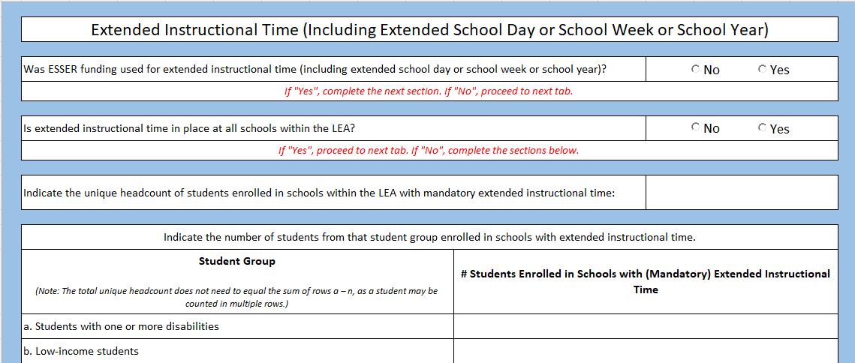
LEA-Level Survey - Extended Instructional Time
Notes:
Next in the LEA-Level survey, you’ll see a tab for Extended Instructional Time, and you’ll answer the following questions related to that program.

Slide 11
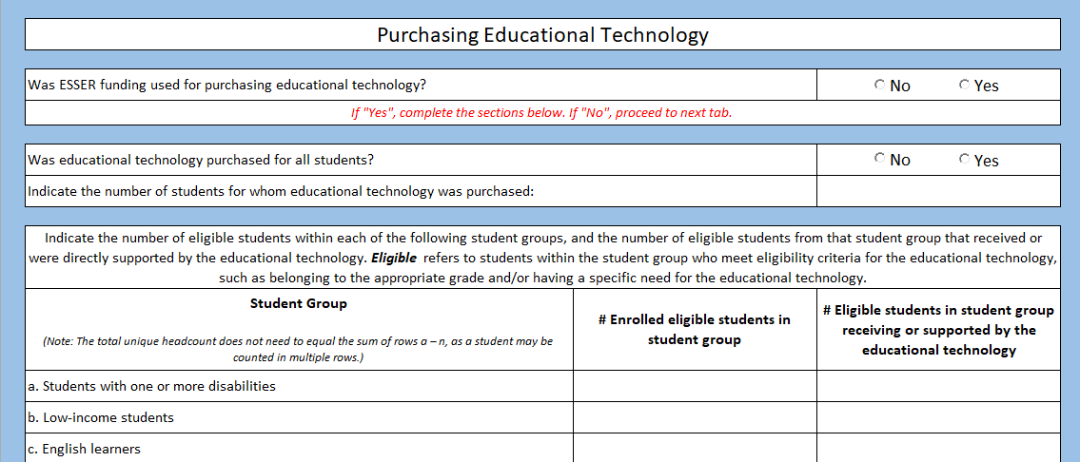
LEA-Level Survey - Purchasing Educational Technology

Slide 12
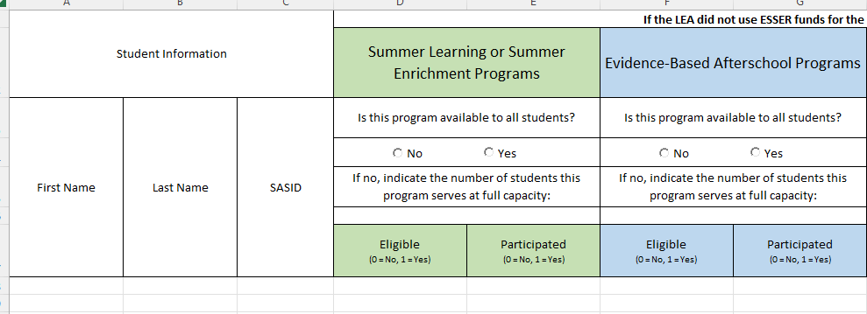
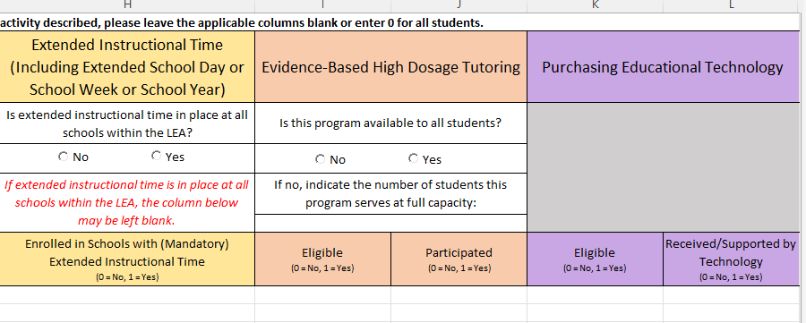
Student-Level Combined Survey - Student Participation
Notes:
If the LEA chooses to fill out the Student-Level Combined Survey, on the Student Participation tab, please provide student first names, last names, SASIDs, and whether or not they participated in each of the activities in the screenshots. If the LEA did not use ESSER funds for the activity described, please leave the applicable columns blank or enter 0 for all students.

Slide 13
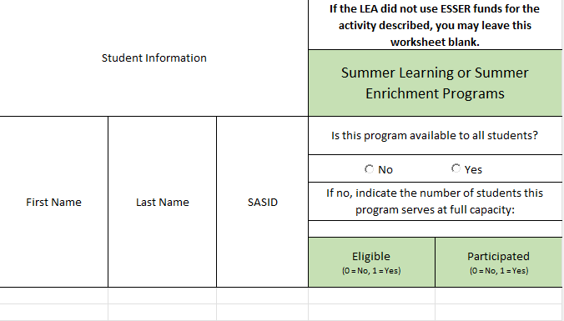
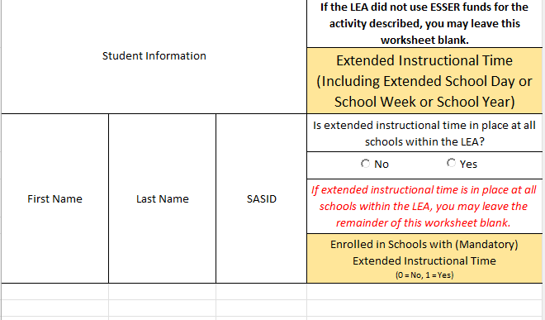
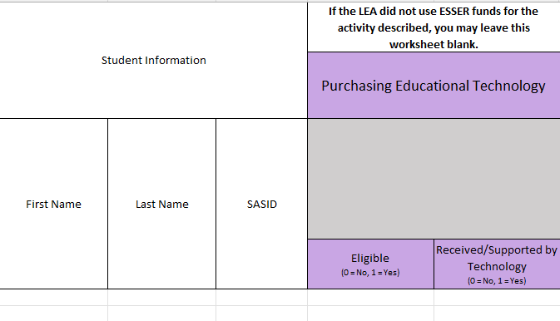
Student-Level Separate Survey - Summer, Afterschool, Extended Time, Tutoring, Technology
Notes:
If the LEA chooses to fill out the Student-Level Separate Survey, for the Summer, Afterschool, Extended Time, Tutoring, and Technology tabs, please provide student first names, last names, SASIDs, and whether or not they participated in each of the activities in the screenshots on the following slide. If the LEA did not use ESSER funds for the activity described, please leave the tab blank. Summer, afterschool, and tutoring tabs all have the same questions.

Slide 14
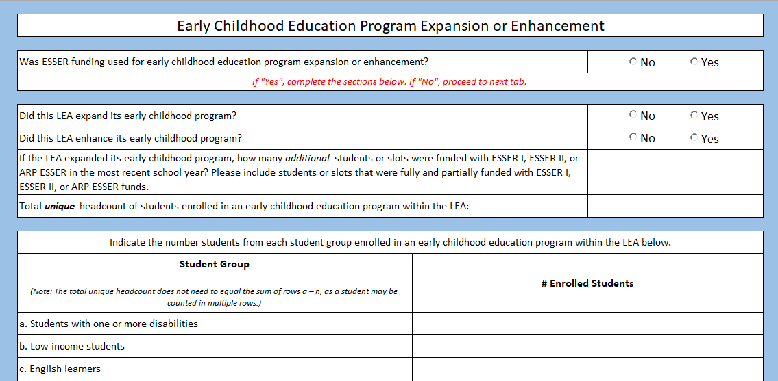
Early Childhood Education Programs
Notes:
The Early Childhood Education Programs tab will look the same across all versions of the templates. You’ll answer the following questions in each template.

Slide 15
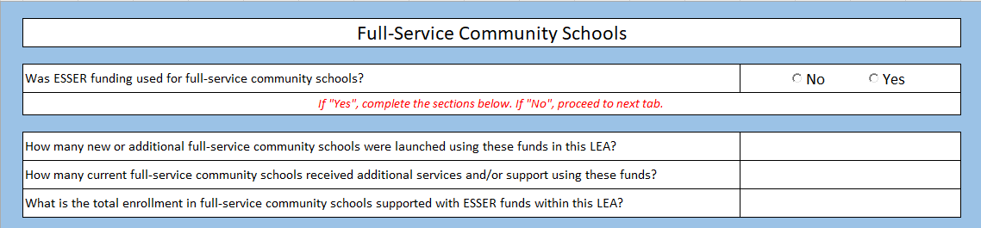
Full Service Community Schools
Notes:
The Full-Service Community Schools tab will look the same across all version of the templates. You’ll answer the same questions in each template.

Slide 16
Submission
Data collection templates will be submitted via Syncplicity. Each LEA will receive an email with an ESSER Reporting folder within Syncplicity (e.g., “DistrictNumber - DistrictName - ESSER Reporting”).
  Emails will be sent to ESSER III application contacts. If you did not receive an email from CDE, please reach out to Mackenzie Owens at owens_m@cde.state.co.us.
  Please do not send templates via email.
Notes:
As a reminder, please only submit one template via Syncplicity.

Slide 17
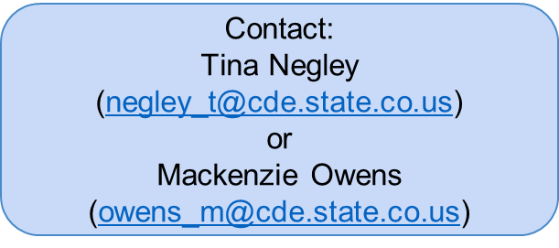
Resources
CDE has created an ESSER Grantee/Subgrantee Reporting webpage to share resources, trainings, and data collection templates/surveys, to support grantees in successfully meeting these reporting requirements.
Recorded trainings, instructional manuals and FAQs, and links to surveys and data collection templates will be available starting next week.
CDE will also continue to dedicate time during upcoming Office Hours to provide updates and host Q&A sessions concerning these reporting requirements:
February 9, 2023
March 23, 2023
April 13, 2023

