Slide 1
American Rescue Plan, Emergency Assistance to Non-public Schools Grant
Application training

Slide 2
EANS Overview
The American Rescue Plan Act, which passed in March 2021, created the Emergency Assistance to Non-Public Schools (EANS) grant within the Governor’s Emergency Education Relief (GEER) II Fund. The $2.75 billion program will provide funding for emergency assistance to nonpublic schools with $28,709,729 allocated to Colorado.
Nonpublic schools can apply for these funds for “secular, neutral, and non ideological” services and assistance, including sanitization, personal protective equipment, COVID testing, educational technology, and connectivity.
Application due: March 28^{th,} 2022
Notes:
DC

Slide 3
Eligibility
Funds are available to non-public schools that meet the following definitions below:
K-12 Non-profit non-public school or a consortium of K-12 non-public schools. Standalone Pre-K schools are not eligible to apply for funding.
School that is accredited, licensed, or otherwise approved to operate in accordance with State law.
School that existed and operated prior to March 13, 2020;
Schools that have a minimum 21% of its students from low-income families.
Schools that are most impacted by the novel Coronavirus Disease 2019 (COVID-19) emergency. (see Identification of Eligible Non-Public Schools).
Notes:
DC

Slide 4
Identification of Eligible Non-public Schools
Under section 2002(a) of the ARP Act, services or assistance to non-public schools under the ARP EANS program are limited to “non-public schools that enroll a significant percentage of [students from low-income families] and are most impacted by the [COVID-19] emergency.” Based on guidance from the U.S. Department of Education, CDE set the poverty percentage at 21% and worked with the Colorado Department of Public Health and Environment and the Colorado State University, Department of Agriculture and Resource Economics to identify areas that have been most impacted by COVID-19.
The following documents list the counties that have been identified as most impacted by COVID-19 based on the following criteria:
Infection rates or
Economic impact
Note: To be eligible to participate, non-public schools must satisfy the poverty requirement and be located in a county that has been identified as most impacted by one of the COVID-19 impact criteria.
Notes:
DC- CDE worked with CDPHE and University of Colorado Economic development office to determine the counties that meet this requirement. For Infection rates, we looked at the Counties listed have a greater than 5% case rate by the population of each county.
For the economic impact, we looked at employment. And listed counties that had a greater than 6% reduction in mean observed employment compared to forecasted employment.

Slide 5
Non-Governing Consortia Applicants
Applications will be accepted from non-profit organizations that aggregate support for a group of non-public schools but do not have governing authority over the schools it represents. A non-public school within that consortium must be named as the applicant/fiscal agent, and the consortium lead must collect Consortia Sign-Over agreement from each participating school to work on behalf of the schools included in the application.
Only the eligible schools that are a part of the consortia will receive services from ARP EANS funding, the non-governing organization may not be eligible for ARP EANS funding.
The Consortia Sign-Over agreement must be submitted to eansapplications@cde.state.co.us by March 28th, 2022.
Notes:
DC

Slide 6
Determining Low-Income Students
Applicants will be required to report the number of students from low-income families enrolled in a non-public school. To identify low-income students, the applicant may use one or more of the following sources of data, provided the poverty threshold is consistent across sources and does not exceed 185 percent of the 2020 Federal poverty level:
Data on student eligibility for free or reduced-price lunch;
Data from a different source, such as scholarship or financial assistance data
Eligible applicants must indicate in its application the source that is used to determine poverty. This information must be maintained by the non-public school and made available to CDE upon request.
Notes:
DC

Slide 7
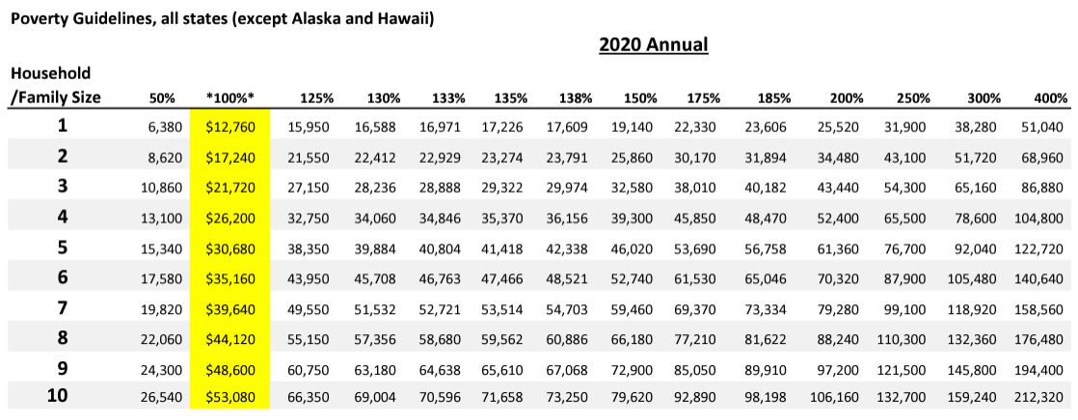
Income Poverty Guidelines
Notes:
DC

Slide 8
Application Components
Applications will be submitted through a Smart Sheets form. Information needed to complete the application is listed below:
Non-public school demographics
Amount of funding request
Use of funds
Description of COVID Impact
Assurances
Attachments
  Certification, Approval and Transmittal form
  ARP EANS Non-Governing Consortia Sign Over Agreement (if applicable)
  ARP EANS Goods, Goods/Services and or Projects Over $25,000 form (if applicable)
  FACTS ED Budget Workbook (to be provided after initial review) - is not required to submit the application.
Notes:
EM

Slide 9
Allowable Use of Funds
A non-public school may apply to receive services or assistance from the SEA or its contractors to address educational impact from COVID-19 for:
Supplies to sanitize, disinfect, and clean school facilities
Personal Protective Equipment (PPE)
Improving ventilation systems, including windows or portable air purification systems
Training and professional development for staff on sanitization, the use of PPE, and minimizing the spread of infectious diseases
Physical barriers to facilitate social distancing
Other materials, supplies or equipment recommended by the CDC for reopening and operation of school facilities to effectively maintain health and safety
Expanding capacity to administer coronavirus testing to effectively monitor and suppress the virus
Educational technology
Redeveloping instructional plans for remote or hybrid learning or to address learning loss
Leasing sites or spaces to ensure social distancing
Transportation costs
Initiating and maintaining education and support services or assistance for remote or hybrid learning or to address learning loss
Notes:
EM

Slide 10
Unallowable Uses of EANS Funds
EANS Funds cannot be used for the following:
to provide direct or indirect financial assistance to scholarship granting organizations or related entities for elementary or secondary education
to provide or support vouchers, tuition tax credit programs, education savings accounts, scholarships, scholarship programs, or tuition-assistance programs for elementary or secondary education
for services, instructional materials and other materials that are non-secular, ideological and/or faith based
for payroll, salary, benefits, etc. for any existing school staff providing regular instructional services, costs/payments to contractors providing services within their existing contractual obligation with a school
Construction and/or capital improvement to the building
Services, subscriptions, licenses or warranties that exceed the ARP EANS performance period (9.30.2024)
Supplemental disinfecting systems, such as peroxide or bi-polar ionization
Reimbursement is not allowed
Notes:
EM

Slide 11
EANS II Fund Distribution
Based on the applications received, CDE will calculate a per pupil allocation to determine final award amounts for each school/applicant. For preliminary application and budget purposes, the per pupil allocation will be capped at an amount not to exceed the other supplemental per pupil allocation ranges for the state from similar funding sources.
Applicants that meet the eligibility requirements can request $1900 per student in the school.
Note: All schools in a consortia application must meet the eligibility requirements and funding can be provided for services in those schools.
Example: School A has 250 students enrolled as of the 2020-2021 school year and meets the eligibility requirements.
$1900
x 250
$475,000
Notes:
EM - If school A has a poverty percentage of 21% or greater and resides in a county that has been identified as most impacted by infection rates OR experienced an economic impact as

Slide 12
Assurances
The assurances in the application are your positive declaration of adherence to the program rules and requirements. Additionally, the assurances inform you of your role, responsibility, and the role and responsibility of CDE.
Notes:
EM

Slide 13

Enrollment and Low-Income Data
Student enrollment
Total student enrollment
  #K-12 low-income students in the 2019-2020 school year
  % of total low-income students
Consortia applicants
  Complete the EANS Consortia Enrollment and Low-Income Data form
Notes:
EM

Slide 14

Data Sources
Options:
  Free or reduced-price lunch data
    Resources: Income Eligibility Guidelines
  Scholarship or financial assistance data
Notes:
EM

Slide 15
Application Narrative
Impact of Covid
Loss of tuition revenue
Decrease in enrollment
Increase in enrollment
Lack of capacity to provide remote learning due to insufficient technological support
Learning loss attributed to the education disruptions caused by COVID-19
Other
Notes:
EM

Slide 16
Purchasing Requested Items
Notes:
Sharon and Maggie

Slide 17
ARP EANS Purchasing Overview
•Schools may not directly make any purchases.
•No reimbursements are allowed for ARP EANS.
•CDE has contracted with FACTS Education (FACTS ED) to purchase certain ARP EANS goods and services for schools.
Notes:
Sharon and Maggie

Slide 18

Purchases Handled by CDE
•Purchase from a single vendor over $25,000
•Purchases of related goods over $25,000, when a vendor has not been identified (such as laptops, cases, monitors, licenses)
•Purchase of goods and related services over $25,000 (such as display boards, mounts and installation)
•Purchase of projects over $25,000 (cannot be capital improvement projects)
Notes:
Sharon and Maggie

Slide 19
CDE Procurement
Information for school to include on the CDE PURCHASES OVER $25K FORM
•Detailed specifications or statement of work for what needs to be purchased
Examples for goods: model numbers, part numbers, quantity, size, location for delivery, quotes, related services (installation)
Examples for services: scope of the project, expected outcome, timeline, location of services, quotes
•Any other information that may be relative to the purchase (i.e., compatibility concerns)
Notes:
Sharon and Maggie

Slide 20
CDE Procurement
Example Scenario:
Your purchase is estimated at $3,000 each for 10 units (total of $30,000). The total of $30,000 exceeds the $25,000 procurement threshold requiring competition.
Result: This purchase requires competition. This is based upon total price, not unit price. School must complete the CDE PURCHASES OVER $25k FORM for this purchase
Notes:
Sharon and Maggie

Slide 21
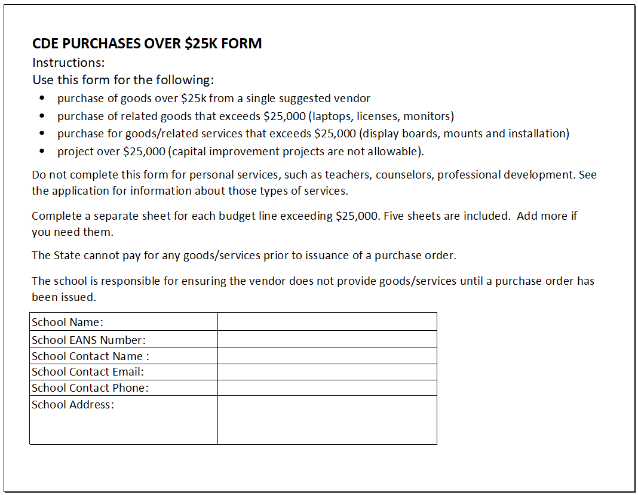
CDE PURCHASES OVER $25K FORM
Notes:
Sharon and Maggie

Slide 22
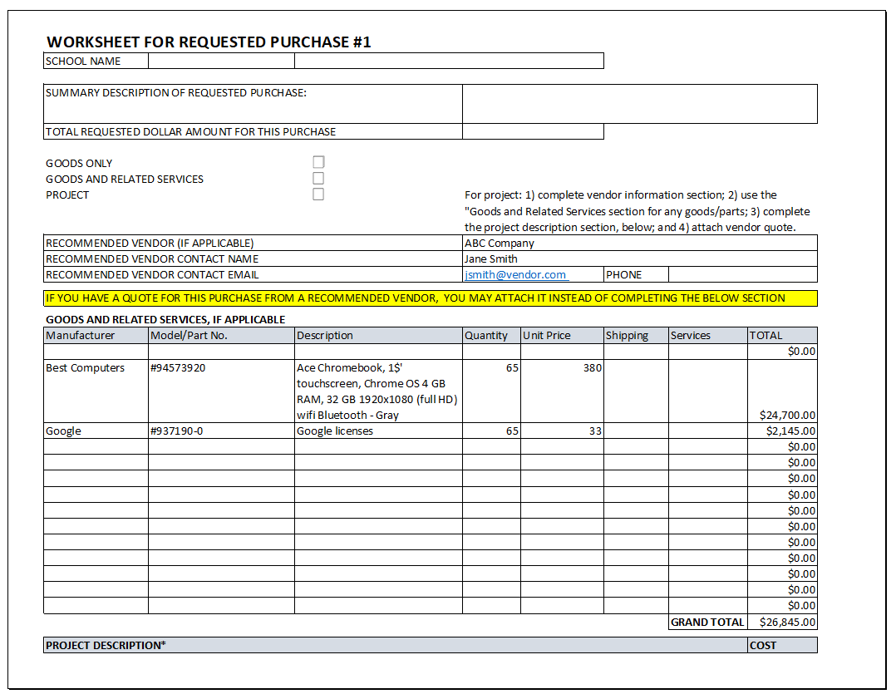
CDE PURCHASES OVER $25K FORM
Notes:
Sharon and Maggie

Slide 23
CDE Procurement Process
School has submitted application by the deadline. Application includes completed CDE PURCHASES OVER $25K FORM for each purchase of goods over $25k, goods/related services over $25k, projects over $25k.
CDE notifies school in writing that application is approved.
State procurement and fiscal laws, rules and policies apply to CDE purchases.
CDE Procurement works with school, vendor(s), makes selection of vendor. If a school has recommended a vendor, CDE Procurement will determine whether the goods/services may be purchased from that vendor.
Notes:
Sharon and Maggie

Slide 24
CDE Procurement Process (continued)
5. CDE handles type of contract as appropriate (i.e., purchase order, or formal contract).
6. Must ensure that no goods/services are delivered prior to issuance of a purchase order or contract, if required (violation of law and delays processing).
7. Vendor delivers goods/performs service
8. School confirms delivery or performance to CDE.
9. CDE pays vendor.
Notes:
Sharon and Maggie

Slide 25
CDE Procurement Method
CDE Procurement will consider all methods available and decide on the best method to use for each purchase.
There are several methods to choose a vendor, including but not limited to:
  State price agreements
  State approved cooperative agreements
  Competitive solicitations
The process can be time consuming – plan ahead!
Notes:
Sharon and Maggie

Slide 26
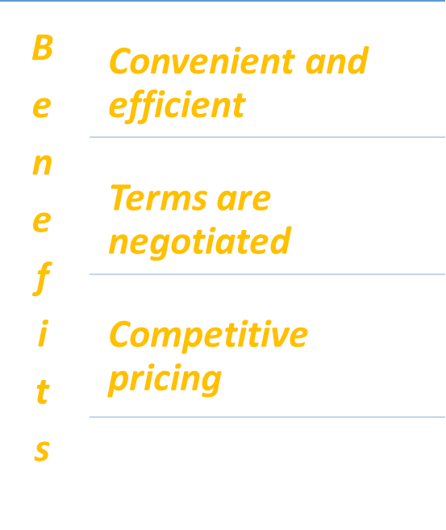
CDE Procurement - Price & Cooperative Agreements
•Contracts for commonly sourced goods/services
•Solicited, negotiated, managed, and maintained by State or Coop
•Available to state agencies
•Limited to goods/services on agreement
•Only with vendors having existing agreement
•Includes PPE, sanitization supplies, certain models of Chromebooks, some Software
Notes:
Sharon and Maggie

Slide 27
CDE Procurement – Competitive Solicitations
CDE Procurement will determine the appropriate solicitation method, as applicable.
Evaluation of bids/proposals range from lowest responsive bidder to “most advantageous”.
CDE Procurement will work with the school on any competitive solicitations.
Notes:
Sharon and Maggie

Slide 28
Vendor Agreements
DO NOT SIGN VENDOR AGREEMENTS
Often vendors will provide agreements for software, licenses, services, and maintenance or support.
Sometimes vendors will include terms and conditions on an estimate or invoice. Do not sign. If the vendor requires a delivery signature, line through the terms and initial next to deleted terms.
Reasons not to sign vendor agreements:
  A non-public school does not have authority to bind CDE or the State.
  Signing an agreement puts the school at risk as well as CDE and the State.
  Certain terms in vendor agreements are not permissible for the State (ex: indemnification, binding arbitration, certain limitations of liability, automatic renewals).
  Vendor agreement fine print may include additional costs/requirements.
If the vendor insists upon a signature, contact CDE Procurement.
Notes:
Sharon and Maggie

Slide 29
Purchases Handled by FACTS ED
Applicants that receive Substantial Approval will be contacted by representatives of FACTS ED to begin develop the workbook.
March 8, 2022 - Overview of FACTS ED workbook completion
Applicants will provide the necessary documentation required by FACTS ED to complete purchases
The budget workbook is not required to submit the application.
Notes:
Sharon and Maggie

Slide 30
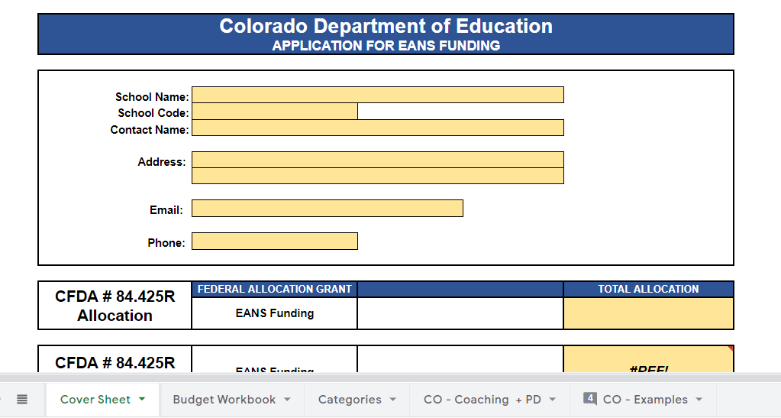
FACTS ED Workbook Snapshot

Slide 31
Conflict of Interest/Ethics
Federal and state laws and policies require ethical behavior and avoidance of conflicts of interest.
•ARP EANS procurements are subject to audit.
•When spending public funds, it is essential to always act ethically.
•Do not request approval for purchases from family members or other vendors with potential conflicts of interest
•Do not accept gifts or other incentives from ARP EANS vendors or potential ARP EANS vendors
If you have any questions regarding conflicts of interest or ethics, contact eansapplications@cde.state.co.us
Notes:
Sharon and Maggie

Slide 32
Submission Process and Deadline
Applications must be completed and submitted through the online application by Monday, March 28, 2022, 5:00 pm.
Note: Incomplete or late applications will not be considered. Applicants should receive an automated confirmation email from the online system upon submission. If you do not, please email eansapplications@cde.state.co.us.
Notes:
EM

Slide 33
Summary
Successful single school applicants will have completed and submitted the following:
  Submitted the Online Application and attached the signed Certification, Approval and Transmittal signature form and CDE Purchases over $25K form (if applicable) to the web form
Successful consortia applicants will have completed and submitted the following:
  Submitted the Online Application and attached the Certification, Approval and Transmittal signature form, EANS Consortia Enrollment and Low-Income Data form, and the CDE Purchases over $25K form (if applicable
Applicants will be notified if additional information is needed prior to providing substantial approval of the application.
Notes:
EM

Slide 34
Any Questions??
Notes:
EM

Slide 35
Contacts
Application and Program Questions:
DeLilah Collins (collins_d@cde.state.co.us)
Elena Merrit (merrit_e@cde.state.co.us)
Budget/Fiscal Questions:
Robert Hawkins (hawkins_r@cde.state.co.us)
Application Process Questions:
Kim Burnham (burnham_k@cde.state.co.us)
CDE Purchasing Questions:
Sharon Meyer, Maggie Van Cleef, Trish Bohm
(eansproc@cde.state.co.us)
Website: EANS
Notes:
EM

Slide 36
Colorado EANS II Funds & FACTS Education Solutions
Colorado EANS II Funds & FACTS Education Solutions
February 22, 2022

Slide 37

Welcome

Slide 38
FACTS Education Solutions Team
Mark Schilmoeller, Chief Operations Officer
Elizabeth Shelton, Accounts and Contracts Director
Dr. Susan Abelein, Academic Services Director
Tiffany Wilbur, Educator Services Director
Kathy Mears, Project Manager - EANS
Sarah Noble, Fiscal Agent and Financial Operations Manager
Shannon Farnworth, Partner Success Manager
Leslie Santana, Sales Support Coordinator
Carlos R. Hernandez, Regional Vice-President for the Southwest Region

Slide 39
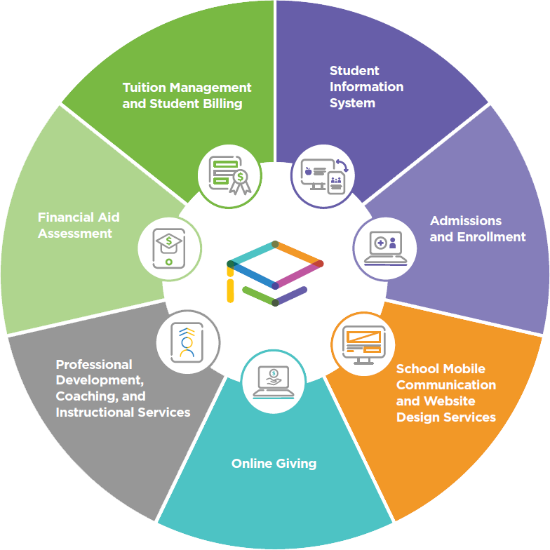
The FACTS Family
The FACTS Family
Mission
To enhance teaching and learning for K-12 educators and students.
Vision
To be the premier education services provider for K-12 private and faith-based schools.
Notes:
The FACTS Family
11,500 schools
$9.0 billion in tuition funds annually
3 million students and families

Slide 40
FACTS Ed- Fiscal Agent Provider
FACTS Ed – Fiscal Agent Provider

Slide 41
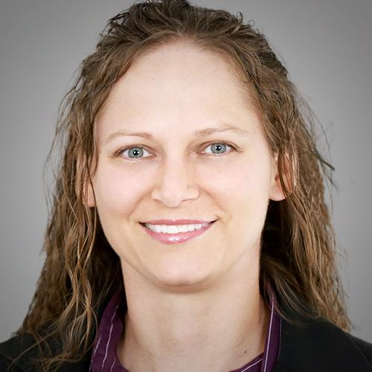
Elizabeth Shelton: Accounts and Contracts Director
Elizabeth Shelton: Accounts and Contracts Director
Fiscal Agent
Management of funds, report on remaining balances
Process purchase requests, vendor invoices
Regular point of contact for questions, will work with CDE for resolution
Vendor Selection
FACTS Ed as a service provider
Other Vendors
  Contract or Agreement, including objective
  Monthly invoices
    Service description, event date(s), agenda, attendees

Slide 42

Sarah Noble: Fiscal Agent and Financial Operations Manager
Sarah Noble: Fiscal Agent and Financial Operations Manager
Workbook
After Application is approved
Carlos can assist with completion
Emailed to EANSfunds@FACTSmgt.com
FACTS Ed – First Approval | CDE – Second Approval
Dynamic Forms
Platform used to initiate payments / purchases
Specifics of request will be submitted to FACTS Ed
Review & Approval = Payment or Purchase
Spend Down Reports
Monthly
Designated Contact(s)

Slide 43

Mark Schilmoeller: Chief Operations Officer
Mark Schilmoeller: Chief Operations Officer
Responsibilities
• Intake Process
• Referred / Recruited
• Hiring
• Candidate Information
• Offer Letter
• Onboarding
• PING-ID – WorkDay HR / Payroll System
• Background Check / I-9
• On-Line Help
• Payroll
• Monitoring & Compliance

Slide 44
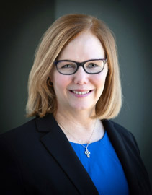
Kathy Mears: Project Manager – EANS
Kathy Mears: Project Manager – EANS
FERPA – Watch video or read document and acknowledge that you have read it
Google Form – Record your activities with students - Reviewed each month for compliance
Please remember that EANS funds cannot pay you to teach or promote a specific religion
Pay – Hourly employees submit hours via email to FactsEdPayroll@factsmgt.com
Salary employees let us know when you are not working by emailing Julie Masek Julie.Masek@factsmgt.com or Missy Neuman missy.Neuman@nelnet.net.
Benefits – Lydia Blackwell – lblackwell@factsmgt.com

Slide 45
FACTS Ed
Programs and Services
FACTS Ed
Programs and Services

Slide 46
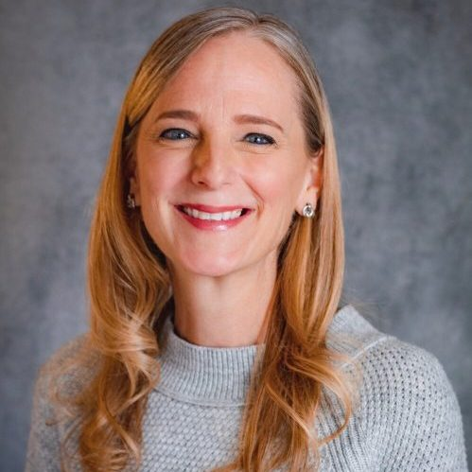
Susan Abelein: Academic Services Director
Susan Abelein: Academic Services Director
Responsibilities
Interventions to Address Learning Loss
Leadership Coaching
Teacher Coaching

Slide 47

Pieces to the Puzzle: Designing Coherent Solutions to Address Learning Loss
Pieces to the Puzzle: Designing Coherent Solutions
to Address Learning Loss
EANS Funding
Solutions
Time

Slide 48
How will you know if EANS mattered?
22-23 SY
23-24SY
  Address Immediate Needs?
  Lasting Impact?
  Address Immediate Needs?
  Lasting Impact?
  Address Immediate Needs?
  Lasting Impact?
  Address Immediate Needs?
  Lasting Impact?
  Address Immediate Needs?
  Lasting Impact?
Summer 2022
Summer 2023
Summer 2024
Don’t be reactionary.
Slow down. Use data. Be proactive.
Don’t engage in initiative-itis.
Develop a Plan. Stick to it.

Slide 49
Step 1: Develop an Ambitious Vision
1. Identify a Focus:
  Data
  Mathematics (including early numeracy)
  Language (including early literacy)
Envision what you will see happening in the classrooms
  Individually and Collectively
Check your Vision
  Does it address immediate need?
  Will it lead to lasting impact?
  Is it Ambitious AND Realistic?
Own it and move to Step 2
Student
Improved Student Achievement
Teacher
Content
Resource adapted by Susan Abelein, PhD from Forman, M.L., Leisy-Stosich, E., and Bocala, C. (2017). The Internal Coherence Framework: Creating the Conditions for Continuous Improvement in Schools. Boston: Harvard Education Press.

Slide 50
Step 2: Map Out Solutions
Customized solutions to meet your unique needs to ensure safe and productive learning environments:
  Intervention and support services for students
  Professional Development
    Provided by FACTS Education Solutions Presenters
    Provided by FACTS Education Solutions Partners
  Coaching by FACTS Ed certified Coaches
22-23 SY
23-24SY
Summer 2022
Summer 2023
Summer 2024
Notes:
Customized solutions to meet your unique needs to ensure safe and productive learning environments:
Intervention and support services for students
Professional Development for teachers and leaders
Instructional and Leadership Coaching by FACTS Ed certified coaches for teachers and leaders

Slide 51
Solution: Interventions to Address Learning Loss
Summer | Staffing | Staffing + FACTS ES Support
Summer School Enrichment Packages ESTI Phonics/Literacy Intensive Parent & Family Engagement Events | Ed Tech Site-based Coach* Math/ELA Site-based Coaches* Push-in Specialists** Interventionists ** Lead Interventionists** Tutors** Counselors** Parent Engagement/Support Specialists*** | *Train site-based Coaches **Cohort supports including interventions PD, Ed Camp, office hours, site visits, Vosaic observations and coaching supports. ***Access to Parent Engagement resources
22-23 SY
23-24SY
Summer 2022
Summer 2023
Summer 2024
Notes:
Educational technology (including hardware, software, connectivity, assistive technology, and adaptive equipment) to support remote or hybrid learning. Category 2
Redeveloping instructional plans, including curriculum development, for remote or hybrid learning or to address learning loss. Category 3
Interventions. Initiating and maintaining education and support services or assistance for remote or hybrid learning or to address learning loss. Category 3

Slide 52



Solution: Professional Development
FACTS Education Solutions | Our PD | Our Featured Partners
Custom built sessions Tailored to your school’s vision and circumstances Research-based content Highly qualified presenters Relevant topics Onsite workshops, Webinars, Pop-up Coaching | Addressing Learning Loss (for Teachers, Aides, Specialists) Redeveloping Instructional Plans* Understanding Data** and Using it to Improve Teaching & Learning *Teachers can earn stipends for work outside of contracted work hours **Can be combined with purchase of FACTS SIS and “Super-User” Training
22-23 SY
23-24SY
Summer 2022
Summer 2023
Summer 2024
Notes:
Educational technology (including hardware, software, connectivity, assistive technology, and adaptive equipment) to support remote or hybrid learning. Category 2
Redeveloping instructional plans, including curriculum development, for remote or hybrid learning or to address learning loss. Category 3
Initiating and maintaining education and support services or assistance for remote or hybrid learning or to address learning loss. Category 3

Slide 53
Solution: Coaching
FACTS Education Solutions | Instructional Leadership (& Team) | Teacher Coaching (& Team)
Leadership Coaching: 5-8 sessions per cycle Educated/Experienced Coaches Teacher Coaching: 6-week Cycles Vosaic video + Virtual conversation Toolkits Trained Coaches | Leaders & Leadership Teams: Principals, APs, Dept. Chairs, etc. Instructional Leadership: Data Analysis & Use Curriculum Adoption Instructional Design Walkthroughs & Supervision MTSS Design | Tier I Practices in Math/ELA Unit & Lesson Design Assignment & Assessment Design Formative Asmts. & Feedback Instruction: Differentiation and Multiple Exposures for Mastery Curriculum Adoption (custom Toolkit) Explicit & Systematic Phonics SEL, Inclusion, ELL
22-23 SY
23-24SY
Summer 2022
Summer 2023
Summer 2024
Notes:
Educational technology (including hardware, software, connectivity, assistive technology, and adaptive equipment) to support remote or hybrid learning. Category 2
Curriculum Adoption. Redeveloping instructional plans, including curriculum development, for remote or hybrid learning or to address learning loss. Category 3
Coaching. Initiating and maintaining education and support services or assistance for remote or hybrid learning or to address learning loss. Category 3

Slide 54
Step 3: Implement (and Revise) Solutions
Name an Instructional Core Team to Develop an Ambitious Vision and Map Out Solutions to address immediate needs and for lasting impact.
Select a Project Manager or Point-person who will engage with 3rd party Project Manager to monitor progress and communicate with the IC Team throughout Implementation.
Stop to assess (and edit, if needed) after each phase of the Timeline.
Student
Improved Student Achievement
22-23 SY
23-24SY
Teacher
Content
Summer 2022
Summer 2023
Summer 2024

Slide 55
We are here to help!
Select a Project Manager or Point-person to engage with 3rd party Project Manager to do the following:
Name an Instructional Core Team who will…
Develop an Ambitious Vision and
Map Out Solutions to address immediate needs and for lasting impact.
    Interventions
    PD
    Coaching
Implement Solutions with fidelity. The Project Manager monitors progress and communicates with the Instructional Core Team throughout the Implementation.

Slide 56

Educator Services: Tiffany Wilbur, Director
Educator Services: Tiffany Wilbur, Director
Responsibilities
• Professional Learning Partnerships
• Program Design and Implementation
• Content
• Facilitators and Coaches
• Delivery Models
• Cvent
• Monitoring & Compliance
• Ongoing Evaluation of Services

Slide 57

Professional Learning and Development
Professional Learning and Development
“A 2009 report from the National Staff Development Council noted that while 90 percent of teachers said they participated in professional development trainings, most of them also said it was useless.”
“A report from the Center for Public Education stresses that the ‘duration of professional development must be significant and ongoing to allow time for teachers to learn a new strategy and grapple with the implementation problem.’ A study that included analysis of 1,300 pieces of research found that PD programs of 14 hours or less did not affect student achievement at all – in fact, they failed to even change teachers’ practices.”
What makes professional development for teachers effective? May 4, 2018. Washington, DC: American University. Available at: https://soeonline.american.edu/blog/what-makes-professional-development-for-teachers-effective
Notes:
Determining a PD Direction, then Selecting and Supporting the Right PD for your School.

Slide 58

Professional Learning and Development
Professional Learning and Development
Custom built learning sessions designed with your school in mind
Research-based content
Collaborative: Needs Assessment, Data-informed
Highly qualified education experts
Delivery Model Options: Onsite, Webinars, Pop-Up Coaching

Slide 59
Professional Learning and Development
Professional Learning and Development
EANS Packages
Literacy and Comprehension Gaps (PD and Instructional Services)
      Explicit Phonics Instruction (K-3)
      Making Literacy Learning Visible (K-5)
      Remedial Foundational Literacy (K-5, 6-8, 9-12)
Addressing Learning Gaps in Mathematics
College and Career Readiness: MS and HS Mathematics
Data-Informed PLC Leadership (K-12)
Early Childhood Teaching and Learning (PD and Instructional Services)
New Principal Training
New Teacher Training
Social Emotional Learning and Mental Health: Students -- Kognito
Social Emotional Learning and Mental Health: Teachers -- Kognito
Support for ELL: Closing Literacy and Numeracy Gaps (K-12) -- Confianza
Support for Parents
Technology to Support Teaching and Learning -- iDEAL

Slide 60
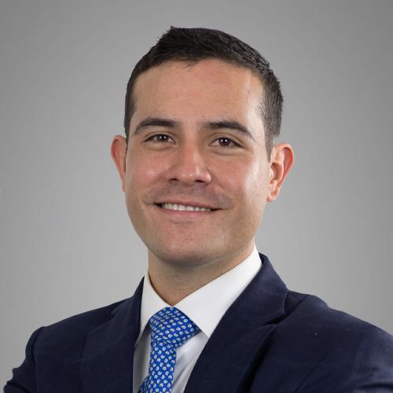
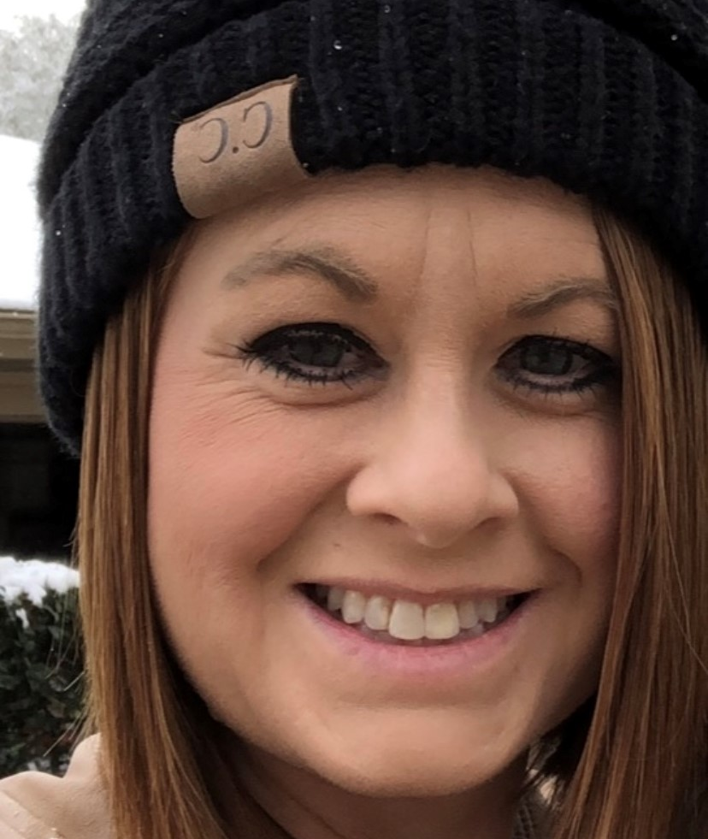

Your Colorado RVP and EANS Support
Your Colorado RVP and EANS Support
Leslie Santana
Carlos R. Hernandez
Shannon Farnworth

Slide 61
Q&A with the Team
EANSfunds@FACTSmgt.com
Q&A with the Team
EANSfunds@FACTSmgt.com

Slide 62
Thank you

