Slide 1
PARCC for ELA and Literacy
Module 3
Texts Worth Reading
Problems Worth Solving
Tests Worth Taking

Slide 2
Using These Modules
Description: The PARCC assessment brings a new face to Colorado’s state assessment for literacy.Modules 3 and 4 were designed in increase understanding about the PARCC assessment for ELA and literacy. Within Module 3, teachers will find details about test types and items found on the PARCC assessment. Included here are sample test items as well as questions to guide thinking and conversation. When teachers engage students in rigorous learning experiences that are tied to standards, they are preparing students for the PARCC assessment. Module 4 explores both the comprehension and critical thinking strategies students will use to demonstrate mastery of the standards as measured by PARCC, and the concept of rigor itself. This module includes readings, video, and questions to guide thinking and conversation.
Suggestions for Use: Content within these modules may be presented to large groups, may be used by small groups or teams, or may be viewed by individuals to build their own understanding. Module contains facilitating questions that are intended to support thinking and processing of content. Handouts are included as slides, and are indicated within the notes section.
Target Audience: Both Modules 3 and 4 may be used by teachers K-12 as well as by specialists, coaches and administrators.

Slide 3
PARCC for Literacy:
PARCC Assessment Design
Module 3
Texts Worth Reading
Problems Worth Solving
Tests Worth Taking
Notes:
Module 3
PARCC: Assessment Design
Context:
This module was created by Colorado educators to support understanding about the
PARCC Assessment.
Target Audience:
K-12 teachers, instructional coaches, specialists and administrators
Learning Objectives:
To understand the design of the PARCC ELA/Literacy Assessment
Content Summary:
The PARCC assessment brings a new face to Colorado’s state assessment for literacy. Within this module, teachers will find details about test types and items found on the PARCC assessment. Included here are sample test items as well as questions to guide thinking and conversation.
Considerations for use of module:
Content within this module may be presented to large groups, may be used by small groups or teams, or may be viewed by individuals to build their own understanding. The module contains facilitating questions that are intended to support thinking and processing of content. Handouts are included as slides, but are indicated within the notes section.

Slide 4
Purpose For This Module
To understand the design of the PARCC ELA/Literacy Assessment

Slide 5
What would an ideal test tell you about students’ literacy achievement?
Notes:
We know that we need summative data to support us in understanding how we are doing in terms of supporting students in meeting grade level expectations.
So…what would our ideal assessment look like?
Turn and talk
Some of you may have said:
tasks worth doing—connected to real learning, problems worth solving requiring true thinking, texts worth reading—great writing, not text for tests

Slide 6
Tests worth taking
The PARCC Vision
Texts worth reading
Problems worth solving
Notes:
PARCC vision:
New tests and teaching tools in English Language Arts/Literacy
• Tests worth taking, made up of texts worth reading and problems worth solving
• Full of the kinds of questions great teachers routinely ask their students
• Closely aligned to college- and career-ready standards that prepare students for success after high school

Slide 7
PARCC Assessments will…
Measure problem-solving and critical thinking skills
Give timely feedback to teachers and students allowing teachers to better meet student needs
Determine whether students are on track for college or career
Include a writing component at every grade level
Allow comparison across schools, districts and states
Notes:
an elaboration of the PARCC vision for assessment

Slide 8
In what ways might the PARCC vision capture your own vision of the “ideal test”?
In what ways is it different?
Tests worth taking
Texts worth reading
Problems worth solving
Notes:
allow processing time for participants to revisit their original answers

Slide 9
Full Name | Key Points
Partnership for Assessment of Readiness for College and Careers | In August of 2012, Colorado decided to adopt PARCC Aligned to CCSS (which are all part of CAS) 18 governing states and 5 participating states Assessments in Math and ELA/Literacy ELA test includes cross content literacy and oral communication

Slide 10
A Pathway Toward College and Career Readiness
K-2
Optional K-2 formative assessment being developed, aligned to PARCC
3-8
Timely student achievement data which communicates whether all students are on track for college and careers
9-11
College readiness score will identify which students are ready for college level course work.
Ongoing instruction , support, and intervention in response to data

Slide 11
Notes:
This is the vision of the assessment system as a whole. The top part includes the diagnostic and formative assessments that support student learning. These are optional.
The bottom portion includes summative assessments designed to measure growth which are required.

Slide 12
Summative Components
End of Year Assessment
Total Score
Performance Based Assessment
Notes:
Total score represents proximity to college and career readiness

Slide 13
Three Innovative Item Types That Showcase Students’ Command of Evidence with Complex Texts
Evidence-Based Selected Response (EBSR)—Combines a traditional selected-response question with a second selected-response question that asks students to show evidence from the text that supports the answer they provided to the first question. Underscores the importance of Reading Anchor Standard 1 for implementation of the CCSS.
Technology-Enhanced Constructed Response (TECR)—Uses technology to capture student comprehension of texts in authentic ways that have been difficult to score by machine for large scale assessments (e.g., drag and drop, cut and paste, shade text, move items to show relationships).
Range of Prose Constructed Responses (PCR)—Elicits evidence that students have understood a text or texts they have read and can communicate that understanding well both in terms of written expression and knowledge of language and conventions. There are four of these items of varying types on each annual performance-based assessment.
*
Notes:
This slide may be used as a handout.
Take a moment to review the innovative test types found on PARCC. The EBSR and TECR item types will be found on both the PBAs and on the end of year assessment. The PBAs will have the additional PCR, but this will not be on the end of year assessment.

Slide 14
End of Year
On the end-of-year assessment, students have the opportunity to demonstrate their ability to read and comprehend complex information and literary texts. Questions will be sequences in a way that they will draw students into deeper encounters with the texts and will result in more thorough comprehension of the concepts.
All computer scored.
End-of-Year
Assessment

Slide 15
Literary Analysis
Performance
Based
Assessment (PBA)
Narrative
Research Simulation
Notes:
The performance based assessment is comprised of a literary analysis, narrative and research simulation tasks which include multiple types of assessment items which we discuss in depth later in this presentation.

Slide 16
The Literature Task plays an important role in honing students’ ability to read complex text closely, a skill that research reveals as the most significant factor differentiating college-ready from non-college-ready students. This task will ask students to carefully consider literature worthy of close study and compose an analytical essay.
Literary Analysis

Slide 17
The Narrative Task broadens the way in which students may use this type of writing. Narrative writing can be used to convey experiences or events, real or imaginary. In this task, students may be asked to write a story, detail a scientific process, write a historical account of important figures, or to describe an account of events, scenes or objects.
Narrative

Slide 18
The Research Simulation Task is an assessment component worthy of student preparation because it asks students to exercise the career- and college-readiness skills of observations, deduction, and proper use and evaluation for evidence across text types. In this task, students will analyze an information topic presented through several articles of multimedia stimuli, the first text being an anchor text that introduces the topic.
Research Simulation

Slide 19
Sixth Grade Practice Test Items-Research Simulation Task
Notes:
What are implications for our instruction, knowing that these are the types of questions students will respond to?
Have participants discuss implication for lesson and task design with the two part questions and vocabulary in context (e.g., What is the role of the traditional weekly “vocabulary quiz” in light of assessment items like this one? How do teachers select words to teach? How would teachers design vocabulary assessment for routine classroom practice?)

Slide 20
Sixth Grade Practice Test Items-Research Simulation Task
Notes:
Have participants discuss the skill being assessed by this item and the challenges this skill presents for students. What kinds of tasks can teachers create to introduce this skill at the beginning of the year?

Slide 21
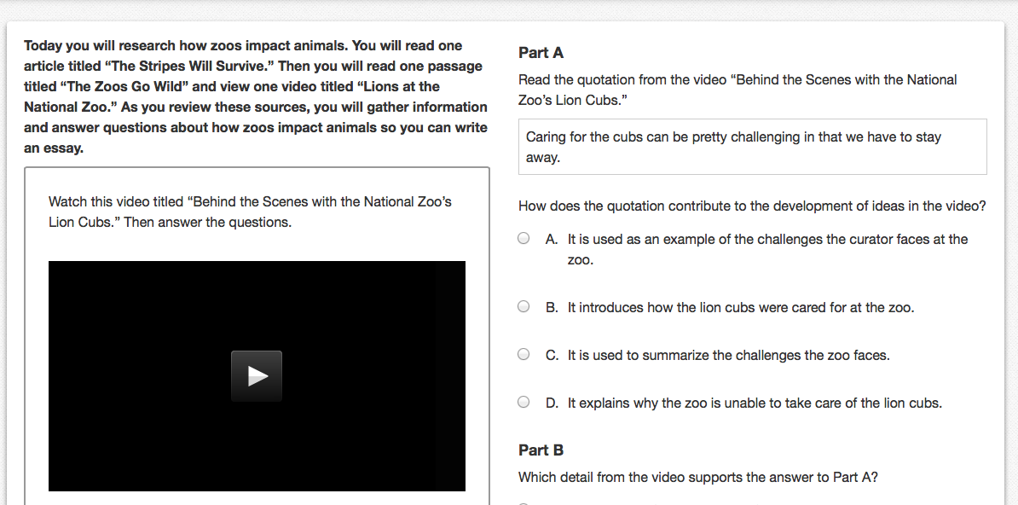
Sixth Grade Practice Test Items-Research Simulation Task
Notes:
Have participants discuss the format and instructional challenges posed by this type of item. Points to consider: students’ listening skills; manipulating/taking notes from video.

Slide 22
Sixth Grade Practice Test Items-Research Simulation Task
Notes:
Ask participants to discuss what skills students need to have in order to perform well on a prose construction response such as this one.

