Slide 1
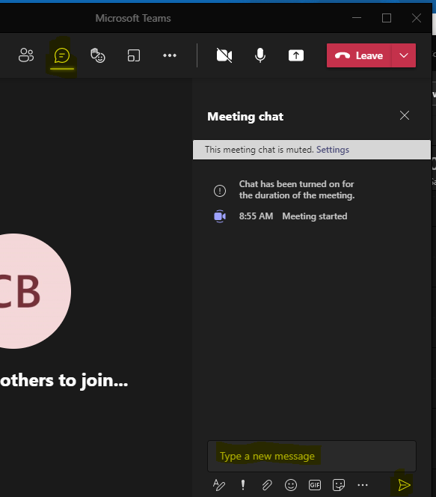
2022-2023
District Assessment Coordinator Kickoff Meeting
Welcome!
Introduce Yourself
From the top of the navigation select the Chat icon
In the Type a new message section tell us your district role and how long you have held your position
Select the paper airplane icon in the bottom right corner of the window to send
Note: Select the three dots (…) and click “Turn on live captions” to access closed captioning
Select the Chat icon
Tell us your district role and how long you have held your position.
Send your message
Notes:
We will be using the Q&A feature in today’s webinar. Place your questions here and if time allows, I will address them during the meeting. I will reach out to individuals and post on our website questions that cannot be addressed during this session.

Slide 2
2023-2024
District Technology Coordinator
Kickoff Meeting
CDE Assessment Division
October 11, 2023
Notes:
Start the recording!!!

Slide 3
Welcome and Agenda
General Information
DTC responsibilities and privileges
DTC Listserv
State Assessment Schedule
ACCESS/DRC updates
CMAS/Pearson updates
CoAlt/KITE updates
Introduction to PSAT/SAT Technology
NAEP Assessment Technology Request for Selected Districts

Slide 4
General Information

Slide 5
Spring 2024 Colorado Assessments
Colorado Measures of
Academic Success
(CMAS)*
Colorado Alternate Assessments
(CoAlt)*
CO PSAT/SAT**
SAT – Grade 11
PSAT – Grades 9 and 10
Math
Math (DLM)
Math
ELA
ELA (DLM)
Evidenced-based Reading and Writing
Optional SAT Essay
Science
Science
*Social Studies will not be administered in spring 2024. A request for proposals for the CMAS program and CoAlt science program will be released this year.
** New digitally-based assessments
***Reading and math administered in grades 4 and 8 in selected schools
NAEP ***
& International Assessments
ACCESS
for ELLs

Slide 6




Online Assessment Platforms
Assessment | Test Engine | Student Info System | Features
ACCESS for ELLs® |  | WIDA AMS | Caching server Clients for Windows, Linux, Mac OSX, Chromebooks, iPads and Linux
CMAS |  |  | Caching server available Installable apps for desktop, Chromebooks, Linux and iPads
CoAlt Science | N/A
CoAlt ELA and Math (Dynamic Learning Maps) | Student Portal | Educator Portal | KITE Student Portal installed on each student device
PSAT and SAT | Student Portal: Bluebook App | Test Day Toolkit (TDTK) | Bluebook is an installable app for Windows, Mac, iPad or school-managed Chromebooks TDTK can be accessed through an established College Board account

Slide 7
Assessment Technology Device Requirements
Devices/OS | CMAS TN Supported Versions | ACCESS Insight Supported Versions | PSAT/SAT Bluebook Supported Versions | CoAlt DLM KITE
Tablets, Chromebooks, Chromeboxes
Chrome OS | Stable Channel (S) | Stable Channel (S) | Chromebooks must be school-managed, run in kiosk mode, and from 2017 or later.
 | 115 S+ | 109 S+ | 114+ | 102+
 | Long-term support (LTS)*
 | 114+ LTS after Aug. 2023
 | No tablet mode for Convertible Chromebooks
Stable channel update for Chrome OS
Stable channel update for Chrome OS

Slide 8
Assessment Technology Device Requirements
Devices/OS | CMAS TN Supported Versions | ACCESS Insight Supported Versions | PSAT/SAT Bluebook Supported Versions | CoAlt DLM KITE
Windows | 10 x64 - 21H2, 22H2 | Windows 8.1 | 10 and 11 (Home, Pro, Education, and Enterprise) | Windows 8.1
 | 11 x64 - 21H2, 22H2 | Windows 10 in S mode, 20H2, 21H1, and 21H2 | Windows 10 in S mode is not supported. | Windows 10
 |  | Windows 11 in S mode, 21H2, and 22H2 |  | Windows 11
 |  | Windows Server 2012 R2, 2016, 2019, and 2022
Stable channel update for Chrome OS
Stable channel update for Chrome OS

Slide 9
Assessment Technology Device Requirements
Devices/OS | CMAS TN Supported Versions | ACCESS Insight Supported Versions | PSAT/SAT Bluebook Supported Versions | CoAlt DLM KITE
iPadOS | 15.2 - 16.x | 14.x-16.x | 14.x+ | 14.3 – 17.0
Laptops, Desktops
Linux | Fedora 37+ x64 |  | Not Supported | Coming Fall 2023
 | Ubuntu 22.10+ x64 | Ubuntu 18.04, 20.04, and 22.04 LTS version with Gnome
macOS | 12, 13 | 10.15, 11.x, 12.x, 13.x | 11.4+ | 11.7 - 13.3
Stable channel update for Chrome OS
Stable channel update for Chrome OS

Slide 10
Assessment Technology Minimum Hardware Specifications
Minimum Hardware Specifications | CMAS TN Supported Versions | ACCESS Insight Supported Versions | PSAT/SAT Bluebook Supported Versions
Processor | x64 - AMD, ARM, ARM64, or Intel-based™ | Minimum: CPU benchmark rating of 600* | 1 GHz processor
 |  | Recommended: CPU benchmark rating of 3000* or higher
Memory | Recommended - 4 GB RAM Minimum - 2 GB RAM | Minimum – 2 GB RAM Recommended – 4 GB RAM or higher | 2 GB RAM
 | Linux and iOS - 2 GB RAM; Minimum - 1 GB RAM
Stable channel update for Chrome OS
Stable channel update for Chrome OS

Slide 11
Assessment Technology Minimum Hardware Specifications
Minimum Hardware Specifications | CMAS TN Supported Versions | ACCESS Insight Supported Versions | PSAT/SAT Bluebook Supported Versions
Free Disk Space | Local File access to home directory OS X, macOS Windows | 1 GB | 150 MB free hard drive space on Chromebook, iPads, macOS.
 |  |  | 250 MB free hard drive space for Windows device.
Screen Size | 9.5-in | 9.5-in | 10 inches on Desktops and Laptops, 8 inches on tablets.
Resolution | 1024 x 768 | 1024 x 768 | 1024 x 768
Stable channel update for Chrome OS
Stable channel update for Chrome OS

Slide 12
Assessment Technology Minimum Hardware Specifications
Minimum Hardware Specifications | CMAS TN Supported Versions | ACCESS Insight Supported Versions | PSAT/SAT Bluebook Supported Versions
External Mice and Keyboards | Windows (required), iOS (recommended) | Headset with Microphone | External keyboards are required on iPads.
 | External keyboard and mouse (or touchpad) for touchscreen devices | Windows and ChromeOS: Both touchscreen and non-touchscreen devices
 |  | macOS and Linux: Non-touchscreen devices only
 |  | iPadOS: iPads that support iPadOS 15.x or above
Stable channel update for Chrome OS
Stable channel update for Chrome OS

Slide 13
DTC Responsibilities and Privileges

Slide 14
District Technology Coordinator (DTC)
DTC responsibilities and privileges
  Primary technology contact for the district who works with CDE Assessment Division regarding online administration of state assessments
    Receive critical, in-depth testing vendor communications directly from CDE during administrations
    Communicate pertinent technology information to district stakeholders concerning the online administration of state assessments
  DTC support for CMAS math, ELA, science and social studies
    DTCs are escalated to Pearson’s Level 2 Technical Support when contacting the help desk with questions regarding the online assessment system
    Note: Only the one officially identified DTC for each district is escalated
  Request support directly from Collin Bonner in the CDE Assessment Division

Slide 15
District Technology Coordinator (DTC)
Check the CDE website to determine the appropriate person is listed as DTC
  http://www.cde.state.co.us/assessment/DTC
It is important to identify a DTC for the district – make sure this position is updated if there is a change
  Superintendent-appointed
DTC receives emails from CDE with information about training and technology updates throughout the year

Slide 16
DTC Listserv

Slide 17
New DTC Listserv
Option to unsubscribe from this listserv reply to dtc-unsubscribe-request@cdelist.cde.state.co.us
Delivery errors automatically deleted from the list when:
  errors have been reported for a period of 4 days or more or,
  more than 100 delivery errors have been received
I will only reach out when active DTCs receive errors.
Contact me to request additional district subscriptions.

Slide 18
2023-2024
State Assessment Schedule

Slide 19
Tentative 2023-24 State Assessment Calendar
Assessment | Grade(s) | Tentative Windows
ACCESS for ELLs® | K-12 | January 8 - February 9, 2024
CMAS and CoAlt: Science | 5, 8, 11¹ | April 8 - 26, 2024
CMAS: Math and ELA (CSLA²) | 3-8¹
CoAlt: DLM ELA and Math | 3-8 | Aligned to CMAS: Math and ELA schedule
CO PSAT | 9, 10 | April 15 - April 26, 2024 Dates may be selected based on district/school preference within this window
CO SAT | 11 | April 15 - April 26, 2024 Dates may be selected based on district/school preference within this window
CoAlt: DLM ELA and Math | 9-11 | Aligned to PSAT and SAT schedules
¹See next two slides for early and extended window options
²CSLA is for eligible multilingual learners in grades 3 and 4 only

Slide 20
CMAS Assessment Window
Official window: April 8 - 26, 2024
  All elementary and middle school science administrations must be completed within this window
  All school-wide paper-based administrations for math and ELA must be completed within this window
    Students taking CoAlt ELA and math (DLM) and those requiring paper accommodations should test at the same time as their peers (this includes CSLA)

Slide 21
CMAS Early and Extended Window Options
Online math and ELA
  To compensate for technology capacity, the math and ELA window can open as early as April 1 and extend through May 3 online administrations only*
    Students taking CoAlt ELA and Math (DLM) and those requiring paper accommodations should test at the same time as their peers (includes CSLA)
  This is an extended window – total of 5 testing weeks
Grade 11 science
  To accommodate high school assessment schedules including SAT, AP and IB exams, the grade 11 science window can open and close early
  Early window option: April 1 – April 19
  This is an early window – total of 3 testing weeks
By December 15, DACs notify CDE of intent to participate in these options through the District Testing Information and Format Selections Form
  The form is distributed to official DACs upon completion of the Spring 2024 CMAS Administration Training for DACs
*Additionally, offering a back-end extension in 2024 allows greater avoidance of primary religious observance days when groups of students may be unable to test. This provides greater scheduling flexibility when overlap cannot be avoided.

Slide 22
WIDA
ACCESS for ELLs®

Slide 23
ACCESS for ELLs® Key Dates
DRC / ACCESS Training
    Pre-Testing: Software Updates and Tech Readiness Checklist
      Tuesday, October 3, 2023 Pre-Testing: Technology Installations - Part 1
      Tuesday, October 10, 2023
      Pre-Testing: Technology Installations - Part 2
      Thursday, October 12, 2023 ]
    Pre-Testing: Technology Coordinator Support for Test Administrators
      Tuesday, November 7, 2023
    During Testing: Technology Troubleshooting
      Thursday, December 15, 2023
ACCESS Testing Window
  Monday, January 8 – Friday, February 9, 2023
WIDA AMS Test Setup Available
  November 29, 2023 – February 14, 2024
  DTC Website http://www.cde.state.co.us/assessment/newassess-dtc or Technology Webinars for Technology Coordinators in the 2023-2024

Slide 24
New DRC Insight WIDA AMS
Import Management
  The Import Management functionality allows users to import students to WIDA AMS and create generic registrations. Import Management replaces the Multiple Student Upload or Pre-ID File upload process.
Student Management
  Search for students
  Add an individual student
  View/edit student demographics
  View/edit student accommodations
  Export student records
  View a student’s online registrations
WIDA AMS User Guide

Slide 25
New DRC Insight WIDA AMS
Test Management
  Create registrations
  View/edit registrations
  Cancel (delete) registrations
  Export registration details, including tier placement
  Print test tickets and student rosters
  Add or remove Do Not Score indicators
  Add a new student to WIDA AMS and registrations (quick registration)
Reporting Services
  Screener Export (formerly Screener Data Export)
  Screener Score Report
  ACCESS Translated Report
  ACCESS Individual Student Reports, Roster Reports, and Frequency Reports
  Secure Material Tracking Report
WIDA AMS User Guide

Slide 26
DRC Device and OS in Phase 4 End of Support
Windows
  Windows 8.1
  Windows 10 20H2, 21H1
  Windows Server 2012 R2
iPadOS
  iPadOS 14.x
  15.4.x
Chrome OS
Chrome OS current stable channel above 109
macOS
macOS 10.15
Linux
Ubuntu 18.04

Slide 27
Disable Background Processes
For both test security and device performance, DRC recommends that unnecessary background processes and software be disabled.
Test Performance
  Update processes or unnecessary applications and features running in the background on testing devices consume CPU and memory
  Can affect the testing experience
    Audio playback may be choppy
    Speaking test responses may be distorted
Test Security
  Software that can compromise test content

Slide 28
Disable Background Processes
The following are five (5) types of applications sites should review before devices are used for testing:
  Instructional Software
  Automatic Updates
  Intelligent Personal Assistant (IPA)
  iPadOS, Chrome OS, Netbook Devices
  Collaboration Tools
  Microsoft Game Bar and Other Screen Capture Software
Notes:
The following are five (5) types of applications sites should review before devices are used for testing:
Instructional Software
Typing assistant or grammar checking application (e.g., Grammarly, Ginger Software, ProWritingAid)
Classroom monitoring tools (e.g., Linewize Classwize, Impero Wellbeing, GoGuardian, Securly)
Remote access/remote control tools (e.g., TeamViewer, AnyDesk, Remote PC, LogMeIn)
Automatic Updates –
Automatic Updates - Audio playback may be choppy
Speaking test responses may be distorted
Intelligent Personal Assistant (IPA)
iPadOS, Chrome OS, Netbook Devices - unnecessary applications and features
Collaboration Tools – MS Teams
Microsoft Game Bar and Other Screen Capture Software

Slide 29
CMAS
Mathematics, English Language Arts/Literacy, Colorado Spanish Language Arts (CSLA) & Science

Slide 30
CMAS Grades and Content Areas
Science
Elementary, middle and high school assessments
  Science: grades 5, 8 and 11
Math and ELA
Elementary and middle school assessments
  Math: grades 3-8
  ELA: grades 3-8
    CSLA: ELA accommodation only for eligible multilingual learners in grades 3-4
Note: Social Studies will not be administered in Spring 2023

Slide 31
PearsonAccess^{next}
The online platform used for CMAS data management and administration
  CDE updates DAC permissions throughout the year
PearsonAccess^{next} use will be covered during trainings
Training modules available through the Colorado Assessments Portal at https://coassessments.com/training-mods/
  Welcome to PearsonAccess^{next}
  User Accounts
  Student Registration/Personal Needs Profile (SR/PNP)
  Paper and Online Pre-Testing Materials Management
  Assessment Coordinator Online Session Management
  Test Administrator Online Session Management
  Additional Orders
  Post-Testing Materials Management
  Post-Testing Data Clean-up

Slide 32
TestNav Requirements Policy
OS: | Based on manufacturer support Pearson will support: | Resources:
OS X and macOS | The two past releases as of July 15. | N/A
iOS | The two past releases as of July 15. | iOS Life Cycle Management
ChromeOS | Releases Google supports as of July 15 of the current calendar school year. | Chrome Update Policy
Windows | Releases Microsoft supports as of July 15 of the current calendar school year. | Windows lifecycle fact sheet
Ubuntu | The last two long-term releases. | N/A
Stable channel update for Chrome OS
Stable channel update for Chrome OS

Slide 33
TestNav Components 2023-24
Component | Installation
Proctor Caching | No updates, uninstall and reinstall current version if necessary
TestNav Server side software | No install required apps are automatically updated
Desktop Client App | The new app can be pushed out to Mac OS or Windows OS devices without the need to uninstall the old version Apps on windows stores now support auto updates
iPad Client App | Auto updates are supported
Chromebook Client App | Auto updates are supported

Slide 34
Site Readiness Activities 2023-24
CDE recommends:
  Conduct CMAS Infrastructure Trial through the PearsonAccess^{next} Training Site
    Provides a way to test the local online assessment environment to verify the network, proctor caching devices and student testing devices are configured correctly using CMAS items
    Highly recommended for districts and schools using virtualized device solutions

Slide 35
2023 CMAS Administration

Slide 36
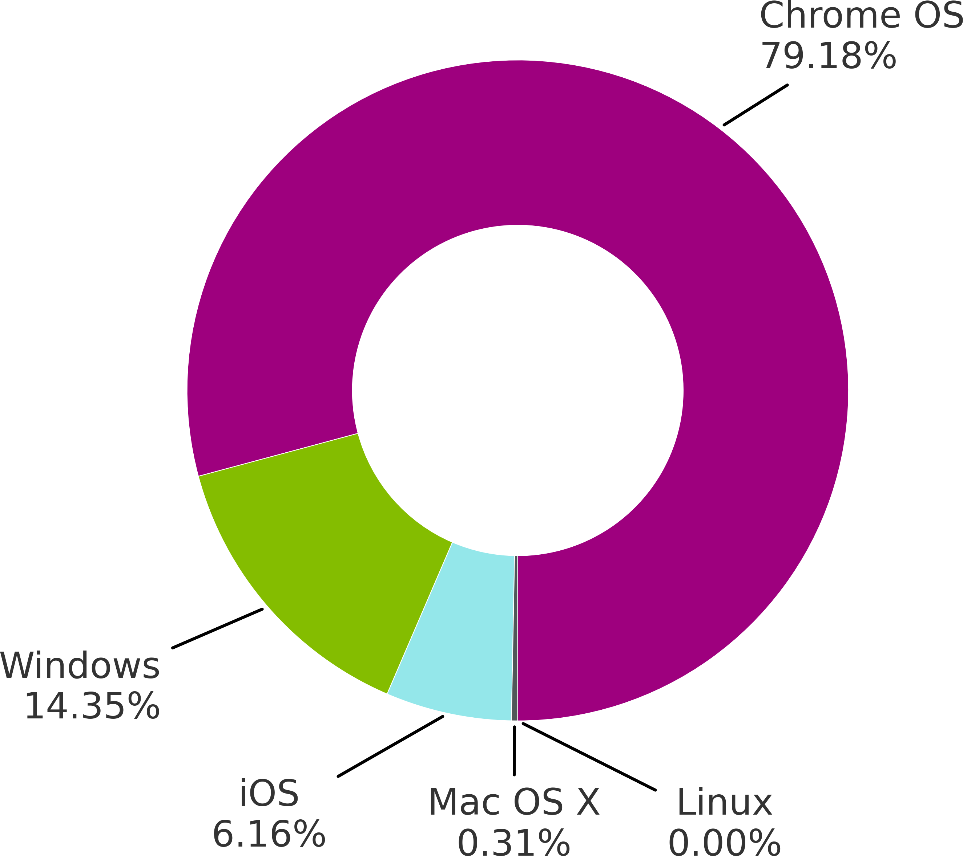
2023 CMAS Operating System Usage
Most Common
Devices using Chrome OS were the most-used during this testing period, accounting for 1,796,403 tests.
Least Common
Linux was the least common operating system; it was used for only 1 test.

Slide 37
2022 CMAS Top 5 Error Codes

Slide 38
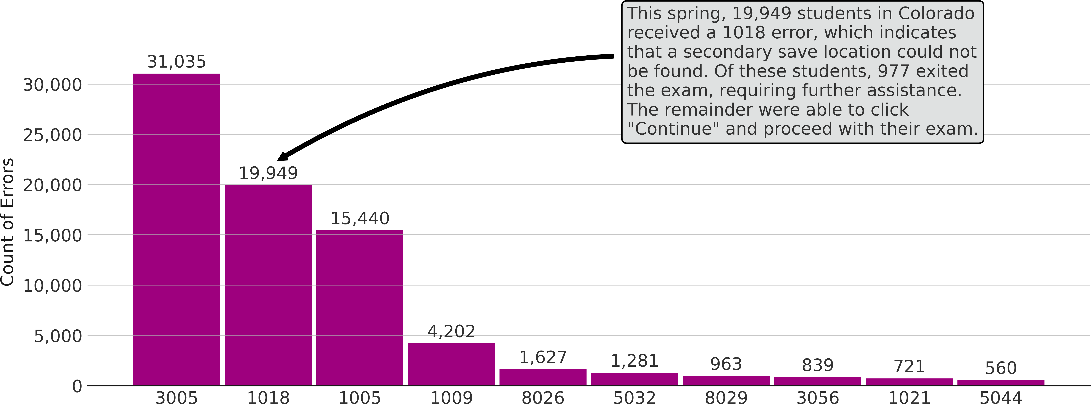
Top Errors
Top Ten Errors Observed
Notes:
3005- TN another app attempted to take focus
1018- “Alternate SRF location is not writable”
1005 - No saved response file found
1009 - The Testing server cannot be reached. Any un-sent responses have been saved on this computer..
8026- Unable to connect to the proctor caching computer.
5032- TestNav has detected a prohibited application '<processname>' running in the background that is preventing you from continuing this test.

Slide 39
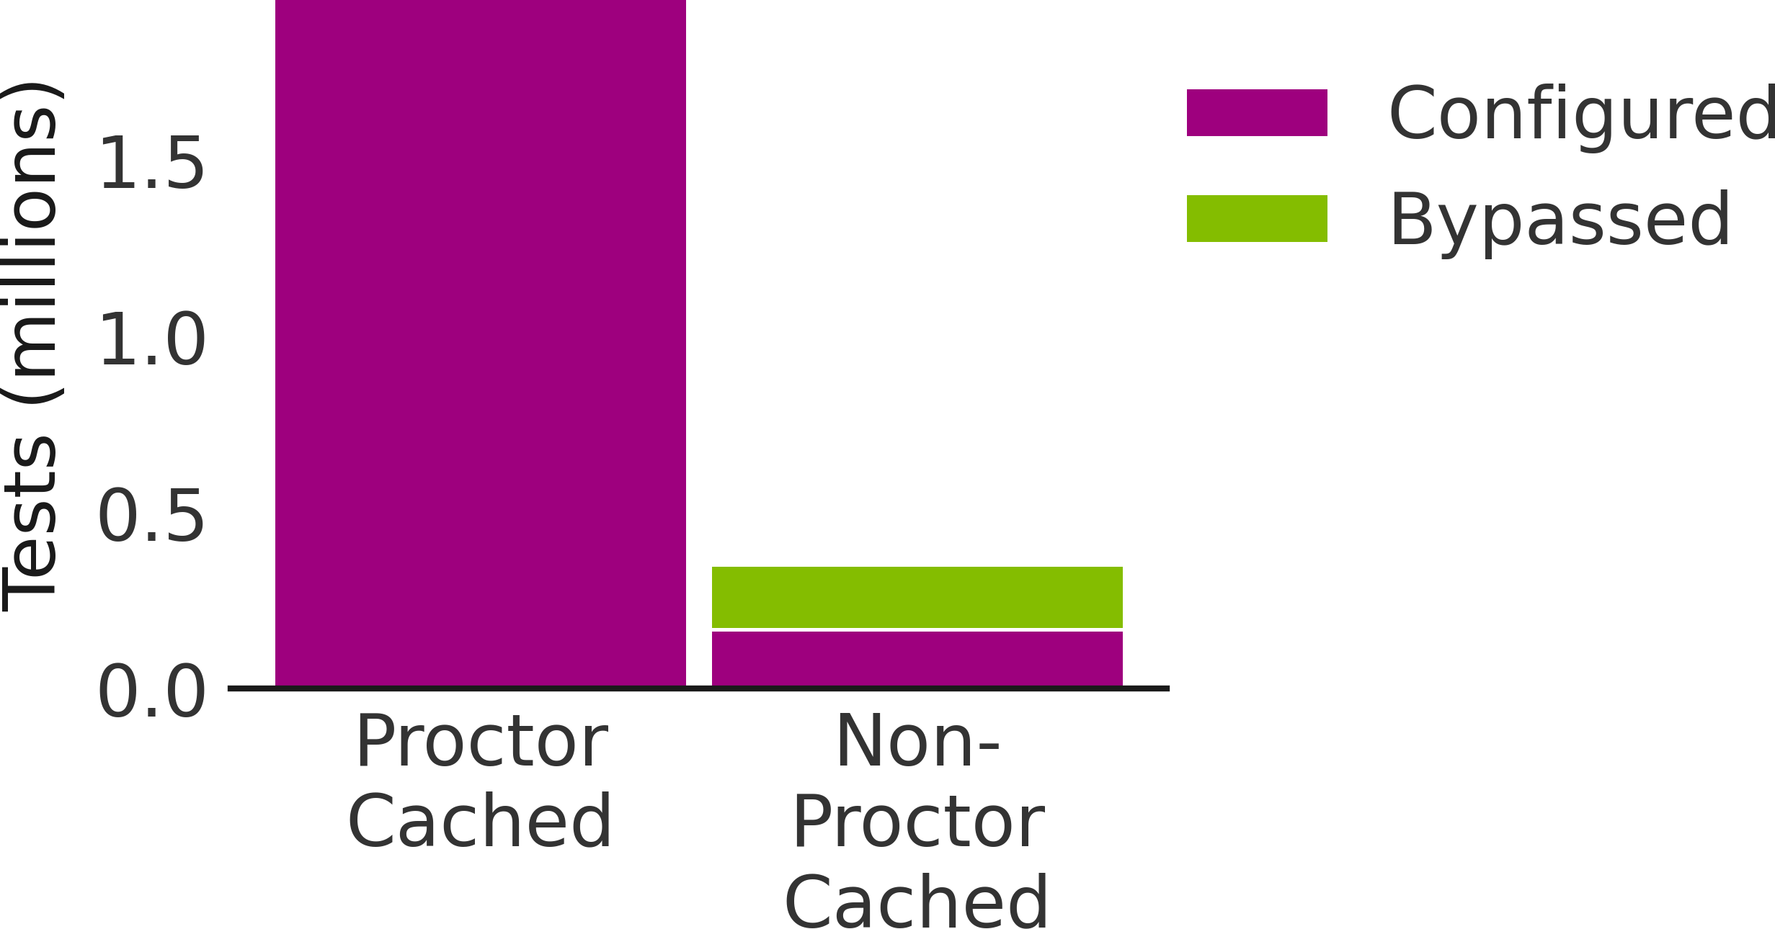
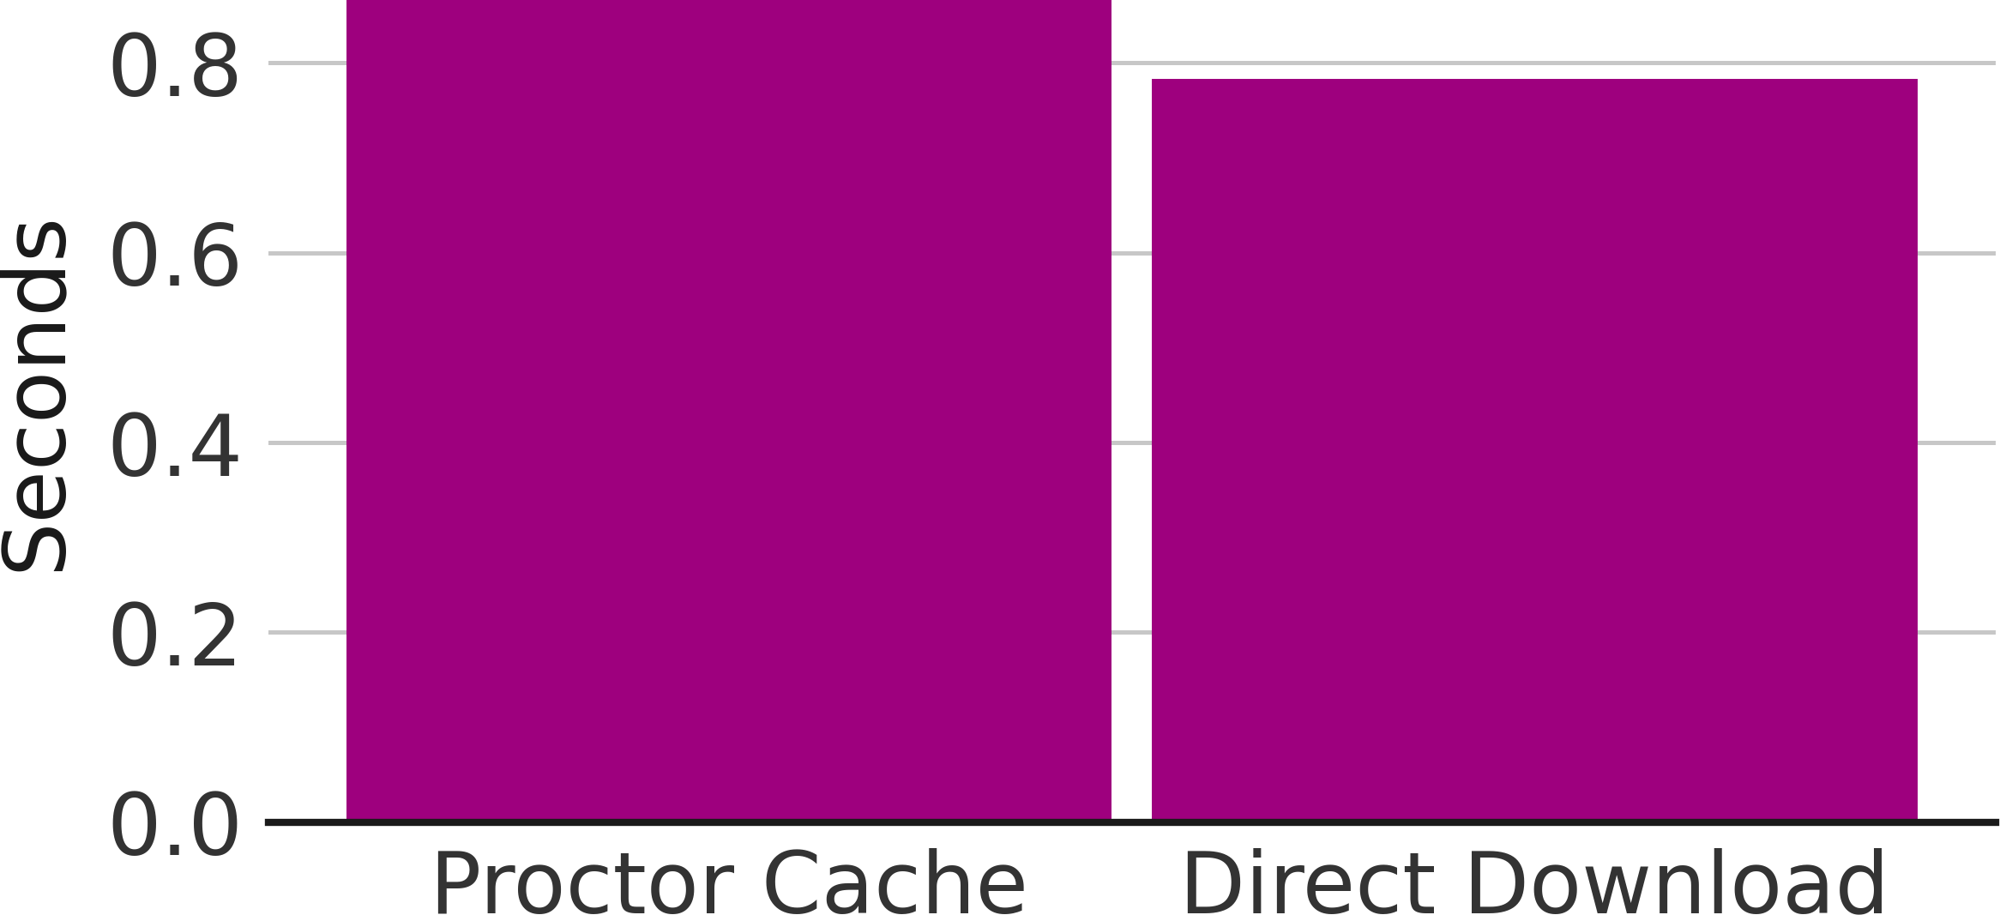
Testing Conﬁguration Performance
ProctorCache Usage
85% of Colorado testers utilized Proctor Caching. However, more than 182,000 testers were unable to connect to the local cache at login due to misconﬁguration, typically leading to
delays of 20–30s prior to starting the test. The enabled cache override option allowed these students to bypass the cache and test without further interruption.
Median Item Load Time
For those who used Proctor Caching, the median test item load time was 0.87 seconds. For those who did not use Proctor Caching the median test item load time was 0.78 seconds.

Slide 40
Colorado User Testing Experience with Proctor Caching
Pearson conducted a data study to find any difference between test delivered using Proctor caching and test that do not.
Students experienced a shorter average load time without proctor caching.
Where Proctor caching was configured and bypassed, 8% of those instances resulted in significant waits of 20-30 seconds.
Use of proctor cache bypass increases average load times.
Test that used proctor caching experienced errors over three times as often as those with no caching configured.
If you would like to see the Proctor caching data from your district, email me to request your district data.
CMAS Science | Cache Bypassed Test Count | Cache Used Tests Count | No Cache Configured Test Count | Cache Bypassed Error Rate | Cache Used Error Rate | No Cache Configured Error Rate
ALL DISTRICTS | 36562 | 339303 | 26894 | 4.49% | 2.87% | 1.78%

Slide 41
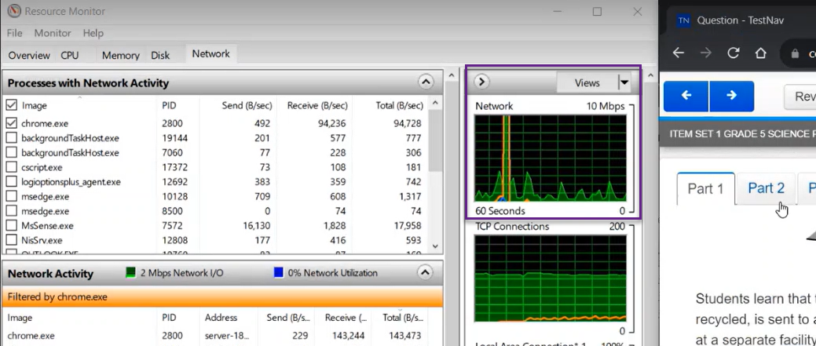
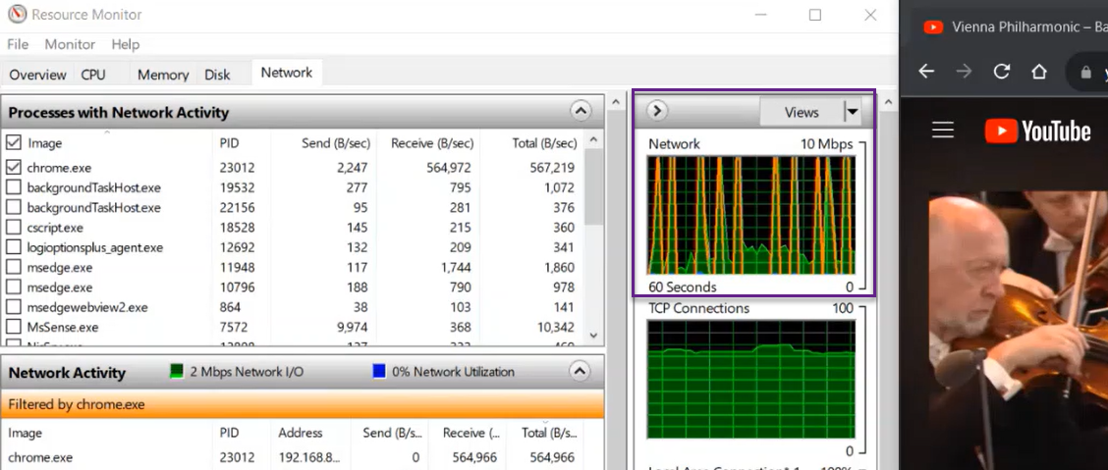
CMAS Science and Text-to-Speech Assessment Size
CMAS Grade 5 Science Practice Assessment with Text-to-Speech
Typical YouTube Video
Notes:
Take away
CMAS Science and Text-to-Speech network activity mostly occupies Kbps with one initial spike of 10Mbps
while YouTube network activity regularly exceeds 10 Mbps.

Slide 42
CDE CMAS Support
Technical Training Slide Decks – Detailed Training
  Follow the structure of documentation
  Detailed instructions with links to documentation
    New DTC/ New TN installation- December 13th,2023 from 1pm to 3pm
    Experienced DTC/ Existing TN Assessment environment- December 15th from 10am to noon.
Webinars
  Trainings - Cover Technical Training Slide Decks
  Q & A Sessions to answer specific questions
  Check http://www.cde.state.co.us/assessment/newassess-dtc for details.
Site Readiness Support Request
  Pearson Field Engineering Services meetings 15, 30, or 60 minutes
  Request a Technical Site Visit

Slide 43
CoAlt Science
CoAlt English Language Arts & Mathematics (DLM)

Slide 44
DLM Admin System: KITE Components
Component | Software Version | Recommendations
KITE Local Caching Server |  | Not Available
KITE Student Portal | 9.0.0 | Must uninstall and reinstall on Mac and PC student devices. Chromebooks will auto update.

Slide 45
Compatible OS platforms to use for Kite® Student Portal
The new iPad OS 17.0 is compatible with Kite Student Portal.
Kite Student Portal supports iPad OS 14.3–17.0.
Macs running OS 11.7 will be supported for Kite Student Portal until the end of November 2023. By that time, Mac users should upgrade to Mac OS 12+.
Avoiding Locked iPads During Testing
  Tap the Close Kite button at the top of the home screen or select the Sign Out button.
  Tap Quit in the pop-up window that appears.

Slide 46
Colorado
PSAT & SAT

Slide 47
Colorado PSAT and SAT
Assessment | Grade | Administration Dates
PSAT 8/9 PSAT 10 | 9 10 | April 15 - April 26, 2024 Primary and make-up dates may be selected based on school preference within this window
SAT | 11 | April 15 - April 26, 2024 Primary and make-up dates may be selected based on school preference within this window

Slide 48
Digital Testing Preview
Test Form: PSAT 9, PSAT 10 and SAT tests will be presented in a digital format through the Bluebook app
  Paper-based testing will be reserved for accommodated students only
Digital testing platforms
  Test Day Toolkit – Test administration site used by testing staff
  Bluebook – Testing application used by students
Test Structure
Test Section | Number of Questions | Time Limit | Assessment
Reading & Writing | 54 questions | 64 minutes | PSAT 9, PSAT 10 & SAT
Math | 44 questions | 70 minutes | PSAT 9, PSAT 10 & SAT
Essay (optional) | 1 prompt | 50 minutes | SAT only

Slide 49
About Bluebook Digital Testing
Content is downloaded at the form level and not the item level
  All student test content will be downloaded when the student authenticates.
  Adaptive assessment means three forms will be downloaded: Initial, form A, and form B.
  Once content has been downloaded, testing can continue without internet connectivity.
  Student must have internet connectivity to upload answer files and submit the assessment.
Answer files are continually uploaded to College Board.
  Answer files are transferred to College Board on periodic intervals or “heartbeats” with continued internet connectivity.
  This allows a student to switch devices in the event of a device failure or power loss.
  The student’s process is tracked and can be viewed by the test administrator.
Bluebook requires operating system (OS) accessibility features for some accommodations
  This may require additional device configuration. i.e., Chromebook floating accessibility menu or third-party accessibility software.

Slide 50
Bluebook Resources
Bluebook Technology for Professionals
https://bluebook.collegeboard.org/technology
  Network Readiness
    https://bluebook.collegeboard.org/technology/networks
  Digital SAT Device Requirements
    https://satsuite.collegeboard.org/digital/device-requirements
  Device Readiness
    https://bluebook.collegeboard.org/technology/devices
  Chromebook Installation
    https://bluebook.collegeboard.org/technology/devices/chromebook
  Windows Installation
    https://bluebook.collegeboard.org/technology/devices/windows
  iPad Installation
    https://bluebook.collegeboard.org/technology/devices/ipad
  Mac Installation
    https://bluebook.collegeboard.org/technology/devices/mac
  Bluebook Updates
    https://bluebook.collegeboard.org/technology/updates?SFMC_cid=EM1036463-&rid=508094591
  Accommodations and Assistive Technology
    https://bluebook.collegeboard.org/students/accommodations-assistive-technology
  Bluebook Technology Training
    Tuesday, October 17 from 3:00-4:00PM MT
    Thursday, October 19 from 11:00AM-12:00PM MT

Slide 51
National Assessments
NAEP
(Selected Schools Only)

Slide 52
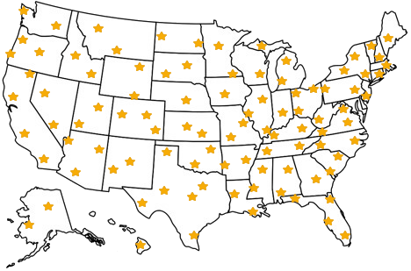

NAEP Overview
The National Assessment of Educational Progress, also known as NAEP or The Nation's Report Card, is the largest nationally representative and continuing assessment of what America's students know and can do in various subject areas.
Results are released as The Nation’s Report Card

Slide 53



NAEP 2024 Assessment Program
Grades: 4, 8, and 12 students
Subjects: Mathematics, Reading, or Science
  Each student will take one subject only.
Assessment Window: JANUARY 29, 2024 - MARCH 8, 2024
Notes:
Selected schools only
Hundreds of schools in 60-65 districts

Slide 54
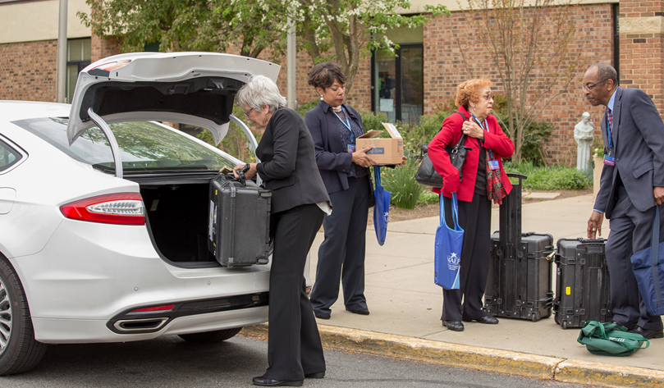
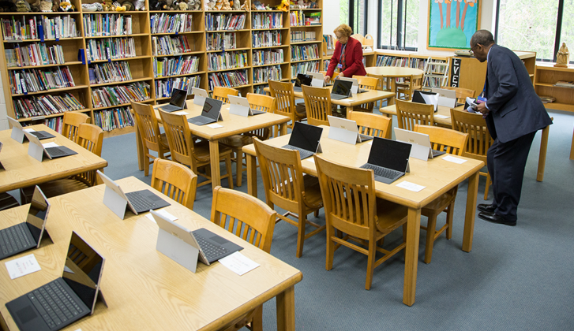
NAEP 2024 Assessment Program
NAEP representatives will administer the assessment and bring all necessary materials and equipment.
Students will complete the assessment on NAEP-provided Chromebooks and Surface Pros
The device will include a keyboard, stylus,
and earbuds.
There will be 2 sequential assessment sessions with up to 25 students each.
Notes:
NAEP representatives will administer the assessment and bring all necessary materials and equipment.
External NAEP-provided devices are federal government-furnished equipment secured according to NAEP assessment delivery policies.
The NAEP assessment delivery application launches in a secure, locked down browser on a Windows device and as a secure kiosk application on a Chromebook device, preventing access to other software, applications, and websites. Students can only view assessment content.

Slide 55

NAEP 2024 Goal
The NAEP team's goal is to connect NAEP-provided devices to the school's Wi-Fi to conduct the assessment.
NAEP will work with districts and schools to determine if this is feasible.
Notes:
The NAEP team's goal is to connect NAEP-provided devices to the school's Wi-Fi to conduct the assessment.
During the assessment, all NAEP-provided devices will establish a secure connection with NAEP Cloud systems to load assessment content, monitor progress, and upload assessment responses in real time via the school-provided internet.
NAEP will work with districts and schools to determine if this is feasible.
Best Practice: conserve bandwidth on assessment day

Slide 56
District Technology Director Communication
November- DTCs with NAEP selected schools will receive communication with:
Lists of selected schools
Request that you to designate a School Technology Coordinator.
Lists Technology Team Responsibilities:
  Register for the Assessment Management System (AMS).
  Complete the Internet Connectivity Survey.
  Set up a dedicated Wi-Fi network or identify an existing Wi-Fi network for the assessment.
  Safelist the NAEP URLs and work with the on-site technology coordinator to confirm they are safelisted.
  Attend a 30-minute assessment planning meeting with NAEP field staff, if necessary.
  Assist schools on their assessment date, if necessary.

Slide 57
Questions?

