Slide 1
CoAlt: ELA and Math (DLM)

Slide 2
Introduction (CoAlt)
Science & Social Studies
Paper based
Registrations are through PAnext
SS: 4 & 7 if peers are taking
SC: 5,8, & 11
Test window: April 9-27
High School Science may start earlier with CDE approval (as early as March 26)

Slide 3
Introduction
ELA & Math
Computer based
Registration is through Educator Portal
Students test using KITE
3-8 alternate to CMAS ELA and Math
9-11 alternate to College Board PSAT/SAT
Test window: April 9-27
*Note: If a district applies for an early window for ELA and Math, then the early window also applies to CoAlt.

Slide 4
DAC Activities
Enroll students
Verify enrollment from CDE
Verify student grade
Upload/Input users
Train teachers
Create Rosters
Monitor testing progress

Slide 5
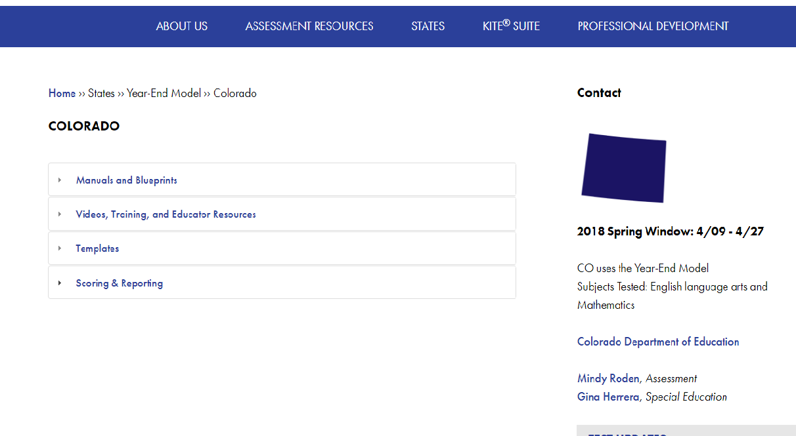
http://dynamiclearningmaps.org/colorado

Slide 6
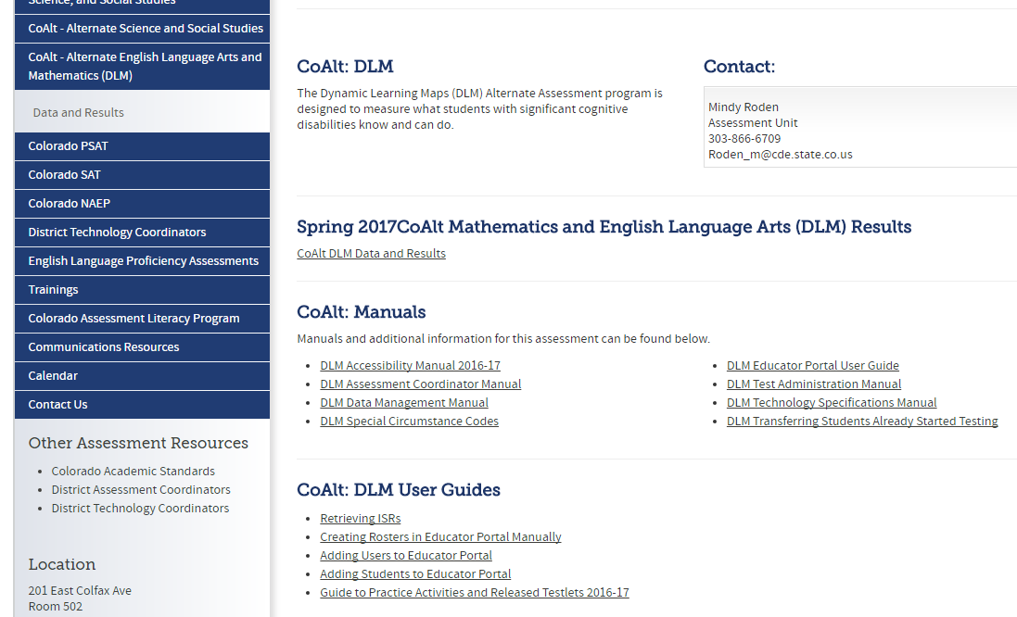
http://www.cde.state.co.us/assessment/newassess-coaltelam

Slide 7
Adding Users

Slide 8
Adding Users
Two ways to add users:
User Upload template
User Interface
Edit user information instead of creating new account:
Name change
Email change
School change
Educator Portal account creates Moodle account

Slide 9
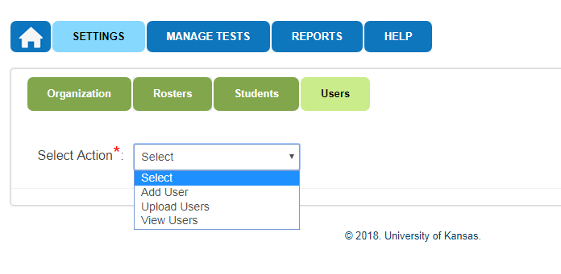

Slide 10
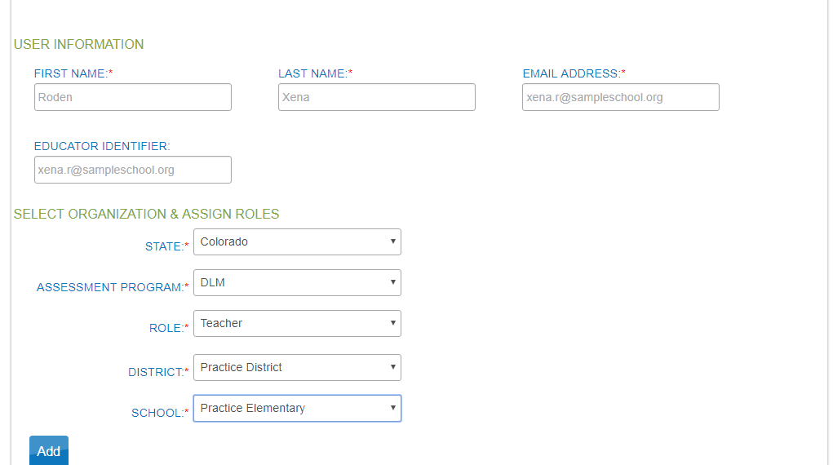

Slide 12
Enrolling Students

Slide 13
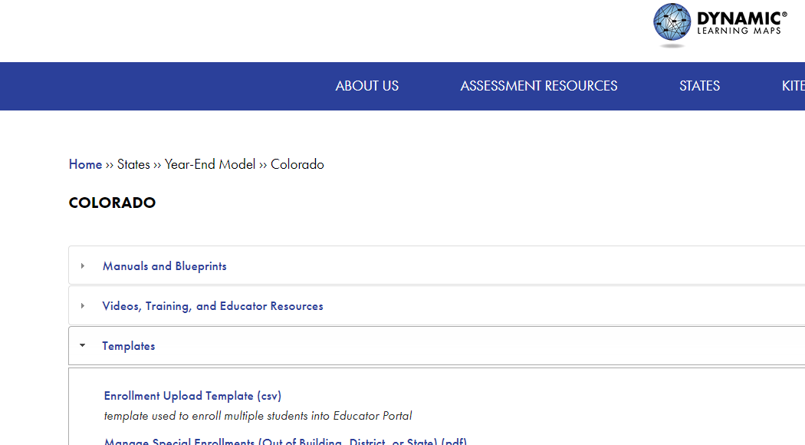
Enroll Students
2 ways to enroll
User Interface
CSV file upload

Slide 14
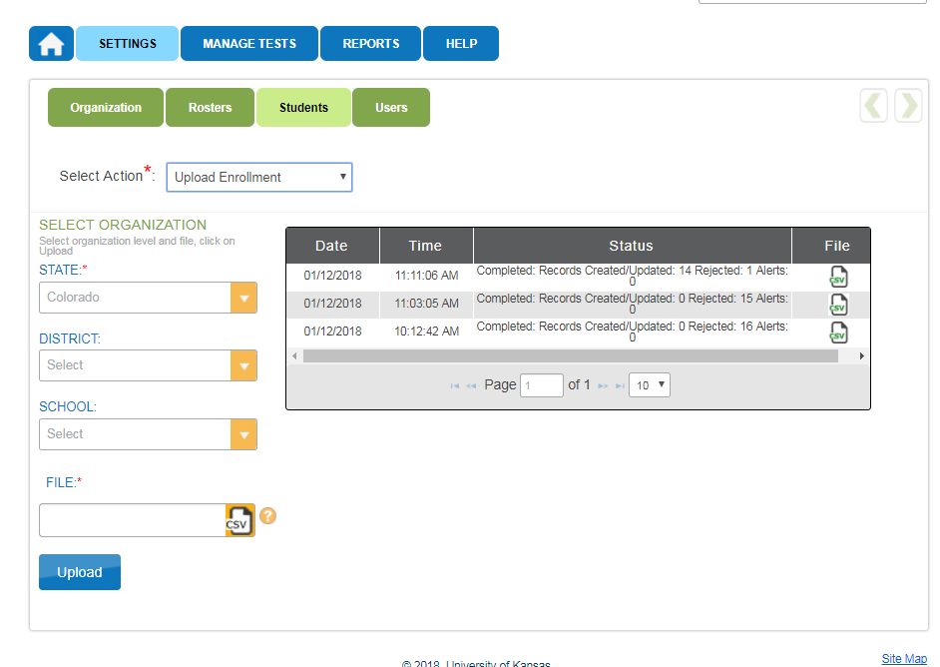

Slide 15
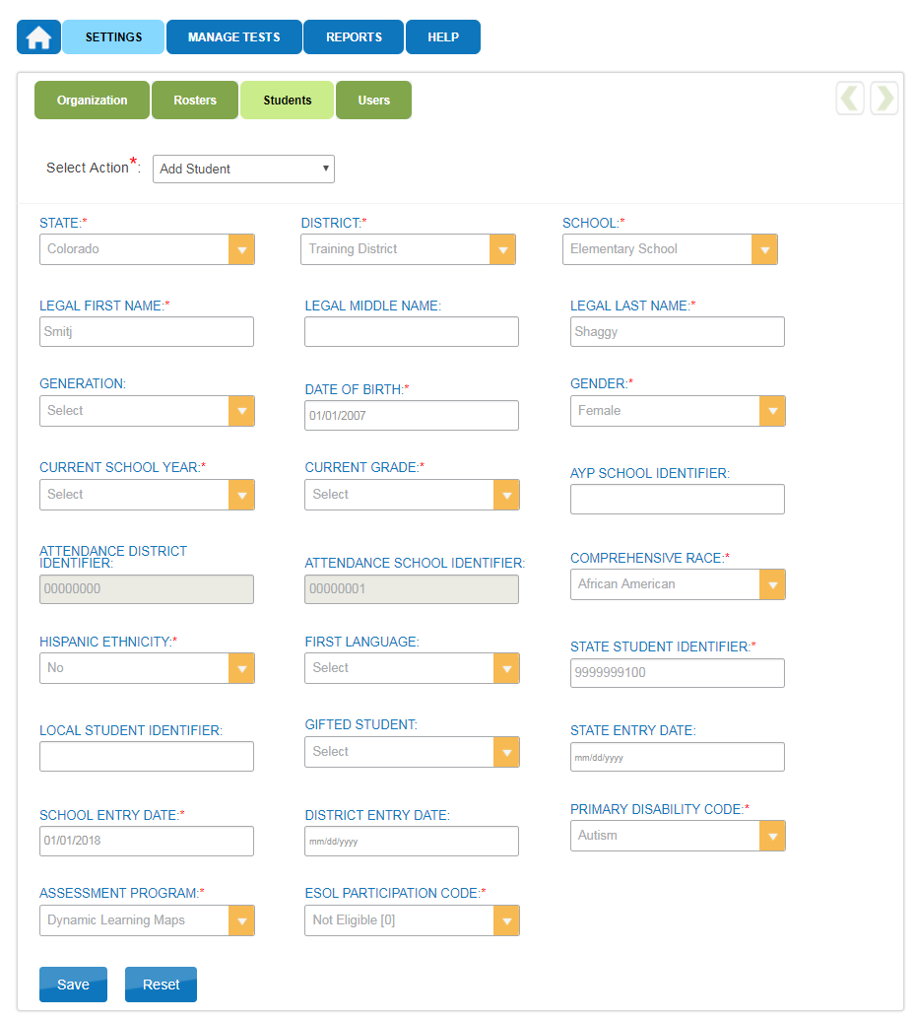

Slide 16
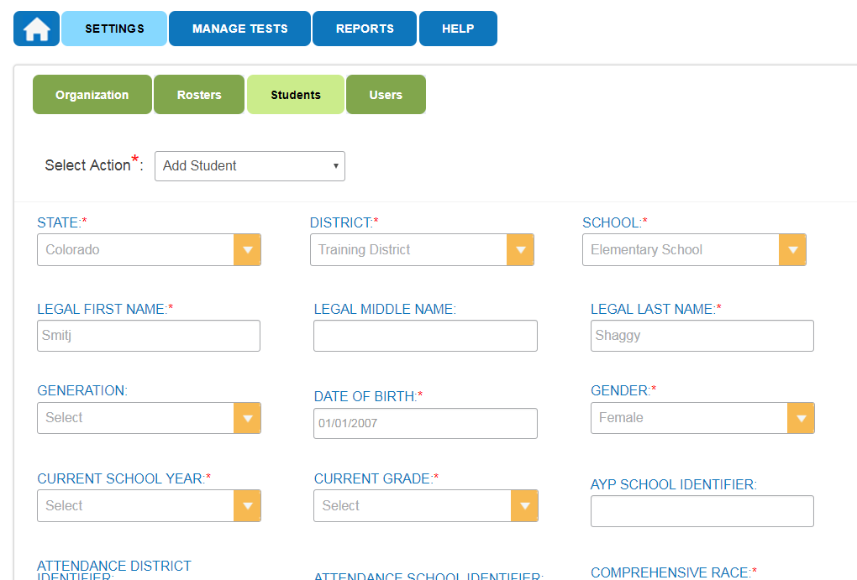

Slide 17
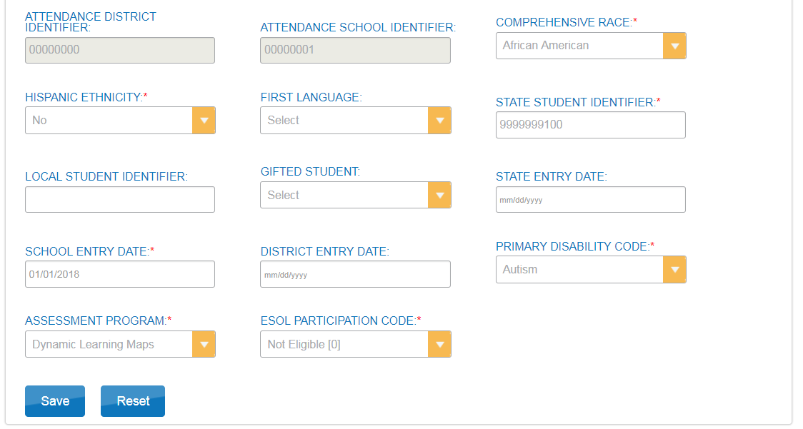

Slide 18
Creating Rosters

Slide 19
Rostering
All students are rostered to 2 separate rosters
Math
ELA
Do not create a roster for Science or Social Studies (PAnext)
Recommended naming conventions
Last name_subject

Slide 20
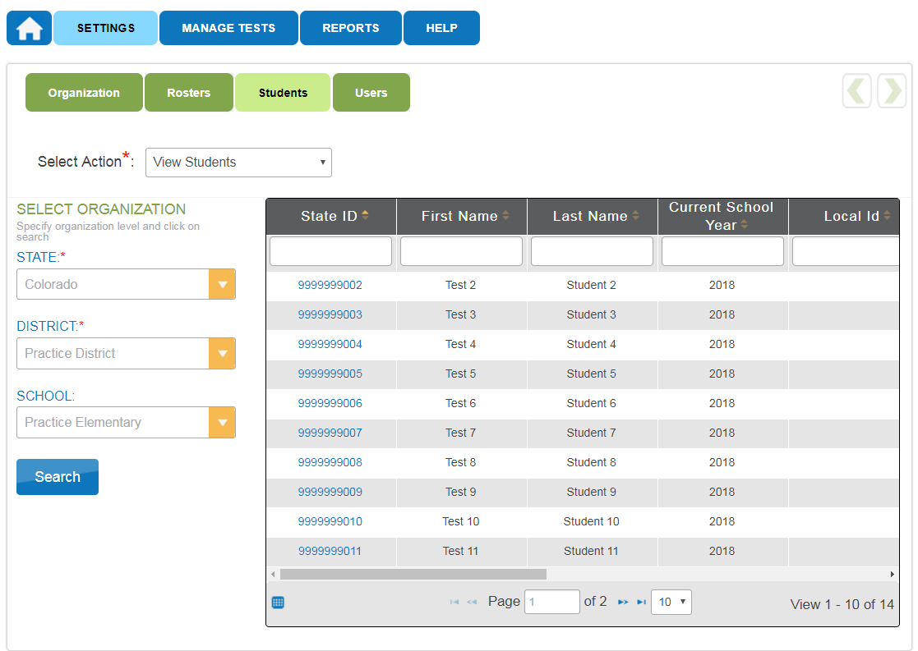

Slide 21
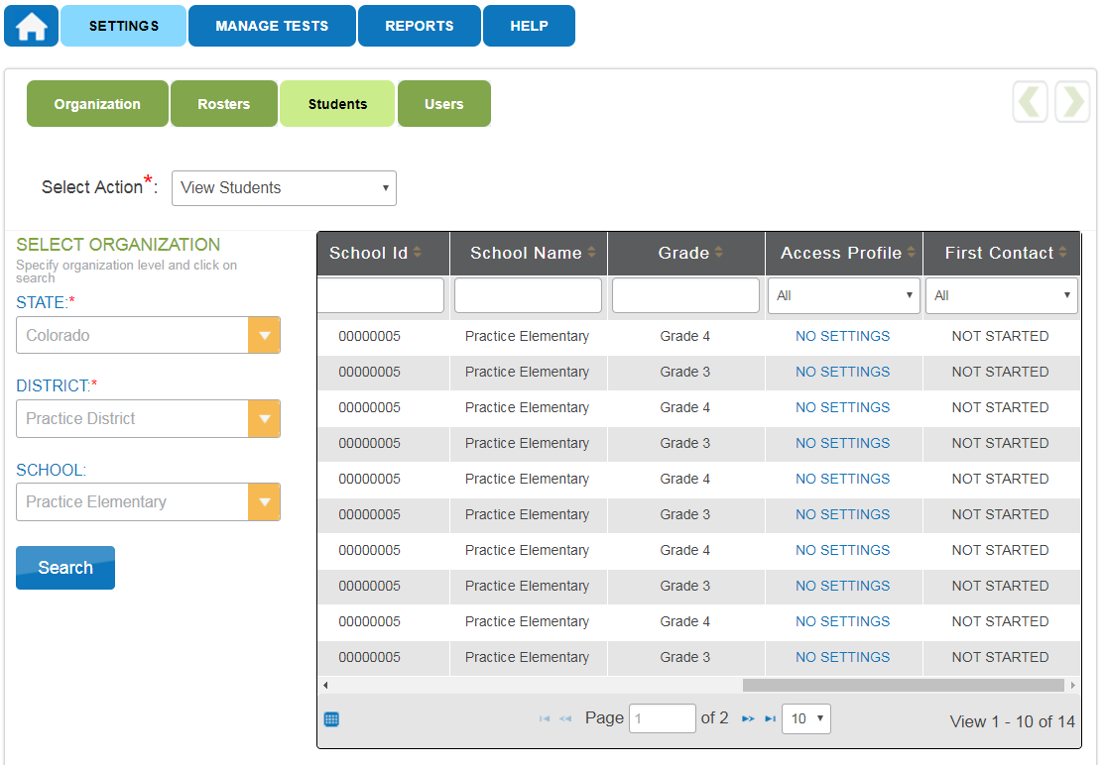

Slide 22
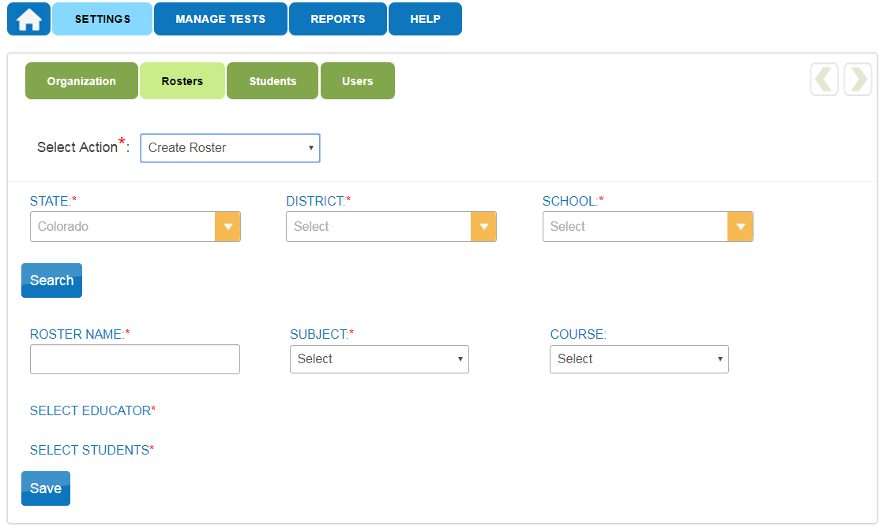

Slide 23
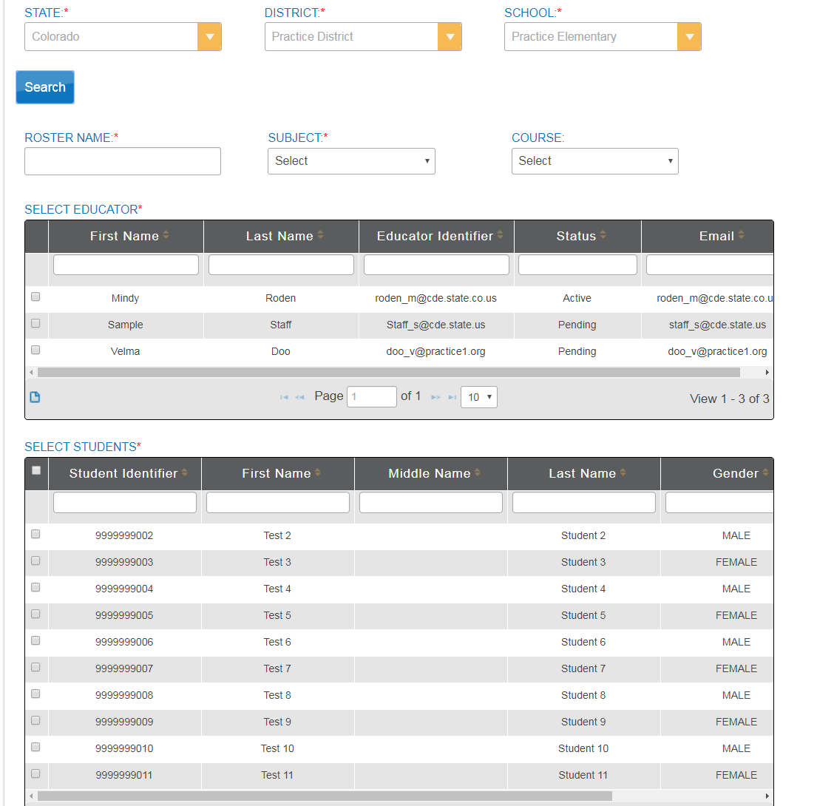

Slide 24
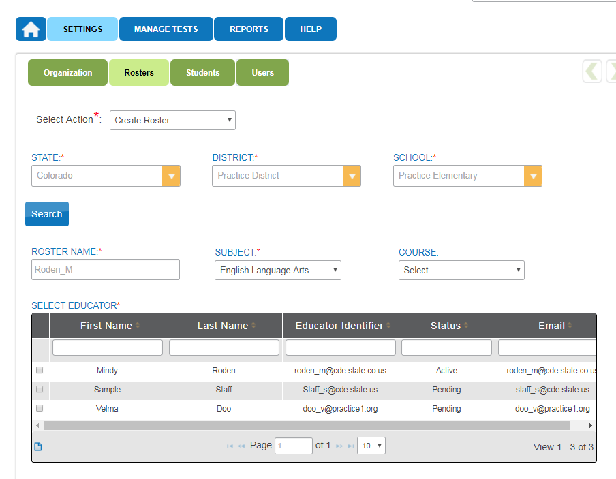

Slide 25
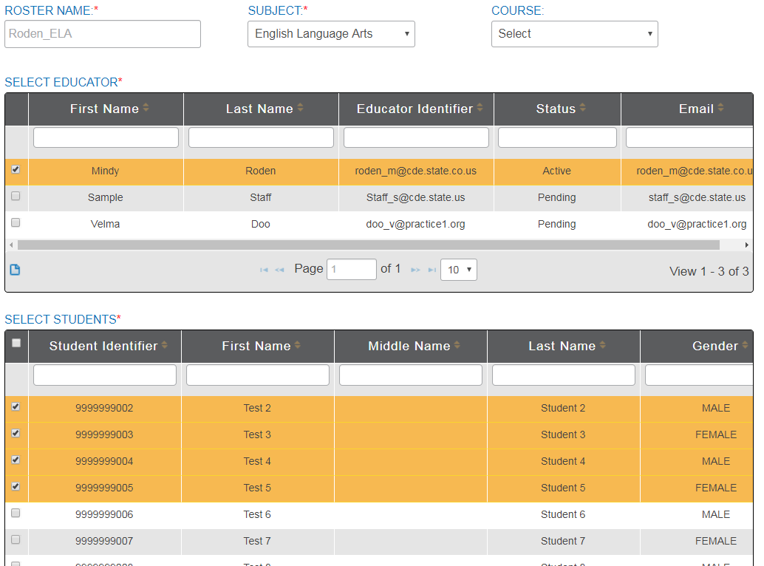

Slide 26
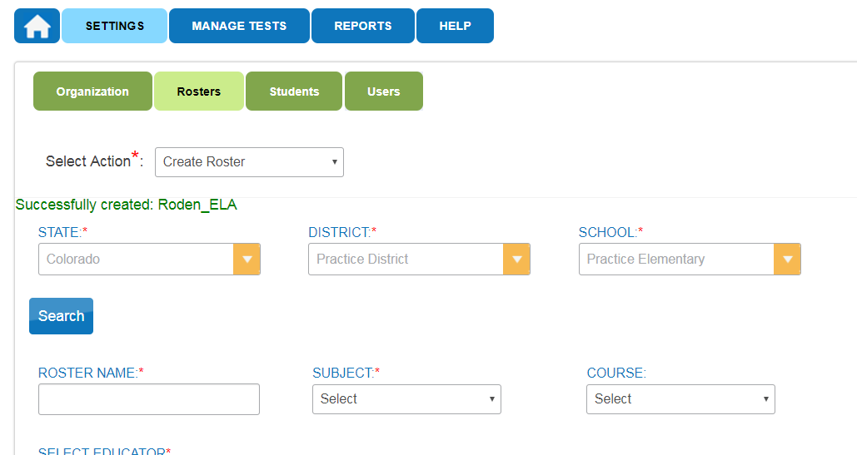

Slide 27
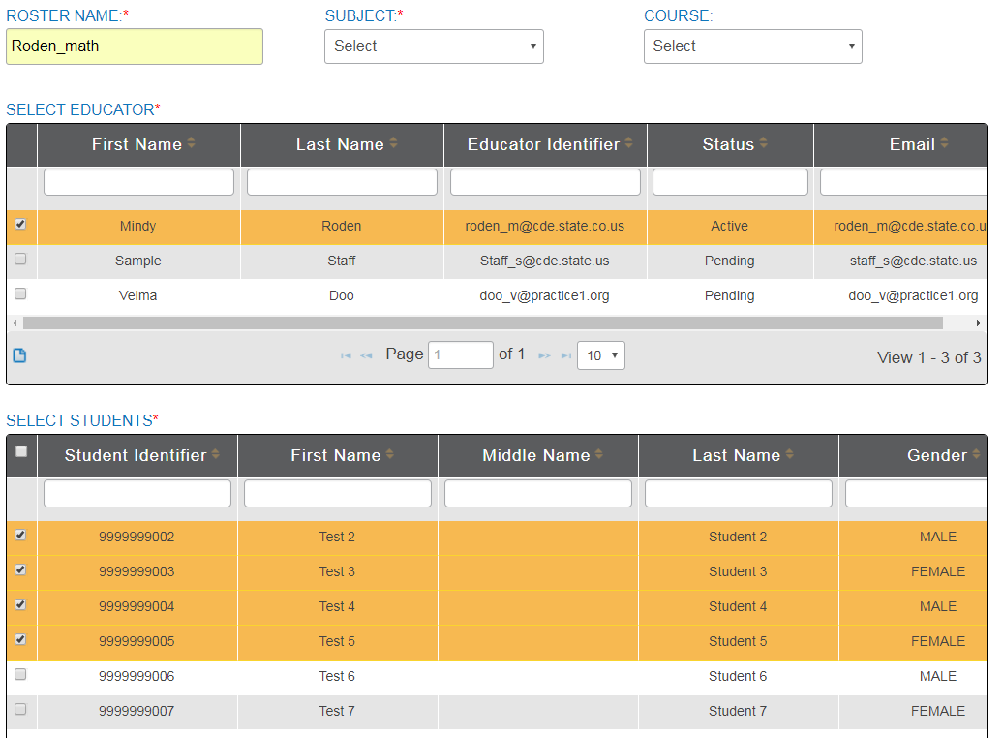

Slide 28
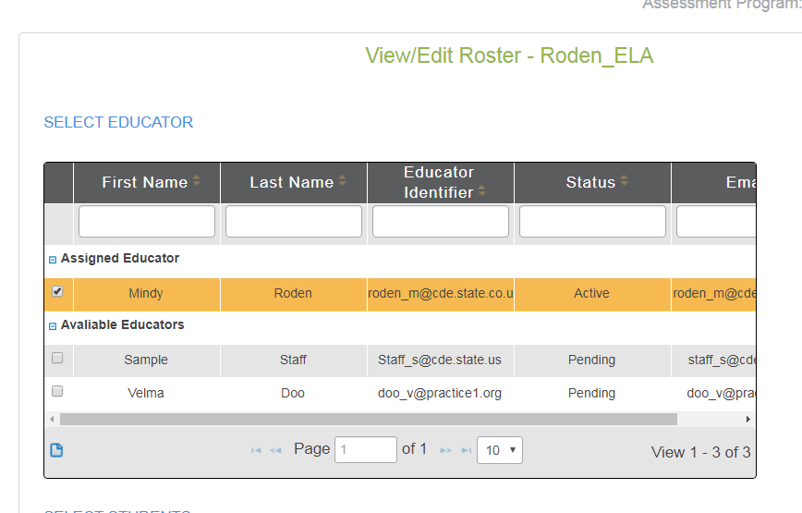

Slide 29
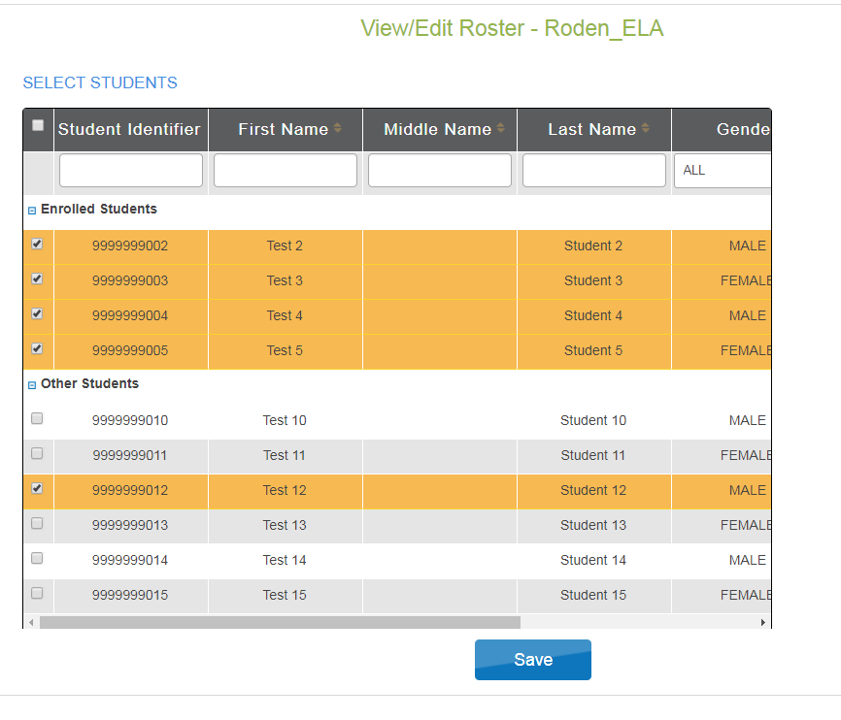

Slide 30
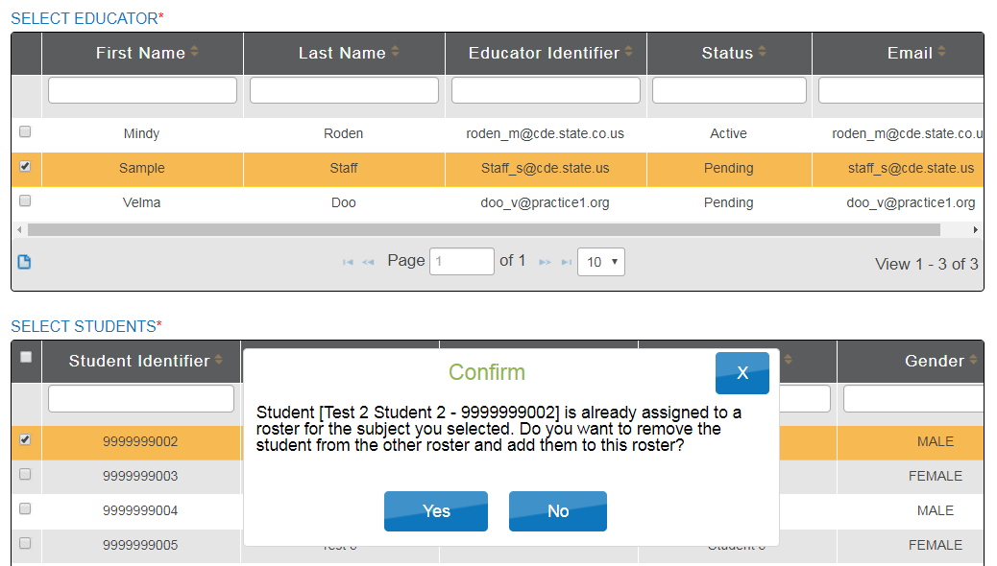

Slide 31
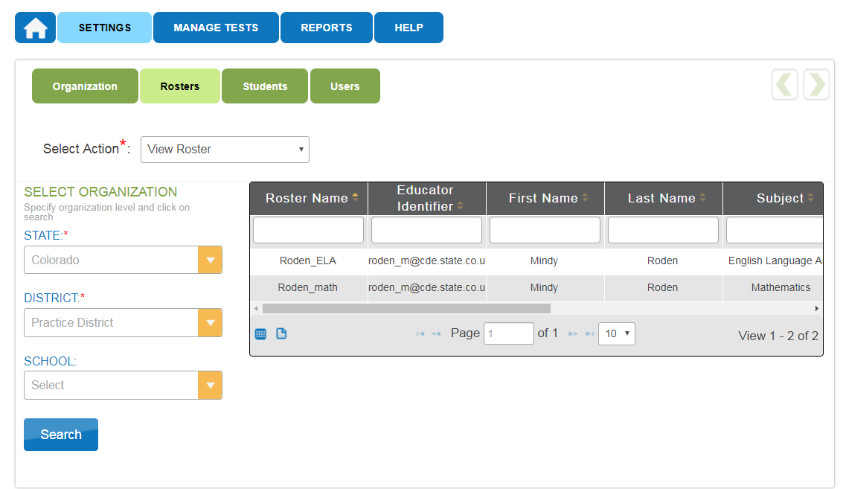

Slide 32
In-district student transfers

Slide 33
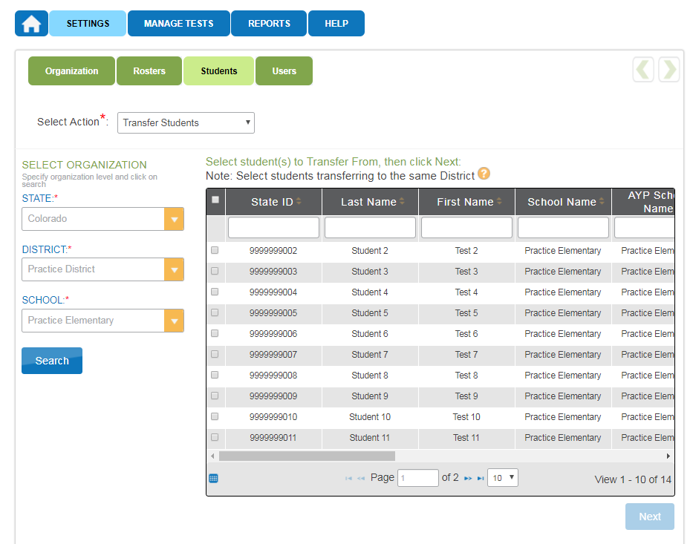

Slide 34
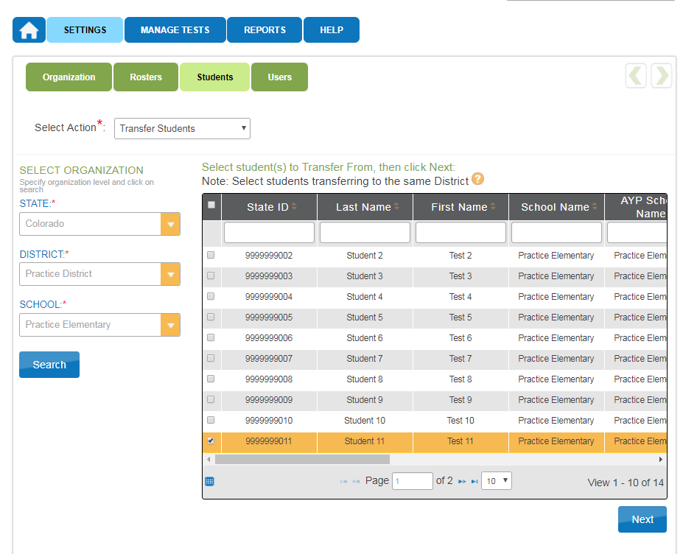

Slide 35
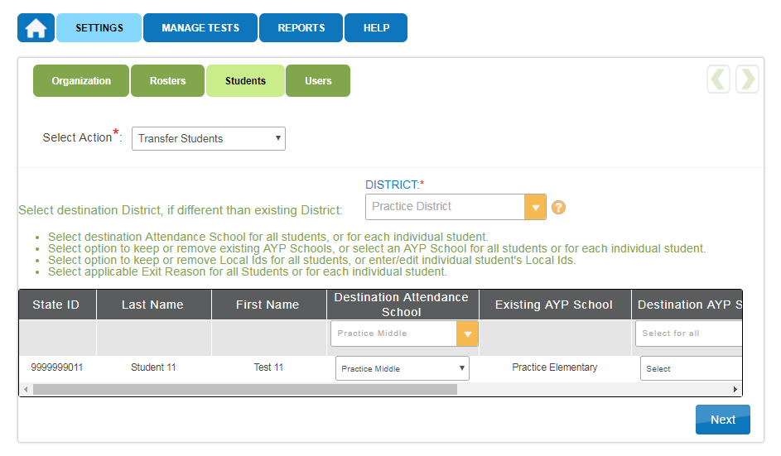

Slide 36
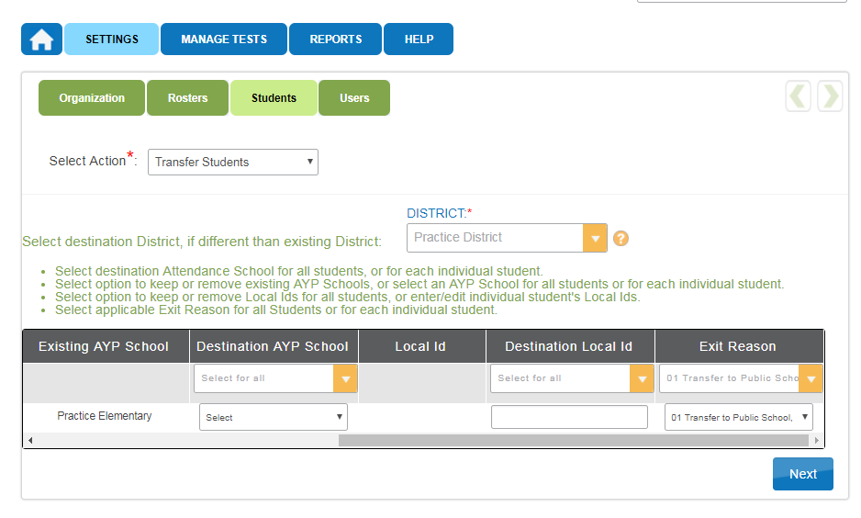

Slide 37
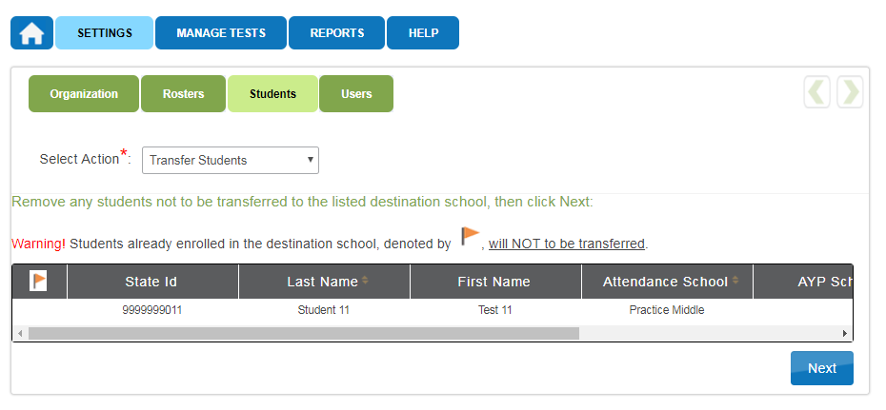

Slide 38
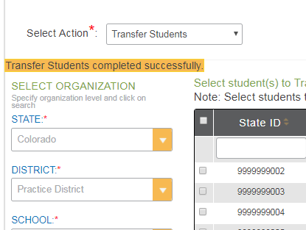

Slide 39
Out of district transfers
Contact Mindy or Jasmine
If the student is not rostered, CDE will move the student
If the student is rostered, CDE needs confirmation from the sending district
DAC from receiving district should reach out to sending district
Email confirmation from sending DAC is needed

Slide 40
Teacher Activities

Slide 41
Teacher Activities
Complete PNP/First Contact Survey for each student
Create testing schedule
Download TIP and gather materials
Download student login and passwords
Test students
Securely destroy TIP, logins, and passwords

Slide 42
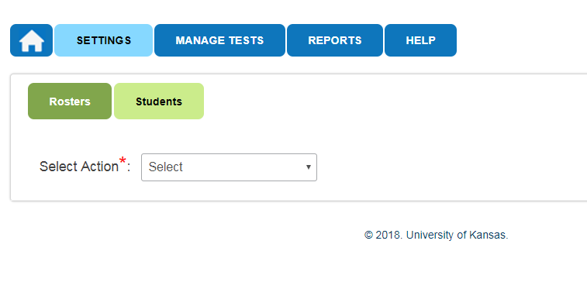

Slide 43
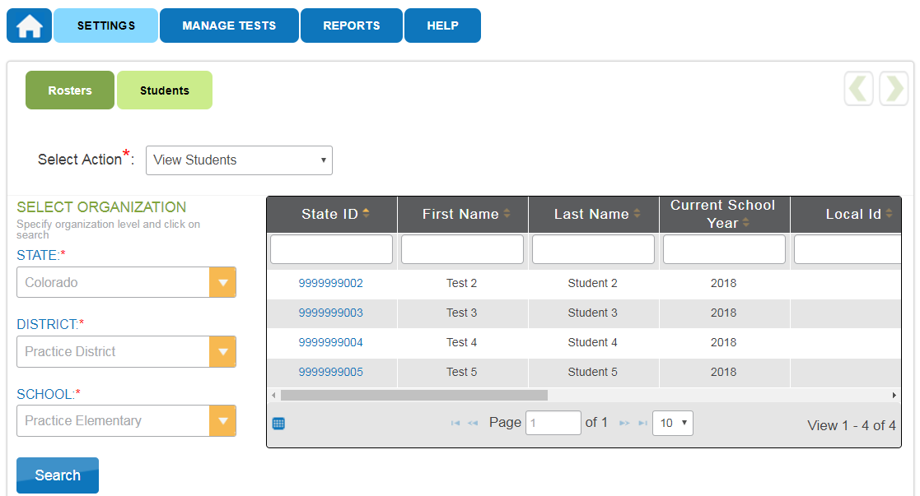

Slide 44
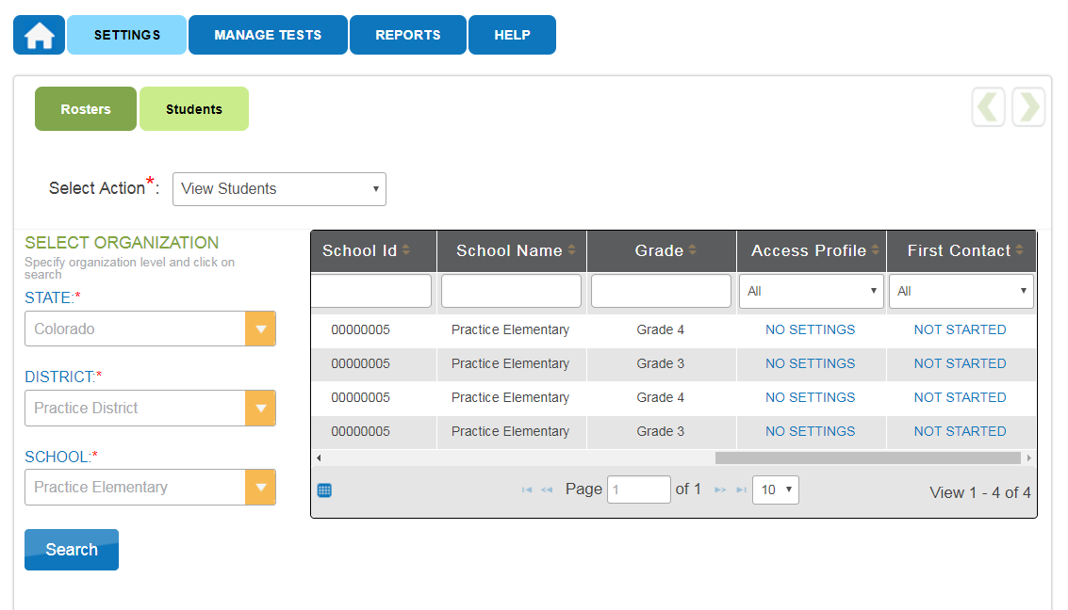

Slide 45
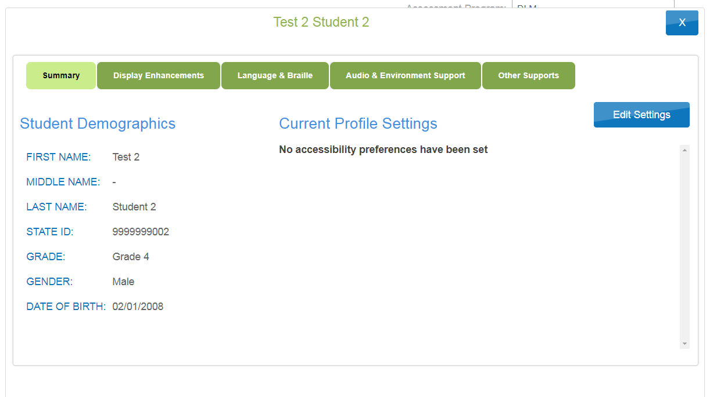

Slide 46
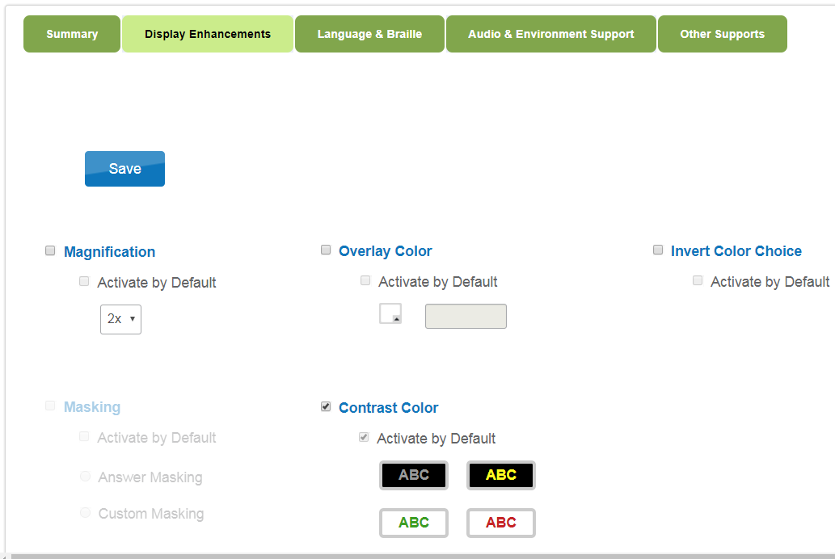
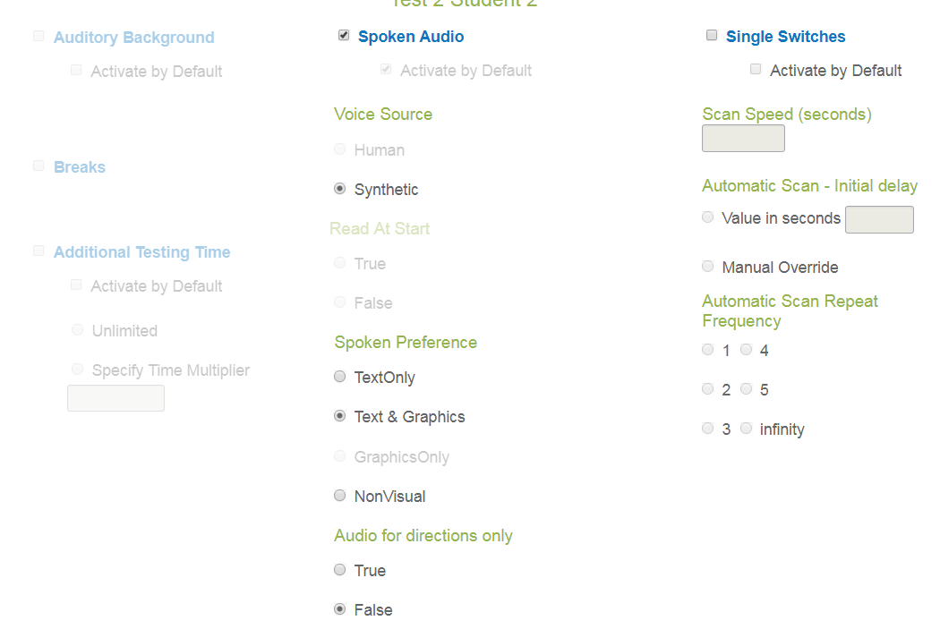

Slide 47
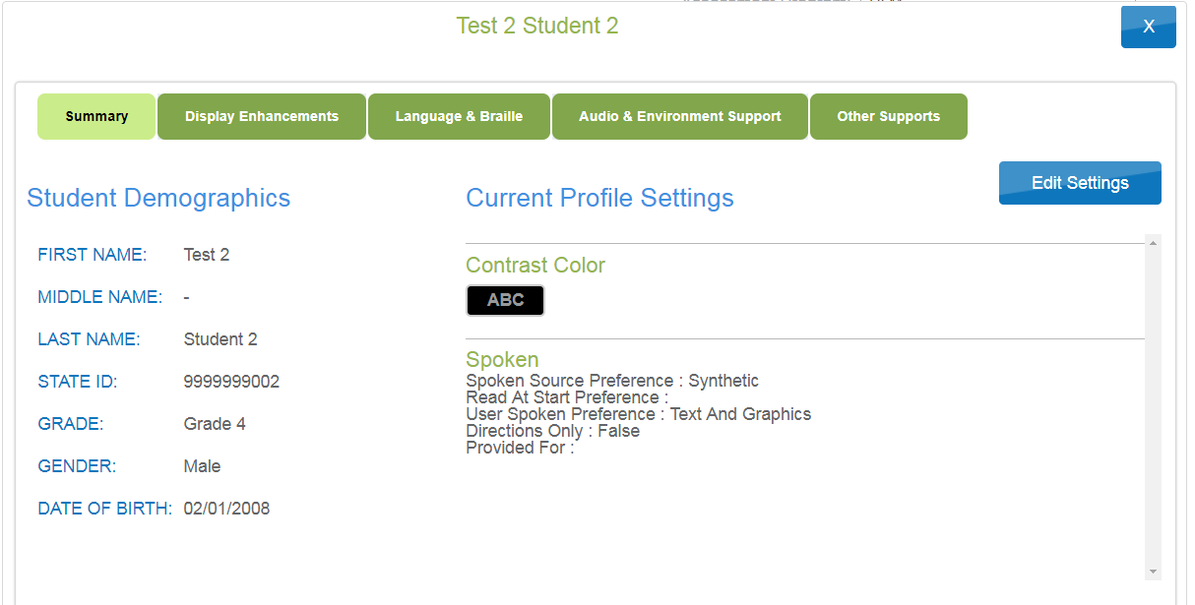

Slide 48
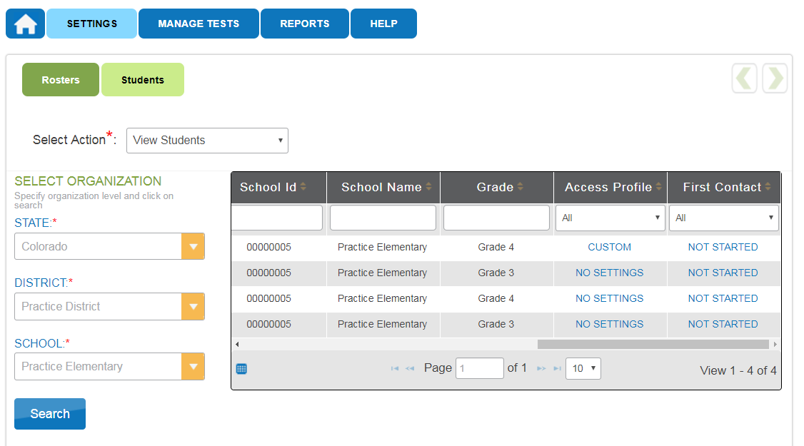

Slide 49
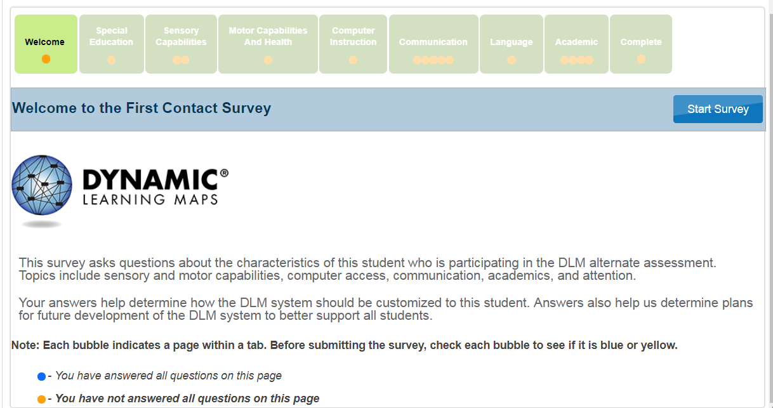

Slide 50
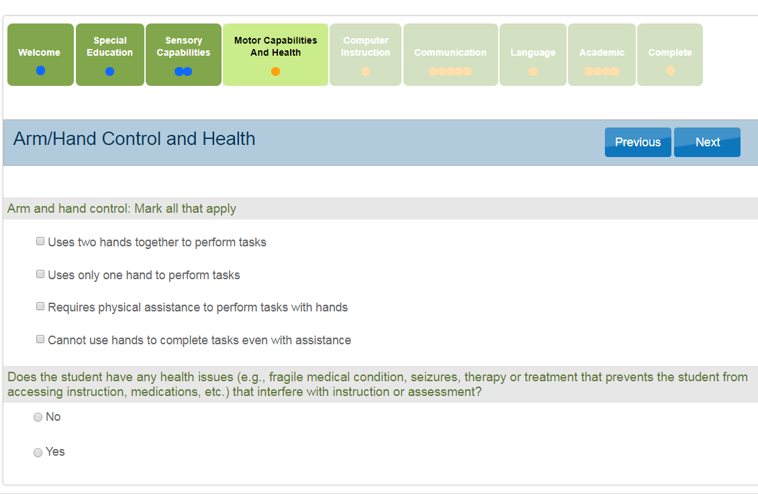

Slide 51
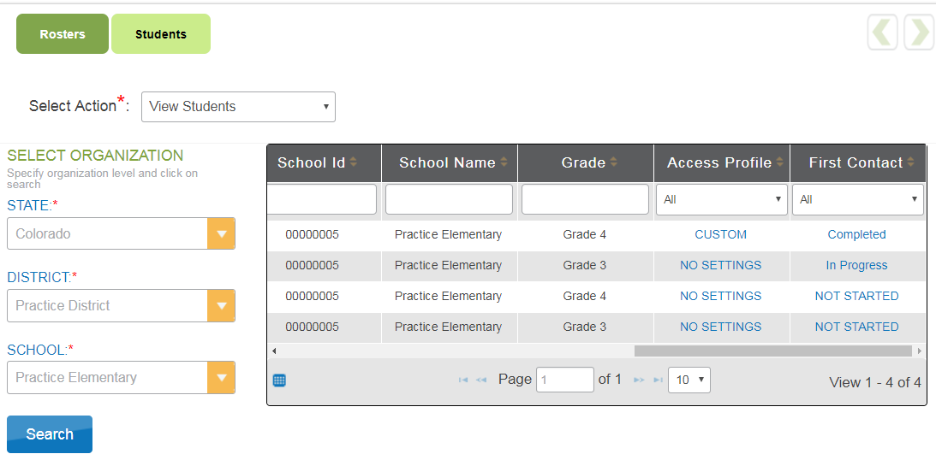

Slide 52
Accessing Tests

Slide 53
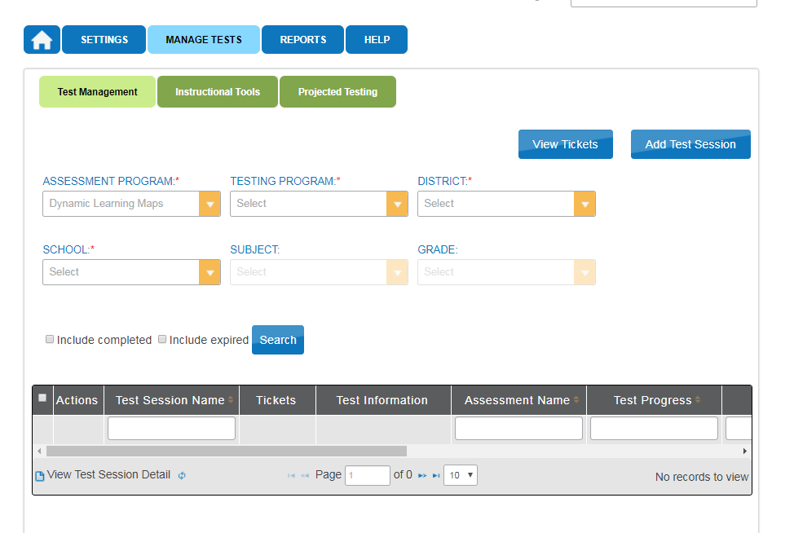
Login
TIP

Slide 54
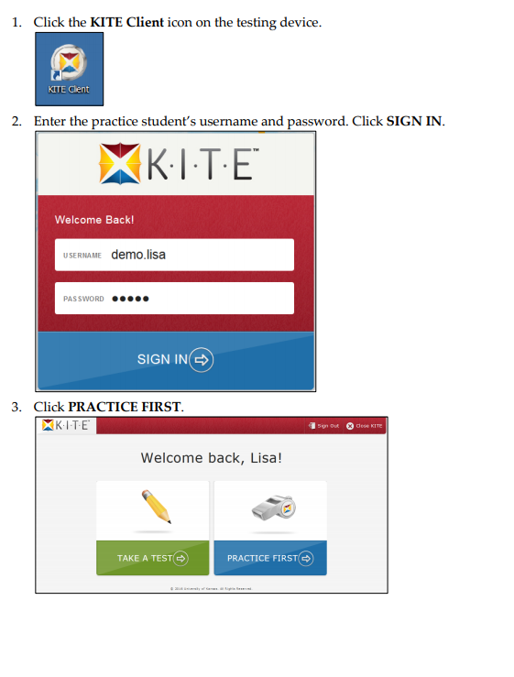

Slide 55
Wrap Up

Slide 56
Remember!
Data management happens in Educator Portal
Student testing happens in KITE
Only for ELA and Math (grades 3-11)
KITE system scores the testlets
There are no materials to be returned
Everything is securely destroyed locally
CoAlt Science and Social Studies is a paper test registered through Pearson Access Next
Paper materials are returned to Pearson
Scores are manually entered into PAnext

Slide 57
Questions?
Assessment Questions
Mindy Roden (EP, Moodle, testing)
Roden_m@cde.state.co.us
303.866.6709
Jasmine Carey (EP, data)
Carey_j@cde.state.co.us
303.866.6634
Instruction Questions
Gina Hererra
Hererra_g@cde.state.co.us
303.866.6605

