Slide 1
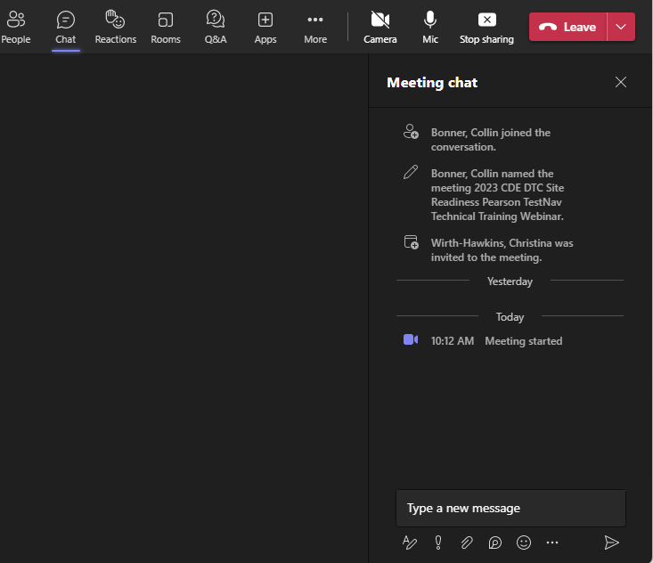
2023-2024
CMAS TestNav Technical Site Readiness Training
Welcome!
Introduce Yourself
From the top of the navigation select the Chat icon
In the Type a new message section tell us your district role and how long you have held your position
Select the paper airplane icon in the bottom right corner of the window to send
Use the Q &A to ask questions specific to the webinar.
Note: Select the three dots (…) and click “Turn on live captions” to access closed captioning
Select the Chat icon
Use the Q &A to ask questions specific to the webinar.
Tell us your district role and how long you have held your position.
Send your message
A recording of this meeting will be available at http://www.cde.state.co.us/assessment/newassess-dtc after December 20
Notes:
Michael Reynolds from Pearson’s Field engineering will join us on the call today to address Questions in the Q & A section
A recording of this meeting will be available at http://www.cde.state.co.us/assessment/newassess-dtc after December 20

Slide 2
CMAS TestNav Technical Site Readiness Training
Existing TestNav Configurations
December 15, 2023
Notes:
RECORD!
Michael Reynolds from Pearson’s Field engineering will join us on the call today to address Questions in the Q & A section

Slide 3
Topics
Test Nav System Overview
Network Preparation
Proctor Caching Maintenance
Device Preparation
Infrastructure Trial
Support During Testing

Slide 4
Test Nav System Overview
Network Preparation
Proctor Caching
Device Preparation
Infrastructure Trial
Support During Testing

Slide 5
Test Nav System Overview
Online Resources
Components
TestNav
Proctor Caching
PearsonAccess^{next}
Student Responses
Best Practices and Recommendations

Slide 6
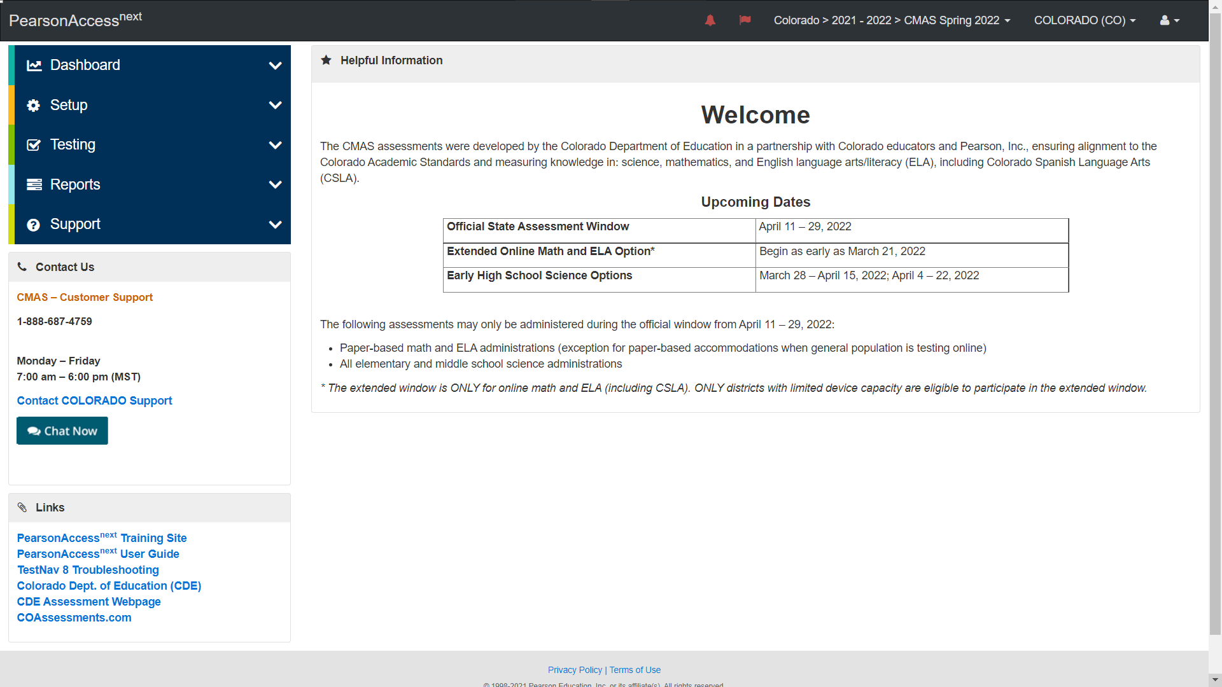
CMAS Online Resources

Slide 7
TestNav Evolution
T E S T N A V in 2014
Downloaded entire test form on initial student authentication.
Saved Student Response Files (SRF) in bundles, saved locally, then sent to Pearson Servers.
Proctor caching allowed offline testing.
TestNav Today
Downloads test items individually as the student navigates through the test.
SRF file are saved directly to Pearson Servers first. SRFs will be saved locally in the event of a network interruption.
SRFs are written to Pearson each time a student navigates to the next question and every 2 minutes during constructive responses.
A network interruption will stop a student from testing until connectivity to Pearson servers is re-established.

Slide 8
TestNav Components
Component | Current Software Version | Installation
Proctor Caching | v2022.1 | Uninstall and reinstall newest version
TestNav Server side software | v8.21 | No Install required apps are automatically updated
Desktop App | V1.12.5 | The new app can be pushed out to Mac OS or Windows OS devices. Uninstall and reinstall newest version
iPad App | v1.12.5 | Auto updates are supported
Chromebook App | v1.12.6 | Auto updates are supported
Notes:
Note: Testing for TestNav Server side software v8.12 is currently in process
Note: Testing for TestNav Server side software automatically updates
TN apps from App stores will automatically update.

Slide 9
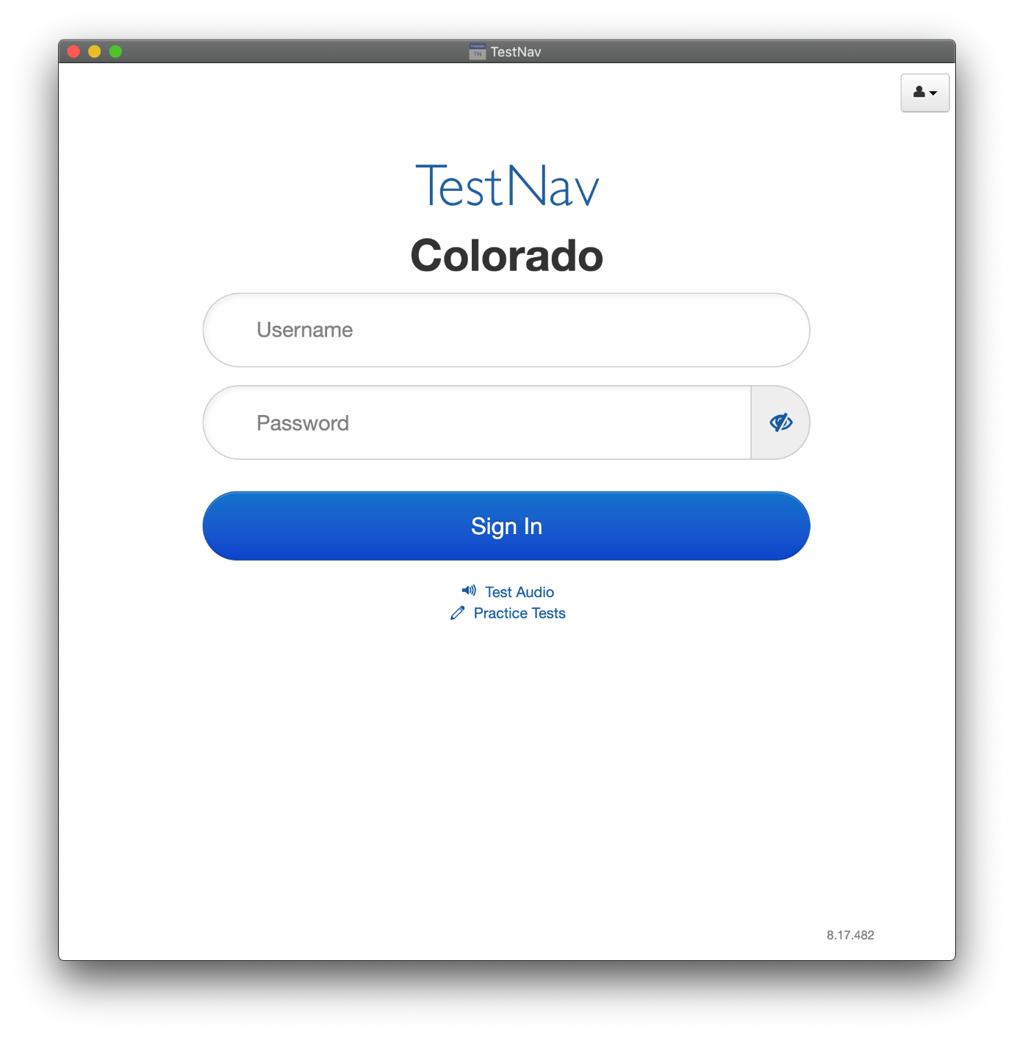
Finding the Current Server Version of TestNav
Notes:
Bottom right-hand corner of the screen

Slide 10
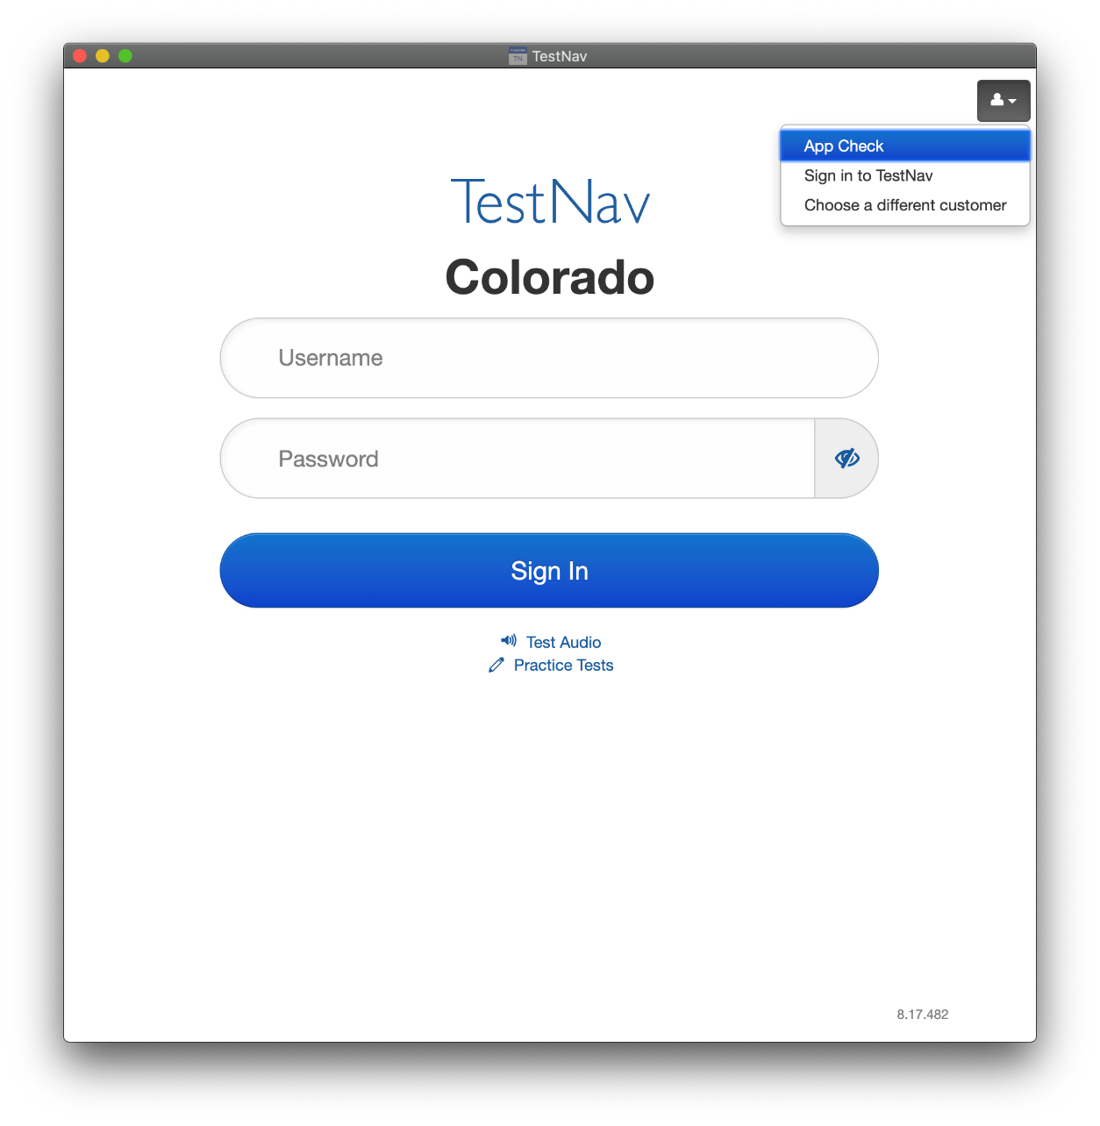
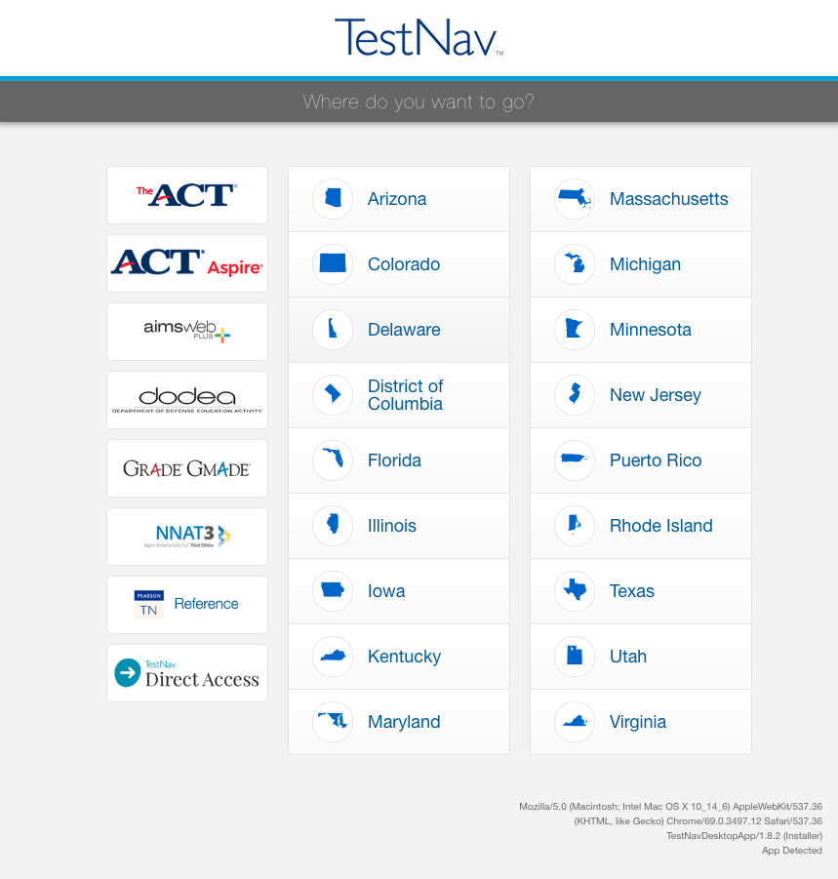
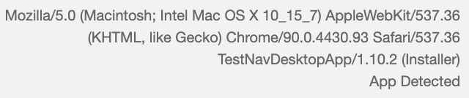
Finding the Current App Version of TestNav
Notes:
Bottom right-hand corner of the screen

Slide 11
TestNav 8.xx Install Options
Installable app available for
  ChromeOS Kiosk Mode (via Admin Console)
  iOS
  Linux Ubuntu
  Mac OS X
  Windows 10/11 .msi installer
  Windows 10/11 Microsoft Store
Does not depend on other software, such as a browser or Java.
Access your test by starting the TestNav app and choosing your test.
Notes:
Using TN on the windows store will mean Microsoft will manage updates.

Slide 12

Proctor Caching
Proctor Caching is Pearson-supplied software that is used in conjunction with TestNav to reduce bandwidth requirements.
Allows you to pre-cache test content to your local network before a test.
Reduces the burden on your ISP by eliminating redundancy in requests for test content.
Stores an encrypted local copy of all pre-cached tests.
Automatic ProctorCache Override if ProctorCache machine connection is unsuccessful.
CanStock Photo
Notes:
What is Proctor Caching?
Proctor Caching is Pearson-supplied software that is used in conjunction with TestNav to reduce bandwidth requirements and accelerate the delivery of test content.
It allows you to pre-cache test content to your local network before testing.
It reduces the burden on your Internet service provider (ISP) by eliminating redundant requests for test content.
Cached content is encrypted and stored locally.

Slide 13
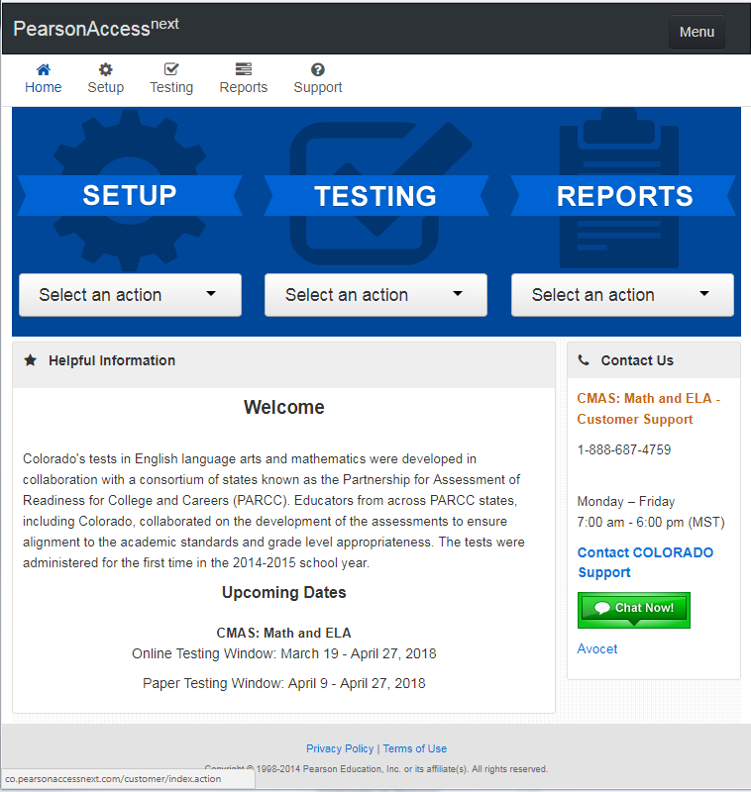
PearsonAccess^{next}
Create TestNav configurations and save file locations.
Create test sessions.

Slide 14
Device Preparation
Any software that would allow secure test content on student computers to be viewed on another computer must be turned off.
Any applications that may automatically launch on a computer are configured not to launch during testing sessions.
Turn off notifications for software that cannot be disabled.
Allow local file access to home directory <home dir>/Pearson/ and any alternative SRF save locations.
Use App Check to verify Device and Network Connectivity.

Slide 15
SRF and Log File Save Locations
TestNav saves SRF and log files in different locations depending on the operating system and platform.
Saved Response File (SRF) - a file in which TestNav saves a student response if an error stops a response from saving to the Pearson server. The SRF preserves these responses and sends them to the server when connectivity is re-established.
Log File - a file that contains current TestNav output and any error messages that TestNav displays during a test session. This information helps Pearson Support diagnose issues, if they occur.

Slide 16
Student Responses – SRF Files
Student response files write to Pearson on every student navigation.
Both the Primary and Alternate files are written to at the same time. If files cannot be written to Pearson.
Uploading of response data is continuous. If an upload fails, TestNav save the SRF to the primary save location (student device) and the secondary save location if configured.
If the response data upload is successful, TestNav will create a new empty SRF file and begin the process again. TestNav will only delete an SRF file once it is successfully uploaded.
Notes:
Illustrate the benefits of supplying a secondary response location.
Note that SRF and log files can be retrieved if necessary. Full instructions can be found on the support site.
SRF sent directly to Pearson every 2 minutes in constructed response

Slide 17
Best Practices and Recommendations
  Use Proctor Caching for Science as well as Text to Speech forms due to the larger file sizes for these assessments.
  Use Student Device as Primary SRF save location.
  Use the CMAS PearsonAccess^{next} Training center to run Site Readiness test forms to verify testing devices, proctor cache devices, and network configurations.
  Open the TestNav app before live testing so it can be allowed to update if necessary.

Slide 18
Network Preparation
Test Nav System Overview
Proctor Caching
Device Preparation
Infrastructure Trial
Support During Testing

Slide 19
Network Preparation
TestNav Test Delivery URLs and Ports
Proxy Servers
Firewalls
Content Filtering
Anti-Virus
Wireless Network Best Practices

Slide 20
TestNav Test Delivery URLs and Ports
Test Delivery URLs and Ports
  *.testnav.com:80
  *.testnav.com:443
  *.pearsontestcontent.com:80
  *.pearsontestcontent.com:443
  *.chime.aws
    TCP:443
    UDP:3478
Certificate Authority URLs
  *.thawte.com
  *.usertrust.com
  *.comodoca.com
  google-analytics.com (optional)
  Allow traffic on ports 4480 and 4481 to flow freely on the network. Proctor Caching uses these ports.
https://support.assessment.pearson.com/x/AxZgAQ

Slide 21
Proxy Servers
Exempt 127.0.0.1 from all proxy services.
Proxy servers can cause delays in TestNav traffic that can sometimes cause communication timeouts.
Some web-based content filters can act as a proxy. As a result, Pearson support recommends that you add TestNav URLs to proxy bypass lists, when possible.

Slide 22
Firewalls
Exempt TestNav URLs from firewall inspection.
Firewall services that can interrupt TestNav traffic:
  Gateway antivirus inspection
  deep packet inspection
  reverse DNS checks
  gateway SSL decryption/inspection
Notes:
Known to Cause Issues

Slide 23
Content Filtering
Allowlist TestNav URLs within any applicable services.
Security/content filter services can interrupt TestNav traffic.
Services known to cause TestNav interruptions:
  reverse-DNS checks
  SSL decryption/inspection
  deep packet inspection
  HTTP inspection
  blocking audio/multimedia files
  blocking archival files
Notes:
Ssl inspection common cause with network errors

Slide 24
Anti-Virus
Exempt TestNav URLs and file directories from antivirus scanning or inspecting.
Install paths vary by platform and installation method. Windows and Mac devices have an additional path where they store minor updates:
  Windows: {user_home}\AppData\Local\Pearson
  Mac: {user_home}/Library/Application Support/Pearson
Some antivirus software uses real-time protection to scan network traffic and file downloads, which may cause issues in test data transfers during secure online testing.

Slide 25
Proctor Caching
Test Nav System Overview
Network Preparation
Device Preparation
Infrastructure Trial
Support During Testing

Slide 26
Proctor Caching
History
Testing Conﬁguration Performance
Colorado User Testing Experience with Proctor Caching
CMAS Science and Text-to-Speech Assessment Size
Pre-Installation Planning
Install & Device Requirements
Configure TestNav in PearsonAccess^{next}
Proctor Caching Monitoring
Tinylink: https://support.assessment.pearson.com/x/HAACAQ

Slide 27
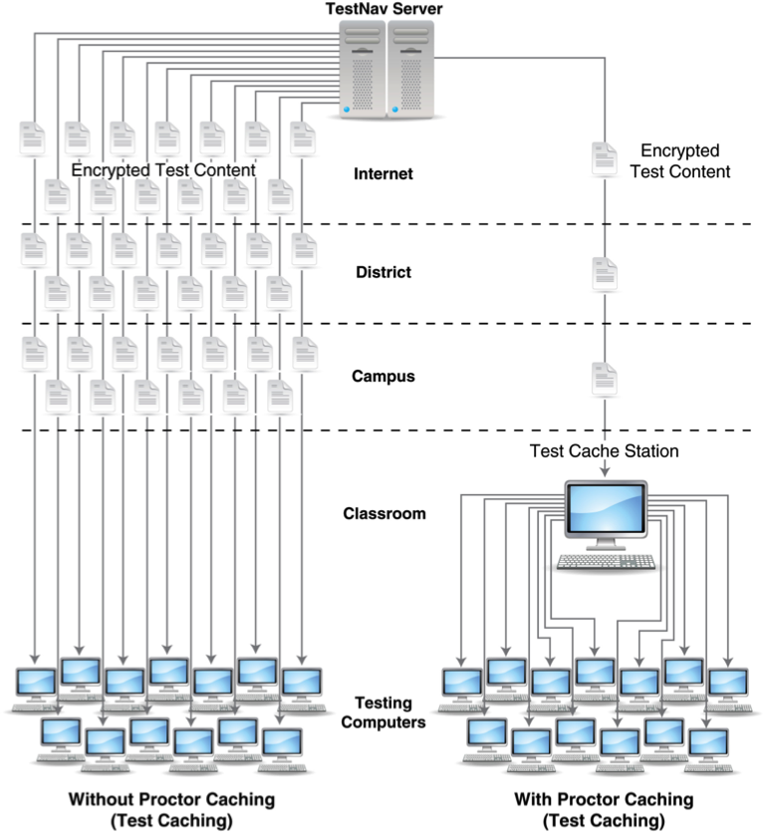
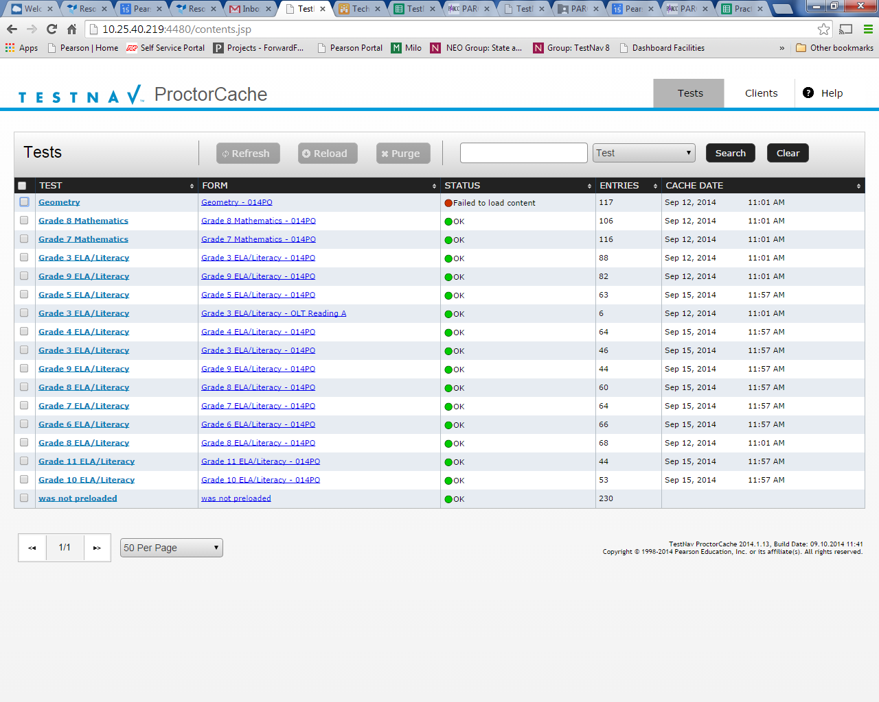
Proctor Caching History
ProctorCache was originally developed in 2001 to support testing environments with:
Very low network and or internet bandwidth.
Tests with large media files like Colorado Science simulations and Text to Speech forms.
Early TestNav versions that attempted to download the entire test at sign in.
Notes:
100s of Kilobites

Slide 28
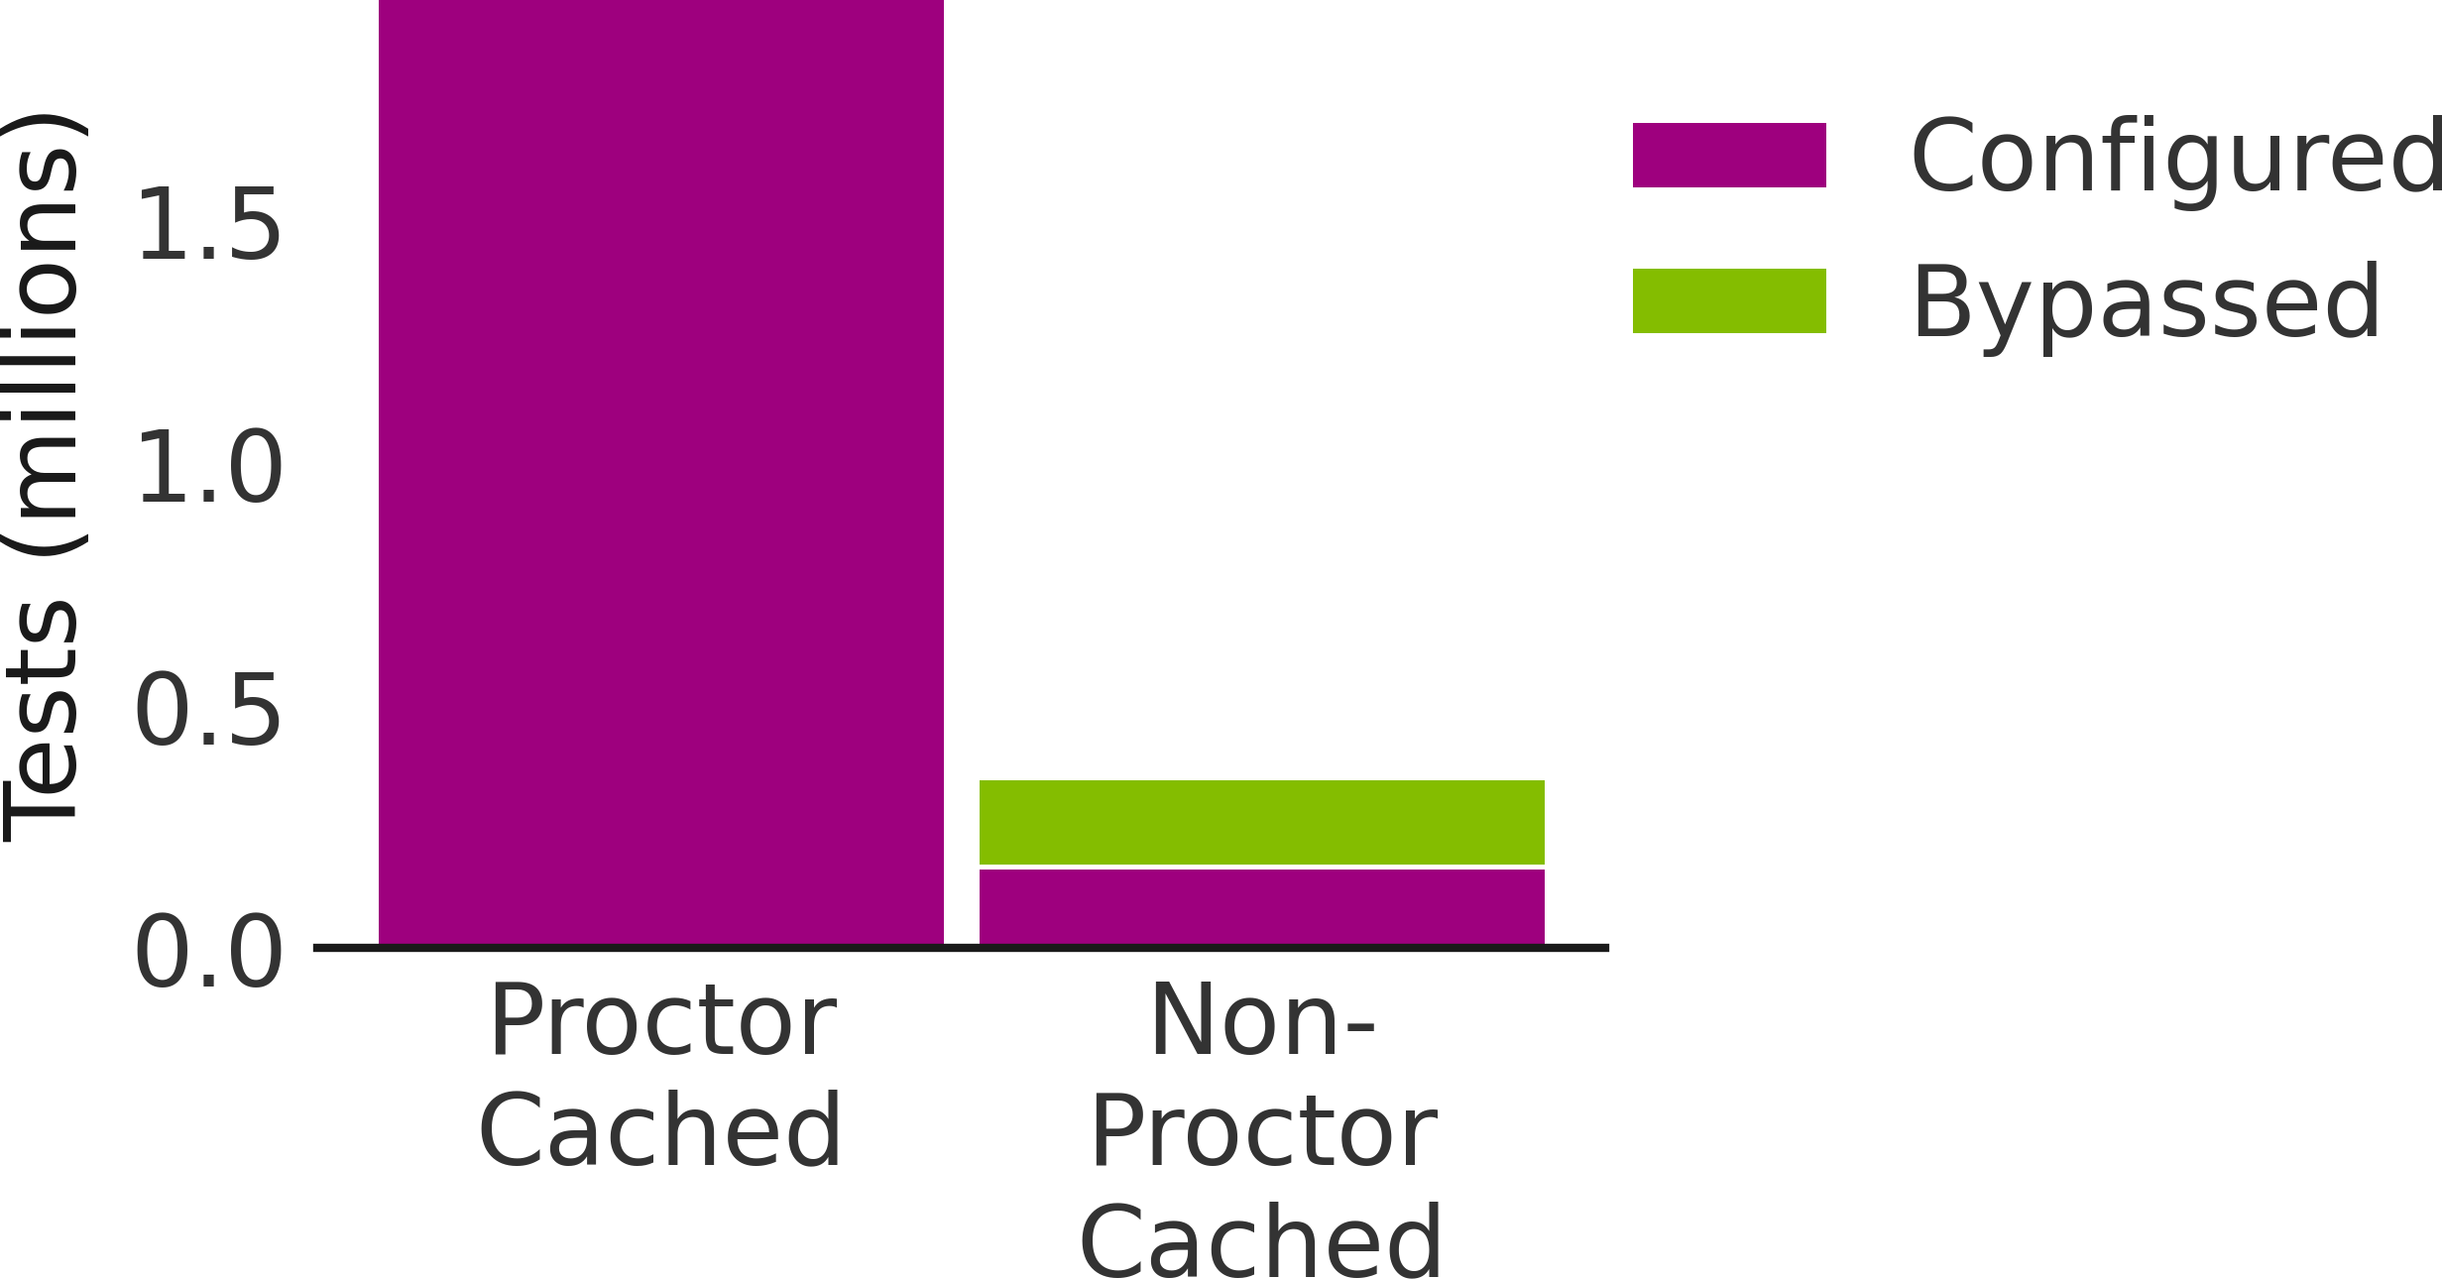
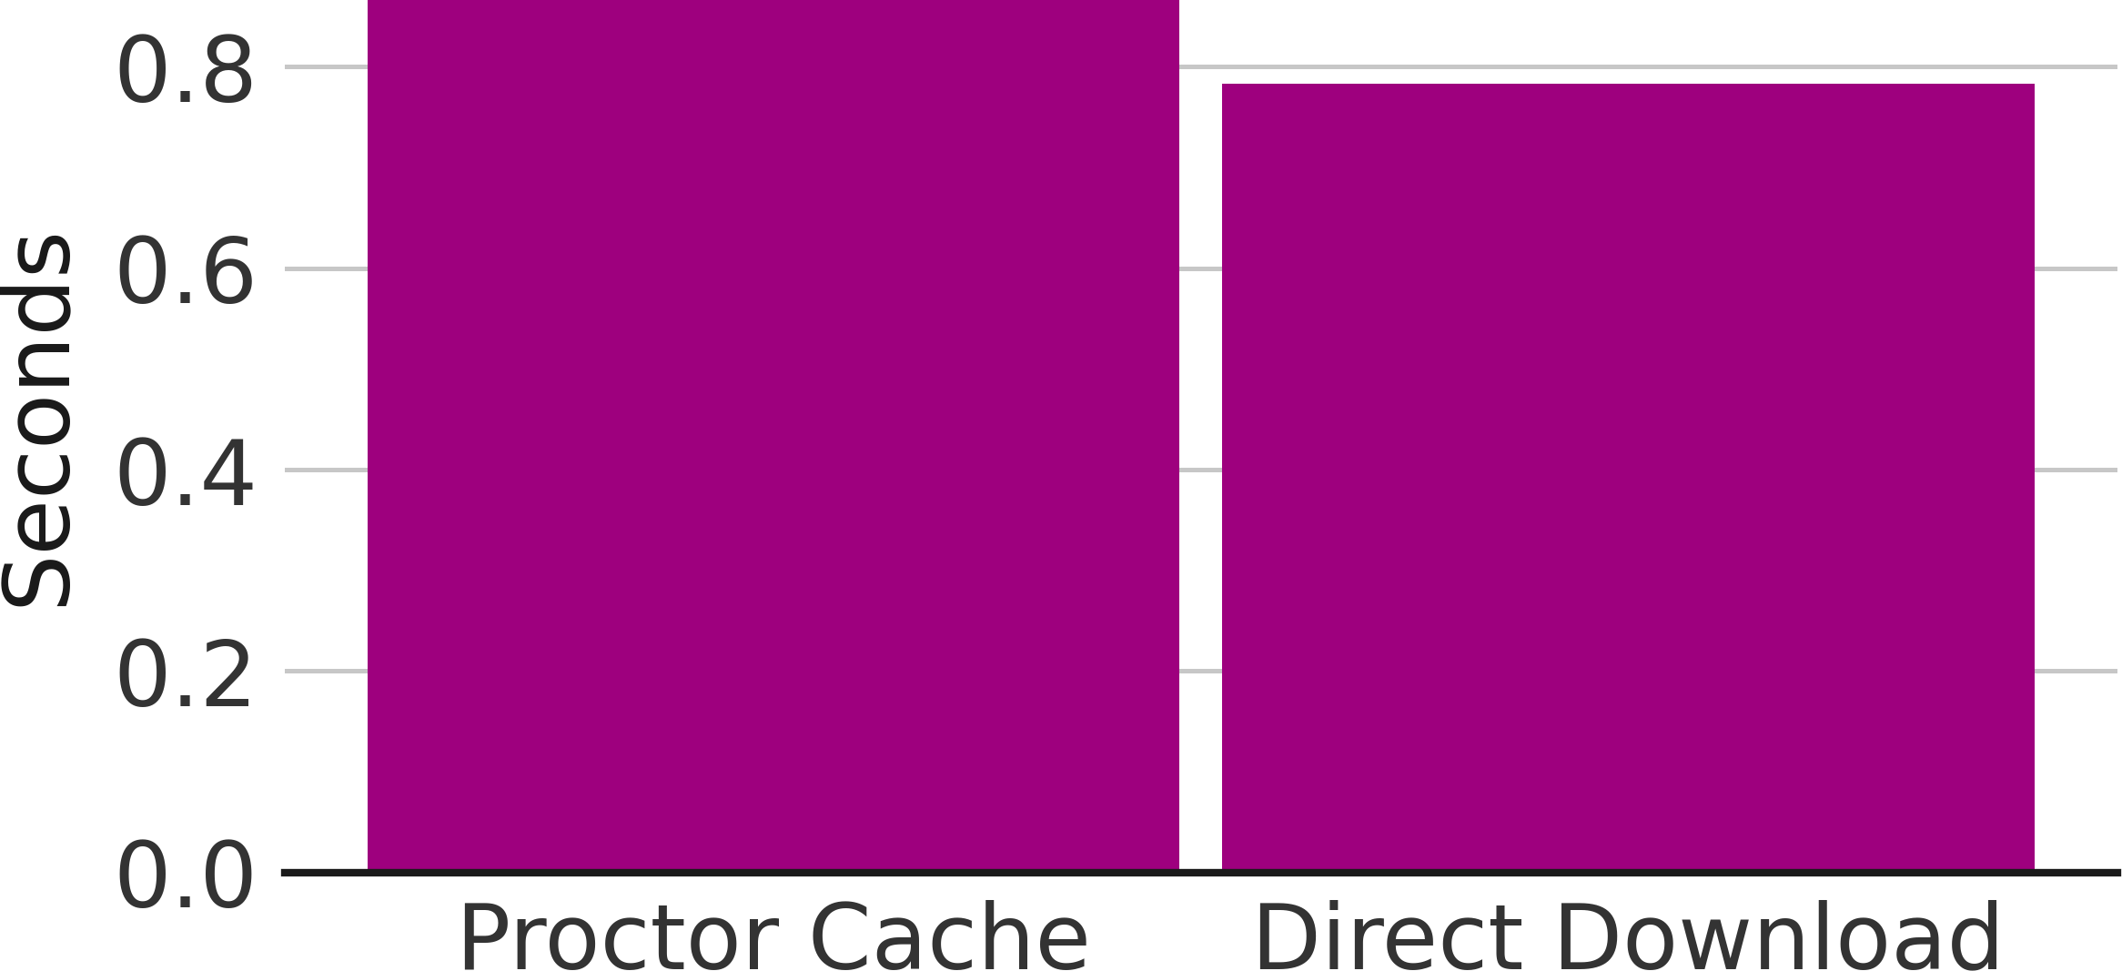
Testing Conﬁguration Performance
ProctorCache Usage
85% of Colorado testers utilized Proctor Caching. However, more than 182,000 testers were unable to connect to the local cache at login due to misconﬁguration, typically leading to
delays of 20–30s prior to starting the test. The enabled cache override option allowed these students to bypass the cache and test without further interruption.
Median Item Load Time
For those who used Proctor Caching, the median test item load time was 0.87 seconds. For those who did not use Proctor Caching the median test item load time was 0.78 seconds.

Slide 29
Colorado User Testing Experience with Proctor Caching
Pearson conducted a data study to find any difference between test delivered using Proctor caching and test that do not.
Students experienced a shorter average load time without proctor caching.
Where Proctor caching was configured and bypassed, 8% of those instances resulted in significant waits of 20-30 seconds.
Use of proctor cache bypass increases average load times.
Test that used proctor caching experienced errors over three times as often as those with no caching configured.
If you would like to see the Proctor caching data from your district, email me to request your district data.
CMAS Science | Cache Bypassed Test Count | Cache Used Tests Count | No Cache Configured Test Count | Cache Bypassed Error Rate | Cache Used Error Rate | No Cache Configured Error Rate
ALL DISTRICTS | 36562 | 339303 | 26894 | 4.49% | 2.87% | 1.78%

Slide 30
Proctor Caching Considerations
Districts with increased network and or internet capacity may conduct an infrastructure trial to determine if the capacity exists to test without caching.
District may explore having either schools or grade levels administer an assessment without content cached.
Contact CDE and Pearson if you would like to explore administering assessments with out proctor caching.
Consider the number of concurrent testers during the test window as well as other network activity that occurs during the assessment.

Slide 31
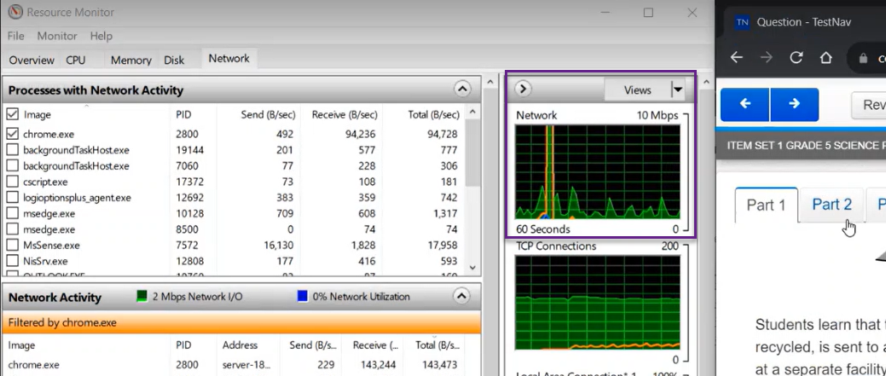
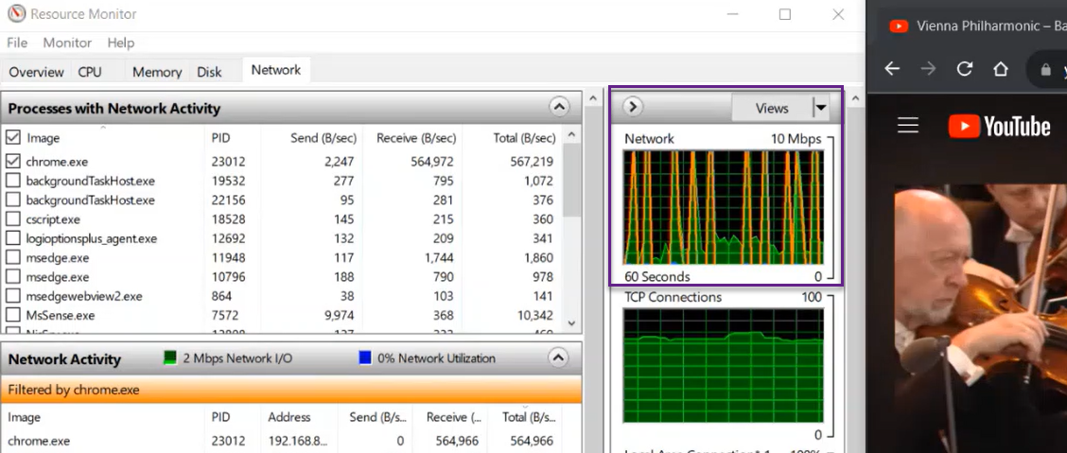
CMAS Science and Text-to-Speech Assessment Size
CMAS Grade 5 Science Practice Assessment with Text-to-Speech
Typical YouTube Video
Notes:
Take away
CMAS Science and Text-to-Speech network activity mostly occupies Kbps with one initial spike of 10Mbps
while YouTube network activity regularly exceeds 10 Mbps.
Consider concurrent testers and other network activity during testing

Slide 32
Proctor Caching Requirements
Must have Fixed internal IP address.
Open traffic on TCP Ports include: 80 & 443 (Internet), 4480, and 4481 (Local Network).
Does not require an underlying server-based operating system.
For setting up an upstream proxy, refer to the Windows Upstream Proxy Configuration.
https://support.assessment.pearson.com/x/HAACAQ
Notes:
Proctor Caching runs solely on Windows.
It does not require an underlying server-based operating system. It can run on desktop class hardware and a desktop class operating system, which gives districts flexibility on what machines they use for Proctor Caching.
Proctor Caching uses TCP Port 80 for communication between the Proctor Caching machine and the Pearson servers, and ports 4480 and 4481 for communication between testing workstations and the Proctor Caching machine.
Because testing workstations must know a predictable network location for the Proctor Caching machine, Proctor Caching requires a fixed internal IP address. Those districts that require Internet traffic to pass through an upstream proxy server will have to configure Proctor Caching to point to their proxy server. For details on setting up an upstream proxy, refer to the Windows or Mac “Tips on Proctor Caching” section in the TestNav 8 Proctor Caching User Guide.

Slide 33
Proctor Caching Operating System Requirements
Windows
v2022.1
Processor
x86/x32 and x64
Minimum
2 GHz
Memory
Recommended: 4 GB RAM
Minimum: 2 GB RAM
MacOS
Pearson is no longer developing Proctor Caching software for MacOS.
For the legacy version of ProctorCache for macOS visit:
https://coassessments.com/technology-setup/

Slide 34
Pre-Installation Planning
Proctor caching computers must run on the same network as the students’ testing computers.
If you need to update ProctorCache to a more recent version, uninstall the previous version. Then, reboot the computer and install the more recent version. You can uninstall ProctorCache using the software removal process for your operating system.
Must have full local administrator permissions on the PC device & working knowledge of your network.
Network connection 100 Mbps full-duplex or higher recommended. Minimum network connection is 10/100.
Network is set to use IPv4 DNS (Domain Name System) servers.
Notes:
ProctorCache does not require special hardware or server equipment.
You should not install ProctorCache on a computer you intend to use for student testing.
A typical installation takes approximately 10 minutes per proctor caching computer.

Slide 35
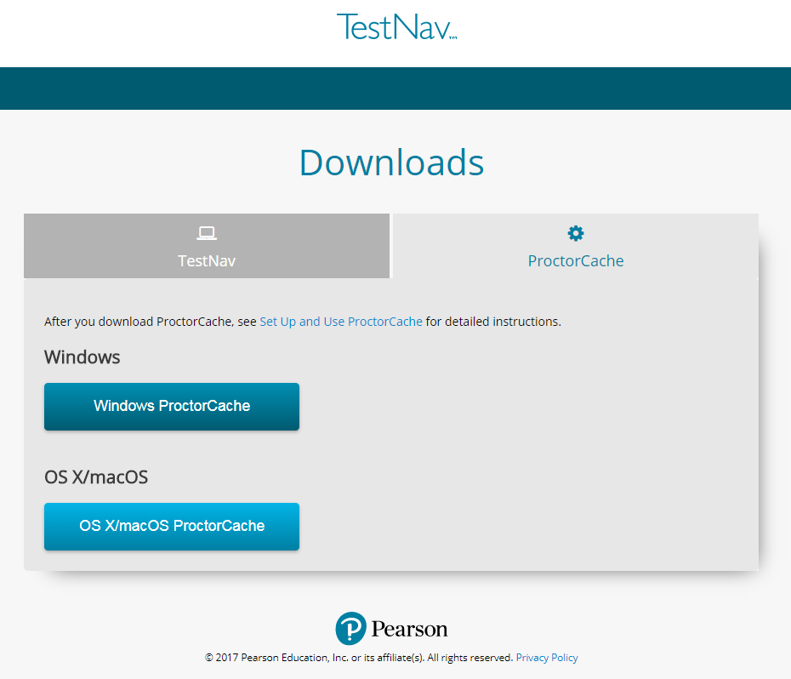
Install & Device Requirements
Download Proctor Caching installer from http://download.testnav.com/
Run the installer and Start Proctor Caching if not already started by the installer.
Visit the ProctorCache administration page to verify that the ProctorCache service has started.
Use the Configuration Identifier and AppCheck from a client computer to verify that Proctor Caching is functional.

Slide 36
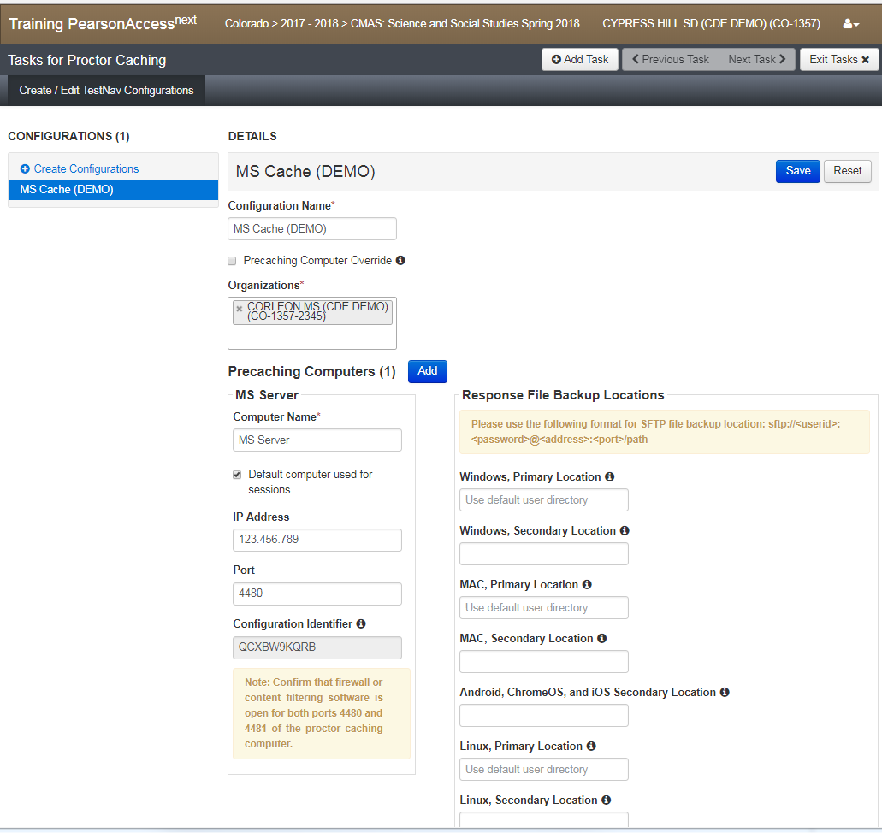
PearsonAccessnext TestNav Configurations
TestNav requires at least one working save location.
TestNav by default saves student response data to:
<home dir>/Pearson/student/srf
Create a TestNav Config in PearsonAccess^{next} to specify custom Primary and Alternate file locations
    Best Practice: Primary Response File Location should be on the student workstation. Designated in TestNav config in PearsonAccess^{next}. Students must have full access to designated Response File Locations.
Notes:
When a student responds to a test question, TestNav saves the response in a saved response file (SRF) and sends these responses to the Pearson server. After the responses successfully save to the Pearson server, TestNav deletes the SRF.
Before testing, refer to your PA next user guide to configure TestNav and complete the following steps.
Configure primary and a secondary save location through PA next .
Configure student accounts to have complete read, write, and delete access in these save locations.
Communicate SRF and log file locations to test proctors.

Slide 37
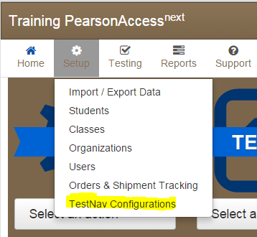
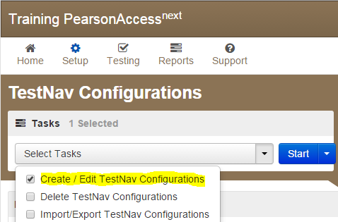
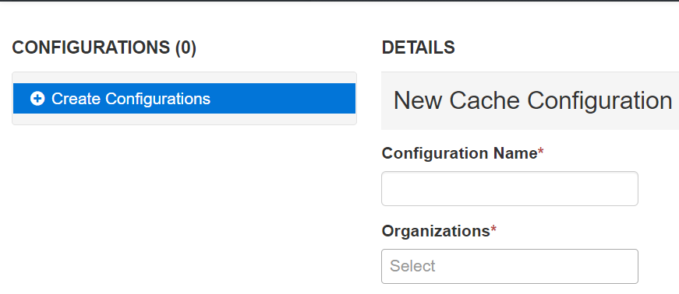
Configure TestNav Setup
Sign in to the CMAS PearsonAccessnext website at
  https://trng-co.pearsonaccessnext.com/customer/index.action
  Select Setup > TestNav Configurations.
Select /Edit Configurations; Select Start to launch Create the configuration.
Enter a Configuration Name.
Using the Organizations drop-down menu, select your school or district.
Notes:
Next you will need to create a TestNav configuration. Sign in to the CMAS PearsonAccess^{next} website. Technology staff will need to receive secure access from their district coordinator.
The Configuration screen can be accessed by selecting Setup and then TestNav Configurations from the drop-down menu. This will allow you to access the configurations settings to set primary and secondary temporary student response save locations for TestNav, and if applicable, set up a connection to your Proctor Caching machine(s).
Select Create/Edit Configurations from the tasks menu to launch the Configuration screen.

Slide 38
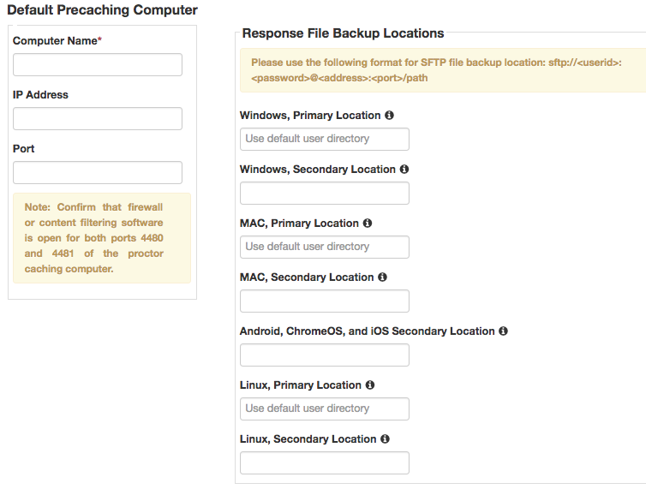
Configure TestNav Setup
Computer Name will be the name that displays when selecting a Caching machine during test session creation.
Internal Network IP address of the caching machine
Port Number which unless modified is 4480
Then specify student response file backup locations.
Select Create.
Verify the connection to the Precaching Computer by opening a new browser window and navigating to http://<ip-address>:<port>
TIP: If you will not be Precaching, simply leave the IP Address and Port fields blank
Notes:
Next, you can identify the Proctor Caching computer. In the “Default Precaching Computer” section, enter a computer name, the computer’s IP address, and port information.
The computer name will be the name that displays when selecting a Caching machine during test session creation. If you will be Proctor Caching, provide the internal network IP address of the caching machine and the port number, which unless modified is 4480 for Pearson-supplied Proctor Caching. The IP address should be a static address to ensure students can access content during testing. Also note, the computer selected for Proctor Caching should not be a student testing machine.
If you will not be Precaching, simply leave the IP Address and Port fields blank; you will still need to complete the next steps for TestNav.
For Response File Backup Locations, it is recommended that a Secondary Location be specified for Windows and Macintosh computers. The Secondary Location must be writeable by students and can be a network share on school network or a shared location on the local computer.

Slide 39
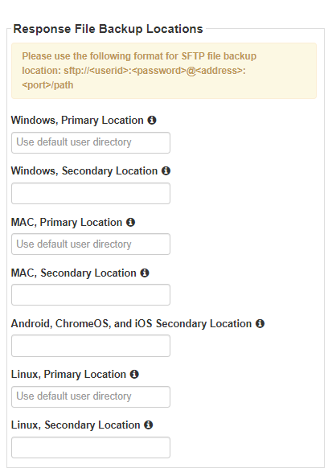
Configuration of Secondary SRF Backup Locations
If you set a network file server as secondary backup location, do not use:
Spaces in the save location path.
A location that requires authentication. If authentication is required, TestNav cannot access the shared location.
A Windows UNC (Uniform Naming Convention) or network path, such as \\ComputerName\SharedFolder\Resource on a Mac or Linux. Pearson recommends that you specify a mapped drive location, such as D:\TopDirectory\NextDirectory\SaveLocation.
If using an SFTP server ensure:
The device is turned on, and SFTP services are running.
The syntax inside of PearsonAccessNext is correct. (e.g. sftp://<userid>:<password>@<address>:<port>/path).
That neither the userid or password contain the @ symbol. This will invalidate the syntax and result in an EWS 1018 error message.
TIP: Proper Response File Backup Location configuration avoids 1018 errors.
Notes:
Not required
Artifact of older version of TN with larger SRF files
Not reccomend

Slide 40
Proctor Caching Maintenance
Import and Export TestNav Configurations
  Check Configuration Name
  Check Computer Name- displays when selecting a Caching machine during test session creation.
  Check IP Addresses and Ports
  Check student response file backup locations
TestNav Configuration- Cache vs No Cache Configuration
  On Campus with Caching or Off Campus without caching
  Caching for Science and ELA/Math Text to Speech while not caching Standard ELA / Math
  What will test session creators see?

Slide 41
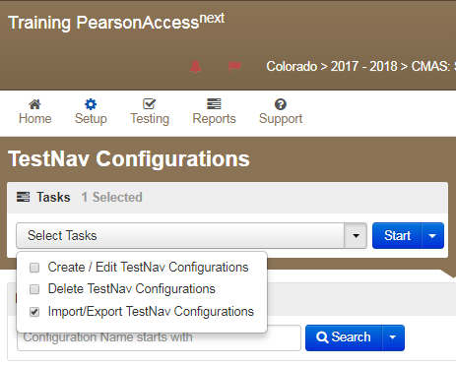
Import and Export TestNav Configurations
Notes:
Date when Configurations can be added will go here once available.

Slide 42
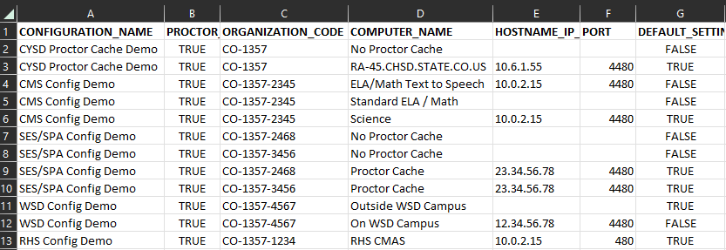
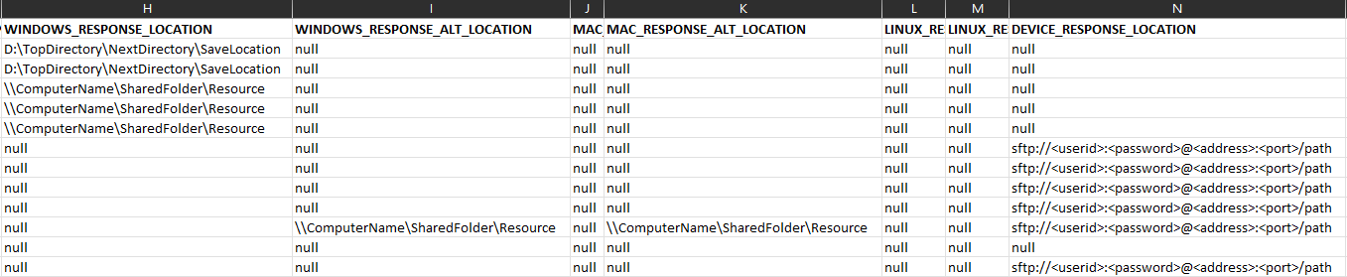
Import and Export TestNav Configurations
  Check Configuration Name
  Check Computer Name- displays when selecting a Caching machine during test session creation.
  Check IP Addresses and Ports
  Check student response file backup locations
Notes:
Columns
A Config Name- only you will see
B PC bypass, artifact from when there was a toggle, now it is standard
C Org code
D Computer name- Test session creators can see this name
E IP Address
F Port
RESPONSE_LOCATION is primary while RESPONSE_ALT_LOCATION is a secondary SRF save location.
Double check IP addresses, ports, and response locations UNC vs Mapped drives.

Slide 43
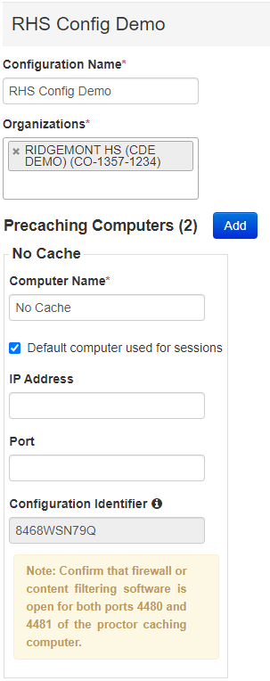
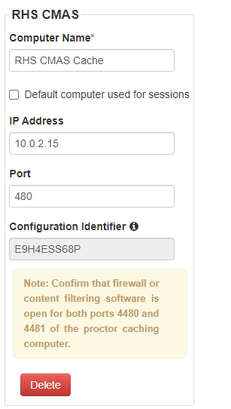
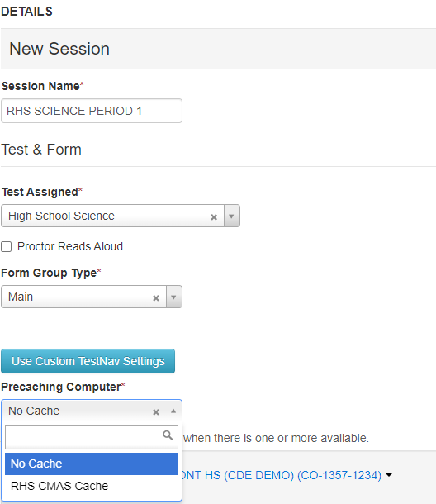
Cache vs No Cache Configuration
Test Nav Configurations
Test Session Creation
Notes:
To configure a No Cache option simply leave the IP Address and Port fields blank.
You can still assign Save Locations IP Address and Port fields blank
Select the “default computer used for sessions” to match your strategy.
In the example the no cache is default while PC is available if bandwidth issues arise by having test administrators select a caching computer by editing the testing sessions.
Be sure caching devices are set up and preloaded with caching content.

Slide 44
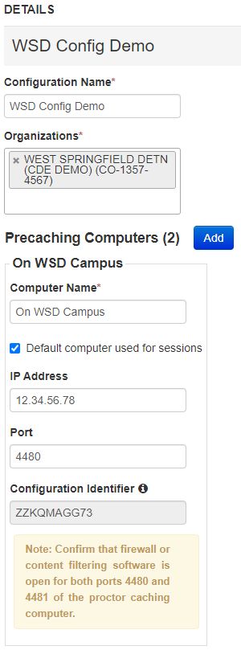
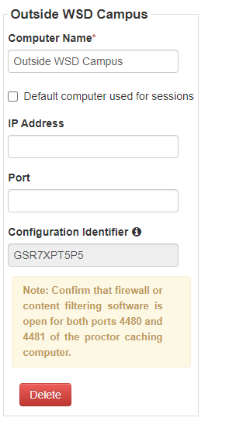
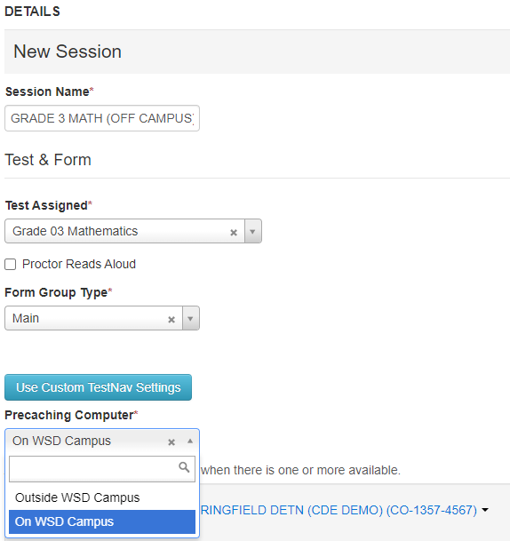
On Campus with Caching or Off Campus without Caching
Test Nav Configurations
Test Session Creation
Notes:
Here is an example of a situation where testing may occur in within a school network or in an off-campus environment using the “no cache” method.
The responsibility falls to the test session creator to choose the correct Precaching computer option.
Work closely with your DAC if implementing this type of solution.

Slide 45
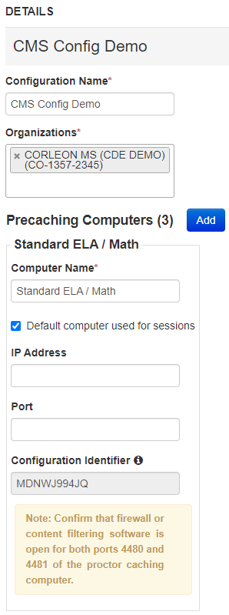
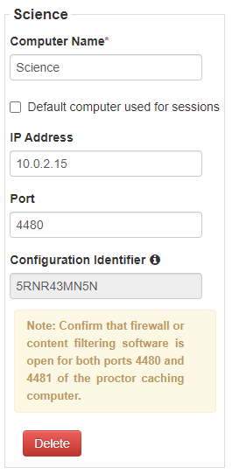
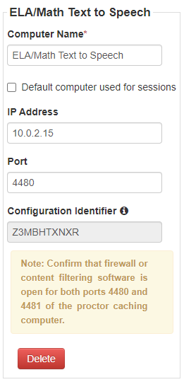
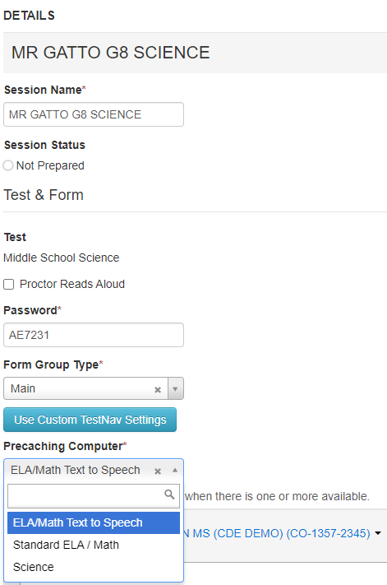
Caching for Science and ELA/Math Text to Speech while not caching Standard ELA / Math
Test Nav Configurations
Test Session Creation
Notes:
Here we have an example of a middle school where the sessions containing Science and ELA/Math TTS will connect to a proctor cache device. Standard ELA/Math use a “no cache” configuration.
The responsibility falls to the test session creator to choose the correct Precaching computer option.
Work closely with your DAC if implementing this type of solution.

Slide 46
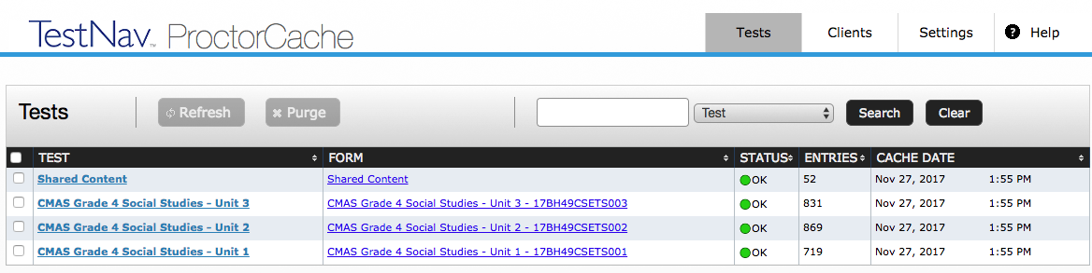
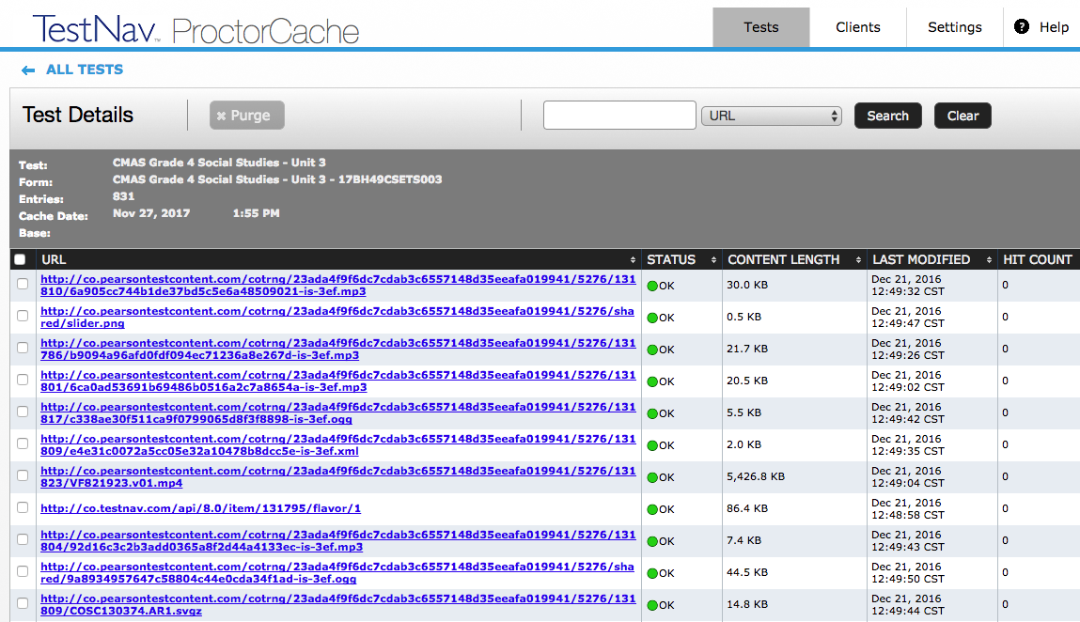
Tests Tab
http://<ip-address>:<port>
Content is displayed at the Test and Form level.
Functionality is available to Refresh or Purge selected test content.
Selecting a test name will display the Test Details screen which displays individual items in a test.
Notes:
On the Tests tab content is displayed at the Test and Form level.
Functionality is available to refresh, reload, or purge selected test content if necessary, and requires a password. The password is available in the Proctor Caching User Guide to protect against unauthorized deletion of cached content.
Selecting on a test name will display the Test Details screen which displays individual items in a test.

Slide 47



Tests Tab – Status
Ok – Content is successfully cached.
Not Loaded – Content is not cached.
Waiting… - Loading Content.
Loading… - Loading Content.
Failed to load content – There was a failure to load content.
MD5 Check Invalid – MD5 comparison Failed.
MD5 Mismatch – MD5 comparison was completed but files did not match.
In general, any status in red is a critical problem. Any content with a red status should be checked and Reloaded. If the problem is not resolved contact Pearson Support.
Notes:
The Tests tab provides status indicators for each item of cached test content.
An OK status means the content has successfully cached.
The yellow status indicators appear when the content is in the process of being cached.
Not Loaded means the content is not cached.
Waiting… means the content is in the queue, waiting to be loaded,
and Loading… means the content is currently loading.
Red status indicators indicate problems with cached content.
Failed to load content means there was a failure to download content .
Proctor Caching also performs an MD5 check once an item has been cached to compare the test content on the Pearson servers with the cached item. The MD5 check should show that the items are identical.
MD5 Check Invalid means the MD5 comparison could not be completed successfully.
MD5 Mismatch means the MD5 comparison was completed but the files did not match.
In general, any status in red is a critical problem. Any content with a red status should be checked and reloaded.
If the problem is not resolved, contact Pearson Support for technical assistance.

Slide 48
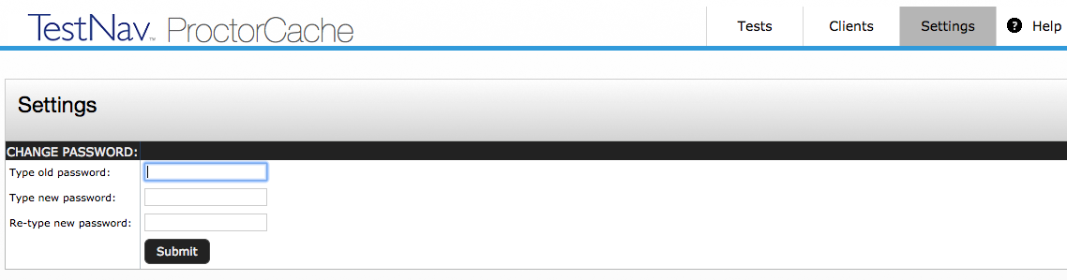
ProctorCache Password
ProctorCache requires a password to refresh, reload, or purge content. You can use the default password, or you can change the default password at any time these instructions.
  Connect to ProctorCache on your local host - http://localhost:4480.
    *If you access ProctorCache from a remote computer using an IP address (for example,http://10.25.99.142:4480), you cannot view the Settings tab, which contains the option to change the default password.
  Select the Settings tab.
  Enter the old password, and then enter the new password twice in the required fields.
  Select Submit.
Notes:
What does the new Proctor Caching software offer?
The user interface has been redesigned to include the following enhancements:
renaming the Contents tab to Tests and the Client List tab to Clients for clarity,
simplifying use by consolidating information previously displayed on the Home page into the Clients and Tests tabs,
resolving issues with Internet Explorer 11 not displaying the list of cached content,
Enabling a more robust comparison between content on the caching computer and content on the Pearson server, to verify the cache has the most up-to-date content, and
renaming the “undefined” directory to “Was not Preloaded” to eliminate confusion.
CMAS recommends that all schools upgrade to the latest version to take advantage of these enhancements.

Slide 49
Additional Technical Notes
Java runtime is included with Windows install.
Java runtime plugin is required for PearsonAccess^{next} pre-caching functionality.
If you must direct the ProctorCache machine to an upstream proxy server to access the Internet, the ProctorCache service can be configured to use the proxy server.
Notes:
Note that Java runtime is included with Windows install and Java runtime plugin is required for PearsonAccess^{next} pre-caching functionality.
For additional help, refer to the Proctor Caching User Guide. The guide provides details for planning, installing, and monitoring, as well as “Tips on Proctor Caching.” The “Tips” section provides guidance on changing computer settings and how to edit the configuration file to point to an upstream proxy computer if needed.

Slide 50
Device Preparation
Test Nav System Overview
Network Preparation
Proctor Caching
Infrastructure Trial
Support During Testing

Slide 51
Device Preparation
Device Preparation
Hardware Requirements
TestNav App Installers
Virtual Environments
Chrome Highlights
Windows Highlights
macOS Highlights
TestNav Desktop Mass Install
iOS Highlights
Point TestNav App Toward TestNav URL
TestNav App Check

Slide 52
Device Preparation
Any software that would allow secure test content on student computers to be viewed on another computer must be turned off.
Any applications that may automatically launch on a computer are configured not to launch during testing sessions.
Turn off notifications for software that cannot be disabled.
Allow local file access to home directory <home dir>/Pearson/ and any alternative SRF save locations.
Use App Check to verify Device and Network Connectivity.

Slide 53
Virtual Environments
There are many different types of virtualization technologies in use in school environments, many of which have broadly different implications on both test security as well as the potential for performance impacts to a student experience.
The DTC must ensure virtualization solutions for online testing can both:
  ensure appropriate test security during the assessment.
  as well as provide a comparable student experience in order to prevent performance issues from impacting student performance on the assessments.
Pearson does not provide support for these technologies.

Slide 54
Hardware Requirements
Processor | x64 - AMD, ARM, ARM64, or Intel-based
Memory | 4 GB RAM; Minimum - 2 GB RAM Linux and iOS - 2 GB RAM; Minimum - 1 GB RAM
Screen Size | 9.5-in
Resolution | 1024 x 768
Other | External keyboard and mouse (or touchpad) for touchscreen devices Android, Windows (required) iOS (recommended) Local File access to home directory OS X, macOS Windows Wired keyboards (recommended) Convertible Chromebooks - no tablet mode
*Devices with ARM-based processors running Windows must be running Windows 11 to install TestNav.
Notes:
*Devices with ARM-based processors running Windows must be running Windows 11 to install TestNav.

Slide 55
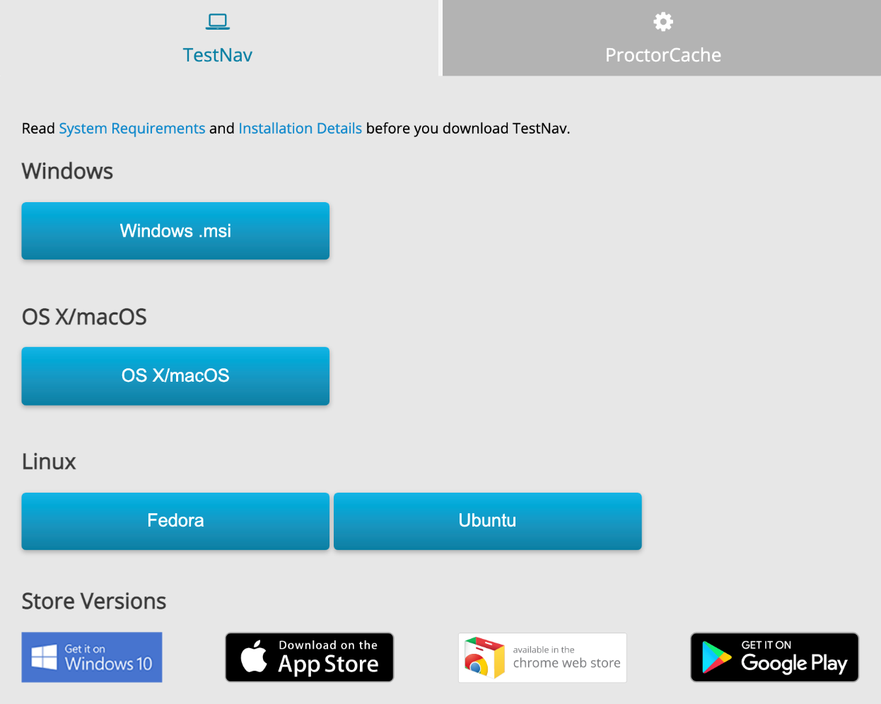
TestNav App Installers
msi (Microsoft installer) file - contains explicit instructions about installing and removing an application.
Microsoft Store Installer – allows for quick install that updates automatically.
The Desktop Installation
Generally only takes a few minutes on an individual computer; network installations will vary depending on your environment.
TestNav Desktop Update
TestNav program file updates are saved in {user_home}\AppData\Local\Pearson. You must give students write access to the update directory.
http://download.testnav.com
Notes:
If your school is downloading the TestNav 8 app, it is accessible at http://download.testnav.com.
If you are using a device that requires an application installation, or if you are planning to use the TestNav Desktop application for laptops and desktops, you can download the app or apps that you will need from this site, or you can go to the applicable device store for Chromebooks, iPads, and Android devices. We will talk more about these device types shortly.
For now, if you are installing TestNav Desktop, there are options for Mac, Windows, and Linux.
There are two options for Microsoft Window: .msi and .exe.
The .msi file is optimized for network installation as a group and pushing out to multiple computers.
The .exe file is for downloading onto individual computers.

Slide 56
Chrome Highlights
General
CDE recommends waiting for Pearson to complete testing on newly released Chrome OS
Chromebook must be set to Kiosk mode.
To locate SRF & Log files press <ctrl><shft>z, while hovering over the username or password field, and the File Viewer box will then appear.
User Data Configuration
Ensure each device's settings are set to keep local data to avoid accidentally deleting the SRF and log files.
Note which specific device each student uses during each test. The TestNav app saves SRFs to only one designated place on the testing device. If an error occurs, you can locate files only on that specific device.
Chrome OS Stable Channel (S) 114 S – 118; Long-term support (LTS) 114+ LTS
Default Primary Save Location
Unmanaged Chromebooks purchased after 2017 cannot run in kiosk mode.
Be sure the Do not erase all local user data is selected in the Admin console.
Notes:
Do not block newer or older versions –just not supported

Slide 57
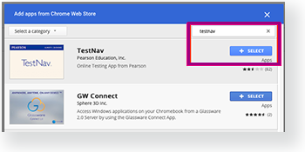
Install TestNav on Managed Chrome Devices
To install TestNav on Chromebooks, enroll Chromebooks in the Admin Console. Then add TestNav as a kiosk app. Ensure each device's settings are set to keep local data to avoid deleting SRF and log files.
Sign in to the Google Admin console for your domain, using your administrator account.
From the Google Admin console home page, go to Devices > Chrome.
Select Apps & extensions.
On the left, select the top-level organization for which you want to configure settings. Then, select a child organization, if necessary.
Select Kiosks.
Select Add and choose Add from Chrome Web Store. Do not add TestNav from Google Play.
Search for TestNav and Select Select.
If prompted, accept the app permissions.
In the panel on the right, set the app and extension policies.
Select Save.

Slide 58
Installable TN on Windows, macOS, & Linux
Install TestNav Desktop.
Start TestNav Desktop.
Preform a TestNav app check to ensure that it installed properly.
Point TestNav App Toward our Colorado TestNav URL.
Set up Proctor Cache on your proctor caching computer(s).
Configure Proctor Cache in PearsonAccess^{next} to Set Up Response File Backups, and set up a Secondary Save Location.
Run an infrastructure trial.
TestNav Setup

Slide 59
Windows Highlights
TestNav App available in the Microsoft App Store
TestNav .msi Installers and Updates
Automatic updates.
Students must have write access to the update directory.
Default Primary Save Location
{USER.HOME}\Pearson\srf\
{USER.HOME}\Pearson\logs\
TestNav installation does not add entries to the Windows registry so you can copy the TestNav application and push it to student computers for mass installation.
Program files for minor updates save in {user_home}\AppData\Local\Pearson.
General
Disable Cortana, XBox Game Bar, and cloud clipboard.
OS: Windows 10 x64 - 20H2, 21H1, 21H2; Windows 11 x64 - 21H2, 22H2
TIP: CMAS Error Codes 5041 errors, TestNav has detected the Game Bar running.

Slide 60
iOS Highlights
Requires TestNav App for security.
Download and install from Apple Apps Store
Run App check
Enable Microphone Permission message. Select OK to grant microphone permission
Point TestNav App Toward our Colorado TestNav URL.
Confirm App Self Lock message, select Yes to continue.
Students select no, cannot continue testing in the secure test.
If Students select no, restart the app and select yes to continue testing.
Locate SRF & Log files using iPad’s Safari Browser: testnav://admin.
iOS 15.2 - 16.x

Slide 61
macOS Highlights
TestNav .dmg Installers
TestNav App Updates
Students must have write access to the update directory.
Default Primary Save Location
{USER_HOME}/Pearson/srf/
{USER_HOME}/Pearson/logs/
TestNav program file updates are saved in {user_home}/Library/Application Support/Pearson
General
macOS 12, 13, 14
For macOS, you must grant TestNav full privacy & accessibility control to administer secure tests. Select System Preferences > Security & Privacy > Privacy. Scroll to Accessibility and add or select TestNav.
Disable Siri and/or Dictation services before attempting to sign into TestNav.
Drag the TestNav icon into the Applications folder.
iPadOS 17 is currently in testing

Slide 62
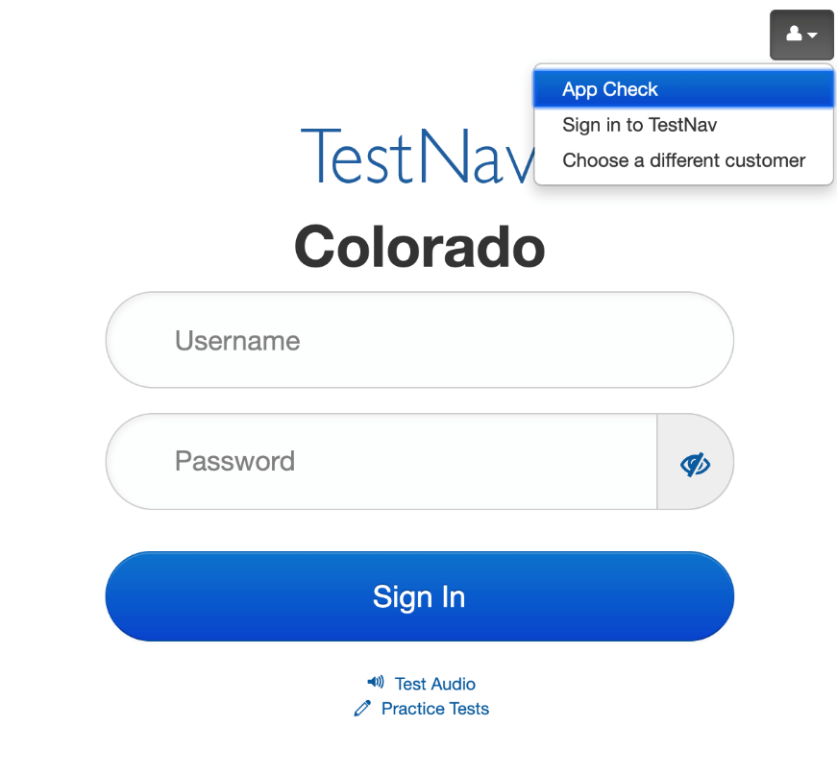
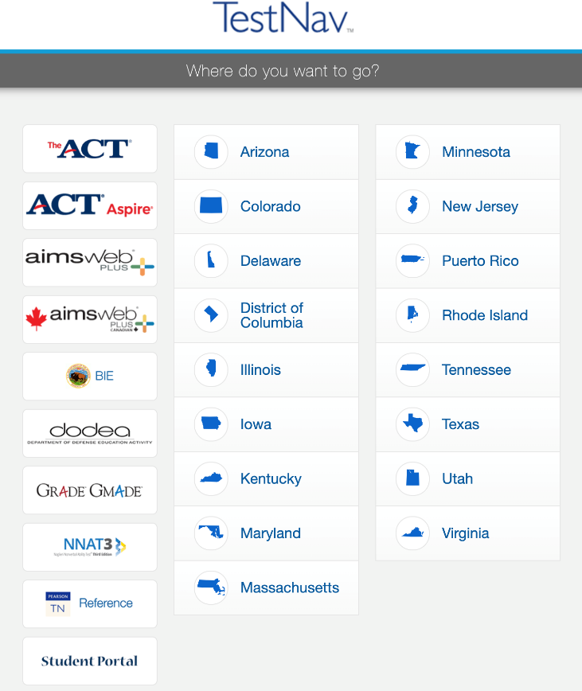
Point TestNav App Toward TestNav URL
Choose the icon in the top right-hand portion of the screen and select > Choose a different customer.
Select Colorado for all operational assessments.

Slide 63
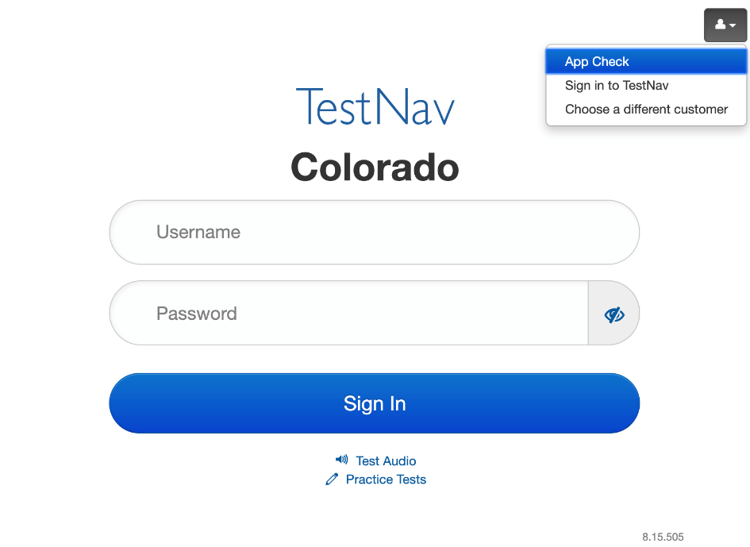
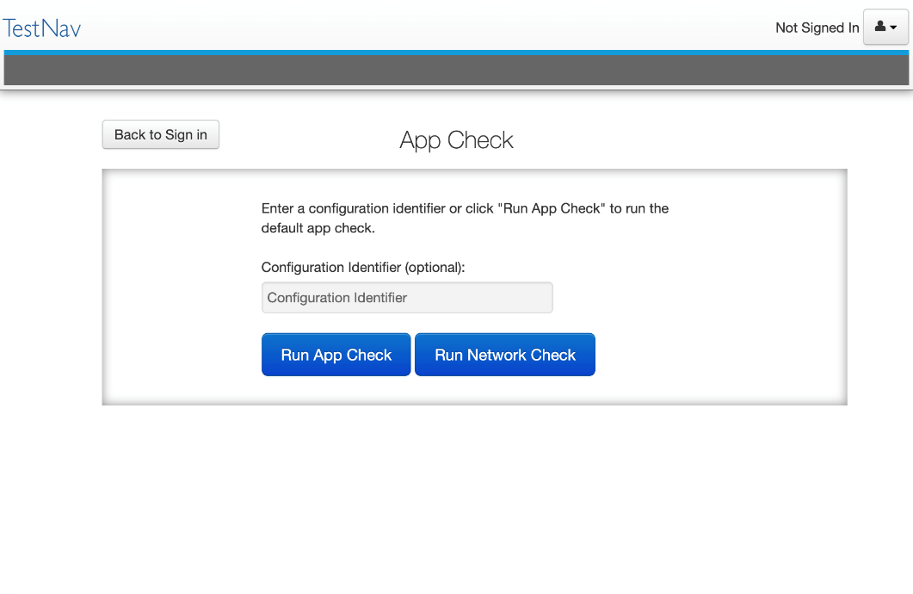
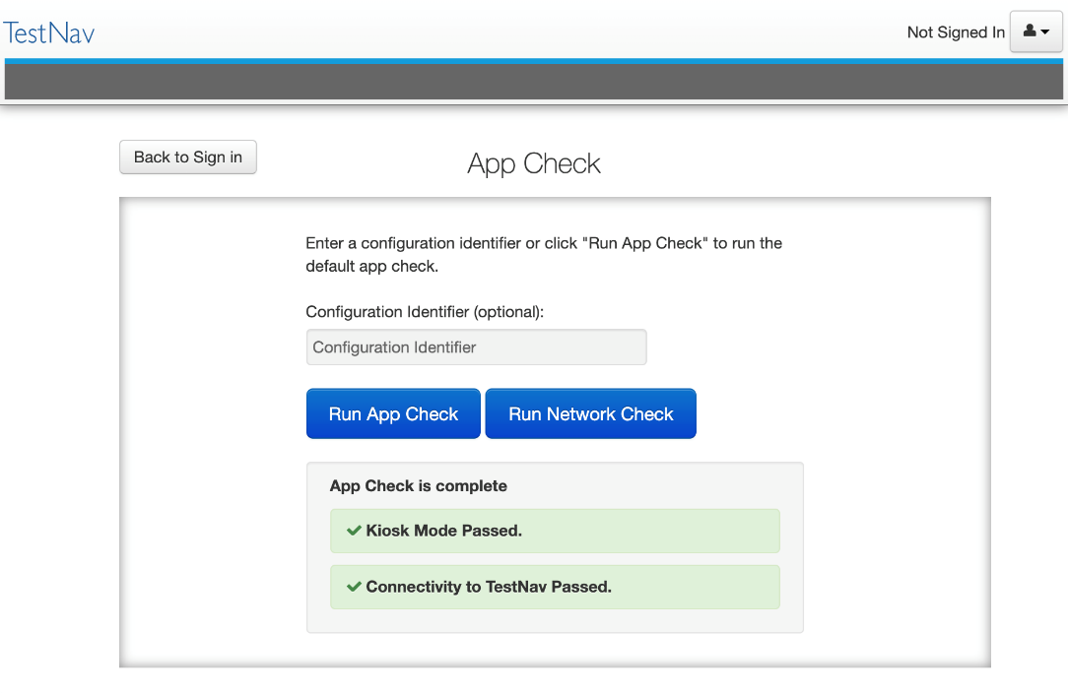
TestNav Device App Check
Notes:
Replaces the TN quick verification.
Can now check connection to the Proctor caching device with a configuration identifier created when you configure TN in PearsonAccess^{next}

Slide 64
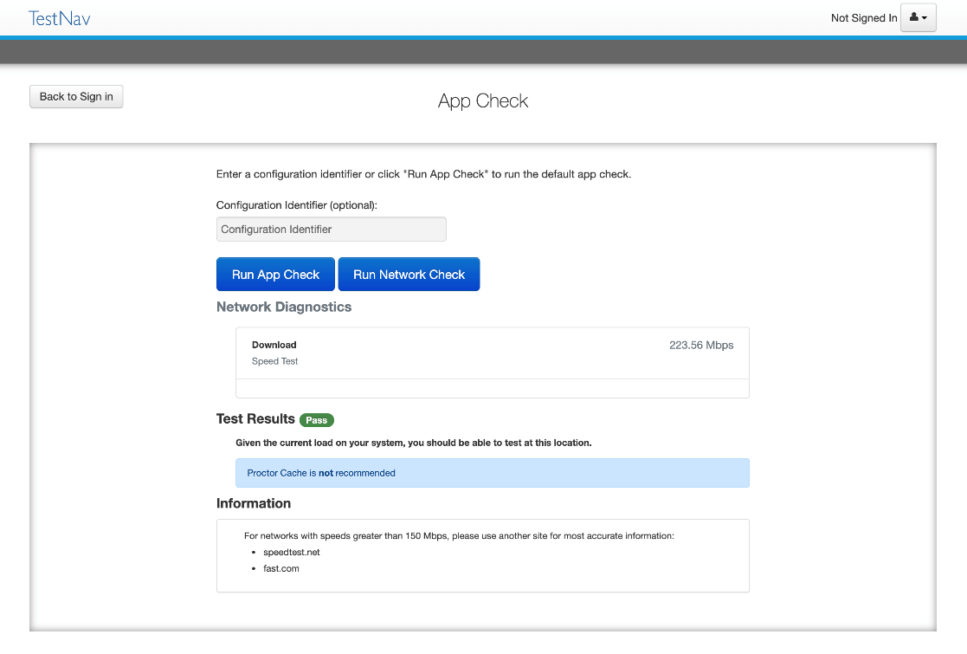
TestNav Desktop Network Check
Demo
Notes:
Replaces the TN quick verification.
Can now check connection to the Proctor caching device with a configuration identifier created when you configure TN in PearsonAccess^{next}

Slide 65
Infrastructure Trial
Test Nav System Overview
Network Preparation
Proctor Caching
Device Preparation
Support During Testing

Slide 66
Infrastructure Trial
PearsonAccess^{next} Infrastructure Trial Form Types
Setup
PearsonAccess^{next} Tasks
CMAS Site Readiness Infrastructure Trial Guide

Slide 67
Types of Infrastructure Trial Forms
Technical Site Readiness verifies:
  Proctor caching devices and student testing devices are configured correctly.
  Devices can process Colorado-specific item types.
  Points of constraint within a network.
A Standard Infrastructure Trial is a full scale dress rehearsal that verifies:
  TestNav is configured correctly.
  Devices can successfully run TestNav.
  Network will bear the full load of simultaneous test-takers.
  School personnel know what to do for computer-based assessments.
  Students are familiar with the computer-based tools and formats.

Slide 68
Technology Setup
Complete Technology Setup prior to Infrastructure Trial
  Configure the Network.
  Proctor Caching.
  Proctor Caching Configuration.
Notes:
Before conducting an Infrastructure Trial, it is important that the Technology Setup be completed and that technology coordinators, school personnel, and students are all equally prepared to participate in the Infrastructure Trial.
For the Technology Setup, it is recommended that these steps be completed:
Configure the network, so that network security devices such as content filters and firewalls allow connectivity with PearsonAccess^{next}, TestNav, Proctor Caching, and email communication with Pearson.
Proctor Caching software should be installed on selected computers with local static IP addresses.
TestNav and Proctor Caching configurations will then need to be added to PearsonAccess^{next} for both the production site and the training site.
Practice tests available in the Training site, as well as sample items and student tutorials can be utilized to gain further experience with TestNav and the CMAS test administrations.
Once the Technology Setup is completed, schools can then conduct an Infrastructure Trial to collectively evaluate the test environment. This will allow schools to identify and resolve any remaining potential issues prior to the CMAS test administrations.
For detailed steps on Proctor Caching and TestNav configuration please reference the “Proctor Caching & TestNav Configuration” training module.

Slide 69
PearsonAccess^{next} Setup
Complete Tasks in PearsonAccess^{next} prior to the Infrastructure Trial
  Create Sample Students.
  Enter TestNav Configuration.
  Create Sessions.
  Print Student Testing Tickets.
Notes:
Once TestNav and Proctor Caching configurations have been added to PearsonAccess^{next}, the next set of tasks can be completed by school personnel:
Sample Students can be created in the PearsonAccess^{next} Training site in order to administer an Infrastructure Trial.
Online Testing Sessions will then be created.
And from each session print Student Testing Tickets, Session Unlock Codes, and Rosters may be printed in preparation for the Infrastructure Trial.
We will now demonstrate each of these tasks.

Slide 70
Support During Testing
Test Nav System Overview
Network Preparation
Proctor Caching
Device Preparation
Infrastructure Trial

Slide 71
Support During Testing
Error Codes
Connectivity/Save Warning System
Find Saved Response File (SRF) and Log Files
Online Test Security
CMAS Customer Support

Slide 72
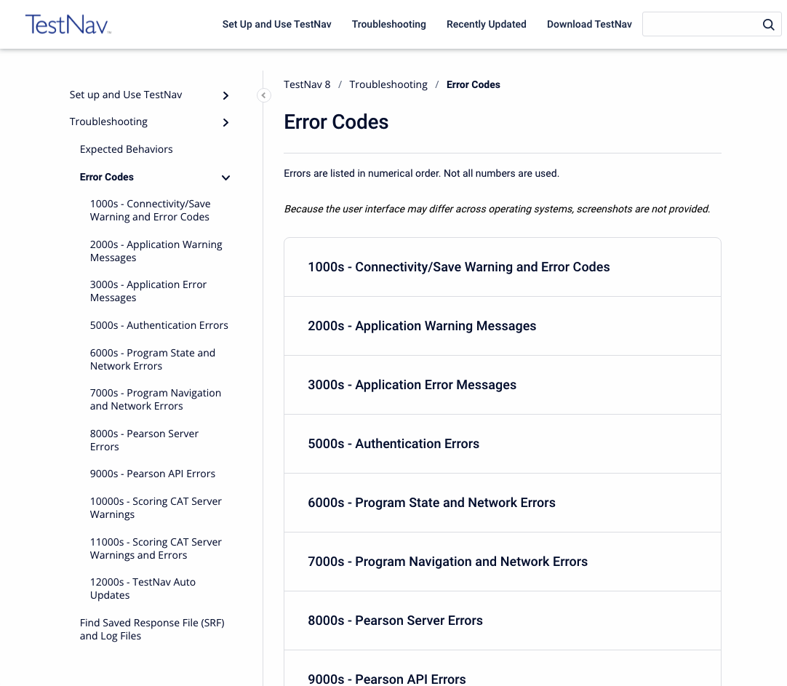
TestNav 8 Error Codes
The TestNav 8 Error Codes should be available to all test proctors to help support students as they test.
The Guide provides a list of all the warning messages that TestNav may display, what generally causes the message, and how to resolve it.
Available through https://support.assessment.pearson.com/x/DwACAQ

Slide 73
Find Saved Response File (SRF) and Log Files
TestNav saves student responses to a local, encrypted backup file called an SRF when it cannot communicate with the Pearson server.
In some scenarios, TestNav allows the student to Select Retry within an error message to try submitting the response again.
If the system cannot transmit the response, the student is exited from the test, and the student can resume testing at a later time, without losing the saved response.
This process automatically occurs without additional installation or action.
When the network is functioning normally, TestNav sends student responses to the Pearson testing server while the student tests.
When the network is not functioning normally, and a student's testing device cannot transmit responses to the Pearson server, TestNav saves the student's responses to the SRF.

Slide 74
Online Test Security
Maintaining Security of the Assessments
Prepare Devices to Meet Security Needs
Monitoring and Reporting Security Breaches and Testing Irregularities and Item Irregularities

Slide 75
Maintaining Security of the Assessments
All secure test materials must be secured while in the Test Administrator’s possession.
No duplication of secure CMAS materials is permissible.
No cell phones or other communication, reproduction, or recording devices are allowed during test sessions unless required for accessibility.
Test Administrators may have cell phones to communicate with SACs and DTCs as long as the ringer is turned off and the phone is not used for any other purposes.
Students should be aware that cell phones or other electronic devices are prohibited. Students who are found with these electronic devices in their possession during testing (including if they have finished testing but other students have not) or during a break may lead to the invalidation of not only their test, but to the invalidation of others’ tests as well.
All individuals are strictly prohibited from taking photos of TestNav screens. Please ensure that individuals in your district are aware of this critical instruction.
Any software that would allow secure test content on student devices to be viewed on another device must be turned off.
Notes:
These are general Assessment Administration rules and how they apply to Computer based assessment administrations
Just like Teams is running and allows everyone to view and recording this meeting software with these capabilities should be disabled during the CMAS administration.

Slide 76
Monitoring and Reporting Security Breaches and Testing Irregularities
Testing Irregularity or Security Breach
The DAC will contact the state immediately upon receiving the call.
Item Irregularities
If an item does not display or if students indicate an issue with an item, this should be reported immediately to the Pearson call center.
SAC will complete the Form to Report a Testing Irregularity or Security Breach (Appendix E)
DAC submits completed form through Syncplicity in the CMAS folder.
All instances of security breaches and testing irregularities must be reported to the SAC, and subsequently, the DAC, immediately.

Slide 77

CMAS Customer Support
Customer Support
Sign into PearsonAccess^{next} for Chat Support
1-888-687-4759
Monday – Friday
7:00 am - 6:00 pm (MST)

Slide 78
Thank you for your Time!
CDE Support
Collin Bonner
CDE Assessment Technology Specialist
303-895-5750
bonner_c@cde.state.co.us
Pearson Support
888-687-4759
Districts/Schools should use Pearson as the first contact for support during testing

