Slide 1
ATTENTION
This presentation may be used for Spring 2016 CoAlt Test Examiner trainings. Districts/schools may need to be update slides with local assessment administration policies and additional information.

Slide 2
CoAlt: Science and Social Studies Administration Training for Test Examiners Spring 2016

Slide 3
Topics
Before Testing
Security
Test Environment
Training
During Testing
Administering the CoAlt Assessment
Select Response Items
Supported Performance Tasks
After Testing
Online Score Entry
Return Materials
Support

Slide 4
CoAlt: Science and Social Studies Before Testing
Before
During
After

Slide 5
Security and the Chain of Custody page 54 of the Procedures Manual
All CoAlt testing materials are secure.
Each person in the chain is responsible for test security while the assessment is in their possession.
Secure Storage
Distribution of Materials

Slide 6
Test Security page 54 of the Procedures Manual
Items are not to be reproduced
Student responses are not reproduced
Student responses are recorded in the test book or on the included score form
After administering the CoAlt, the scores must be entered into PearsonAccess^{next}
No digital cameras, video cameras, or recoding devices of any type are allowed in the testing environment

Slide 7
The Testing Environment page 46 of the Procedures Manual
Separate testing space
No distractions
Turn off the phone (including cell phones)
Not disrupted by other staff
Not disrupted by other students
Anyone in the testing room
Must be trained on test security
Must sign a Security Agreement/confidentiality form

Slide 8
Test Examiners page 36 of the Procedures Manual
Must be a Certified Educator
District Employee
General Education/Special Education
NOT Substitute License
Should be the person who knows the student best – but not a relative
Must be trained annually

Slide 9
Annual Training page 62 of the Procedures Manual
CoAlt Trainings
http://www.cde.state.co.us/assessment/trainings > 2015-2016 Trainings > CoAlt: Science and Social Studies Administration
Examiner’s Manual
http://www.cde.state.co.us/assessment/coaltem
Procedures Manual
http://www.cde.state.co.us/assessment/copromanual
Released Items
http://www.cde.state.co.us/assessment/CoAlt-Items.asp
CoAlt Administration Training (Recorded Fall 2015)
https://enetlearning.adobeconnect.com/p78xxelh5bu/
Should include:
Available Resources
Communication Protocols
Security
Administration Procedures
Provide an opportunity to practice giving released items
Provide an opportunity for immediate feedback
Provide an opportunity to ask questions

Slide 10
CoAlt: Science and Social Studies During Testing
Before
During
After

Slide 11
Administering the CoAlt: Science and Social Studies Assessment
Student is presented with three or four answer options
Student will work with item until the correct answer is received or maximum attempts is reached
CoAlt Test Examiners may NOT reword prompts
Re-present prompt at level four only when the student does not respond
An additional prompt is included to engage the student at level three
Only one data point is recorded

Slide 12
Administering the CoAlt: Science and Social Studies Assessment
Test book layout
Two item types
Selected Response
Supported Performance Tasks
Online Score Entry
Should be completed the same day the assessment is administered.
Must be completed by May 4th

Slide 13
Administering the CoAlt: Science and Social Studies Assessment
Test Materials
In grades 4, 5 & 7 there is one test form per grade level.
In grade 8 and HS there are two test forms.
Form 016
Form 026
Each student must be assessed with their own test book and corresponding task manipulatives.

Slide 14
Administering the CoAlt: Science and Social Studies Assessment
Task Manipulatives
Task manipulatives shrink-wrapped with each test book must be used with that specific test book.
Keep test materials that were shrink-wrapped together.

Slide 15
Administering the CoAlt: Science and Social Studies Assessment
Test Materials and Task Manipulatives
Each CoAlt Test Kit contains:
Test book with form number on the front
Task manipulatives
Score entry form (with task manipulatives)
Secure return envelope

Slide 16
Administering the CoAlt: Science and Social Studies Assessment
Test Materials and Task Manipulatives, continued
Write the student’s full name on the cover of the test book.
Write the student’s full name with a black marker on the secure return envelope.
Cut apart the task manipulatives for each performance task.
Paper clip the cut-apart task manipulatives to the corresponding student response page.
In between testing sessions, task manipulatives may be stored in the secure return envelope.
Keep all materials together throughout the test administration.

Slide 17
Administering the CoAlt: Science and Social Studies Assessment
Test Materials and Task Manipulatives, continued
Use the provided picture symbols, except when the student:
Needs to use objects rather than pictures
Needs pictures of real objects rather than drawings,
-OR-
The student has a personal lexicon with a specific representation for the concept or words in the student answer choices
In this case, all answer choices must be from the student’s personal lexicon

Slide 18
Selected Response Items

Slide 19
Selected Response Items
Selected Response items are identified as “Item ##” within the test book.
They contain both a primary prompt and an additional prompt.

Slide 20
Present the Primary Prompt
Student Responds Correctly
Student Does Not Respond
4 Points
Repeat the Primary Prompt
Student Responds Correctly
4 Points
Student Responds Incorrectly OR Student Does Not Respond (after repeating the Primary Prompt)
Present the Additional Prompt and then present the Primary Prompt again
Student Responds Correctly
3 Points
Student Responds Incorrectly OR Student Does Not Respond
Present the Correct Answer and then present the Primary Prompt again
Student Responds Correctly
2 Points
Student Does Not Respond
Student Responds Incorrectly
“NR”
1 Point

Slide 21
Selected Response Items
Teacher Facing Page

Slide 22
Selected Response Items
Student Facing Page

Slide 23
Selected Response Items
Student Facing Page

Slide 24
Selected Response Items
Student Facing Page
Does not respond?

Slide 25
Selected Response Items
Teacher Facing Page

Slide 26
Selected Response Items
Student Facing Page

Slide 27
Selected Response Items
Student Facing Page

Slide 28
Selected Response Items
Student Facing Page
Responds incorrectly?

Slide 29
Selected Response Items
Teacher Facing Page

Slide 30
Selected Response Items
Teacher Facing Page

Slide 31
Selected Response Items
Teacher Facing Page

Slide 32
Selected Response Items
Student Facing Page

Slide 33
Selected Response Items
Teacher Facing Page

Slide 34
Selected Response Items
Student Facing Page

Slide 35
Selected Response Items
Student Facing Page

Slide 36
Selected Response Items
Student Facing Page
Does not respond?
Responds incorrectly?

Slide 37
Selected Response Items
Teacher Facing Page

Slide 38
Selected Response Items
Teacher Facing Page

Slide 39
Selected Response Items
Student Facing Page

Slide 40
Selected Response Items
Teacher Facing Page

Slide 41
Selected Response Items
Student Facing Page

Slide 42
Selected Response Items
Student Facing Page

Slide 43
Selected Response Items
Student Facing Page
Responds incorrectly?

Slide 44
Selected Response Items
NR
Student Facing Page
Does not respond?

Slide 45
Partner Practice
PARTNER 1:
Person 1 is the Student
Person 1 answers as instructed on the Student 1
PARTNER 2:
Person 2 is the Test Examiner
Give the Practice items following the protocol
Mark the score on the Practice Answer Page
Compare your scores to the answers on the bottom of Student 1
Switch so Partner 1 is the Test Examiner and Partner 2 is the Student. Use Student 2

Slide 46
Supported Performance Tasks

Slide 47
Supported Performance Tasks
Identified as Task # within the test book
Three prompts related to one task
Student manipulates option cards by placing them on the student response page (or indicates location for placement)

Slide 48
Supported Performance Tasks
Student Responds Correctly
2 Points
Present the Prompt
Student Responds Incorrectly
1 Point
Student Does Not Respond
Repeat the Prompt
Student Responds Correctly
2 Points
Student Responds Incorrectly
1 Point
Student Does Not Respond
“NR”
Present the next prompt

Slide 49
Supported Performance Tasks
Teacher Facing Page 1

Slide 50
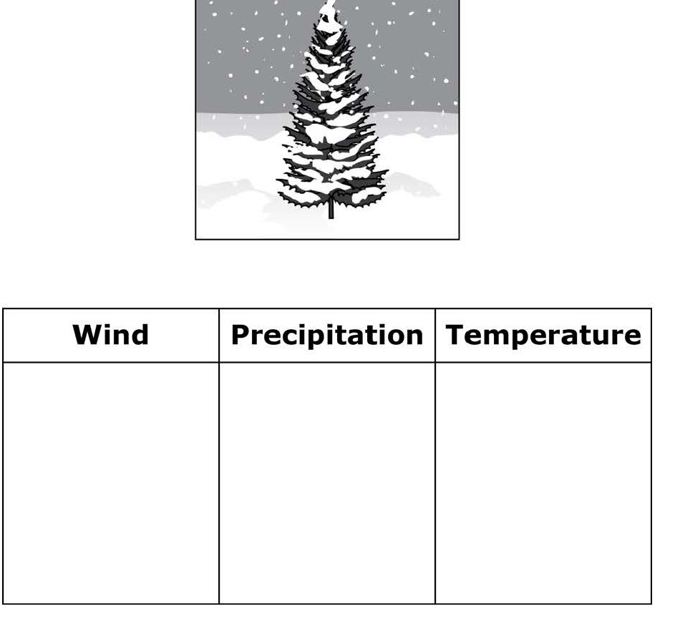
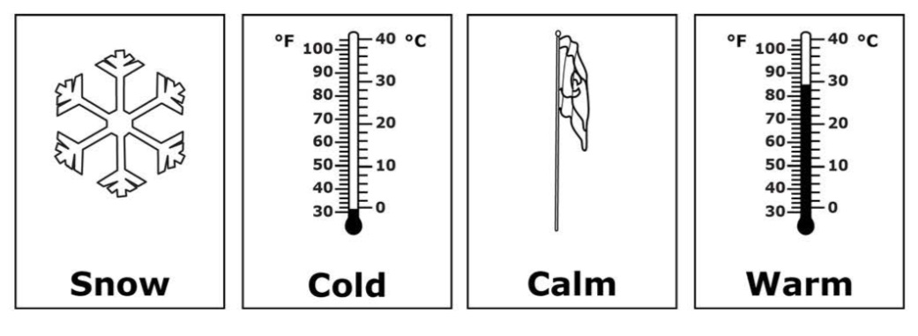
Supported Performance Tasks
Student facing page

Slide 51
Supported Performance Tasks
Teacher Facing Page 1

Slide 52
Supported Performance Tasks
Student facing page

Slide 53
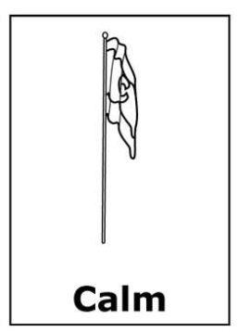
Supported Performance Tasks
Student facing page

Slide 54
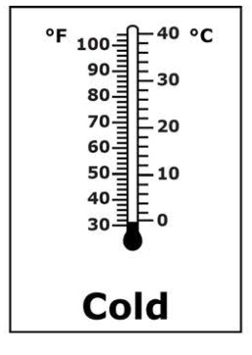
Supported Performance Tasks
Student facing page

Slide 55
Supported Performance Tasks
NR
Student facing page

Slide 56
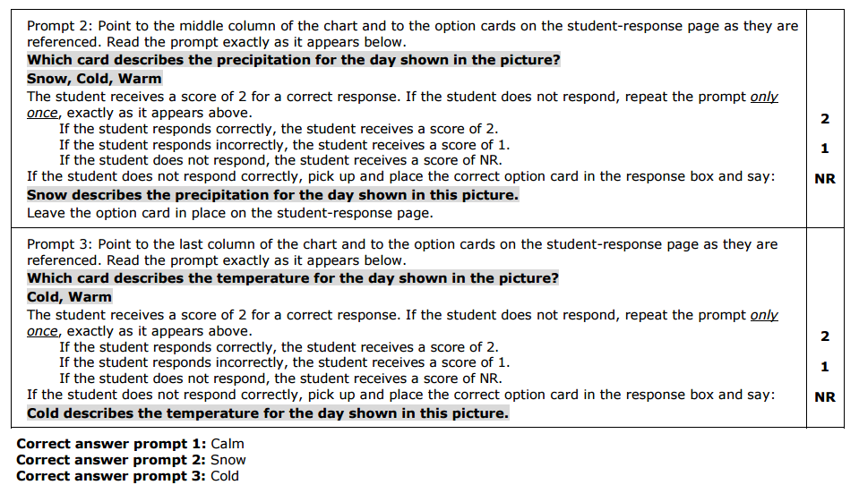
Supported Performance Tasks
Teacher Facing Page 2

Slide 57
Supported Performance Tasks
Student facing page

Slide 58
Supported Performance Tasks
Student facing page

Slide 59
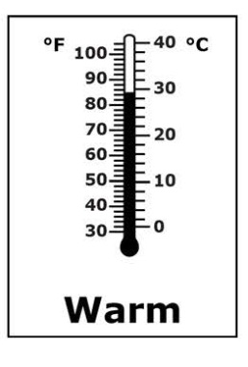
Supported Performance Tasks
Student facing page

Slide 60
Supported Performance Tasks
NR
Student facing page

Slide 61
Supported Performance Tasks
Teacher Facing Page 2

Slide 62
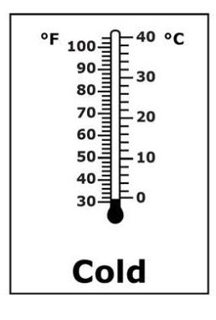
Supported Performance Tasks
Student facing page

Slide 63
Supported Performance Tasks
Student facing page

Slide 64
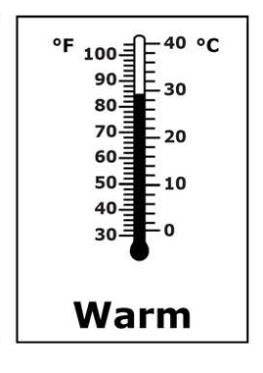
Supported Performance Tasks
Student facing page

Slide 65
Supported Performance Tasks
NR
Student facing page

Slide 66
Partner Practice
PARTNER 1:
Person 1 is the Student
Person 1 rolls to see how they will respond to each prompt.
(score NR, 1 or 2)
PARTNER 2:
Person 2 is the Test Examiner
Give the Practice items following the protocol
Mark the score on the Practice Answer Page
Compare your scores to what your partner rolled
Switch so Partner 1 is the Test Examiner and Partner 2 is the Student. Use Student 2

Slide 67
CoAlt: Science and Social Studies After Testing
Before
During
After

Slide 68
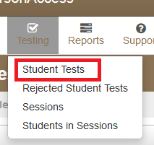
Online Score Entry Enter the students score in PearsonAccessNext
Sign into PearsonAccess^{next} and select the CoAlt administration.
Select the appropriate organization
Select Testing > Student Tests.

Slide 69
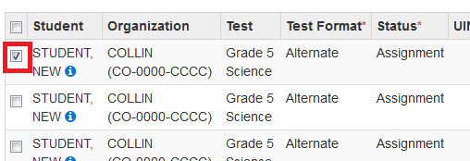
Online Score Entry
Locate the student by typing the student’s last name into the search box or by selecting the Search drop-down and “Show all results”.
Select the checkbox in line with the student’s name (additional students can also be selected at the same time if scores need to be entered for multiple students).

Slide 70
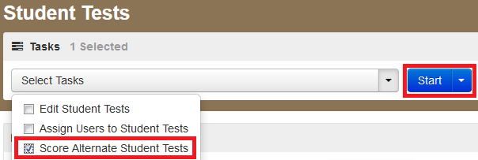
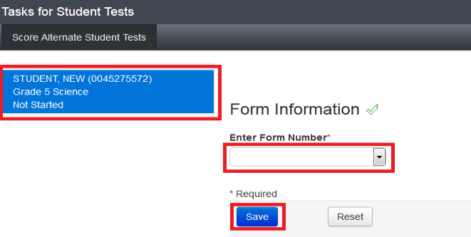
Online Score Entry
Select “Score Alternate Student Tests” and then select the Start button.
Select the student’s name on the left side of the screen, select the appropriate form number from the Enter Form Number drop-down, and select the Save button.

Slide 71
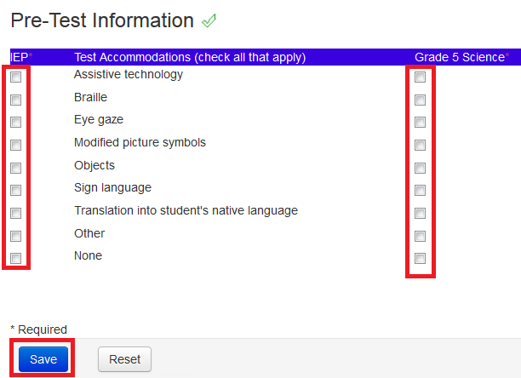
Online Score Entry
Enter IEP (left) and assessment (right) accommodations
Select Save.

Slide 72
Online Score Entry
Enter the student’s scores
Optional: Enter responses to the Test Administration Questions.

Slide 73
Online Score Entry
Select the Save button.
Once the green “Success: Changes saved” message appears at the top of the screen, select the Exit Tasks button.

Slide 74
CoAlt: Science and Social Studies Return Materials
Page 94 in the Procedures Manual
Return CoAlt materials to the SAC
The following materials must be returned:
Secure Return Envelope (1 per student)
Task manipulatives
Used score recording forms
Verify student scores have been entered in PearsonAccess^{next}
Security Agreement form (1 per Test Examiner)

Slide 75
Support
Support Page on PearsonAccess^{next}
Toll Free Phone Support
1-888-687-4759
Email Support*
COHelp@support.Pearson.com
*Student Personally Identifiable Information (PII), including names and SASIDs, must not be emailed.

