Slide 1
CoAlt Assessment Administration Training for Assessment Coordinators
Spring Administration 2025

Slide 2
Agenda
Lesson 1 – What are the CoAlt Assessments
Lesson 2 – Security Standards
Lesson 3 – The CoAlt Assessments: ELA and Math
Lesson 4 – DLM Kite Suite
Lesson 5 – Assessment Coordinators
Lesson 6 – DLM Testlets – ELA and Math
Lesson 7 – CoAlt Science
Lesson 8 – Planning, Scheduling, and Resources

Slide 3
Resources
Spring 2025 CoAlt Assessments Administration Training for Assessment Coordinators
CDE CoAlt Assessments for Science
CDE CoAlt Assessments for ELA and Math
Kite/DLM Educator Portal

Slide 4
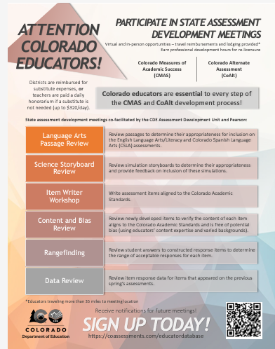
Assessment Development
Register for the Educator Assessment Development Meetings

Slide 5
Accessing the CoAlt Assessment Administration Training Platform
Spring 2025 CoAlt Assessments Administration Training for Assessment Coordinators
Start the training by clicking on the “Start Training" button

Slide 6
Using the Menu Bar

Slide 7
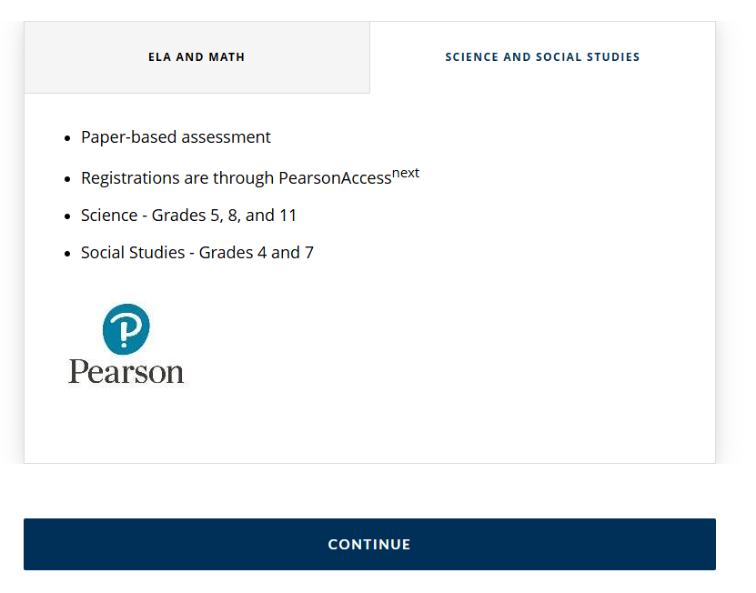
Moving to the Next Section

Slide 8
What are the CoAlt Assessments?

Slide 9
Lesson 1 of 8
What are the CoAlt Assessments?
Questions

Slide 10
Security Standards

Slide 11
Lesson 2 of 8
Security Standards
Questions

Slide 12
The CoAlt Assessments: ELA and Math

Slide 13
Lesson 3 of 8
The CoAlt Assessments: ELA and Math
Questions

Slide 14
DLM: Kite Suite

Slide 15
Completing the First Contact Survey and the Personal Needs and Preferences (PNP) Profile
Completing the First Contact Survey and Personal Needs and Preferences (PNP) Profile
Completing the First Contact survey and PNP Profile

Slide 16
Lesson 4 of 8
DLM: Kite Suite
DLM/Kite Educator Portal
Questions

Slide 17
Assessment Coordinators

Slide 18
Video Resources for District Assessment Coordinators
Adding and Editing Users In Educator Portal
Find Previously Enrolled Students in Educator Portal
Adding and Editing Students Manually in Educator Portal
Transfer Students Within the District in Educator Portal
Adding and Editing Rosters in Educator Portal

Slide 19
Lesson 5 of 8
Assessment Coordinators
Questions

Slide 20
DLM Testlets: ELA and Math

Slide 21
Lesson 6 of 8
DLM Testlets: ELA and Math
Administrative training is available through DLM Educator Portal
DLM/Kite Educator Portal
Questions

Slide 22
CoAlt: Science

Slide 23
CoAlt: Science Test Administration
Selected Response Items
Questions

Slide 24
CoAlt Science Administration
Supported Performance Task (SPT) Items
Questions

Slide 25
Lesson 7 of 8
CoAlt: Science
Questions
Note: Districts of the selected schools will be contacted in January for the CoAlt Social Studies Assessment Administration Training

Slide 26
Planning, Scheduling, and Resources

Slide 27
Lesson 8 of 8
Planning, Scheduling, and Resources
Required administrative trainings for CoAlt DLM ELA/Math will be found through the Kite/DLM Educator Portal.
Administrative Training for CoAlt Science will be available in the Kite/DLM Educator Portal.*
*Assessment Administration Training for CoAlt Science is included in the Spring 2025 CoAlt Assessment Administration Training for Assessment Coordinators.

Slide 28
Contact Information
Title | Contact Information
CoAlt Assessments and Accommodations for Students with Disabilities | Arti Sachdeva Sachdeva_a@cde.state.co.us
Instructional Accommodations | Gina Herrera Herrera_g@cde.state.co.us
CMAS: Science, Mathematics, and English Language Arts | Sara Loerzel Loerzel_s@cde.state.co.us
Linguistic Accommodations | Heather Villalobos Pavia Villalobos-Pavia_h@cde.state.co.us
Technology Specialist | Collin Bonner Bonner_c@cde.state.co.us
Student Data | Jasmine Carey Carey_J@cde.state.co.us

Slide 29
Thank you!

