Slide 1
2013-2014 Student Biographical Data (SBD) Training
Assessment unit
January 2014

Slide 2
Training Outline
Overview of SBD
  Purpose, general description and 2013-2014 timeline.
Getting Started
  Data Pipeline Assessment Webpages, SBD support documents, CDE’s Identity Management System and User Roles.
SBD Step by Step
  Two options
  SBD Demonstration.
SBD Resources
  SBD Manual, Data Pipeline Webpage, Assessment Webpage and CDE contacts.
Notes:
Welcome to the 2013-2014 Assessment Unit Data Pipeline training.
This training will provide participants
An overview of SBD that includes a general description and purpose of SBD as well as the 2013-2014 tentative timeline.
An overview of the Assessment webpages on the Data Pipeline website, including the support documents posted on the pages. An introduction to CDE’s Identity Management system and Data Pipeline user roles.
Step by step instructions on how to complete an SBD Review, presented as a demonstration.
A list of SBD resources.

Slide 3
What is Student Biographical Data (SBD) Review?
Purpose:
  Voluntary district review of student demographic data collected during assessment cycle.
  Not an opportunity to provide student data for the first time.
Basic process
  Occurs after the testing window closes and before scores are released.
  CDE uploads data provided by vendor to Data Pipeline
  Districts download, review, edit, upload and approve their data to Data Pipeline
  CDE returns data to vendor after SBD window closes.
Communication:
  Assessment coordinates and communicated about SBD with District Assessment Coordinators (DACs).
Notes:
Purpose: The purpose of the Student Biographical Data (SBD) review is to allow districts the opportunity to verify the accuracy of student level demographic data submitted for each state assessment. The review process takes place after testing has been completed but before scores are released. This is step is intended to be a review of data already collected. SBD should not be the first opportunity data is being submitted.
Process: After the testing window, each test vendor provides CDE with a SBD file. For ACCESS for ELLs, TCAP/CoAlt: Reading, Writing and Mathematics and CO ACT SBD the records come from all the test booklets submitted for scoring. For CMAS/CoAlt: Science and Social Studies the records are from any student in Pearson Access. Assessment uploads this file to Data Pipeline.
For each SBD review, districts will log into the state Data Pipeline system and download a data file containing demographic data from student assessment records. During the SBD window, districts review and update the student demographic data. Once all corrections are made, districts submit/approve the file to Data Pipeline.
CDE returns approved student demographic data to the vendor. The vendor merges this data with the score data and districts receive the updated data along with the scores in a file directly downloaded from the vendor.
Communication: Assessment coordinates and communicated about SBD with District Assessment Coordinators (DACs).

Slide 4

2013-2014 SBD Collections
Assessment | Tentative Dates*
ACCESS for ELLs | March 20-27
TCAP/CoAlt: Reading, Writing and Mathematics | May 22- June 6
CMAS/CoAlt: Science and Social Studies (Spring 2013) | May 22– June 3
CO ACT | June 17 - June 24
CMAS/CoAlt: Science and Social Studies (Fall) | TBD
* Dates are tentative. DACs will receive updates about changes to dates as needed.
Notes:
This slide contains the tentative dates for the 2013-2014 SBD collections. Please note that DACs will be informed if the dates change.

Slide 5
Student Biographical Review: Getting Started

Slide 6
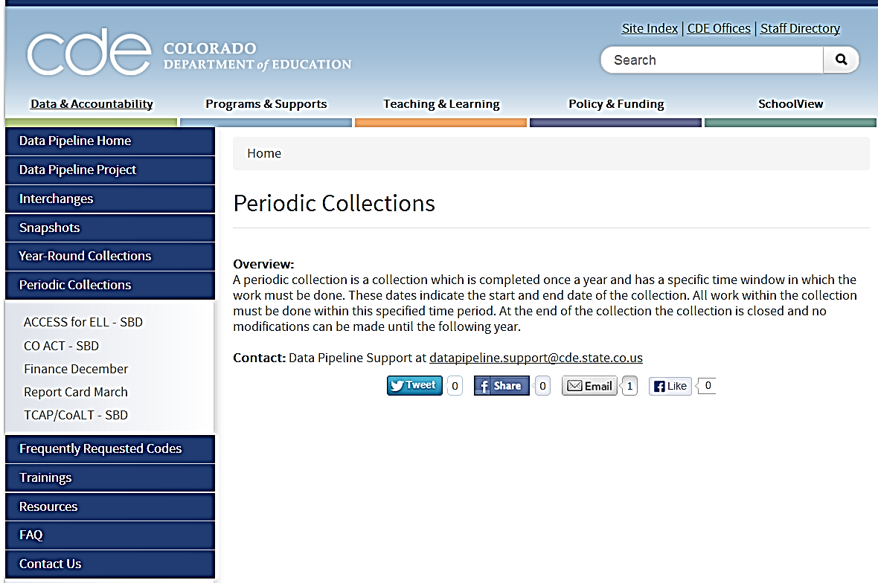
Data Pipeline Website
http://www.cde.state.co.us/datapipeline
Links for Assessment collection websites are under the Periodic Collections.
Notes:
CDE’s Data Pipeline system is used for SBD reviews.
General information about the SBD collections can be found using the navigation menu on the main data pipeline webpage. The link to the main data pipeline webpage is provided at the top of this slide. Links for Assessment collection websites are under the Periodic Collections on the left side of the main page.

Slide 7
SBD Support Documents
Each assessment Data Pipeline web page has the following information:
Overview: Provides a brief description of Pre-ID extracts and SBD processes.
File Layout and Definitions: The SBD file layout and variable definitions.
Business Rules: Collection warnings and errors when there are problems or inconsistencies in the data submission.
  Errors need to be resolved before a file can be approved.
  Warnings alert to a potential problem that should be carefully checked, but do not block file approval.
Templates: Excel files that districts can use to build the data files.
Trainings: Links to SBD specific trainings.
Resources: Links to other webpages that may be useful during the SBD process.
Notes:
Each Data Pipeline web page has the following information.
The overview provides the purpose and a general description of the SBD collections.
The File Layout and Definitions provide the file layouts districts will need to use during SBD. These file layouts are the format of the data downloaded and uploaded to Data Pipeline for each SBD collection. If districts edit data locally, they provide the roadmap to the data format. These files also contain the variable definitions. Districts need to use these definitions to cross check the data begin reviewed during SBD.
The business rules documentation provides detailed information about collection errors and warnings. Like other Data pipeline collections, SBD collections contain errors and warnings when submitted data is incorrect. For example, districts will receive an error if a student is enrolled in an ELL program but has English indicated as their primary language.
The templates are excel documents of the file layouts – but just the header row. Districts can use this to help format or prepare for SBD collections.
The trainings section provide links to trainings that support SBD collections.
The resources section provides links to other supporting documents. For example, a link to the Assessment unit trainings page – where this presentation will be posted.

Slide 8
CDE’s Identity Management System
Data Pipeline is part of CDE’s Identify Management System.
Local Access Manager (LAM) assigns roles to each collection.
Assessment Collection’s are identified in Data Pipeline using the following groups:
  ACT: CO ACT SBD collection
  ACC: ACCESS for ELLs SBD collection
  TCP: TCAP/CoAlt: Reading, Writing and Mathematics SBD collection
  CMS: CMAS/CoAlt: Science and Social Studies SBD collection
Notes:
Data Pipeline is an application within CDE’s Identify Management System (IDM). A change from last year is that districts are responsible for assigning user roles for the SBD collections. DACs should work with their Local Access Manager (LAM) to assign roles to each collection. See the slide for the collection codes.
If a potential user already has a user name within Data Pipeline or even for another IDM application, they will use that same user name and password for SBD collections. For example, if a user has permissions for Data Pipeline’s Student Interchange or the CEDAR application – they same user name and password will be used for the SBD collections. The user just needs to be given permissions to the SBD collection.

Slide 9
Data Pipeline User Roles
The Assessment collections have three different district user roles.
  LEA Viewer: These users can only view the data and reports.
  LEA User: These users have the same permissions as the LEA Viewer, plus they can download, edit and upload data.
  LEA Approver: These users have same permissions as the LEA User, plus they can approve data.
Notes:
Another change from ADE is that there are multiple user roles that can be assigned for each SBD collection. Districts can assign one or all of these roles to individuals in their district.
The LEA VIEWER: Can only view data and reports. This role could be assigned to someone who needs to review the data but should not make changes to the data.
The LEA USER can view, download, edit and upload data and reports. This could be assigned to someone who will review and change the SBD data.
The LEA APPROVER has the same permissions as the LEA USER and can also approve the collection. This is the role most similar to the ADE user role. This could be assigned to the person who had final sign off on the data.

Slide 10
Data Pipeline User Roles: Notes
An individual may only have one user role per Assessment collection.
  An individual cannot be both an LEA Approver and LEA Viewer for ACCESS for ELLs.
An individual may be assigned roles in several or all the Assessment Collections.
  An individual can be an LEA Approver for ACCESS for ELLs and LEA Viewer in CO ACT.
For more information about how to assign user roles to collections and more detail on Data Pipeline User Roles see the Data Pipeline’s District User Manual (http://www.cde.state.co.us/datapipeline/datapipelinedistrictusermanual).
Notes:
There are some rules around how to assign user roles.
1. An individual may only have one user role per Assessment collection. For example, an individual cannot be both an LEA Approver and LEA Viewer for ACCESS for ELLs.
2. An individual may be assigned roles in several or all the Assessment Collections. For exampl,e, an individual can be an LEA Approver for ACCESS for ELLs and LEA Viewer in CO ACT.
For more information about how to assign user roles to collections and more detail on Data Pipeline User Roles see the Data Pipeline’s District User Manual (http://www.cde.state.co.us/datapipeline/datapipelinedistrictusermanual).

Slide 11
Student Biographical Data (SBD) Review:
Step by Step
Notes:
The next part of the presentation is going to be a demonstration on how to complete an SBD collection in Data Pipeline.
All of the information in this demonstration is covered in the 2013-2014 Assessment Unit Data Pipeline Manual – posted on the Assessment Trainings page.

Slide 12
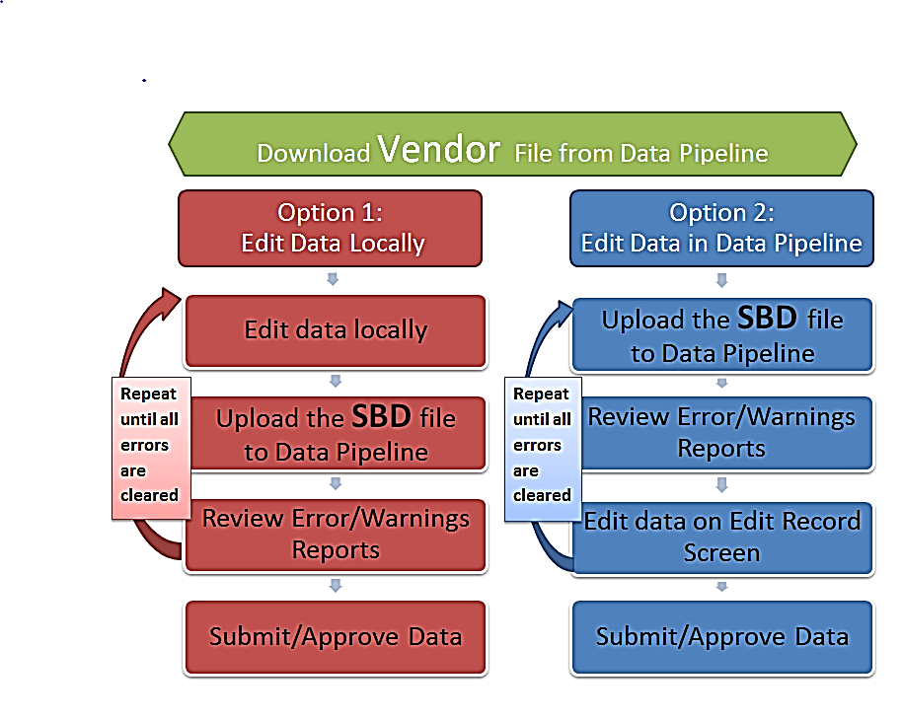
SBD: Two Options
The current Pre-Coded Label/Pre-ID Data Extract and Student Biographical Data Review (SBD) Manual has step by step instructions for completing SBD.
http://www.cde.state.co.us/assessment/2014_assessment_datapipeline_manual
Notes:
In Data Pipeline, there are two main options for how to review and clean the SBD data. (Note the demonstration will cover these steps in more detail)
Both options begin with a district downloading the original vendor file from Data Pipeline. Districts then have a choice to edit data on their local computers (option 1) or edit data directly in Data Pipeline (option 2).
Option 1: Edit data locally. In this option, districts take the data they initially downloaded and make changes to the file on their local computer or local network. A corrected file is uploaded to Data Pipeline so that error/warning reports can be produced. The local file goes through a series of corrections and uploads until all errors/warnings are cleared. The file is then approved.
Option 1: Edit data in Data Pipeline. In this option districts pull down their data and immediately re-upload it to Pearson Access. This step triggers the errors and warnings to be applied to the file. The districts then do all changes directly within the Data Pipeline User Interface.

Slide 13
SBD: Demonstration
Demonstration Topics
  Logging into Data Pipeline
  Downloading the SBD file from Data Pipeline
  Uploading the SBD Data File to Data Pipeline
  Correcting Errors directly in Data Pipeline
  Reviewing Three Cognos Reports
    SBD Error Detail Report
    SBD Error Summary Report
    SBD Student Location Report
  Approving SBD Data in Data Pipeline
Start demonstration
Notes:
The next portion of the training is going to be done as a demonstration. The topics listed on the slide will be covered. There are also detailed instructions on each of the topics in the Assessment Unit Data Pipeline User Manual.

Slide 14
SBD Resources

Slide 15
Assessment Unit Data Pipeline Manual
Step by Step instructions for
  Updating Student Interchange data for Pre-Coded Label/Pre-ID extracts
  Completing SBD
Detailed information about each Assessment Collection
  Changes from previous year
  Details that make each collection unique
  Specific criteria used to pull data for Pre-Coded Label/Pre-ID extracts
Notes:
The Assessment Unit Data Pipeline manual provides the following information
1. Step by Step instructions including screenshots for pre-coded label/Pre-Id extracts and completing the SBD review.
Detailed information about each Assessment Collection.
Including changes from previous years. For example, file layout changes.
Details on how collections differ. For example, TCAP has multiple records per student and CO ACT has one record per student.
Criteria used to pull data for Pre-coded label/Pre-ID.

Slide 16
CDE’s Website
Data Pipeline Assessment pages
  Current SBD File Layouts
  Documentation on the Errors and Warnings
Assessment Website
  Assessment Policies and Procedures
  Assessment Timelines
  Data documentation and manuals
    Assessment Procedure Guides
    Pre-Coded Label/Pre-ID and SBD Manual

Slide 17
CDE Contacts
Topic | CDE Unit | Person to Contact | Email | Phone
Pre-Coded Labels/Pre-ID Extract (All) | Assessment Unit | Jessica Allen | allen_j@cde.state.co.us | 303.866.6281
ACCESS for ELLS SBD | Assessment Unit | Jessica Allen and | allen_j@cde.state.co.us | 303.866.6281
TCAP/CoAlt SBD
CMAS/CoAlt SBD |  | Sarah Underwood | underwood_s@cde.state.co.us | 303.866.6198
CO ACT SBD Review | Assessment Unit | Jasmine Carey | carey_j@cde.state.co.us | 303.866.6634
State Accountability | Accountability and Data Analysis | Josh Perdue | perdue_j@cde.state.co.us | 303-866-2865
NCLB Waiver Program | Federal Programs | Nazanin Mohajeri-Nelson | mohajeri-nelson_n@cde.state.co.us | (303) 866-6205
Annual Measurable Achievement Objectives | Federal Programs | Donna Morganstern | morganstern_d@cde.state.co.us | 303.866.6209
SASIDS | IMS - Records Integration Tracking System (RITS) | Debbie Pulscher | pulscher_d@cde.state.co.us | 303.866.6612
Policies about English Language Development | Office of Language, Culture, and Equity. | Liliana Graham | graham_l@cde.state.co.us | 303.866.6138
11th Grade Alternate Assessment | Exceptional Student Services | Linda Lamirande | lamirande_l@cde.state.co.us | 303.866.6863
Notes:
Although Assessment manages the SBD collection, the data being reviewed impacts other units across CDE. This slide provides a list of contacts for different district questions that may occur during the SBD review.

Slide 18
Thank you
Notes:
Thank you for viewing the training. If you have further questions please contact the appropriate CDE staff member listed on the CDE contact slide.

