Slide 1
2013-2014 TCAP Administration Training for DACs
December, 2013
Notes:
Welcome to the 2013-2014 TCAP test administration training for District Assessment Coordinators, or DACs. Participation in this training satisfies the annual requirement for DACs to be trained in TCAP test administration.
At the end of this pre-recorded webinar, you will find a link to an online survey. Completion of that survey will serve as evidence of your completion of annual training. The survey includes both attendee information, and a brief quiz on important aspects of assessment administration as well as questions about updates to this year’s procedures. All DACs must complete this training on or before January 17th, 2014.
This training is not intended for, and may not be used for, School Assessment Coordinators, or SACs, or test proctor training. The DAC is responsible for training SACs, who in turn are responsible for training test proctors. A separate PowerPoint template for proctor training has been posted on the Assessment Unit website for your use in developing test proctor training.
This webinar is not secure and may be shared with other district or school staff as needed.

Slide 2
Overview
Changes
Important Dates
The Colorado Assessment System
Personnel Roles and Responsibilities
Assessment Administration
Test Accommodations
Test Security
Resources and Contact Information
Notes:
This training will cover all important aspects of TCAP administration. It will start with an overview of key changes to procedures and the assessment windows for 2013-2014. Then the training will provide a brief overview of the Colorado assessment system including updates on the assessment’s future, followed by details of TCAP administration, including Personnel roles and responsibilities, Assessment administration, testing accommodations, issues of test security and resources and information. At the end of this training, and on the Assessment Unit website, you will find a link to an online survey and quiz. Completion of the online survey and quiz will constitute evidence of completing annual DAC Training. This Training must be completed on or before January 17th, 2014.

Slide 3
Important Dates
TCAP enrollment on CTB Navigator ended 11/15, 2013
All non-standard test accommodations must be requested by December 17, 2014
All testing, including make-ups, must be completed within your district’s testing window
2014 Early Testing Window
Grade 3 reading/Lectura | February 10 – 21
Grade 3-10 All other tests | March 3 - 28
2014 Regular Testing Window
Grade 3 reading/Lectura | February 24 -March 7
Grade 3-10 All other tests | March 10 - April 11
Notes:
Here are some important dates to remember. Enrollment for the 2014 TCAP has ended. Any non-standard accommodations must be requested from CDE by December 17th. Please contact Mira Monroe in the Office of Student assessments for non-standard accommodations. Also, please note that all testing must be done within your district’s testing window… this includes all make-ups.

Slide 4
TCAP
Timed
Whole class
CoAlt
Untimed
One-on-one
ACCESS
for ELLs
One-on-one and grade span groups
Partially scored by administrator
Partially scored by examiner
Students may take breaks
Scored only by CTB
No breaks during session
Reading, Writing, & Mathematics
Reading, Writing, Mathematics, Science, & Social Studies
Notes:
For purposes of review, here are the required Colorado assessments and some of the key differences in administration between each.
State and federal law require that every student enrolled in a Colorado public school must be assessed with the TCAP or the CoAlt. ACCESS for ELLs is an additional assessment administered to students identified as English Language Learners. TCAP is a timed assessment, and each session must be completed in a single sitting, unless there is an emergency. It is typically administered to a classroom of students, but it may be administered individually, especially in cases where an accommodation requires an individual setting. CoAlt is an untimed test that must be administered one-on-one. Students can take breaks within a CoAlt session, provided that they finish the item they are on and then begin again on the next item after the break. TCAP proctors must not attempt to score student responses and must return test books to CTB/McGraw-Hill for scoring, whereas test examiners for CoAlt and ACCESS for ELLs are responsible for scoring a portion of the assessment. ACCESS for ELLs has grade spans and there are sections of the test that can be administered by grade span. TCAP, however, must not have multiple grades and multiple content areas assessed in the same testing environment. While there are no changes to the subjects covered in the CoAlt assessment, Science will not be included in the TCAP assessments and both Science & Social Studies will be included in the new Colorado Measures of Academic Success (CMAS) assessments which will be covered in a separate training.

Slide 5
TCAP Assessment Life Cycle
Enrollments: October through February
  Special populations enrollment (ended November 15th)
  Short Add
  Pre-Coded Label data extracted from Data Pipeline mid-January
Training: November through February
  TCAP Administration for district assessment coordinators (DACs)
  DACs train school assessment coordinators (SACs)
  SACs train test proctors
  Logistics Training
Receiving Materials: February
  Materials are sent to district office and distributed to schools
  Chain of custody is established and documented
Notes:
Here is a brief overview of the TCAP Assessment Life Cycle. This continues on the next slide.
Right now, we are in the testing preseason. Enrollments and district level training are taking place. This is the TCAP required annual training for DACs, but DACs and other personnel are required to have training in other assessments besides TCAP. After DACs are trained in TCAP test administration, they will train SACs, who in turn will train the test proctors.
Besides these required trainings, the non-required logistics training covers the basics of receiving, handling and returning test materials and managing student data.
As training winds down, the next big task for DACs is materials management. It is up to the DAC to ensure that test books are distributed where they are needed, that they are kept secure, and that the chain of custody is documented.

Slide 6
TCAP Assessment Cycle Continued
Administration: February through April
Return Materials: February through April
  Schools return materials to the district as soon as they are done with testing
  Not-to-be-scored materials are separated and packaged separately from test books that are to be scored
  Districts return materials to CTB as soon as they are able
Spring data clean up: May through June
  n-Count verification
  Student Biographical Data (SBD) review
Preparation for next year: August through October
  DAC Academy
  Procedures Manual Revision
Notes:
Prime-time for the TCAP begins in February with the 3rd grade reading early testing window. Be sure to clear your calendar during the testing window as issues can and will crop up that will require your immediate attention.
Materials should be returned as soon as they are completed. After materials have been returned comes the time to verify and clean up student data so that all students are completely accounted for. Training for the spring data clean ups will be conducted in the spring.
Finally, once we are done with our assessment tasks, it’s time to reflect and prepare for the next year of assessment. Our big kick-off event is the DAC Academy which is held every August. At the DAC academy, the Assessment Unit provides updates on the changes in assessment for the coming and workshops for specific assessment issues. The DAC academy is also the perfect place to network with other DACs and come up with creative solutions to issues that arise at the school district level.

Slide 7
Colorado Assessment Future
 | TCAP (Paper & Pencil) | New Assessment (Online) | PARRC (Online)
Contact: | Assessment Unit (Margo Allen) | Jason Clymer | Stephanie Boyd
2013-2014 | Reading, Writing and Math | Science and Social Studies | In Development
2014-2015 | Phased Out | Science and Social Studies | Reading, Writing and Math
Note: All new assessments will assess the Colorado Academic Standards. The Common
Core is included in the Colorado Academic Standards.
Notes:
Big changes are under way in the Colorado Assessment system. Here you will see the current schedule for transition to the new assessments. This transition schedule may be subject to change based on funding and future legislative decisions. Note that different phases of the transition are being managed by different consultants in the Assessment Unit. Contact information for each consultant can be found in the beginning of the Procedures Manual
For questions and issues about the current TCAP, including training, administration, procedures, logistics and accommodations, contact Margo Allen in the Assessment Unit and she will answer your questions or direct your call to a staff member who can assist you.
For questions about new assessments, including frameworks and standards alignments, format, participation by Colorado educators and other questions, contact Jason Clymer.
For questions about Colorado’s membership in the PARRC consortium and the development of PARRC assessments, contact Stephanie Boyd.
The TCAP will continue this year for Reading, Writing & Mathematics.
The new CMAS assessments for science and social studies will become operational in this year and additional information regarding those assessments will be coming soon.
PARRC is a multi-state consortium that is designing assessments for reading, writing and math based on the common core. Colorado is now a governing member of PARRC and we expect to make the PARRC assessment operational in the 2014-2015 school year. The PARRC assessment covers all common core standards. Note that the common core standards are fully embedded in the Colorado Academic Standards.

Slide 8
The Core Assessment Team
Roles and Responsibilities
Notes:
Now we will move on to discussing the roles and responsibilities of the Core Assessment Team.

Slide 9
Core Assessment Team
District Assessment Coordinator (DAC)
English Language (EL) Director/Coordinator
Special Education (SPED) Director/Coordinator
Others…
Notes:
The Core assessment team is made up of key individuals from a district who must communicate and work collaboratively to ensure that students’ instructional and assessment needs are met.
Today we are focusing on the core assessment team in terms of matching student needs to services for instruction and assessment.
The core assessment team is lead by the DAC, and includes the EL Director, and the Special Education Director. The core assessment team may also include other key personnel as needed by your district.
Over the next few slides, I will review the specific roles and responsibilities of each member of the core assessment team.

Slide 10
DAC Role & Responsibilities
What is a DAC?
  District Assessment Coordinator
  Appointed by the district superintendent
  Official point of contact with CDE
Responsibilities vary by district, but always include:
  Training School Assessment Coordinators (SACs)
  Ensuring all students are assessed
  Ensuring a standardized administration of assessments
  Managing and communicating assessment score results
  Declaring, investigating and reporting misadministrations
Notes:
What is a DAC? The DAC is the District Assessment Coordinator. The DAC is responsible for establishing and maintaining effective communication with the superintendent, the core assessment team, and others in the district. DACs are appointed by the superintendant, and in some cases, the DAC is the superintendant. The DAC holds a vital leadership role as the one ultimately responsible for the smooth administration of the Colorado Assessments. Only ONE person can be designated as the DAC in each district.
A DAC’s key responsibilities include, being familiar with all Colorado assessment procedures, security issues and protocols, district assessment procedures and protocols, training school assessment coordinators, ensuring that all students are assessed and that those students who are eligible have proper accommodations. The DAC is further responsible for managing assessment score results when they are issued to districts.
Declaring and investigating misadministrations and potential misadministrations is also a DAC responsibility, but I will touch on misadministrations in greater detail later in this presentation.

Slide 11
EL Director Role and Responsibilities
  Appropriate accommodations
  Accommodations monitoring
  Assessing language proficiency
  Designation and re-designations of EL students (NEP, LEP and FEP) for assessment purposes
  Meeting the needs of EL students with disabilities (dually identified)
  Distinguishing between language difficulty and learning disability
  Office of Student Assessment
  Mira Monroe (303) 866-6709
  Language Culture and Equity Unit
  Liliana Graham (303)866-6138
Notes:
The EL Director is the next core assessment team member. The EL director will be able to share extensive information on how to best meet the assessment needs of our EL students. The EL Director has specific knowledge regarding key laws that relate to the instruction and assessment of English Learners. They have in-depth knowledge of linguistic accommodations for EL students for classroom instruction, formative assessments, and state assessments. They also ensure that EL designations are accurate for assessments and reporting.
The EL Director will need to collaborate with the Special Education Director regarding ELLEN students, those who are English Language Learners and have exceptional needs (such as a disability). Together, the EL and Special education directors decide what services are most appropriate for a dually identified student.

Slide 12
SPED Director Role and Responsibilities
Meeting the assessment needs of students with disabilities
Matching a specific need by including specific accommodations in plans
  IEP, 504, RtI, etc.
Accommodations monitoring
Work with EL team to meet needs of dually identified students
Non-standard Accommodations Requests
  Unit of Student Assessment
  Mira Monroe (303)866-6709
  Exceptional Student Services Unit
  Tanni Anthony (303) 866-6690
Notes:
The special education director ensures that students with special needs have the opportunity to show what they have learned by ensuring that students have appropriate assessment accommodations or if a student is eligible for the CoAlt. The Special education director will work with the EL team to help meet the needs of dually identified students. The special education director also works with the DAC to identify and request non-standard accommodations.

Slide 13
Core Assessment Team Expansion
Districts are unique
Other staff may need to be included in the work…
  Data Pipeline Respondents
  Superintendents/other District Leadership
  SASID/RITS respondents
  Lead Teachers, etc.
Notes:
Throughout the year, there will be times when your core assessment team grows to include other critical staff such as Automated Data Exchange respondents, or Data Pipeline respondents, superintendants, principals or other lead teachers. As the team grows, it is important that the DAC ensure the completion of all team member responsibilities and that effective and efficient communication is maintained.

Slide 14
Data Pipeline Respondents
Who are they?
  Responsible for submitting data to the various data collections throughout the year.
These include:
  Pre-coded Labels extract (January)
  TCAP/CoAlt Student Biographical Data (late May/early June)
  COACT Student Biographical Data (mid-June)
Notes:
Automated Data Exchange Respondents are responsible for submitting data from the various data collections throughout the year for the Student October Count, Precoded Labels, and Student Biographical Data, or SBD.
Should the DAC be the ADE respondent? Not necessarily, but the DAC must work with these respondents. DACs have the critical information regarding CoAlt eligibility, test invalidation, and accommodations needed for these collections to be completed.

Slide 15
District Trainers
Everyone involved in TCAP administration must be trained each year. This includes DACs, SACs, Proctors, Examiners, and any other school or district staff involved in TCAP administration
DACs are responsible for maintaining training confidentiality agreement records.
Notes:
The district is responsible for providing training to all faculty and staff on a yearly basis for the state’s assessments.
All faculty and staff must receive this training in order to be qualified to administer or proctor the states assessments in an ethical and standardized manner. Different members of the core assessment team may be responsible for different areas of training relating to administration or accommodations. DACs are also responsible for maintaining a record of district training completion and signed confidentiality agreements.

Slide 16
TCAP Administration
Notes:
The TCAP administration portion of this presentation will provide an overview of important standardization considerations, scheduling requirements and tips, testing environment and proctoring considerations, how to handle unusual situations, and how to identify and handle misadministrations of the TCAP.

Slide 17
TCAP
PURPOSE: To measure student achievement relative to the Colorado Model Content Standards. The TCAP replaced the CSAP in order to support schools as they transition to curricula aligned with the new, Colorado Academic Standards.
28 tests
  Reading and Writing (Grades 3-10)
  Mathematics (Grades 3-10)
  Lectura/Escritura (Grades 3 & 4)
Notes:
The Transitional Colorado Assessment Program, or TCAP, tests Reading, Writing, and Math in Grades 3-10.
Reading and Writing books are combined for Grades 4-10. Grade 3 has separate Reading and Writing books because Grade 3 Reading must be assessed earlier and has an earlier data release due to CBLA requirements.
Calculators can only be used in Grades 9 and 10 Math on Session 3. Calculators must not be used for tests in any other content area, grade or session. An eligibility flow chart for Grades 3 and 4 Lectura/Escritura is available in the Accommodations Guide and in the Procedures Manual.

Slide 18
What is a “Standardized” Assessment?
  All students will have the same test content, resources, directions, testing conditions, and scoring procedures.
  A score obtained by one student in one part of Colorado will mean the same as the same score obtained by another student in a different part of Colorado.
Notes:
The TCAP is a “standardized” assessment. Standardization is ensuring that all students have an equitable opportunity to show what they know, and that no students are provided an unfair advantage. It means that the test score that one student receives is comparable to the test scores of every other student taking the TCAP, even though they may attend different schools or live in different parts of the state. Everything that we publish in terms of allowable accommodations, requirements for scheduling and timing all come back to standardization. Standardization requires that students all across the state have the same testing conditions, not that each student is tested in the same environment they are instructed in.

Slide 19
Important – Permitted Practices
Please Note: Due to the complex nature of a standardized assessment process, any practice not specifically permitted should be presumed inappropriate until and unless specifically authorized by the program sponsor (in this case, CDE).
Notes:
Due to the complex nature of a standardized assessment process, any practice not specifically permitted should be presumed inappropriate until and unless specifically authorized by the program sponsor (in this case, CDE). In other words, if it doesn’t say you can, that means you can’t. If you have any questions about TCAP Administration or standardization, please contact the Office of Student Assessment.

Slide 20
The Media and Standardization
Media presence at a school during testing can create a non-standard assessment environment by causing disruptions in the regular flow of the school day or by adding increased stress on the students being assessed.
Notes:
The high profile of state assessments makes them an attractive subject for media reports at testing time. However, media presence at schools can be disruptive to the standardization of testing environments. Furthermore, the media are expressly prohibited from taking pictures or video of test materials or students in the process of being tested. CDE notifies the media of this prohibition prior to testing time, but essential school and district personnel such as superintendants, principals and teachers should also be made aware of this policy.

Slide 21
TCAP Scheduling
Test sessions must be administered in the order they appear within each test book.
  Make-ups needed for missed sessions
Students in the same grade, at the same school, must take the same session(s)at the same time.
District test administration schedules
support a smooth and timely return of materials.
Notes:
Maintaining a tight assessment schedule is essential for ensuring standardization and for minimizing potential delays in the processing and scoring of completed tests.
When scheduling your district’s testing, keep in mind that test sessions must be administered in the order they appear in the test booklet. If a make up is necessary for a student, that make up should be done after all other testing is complete.
Also, students in the same grade, in the same school must take the same sessions at the same time. This is a precaution against students sharing test items and therefore compromising the validity of test scores.
Failure to comply with these scheduling procedures will result in a misadministration of the entire affected test session.
Finally, please do not wait to return your test materials. Timely return of test materials results in a more rapid processing and scoring of assessments and increases test security.

Slide 22
TCAP Scheduling
  CDE strongly recommends that …
  the SAC keep on file the schedules of exactly when and where each proctor is administering which assessments to which students.
  Each proctor be given a clear schedule of when to administer each test by content area and session.
  The schedule allows time for the proctors to read the directions from the Proctor’s Manual and distribute materials before and to collect and secure materials after the administration of each assessment.
  Considerations for accommodations are included in the development of the schedule.
Notes:
CDE strongly recommends that …
the SAC keep on file the schedules of exactly when, where and to whom and by whom each assessment is being administered.
Each proctor be given a clear schedule of when to administer each test by content area and session.
The schedule allows time for the proctors to read the directions from the Proctor’s Manual and distribute materials before and to collect and secure materials after the administration of each assessment.
Considerations for accommodations are included in the development of the schedule.

Slide 23
Test Materials
Ensure that there are enough materials for each session, each day.
  Test booklets
  #2 pencils
  Test Proctor Manuals
  Math Manipulatives
  Etc.
It is highly recommended that proctors double check that they have the correct materials before going to their testing site.
Notes:
It goes without saying that all necessary materials must be provided to students testing. CDE also recommends that districts and schools adopt double-count procedures to ensure that there are sufficient test materials for all students and that test can proceed smoothly.

Slide 24
The Test Environment
The testing environment must:
Be adequately lit, quiet, free of distractions and heated or cooled
Provide an adequate writing surface
Be free of cell phones, music or other distracting devices
“Do Not Disturb” and “No Cell Phones” signs must be placed on the door during test sessions
Notes:
The testing environment is important to the standardization of assessment administration. It is essential that the testing environment provide students an opportunity to show what they have learned without providing them with any special advantages. This is a list of some of the important environmental considerations, but DACs should consult the Procedures Manual to ensure that testing environments are in full compliance with standardized practices.

Slide 25
The Test Environment
No food or drinks are allowed on desks or near test materials
The testing environment must be free of any content related posters or aids that suggest possible answers to students
  Word walls
  Steps for long division
  Multiplication tables
Notes:
In addition to other testing environment concerns, the Procedures Manual is very specific about what visual aids, learning aids and other information may be posted in the test environment. DACs should make themselves familiar with these considerations and ensure that testing environments are compliant with standardization procedures. This slide is not an exhaustive list of what may or may not be posted, but it should give you some idea of what is permitted. The testing area must be free of any content related posters or aids that suggest possible answers to students. Many such aids would be typical in a classroom, such as word, walls, steps for solving formulas and multiplication tables. These must be covered or removed before testing begins. But some content is considered postable.

Slide 26
The Test Environment
Generally, posters that do not include content specific definitions, content related processes or solutions may remain on the wall
  A picture of the Earth
  The Alphabet
  Basic Number Lines
Consult the Procedures Manual for more guidance
Notes:
Generally, if the posters do not suggest answers by including content related definitions, processes or solutions, they may remain posted. Some examples of permitted posters are, the alphabet, or number lines without negative integers, fractions or highlighted prime numbers.

Slide 27
Proctoring TCAP
Only one test session at one grade level and in one content area may be given in a testing environment.
If a student finishes a test session early, they may read or sit quietly but must not write or do any other activity. All test materials must be removed before a student begins reading.
All test proctor’s must meet the qualifications for proctoring as described in the Procedures manual
All test proctors must undergo school or district training before administering the TCAP. Proctor training is required annually
Proctoring is active
Notes:
For the TCAP, only one session at one grade level and in one content area may be given in any one location. Session administration requirements differ by assessment, so consult the requirements for the ACCESS and CoAlt for their specific environment and proctoring considerations.
If students finish a test session before the scheduled end time they may read, but they must not write anything.
TCAP proctors must be qualified to administer assessments in accordance with the requirements described in the Procedures Manual. Proctors must undergo annual training, before administering the TCAP.

Slide 28
Active Proctoring
Active Proctors Should:
Active Proctors Should Not:
Ensure they have all necessary materials for each session
Ensure that the testing environment complies with TCAP instructions
Complete student name, teacher, school and district fields on test booklets
Follow all scripts exactly as written
Move throughout the room during testing
Provide feedback
Clarify test questions
Answer content related questions
Interfere with the students’ demonstration of skills
Interact with students in any way that would impact student responses
Engage in other tasks during test sessions
Read through test booklets or test items
Notes:
TCAP proctors are active proctors. This means that one is not sitting in the back or in the front of the class grading papers, working on the computer or leaving the room to talk on the phone. During the TCAP proctors must be actively moving about the room, ensuring that students are working on their own tests. Proctors are not permitted to interfere with student responses on the test in anyway, this includes actions from explaining test items, spelling words or giving word definitions, to encouraging students to work faster. Proctors are active, but not actively participating or interfering with students.
If a student asks for the instructions to be repeated, they can be repeated, but must be repeated orally to the entire class. The test proctor may not interrupt students during testing to repeat directions, this can only be done before the assessment begins.
In an absence of active proctoring, we have run into students using cell phones in the classroom, sharing answers, or continuing onto other sessions. These are often avoidable if the test proctor is actively monitoring students during the test administration.

Slide 29
Unexpected Situations
If a student becomes ill during a test:
  The student’s needs are the primary consideration
  The student may make up the test
  The student may not change answers in a session that was already begun
  The student may only have the amount of time that was left when the test was suspended
Notes:
Despite the best plans, unexpected situations can arise. If illness or an emergency requires a test to be stopped, it may be resumed at a later time, providing that students do not change any previous answers and that they are given only the amount of time they had left in the session. In all cases, the safety and needs of the students are paramount.

Slide 30
Unexpected Situations
If there is an emergency requiring the test to be stopped:
  Evaluate and respond to the emergency… safety first!
  If it is possible to do so without any risk to students, note the time remaining in the test session.
  Students will be allowed to use the remainder of the testing time to complete the session at a later date.
Notes:
If an emergency requires action, that should take precedence over the test. It should go without saying that fire or other emergency drills should not be planned during testing times. Also, if a student appears ill before a test session begins, they should not begin the session, but should instead take the session during make-ups.

Slide 31
Transcribing Books
When transcribing is NOT an accommodation
  Damaged books
  Alternate formats (Large Print and Braille)
When transcribing IS an accommodation
  When a student responds in a language other than English (Math, Science and Reading)
  Colorado Accommodations Manual for EL students
Must be done in a scannable test booklet
Example of a transcribed booklet (Appendix A – Procedures Manual)
Notes:
Transcribing is different than scribing. Transcribing is done for damaged books or when students take Large Print or Braille tests or when students respond in a language other than English for Math or Reading and their responses are translated and transcribed.
A couple of things to keep in mind – transcriptions must be done in a scannable test booklet.
There is an example of what the transcribed booklet should look like, located in appendix B of the procedures manual.

Slide 32
Misadministrations
A misadministration is any event that leads to the invalidation of one or more student test scores in one or more given test sessions
DACs investigate, identify and declare misadministrations
Major Misadministrations must be reported to CDE
Notes:
In this section I will discuss misadministrations of the TCAP. A misadministration is any event that causes one or more test scores to be invalidated. It is the responsibility of the DAC to investigate, identify and declare misadministrations. Some events are considered major misadministrations. DACs are responsible for reporting instances of major test misadministrations to the Office of Student Assessment at the CDE and if the misadministration involves a teacher or school or district administrator, then it must also be reported to the Office of Licensing. The next few slides will cover misadministrations, how to differentiate major misadministrations and what to do when a misadministration occurs

Slide 33

Misadministrations
A student moves on to a new test session or takes the wrong session
A student receives help from anyone on a test item
A student uses an unauthorized instrument, such as a calculator, cell phone or notes, during a test session
A student is denied appropriate accommodations or given the wrong accommodations
Notes:
Any deviation from established testing procedures will constitute a misadministration. This list of potential misadministrations highlights where proctors and other assessment personnel need to be especially vigilant. With proper planning, training and active proctoring, all of these misadministrations are easily preventable.
If a student continues onto another session it is a misadministration – this is true if they continue into the session only one page, or if they turn four. Between each session there is a stop page – you can see a sample of what that page looks like here. If a student begins on the wrong session, or is instructed to do the wrong session it is a misadministration.
If a student receives help from anyone on a test item, it is a misadministration. This includes instances of when answers are shared or even when a student is given the suggestion to, “double check” a particular answer. There should never be any interference with a student’s answers, whether verbal, non-verbal or written.
Students are permitted to use calculators only in Grade 9 and 10 math and only in session 3. Some accommodations, such as speech-to-text require the use of a computer or other device. But there is no other instance when a calculator, electronic device, notes or other type of instrument is permitted for use in the TCAP. Any use of such an instrument, electronic or otherwise, constitutes a misadministration.
Students must receive appropriate accommodations. Accommodations increase the validity of the test score. If a student is denied accommodations for any reason, it is considered a misadministration.

Slide 34
When a Misadministration Occurs
The student must immediately stop working on that session, but should still complete other test sessions as normal
The Test Proctor must immediately inform the SAC, who must inform and consult with the DAC
Use discretionary judgment
The appropriate misadministration bubble should be filled in on the student data grid.
The student receives a “no score” for the content area, however information on student performance can be obtained from the GRF.
Notes:
In the unfortunate event that a misadministration occurs, the test session should be stopped immediately and the test proctor should immediately notify the SAC, who in turn notifies and consults with the DAC. Declaration of a misadministration will be obvious in most cases, but some cases require the discretionary judgment of assessment personnel. The mere appearance of a cell phone in an open student back pack may not be enough to justify a misadministration, but should still be investigated. When a misadministration is declared, the appropriate bubble must be filled in on the Student Data Grid and the student will receive “no score” for that content area. However, some data in that content area may be obtained from other sessions and is accessible from the GRF. When using this incomplete data though, it should be noted that the completeness of the test form and the nature of the misadministration affect its reliability.

Slide 35
Major Misadministrations
Misadministrations affecting an entire class or group of students
  The wrong test session is administered to a class
Systematic unethical behavior
  A teacher, administrator or other person gives students hints, prompts or answers to questions
  Students obtain or share secure test materials
Breach of secure test materials
  Discussing, reproducing, or transmitting, by any means, secure test materials, or descriptions of secure test materials
Notes:
No type of misadministration should be considered common, but some types of misadministration are considered especially egregious and have much more serious direct and indirect consequences. These high consequence misadministrations are considered Major Misadministrations. In addition to normal invalidation procedures followed by DACs, any misadministration, or suspicion of misadministration must be reported to CDE as soon as practicable. If the major misadministration involves a licensed educator, then it must also be reported the Office of Teacher Licensing. Major misadministrations fall into three main types: those that affect an entire class or group of students, those that involve systematic unethical behavior and those involving any breach of test security. Examples of each type are given here and more are given in the Procedures Manual

Slide 36
Administering the Wrong Session
The same session of the same content area is given to all students at the same grade level.
The school is solely responsible for proper administrations
Prevention: Create schedules and focus on communication
  Only one test book is out at one time
  Say, “Session 3 Reading”
  Do not say, “Reading Session 3”
Notes:
Unfortunately the most frequent cause of major misadministrations occurs when a test proctor administers the wrong test session and then students are allowed to intermingle and therefore invalidate further testing because of the risk of pre-exposure. This type of misadministration is especially harmful because it destroys student growth data and has a serious psychological impact on the school community that places its trust in schools to ensure that their students are conscientiously taught and that the school is accountable. In some cases, such misadministrations have ended jobs or careers.
It is the school’s responsibility to ensure that it is complying with all test procedures. CDE will not be responsible for what a school does or doesn’t do.
It is worth repeating that all students in one grade must be given the same test session at the same time. If this doesn’t happen, and students intermingle and risk pre-exposure of the test then the entire grade level of a content area will be misadministered.
The most important step is to prevent this from occurring. Specific training on this issue should help. Furthermore, publishing simple, consistent and unambiguous testing schedules will help teachers to know what session is to be tested. Only one content area of test books should ever be checked out to a test proctor at one time. This alone will prevent many possible instances of class-wide misadministration
When using the combined Reading/Writing test book, it is imperative that proctors test by session number. One of the biggest confusions stems from the way some people describe the test book. Specifically, when one says reading session 3, it implies the third session of reading, rather than the 3rd session of the reading/writing combined test book. To alleviate the potential confusion, CDE encourages DACs and others to refer to session first, and then the content area. For example, say Session three reading, but do not say reading session three.
Other steps that will help avoid such misadministrations is the use of call backs in training and when checking out test books. Have the test proctors say out loud what session they are going to test. Walkthroughs by school personnel to verify that the correct session is being administered are also helpful. Neither of these are required, but they will go a long way towards preventing misadministrations.

Slide 37
Administering the Wrong Session
Verification
  Call backs
  Classroom checks
Action
  Students must be kept separate
  Corrective action must be taken by the end of the school day, or a misadministration will be declared
Notes:
Finally, in some cases, the declaration of a misadministration can be avoided even after it is discovered that the wrong test session has been administered. Follow these steps if it is discovered that the wrong test session has been given:
If the situation is discovered while the session is in progress, the SAC and DAC should immediately be notified
Students must be kept separate. If students are dismissed from class and allowed to mingle before the situation has been corrected then a misadministration will be declared. There is no gray area. Any suspicion of student pre-exposure is grounds for test invalidation.
Students should complete the test session they started
Students should complete the next test session so that all students in the grade level have completed the same sessions before they are allowed to intermingle again.
If the issue is not corrected before students are dismissed for the end of day, then affected tests will be declared misadministered.
The Assessment Unit must be notified of the event as soon as possible to verify that the correct steps were taken.

Slide 38
District Policies for Misadministrations
Misadministrations are declared to preserve the reliability of test scores and assessment data
Districts should establish policies and procedures for investigating and declaring misadministrations
A record of misadministrations must be kept by the DAC
Reports or suspicions of major misadministration must be reported to CDE as soon as practicable
Notes:
Districts should establish their own policies for investigating, declaring and reporting misadministrations. In most cases investigation and declaration is handled at the district level. Once the misadministration is reported and recorded, no further action is required. But it is imperative that reports or suspicion of major misadministrations are made as soon as possible. The sooner a major misadministration is reported, the easier it is to determine the impact on score data and the better we are able to ensure the validity of score reports. In some instances, early reporting and investigation of major misadministration enhances the security and therefore the reliability of the assessment.

Slide 39
District Policies for Misadministrations
Districts should establish policies and procedures for how and when to apply disciplinary actions to students or staff arising from misadministrations
The declaration of a misadministration should not be used as a disciplinary measure.
CDE reserves the option to investigate and declare misadministrations and apply its own disciplinary sanctions.
Notes:
Districts should establish policies about when to apply disciplinary measures to students or staff regarding misadministrations.
In any case, the purpose of declaring misadministrations is to preserve the reliability of test score data. Misadministration declarations should never be used as a disciplinary measure. If one student gives answers to a second student, for example, the first student’s test score are still valid, even though the second student’s score is not. A misadministration should not be declared for the first student.
CDE also reserves the option of performing its own investigation and declaration of misadministrations, as well as the option of applying its own sanctions.

Slide 40
Misadministration Assistance and Reporting
If there has been a major misadministration, the DAC must notify the Assessment Unit.
For assistance in determining whether or not a misadministration has occurred, please contact the Assessment Unit.
Notes:
Almost all test invalidations can be prevented with proper planning and training. If there has been a major misadministration you must contact the Assessment Unit, as soon as possible.

Slide 41
Accommodations for TCAP
Notes:
This section will cover what you need to know about accommodations for the TCAP. change

Slide 42
Standard Accommodations
Nonstandard Accommodations
Students with a documented need
Students with an IEP or 504
Linguistic Accommodations
Students identified as English Learners
Notes:
There are three kinds of accommodations available for the TCAP, Standard, Non-standard and linguistic.
Standard and Non-Standard Accommodations must be in place at least 90 days before TCAP testing begins and be used on classroom, school, or district assessments the student takes.
Standard Accommodations are changes to the standardized testing procedures that have been predetermined by CDE to maintain the integrity, validity, reliability and comparability of the assessment.
Nonstandard accommodations are changes to the standardized testing procedures that have not been predetermined to maintain the integrity, validity, reliability and comparability of the assessment, and must be approved by the Colorado Department of Education (CDE) prior to use on statewide assessments. Standard accommodations on the state assessment should be considered prior to requesting a nonstandard accommodation.
The Non-Standard Accommodations request form is available now on Navigator. It must be submitted (by FAX, password protected PDF file,or Courier) by the DAC to CDE by December 17th.
Linguistic Accommodations are available to students who are identified as English Learners.

Slide 43
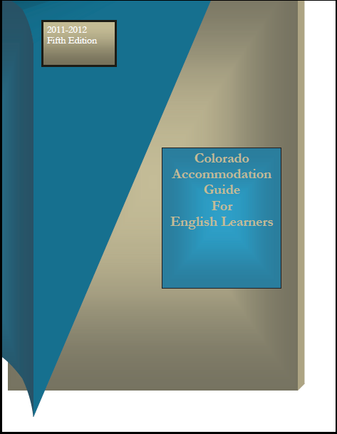
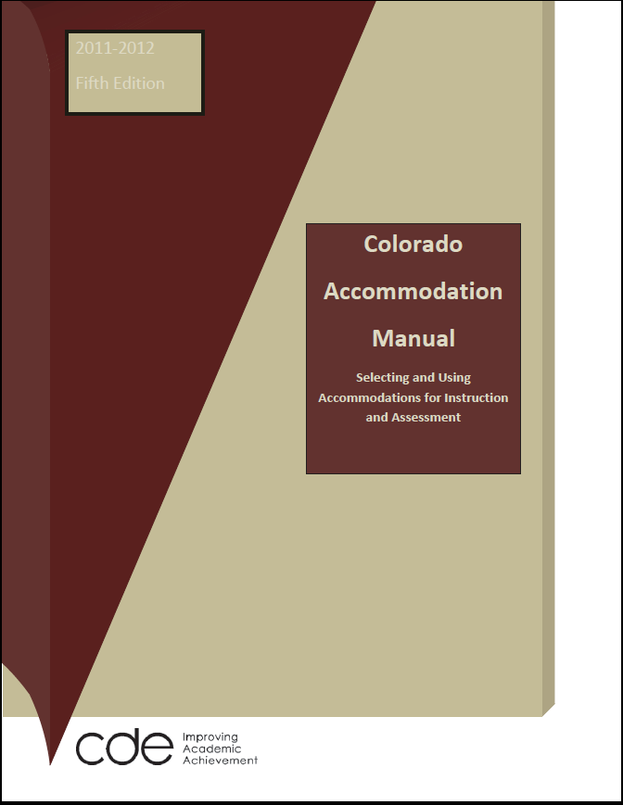
Notes:
There are two references for accommodations: There is a Colorado Accommodations Guide and a Colorado Accommodation Manual. These are available under “Frequently Asked Questions” on the Office of Student Assessments main CSAP/TCAP page.
The Colorado Accommodations Guide is for selecting and using assessment accommodations for English Learners. It:
Focuses on statewide assessment accommodations
Starts with linguistic accommodations specific to English Learners
Includes Standard and Nonstandard accommodation which are available to qualified English Learners
The Colorado Accommodations Manual is for selecting and using accommodations for instruction and assessment for students eligible for test accommodations. It:
Focuses on Standard accommodations for all students with a documented need
Gives information about the Non-Standard Accommodation process available to students with a 504 or IEP
Has a section outlining those accommodations specifically allowable for the state assessments.
There are a few key points we need to highlight about accommodations:
Decisions regarding accommodations must be made based on an individual students need. No accommodations should be universally provided to a specific group of children.
Final decisions regarding provision of accommodations must be made by a team that includes the parent. Each year we receive phone calls from parents wanting to know why accommodations were provided to their child. Accommodations cannot be provided just for the state assessments, when a child receives an accommodation he or she does not regularly use, their performance is often negatively impacted.

Slide 44
Planning for Reading/Writing Accommodations – 2014 sessions
 | Session1 | Session 2 | Session 3 | Session 4 | Session 5 | Session 6
Grade 4 | Writing | Writing | Reading | Reading | Writing | R/W
Grade 5 | Writing | Writing | Reading | Reading | Writing | R/W
Grade 6 | Writing | Writing | Reading | Reading | Writing | R/W
Grade 7 | Writing | Writing | Reading | Reading | Writing | R/W
Grade 8 | Writing | Writing | Reading | Reading | Writing | R/W
Grade 9 | Writing | Writing | Reading | Reading | Writing | R/W
Grade 10 | Writing | Writing | Reading | Reading | Writing | R/W
Notes:
An important aspect of planning for accommodations is ensuring that resources are available during required testing sessions. In 2014, aside from the removal of science, the testing sessions will be the same as they were in 2013. You should note that although session 6 is combined reading and writing, that reading accommodations may only be used for reading items and writing accommodations may only be used for writing items. Session 6 is predominantly reading. Only the last item in session 6 is a writing question.

Slide 45
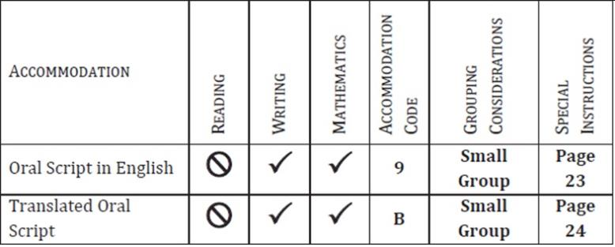


Oral Script
Notes:
Oral scripts can be either a standard accommodation or a linguistic accommodation, depending on the reason the student needs the oral script to access the test.
Oral Scripts are available for TCAP on the Writing and Math Assessments. Oral Scripts are not provided on the Reading TCAP because the Reading test measures students’ ability to read and it would violate the construct of the test to read the Reading test to students.
Oral Scripts must be administered individually or small group (no more 15 students) in a separate environment with students of fairly equivalent language skills and abilities.
Spanish oral scripts are provided by CDE, but if districts want the Oral Scripts translated into any other language they must translate them themselves. Guidelines for how to translate the oral script into other languages are provided in the Procedures Manual Students do not need to be receiving translation accommodations in the classroom to be provided translated oral scripts.
The use of Oral Scripts must be documented and is bubbled on data grid.

Slide 46
Teacher Read Directions
English or native Language
TCAP Reading, Writing, and Mathematics
Follow directions exactly
Separate environment
Individually or small group
Notes:
Teacher Read Directions accommodations are provided by CDE in English or Spanish. They can be used on TCAP Reading, Writing, Mathematics, and Science tests. Proctors must follow directions exactly and administer the tests in a separate environment, individually or in a small group.

Slide 47
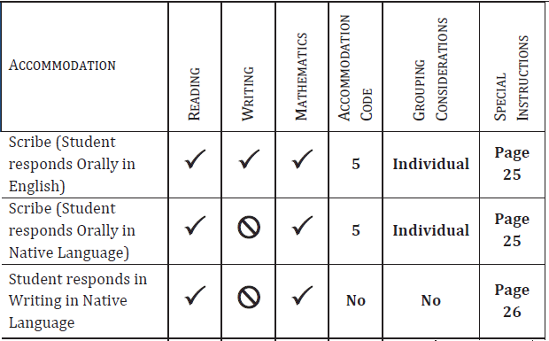

Oral or Written Student Response
Notes:
Oral Response in English or native language or Written Response in native language is a Linguistic Accommodation.
On the TCAP Writing test students must respond in English. There is an accommodation available on TCAP Writing for students to respond orally in English and have their responses scribed into a test book.
For TCAP Reading, or Math there is an accommodation available for students to respond either orally or in writing in either English or their native language. If students respond in another language, their responses must be scribed, translated into English, and transcribed into a new test book.
These accommodations are based on an individual EL’s progress on the continuum of English language development and are appropriate for a student who is Unable to show what he or she knows in a written response based on linguistic development in English, but is Able to show what he or she knows on TCAP by responding orally in English or their native language. The scribe must be trained in scribing for assessments to prevent misadministration

Slide 48
Lectura/Escritura Grades 3 & 4
All procedures for administration are the same as for TCAP, with the following exceptions:
Must be administered in a separate environment by a Spanish-speaking test proctor.
STOP pages – must be printed and inserted before testing and removed before shipping and scoring.
Oral Scripts will be available for Escritura.
Notes:
With just a few exceptions, every aspect of test administration ---procedures and rules regarding security, are the same as the English CSAP – this includes information needed for the data grid.
Lectura and escritura must be administered by test proctor who is fluent in Spanish
Stop pages for Lectura and Escritura are in Appendix B of the procedures manual. These need to be printed and inserted into the test books before the administration of the test and removed before the test books are shipped for scoring. Failing to remove the stop pages for Lectura and Escritura will hinder the scoring process.
Oral Scripts will be available for Escritura.

Slide 49
Student Biographical Data and Test Scores
Notes:
This section will discuss accountability and data management

Slide 50

Use only a standard, wooden, graphite-based, #2 pencil on any part of the test book….
including the front cover!
Notes:
The most basic data we collect is student information so that scores may tied directly to the student who took the test. Assessment personnel should be diligent in avoiding mistakes such as giving the wrong test booklet to a student, or confusing two students with similar or identical names. Test Proctors should fill out the student information on the test booklet cover prior to the first testing session.
Also, it is essential that the test booklets can be properly scanned. Please ensure that number two pencils are to the only thing used to answer items and fill out student data on the front of the test book and the student data grid.

Slide 51
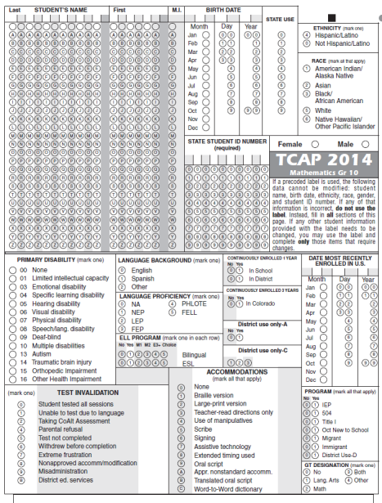
Notes:
The student data recorded on the back of each TCAP Test book is required by Federal and State law. CTB/McGraw Hill will provide bar-coded, adhesive labels that contains the student data required. But if there is no bar code for a student in your district, this student data grid must be completed using a number two pencil. When filling in the student data grid by hand, remember that all student data fields must be filled in.
Testing accommodations are not contained in the student bar code and must be bubbled in on the student data grid. Remember that all accommodations must be bubbled in… not just the primary accommodations.
This is also where you fill in an invalidation code, if necessary.

Slide 52
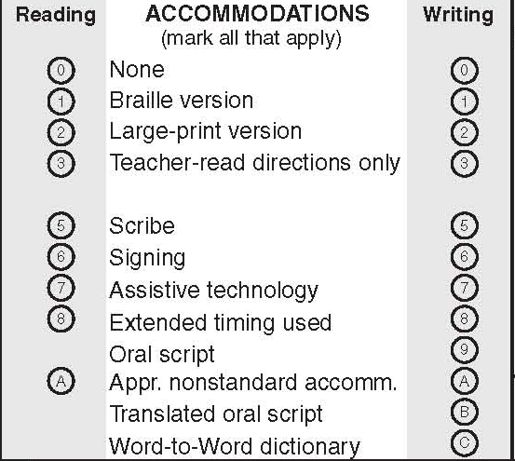
Mark All Accommodations
Notes:
Here is the accommodations box in the student data grid. I emphasize that accommodations used in a particular content area are bubbled in.

Slide 53
Reporting Results
Requirements
  CRS 22-7-409-1.9
    “The results of the assessments…shall be part of the student’s permanent academic record.”
All schools in each district receive reports in a timely manner
Parents receive reports in a timely manner
Notes:
Results from state tests are included in the student’s academic record. CTB/MCGraw Hill will provide score reports to districts, who are in turn responsible for mailing or giving score reports to parents in a timely manner.

Slide 54
Data Interpretation Guidelines
Resource for all stakeholders
Colorado Growth Model guidance
What is data from each assessment used for? What questions can it answer?
Notes:
The Data Interpretation Guide is a resource that is designed for everyone from the superintendent to parents.
It includes guidance for use of the Colorado Growth Model and provides information related to the types of questions each report or assessment can answer – it is directly linked back to the purpose of each assessment.
The data interpretation guidelines are available on the office of student assessment web page, under the menu tab labeled “Data and Results”

Slide 55
Questions about Scores
If school/district personnel or parents have a question about a score…
  First, the DAC should review:
    GRT file
    Past results
    District assessment results
Notes:
When there are questions about scores, and there are every year, there are a couple of things that you need to do before contacting CDE.
First of all, review the GRT file – if there is a question about a no score, consider first if were all the sessions completed and whether a student may have only respond to multiple choice items. The district owns the data so we will direct you back to your GRT file if you call with questions and have not taken that first step. Secondly, you will want to review previous CSAP and TCAP results and district assessment results – if the question centers on inconsistent performance, these pieces of information may help you answer those questions.

Slide 56
Questions about Scores
  Irresolvable questions are forwarded to CDE by the DAC
    Assessment Unit works with CTB to examine the data
    May possibly call you in to review material with us
  Parents cannot view assessments
Notes:
If there are still unanswered questions after you have done your investigative work, then you should forward this to us – we will work with CTB to examine the data and the test itself if necessary. If that happens we will call you into our office to review the material with us. Under no circumstances are parents permitted to view the assessments.

Slide 57
Training
Notes:
All personnel involved in the administration of state assessments must be trained annually. This includes DACs, SACs, test proctors, test examiners and school administrators.

Slide 58
Assessment
Unit
CTB
McGraw-Hill
DAC
and
Core Team
School Assessment Coordinators
Test Proctors, Examiners and Administrators
Notes:
The training you are receiving today constitutes the mandatory DAC training for the administration of the TCAP. The DAC is in turn responsible for providing training to SACs, who are in turn responsible for training the test proctors, examiners and administrators at their school.
But the training cycle is not merely top-down. Throughout the year, CDE and CTB/McGraw Hill disseminate crucial assessment information and schools and districts create attendance, administration and scheduling policies that are unique to their setting. The DAC must ensure that assessments are administered that comply with standardized rules as well as school and district policies and that those policies are complimentary and not contradictory. Additionally, certain members of the Core Assessment Team may be delegated training responsibilities as appropriate.
Finally, the feedback we receive from DACs and personnel down the chain are crucial for better test administration and better training in the future.

Slide 59
Training
“Inadvertent” misadministrations do not occur
Comprehensive and ongoing training must include:
  Test Security
  Test Proctor Requirements
  Ethics
Notes:
Inadvertent misadministrations do not occur. They are caused by training issues. Comprehensive training for state assessment administration and logistics is essential. Key components of training focus on security of the assessments including chain of custody. Requirements for the test proctors includes discussion on the responsibilities.
It is essential that teachers understand that their role as test proctor is different than their normal teaching role. Whereas teachers are expected to provide feedback and encouragement, test proctors are to be removed from the performance of students. It is their role to ensure that student responses are an accurate reflection of what that student knows or can do, on their own, at the time of the test.
Finally, ethics needs to be a part of the conversation – what actions are considered unethical when it comes to state assessments administration is central to the purpose of training.

Slide 60
Training
Required documentation
  Training attendance/completion
  Confidentiality agreements
School administrators must be involved
An updated template for test proctor training will be available soon
Notes:
It will be required that each district provide a document signed by the superintendent and the DAC assuring the state that all district personnel that come in contact with the assessments understand the training that has been provided and guarantees that these central ideas have been the core of state assessment training.
While you will keep documentation on the training of every person in the district, including confidentiality statements verifying that those working with the assessments understand the proprietary and secure nature of the assessments, only the one signed statement needs to be returned to the Assessment Unit.

Slide 61
District Trainers
DACs, SACs, proctors and
faculty must be trained
on a yearly basis!
This is true for EVERYONE…
DACs maintain a record of signed training completion forms and confidentiality agreements.
District Verification Form faxed to CDE
Notes:
The district is responsible for providing training to all faculty and staff on a yearly basis for the state’s assessments.
I emphasize that ALL faculty and staff must receive this training in order to be qualified to administer or proctor the states assessments in an ethical and standardized manner.
As a part of training it is essential that staff understand that these scores follow the students. Thus, their job, to ensure students have equitable opportunities to demonstrate their skills, abilities, and knowledge, is critical.
DACs must collect and maintain a record of training attendance and completion as well as confidentiality agreements signed by all those who come into contact with test materials, whether they proctor the test or not.
DACs must fax the District Verification form to CDE so that we have a record and assurance of training completion.

Slide 62
Security
Notes:
In this section I will discuss important security considerations and policies.

Slide 63
Test Security
Protection of student information and data
Protecting the validity of the state assessments
Financial considerations
Secure test materials and test material reproduction
  Secure
  Secure and may be reproduced
  Non-secure materials
Notes:
Test security is important for two main goals. The first is to protect sensitive student data and privacy. The second is to ensure the validity of the state assessments. When item security is breached, the validity of that item can no longer be ensured. In addition to compromising test scores, a breach of security demands that tests or test items be replaced and this creates an additional financial cost to the assessment system. Following some basic security procedures and active monitoring of test security ensures that test scores are valid an that the assessment system operates efficiently.
In previous editions of the Procedures Manual, it was stated that all testing materials are secure and may not be reproduced. But some test materials such as the Test Proctor’s Manual and the DAC/SAC Guide are not secure and may be reproduced, if needed. Additionally, some test materials are secure but must still be reproduced by DACs such as Oral Scripts and Teacher Read Directions. The 2013-14 Procedures Manual clarifies which materials are secure and not to be reproduced, which materials are secure but may be reproduced, and which materials are not secure.

Slide 64
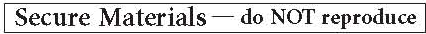
Maintaining Security of TCAP
Test books must be secured while in the TCAP Test Proctor’s possession
No duplication of TCAP materials is permissible.
No cell phones or other communication, reproduction or recording devices are allowed in the classroom
Notes:
There are some basic principles to consider in maintaining the security of test materials. The first is physical security. When not being used for test sessions, test materials should be locked in a secure, centralized location accessible only to those responsible for test security.
TCAP test books, draft books containing student responses, student responses themselves, and other secure assessment materials should never be reproduced or transmitted in any way. This even includes writing test specific content into an e-mail for clarification. Any specific questions about test items should only be discussed over the phone. If it becomes necessary for CDE to see actual test materials, you should call the Office of Student Assessment and arrange for a transfer of those materials which may be done by fax or secure courier mail.
Test items and material should never be discussed by test proctors or administrators with one another. This includes conversations as well as writing or communicating via electronic devices. It should go without saying that it is highly unethical to discuss test items with students and parents.
One of the simplest ways to reduce the risk of test material reproduction is to remove devices with the capability to reproduce or communicate about test items from the test environment. Cell phones and other communication, reproduction or recording devices such as cameras, voice recorders, calculators with a file saving function or any device with similar capabilities are expressly prohibited in the testing environment. Electronic devices represent a particular security threat because of their ease of use. But proctors and others involved in test administration should also be on the lookout for lower tech means of test material communication such as notes.

Slide 65
Chain of Custody
Document before, during, and after testing
Deliver materials to schools no more than 1 week in advance
Distribute only the content area being assessed
Return materials to a designated secure location
  Not stored in classrooms
Return materials to CTB
Notes:
Besides preventing the reproduction and transmission of test items, the most basic and effective measure of maintaining test security is a strong chain of custody.
Your district and school testing plans should identify where testing materials will be kept and who will be responsible for them at what times. Materials should arrive at schools no more than one week prior to testing. If a school has requested materials for the early testing window, then they should test in that early window. Any delay increases the possibility of test security breaches. The same logic applies to returning materials. The sooner materials are returned the better.
A documented chain of custody is a record of where materials are before, during and after testing. Materials should not be delivered to schools more than one week in advance of testing. Test booklets must be distributed right before administration, and only the content area being assessed may be distributed for instance, if my school is testing math, then only the math test is to be distributed. The tests are distributed the day of testing, not before.
In depth data grid, packing and shipping information is covered in the logistics training.
The chain of custody is essential, and in the big picture means that you have documentation of where any of the TCAP materials are at any given time. This applies from the time materials arrive in the district, throughout administration, during packing and shipping, and even after materials leave the district. Keeping an accurate record of materials shipped can help you solve any problems if they were to arrive.
Materials must be returned to a designated secure location each day. Materials must not be stored in classrooms in advance of or following days of administration.
Secure materials are all the test books, including large-print and Braille test books. The oral scripts and teacher read directions are also secure and must be returned to CTB with not to be scored materials.

Slide 66
Teacher Created Test Preparation Material
  Ensure that any teacher-created materials (whether distributed or not) are free of actual assessment items
      (Does not apply to TCAP released items) DACs need a methodology to document that this has been taken care of at every school.
Notes:
If teachers have created TCAP test prep materials other than using information off the website, make sure that there are no actual assessment items (current year or previously used) included in those materials.
The assessment unit also strongly encourages, but does not require, schools to maintain a record of materials used in test preparation by teachers, including where the materials came from, or who created them and when and also when they are intended to be used in class. This step helps to prevent an unscrupulous teacher from passing off their use of actual test items as items that they created on their own.

Slide 67
Communication
Notes:
This section will review the communication protocols and resources available to DACs

Slide 68
The Ways We Communicate
Manuals
DAC Emails
Phone Calls and Emails
CDE Trainings
Websites
  cde.state.co.us
  ctb.com and Navigator
Notes:
Here is a list of the various ways that the Assessment Unit communicates with District Assessment Coordinators. In this section I will briefly discuss each of these.

Slide 69
Assessment Resources
2013-2014 Procedures Manuals
2013-2014 Accommodation Manual and Guide
2014 SAC/DAC Manuals
2014 Test Proctor’s Manuals
SBD Manual
Notes:
We have many resources available for your use that deal specifically with the many aspects of TCAP administration, all of which will be available to download from the CDE website. Whenever we post materials on the website we will send a DAC email to notify you. Remember that hard copies of the test proctors manuals are sent to you with the test books. These resources need to be the first place you look in response to your questions. They contain the highest quality, most thoroughly vetted information and have been reviewed by other units at CDE and by CTB. We often direct you back to these resources when you contact us. These really do have the answers to 95% of your questions, so please take the time to familiarize yourself with the information they contain.
A large part of our responsibility at the Assessment Unit is to provide you the DAC with the support necessary to implement the required policies and procedures. DACs, please know that you can and should call or email us when you have questions. We may direct you back to the procedures manual (or another manual or guide) in response to your question, but only because we want you to be able to fully utilize the resources that are available.

Slide 70
DAC EMAILS
The DAC must forward the important information to the appropriate people in the district.
When responding to a DAC email
  DO NOT click Reply
  Send an email directly to the contact person
    Forward the message to the contact person OR click on the contact person’s email address
Notes:
The DAC is the only district staff member officially designated to conduct the official business between the school district, the Office of Standards and Assessments at the Colorado Department of Education, and the assessment vendor CTB-McGraw-Hill. This is why we must have one official email for you.
It is important that you establish a communication system with your district leadership and throughout your district as a way to ensure consistent and reliable dissemination of critical information relative to the assessment system. This includes providing important information regarding expectations for security and confidentiality, and ensuring critical information, such as the accommodations manuals are distributed to every teacher in your schools. Information available on the CTB navigator site is accessible only to the DAC. After obtaining the secure assessment materials, the DAC may make them available to others as needed.
When responding to a DAC email or asking a follow up question, please send your email directly to the contact person listed. Do Not click Reply. All of our DAC emails are sent from Margo Allen at CDE, but many times she is not the contact person. Please forward the message to the contact person or click on the contact person’s email address. If emails are not sent to the correct person, it takes additional time to respond. This delay can be critical.

Slide 71
Assessment Unit Contacts
Joyce Zurkowski– Executive Director
Jason Clymer – New Assessment Contact
Assessment Unit (Margo Allen) − TCAP contact
Mira Monroe – CoAlt, Non-Standard Accommodations
Heather Villalobos Pavia – WIDA Assessments, Linguistic Accommodations
Stephanie Boyd – PARRC contact
Jessica Allen – Data Operations
Margo Allen − DAC List
Christina Wirth-Hawkins – Director, Assessment Development
Clayton Hollingshead – Director, Assessment Administration
Notes:
The Assessment Unit is always standing by for your questions and to assist you with assessment administration. The contact information for all Assessment Unit personnel can be found in the front of the Procedures Manual.
At this time, for questions regarding the TCAP assessments please call the Assessment Unit main number and Margo Allen will ensure your call is directed to the appropriate staff member.

Slide 72
CTB.com and Navigator
Secured Site – for DACs
  Online enrollments and special populations
  Secure Materials: oral scripts, translated oral scripts, teacher read directions for TCAP
  Archived Emails
  Data: NCounts, GRT files, official data retrieval
  Help Desk (800) 994-8557
Notes:
Our test vendor, CTB, maintains two websites, a non-secure site at ctb.com/tcap and a secure website called Navigator that is used to obtain secure materials. Navigator is available by going to the non-secure site, clicking on the Navigator tab on the left, and entering your username and password. Navigator is organized by assessment (TCAP or CoAlt) and then its organized by section.
Only DACs can log in to Navigator. You will need a username and password to login and get secure files. If you do not already have a username and password for Navigator call the CTB customer service line at 800.994.8557. CTB will walk you through the process. You may have other staff in your district that need to login to Navigator to access certain information – maintaining confidentiality is critical. The Procedures Manual contains confidentiality agreements for you to use with your staff as needed.
CTB stores secure materials on Navigator like GRT files and Ncount files, the English and Spanish versions of oral scripts and teacher read directions, and interpretation guides. Some collection of information important for CTB operations also happens through Navigator. Online Enrollments, for example, for CSAP special populations (LP, Braille books) are entered by district through Navigator for CTB to fulfill.

Slide 73
Thank You!
Please complete the survey after this training. This is our record of your attendance at this required training.
Go to:
https://www.surveymonkey.com/s/TCAP2014
Notes:
Thank you for your time today.
Please complete the required survey after participating in this training. Not only is it the record of your attendance, it will allow us to improve this and other online trainings in the future.
https://www.surveymonkey.com/s/TCAP2014

