Slide 1
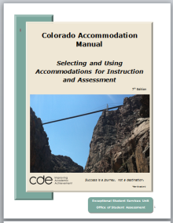
Welcome!
Colorado Department of Education
Exceptional Student Services Unit
Overview of the 2013-14
Building Bridges for the Future
Colorado Accommodation Manual
Part I
Section I Guidance
Section II Five-Step Process
Notes:
Here’s our new 7th Edition of the Colorado Accommodation Manual—We did a pretty complete overhaul last year, so most things are still the same. We’ll point out new features as we go along.
We are still working on preparing the final copy to post, so please bear with us for a few more days. Our goal is Sept. 1!

Slide 2
CDE Contacts
Instructional Accommodations
  Linda Lamirande – Exceptional Student Services Unit
  Lamirande_L@cde.state.co.us
  303-866-6863
Accommodations for State Assessments
  Mira Monroe – Assessment Unit
  Monroe_M@cde.state.co.us
  303-866-6709
Notes:
For questions regarding the selection and implementation of instructional accommodations for students with disabilities, please contact Linda Lamirande, Assessment & Accommodations Senior Consultant, Exceptional Student Services Unit 303-866-6863 or email Lamirande_L@cde.state.co.us]
Linda is also the contact for alternate standards and assessment eligibility, the 11th Grade Alternate for Colorado ACT and alternate standards for standards-based IEPs
For questions regarding accommodations allowable for the state general and alternate assessments, please contact Mira Monroe at (303) 866-6709 or monroe_m@cde.state.co.us

Slide 3
Who Needs Training About Accommodations?
Develop District Training Plan
  Administrators
  Classroom Teachers
  Related Service Personnel
  Paraprofessionals
  Campus support staff
  Parents
Notes:
Thank you for taking time today as we review the updated Seventh Edition of the Colorado Accommodation Manual. In order for students who have a documented need or a disability to fully access their instruction and assessment, administrators, teachers, service providers, students and parents need to develop an understanding of how the use of accommodations can foster independence.
Any educational personnel who support the education of a student with a disability, should have an appropriate level of understanding about the student’s use of an accommodation.

Slide 4
Colorado Accommodation Manual Guidance applies to….
Any student with a documented need, including students with a disability who are served under Section 504 of the Rehabilitation Act of 1973, and students who are eligible to receive special education services under the Individuals with Disabilities Education Improvement Act 2004 - IDEA
Notes:
Note that Section 504 and IDEA -special education- are federal laws protecting individuals with a disability; all other educational plans and educational teams are defined and administered by the district.

Slide 5

Who will use the manual?
Various types of educational teams may be assembled to consider a student’s educational needs.
The role of the team is to thoughtfully determine and document appropriate accommodations needed to access instruction and assessment.
All decisions will be made and documented in a formal educational plan according to applicable local, state and federal guidelines
Formal plans may include, but are not limited to:
English Language Acquisition Plan
Individual Literacy Plan
RtI Plan
Advanced Learning Plan
School or district document kept in the student’s cumulative record
Section 504 Plan / Individual Accommodation Plan
Individualized Education Program IEP
nationalspecialedlaw.com
Notes:
There may be some new requirements related to the READ Act and how that may need to be included in the IEP. Those decisions are not final yet, so just know that will be coming.

Slide 6


Who will use the manual?
Notes:
Where does this manual need to be? …. in the hands of Colorado teachers. If educators are not aware of their responsibility to thoughtfully choose and evaluate the use of accommodations for certain qualified students, then the only losers are the students.
With our focus on educator effectiveness and improved student achievement, using accommodations appropriately for all eligible students can move us one step closer to ensuring that ALL students in Colorado have a fair and equal chance to receive standards-based instruction and demonstrate mastery.
We are reaching out to all of you who watch this training today, to take this information back to your districts and campuses as our trainers, or into the classroom with your students. All the words in this manual will do absolutely no good for students unless YOU make the effort to see that teachers know about the manual—know where to access it—and know how to use it effectively for instruction and assessment.

Slide 7

Why should teachers use the manual?
Measuring our progress is not only required legally, but….
Implementing the use of accommodations with fidelity is
Best Practice, which will lead to…
Notes:
The student in this picture is signing the concept MEASURE…..Why are we required to measure our effectiveness as educators? ….Why are we required by law to follow both federal and state regulation with regard to serving students with a documented need, including students with a disability?...
Because as educators, we are not only legally bound, but also ethically bound to follow Best Practice, as well as we know it at the time, because simply….it’s the right thing to do for students.

Slide 8
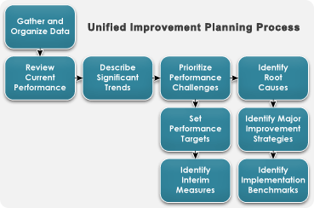
Compliance & School Improvement
Notes:
As all schools and districts strive to mark progress in the Unified Improvement Planning Process and receive improved school ratings, or to adopt specific strategies for a Turnaround or Priority Improvement Plan, implementing the best instruction possible for ALL students, will reap great benefits. Utilizing the concept of Universal Design will increase access for all types of learners.

Slide 9
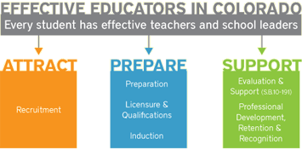
Improved Educator Effectiveness
Notes:
Great teachers and great leaders matter. Classroom teaching and principal leadership are the strongest predictors of student achievement. That’s why the Colorado Department of Education is focused on helping the state’s 178 school districts better attract, prepare and support educators who significantly improve students’ academic growth and mastery of standards, and prepare students for postsecondary education and the workforce.

Slide 10

Improved Student Performance
Notes:
But most of all, appropriate access to instruction and assessment will lead to improved Student Performance.
I haven’t had a chance to compile and analyze our data from this past spring yet. I’m hoping to see some improvement in the performance of students with an IEP compared to those that do not. Last year, there was a gap of more than 40 points. Remember we are not after “The illusion of inclusion”….we want to transform and differentiate our instruction in order for students to not only “access” the general curriculum, but to achieve mastery.

Slide 11

New Features
Cover – Building Bridges for the Future
Section 1: Guidance
  Revised Participation Guidelines for Alternate Instruction and Assessment
  Companion Document
Section 2: The Five-Step Process
  Document Technology Considerations for PARCC (New Section IV
Notes:
The front cover graphic is intended to represent our transition into a new age of computer-based instruction and assessment for students, including students with a disability. My husband took this picture of the Royal Gorge Bridge from the open car of the Royal Gorge Train a few weeks ago. I thought the picture could represent the idea that we are firmly anchored in the past, but are aiming for improved student performance in the future. The crossover—or the bridge-- to computer-based assessment has seemed somewhat far away and is a little bit scary, but with the help of the PARCC consortia and Pearson, who is building the Science and Social Studies tests, the accessibility features and enabled accommodations will become a reality….not exactly sure how everything will work yet…I’m sure some things will change as the various accessibility features are field tested…. but there are some considerations the IEP Team will need to consider and decisions documented in IEPs as the annual meetings come up during this school year. I’ve added a new Section IV for Technology, so we will talk much more about that in next Thursday’s webinar session.

Slide 12
Purpose of the
Accommodation Manual
Provide decision-making guidance for all types of educational teams
Participation Guidelines for Alternate Standards for Instruction and Assessment
Instructional adaptations
Accommodations for state summative assessments
Notes:
The purpose of the manual is to provide decision-making guidance for all types of educational teams, the personnel of which may include campus administrators, general education teachers, special education teachers, school psychologists, speech and language pathologists, related service personnel, and paraeducators who are working in collaboration with families to
design and provide effective educational plans for students
set forth participation guidelines for students with a significant cognitive disability who will take alternate assessments based on alternate academic achievement standards
offer suggestions and resources for instructional adaptations based on student characteristics which are intended to provide access to the general curriculum for all students who have a documented need, including students with a disability
outline qualifications for the use of standard, restricted, and nonstandard accommodations on state summative assessments

Slide 13
Features
Navigation – the manual is formatted to be read online
  Each section can be accessed independently
  Section headings are bookmarked to specific sections in the document
Manual will be posted soon!
Notes:
In order to conserve resources and improve ease of access, the Seventh Edition of the Colorado Accommodation Manual is offered as an online version for Colorado educators.

Slide 14
Part I – Instructional Accommodations
August 22nd Webinar:
Section 1 Guidance
Section II The Five-Step Process
August 29th Webinar:
Section III Tools
Section IV Technology
Notes:
Each Section will be covered in the upcoming webinars on Aug. 29th , ………..

Slide 15
Part II –Accommodations for State Assessment
Part 2: Accommodations for State Assessment
September 5th Webinar:
Section V Policies and Procedures
Section VI Accommodations for Use on TCAP
Section VII Accommodations for Use on CoAlt (Current and New)
September 12th Webinar:
Section VIII Accommodations for ACCESS for ELLS and Alternate ACCESS
Section IX Accommodations for Science and Social Studies
Notes:
Part II - Sept. 5th and Sept. 12th will be Mira’s.
Instructional Accommodations – Linda-------State Assessment accommodations, Mira.

Slide 16
Instructional Accommodations
Section I: Guidance

Slide 17

Section I
Responsibilities of Educational Teams
  Documenting decisions in the Educational Plan
Guidelines for Determining Eligibility for Accommodations
  Culturally and/or Linguistically Diverse Learners
  Students Identified as Gifted and Talented Who Also Have a Disability
  Students with a Disability Served Under Section 504
  Special Education Disability Categories
Determining Academic Standard for Instruction and Assessment
    Participation Guidelines Worksheet and Companion Document
Federal and State Laws
Notes:
At the beginning of each Section of the manual, there is a table of contents that lists the topics discussed in that section. We’ve tried to be very detailed here, so that you can locate the information you need easily. Just click on the title and it will take you to that section of the document.
The new feature in this section that we will look at today, is the revised Participation Guidelines Worksheet and companion document. These tools are intended to offer clarification to IEP Teams around the choice of grade-level or alternate standards for instruction and then for appropriate assessment.

Slide 18
Alternate Academic Achievement Standards and
Alternate Assessment
Participation Guidelines Worksheet
Notice the change of title:
Alternate Standards and Assessment Eligibility Criteria Worksheet
To new title:
Alternate Academic Achievement Standards and Alternate Assessment
Participation Guidelines Worksheet
Notes:
The reason for the change of name is twofold:
To separate the Determination of Eligibility Checklists that are used to determine whether a student meets eligibility criteria to receive special education services from the process of determining whether a student meets participation guidelines to receive instruction on alternate standards (EEOs) and to take alternate assessment –
to be in line with wording the consortias are using
Let’s look more closely at the worksheet: I will develop a stand alone training that will likely be offered as a live webinar and posted later on so we’ll not go totally into it now, but I do want you to get the basic gist….

Slide 19
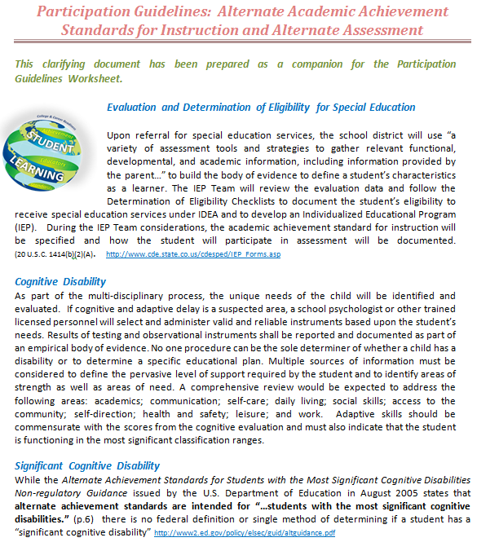
Alternate Academic Achievement Standards and Alternate Assessment
Participation Guidelines Worksheet
Alternate Academic Achievement Standards and
Alternate Assessment
Participation Guidelines Companion Document
Will be Available in
Booklet format also
Notes:
This clarifying document has been prepared as a companion for the Participation Guidelines Worksheet for educators and IEP Teams to give expanded definition of terms.

Slide 20
Special Education Eligibility Alternate standards and assessment
Determination of Eligibility- Disability Category
Identification of Student Need & Evaluation of Cognitive Component
Impact of the disability falls within the
Significant cognitive disability range
IEP Team considers alternate standards for instruction and alternate assessment
Notes:
You may consider the IEP Team process of working through the Participation Guidelines Worksheet as being like that of using a funnel…..going from broad to a very specific population. This process can also help you have conversations with parents about cognitive and adaptive abilities. I understand it is not always easy to go there….but in order for the student to have the very best program we can design, it is necessary. Parents absolutely must understand the concept of standards-based instruction and how it best applies for their child.

Slide 21
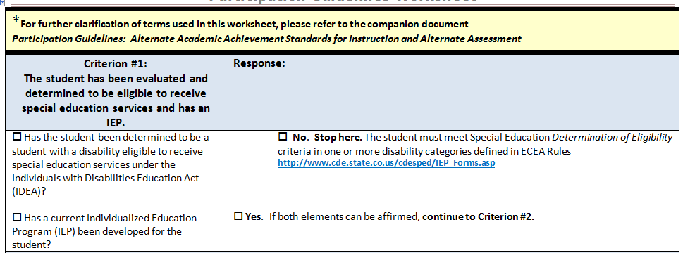
Participation Guidelines Worksheet
Notes:
Upon referral for special education services, the school district will use “a variety of assessment tools and strategies to gather relevant functional, developmental, and academic information, including information provided by the parent…” to build the body of evidence to define a student’s characteristics as a learner. The IEP Team will review the evaluation data and follow the Determination of Eligibility Checklists to document the student’s eligibility to receive special education services under IDEA and to develop an Individualized Educational Program (IEP).
If the student was referred, but did not meet eligibility criteria to receive special education services, then the process stops here and the student receives instruction based on grade-level standards and takes grade-level assessment with/without accommodations (perhaps under Section 504)
If the student is eligible under one of the 13 disability categories and the IEP Team develops an IEP, then considerations proceed to Criterion #2

Slide 22
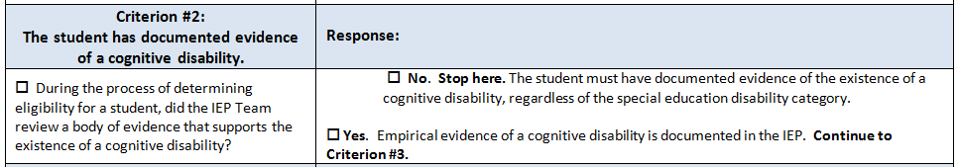
Participation Guidelines Worksheet
Notes:
As part of the multi-disciplinary process, the unique needs of the child will be identified and evaluated. If cognitive and adaptive delay is a suspected area, a school psychologist or other trained licensed personnel will select and administer valid and reliable instruments based upon the student’s needs. Results of testing and observational instruments shall be reported and documented as part of an empirical body of evidence. No one procedure can be the sole determiner of whether a child has a disability or to determine a specific educational plan. Multiple sources of information must be considered to define the pervasive level of support required by the student and to identify areas of strength as well as areas of need. A comprehensive review would be expected to address the following areas: academics; communication; self-care; daily living; social skills; access to the community; self-direction; health and safety; leisure; and work. Adaptive skills should be commensurate with the scores from the cognitive evaluation and must also indicate that the student is functioning in the most significant classification ranges.

Slide 23
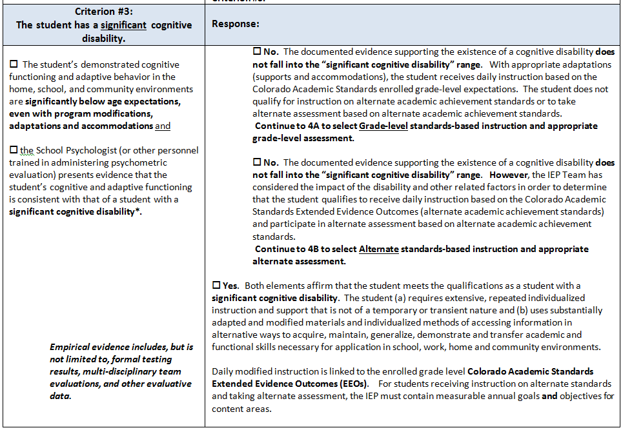
Participation Guidelines Worksheet
Notes:
While the Alternate Achievement Standards for Students with the Most Significant Cognitive Disabilities Non-regulatory Guidance issued by the U.S. Department of Education in August 2005 states that alternate achievement standards are intended for “…students with the most significant cognitive disabilities.” (p.6) there is no federal definition or single method of determining if a student has a “significant cognitive disability” http://www2.ed.gov/policy/elsec/guid/altguidance.pdf
Since the impact of having an intellectual or cognitive disability varies considerably, just as the range of abilities varies considerably among all people, the designation of “the most significant cognitive disability” is left to the professional judgment of the school psychologist and other professionals contributing to the body of evidence gathered during the evaluation and considered by the IEP Team. Generally, such students can be characterized as having intellectual functioning well below average (typically associated with cognitive measures indicating an IQ below 55, / 3.0 standard deviations or more below the mean) that exists concurrently with deficits in adaptive functioning. This reference is offered to help distinguish between students who meet eligibility criteria to receive special education services as a student with an Intellectual Disability and students with a significant cognitive disability.
The words “typically associated with IQ below 55” allow for some district/school flexibility; it is not intended to be an absolute requirement. For students with IQ measured in the 55-70 range, additional factors related to the impact of the disability must be taken into account.

Slide 24
Companion Document
Significant Cognitive Disability
While the Alternate Achievement Standards for Students with the Most Significant Cognitive Disabilities Non-regulatory Guidance issued by the U.S. Department of Education in August 2005 states that alternate achievement standards are intended for “…students with the most significant cognitive disabilities.” (p.6) there is no federal definition or single method of determining if a student has a “significant cognitive disability” http://www2.ed.gov/policy/elsec/guid/altguidance.pdf
Since the impact of having an intellectual or cognitive disability varies considerably, just as the range of abilities varies considerably among all people, the designation of “the most significant cognitive disability” is left to the professional judgment of the school psychologist and other professionals contributing to the body of evidence gathered during the evaluation and considered by the IEP Team. Generally, such students can be characterized as having intellectual functioning well below average (typically associated with cognitive measures indicating an IQ below 55, / 3.0 standard deviations or more below the mean) that exists concurrently with deficits in adaptive functioning. This reference is offered to help distinguish between students who meet eligibility criteria to receive special education services as a student with an Intellectual Disability and students with a significant cognitive disability.
The words “typically associated with IQ below 55” allow for some district/school flexibility; it is not intended to be an absolute requirement. For students with IQ measured in the 55-70 range, additional factors related to the impact of the disability must be taken into account.
Notes:
Here’s an excerpt from the companion document related to the definition of significant cognitive disability.
If you have questions related to evaluating the cognitive component of a specific disability category, the specialists of the Exceptional Student Services Unit are always available to you. The contacts are on the IEP Forms page where the eligibility checklists are located.

Slide 25
Participation Guidelines Worksheet
Notes:
While the Alternate Achievement Standards for Students with the Most Significant Cognitive Disabilities Non-regulatory Guidance issued by the U.S. Department of Education in August 2005 states that alternate achievement standards are intended for “…students with the most significant cognitive disabilities.” (p.6) there is no federal definition or single method of determining if a student has a “significant cognitive disability” http://www2.ed.gov/policy/elsec/guid/altguidance.pdf
Since the impact of having an intellectual or cognitive disability varies considerably, just as the range of abilities varies considerably among all people, the designation of “the most significant cognitive disability” is left to the professional judgment of the school psychologist and other professionals contributing to the body of evidence gathered during the evaluation and considered by the IEP Team. Generally, such students can be characterized as having intellectual functioning well below average (typically associated with cognitive measures indicating an IQ below 55, / 3.0 standard deviations or more below the mean) that exists concurrently with deficits in adaptive functioning. This reference is offered to help distinguish between students who meet eligibility criteria to receive special education services as a student with an Intellectual Disability and students with a significant cognitive disability.
The words “typically associated with IQ below 55” allow for some district/school flexibility; it is not intended to be an absolute requirement. For students with IQ measured in the 55-70 range, additional factors related to the impact of the disability must be taken into account.

Slide 26
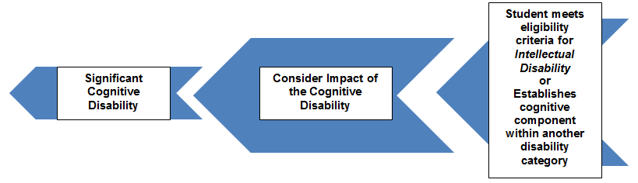
Participation Guidelines Worksheet
It is the existence of the significant cognitive disability, regardless of special education eligibility category, that allows the IEP Team to consider the option of alternate standards and assessment.
Notes:
It is the existence of the significant cognitive disability, regardless of eligibility category, that allows the IEP Team to consider the option of alternate standards and assessment.
Only a small number of students who have a significant cognitive disability meet the participation guidelines to receive instruction based on the EEOs and take alternate district/state assessments based on alternate academic achievement standards. However, the number of students who meet the participation guidelines is not limited, nor can it be administratively determined.

Slide 27
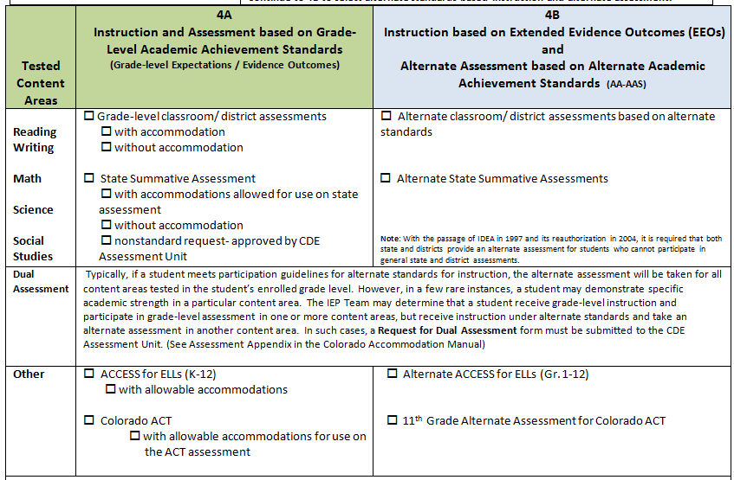

Participation Guidelines Worksheet
Data Pipeline for 2014
Notes:
This section is also arranged a little differently from the previous worksheet. If the IEP Team chooses Grade-Level academic achievement standards, then mark the appropriate boxes under the green section 4A. The student will take all tested areas for their grade level with or without accommodation. If an accommodation is chosen that is considered to be a nonstandard accommodation, then that would be sent in to the Assessment Unit for approval
If the IEP Team decides on alternate standards, then the boxes are under the blue section 4B. Previously, each content area was marked separately. Our current information from the consortias is that if a student meets participation guidelines for alternate, the student will take an alternate for all tested areas. Now, there is a note for Dual Assessment that says…..

Slide 28

Questions?

Slide 29
Instructional Accommodations
Section II: The Five-Step Process for Selection, Implementation and Evaluation of Instructional Accommodations

Slide 30
Step 1
Colorado Academic Standards with
Extended Evidence Outcomes
Expect all students to achieve
standards-based instruction

Slide 31
Standards-Based Instruction
Colorado English Language Proficiency Standards
Colorado Academic Standards
Common Core Standards
21st Century Learner Skills
Post-Secondary Workforce Readiness
Grade-level Skills & Evidence Outcomes
In Colorado, “all” means “all” learners….
Notes:
In Colorado, “all” means “all” learners. The integration of the Extended Evidence Outcomes into—not along side of or in addition to—but into the Colorado Academic Standards is evidence that students with a disability are not separate learners from their peers, but rather they are supported learners receiving sound standards-based instruction with appropriate levels of support.

Slide 32
Extended Evidence Outcomes (EEOs)
Extended Evidence Outcomes Adopted August 3, 2011 On August 3, 2011, the State Board of Education unanimously adopted the EEO. EEO provide the alternate standards in Mathematics, Science, Social Studies and Reading, Writing and Communicating for students with significant cognitive disabilities who qualify for the alternate assessment. These alternate expectations are directly aligned to the grade level expectations for all students.
Mathematics with EEOs
Reading, Writing and Communicating with EEOs
Science with EEOs
Social Studies with EEOs
For students receiving instruction on alternate standards, measurable goals and objectives are required in the IEP

Slide 33
Step 2
Colorado Accommodation Manual
Description of Accommodation Categories
Presentation
Response
Setting and Environment
Timing and Scheduling
Learn about accommodations for instruction and assessment

Slide 34
Step 3
Documentation Tools
Selection Process Considerations | Accommodation Selection Tools
Student Characteristics as a Learner | Student Characteristics Charts
Frequently Used Accommodations Arranged by Disability-Specific Categories | Tables A-N
Selecting, implementing and evaluating accommodations for Instruction | Glossary of Instructional Accommodations Chart
Documenting Accommodations | IEP: Instructional & Assessment
Select and document accommodations based on the learning needs of an individual student

Slide 35
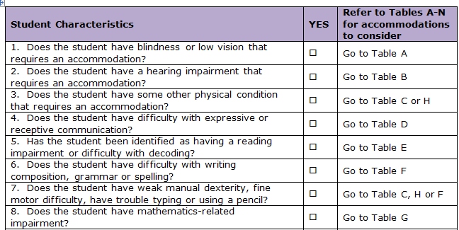
Step 4
Using Accommodations During Instruction
Implement accommodations during instruction and assessment

Slide 36
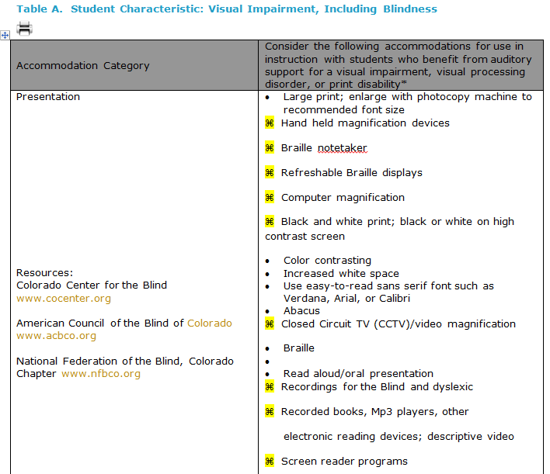
Tables A-N

Slide 37
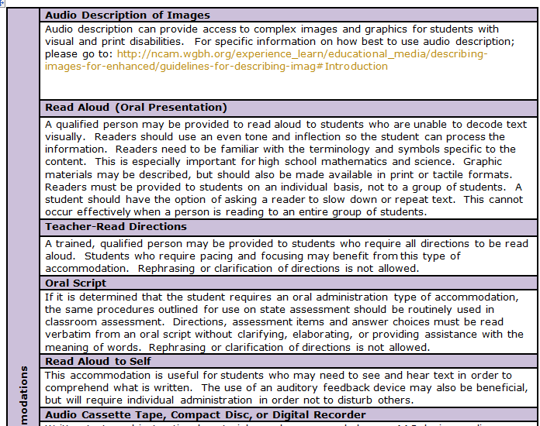
Glossary of Instructional Accommodations Chart

Slide 38
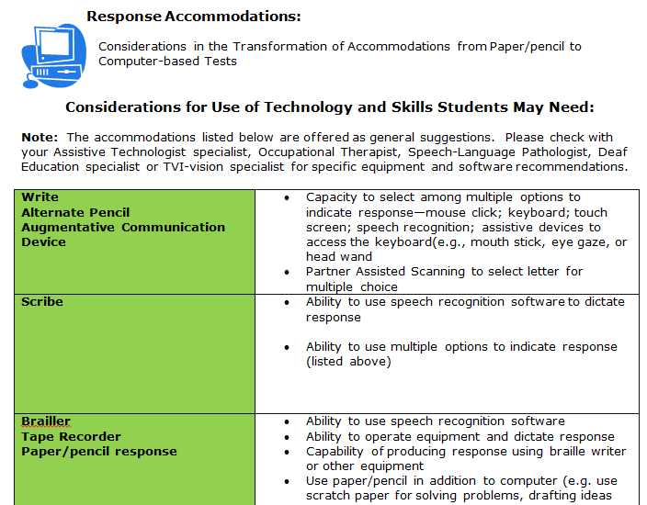
Technology Considerations

Slide 39
Step 5
Data Gathering Tools
Evaluation of Accommodation Use Data Collection Sheets
Infused Skills Grid
Accommodations from the Student’s Perspective
After-test Accommodations Questions
Evaluate and monitor the use of accommodations

Slide 40
Questions?

Slide 41
Part I – Instructional Accommodations
August 22nd Webinar:
Section 1 Guidance
Section II The Five-Step Process
August 29th Webinar:
Section III Tools
Section IV Technology
Notes:
We are so pleased with the great response, but we still have to work on some solutions to accommodate access for everyone, so please be patient and watch your email! Information will go in the SCOOP next Wednesday and we will be contacting those who have already registered for the Aug. 29th session to let you know if we’ll have two sessions again from 9-10:30 and a repeat from 11:30-1.

Slide 42
Please call if we can help!
Contact Information:
Linda Lamirande – Instructional Accommodations
Lamirande_L@cde.state.co.us
303-866-6863
Mira Monroe- Accommodations for Assessment
Monroe_M@cde.state.co.us
303-866-6709

