Slide 1
TAP Meeting
September 26, 2024

Slide 2
Welcome & Introductions
Welcome!
  The purpose of the TAP is to provide non‐binding technical recommendations to CDE regarding the Colorado Growth Model, state accountability, and other topics as needed.
Meeting Logistics:
  Non‐members, please add your Name/Affiliation to the chat box.
  Everyone please mute your sound.
  We ask all non‐TAP members to hold any comments until the end of the meeting. We do this to ensure we have sufficient time to address all meeting agenda items.

Slide 3

Content for Today’s Presentation
Summary of 2024 Growth & Prelim Framework Results
Update on 1241 Stakeholder Taskforce
Update on digital PSAT/SAT Implications for Accountability
Changes for 2025 frameworks & Prep for 2025 Target Setting
Public Comment

Slide 4
Content for Today’s Presentation
Summary of 2024 Growth & Prelim Framework Results
Update on 1241 Stakeholder Taskforce
Update on digital PSAT/SAT Implications for Accountability
Changes for 2025 frameworks & Prep for 2025 Target Setting
Public Comment

Slide 5
Summary of CMAS & PSAT/SAT Notable Trends for Growth Data
ES & MS Growth | Growth continues to generally match pre-pandemic levels for elementary (ES) and middle school (MS) levels, including a little boost in Math.
ES & MS Pandemic Recovery | While historically-equivalent growth is encouraging, higher growth will increase ES and MS students' likelihood of returning to pre-pandemic levels of achievement.
Growth Gaps | Populations of historically disadvantaged students have returned to pre-pandemic growth levels. Given historical trends, however, these groups will continue to fall further behind without a focus on acceleration.
High School PSAT/SAT | The 2024 digital assessment results will be a new starting point for describing future trends. There are already noticeable gaps for some disaggregated student groups in the current year.

Slide 6
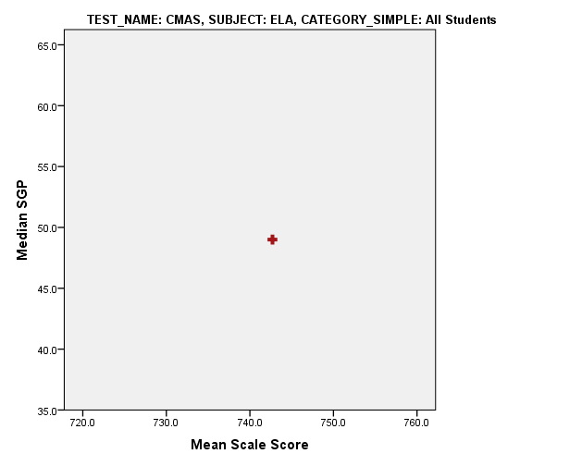
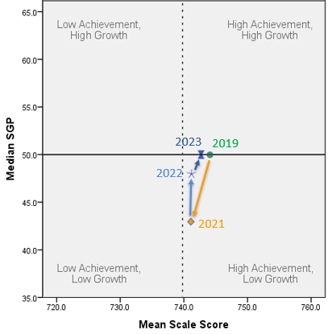
For ES and MS ELA, growth will need to increase to return to pre-pandemic levels.
Summary: To move to the "high ach/high growth" quadrant, higher growth is needed. The gap between 2024 and pre-pandemic levels is unlikely to close without higher growth.
English Language Arts
2024
Vertical dotted line approximates performance framework “Meets State Expectations” cut-score
Notes:
Slightly lower growth than 2023, but nearly identical mean scale score
Almost back to 2019 achievement
Note- Having looked last week and again today, I cannot find the excel doc where I build the original 4-quad charts, so I’m just pasting the 2024 data directly on top of the graphic, but will fix for SBE pres

Slide 7
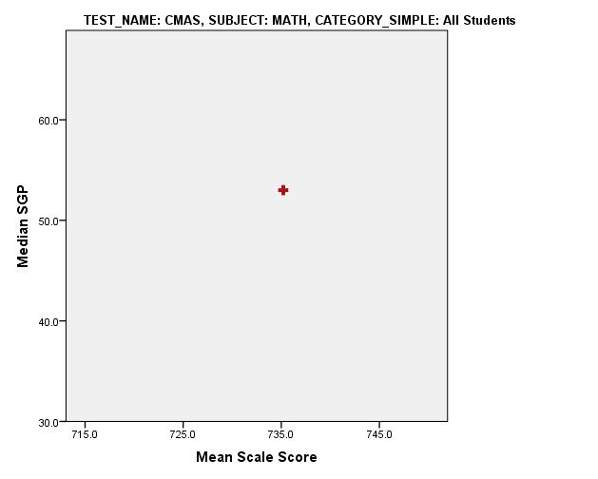
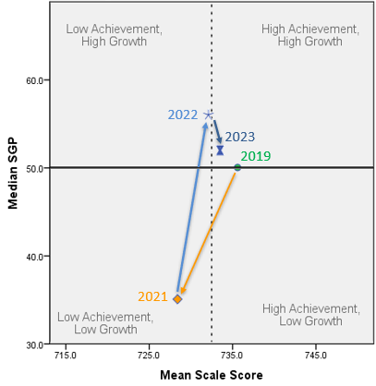
Higher Growth for ES and MS Students in Math is leading gains in achievement closer to pre-pandemic levels.
Summary: In the High Ach/ High Growth quadrant. High growth is helping to gradually return to pre-pandemic achievement levels. Continued high growth will help to surpass 2019 achievement.
Mathematics
2024
2023
Vertical dotted line approximates performance framework “Meets State Expectations” cut-score
Notes:
2024 baseline growth is slightly higher than 2023 and mean scale score has increased, almost back to 2019

Slide 8
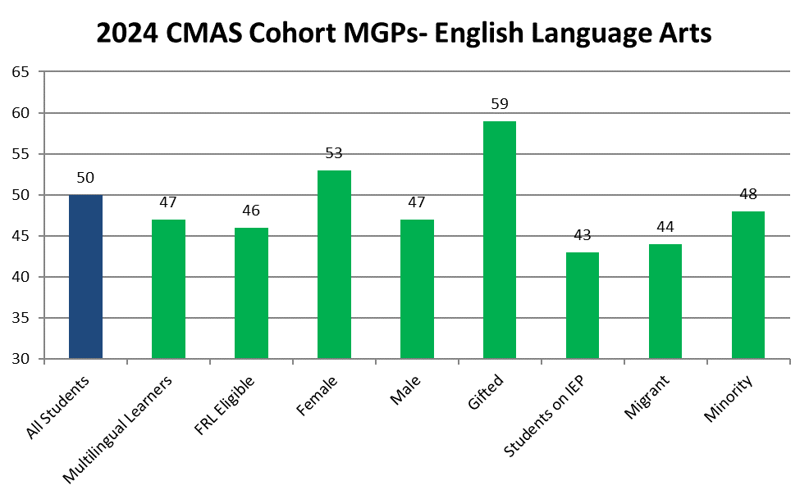
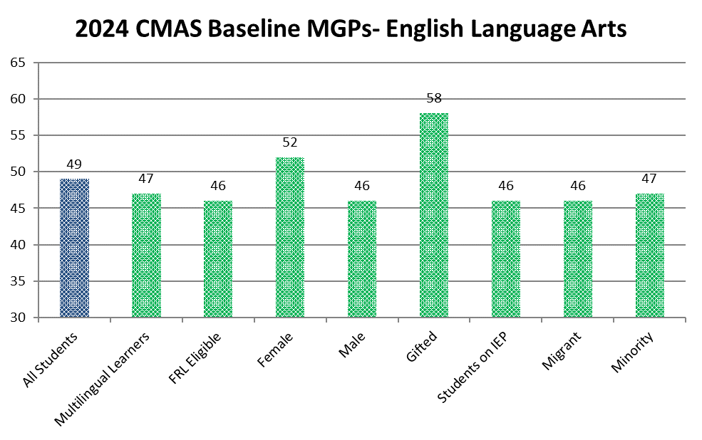
2024 CMAS State Growth Disaggregated Results

Slide 9
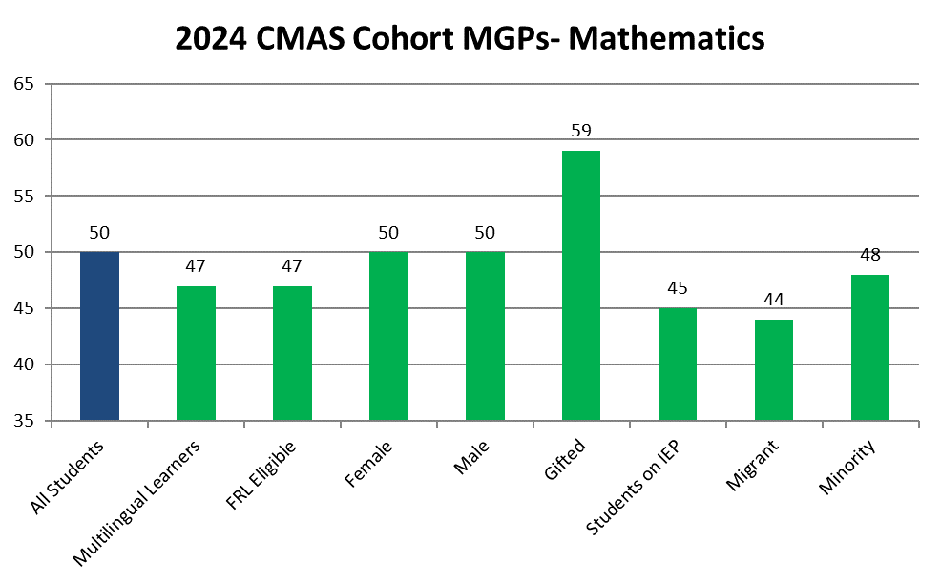
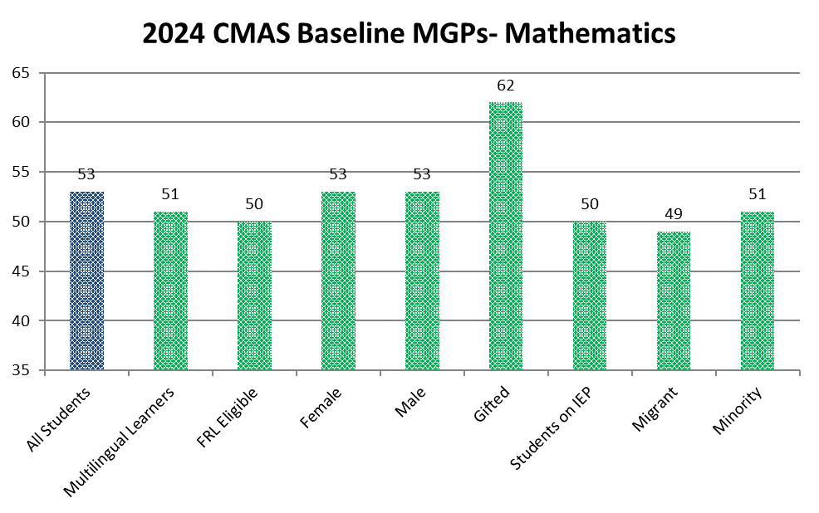
2024 CMAS
State Growth Disaggregated Results

Slide 10
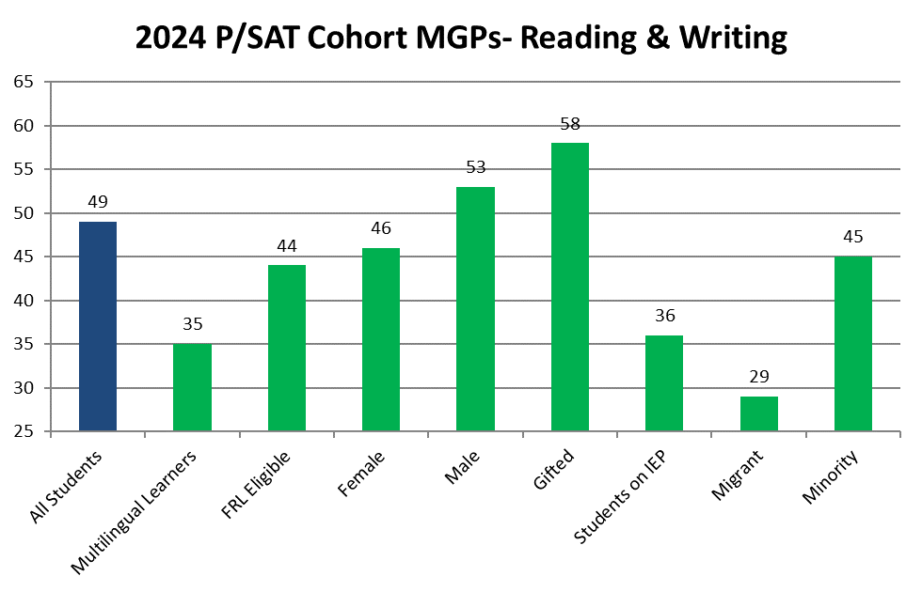
There are significant differences in PSAT/SAT Reading & Writing growth for historically disadvantaged groups.
Summary: Historically disadvantaged groups of HS students have considerably lower cohort growth in PSAT/SAT R&W. This is concerning given limited time before graduation.

Slide 11
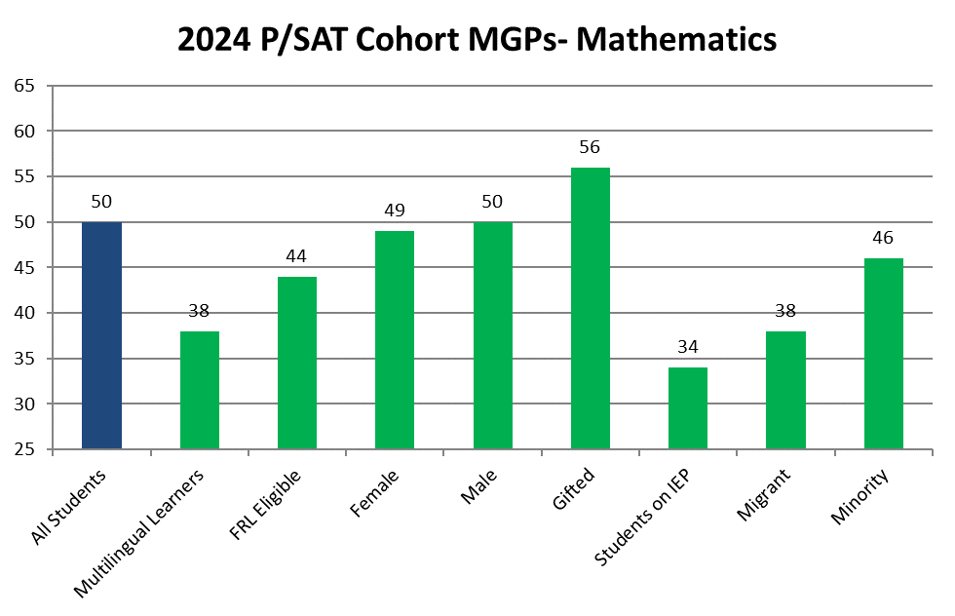
Low levels of growth persist for historically disadvantaged groups in Math, as well.
Summary: Historically disadvantaged groups of HS students have considerably lower cohort growth in PSAT/SAT Math. This is concerning given limited time before graduation.

Slide 12
Performance Frameworks | Changes from Last Year
Multi-year Frameworks now include three years of data (where available).
CMAS Science Achievement for all schools (including disaggregated groups) and Attendance & Truancy rates for Alternative Education Campuses (AECs) included for points for fall 2024.
Clarifications on Newly Arrived Multilingual Learners and implications for accountability.
A new “Postsecondary Program” pathway (i.e., ASCENT, P-TECH, TREP) added to the Matriculation sub-indicator for PWR.
CDE re-normed cut scores for PSAT/SAT due to the digital assessment transition that occurred this past spring.

Slide 13
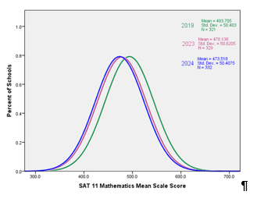
Summary of PSAT/SAT in 2024 Frameworks
Data is appropriate to use for Growth. This is because the Digital PSAT/SAT is comparable (but not interchangeable) with the paper-based version and because we verified that the trends were consistent enough that it is appropriate to use for Colorado Growth Model calculations.
Overall scores shifted down, especially on the lower end of the scale. For the most part, we observed that scale scores are lower than in the past. This is especially true for math. The one exception is 10th grade reading and writing (RW) which increased for higher achieving students in comparison to past PSAT results.
Scores are different enough to warrant re-norming the 2024 accountability cut scores. Given the downward shift in scores, CDE determined that re-norming the accountability cut scores is appropriate for use in the 2024 School and District Performance Frameworks. The cut-scores have been revised for the 1-year and 3-year PSAT (Achievement indicator) and SAT (Postsecondary & Workforce indicator). While all other cut scores are lower, the 10th grade reading and writing “exceeds” cut score (i.e., 85th percentile) will remain consistent with 2023 and 2019 to avoid raising state expectations after assessments have been completed.

Slide 14
Distribution of 2024 Preliminary District Ratings
Most Districts Earned an Accredited Rating or Higher
 | Number of Districts | Percent of Districts
Distinction | 17 | 9%
Accredited | 78 | 42%
Improvement Plan | 54 | 29%
Priority Improvement Plan | 8 | 4%
Turnaround Plan | 3 | 2%
Insufficient State Data | 24 | 13%
Total | 184

Slide 15
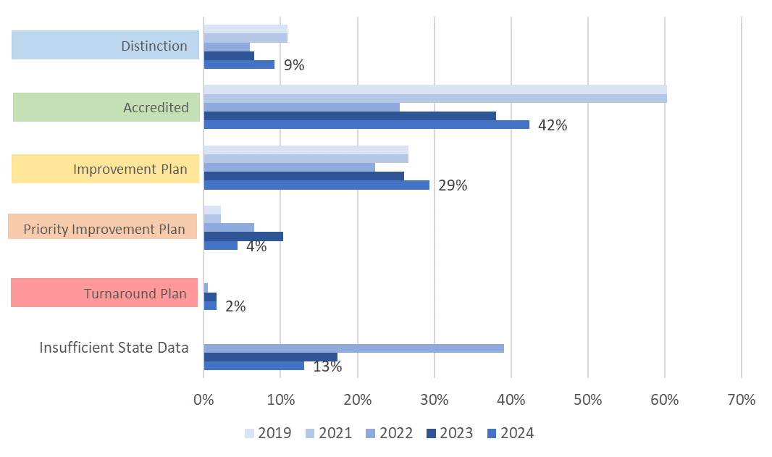
Preliminary District Ratings Trends Over Time (2019-2024)
Summary: Slight decrease in ISD ratings compared to 2023. More districts at Improvement or higher than in 2023, but not as high as 2019. Lower % on clock than 2023.
More District Ratings Have Improved Since Last Year
NOTE: Includes preliminary ratings for 2023 and 2024 and final ratings for earlier historical data. Frameworks were not calculated in 2020 and 2021; ratings were rolled over from 2019.

Slide 16



Trends Over Time for District Participation in Assessment for Accountability
Summary: Greater total participation in 2024 compared to 2023, but lower than 2019. Fewer district plans were decreased due to participation.
Assessment Participation is Rebounding but Has Further to Go
Accountability Participation
  Parent excusals removed from numerator and denominator. For accountability purposes, if below 95% participation in two content areas, then plan type decreased one level.
KEY
Participation Descriptor | 2019 | 2020 to 2022 | 2023 | 2024
Decreased Due to Participation | 3% | N/A | 10% | 3%
}
Student Participating in Assessments
Total Participation
  Parent excusals remain in numerator and denominator. If below 95% total participation in two content areas, then plan is listed as "low participation." This is just for informational purposes and does not impact calculation of frameworks.
What % of students without parent excusals participated?
Student not Participating in Assessments with Parent Excusal
Participation Descriptor | 2019 | 2020 & 2021 | 2022 | 2023 | 2024
Low Participation | 34% | N/A | 64% | 56% | 57%
Meets 95% Total Participation | 63% | N/A | 19% | 34% | 39%
}
Student not Participating in Assessments without Parent Excusal
What % of ALL students participated?
Note: Percentages based on the total number of districts receiving a participation descriptor

Slide 17
District Performance Watch Comparison Over Time (2019-2024)
Summary: Decrease in number of districts on Performance Watch since 2022, but not as low as 2019.
Fewest Districts on Performance Watch Since Pandemic
Notes:
2020 & 2021 not included because of framework pause
2022 was a transitional year. Year 0 & Year 1 are included in the newly identified.
2019 and 2022 data are based upon final plan types v. 2023 and 2024 based upon preliminary plan types.

Slide 18
Distribution of Preliminary School Plan Types
Most Schools Earned a Performance Plan Type
 | Number of Schools | Percent of Schools
Performance Plan | 1125 | 64%
Improvement Plan | 325 | 19%
Priority Improvement Plan | 120 | 7%
Turnaround Plan | 47 | 3%
Insufficient State Data | 109 | 6%
New School | 8 | <1%
School Closed | 13 | 1%
Total | 1747 | --
* Note that 94 AECs are not included in these counts as ratings are still pending

Slide 19
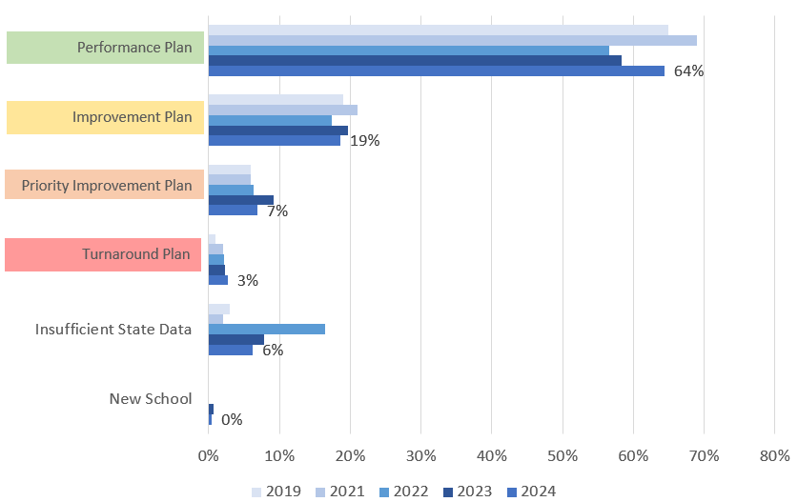
Preliminary School Plan Types | Distribution of Plans Over Time (2019-2024)
Summary: Similar trends as with districts. Decrease in ISD meant more schools earned plan types. Greater % earned Improvement or higher than in 2023 but not quite as high as 2019. Fewer schools on accountability clock compared to 2023.
More School Plan Types Have Improved Since Last Year
Preliminary School Plan Type Trends Over Time (2019-2024)
NOTE: Includes preliminary ratings for 2023 and 2024 (excludes AECs) and final ratings for earlier historical data. Frameworks were not calculated in 2020 and 2021; ratings were rolled over from 2019.

Slide 20
Mixed Results for Schools on Assessment Participation
Summary: Fewer school plan types were decreased due to participation in 2024 than in 2023. Lower total participation in 2024 compared to 2023.
Trends Over Time for School Assessment Participation for Accountability
Accountability Participation
  Parent excusals removed from numerator and denominator. If below 95% participation in two content areas, then plan type decreased one level.
}
What % of students without parent excusals participated?
Participation Descriptor | 2019 | 2020 to 2022 | 2023 | 2024
Decreased Due to Participation | 1% | N/A | 6% | 2%
Total Participation
  Parent excusals remain in numerator and denominator. If below 95% total participation in two content areas, then plan is listed as "low participation." This is just for informational purposes and does not impact calculation of frameworks.
Participation Descriptor | 2019 | 2020 & 2021 | 2022 | 2023 | 2024
Low Participation | 24% | N/A | 51% | 45% | 50%
Meets 95% Total Participation | 74% | N/A | 48% | 50% | 48%
}
What % of ALL students participated?
Note: Percentages based on the total number of schools receiving a participation descriptor

Slide 21
Fewest Number of Schools on Performance Watch Since Pandemic
Summary: Decrease in number of schools on Performance Watch since 2023, but still higher than 2019. Greatest number are Year 1 (157). Historically, about 60% of sites in Year 1 exit the clock within a year.
School Performance Watch Comparison Over Time (2019-2024)
Notes:
2020 & 2021 not included because of framework pause
2022 was a transitional year. Year 0 & Year 1 are included in the newly identified.
2019 and 2022 data are based upon final plan types v. 2023 and 2024 based upon preliminary plan types.
2023 & 2024 Data does not include 94 AECs.

Slide 22
Preliminary School Plan Types | 2024 Performance Framework Timeline
Anticipated Timeframe | Activities/Actions
September SBE Meeting | Presentation on 2024 Preliminary Performance Framework Results
September 24 | Districts submit accreditation information and intent to participate in request to reconsider
October SBE Meeting | Presentation on Setting Overall 2025 Performance Framework Targets
October 15 | Districts submit Unified Improvement Plans (UIPs); Request to Reconsider Applications Due
November SBE Meeting | School & District Accreditation Ratings Finalized (for those not submitting a Request to Reconsider) AND 2024 Performance Framework Target Setting Vote
December SBE Meeting | School & District Accreditation Ratings Finalized (for those who submitted a Request to Reconsider)
Note: All dates are subject to change based on data availability.

Slide 23
Content for Today’s Presentation
Summary of 2024 Growth & Prelim Framework Results
Update on 1241 Stakeholder Taskforce
Update on digital PSAT/SAT Implications for Accountability
Changes for 2025 frameworks & Prep for 2025 Target Setting

Slide 24
H.B. 23-1241: Accountability, Accreditation, Student Performance, and Resource Inequity Task Force
Link to Bill: https://leg.colorado.gov/bills/hb23-1241
Purpose: Creates a representative task force of 26-members that studies academic opportunities, inequities, promising practices in schools, and improvements to the accountability and accreditation system.
Website: https://www.cde.state.co.us/accountability/accountability-task-force
Status: Task Force members are finishing up their final recommendations.
Timeline:
  July 1, 2023: Task force members appointed
  August 15, 2023: Department contracts with a facilitator
  No later than September 1, 2023: Convene first meeting
  March 1, 2024: Interim report
  November 15, 2024: Final report reflecting findings and recommendations to the education committees of the house of representatives and senate, the governor, the state board, the commissioner of education and the department.
Upcoming Meetings: October 18 (virtual)
Helpful Resources
  Accountability Reference Handbook
  Analysis of SPF and Demographic Characteristics

Slide 25
Content for Today’s Presentation
Summary of 2024 Growth & Prelim Framework Results
Update on 1241 Stakeholder Taskforce
Recap digital PSAT/SAT Implications for Accountability
Changes for 2025 frameworks & Prep for 2025 Target Setting
Public Comment

Slide 26

Implications of Transition to 2024 Digital PSAT/SAT for Growth
  2024 growth for high schools examines progress between 2023 (paper-based version) and 2024 (digital version with new item types and different technical approaches) of PSAT/SAT.
  At the June state board meeting, CDE received approval to study the results and determine if the data was appropriate to use for growth calculations and whether to adjust accountability cut scores.
  Takeaways from the comparability study:
    It was appropriate to calculate cohort-refenced growth and use in the 2024 performance frameworks with adjusted accountability cut scores.
    It was not appropriate to calculate baseline-referenced growth, so we cannot make pre-pandemic comparisons for this presentation.

Slide 27
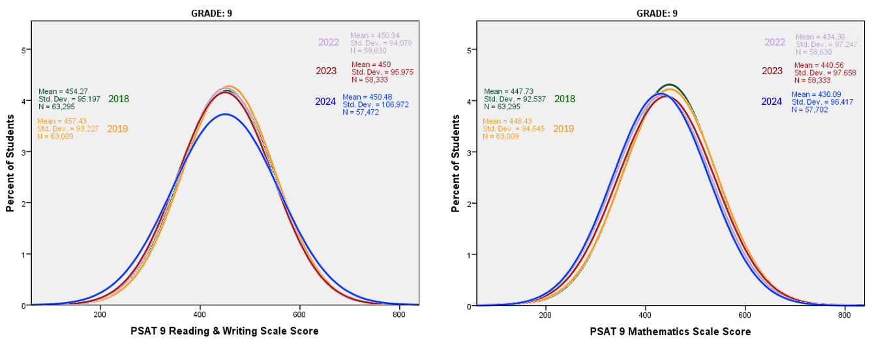
Student Scale Score Distributions- PSAT 9
2024 g9 RW student distribution has widened slightly at both the lower and upper tails, while Math has shifted down about 10 points from 2023 across the whole distribution.

Slide 28
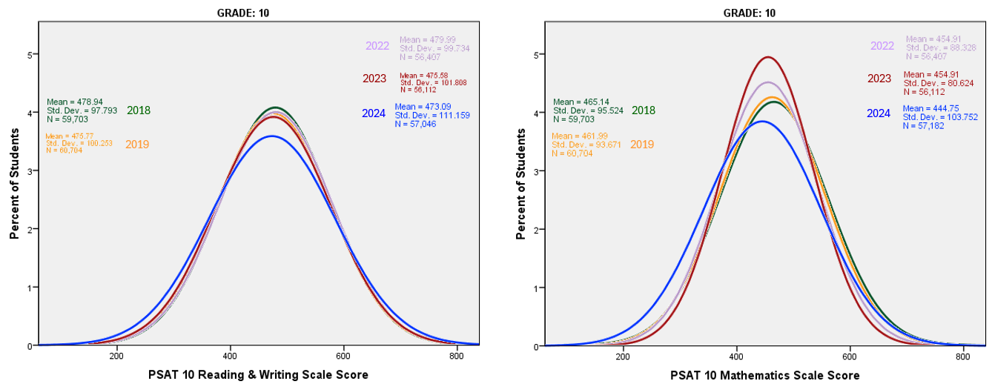
Student Scale Score Distributions- PSAT 10
2024 Grade 10 RW student distribution has a noticeably expanded lower tail and a slightly expanded upper tail. Math distributions have fluctuated a lot over the years (especially 2023) and 2024 shows a 10 point decline driven by a substantial expansion of the lower tail.

Slide 29
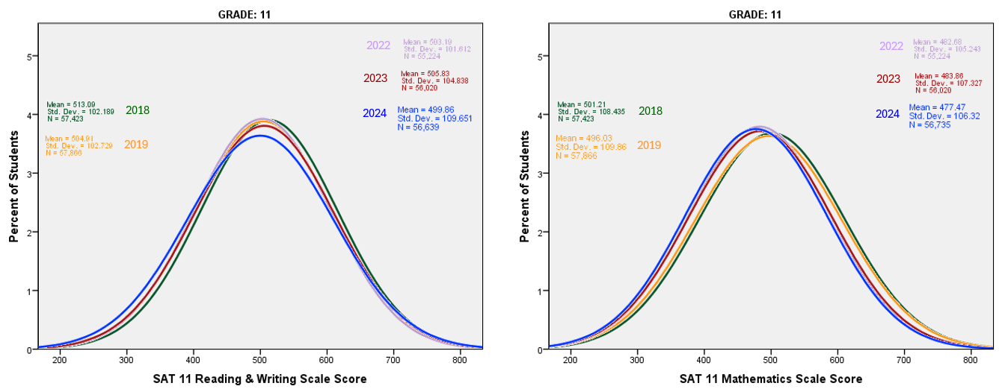
Student Scale Score Distributions- SAT 11
2024 grade 11 RW student-level distribution has a slightly expanded lower tail with no change to the upper tail. Grade 11 math scores have slowly declined over time and for 2024 show a 6 point decline driven by declines at both tails.

Slide 30
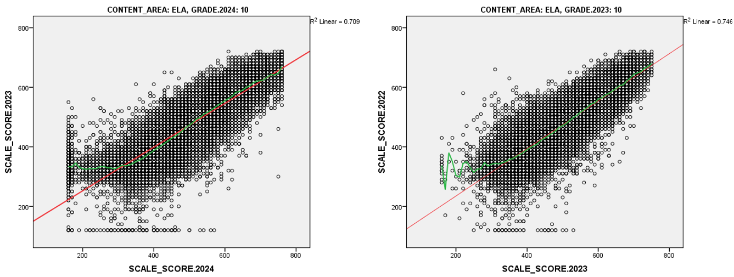
Scale Scores Between Years- PSAT 9 to PSAT 10, Reading & Writing
Relationship between scores from 2023 to 2024 is similar to the relationship from 2022 to 2023, with the exception of the increased number of students scoring at the LOSS in 2024.

Slide 31
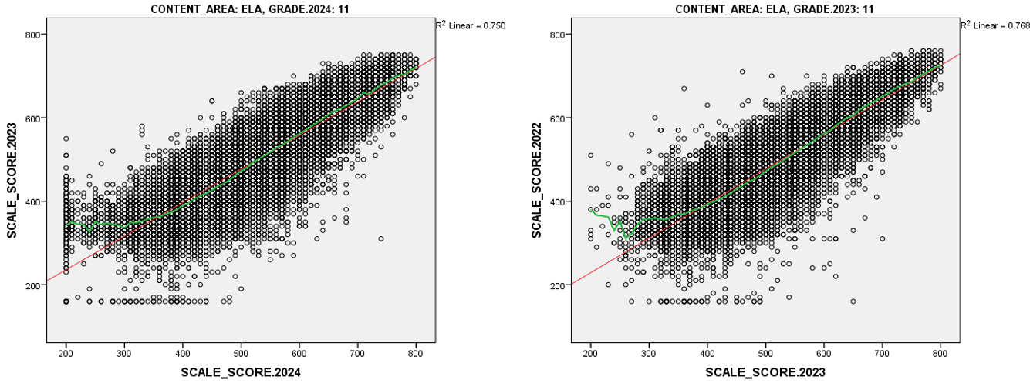
Scale Scores Between Years- PSAT 10 to SAT 11, Reading & Writing

Slide 32
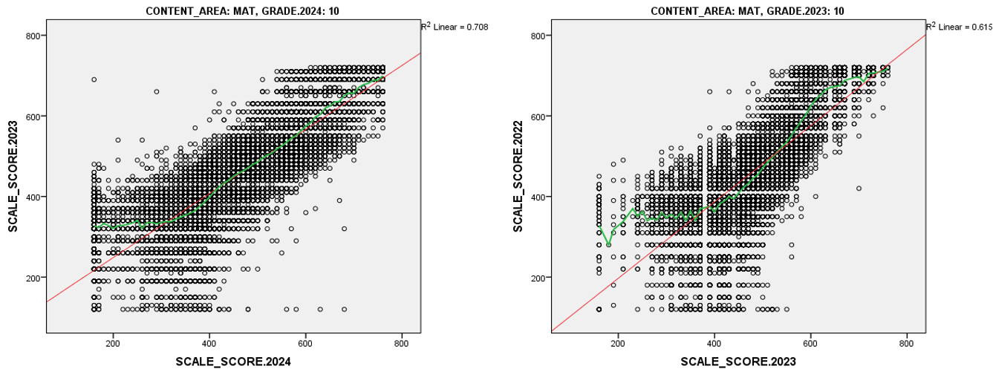
Scale Scores Between Years- PSAT 9 to PSAT 10, Math
Scale score fluctuation in 2023 grade 10 math cause more noticeable differences in the score distributions between years.

Slide 33
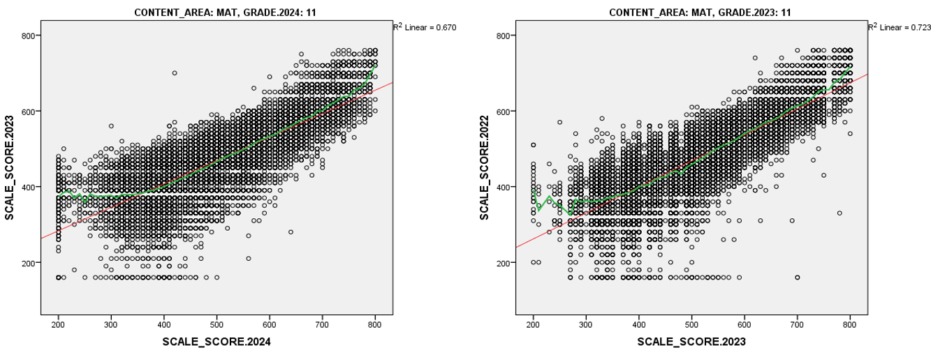
Scale Scores Between Years- PSAT 10 to SAT 11, Math

Slide 34
Correlations Between Student Scale Scores from Consecutive Years
Correlations from 2023 to 2024 are generally similar to or slightly lower than prior year correlations and range from 0.7 to 0.9. This indicates that the relative rankings of students have stayed consistent between years on both the old paper and new digital assessments.
The fairly high correlations for most student demographic groups also indicate that students from historically disadvantaged backgrounds are not being differentially impact by the transition to the new digital PSAT/SAT.
Note that correlations in math are noticeably lower for some groups from 22 to 23, which is likely due to the scale score fluctuation in grade 10 math in 2023.

Slide 35
Correlations Between Student Scale Scores from Consecutive Years

Slide 36
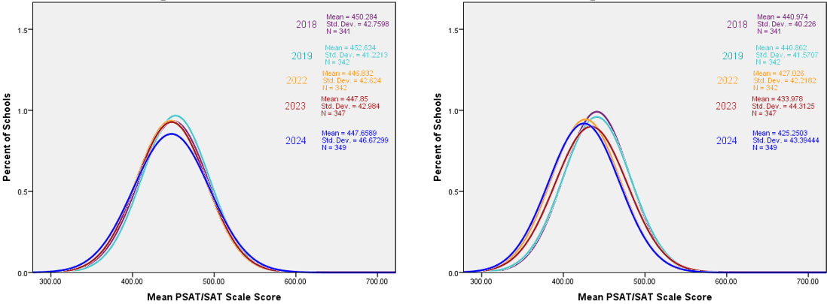
School-level Mean Scale Score Distributions by Year- Grade 9
School level distributions are similar to student-level, but more concentrated towards the mean. Generally, mean scale scores have declined slightly for RW (0-6 points) and more significantly for math (5-12 points)
Note: These distributions include AEC’s so may not align with the re-normed cut-scores

Slide 37
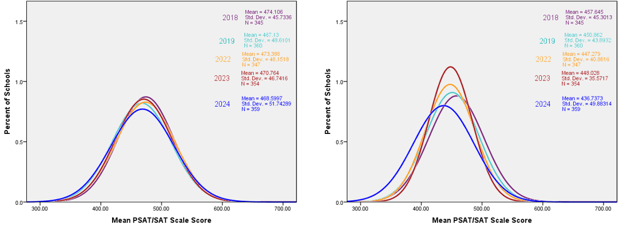
School-level Mean Scale Score Distributions by Year- Grade 10
Note: These distributions include AEC’s so may not align with the re-normed cut-scores

Slide 38
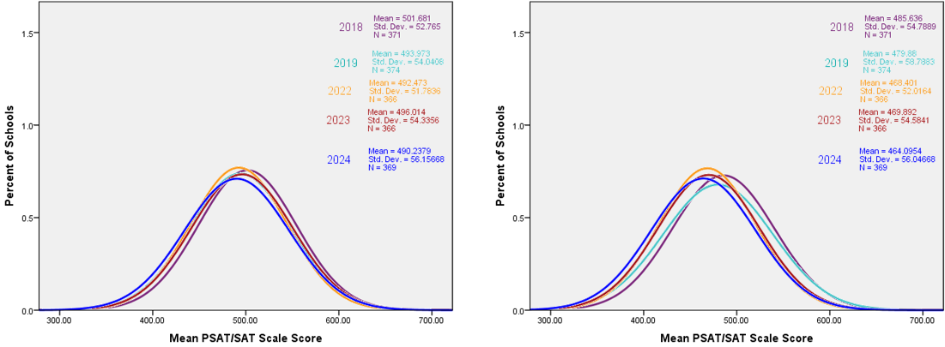
School-level Mean Scale Score Distributions by Year- Grade 11
Note: These distributions include AEC’s so may not align with the re-normed cut-scores

Slide 39
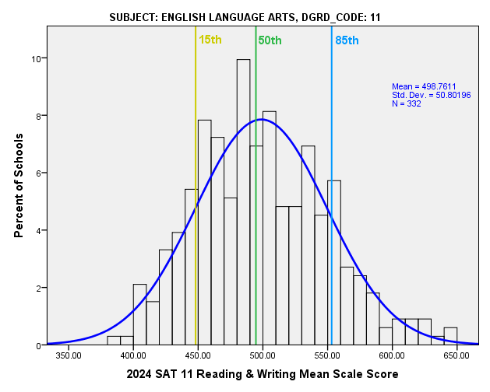
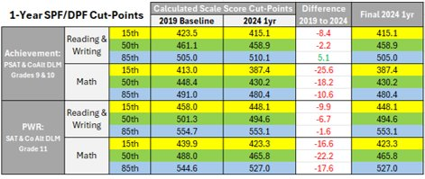
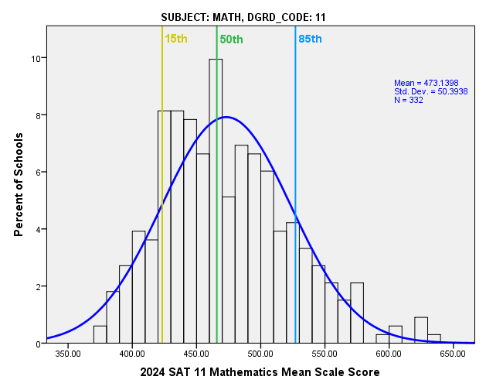
Re-norming 2024 Accountability Cut Scores
In comparison to the 2019 Baseline cut-scores from the paper PSAT/SAT, 2024 results are lower for all but one content area and rating category. The greatest decreases are in math and for students at the Approaching cut-point.
There was a slight increase for grade 9/10 Reading & Writing for the highest performing students, but the 2024 Exceeds target was kept the same to avoid a last-minute change that would negatively impact schools/districts.
Note: Re-norming distributions exclude AEC’s, schools with less than 16 valid scores, and students who were not continuous from October 1 through testing.

Slide 40
Content for Today’s Presentation
Summary of 2024 Growth & Prelim Framework Results
Update on 1241 Stakeholder Taskforce
Update on digital PSAT/SAT Implications for Accountability
Changes for 2025 frameworks & Prep for 2025 Target Setting
Public Comment

Slide 41

Potential Cut Score Revisions for 2025
Move forward with increased 2024 Exceeds target for PSAT Reading & Writing?
Re-norm all
3-year targets based on combined 2025, 2024 digital and 2023 paper results?
CoAlt DLM = Alternate Assessment program designed for students with significant cognitive disabilities
PWR = Postsecondary and Workforce Readiness

Slide 42
TAP Recommendations
For 2025 Target Setting with SBE
  Does the TAP recommend reviewing the 2025 results and (if appropriate) increasing the Exceeds cut-score target for PSAT 9/10 for Reading & Writing to align with 2024 results?
  Does the TAP recommend updating the 3-year cut-score targets based on 2025, 2024 digital results and 2023 paper results? With the intention of re-norming again in 2026 with the three most recent years of digital results?

Slide 43
Content for Today’s Presentation
Summary of 2024 Growth & Prelim Framework Results
Update on 1241 Stakeholder Taskforce
Update on digital PSAT/SAT Implications for Accountability
Changes for 2025 frameworks & Prep for 2025 Target Setting
Public Comment

