Slide 1
UIP Support Webinar:
Priority Improvement / Turnaround
September 5, 2023

Slide 2
Welcome
In the chat, please introduce yourself:
Your name
Your School & District
Where are you in the process of creating your UIP? (Still planning? Making adjustments? Getting it into the Online System? Etc.?)

Slide 3
Focus of this session
This webinar will help schools and districts identified with a Priority Improvement or Turnaround plan type understand related requirements in their UIPs. The session will highlight some best practices and key strategies in improvement planning, explain additional requirements in these plan types, give suggestions for creating a strong UIP and share resources available to help in the UIP process.
This webinar will not discuss:
Frameworks, State or ESSA identification, Accountability Clock/Performance Watch
Meeting Norms
This webinar is being recorded. Q&A at the end of this session won’t be recorded.
Please mute your sound if you are not speaking.
Use the chat feature to ask questions throughout the presentation. I will take pause breaks to answer chat questions.
Slides and the recording will be posted to this UIP resource webpage.

Slide 4
Agenda & Objectives
Agenda | What we will do…
Understanding PI/T Plan Type UIP Requirements | Identify differences in UIP process for district &/or schools with Performance Improvement / Turnaround (PI/T) plan types
Best Practices & Key Strategies | Review the foundations of a strong UIP
Satisfying Program-Specific Requirements | Review the program-specific requirements and how to satisfy them
Capacity-Building | How to leveraging teams to create & implement plans Opportunities for external support (e.g., EASI).
Resources Available | Learn about some of the resources available to help you with your UIP planning and creation.

Slide 5
Engaging with your UIP and Information Packet
Have your own UIP handy, if possible.
Follow along in the information packet or make a copy to take notes
SELF-PACED. Once this is webinar is recorded, use the recording when you’re working on your plan. Consider pausing the recording after each section, as needed to work on your plan.

Slide 6
Understanding PI/T Plan Type Requirements in the UIP Process

Slide 7
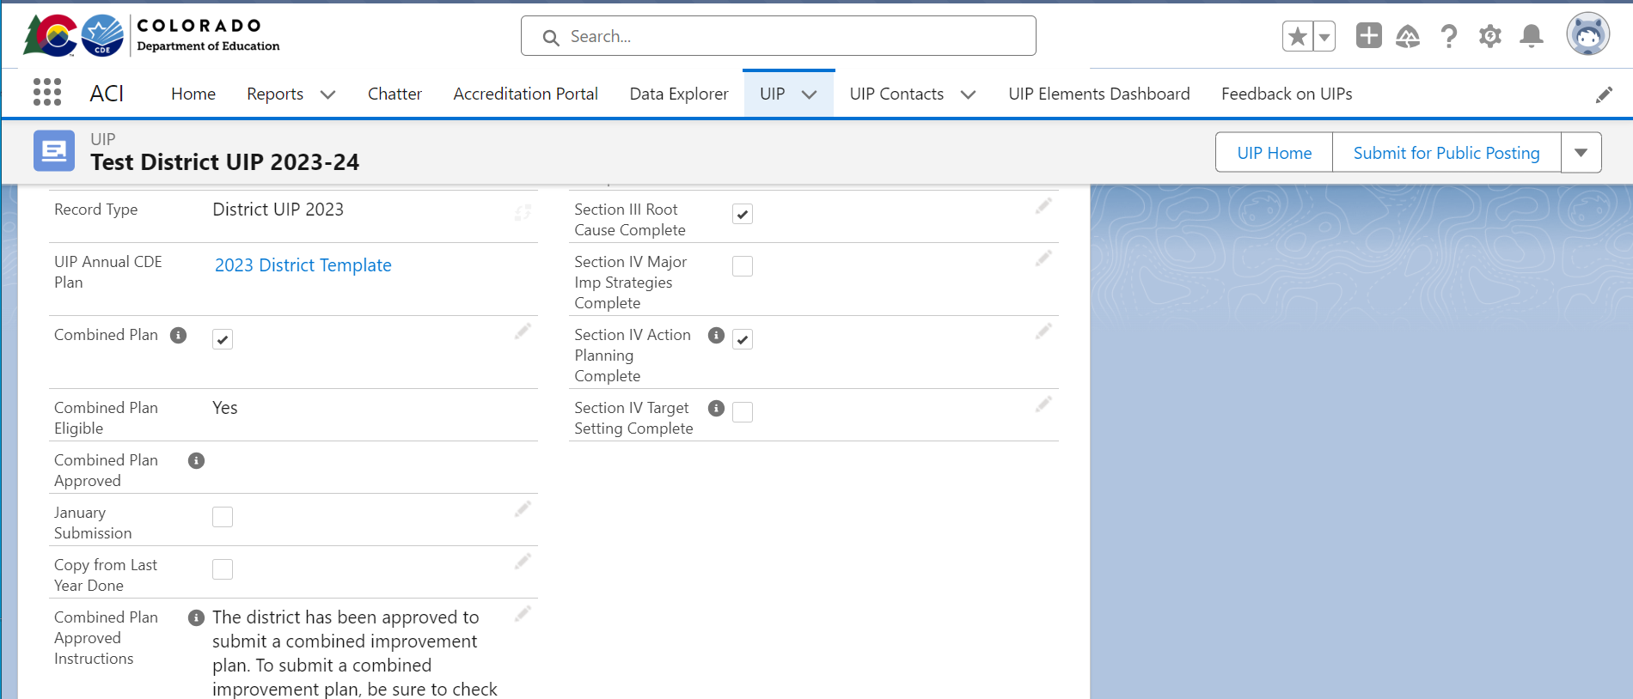
You’ve Been Assigned a Priority Improvement / Turnaround Plan Type
Now what?
Backwards Planning to submit your UIP by October 16 for review and posting
Flexibility for newly identified schools/districts or submitting a Request to Reconsider
districts may select January submission date instead of October. Due: January 16, 2024
The selection will present on the UIP’s landing page (NEW)

Slide 8
UIP Process Requirements
Parent Notification Letters
For each school with a plan type of Priority Improvement or Turnaround, the district must notify families in the school of the school’s plan type, the reason for identification, ways to provide input into the school’s plans (e.g., School Accountability Committee meeting) and notification of the local board’s hearing prior to adopting the school’s plan.
Target Date: within 30 calendar days of receiving initial plan type assignment
Public Hearing at Local School Board Meeting
Target Date: at least 30 calendar days after the date on which the district provides the written notice
Local School Board Adopts the Plan
Your local board must approve your UIP before it is publicly posted either October 16th or January 16th; the latter is only available to newly identified schools and districts.
DUE: On or before the UIP is publicly posted (UIP submission date)
Schedule these two Board Meeting dates now.
UIP Assurance, NEW in 2023
Use the UIP assurances to demonstrate compliance of these requirements related to Parent Notification.
Resources Available:
Parent Notification and Public Hearing Requirements (2023-24) (includes a sample Parent Notification Letter)
Performance Watch webpage, expectations

Slide 9
Additional UIP Requirements for PI/T Plan Types
Note that other categories have additional UIP requirements that are not covered in this session.
Examples include ESSA Identification (CS, TS, A-TS),
Comprehensive Early Literacy Grant (ELG), EASI Grant and
Title I (if satisfying through UIP)
This training focuses on requirements associated to State Identification based on D/SPF plan types.
All Schools with PI/T plan type:
High leverage action steps to increase Family Engagement
Early Learning Needs Assessment (identified schools serving K-3)
Applies to Districts accredited PI/T and with schools operating under a Priority Improvement or Turnaround plan
All Schools and Districts with Turnaround plan type:
State-required turnaround strategies
NEW ~ All Schools with PI/T or an Improvement plan type:
Math Act (HB 23-1231)
We’ll dive into these requirements and supports throughout today’s webinar

Slide 10
Best Practices
& Key Strategies

Slide 11
Foundations of the UIP: The “Big Five” Questions
Priority Performance Challenges
Root Causes
Major Improvement Strategies
Action Plans
Progress Monitoring

Slide 12
Foundations of the UIP: The “Big Five” Questions
Priority Performance Challenges
Root Causes
Major Improvement Strategies
Action Plans
Progress Monitoring
Does the plan investigate the most critical performance areas and prioritize the most urgent performance challenges?
Does the plan identify root causes that explain the magnitude of the performance challenges?
Does the plan identify evidence- based major improvement strategies that have a likelihood of eliminating the root causes?
Does the plan present a well- designed action plan to implement the major improvement strategies and bring about dramatic improvement?
Does the plan include elements that effectively monitor the impact and progress of the action plan?

Slide 13
What to put in your UIP
Priority Performance Challenges
Root Causes
Major Improvement Strategies
Action Plans
Progress Monitoring
Your Data Narrative should show how your priority challenges align to the most urgent needs reflected in the data analysis.
Your root causes should focus on factors in the control of the school (systems, adult behaviors) that are likely contributing to the identified challenges.
Your strategies should be clearly defined and focused enough to be accomplished in the plan period. Your current plan may focus on developing key elements of a larger strategy.
Your action plan should align to your strategies, naming the key actions that must be taken to implement them, target dates for completing them, and persons responsible for each step.
Benchmarks should clearly align to action steps to track fidelity of implementation. Interim Measures specify assessment & mid-year targets for student progress towards annual targets.

Slide 14
What to put in your UIP: Data Narrative Tab
Priority Performance Challenges
Prior Year Targets and Current Performance sections should include the data that has led you to prioritize specific challenges.
State assessment data
Local assessment data
Non-assessment data
Your Data Narrative should show how your priority challenges align to the most urgent needs reflected in the data analysis.
Including this reflection on your prior year targets and current performance will address requirements for “Sustained Improvement”

Slide 15
What to put in your UIP: Data Narrative Tab
Strengths:
✔ Specifies results of key assessments.
✔ Indicates what results suggest about success of strategy last year.
✔ Names implications for planning in current year.
Priority Performance Challenges
Example: Prior Year Targets
Major Improvement Strategy: Sheltered Instruction and Small Group Instruction
Reflection: The results of the 2023 CMAS assessment in ELA and Math, the 2023 ACCESS for ELLs assessment, and the results of the Spring 2023 PALS assessment in grades k-3 showed little to no increase in achievement, MGPs, overall school percentiles, and Mean Scale Scores. This, unfortunately, points to the lack of success from the implementation of the Major Improvement Strategies in the areas of sheltered instruction and meeting all students’ needs in the classroom through small-group instruction. The lack of results in all areas points to deficiencies in instruction that spans all content areas including math, ELA, and instruction for ELLs both in the general education and pull-out setting. The Major Improvement Strategies of improving sheltered instruction should continue and be modified to address particular instructional deficiencies that are appearing in observations and data. The strategy continues to be relevant with approximately 80% of the students being ELLs.
Your Data Narrative should show how your priority challenges align to the most urgent needs reflected in the data analysis.

Slide 16
What to put in your UIP: Data Narrative Tab
Priority Performance Challenges
Priority Performance Challenges (PPCs) are aspects of student performance that your plan focuses on improving this year.
PPCs…
should clearly follow from the data analysis and trends identified.
are the prioritized challenges for this year. Not every challenge indicated by the data should be a PPC.
are the challenges that your Major Improvement Strategies will aim to address.
Your Data Narrative should show how your priority challenges align to the most urgent needs reflected in the data analysis.

Slide 17
What to put in your UIP: Data Narrative Tab
Strengths:
✔ Focus on student performance outcomes.
✔ Focus on areas where expectations are being met OR where inequities are identified in student performance data.
Priority Performance Challenges
Examples: Priority Performance Challenges
Elementary School level: Low growth in CMAS ELA
Students in grade 3-5 are not yet meeting state expectations in ELA on CMAS.
High School level PPC: Achievement shows gaps across disaggregated groups
Disaggregated groups, including Students of Color, ELLs, FRL, and SPED have not yet met the benchmarks for both remediation-free status and SAT suite at the same rate as their peers.
Your Data Narrative should show how your priority challenges align to the most urgent needs reflected in the data analysis.

Slide 18
What to put in your UIP: Data Narrative Tab
Root Causes
Priority Performance Challenge(s): the student performance concerns that are reflected in the data
Your root causes should focus on factors in the control of the school (systems, adult behaviors) that are likely contributing to the identified challenges.
Root Causes: What is feeding into those challenges? What is driving them or making them “grow”?

Slide 19
What to put in your UIP: Data Narrative Tab
Resources Available:
UIP 101: Root Causes video
Root Cause Analysis Task List
Protocols
Circle Map
Five Whys
Fishbone diagram
Root Causes
Root Cause Reflection Questions
What are we doing (or not doing) as adults in the building that is driving these performance challenges?
Are there student needs we haven’t yet met?
Are there missing (or malfunctioning) systems or practices we need to address?
Examples: Root Causes
New instructional practices are not yet being implemented consistently in all classrooms
We lack an approach to understanding and addressing the particular learning needs of individual students.
Your root causes should focus on factors in the control of the school (systems, adult behaviors) that are likely contributing to the identified challenges.

Slide 20
What to put in your UIP: Action Plans Tab
Major Improvement Strategies
Major Improvement Strategies (MISs) are the primary initiatives you will be focused on implementing this year. They should…
Address and resolve identified root causes
Have a likelihood of improving identified PPCs
Your strategies should be clearly defined and focused enough to be accomplished in the plan period. Your current plan may focus on developing key elements of a larger strategy.
Your UIP should…
Clearly define and describe each strategy
Include a rationale for each strategy
Include an evidence-base for each strategy
Explain why each strategy is a good fit for the school

Slide 21
What to put in your UIP: Action Plans Tab
Major Improvement Strategies
In addition, schools and districts with a Turnaround plan type are required to include a state-required turnaround strategy. These strategies include:
Employing a lead turnaround partner
Reorganizing the oversight and management structure in the district
Converting to an innovation school or school zone
Converting to a charter school
Renegotiating or restructuring a charter contract
Research-based strategies focused on early learning and development
Other actions of comparable or greater significance or effect.
For additional information, refer to EASI grant application process that includes options aligned to these turnaround strategies.
Your strategies should be clearly defined and focused enough to be accomplished in the plan period. Your current plan may focus on developing key elements of a larger strategy.

Slide 22
What to put in your UIP: Action Plans Tab
Resources Available:
Strategy Guides
Common Mission & Vision
Data-Informed Instruction
Coaching
MTSS
Other Resources:
UIP 101: Major Improvement Strategies
Major Improvement Strategies
Foundational Major Improvement Strategies
Clear Mission and Vision
Coherent Vision for Instruction
Assessment Systems and Data Culture
Talent Development: Coaching and Feedback
MTSS / Systems of Student Support
Engaging Learning Environment
Effective Student Supports and Cultures
Your strategies should be clearly defined and focused enough to be accomplished in the plan period. Your current plan may focus on developing key elements of a larger strategy.

Slide 23
Application
Priority Performance Challenges
Root Causes
Major Improvement Strategies
Consider your own UIP. Take a moment to do one of the following, depending on where you are in the process:
Write a new PPC, RC, or MIS
Review and revise one of your current PPCs, RCs, or MISs
Make a plan for revising them (what work needs to be done and by whom)

Slide 24
What to put in your UIP: Action Plans Tab
Action Plans
Action Plans detail and sequence the key actions needed to put Major Improvement Strategies into practice. They should include…
A description of the action needed
The owner or responsible person for each action
The deadline for each action (or cadence of repeated actions like coaching sessions or team meetings)
Any resources needed to support that action (e.g., budget for PD, data trackers for observation walks, etc.)
Your action plan should align to your strategies, naming the key actions that must be taken to implement them, target dates for completing them, and persons responsible for each step.

Slide 25
What to put in your UIP: Action Plans Tab
Action Plans
Example Action Steps:
Action Step | Date | Personnel | Resources Needed
Beginning of year PD introducing new ELA curriculum, by curriculum specialists. | August 15th (during BOY Orientation Sessions) | External curriculum specialist (provide PD); all ELA teachers and coaches (attend PD) | Curriculum materials purchased and provided; Budget to pay for curriculum specialist.
Coaches meet weekly with teachers to reinforce curriculum strategies & approach. | September - April (dates determined by coaching pairs) | ELA coaches, ELA teachers | Classroom Observations and Coaching Trackers
Your action plan should align to your strategies, naming the key actions that must be taken to implement them, target dates for completing them, and persons responsible for each step.
Strengths:
✔ Identifies concrete action step, timeline, persons responsible/involved, and resources needed

Slide 26
What to put in your UIP: Action Plans Tab
Progress Monitoring
Progress Monitoring includes three components in the UIP:
Annual Targets that name ambitious but attainable targets in student performance outcomes that will indicate progress on the identified priority challenges.
Implementation Benchmarks that specify key milestones allowing the school to determine whether action plans are being implemented with fidelity
Interim Measures that provide mid-year targets for student performance that indicate they are on track to meet Annual Targets.
Benchmarks should clearly align to action steps to track fidelity of implementation. Interim Measures specify assessment & mid-year targets for student progress towards annual targets.

Slide 27
What to put in your UIP: Action Plans Tab
Resources Available:
UIP 101: Target Setting and Interim Measures
Progress Monitoring
Annual Targets name ambitious but attainable targets in student performance outcomes that will indicate progress on the identified priority challenges.
Example: Annual Targets
Current baseline for 2022-23: 25% of students earned a score of Meets or Exceeds on CMAS Literacy
2023-2024: 30% of students will earn a score of Meets or Exceeds on CMAS Literacy.
2024-2025: 40% of students will earn a score of Meets or Exceeds on CMAS Literacy.
Benchmarks should clearly align to action steps to track fidelity of implementation. Interim Measures specify assessment & mid-year targets for student progress towards annual targets.

Slide 28
What to put in your UIP: Action Plans Tab
Resources Available:
Implementation Benchmarks Guidance Document
UIP 101: Action Steps and Implementation Benchmarks
Progress Monitoring
Implementation Benchmarks specify key milestones allowing the school to determine whether action plans are being implemented with fidelity.
Example: Implementation Benchmark
By October 15, an audit of daily lesson plans will show that 70% of teachers are incorporating language objectives into their daily lesson plans.
Benchmarks should clearly align to action steps to track fidelity of implementation. Interim Measures specify assessment & mid-year targets for student progress towards annual targets.

Slide 29
What to put in your UIP: Action Plans Tab
Resources Available:
UIP 101: Target Setting and Interim Measures
Progress Monitoring
Interim Measures provide mid-year targets for student performance that indicate they are on track to meet Annual Targets.
Example: Interim Measure
By December 15, student performance on the middle of year iReady Diagnostic will show that 35% of students who initially tested below grade level will have reached proficiency.
Benchmarks should clearly align to action steps to track fidelity of implementation. Interim Measures specify assessment & mid-year targets for student progress towards annual targets.

Slide 30
Application
Progress Monitoring
Consider your own UIP. Take a moment to do one of the following:
Review one of your current Implementation Benchmarks or Interim Measures. Check to see if it fulfills these requirements, and revise if needed (or make a note of how you’ll do this later)
Write a new Implementation Benchmark or Interim Measure
Benchmarks should clearly align to action steps to track fidelity of implementation. Interim Measures specify assessment & mid-year targets for student progress towards annual targets.

Slide 31
Satisfying Program-Specific Requirements

Slide 32
Additional UIP Requirements by category
Resources Available:
Performance Watch Expectations (webpage)
District Quality Criteria (PDF)
School Quality Criteria (PDF)
Today’s Focus:
Family Engagement Strategies
READ Act
New Math Acceleration Planning Requirements
Early Learning Needs Assessment (ELNA)
Reminder – other categories have additional UIP requirements not covered in this session: e.g., ESSA Identification (CS, TS, A-TS), Comprehensive Early Literacy Grant (ELG), EASI Grant, Title I (if satisfying through UIP)

Slide 33
All PI/T Schools: Family Engagement Activities
Resources Available:
Family, School, and Community Partnering Standards
Who: All schools with Priority Improvement or Turnaround plans
Requirement:
Where to include this in your UIP:
Action Plans

Slide 34
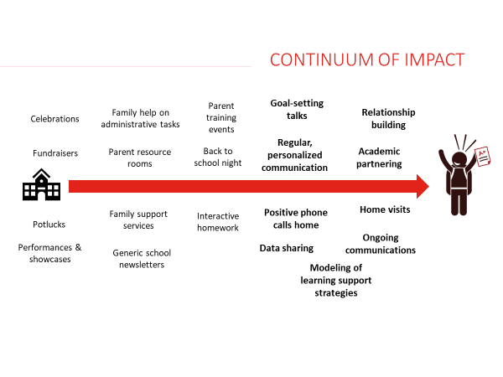
Family & Community Engagement

Slide 35
Family & Community Engagement
Additional Resources Available:
Strategy Guide: For schools that are interested in making Family, School, and Community Partnerships (FSCP) one of their Major Improvement Strategies, this Strategy Guide outlines the core components and key resources needed for a successful implementation.
P-12 Framework: Schools and districts who are interested in strengthening their FSCP work can use this framework to audit the current state of their systems and practices, in order to determine priorities for improvement.
Promising Partnership Practices: CDE’s FSCP Office has collected accounts of successful family-school partnership practices from schools and districts throughout Colorado. These provide useful illustrations for schools and districts seeking ideas for how to more effectively engage their families and communities.

Slide 36
Application
If you don’t yet have family engagement activities in your UIP, using the “Continuum of Impact” graphic or one of the other Family Engagement resources, brainstorm 1-3 Action Steps to incorporate family engagement activities into your UIP.
If you’ve already included family engagement activities, use the Continuum of Impact graphic to audit the activities you’ve identified. Including a blend of school-wide and individualized activities can help build strong family-school partnerships.

Slide 37
All Schools serving K-3: READ Act
What are the Early Literacy Requirements in the UIP?
Data Narrative
Data and trends from a READ interim assessment for grades K-3.
Strategies (in Action Plans tab)
Specific actions to support students who are identified as having a significant reading deficiency (SRD) and students who are not yet reaching grade level expectations.
Target Setting (in Action Plans tab)
Set targets to improve reading outcomes for students as measured by a READ interim assessment.

Slide 38
READ Act in the Data Narrative
Example of Early Literacy Data in a UIP
Strengths:
✔ Data reflects percent of students on grade level and students who are SRD
✔ Identifies a trend over time, per READ Act
Student Grade | Percent On Grade Level |  | Percent Significantly Below Grade Level (i.e., SRD)
 | 2022 | 2023 | 2022 | 2023
Kindergarten | 56% | 25% | 24% | 44%
1st Grade | 70% | 45% | 20% | 18%
2nd Grade | 75% | 72% | 13% | 10%
3rd Grade | 67% | 55% | 13% | 21%

Slide 39
READ Act in the Action Plan
Example of an Early Literacy Strategy
Implement Early Literacy Instruction
In order to effectively support Early Literacy, we will implement instructional systems that have coherence and focus on foundational skills. K-3rd classes will have a dedicated daily phonics block that follows the Science of Reading methodology as supported by the CDE Modules, Heggerty curriculum and Orton Gillingham methodology.
Teachers will receive coaching to have a deeper understanding of foundational skills. Success will be measured by decreasing the amount of students significantly below grade level by 15% and increasing the amount of students on grade level by 10% (especially Black, Multilingual/MLL, and Black MLL students).
This aligns to district priorities around Early Literacy and phonics to provide a high-quality literacy program that incorporates research and evidence-based principles for instruction, fosters independence and confidence, and leverages assessment practices that give teachers and leaders actionable feedback on how to best serve the needs of diverse learners across all classrooms.
Strengths:
✔ Reflect a plan to target the needs of students who are not yet on grade-level
✔ Scientifically and evidence-based actions

Slide 40
READ Act in the Annual Targets
Example of Early Literacy Targets
Strengths:
✔ The targets explicitly focus on increasing the percentage of students reading on grade level and decreasing the percentage of students identified as SRD
Performance Indicator: Academic Achievement Measure/Metric: Reading
2023-24: Students on grade level will increase by 10% as measured by iStation
2024-25: Students on grade level will increase by 13% as measured by iStation
Performance Indicator: Academic Achievement Measure/Metric: Reading
2023-24: There will be a 15% decrease in students SBGL (i.e., SRD) as measured by iStation
2024-25: There will be a 15% decrease in students SBGL (i.e., SRD) as measured by iStation

Slide 41
Application
If your school serves K-3, consider your own UIP. Take a moment and consider the following:
In your Data Narrative or Action Plans (strategies or targets), identify elements that satisfy READ Act/Early Literacy requirements.
Add elements if they are missing and plan for how you will make these revisions, or revise the contents to meet these requirements.
If your school doesn’t serve K-3, reflect on your school / district’s focus to monitor students in grades 4 through high school who are still on Read Plans.
What efforts are you making or need to make, and how might that connect to your Action Plan?

Slide 42
Math Acceleration- Planning Requirements (HB 23-1231)
New requirements for those districts and schools with
Improvement, Priority Improvement and Turnaround ratings
23-24 UIP
UIP Assurance for Data Analysis – analyze at least two years of math assessment data disaggregated by grade level, performance levels, and student demographics (e.g, FRL, IEP, ML)
Priority Performance Challenges – describe rationale for performance patterns that led to prioritizing math; If the data analysis does not support prioritizing math, then include rationale to document the school wide direction.
Future requirements will be connected to Strategies, Action Planning and Target Setting
For more information – HB 23-1231 Fact Sheet: Improving Mathematics Outcomes in K-12th Grade Education
23-24 Grant opportunity connected to Math Acceleration in 9th Grade – Ninth Grade Success Grant

Slide 43
Schools serving K-3: Early Learning Needs Assessment (ELNA)
The Early Learning Needs Assessment supports schools and districts in analyzing the needs and learning of children from birth through age 8. This process can strengthen relationships between schools, districts and early childhood partners to more accurately identify needs within the community, monitor trends, and inform the implementation of preventative strategies.
Applies to schools with a Priority Improvement or Turnaround plan type that serve students in K-3.
Also applies to Districts with a PI/Turnaround Rating and that have a school serving students in grades K-3 operating under a priority improvement or turnaround plan.
Note: The ELNA is frequently conflated with the Early Literacy Grant – these are separate things.

Slide 44
Why is an Early Learning Needs Assessment Important?
Principles of an Early Learning Needs Assessment (ELNA)

Slide 45
ELNA Plan Requirements for Priority Improvement & Turnaround
Indicate in your 2023-24 UIP any steps taken to assess the needs of and resources available for children eight and under across your community.
Take advantage of the resources available on the Improvement Planning and Early Learning website to learn about and plan this year to conduct and report on an Early Learning Needs Assessment in your 2024-25 UIP.
Ideally, districts with identified schools will initiate the ELNA process to coordinate across sites, as needed.
Key resources:
The Early Learning Needs Assessment Handbook
For a deeper dive, the Early Learning Needs Assessment Data Sources Guide contains information on data sources that may be helpful in completing this assessment.

Slide 46
Capacity Building Opportunities

Slide 47
Leveraging a team to create the UIP
Use a team to create the the plans:
Draw on your leadership team to help create your improvement plans:
Data analysis and reflection
Root Cause analysis
Strategy selection
Progress Monitoring measures
Identify key areas for getting stakeholder input
Share your UIP with your SAC
Designate one or two people to write the UIP: Designate someone to translate the UIP creation process and ideas into the written UIP.
Reminder: Parent Notification and Public Hearing Requirements (2023-24)

Slide 48
Implementation Teams to support plan implementation
A strong implementation team can mean the difference between an initiative that persists and gets refined through difficulty and one that gets dropped when challenges arise. Having a team in place before the implementation begins will help you remain nimble and responsive as the plan progresses and the context evolves.
Size: Small enough to be nimble, but with enough capacity to address implementation issues as they arise.
Competencies: Team members should be…
deeply invested in the strategy, collaborative, and able to communicate very clearly
able to weigh different needs, competing interests, trade-offs
decisive and able to act quickly to clear implementation obstacles
Supporting the Implementation Team: You may need to free up capacity of Implementation Team members, so they are able to prioritize strategy implementation. Make sure they also have clear access to leadership so they can get additional support or resources needed to strengthen implementation.
For additional information on Implementation Teams, see the Implementation Guide.

Slide 49
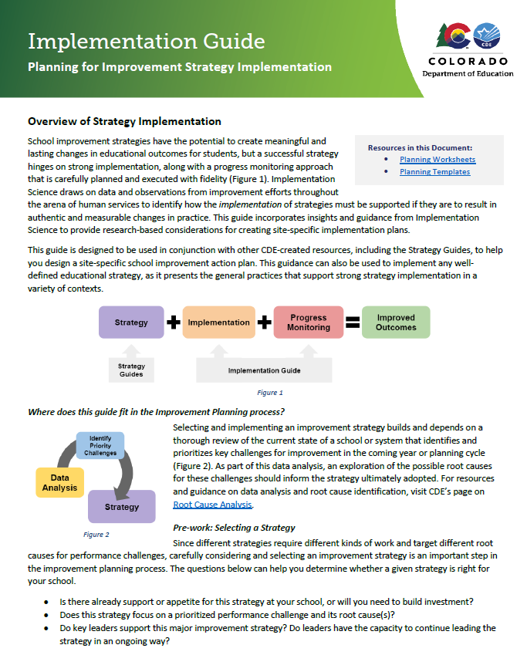
Planning Resource: Implementation Guide
What is the Implementation Guide?
Guidance to support the creation of site-specific implementation plans for any clearly defined strategy. (Based on findings of Implementation Science.)
What is the purpose of the Implementation Guide?
Puts a concise overview of research-based implementation best practices in the hands of schools and districts.
What can it help you do?
Create Action Plans and establish Progress Monitoring measures using the guidance in the document and the Planning Worksheets in the Appendix.

Slide 50
Moving from Strategy to Action Plans
If you’d like stronger guidance on how to create action plans and progress monitoring plans for your identified strategies, use the Implementation Guide and its Planning Worksheets to pull together all the information you need to create these plans.
If desired, you can also use the UIP Working Document (i.e., planning template) to draft UIP content based on those Planning Worksheets; you can then copy and paste this content into the UIP Online System.

Slide 51
External Partners
The CDE publishes an Advisory List of external partners who are able to provide expertise and capacity to support school and district improvement efforts.
These providers have submitted information about their organizations, including services, expertise, areas of focus, evidence of impact, and authentic work products.
View the Advisory List, which includes links to providers’ application materials and work products, to find a partner that meets your needs.
District-level supports
District-level Strategic Planning (holistic or targeted at one or more key district systems)
District Improvement Implementation Support (including STLD)
District Managers
School-level supports
School Holistic Diagnostic Reviews and Improvement Planning
School Improvement Implementation Support (including STLD)
School Managers

Slide 52
EASI Grant Support Options
Schools and districts with a Priority Improvement or Turnaround plan type are eligible to apply for school improvement funding through the Empowering Action for School Improvement – or EASI – Grant.
There are a number of different support models, or “routes,” within EASI, providing options for schools in the diagnosis and planning phase, implementation phase, or end-of-clock phases of school improvement.
For more information, visit the Empowering Action for School Improvement (EASI) website. You can also reach out to your Support Lead or to Lauren Hesse (hesse_l@cde.state.co.us).

Slide 53
Wrap-up
Additional Resources Available

Slide 54
Resources
Accountability
District Accountability Handbook
Parent Notification and Public Hearing Requirements
Performance Watch webpage
2023 Priority Improvement and Turnaround Supplement
(coming soon)
Planning
UIP webpage to Strategy Guides, the Implementation Guide, and other resources
UIP 101 Video Series
UIP Working Document
This link will prompt you to make a copy, then open a planning document in Google Docs.

Slide 55
Contact Us
If you have additional questions, please reach out to uiphelp@cde.state.co.us.
You will then be directed to your district’s UIP contact on the School Improvement and Planning Team.

Slide 56
Q & A
(recording will stop here)
and
Please complete our feedback survey:
https://tinyurl.com/ACIWebinarSurvey
Thank you!!

