Slide 1
Leading to Support a Data Culture
Building a Data Culture Webinar Series
Notes:
Hello and welcome to “Leading to Support a Data Culture,” the fifth webinar in the “Building a Data Culture” Webinar Series.

Slide 2
Building a Data Culture Webinar Series: Themes
Access
Ensure data is easy to access in an interpretable format—educators can't use data if it's not readily available and actionable.
Skills
Provide additional professional learning to know how to interpret and use data.
Meaning
Dedicate time to meet and discuss data, collaborating to find meaningful and useful insights to inform action.
Use
Be clear about how the data will be used, by whom, and for what goal or purpose, so that educators know which teams use data in different scenarios.
Support
Nurture data use and provide the environment to develop the skills and comfort-level needed to meaningfully integrate data use into daily practice.
Adapted from: https://ies.ed.gov/ncee/wwc/PracticeGuide/12
Notes:
The first two webinars in our series focused on ensuring access to data and supporting skill development in foundational data analysis. The third webinar focused on how to begin making meaning of the data you have collected and started to analyze. This forth webinar focused on data use expectations, those factors that contribute to the robust use of data and help support a strong data culture. This fifth webinar will address the role of leadership in supporting a strong data culture.

Slide 3
Session Outcomes
This video will focus on the role of leadership in establishing a robust data culture including:
Continuously demonstrating the value and importance of using data to support decision making
Developing a data mindset
Building time to use data
Ensuring transparency/visibility of data
“Things get done only if the data we gather can inform and inspire those in a position to make [a] difference.”
– Mike Schmoker
Notes:
This webinar will focus on how effective leaders can: continuously demonstrate the value and importance of using data to support decision making. how they can support the development of a data mindset in school staff, build time for staff to use data, and how they can ensure transparency of data.

Slide 4
Leading to Support a Data Culture: Context
School and system leaders are:
Active and intentional about nurturing data use among their teams
Provide the environment for their educators to develop skills
Feel comfortable integrating meaningful data use into daily practice.
TIP #1: School leaders must be champions of data use to support instruction and improve student outcomes.
Notes:
Research indicates that having clearly defined data use expectations will lead to an increase in the use of data, the development of the appropriate skills to utilize the data effectively, and the willingness to dedicate time for school teams to analyze that data. For this to happen school leaders must be active and intentional about nurturing data use among their teams, provide the environment for the their educators to develop related skills and feel comfortable integrating meaningful data use into daily practice. In effect, our first and most critical tip is for school leaders to be champions of data use to support instruction and improve student outcomes. We know that people are more likely to adopt the use of data into their practices when they see those in leadership positions do the same.

Slide 5
Demonstrating the Value of Data Use
A critical factor that impacts data use by teachers is how leadership visibly responds to and uses data in their own practice.
Example:
During analysis of English Language Arts CMAS results it becomes evident that 2nd grade students are struggling with content mastery. So, based on a root cause analysis of this performance challenge school leadership decides to adopt a new ELA curriculum and provide teachers with supplemental resources to support ELA instructional practices.
Notes:
It is important to recognize that data use by teachers is often impacted by how their leaders respond to and use data in their own practice. If it is actively embraced, staff are more likely to follow suit. Conversely, the failure to use data in their practice often results from leadership that discounts its value. One example of how a leader may demonstrate the use of data is presented in the grey box.

Slide 6
Developing a Data Mindset
School leaders need to focus on supporting the development of positive teacher mindset regarding the use of data.
This means that leaders should ensure that data is never used as a ‘gotcha’.
Leaders should ensure that teachers see, feel and believe that data is used to support their practices.
If data indicates gaps in practice, leaders work to ensure that teachers receive additional support.
Notes:
For teachers and staff to most effectively use data, it is imperative that school leaders encourage the development of a data mindset.

Slide 7
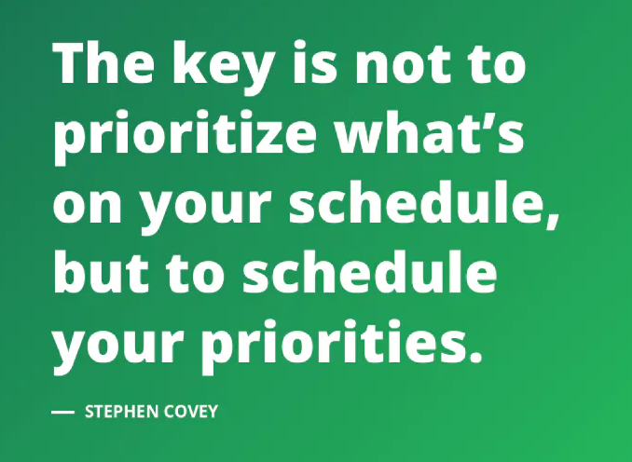
Building Time to Use Data
TIP #2: School leaders must prioritize the use of data by ensuring staff have adequate time available for the use of data.
Notes:
Not only do effective leaders model the use of data while cultivating a data mindset in their staff they also ensure that adequate time is available for staff to use any data that is collected. As Stephen Covey said, the key is not to prioritize what’s on your schedule but to schedule your priorities. This means time is built into teacher schedules to allow for this to happen. Our second tip of this webinar, is that school leaders must prioritize the use of data by ensuring staff have adequate time for the use of that data.

Slide 8
Dedicating Time: Scheduling Considerations
Data Analysis
When will teachers have time to examine, analyze, and reflect on data?
Response to Data
When will teachers respond to insights from their data analysis?
Notes:
In order to support an authentic and meaningful data culture, school leaders need to think about building in time and opportunities for teachers to conduct appropriate data analysis and allow for response to their data analysis. As discussed in a prior webinar, teachers and data teams will need to be provided time to analyze and reflect on data collected on student performance, and they’ll also need time to respond to what their data analysis tells them students need. Should this time not scheduled it increases the chances that the use of data will be deprioritized. This is based not only on their available time to do the work but also the message being sent by leadership that it’s not important enough to dedicate time to.

Slide 9
Dedicating Time: Scheduling Considerations
Data Analysis
When will teachers have time to examine, analyze, and reflect on data?
Daily (planning time to analyze quizzes, exit tickets, etc.)
Weekly (as individual teachers or in teaching teams, PLCs, or coaching meetings)
Larger Step-Backs (quarterly, at semesters, and/or after interim assessments)
Notes:
Even if teachers and teams have access to the data and the data analysis skills necessary to interpret it, they still need to be provided the time opportunity to do the work. School administrators need to consider how to provide teachers time to examine, analyze, and reflect on their data?
You can think about building this into the schedule in a few different ways: at the classroom level, teachers and coaches may need dedicated time (or flexibility in their schedules) to look at results from their students on a weekly (or even a daily) basis. Teachers are usually collecting data from students constantly – e.g., through daily exit tickets or weekly quizzes. If they don’t have time to look at these results, it’s possible that this data won’t meaningfully impact students’ experience. But if teachers do have time to examine and reflect on the data, it can be a powerful tool for identifying and responding to student needs.
Consider also the value of including some larger data step-backs in your annual school calendar. Taking the time each quarter or semester, or after each round of interim assessments, to engage in data analysis at the grade, subject, or even school level give the team the opportunity to meaningfully address any larger patterns of need that are emerging among the group.

Slide 10
Ensuring Transparency, Visibility, and Use of Data
As discussed, effective leaders support use of data by modeling its use in their own practice. In addition they should:
Identify data priorities and identify where staff can access information on major indicators to normalize the use of data.
Publicly reflect on school-level data and share their lessons learned -- what they need to change or do better --- all while modeling a healthy approach (e.g., data helps them to understand how to improve)
Ensure awareness by staff of school priorities and the action plan contained in improvement plans.

Slide 11
Guidance for Data Use
TIP #3: Develop policy and guidance for data use.
Nurturing data analysis skills requires clear expectations on who, when, where, and how staff will incorporate data into their practice. These policies should be consistent across the school (e.g., PLCs, grade level teams).
Examples of Policy and Guidance:
Support Use:
Written descriptions of existing data systems (include purpose) and data-use expectations by grade level.
Support Analysis:
Provide a calendar with time to analyze data and have a common drive with written protocols and norms for data use.
Support Common Expectations:
Data use should be designed to support all students. Include guidance on ways to discuss data with parents/students.
Support Professional Development:
Have an annual schedule of professional learning around data use (formal and informal).
Support Leadership:
Ensure job descriptions and hiring protocols capture the role of data-use across leadership positions (e.g., teacher leader).
Notes:
Lastly, effective district and school leaders not only model the use of data and ensure time for its consideration but they also ensure policy and guidance exists for data use. Again, by making clear expectations related to data use, staff will be more likely to effectively utilize data and data use will continue even when any staff turnover may occur. Examples, of policy and guidance are presented and include supporting use….

Slide 12
Summary

Slide 13
Summary of Key Points
Effective School leaders:
Continuously demonstrate the value and importance of using data to support decision making
Support the development of and model a data mindset
Build time in schedules for teachers to use data
Ensure transparency/visibility of data
Notes:
To summarize this webinar, here are our key points. Effective school leaders….

Slide 14
Thank you for your time!
Email any questions to uiphelp@cde.state.co.us
Notes:
Thank you for your time, we hope that you found this webinar to be beneficial. If you have any additional questions please contact us via email at uiphelp@cde.state.co.us.

