Slide 1
2025 Accountability Bill Informational Webinar
June 12, 2025
Notes:
LM starts slides 1

Slide 2
Agenda
Meeting Practices
Purpose: Provide an overview of HB 25-1278. Review 2025 Performance Frameworks and Improvement Planning Expectations.
Background on the State Accountability System
Overview of HB 25-1278: Education Accountability System
2025 Accountability Process
Accountability Resources and Supports
This meeting is being recorded. Slides and the recording will be posted to the CDE website.
Use the Chat feature in Zoom to ask questions throughout the presentation.
Please mute your sound if you are not speaking.
All participants are encouraged to be on camera if tech allows.

Slide 3
Background on the State Accountability System

Slide 4
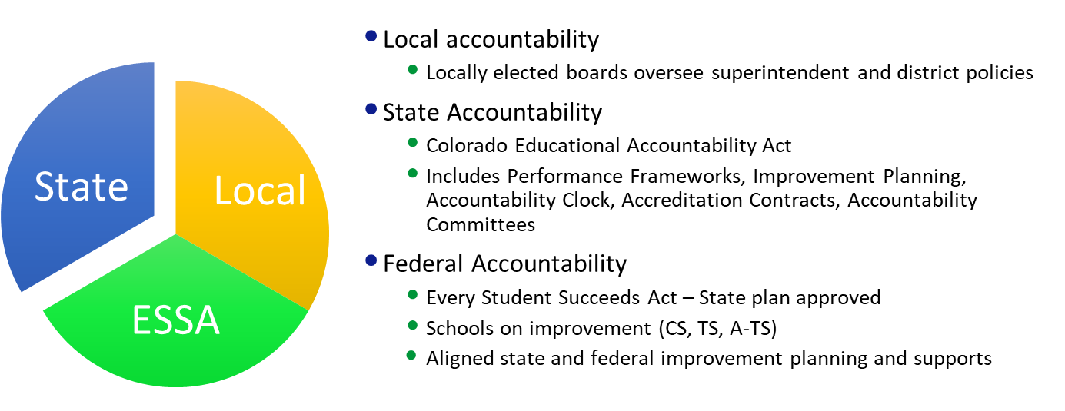
Colorado’s Educational Accountability System

Slide 5
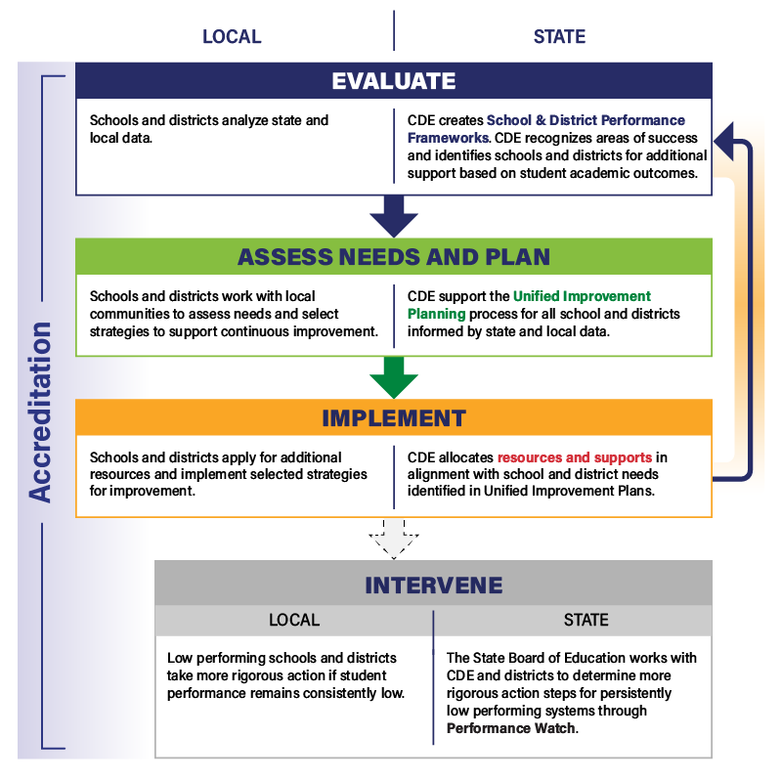
Accountability Theory of Action
Evaluate performance.
Use data to drive improvement.
Provide support and, if necessary, intervention to schools and districts.
Engage stakeholders throughout.
These elements contribute to district accreditation.

Slide 6
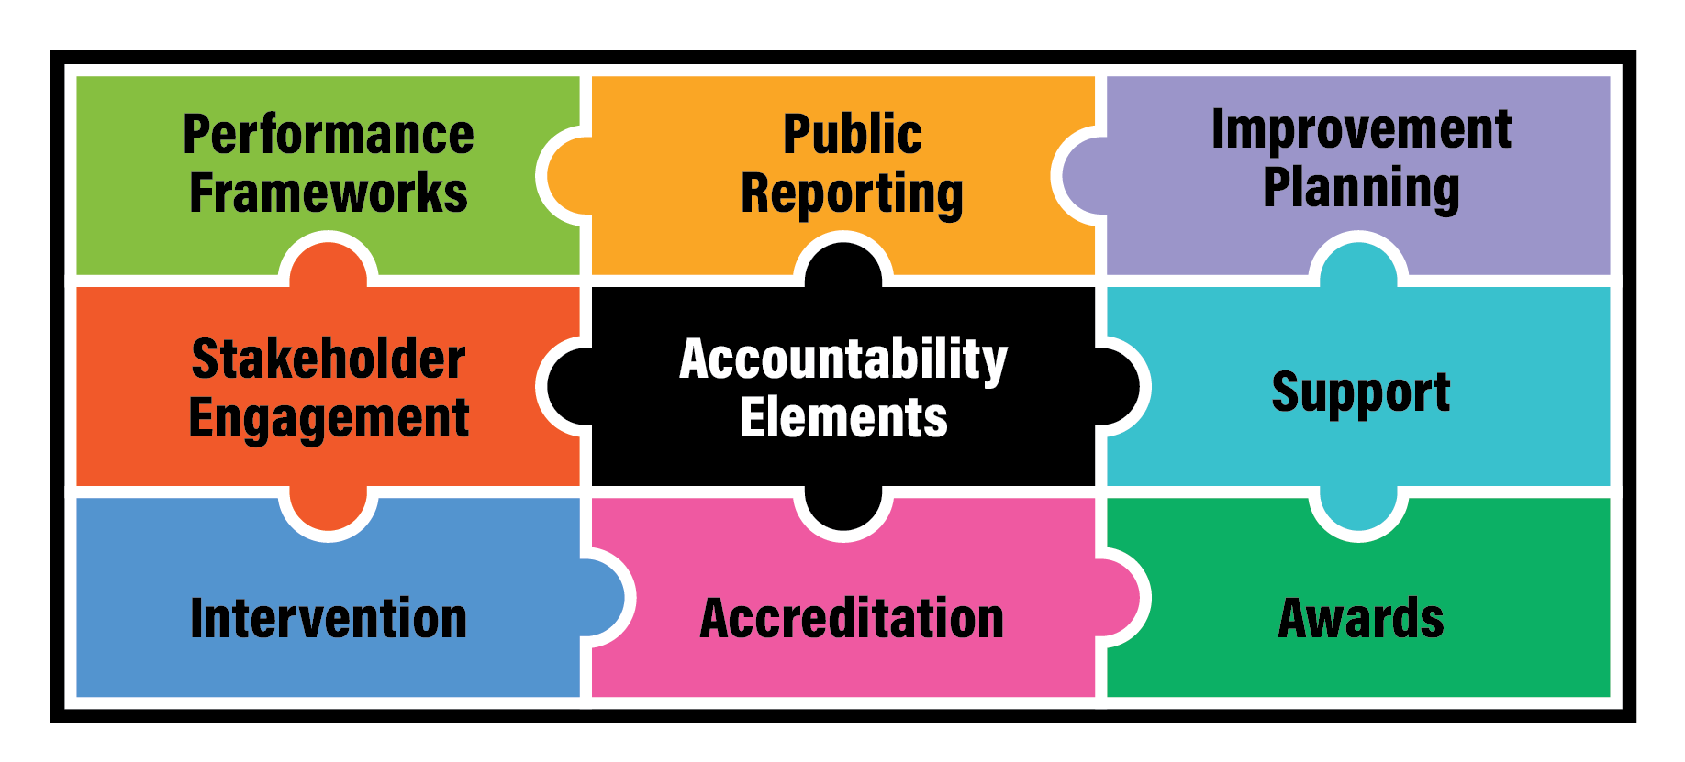
Elements of the Current State Accountability System

Slide 7
HB 25-1278: Education Accountability System

Slide 8
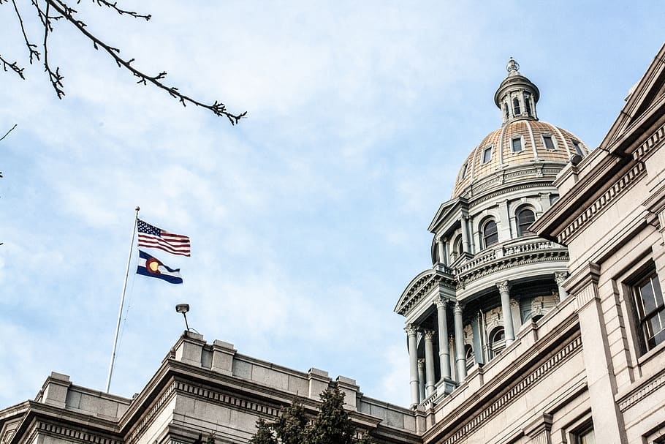
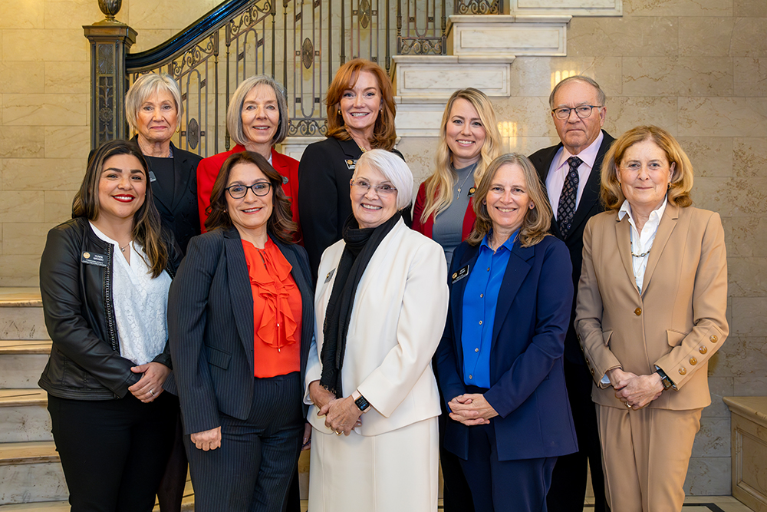
Background | HB 25-1278: Education Accountability System
Policy Development Structures
State Legislature
State Board of Education
CDE Documentation and Guidance
Builds from the 1241 Task Force Recommendation Report. All recommendations were generally included in the final version of the bill, with the exception of some of the studies (e.g., new rating labels, accreditation system, awards, best practices).
(May 23) Signed bill
Several reports to policymakers
Implications for State Board rules and CDE guidance

Slide 9
Big Idea Themes from HB 25-1278
State Assessment
Performance Frameworks
Public Reporting
Insufficient State Data (ISD) - Low Participation
Continuous Improvement and Accountability Clock
Stakeholder Groups and Studies

Slide 10
Implementation Phases of the Accountability Bill
Phase 3:
Launch Full Implementation
Phase 2:
Pilot and Communication
Phase 1:
Discovery and Preparation
2027-28
2026-27
Fully implement changes and establish ongoing continuous improvement cycles.
Drive new initiatives and maintain open communication.
2025-26
Focus on studies, stakeholder engagement, and design work.
Note: Some components begin sooner.

Slide 11
1278 Themes | State Assessments
CDE Action
District Action
Provide guidance on how to divide CMAS into smaller sections for students with disabilities
Develop translated versions of CMAS when at least 1,500 MLs per grade statewide receive instruction in a language
Provide assessment results by June 1st or as soon as practicable
2025 Reporting:
Timeline on CDE’s Website
Family Portal
By Spring 2026:
Prepare for computer-based CMAS administration - paper format will only be available as accommodation
Remove references to the optional SAT essay section from local communications

Slide 12
1278 Themes | Performance Frameworks
CDE Action
District Action
Move SAT to Achievement from PWR indicator
Combine student groups in frameworks, disaggregated groups shared in public reporting
Expand how students with disabilities are counted
Change criteria for how Distinction ratings are assigned
Note: 2025 and 2026 performance frameworks will continue with the current approach
In 2025-26: Provide feedback through advisory groups (e.g., TAP / AWG) and stakeholder engagement sessions
By Spring 2027: Review Informational Performance Frameworks with changes incorporated
By Fall 2027: Review Performance Frameworks with changes (for points)

Slide 13
1278 Themes | Postsecondary & Workforce Readiness Indicator
CDE Action
District Action
Adds a “college and career readiness before graduation” subindicator that is organized around the “big three” (i.e., postsecondary credit, industry-recognized credentials, work-based learning)
Changes “matriculation” to “postsecondary progression” subindicator
Note: 2025 and 2026 performance frameworks will continue with the current approach
In 2025-26: Provide feedback through advisory groups (e.g., TAP / AWG) and stakeholder engagement sessions
By Spring 2027: Review Informational Performance Frameworks with changes incorporated
By Fall 2027: Review Performance Frameworks with changes (for points)

Slide 14
SB 25-315 - Postsecondary & Workforce Readiness Programs
Preserves nearly $28 million of the $37 million in PWR funding
Creates a more equitable distribution among all 178 local education providers
Aligns the “Sustain” and the “Buckner Innovation” funds with the PWR outcomes in 1278
Teacher Recruitment Education and Preparation (TREP) program and Pathways in Technology Early College High Schools (P-TECH) unchanged, though a work group will be convened to draft findings and recommendations concerning the effectiveness of the programs, due to the Joint Budget Committee Dec. 1, 2025
Consolidated 6 of the 8 PWR programs
Accelerated College Opportunity Exam Fee Grant Program
Career Advisor Training Grant Program
Auto Enrollment in Advanced Courses Grant (John W. Buckner)
Career Development Incentive Program (CDIP)
Concurrent Enrollment Expansion and Innovation Grant Program
Accelerating Students through Concurrent Enrollment (ASCENT)
FY 25-26
FY 26-27 & FY 27-28
FY 28 - 29
START UP - ~$5 million
ASCENT - ~$14 million
CDIP - $5 million
START UP - ~$10 million
ASCENT - Rolls Off
CDIP - Rolls Off
SUSTAIN - $14 million
START UP - Rolls Off
BUCKNER INNOVATION - ~$10 million
SUSTAIN - ~$14 million

Slide 15
1278 Themes | Public Reporting
CDE Action
District Action
By November 2026: Legislative report due on a study of a single coherent state dashboard for state and local data (i.e., stakeholder engagement, cost estimates)
Enhance user experience and functionality
Adds new reports (e.g., PWR data, participation for accountability purposes)
In 2025-26: Provide feedback to inform CDE’s updates to data and reporting systems via advisory groups (e.g., TAP / AWG) or stakeholder engagement sessions

Slide 16
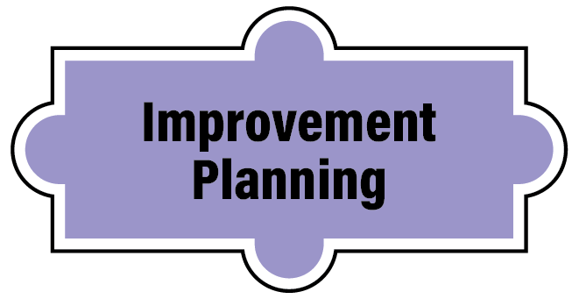
1278 Themes | Insufficient State Data (ISD): Low Participation
CDE Action
District Action
Add a corrective action plan through the UIP when ISD ratings are assigned due to low participation
By Fall 2026: Assign schools and districts as ISD: Low Participation Year 1
In 2025-26: Provide feedback through advisory groups (e.g., TAP / AWG) or stakeholder engagement sessions
Fall 2026: If identified, begin submission of corrective action plan requirement in the UIP
In 2028-29: If Year 3, engage with the state board

Slide 17
1278 Themes | Continuous Improvement
CDE Action
District Action
Universal Support: Provide guidance to local boards on how to review and monitor improvement plans.
Proactive Support: Identify and support schools prior to entering performance watch or early on the clock.
In 2025-26: Provide feedback through advisory groups (e.g., TAP / AWG), stakeholder engagement sessions, or during the state board rule process

Slide 18
1278 Themes | Accountability Clock
CDE Action
District Action
Early the Clock: Offer ongoing support and feedback in Years 1-2.
Late on the Clock: Adds clarity and flexibility on a pathway plan for sites proposing plans to the state board. Adds another state board directed action that is comparable to existing options.
By Fall 2027: Adds an evaluation of external managers.
In 2025-26: Work with State Board on updating rules
In 2025-26: Provide feedback through advisory groups (e.g., TAP / AWG), stakeholder engagement sessions, or during the state board rule process

Slide 19
1278 Themes | Stakeholder Groups and Studies
CDE Action
District Action
Formalizes the Accountability Work Group and expands membership.
By Nov 2026: Legislative reports due on:
Small Systems. Two related studies to examine: (1) lowering student count thresholds for calculations and reporting and (2) volatility within the accountability for small systems.
State Assessments. Study to provide recommendations on shortening assessment and implementing adaptive assessment technology.
In 2025-26: Provide feedback through advisory groups (e.g., TAP / AWG) or stakeholder engagement sessions

Slide 20
Implementation Phases of the Accountability Bill, Cont’d
Phase 3:
Launch Full Implementation
Phase 2:
Pilot and Communication
Phase 1:
Discovery and Preparation
2027-28
2026-27
Fully implement changes and establish ongoing continuous improvement cycles.
Drive new initiatives and maintain open communication.
2025-26
Focus on studies, stakeholder engagement, and design work.
Note: Some components begin sooner.

Slide 21
What will 2025-26 look like for the field?
Phase 1:
Discovery and Preparation
2025-26
Activities for LEAs to Consider in 2025-26
If your school/district uses paper-based assessments (except for students with accommodations in their IEP), this option will not be available in spring 2026.
Next steps: 1. Inform schools/charters using paper; 2. Confirm your District Technology Coordinator; 3. Review CMAS tech readiness information; 4. DACs and DTCs contact Collin Bonner (technology) or Sara Loerzel (administration) for support.
Look for these opportunities
Happening now: Recruiting new members for the AWG and the TAP.
TAP is looking for a district representative with technical expertise - apply by July 18, 2025
Recruitment for AWG will be shared later this summer.
Throughout School Year: Seeking feedback on operationalizing the performance framework changes, statewide accountability reporting dashboard, continuous improvement processes and various studies (i.e., small systems, assessments)

Slide 22
What will 2026-27 look like for the field?
Phase 2:
Pilot and Communication
2026-27
2026-27
Changes to anticipate
Fall 2026: Insufficient State Data: Low Participation Year 1 begins.
Spring 2027: Publish informational frameworks with changes (not for points).
Look for these opportunities
Fall 2026: Completed studies on small systems / assessments and a report on the statewide accountability reporting dashboard.
Throughout School Year: Seeking feedback on operationalizing the performance framework changes and continuous improvement processes.

Slide 23
What will 2027-28 look like for the field?
Phase 3:
Launch Full Implementation
2027-28
Changes to anticipate
Fall 2027: Framework changes (for points).
Spring 2028: Begin preparation for presentations to the State Board of Education for Insufficient State Data: Low Participation.
Look for these opportunities
Fall 2027: Legislative report containing an evaluation of external partners (accountability clock).
Increased and improved CDE support and technical assistance
Continued stakeholder engagement opportunities

Slide 24
2025 Accountability Process

Slide 25
2025 Changes
No big changes to the 2025 Performance Frameworks or other parts of our accountability system this next year.
Changes to note:
Multi-year frameworks
Renorming PSAT/SAT cut scores
2 years of CMAS Science data
New streamlined UIP template and quality criteria
Informational webinar about UIP changes
More details are available in the 2025 Accountability Changes Summary

Slide 26
State Assessment Achievement Data Files and Reports Available to Schools and Districts Throughout June and July
State Assessment Reporting Timeline
Assessment | Student Level Data Files* | District and School Summary Data Files* | Additional Reports Available to Districts and Schools*
CMAS (all content areas) & CoAlt Science | June 10 (PearsonAccess) | June 23 (PearsonAccess) | Early July**
PSAT/SAT | ●June 6 (College Board) ●June 11 (accountability file posted in Syncplicity) | June 6 (College Board)
CoAlt: ELA and Math (DLM) | By June 11 (Syncplicity)
*Data files and reports are confidential - contain PII

Slide 27
Draft 2025 State Accountability Timeline
Anticipated Timeframe | Activities/Actions
Early July | Districts receive ACCESS Growth Data
Mid-August | Districts receive performance framework data files for Achievement, Growth, Postsecondary & Workforce Readiness indicators, and Participation Data; UIP and Secure Data Explorer (N of 1) Data Dashboards available
Late August - Early September | Public Release of Colorado Growth Data Results; Alternative Education Campus (AEC) Designations Finalized; Public Data Dashboards updated Preliminary Performance Frameworks Released to Districts. Public Release 3 days later. Performance data updated in online UIP system for assurances and plan requirements.
Early-Mid September | Identification letter to districts with schools on the accountability clock (i.e., Priority Improvement, Turnaround, On Watch) and/or ESSA Identifications (i.e., CS, TS, A-TS).
Mid-September | AEC Performance Frameworks Released to Districts. Public Release 3 days later.
September 26 | Accreditation Form Submissions Due - ALL Districts
October 15 | Unified Improvement Plan (UIP) Submissions Due Final Request to Reconsider (R2R) Materials Due - Participating Districts
November 13-14 (SBE Meeting) | District Accreditation Ratings & School Plan Types Finalized for Districts/Schools not participating in R2R
December 11-12 (SBE Meeting) | District Accreditation Ratings & School Plan Types Finalized for Districts/Schools participating in R2R
By December 31 | District Accreditation Contracts Due
January 15 | January UIP Submissions Due - Newly Identified, Sites that Participated in R2R
*SBE = State Board of Education

Slide 28
Accountability Resources and Supports

Slide 29
Accessing Communications
District Accountability Contacts:
Receive performance framework results and related data, including Student Personally Identifiable Information (PII)
Submit the Accreditation Form
Receive accountability related communications
Local Access Managers (LAMs) are responsible for assigning District Accountability Contact roles. See the online system set-up and management guide for more information.
Archived accountability contact communications are available publicly here.
Anyone can receive accountability related communications, email accountability@cde.state.co.us to sign up.

Slide 30
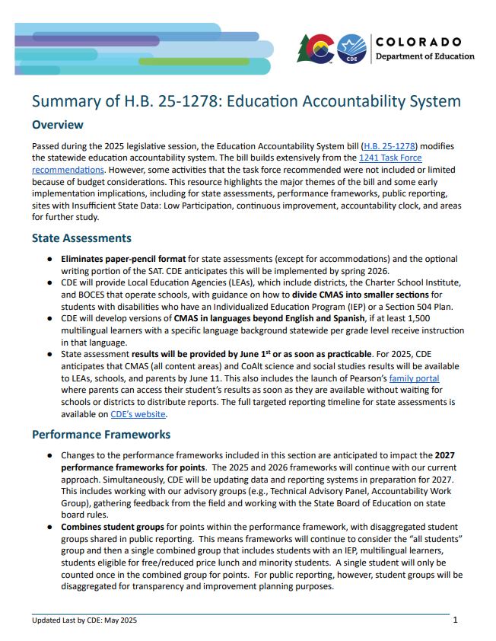
HB 25-1278 Resources
HB 25-1278 Fact Sheet: Provides a high level overview of the key themes of the accountability bill - May 2025
Coming Soon:
New fact sheets based on feedback from stakeholder groups (e.g., TAP, AWG)
Studies on Small Systems, Assessments
Report on Statewide Accountability Reporting Dashboard

Slide 31
Additional Resources
Accountability Resources Website:
Accreditation and Request to Reconsider Guidance - June 2025
District Accountability Handbook - coming soon
UIP Resources Website:
Updated Quality Criteria - April 2025
UIP Online System User Guide - Used to access and navigate the template

Slide 32
Training Opportunities
Accreditation & Request to Reconsider Webinar: 9/3 1-2pm, register here
School/District Streamlined UIP, Improvement Planning & Accountability Support​ Office Hours: Ongoing, register here.
Alternative Education Campus - New Leader Series: 9/9 10-12pm, register here.
Alternative Education Campus - New Optional Measures Application Webinar: 9/25 1-3pm, register here.
For more, go to: Accountability Support: Training & Technical Assistance

Slide 33
Thank you!
Complete our feedback survey: https://forms.gle/vutghs6SBTj4aGLY7

Slide 34
References

Slide 35
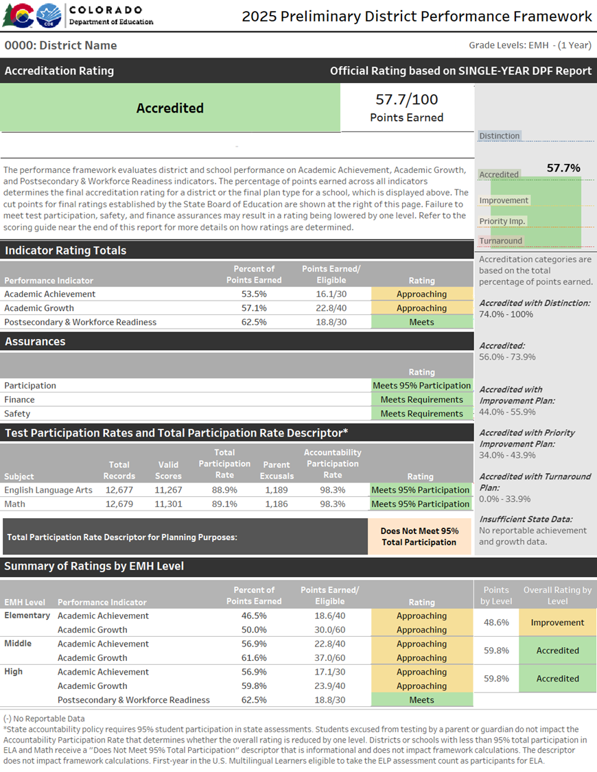
Performance Frameworks
Provides a statewide evaluation of student performance that highlights areas of success and areas for improvement.
Identify those districts and schools whose students are lowest-performing based on academic achievement, growth and postsecondary workforce readiness data, and direct state support and intervention appropriately.
Identify those districts and schools whose students are the highest-performing based on academic achievement, growth and postsecondary and workforce readiness data, recognize them and learn from their practices.

Slide 36
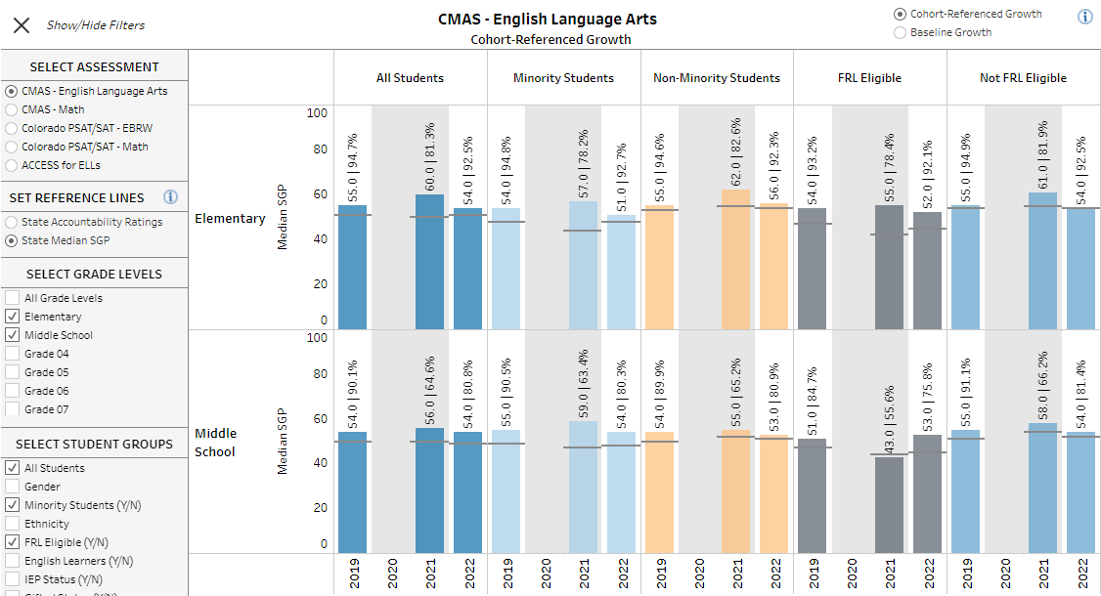
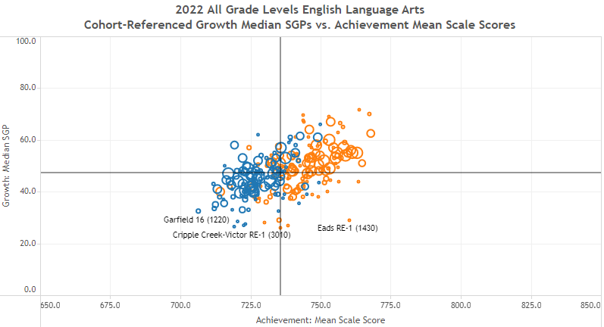
Public Reporting
Accountability Data Tools and Reports
Provides insight into multiple years of accountability data, enhancing transparency and empowering educators, policymakers, and communities to better understand school and district performance.

Slide 37
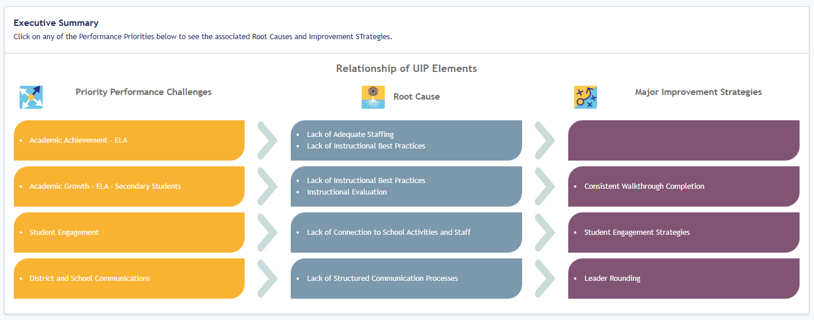
Unified Improvement Planning
Improve student learning and system effectiveness by engaging in a cycle of continuous improvement to manage performance.
New streamlined template

Slide 38
School & District Accreditation Process
August/September - State Accredits Districts: CDE annually reviews performance through school and district performance frameworks
September/October - Districts Accredit their Schools: Districts verify school plan types and district ratings using the Accreditation Form
By December 31st - Districts Sign Accreditation Contracts: Districts officially sign off on final district accreditation ratings and sign Accreditation Contracts

Slide 39
2025 Bills Impacting Accountability
SB 25-315: Postsecondary & Workforce Readiness Programs. Creates a PWR funding model for start-up, innovation and sustainability funding. Adds PWR data collection report that will also be helpful to accountability data.
HB 25-1210: Data Reporting Requirements. Focus on UIP process, including developing a streamlined format, flexibility on the action plan, and centralized reporting to guide distribution of resources and supports.
HB 25-1167: Alternative Education Campuses. For AECs, priority funding on grants, expands eligibility for how some students’ ages are counted, directs CDE to publish an enrollment trends report and adds flexibility on enrollment fluctuations to retain AEC designation.

Slide 40
Background | HB 23-1241: Accountability, Accreditation, Student Performance, and Resource Inequity Task Force
Link to Bill and Link to Website
Purpose: Created a representative task force of 26-members that studies academic opportunities, inequities, promising practices in schools, and improvements to the accountability and accreditation system.
Timeline and Reports:
July 1, 2023: Task force members appointed
August 24, 2023: Convened first meeting
March 1, 2024: Interim report
November 15, 2024: Final report, includes 30 recommendations

