Slide 1
Growth 101 Webinar
August 7, 2023
Daniel Mangan, PhD
Growth & Accountability Analyst
Accountability & Continuous Improvement Unit

Slide 2




Welcome & Introductions
Daniel Mangan, PhD - Growth & Accountability Analyst
  11 years as a middle school ELA teacher
  7 years teaching education classes at CU Boulder and Lewis & Clark College
  PhD in Research and Evaluation Methodology at CU Boulder, Spring 2023
  Studied the effects of multi-year teacher-student assignments (aka “looping”) on student and teacher outcomes.
Notes:
Mention that new to CDE

Slide 3
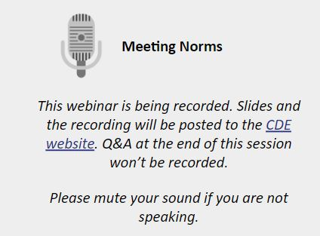



Ice Breaker & Meeting Norms
Zoom Icebreaker…..
  Name (if not visible), district/organization and emoji of your day so far…..

Slide 4
Today’s Topics
Why is student growth important?
What is the Colorado Growth Model and how is growth measured?
  Status vs. Improvement vs. Growth
  How are SGPs and MGPs calculated?
  Cohort v Baseline growth
What does “On-Track Growth” mean and what role does it play in Performance Frameworks?
What “caveats” should I be aware of?
What data reports and resources are available?
  Growth in Colorado | CDE (state.co.us)
Time for Questions
Notes:
Question might come up about frameworks and what sort of growth is used. Cohort.

Slide 5
Student Growth: What, Why, and How?

Slide 6
Performance Framework Scoring Categories

Slide 7
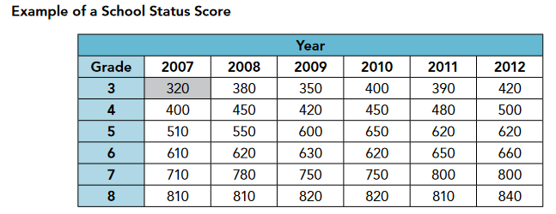
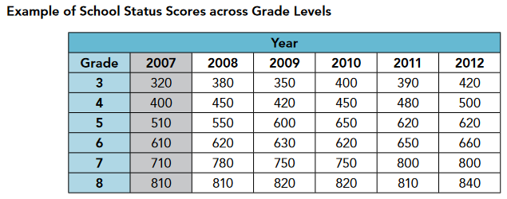
Status, Improvement, and Growth
Status describes the performance of a student (or a group of students) at a single point in time.
Synonymous with “Achievement” or “Scale Score” in Performance Framework
Across groups, status can be thought of as a “vertical slice” through the data table.
Castellano, K. E., & Ho, A. D. (2013). A Practitioner’s Guide to Growth Models. Council of Chief State School Officers.

Slide 8
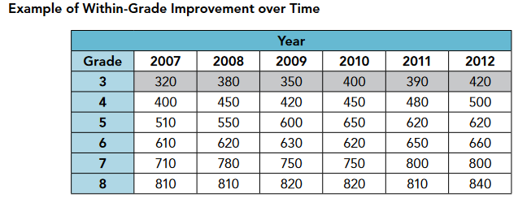
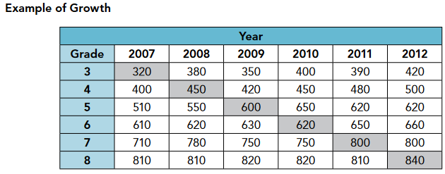
Status, Improvement, and Growth
Improvement describes performance within a group over time (group membership changes)
“Horizontal slice” through the data table
Growth describes performance over two or more time points
Individual or groups whose identity remains constant
“Diagonal” slice through the data table
Castellano, K. E., & Ho, A. D. (2013). A Practitioner’s Guide to Growth Models. Council of Chief State School Officers.

Slide 9


Why is student growth data important?
Growth vs. Status Measures
Status measures are appropriate for inferences about the achievement level of a student or group of students at one point in time..
However, status measures are “blind to the possibility of low-achieving students attending effective schools”
“The fundamental distinction between growth and status models is whether or not additional considerations – specifically prior achievement should be taken into account to understand current achievement.”
Betebenner, D. (2009). Norm‐and criterion‐referenced student growth. Educational Measurement: Issues and Practice, 28(4), 42–51.
Notes:
State has always valued growth.

Slide 10
Why is student growth data important?
Why is growth important?
In 2005, the Federal DoE allows states to comply with NCLB mandates using growth in addition to status measures.
Growth models support inferences about a whole new set of questions asked by parents, teachers, and administrators alike:
Are my students making appropriate progress towards meeting state standards?
How close are my students to becoming proficient?
Does this school/program/group show as much growth as that one?
This is descriptive information, not causal!
Notes:
State has always valued growth.
SGPs don’t really answer these questions. SGP of 50 doesn’t mean one years growth.
Might consider framing as SGP doesn’t immediately tell you this.
These are more growth to standard questions.
Might call out – what does our model do? Measure of relative performance…chance.

Slide 11
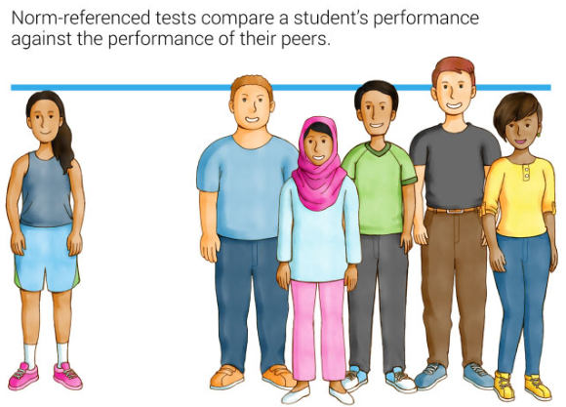
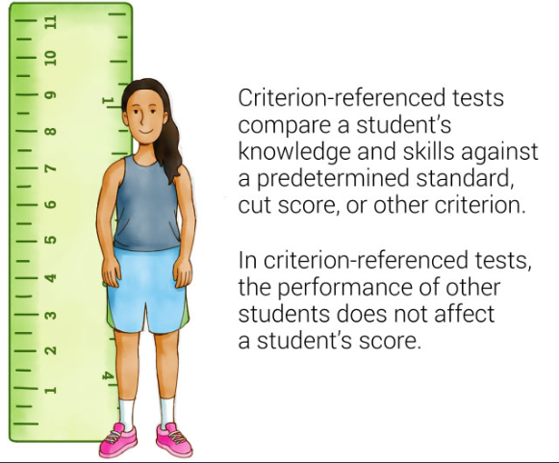
Norm vs. Criterion Referencing
Source: Criterion-referenced test vs. norm-referenced test | Renaissance

Slide 12


How do we measure growth?
The Colorado Growth Model was developed by CDE and the National Center for the Improvement in Educational Assessment (NCIEA) and first used in 2009.
  Currently used by about half the states
A normative picture of change tracking progress in ELA and math as measured by CMAS, PSAT/SAT, and WIDA ACCESS
Growth data can be summarized for specific groups.
Can be re-normed each year (cohort) or compared to a historical point in time (baseline).
The primary metric produced by the Colorado Growth Model is called the Student Growth Percentile (SGP).

Slide 13
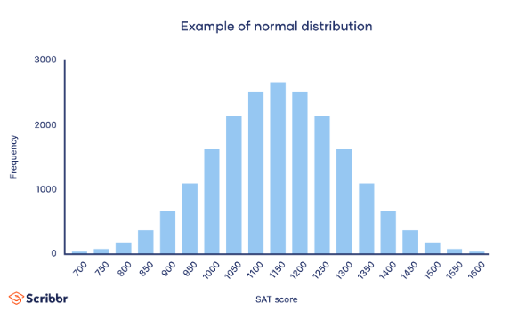
What are Student Growth Percentiles (SGPs)?
Mode, Median, Mean
The student growth percentile (SGP) tells us how a student’s current test score compares with those of other similar students
  “Similar students” refers to other students across the state with similar prior year test scores
Individual SGPs are calculated based on two or more sequential state assessment scale scores.
  CDE uses up to three prior years
  Must be sequential and typical grade progression.
What does this process actually look like?
Count/Frequency of Scores
SAT Scale Score

Slide 14
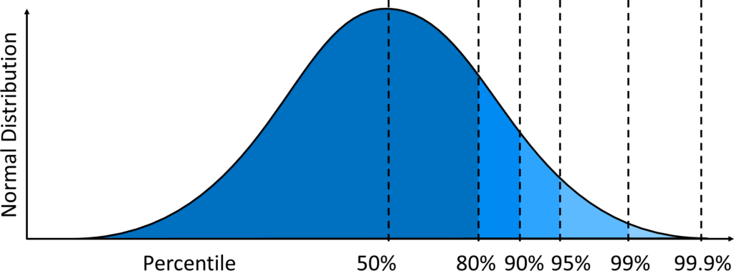
What are Student Growth Percentiles (SGPs)?
We can think of this score distribution in percentiles instead of scale scores.
  Divide scores into equally sized groups.
  A score at the 80% percentile means that the score is higher than 80% of all scores.

Slide 15
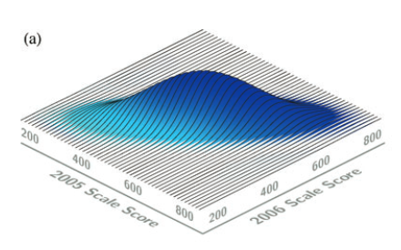
What are Student Growth Percentiles (SGPs)?
Now imagine two years of scores. We can visualize this in 3 dimensions.
A student who scored at the 50th percentile both years would be at the center of the “mound”.
2022 Math Scale Score
2023 Math Scale Score
Betebenner, D. (2009). Norm‐and criterion‐referenced student growth. Educational Measurement: Issues and Practice, 28(4), 42–51.

Slide 16
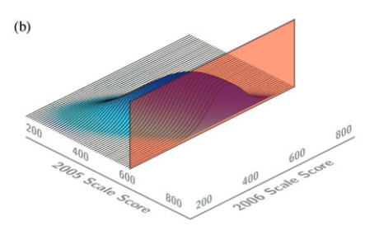
What are Student Growth Percentiles (SGPs)?
Looking at a student’s prior year score, we can take a slice through the bivariate distribution.
  A score of 600 might put a student in about the 75th percentile for 2022.
Many students will have the same (or nearly the same) score in that year, so this slice represents not one student, but a group.
2022 Math Scale Score
2023 Math Scale Score
Betebenner, D. (2009). Norm‐and criterion‐referenced student growth. Educational Measurement: Issues and Practice, 28(4), 42–51.

Slide 17
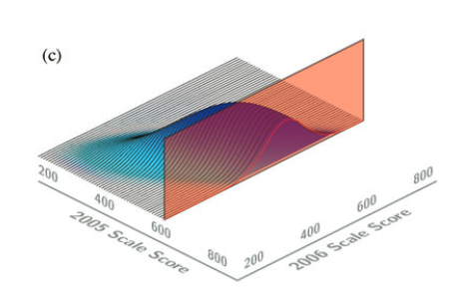
What are Student Growth Percentiles (SGPs)?
This outlined slice shows the distribution of 2023 scores among all students who got the same percentile score in the prior year.
2022 Math Scale Score
2023 Math Scale Score
Distribution of 2023 scores for students who scored 600 in 2022.

Slide 18
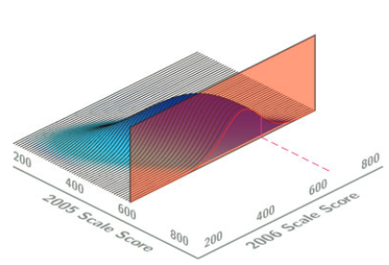
What are Student Growth Percentiles (SGPs)?
Looking at a student’s 2023 score, we can compare against other students who got the same score in 2022 and calculate a percentile.
So, a student who scored 600 in 2022 would need a score of about 650 to be in the 80th percentile of growth in 2023.
This student’s 2023 SGP would thus be 80.
Remember that multiple years are used to establish “similar students”, so this picture would actually be multidimensional in most cases!
2022 Math Scale Score
2023 Math Scale Score
Betebenner, D. (2009). Norm‐and criterion‐referenced student growth. Educational Measurement: Issues and Practice, 28(4), 42–51.

Slide 19




Student Growth Percentile: Cohort Growth Calculation Heuristic
Medium 3rd grade score (700)
High 3rd grade score (725)
Colorado 4th Graders
718
707
720
705
730
706
707
708
693
723
Low 3rd grade score (675)
681
707
695
670
735
‘Heuristic’ slides adopted with permission from Julie O’Brian at the Center for Transforming Teaching and Learning
Notes:
Let’s consider the example of calculating student growth percentiles for 4th grade students in math.
We start with data from all the 4th grade students in the state. A subset of those 4th graders is represented here. First, we put these students in their academic peer groups – in other words, with other students that scored similarly in prior years in math, in this case based on their 3rd grade math scores. We group them with students that had similarly low... medium... or high 3rd grade math scores. This is their academic peer group.

Slide 20
Student Growth Percentile: Cohort Growth Calculation Heuristic
Medium 3rd grade score (700)
High 3rd grade score (725)
706
707
708
693
723
718
707
720
705
730
Low 3rd grade score (675)
681
707
695
670
735
Notes:
Now let’s consider their latest math scores, in this case their 4th grade scores. Since the third grade assessment, some of the students may have made a lot of academic progress, so their fourth grade scores will be a lot higher. Others may not have made as much progress, so their scores won’t be quite as high. As you can see, there is a wide variety of fourth grade math scores, both within each group, and across all the groups.

Slide 21
Student Growth Percentile: Cohort Growth Calculation Heuristic
Medium 3rd grade score (700)
High 3rd grade score (725)
693
706
707
708
723
705
707
718
720
730
11
31
50
58
86
19
24
52
64
99
Low 3rd grade score (675)
670
681
695
707
735
35
39
61
82
95
Notes:
Our next step is to sort the students that are within the same academic peer group by their most recent achievement scores. It is then based on this distribution that percentile rankings for each student are assigned. So, for each student they will be assigned a growth percentile ranging from 1 to 99 that indicates their normative standing relative to their academic peer group. This percentile score is know as a student growth percentile.

Slide 22

From SGP to MGP
SGPs are for single students. How do we describe the growth of a group of students?
The median growth percentile tells us how much a group of students is growing in comparison with other groups.
MGPs represent the summary of student growth percentiles for a given disaggregated group. (The median is used instead of the mean because it is less sensitive to outliers).
MGPs are calculated by CDE for the following groups:
  State, districts, and schools (overall and by grade)
  Minority, migrant, gifted, FRL, IEP, multilingual learners, gender, and performance level.
  The state-level cohort MGP will always be about 50.
The Middle Number is the Median

Slide 23
School Median Growth Percentile Calculation Heuristic
Raider Elementary School
706
670
707
693
705
720
707
708
Students grouped by School
31
35
50
11
19
64
24
58
Bronco Elementary School
730
723
695
707
735
681
718
99
86
61
82
95
39
52
Notes:
Next, let’s explore how individual student growth percentiles are combined to calculate a school level score.
Consider two example schools, raider elementary school and bronco elementary school. Both of these schools have students that came from different academic peer groups – they have a mixture of low, average, and high-achieving students. Notice that in this picture, each student has both a fourth grade scale score (blue box) and a growth percentile (green box).

Slide 24

School Median Growth Percentile Calculation Heuristic
Raider Elementary School
33
In Order
by Student Growth Percentile within Schools
693
705
707
706
670
707
708
720
11
19
24
31
35
50
58
64
Bronco Elementary School
82
681
718
695
707
723
735
730
39
52
61
82
86
95
99
Notes:
To calculated the median growth percentile for the school we would determine the median score for the group of students. So, if we order students by their obtained growth percentiles and then find the mid-most score this would identify the median. In our example, the students at Broncos elementary school had a higher MGP then the students at Raider elementary School.

Slide 25
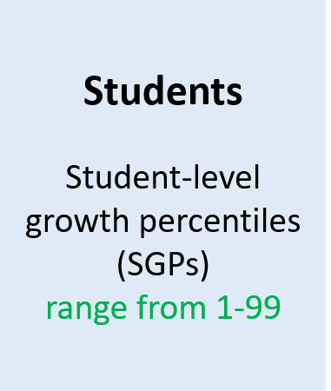
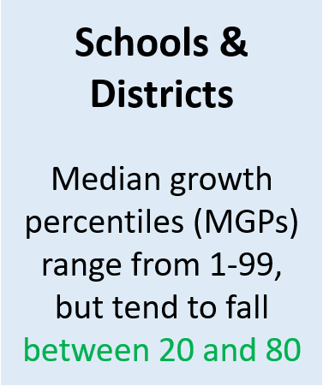
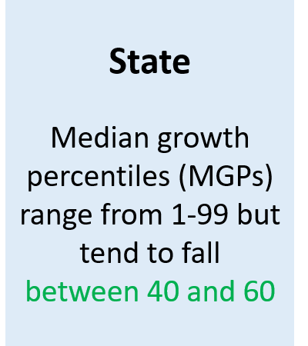
What is the typical range of MGPs?
Notes:
Subgroups between 40-60

Slide 26
Cohort vs. Baseline Growth Models

Slide 27
Cohort vs Baseline Growth
Cohort-Normed
Baseline-Normed
Uses students from the current year to norm scores. (Comparison group is “academic peers”)
Comparison group changes each year such that the median and mean SGP is always about 50.
Two students with the exact same 3rd and 4th grade scores could have different SGPs if they took the tests in different years.
Answers the question: “How does each student’s current achievement compare to current academic peers with similar prior scores?”
Used in performance framework calculations.
Uses students from a stable baseline cohort to norm scores. (Comparison group does not change from year to year.)
Mean/median SGPs can thus vary across years.
CDE uses the last pre-pandemic year of growth as the baseline (2018 to 2019).
Baseline growth allows us to see how much progress students are making compared to pre-pandemic expectations
Answers the question: “How does each student’s current achievement compare to academic peers from just before the COVID-19 pandemic?”
For informational purposes only.
Shear, B.R. (2020). Comparison of 2019 Cohort and Baseline Student Growth Percentiles. Boulder, CO: The Center for Assessment, Design, Research and Evaluation (CADRE). https:// www.colorado.edu/cadre/node/373/attachment

Slide 28
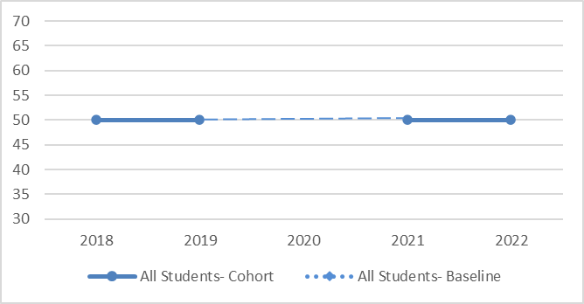
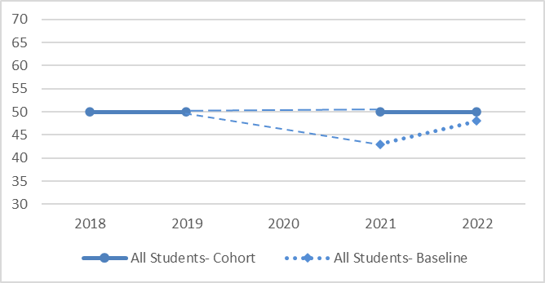
Cohort vs Baseline Growth (ELA)
Cohort-Normed
Baseline-Normed
CMAS English Language Arts
All Students
CMAS English Language Arts
All Students

Slide 29
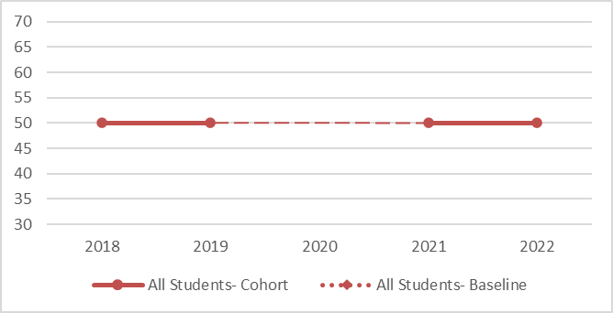
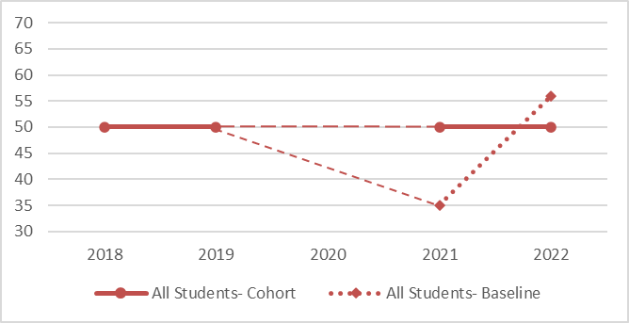
Cohort vs Baseline Growth (Math)
Cohort-Normed
Baseline-Normed
CMAS Math
All Students
CMAS Math
All Students

Slide 30
On-Track Growth

Slide 31
What is On-Track Growth?
Colorado law requires a metric to determine whether a student is making enough growth to reach a target achievement level within a given time frame.
“On-Track Growth” comprises Catch Up and Keep Up calculations.
  Catch Up → are students scoring below grade level catching up to grade-level expectations quickly enough?
  Keep Up → are students who already meet grade-level expectations maintaining their performance?
On-Track Growth for WIDA ACCESS is still included as a sub-indicator within the Growth category of the PFW.
CMAS On-Track Growth will be available in January for informational and planning purposes only. CDE is still determining when this will become part of framework scoring. More information available here: https://www.cde.state.co.us/accountability/ontrackgrowthfactsheet

Slide 32
Visualizing WIDA ACCESS On-Track Growth
ELP students have 6 years to move from Level 1 to proficiency (Level 4).
This 6-year timeline is broken down into the following “stepping-stone” targets:
Students at Level 4, 5, or 6 are expected to remain at that level.
ACCESS On-Track Growth has been part of framework calculations since 2018.

Slide 33
Visualizing WIDA On-Track Growth
Picture an example student currently in grade 4, who scored at level 2 last year as a 3rd grader.
Current Year
L4
Didn’t make it in current year (1 year)
NOT on-track to make it in 2 years
On-track to make it in 3 years
On-track to make it in 4 years
SGP=99
SGP=85
SGP=72
SGP=65
L3
SGP= 76
L2
2022
2023
2024
2025
2026
Notes:
“target”, not “example”

Slide 34
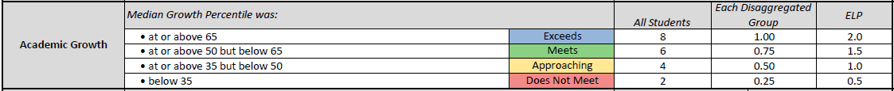
Other Growth Caveats – For Your Information!
What is “typical” growth?
  CDE defines low, typical, and high growth in relation to student level growth only.
    High → 65th percentile or higher
    Typical → 35th to 64th percentile
    Low → Below 35th percentile
  These categories are the help contextualize SGPs for stakeholders.
  Typical or even High growth does not necessarily indicate that a student is “on-track” toward grade level expectations.
MGPs are categorized differently:
Notes:
Middle tercile divided into two

Slide 35
Data, Reports, & Resources

Slide 36
Important Dates
WIDA ACCESS Achievement & Growth – already privately available via Syncplicity
~Aug. 14 → CMAS and PSAT/SAT Achievement & Growth privately available via Syncplicity
  UIP portal access to summary dashboard data available
  Embargoed until Aug. 17
~Aug. 17 → Spring 2023 Achievement & Growth data made public
  Online dashboards updated
~Aug. 23 → Preliminary 2023 Performance Frameworks privately available
~Aug 28 → Preliminary PFWs made public on CDE website
Oct. 16 → R2R deadline
December → SBE meeting – final frameworks released

Slide 37
What resources are available now or coming soon?
CMAS, PSAT/SAT, ACCESS Student Detail & Summary files
  Available to district accountability contacts via Syncplicity
Individual student CMAS growth reports
  Available to district accountability contacts via Syncplicity
  These reports have been prepared for parents to explain the performance and growth of their students on the CMAS assessments.
Summary Excel “flat files” for all schools, districts, state CMAS and P/SAT growth
  Includes overall performance and performance by level.
  To be posted here: http://www.cde.state.co.us/accountability/growthmodelsummarydata
Accountability Data Tools and Reports: State Accountability Data Tools & Reports | CDE
  School and District Dashboards (updated Aug. 17)
  State Accountability Data Explorer (updated Aug. 17)
  Performance Snapshot (updated in December)
  Performance Framework Reports and UIPs (updated in December)
Notes:
WIDA flat files?

Slide 38
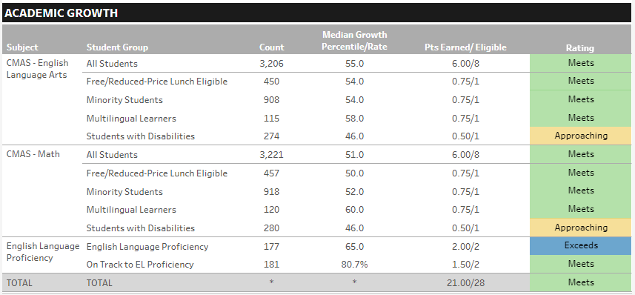
How is growth reported on the 2023 Performance Frameworks?
CDE requires at least 20 students in a subgroup to report growth.
Notes:
We are resetting this metric for 2023.

Slide 39
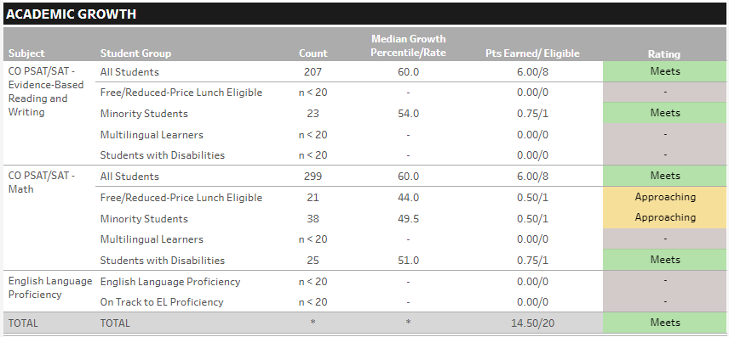
How is growth reported on the 2023 Performance Frameworks?
Important Note → CDE requires at least 20 students in a subgroup for growth calculations.

Slide 40
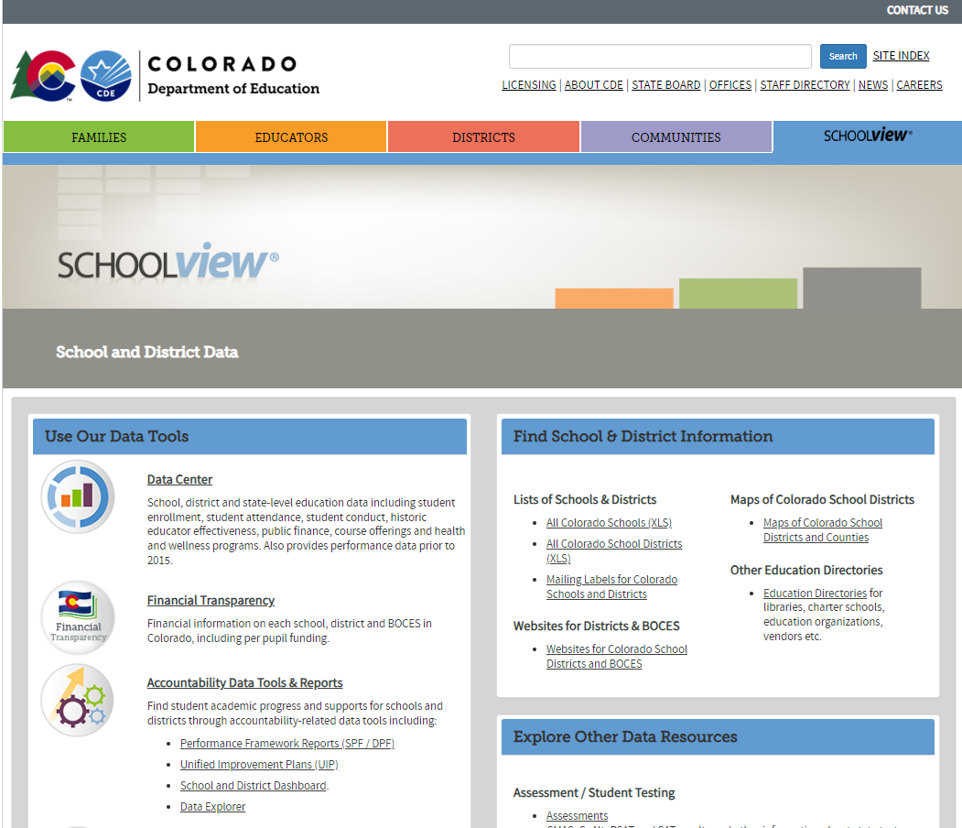
Accountability Data Tools and Reports
Accountability Data Tools and Reports: State Accountability Data Tools & Reports | CDE
  Performance Snapshot (updated in December)
  Performance Framework Reports and UIPs (updated in December)
  School and District Dashboards (updated Aug. 17)

Slide 41
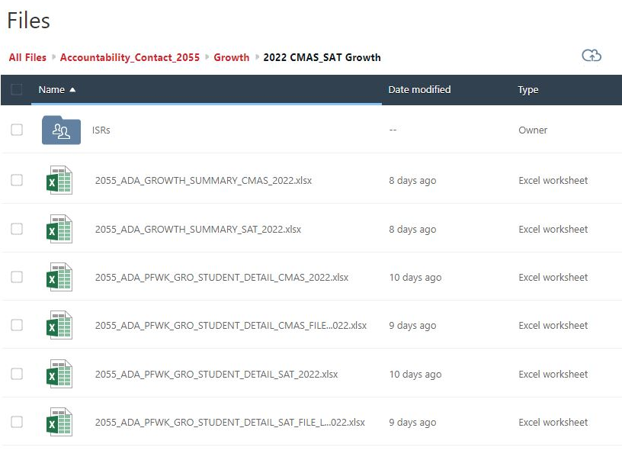
Syncplicity

Slide 42
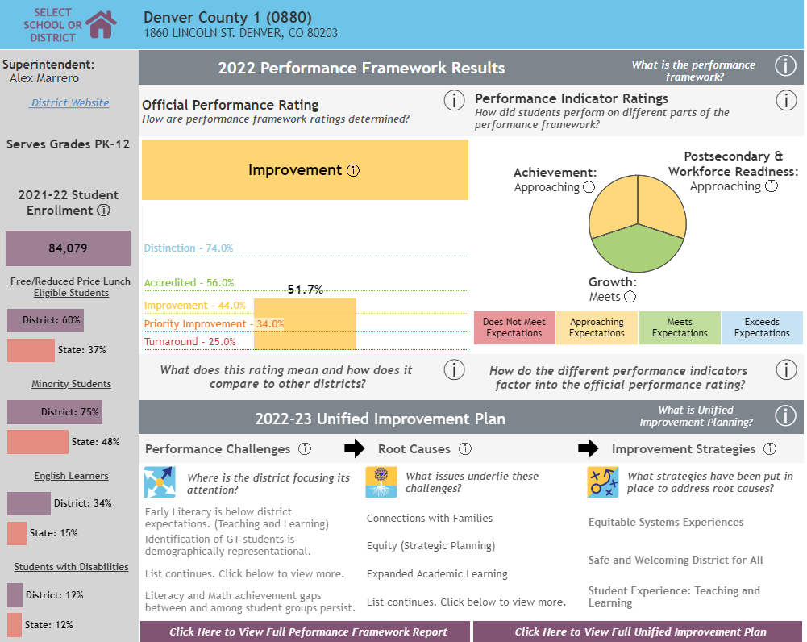
What resources are available now or coming soon?
State Accountability Data Tools & Reports | CDE
  Performance Snapshot

Slide 43
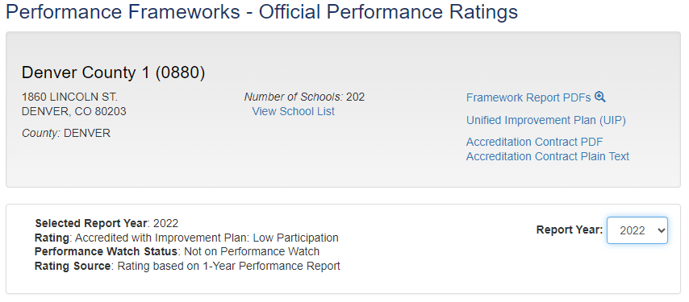
What resources are available now or coming soon?
State Accountability Data Tools & Reports | CDE
  Performance Snapshot
  Performance Framework Reports and UIPs

Slide 44
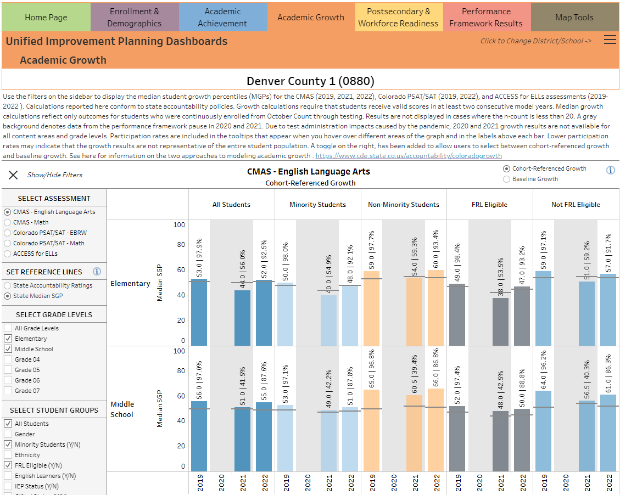
What resources are available now or coming soon?
State Accountability Data Tools & Reports | CDE
  Performance Snapshot
  Performance Framework Reports and UIPs
  School and District Dashboards

Slide 45
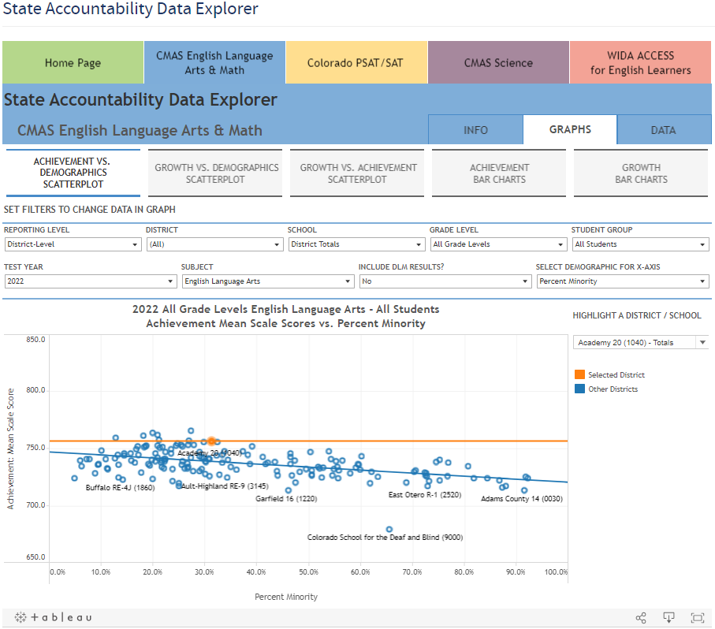
What resources are available now or coming soon?
State Accountability Data Tools & Reports | CDE
  Performance Snapshot
  Performance Framework Reports and UIPs
  School and District Dashboards
  State Accountability Data Explorer

Slide 46
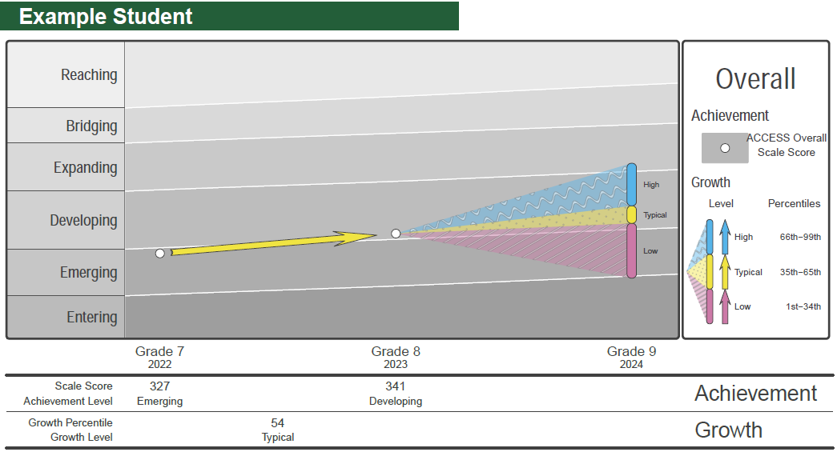
Individual Student Report (ISR)
Prior Year Score

Slide 47
Individual Student Report (ISR)
Prior Year Score
Current Year Score

Slide 48
Individual Student Report (ISR)
Prior Year Score
Current Year Score
Student Growth Percentile
Student Growth Percentile

Slide 49
Individual Student Report (ISR)
Prior Year Score
Current Year Score
Student Growth Percentile
Projected Next Year Score, by Growth Level

Slide 50

Additional Resources & Training
Upcoming trainings will be announced in the Scoop, the CDE newsletter.
  Training web-page
  On-site training opportunities may also be available upon request
Growth Model Website
On-Track Growth Fact Sheet
Additional questions? Email Daniel Mangan at: mangan_d@cde.state.co.us

Slide 51
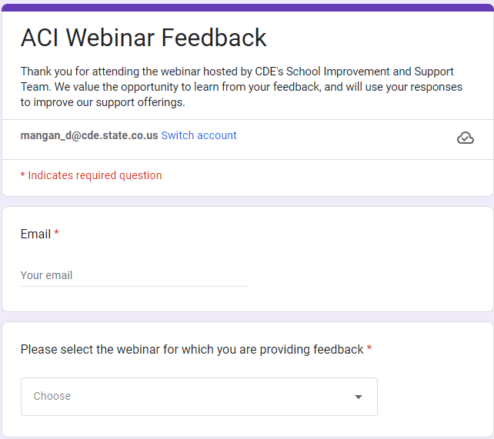
Webinar Feedback Survey
Please take a moment to fill out this quick survey about how well the webinar met your needs and what we can do to improve future webinars. Thank you!
  https://tinyurl.com/ACIWebinarSurvey

Slide 52


