Slide 1
Building Knowledge and Skills to Use Data
Building a Data Culture Webinar Series
Notes:
Welcome to the third webinar in the “Building a Data Culture” Webinar Series on “Building Knowledge and Skills to Use Data”

Slide 2
Building a Data Culture Webinar Series: Themes
Access
Ensure data is easy to access in an interpretable format—educators can't use data if it's not readily available and actionable.
Skills
Provide additional professional learning to know how to interpret and use data.
Meaning
Dedicate time to meet and discuss data, collaborating to find meaningful and useful insights to inform action.
Use
Be clear about how the data will be used, by whom, and for what goal or purpose, so that educators know which teams use data in different scenarios.
Support
Nurture data use and provide the environment to develop the skills and comfort-level needed to meaningfully integrate data use into daily practice.
Adapted from: https://ies.ed.gov/ncee/wwc/PracticeGuide/12
Notes:
The prior webinar focused on ensuring access to data. This third webinar will focus on supporting skill development in foundational data analysis to learn how to interpret and use data.

Slide 3
Session Outcomes
“
This video will focus on the following topics:
Building mindsets and attitudes that support data use
Developing data analysis skills
The research is very clear that setting aside time during the work week to support both examining evidence of student learning AND determining instructional decisions informed by data is a key characteristic of schools and districts that do this work well.
IES 2011
Notes:
This webinar focuses on the following topics:
Building mindsets and attitudes that support data use
Developing data analysis skills

Slide 4
Mindsets and Attitudes to Support Data Use
Notes:
Before diving into using data, we’ll focus on the mindsets and attitudes that support data use.

Slide 5
Changing Attitudes about Data Systems
Accountability
Variety of Data Types
Aggregate
Individual
Information Management
Knowledge Management
Notes:
In the last webinar, we discussed changing attitudes about data systems towards a variety of data types, individual and aggregate data, and a focus on knowledge management to better support short cycle planning, teaching, and learning.

Slide 6
Deficit vs. Asset Mindset
Deficit:
Asset:
Focus on student limitations and reliance on stereotypes about who can achieve.
“
We define children by how they fall short of our grade level standards rather than defining children by the particular talents and brilliance that they bring into our classrooms
Belief that all students have strengths and are capable of learning.
Example: How do you provide feedback to students?
Rich Milner, Vanderbilt University College of Education
Adapted from MIT Open Learning Library.
Notes:
Next, we want to focus on ways we discuss the data we present. When we think about data use in the classroom, we want to establish mindsets that do not reinforce negative stereotypes or biases about any individual students. A deficit mindset focuses on student limitations and a reliance on stereotypes about who can achieve. Shifting to an asset mindset reinforces the idea that all students have strengths and are capable of learning.
In the context of a classroom, one way to frame asset mindsets is in the way teachers provide student feedback. For instance, when talking with a student about their performance on an interim assessment result, a deficit mindset would focus on the overall score. Instead, using an asset mindset, you can reframe the focus from the overall score to praise work that truly deserves it and offer thoughtful critical feedback that, relative to students’ current abilities, taxes them to stretch and expand their skills in a meaningful way.
Here is an example of asset-based feedback when handing back a student math assignment: “By grade 7, students are expected to have fully mastered the many math concepts and operations taught in the earlier grades.When you look over this diagnostic math test that you took last week, you will see that I have written a number of comments highlighting where you made errors or failed to show or explain your work. Judging by past work that I have seen from each of you, I can see that you all have the skills to be strong math students. My comments will point you to where you should put additional effort to ensure success in this course.” Consider using this type of feedback structure not only with your students but in the way you discuss all student data.
As Rich Milner describes in the following quote, “We define children by how they fall short of our grade level standards rather than defining children by the particular talents and brilliance that they bring into our classrooms”. An asset mindset allows you to focus on your data in a way that does not diminish or dismiss the other important skills students bring to your classroom.

Slide 7
Developing Data Analysis Skills
Notes:
Now that we’ve established helpful mindsets that support data use, we’ll focus on how to develop data analysis skills.

Slide 8
Types of Data and What They Tell Us
Conditions Data
Conditions that can support progress on longer-term outcomes. Without the necessary conditions, leading, intermediate, and lagging indicators will suffer.
Examples: course offerings, scheduling, staffing, etc.
Leading Indicators
Data elements that inform progress against intermediate indicators. They are important to identify as they can help predict future performance.
Examples: formative assessments (classroom-based assessments), course taking patterns, etc.
Intermediate Indicators
Data elements that may not be appropriate or ready for high-stakes use. They help inform progress toward achieving intended results on lagging indicators.
Examples: local interim assessments (e.g., NWEA, STAR, iReady), course grades, etc.
Lagging Indicators
Accountability indicators and their corresponding data elements that make up overall school or district ratings. They tell us whether the intended result was actually achieved.
Examples: state assessment data (CMAS, PSAT/SAT, ACCESS), graduation rates, etc.
Do we have what we need to be successful?
Were we successful?
Adapted from: https://www.nciea.org/blog/accountability/whats-name-sometimes-quite-bit
Notes:
This slide shows a continuum of the types of data and the types of information they can be used for.
Starting at the left of the slide, conditions data is beginner level information that describes the conditions that support learning that support learning or are indicative of capacity among personnel, an organization, or procedures that can support progress on longer-term outcomes. Without the necessary capacity or appropriate conditions, leading, intermediate, and lagging indicators will suffer. Some examples of this type of data include course offerings, class schedules, or staffing structures.
Next, we get more specific with leading indicators. These are data elements that inform progress against intermediate indicators. They are important to identify as they are more forward-looking and can help predict future performance. Examples of these data types include formative or class-room based assessments or course-taking patterns.
After that comes intermediate indicators. These are data elements that are closely related to lagging indicators but may not be appropriate or ready for high-stakes use. They help inform progress toward achieving intended results on lagging indicators. Examples include local interim assessments (e.g., NWEA, STAR, iReady) or course grades.
Finally are our lagging indicators. These are most closely associated with our accountability indicators and their corresponding data elements that make up overall school or district ratings. They tell us whether the intended result was actually achieved. Examples include state assessment achievement and growth data (CMAS, PSAT/SAT, ACCESS), graduation rates, dropout rates, or performance framework ratings.
These data elements can help schools and district answer various questions about student performance. This spectrum ranges from telling schools whether their systems have what is needed to be successful to identifying whether implementation was successful after the fact.

Slide 9
Basic Approach to Data Analysis
TIP #1: Be confident! Anyone can learn data analysis skills.
You do not need an advanced degree in statistics to learn some basic data analysis skills. Your skills as a teacher/school leader are just as important to identify the right questions to ask.
3-Step Process:
Identify Entry Points: Generate and collect observations about the data, including bright spots, concerns, patterns, surprises.
Dig In: Examine likely sources of strength or struggle. Which students have low, typical, or high achievement / growth? What has contributed to student success in this area? Why are students struggling with this concept or skill?
Identify Next Step(s): Is there other data that should be analyzed to determine if something is a trend or an outlier? Are there other comparisons that may provide additional insight into the information that’s been collected? What other ways can I make this data meaningful?
Notes:
This slide identifies a very basic approach to data analysis. Before diving in, the first tip I’ll share for anyone beginning to learn more data analysis skills is to be confident. Anyone from any background can learn data analysis skills. You do not need an advanced degree in statistics to learn some basic data analysis skills. Your skills as a teacher/school leader are just as important to identify the right questions to ask.
The three step process to data analysis includes:
Identify Entry Points: Generate and collect observations about the data, including bright spots, concerns, patterns, surprises.
Dig In: Examine likely sources of strength or struggle. Which students have low, typical, or high achievement / growth? What has contributed to student success in this area? Why are students struggling with this concept or skill?
Identify Next Step(s): Is there other data that should be analyzed to determine if something is a trend or an outlier? Are there other comparisons that may provide additional insight into the information that’s been collected? What other ways can I make this data meaningful?
In the next webinar in this series we’ll provide a more in-depth example of how this process looks in the classroom-level.

Slide 10
Making Comparisons
 | Criterion-Referenced Comparison | Norm-Referenced Comparison
Guiding Question | How did we compare to a specific expectation? | How did we compare to others?
Examples of Comparison Points | State expectations (i.e. “Meets” on the performance framework) Cut points for assessment performance levels (e.g. 750 on CMAS ELA/Math) Graduation guidelines cut points (district-specific) Local assessment benchmarks (determined by the vendor) | State average District average Neighboring school average Grade levels, ex. 9th graders to 10th graders Out group v. in group, ex. students eligible for free or reduced price lunch (FRL) to Non-FRL
High Level Questions to Ask about Your Data | Are students mostly meeting or not meeting expectations? How are students performing over time? Is performance increasing or decreasing? Are student groups (e.g., students with disabilities, multilingual learners, students of color) mostly meeting or not meeting expectations? How are student groups performing over time? Is performance increasing or decreasing? Are gaps between student groups increasing or decreasing? | How does the performance of students in my school/district compare to students in other schools/districts/the state? Over time? How does the performance of students overall compare to the performance of student groups/grade levels? Over time? How does the performance of student groups compare to their non-subgroup peers? Over time? How does student performance compare across grade levels? Over time?
Notes:
On the last slide, we mentioned that the third step to the data analysis process is Identifying Next Step(s). When Identifying next steps, you’ll want to identify ways to make the data more meaningful. A helpful way to do that is by making comparisons. There are two types of comparisons when it comes to data analysis: criterion-referenced comparisons and norm-referenced comparisons.
The first type, criterion-referenced, asks how did the school compare to a specific expectation. As an example of criterion-referenced comparison points, you can look at state expectations and see whether you’re meeting or not meeting or you can look at cut points for various assessments, including local assessments. When identifying criterion-referenced comparisons, you’ll want to ask the following questions:
Are students mostly meeting or not meeting expectations?
How are students performing over time? Is performance increasing or decreasing?
Are student groups (e.g., students with disabilities, multilingual learners, students of color) mostly meeting or not meeting expectations?
How are student groups performing over time? Is performance increasing or decreasing? Are gaps between student groups increasing or decreasing?
The second type, norm-referenced, asks how did the school compare to others. As an example of norm-referenced comparison points, you can look at state, district, or local averages to see how you compare. You can also look at your student groups and see how various student groups performed, from grade levels to multilingual learners or percent free or reduced price lunch. When identifying norm-referenced comparisons, you’ll want to ask the following questions:
How does the performance of students in my school/district compare to students in other schools/districts/the state? Over time?
How does the performance of students overall compare to the performance of student groups/grade levels? Over time?
How does the performance of student groups compare to their non-subgroup peers? Over time?
How does student performance compare across grade levels? Over time?

Slide 11
Evaluating the Condition of Data for Reporting
Completeness
Consistency
If data you’re considering meets all four of these areas, it is likely both feasible and appropriate to report.
To what extent are data elements missing?
Was the way the data is defined, calculated, or collected changed?
If data meet some but not all these areas, consider what information or analyses are needed to determine whether or how to report and use the data. This may mean you offer an additional statement of caution around interpretation, or you disclose additional contextual information (e.g., participation rates). If data do not meet any of these areas, it is likely not feasible or appropriate to report. Consider what other data are appropriate substitutes to supplement or support data trends.
Impact
Practicality
Is it likely that data was impacted by other contextual factors?
Is it feasible and reasonable to collect and report the data?
Adapted from: https://ccsso.org/sites/default/files/2020-09/CCSSO_RR_Accountability-v3.pdf
Notes:
Before reporting on your data publicly or with your teachers, you’ll want to do some confidence checks to ensure the data is both feasible and approprirate to report. Whenever we do data reporting, we want to minimize the impact of contextual factors as much as possible. If you have evaluated the condition of the data and feel confident in the information, it’s easier to get buy in from teachers and other staff. There are four primary areas you’ll want to consider: Completeness (To what extent are data elements missing?), Consistency (Was the way the data is defined, calculated, or collected changed?), Impact (Is it likely that data was impacted by other contextual factors?), and Practicality (Is it feasible and reasonable to collect and report the data?).
If data meet some but not all these areas, consider what information or analyses are needed to determine whether or how to report and use the data. This may mean you offer an additional statement of caution around interpretation, or you disclose additional contextual information (e.g., participation rates). If data do not meet any of these areas, it is likely not feasible or appropriate to report. Consider what other data are appropriate substitutes to supplement or support data trends.
We’ll provide an example of this on the next slide.

Slide 12
Example of Evaluating the Condition of Data
Completeness
Consistency
Example: Trying to analyze overall school level results on mid-year interim assessment administration - however, 3rd grade class didn’t administer the assessment.
Missing third grade data.
Previous years included third grade data.
How do you proceed? Will still report but will be sure to add a contextual statement about the missing third grade results.
Impact
Practicality
Lack of administration in 3rd grade was unintentional and skews overall results.
Administered and analyzed every year so practical to report.
Adapted from: https://ccsso.org/sites/default/files/2020-09/CCSSO_RR_Accountability-v3.pdf
Notes:
In this example, a school is trying to analyze overall school level results on mid-year interim assessment administration - however, 3rd grade class didn’t administer the assessment.
We’ll want to go through all four areas in order to know whether this data is feasible and appropriate to report. In this instance, we know:
We’re not quite meeting Completeness because we’re missing third grade data
We’re not quite meeting Consistency because the previous years included third grade data
For impact, while the misadministration was unintentional, it may skew the overall school level results.
We’re meeting practicality because we administer and analyze this data every year and know a lack of reporting would not be beneficial to other teachers in other grade levels.
To proceed, I would still opt to report the data but make sure to add a contextual statement about the missing third grade results and how that impacts the overall scores.

Slide 13
Data Reporting
TIP #2: Sometimes a table or a spreadsheet is just what you need.
While fancy data dashboards can be helpful, access, consistency, and a timely release is more important. Using Google Sheets or Microsoft Excel, your school can create easy to use templates to look at data quickly.
Very Simple Data Table - Example: % of Students with Low, Typical, or High Achievement
 | Beginning of Year | Middle of Year | End of Year | Change from BOY to EOY
Low | 50% | 35% | 15% | 35%
Typical | 35% | 45% | 60% | 25%
High | 15% | 20% | 25% | 10%
Notes:
When reporting data, sometimes a table or a spreadsheet is just what you need.

Slide 14
Common Misconceptions about Data Analysis Skills
Common Misconceptions
Shifting Misconceptions and Why it Matters
Data analysis requires special expertise.
Anyone can participate in data analysis. Asking questions of the data and learning how to easily display information can be learned without any specialized knowledge.
If your data is not perfectly complete, consistent, impactful, or practical, consider whether an additional statement of caution is needed before deciding to dismiss it entirely. Some data is better than none in many instances.
Data shouldn’t be used if it is incomplete or inconsistent.
We don’t have the tools required to report on data.
Data reporting tools don’t need to be sophisticated. Simple tables and charts are completely appropriate - especially if they are understandable and accessible. This will encourage data use across your staff.

Slide 15
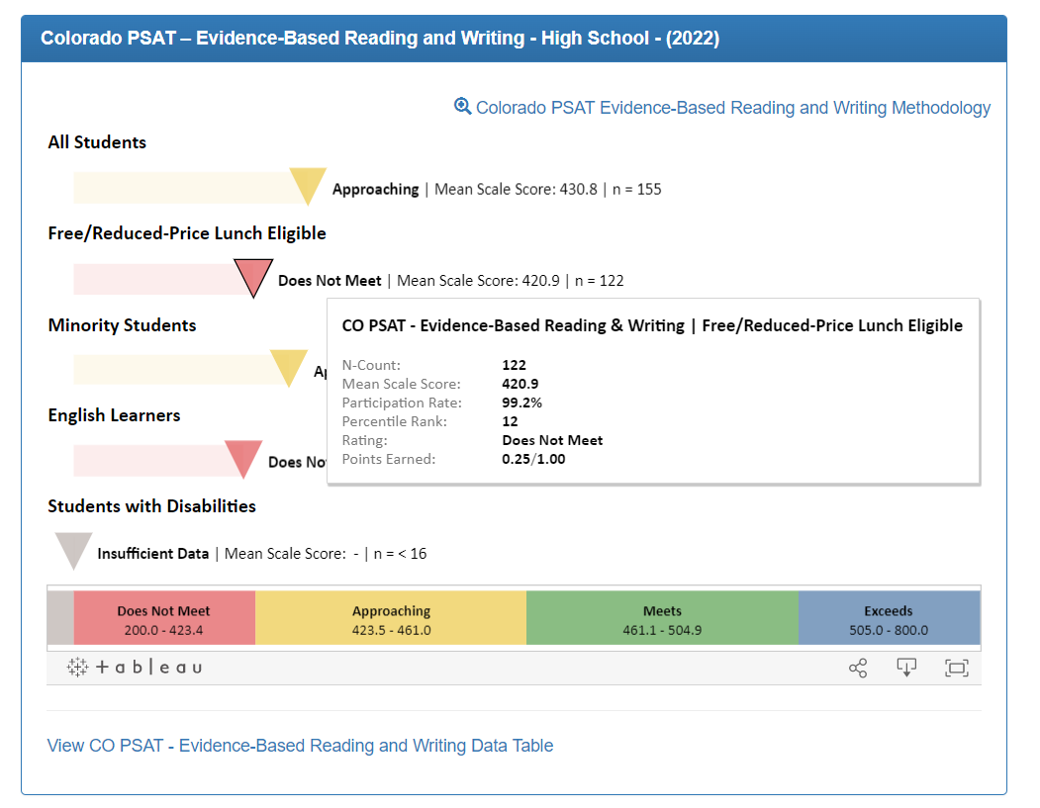
Analyzing State Data Using State Data Dashboards
When analyzing state data, CDE provides a variety of dashboards to facilitate analysis of performance framework measures (i.e., achievement, growth, and postsecondary workforce readiness measures) and state identifications. These dashboards also include other data like enrollment, attendance, and mobility.
These reports include:
Performance Snapshot Dashboard
Online Framework
District and School Dashboard
Data Explorer Tool Dashboard
Taken from the online framework
Notes:
Start with your local data and validate and refine using your state level data. Not the start of your planning. It is your yearly snapshot - but not nuanced enough to tell you how to plan. This data fall under what we consider Lagging indicators. As we learned on the previous slide, this means it can be helpful to give us insight on whether implementation was successful.

Slide 16
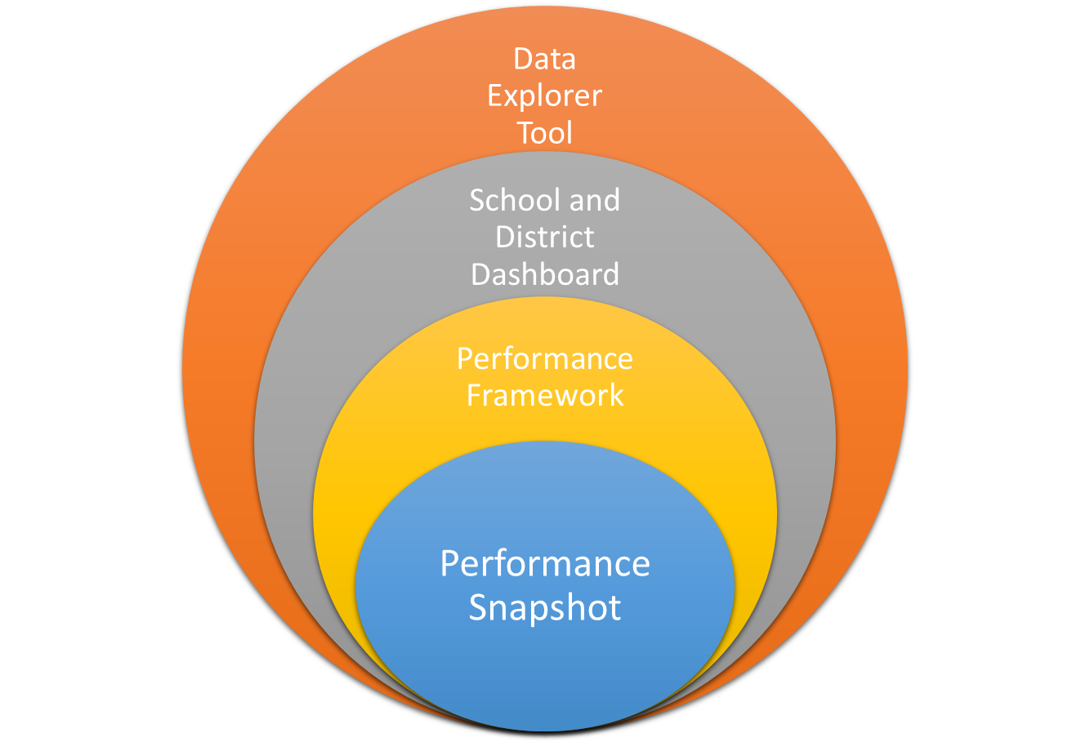
More data
Ability to make comparisons across schools and districts
Ability to look at school/district data trends across years
Ability to understand Identification
Ability to understand Accountability and Continuous Improvement
Less data

Slide 17
Summary of Key Points
Shift from a deficit to asset mindset
There are four primary types of data: lagging indicators, intermediate indicators, leading indicators, and conditions data
Data analysis is a basic 3-step process: (1) identify entry points, (2) dig in, & (3) identify next steps
Once data analysis is complete, consider whether data is of sufficient quality for reporting by evaluating data completeness, consistency, impact, and practicality
When analyzing the state’s lagged data, CDE provides a variety of reporting tools that can assist you in your analysis
Notes:
Shifting from a deficit to asset mindset reinforces high expectations for all students and encourages the use of data to offer critical (and more helpful) feedback.
There are four primary types of data: lagging indicators, intermediate indicators, leading indicators, and conditions data. Each of these types of data serve a distinct role and purpose.
Data analysis is a basic 3-step process: (1) identify entry points, (2) dig in, & (3) identify next steps. Use these three steps to make comparisons and meaning of your data.
Once data analysis is complete, consider whether data is of sufficient quality for reporting by evaluating data completeness, consistency, impact, and practicality.
When analyzing the state’s lagged data, CDE provides a variety of reporting tools that can assist you in your analysis.

Slide 18
Coming Next
The next video will focus on the following topics:
Structures to support data analysis and reflections
Dedicated time
Collaborative structures
Making meaning from data
Responding to insights from data analysis

Slide 19
Thank you for your time!
Email any questions to uiphelp@cde.state.co.us

