Slide 1
Accountability Work Group
May 12, 2023

Slide 2

Welcome

Slide 3

Introductions - Spring is here!
If needed, please update your name in zoom
What was your most disliked vegetable as a child?
What is your favorite vegetable now?

Slide 4
Purpose of AWG
The Accountability Work Group (AWG) serves as an advisory group on policy implementation and CDE practice in support of federal and state accountability. This group will consider input from other stakeholders, when possible, in developing recommendations for policies and practices.

Slide 5

Agenda
Welcome and Overview
Updates- Policy and Previous Topics
TLCC Updates and Feedback
UIP Template Pilot
AWG- Planning for Next Year
Meeting Practices
This meeting is being recorded. Slides and the recording will be posted to the CDE website. Small group breakouts are not recorded at this time.
Please mute your sound if you are not speaking. Be on screen if tech allows.
Non‐members: add your Name/Affiliation to the chat box. All non‐AWG members should hold any comments until the end of the meeting to ensure we have sufficient time to address all meeting agenda items.

Slide 6
Updates

Slide 7
Updates - Accountability in 2023 Legislative Session
H.B. 23-1241: Task Force to Study K-12 Accountability System
Link to Bill: https://leg.colorado.gov/bills/hb23-1241
Purpose: Creates a representative task force of 26-members that studies academic opportunities, inequities, promising practices in schools, and improvements to the accountability and accreditation system.
Builds upon: Accountability Audit and the Local Accountability System Grant
Timeline:
  July 1, 2023: Task force members appointed
  August 15, 2023: Department contracts with a facilitator
  No later than September 1, 2023: Convene first meeting
  March 1, 2024: Interim report
  November 15, 2024: Final report reflecting findings and recommendations to the education committees of the house of representatives and senate, the governor, the state board, the commissioner of education and the department.

Slide 8
Updates - Accountability in 2023 Legislative Session (cont.)
HB23-1231: Math In PK - 12th Grade
Link to Bill: https://leg.colorado.gov/bills/hb23-1231
Purpose: Aimed at improving outcomes in mathematics for PK-12 students.
Department Responsibilities:
  Offer free and optional trainings in evidence-based practices in math, including interventions for students struggling in math
  Administer the Colorado Academic Accelerator grant program to create community learning centers for academic enrichment and support in math
  Integrate the planning requirements on math strategies and target setting into statewide planning efforts and provide supports to identified districts and schools [Implied in statute; addressed in the fiscal note]
  Adjust the ninth-grade success grant program
Local Education Agencies Responsibilities:
  Encouraged to adopt procedures to improve math outcomes
  For districts and schools with an Improvement, Priority Improvement or Turnaround plan type (1) to identify strategies to address needs to students below grade level and (2) to set ambitious but attainable targets to reduce the number of students below grade level
Educator Preparation Program Responsibilities:
  K-12 candidates must be trained in evidence-informed practices in math, including interventions to help students who are below grade level

Slide 9
Updates - CDE Resources and UIP
2023 Resource Updates
Resources (e.g., On-Track Growth, Higher Bar, Summary Changes, Participation and Accountability) are available.
Coming soon: Accountability Handbook, Priority Improvement Supplement, and so much more.
UIP
2023-24 UIP template rollover occurred on April 14.
Resources (e.g., updated Quality Criteria, UIP Handbook, District User Dashboard) are available.

Slide 10

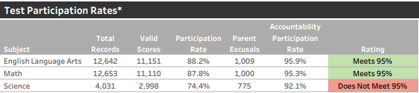
Follow up from April AWG Meeting: Participation Descriptors
Current Framework:
Note: “Decreased Due to Participation” will still be listed with the plan type.
Proposed Changes for 2023:
Accredited
Test Participation Rates and Total Participation Descriptor*
Total
Total Participation Rate Descriptor for informational purposes
Low Participation
(*) Under state accountability policy, 95% of students must participate in state assessments. Students who are excused from testing by a parent or guardian do
not impact the Accountability Participation Rate that is used to determine whether districts and schools meet this requirement.
(*) Under state accountability policy, 95% of students must participate in state assessments. Students who are excused from testing by a parent or guardian do not impact the Accountability Participation Rate that is used to determine whether the overall rating is reduced by one level. Districts or schools with less than 95% total participation in ELA and Math receive a “Low Participation” descriptor to help readers consider when interpreting accountability data. This descriptor does not impact framework calculations.
Images for discussion - not approved changes

Slide 11
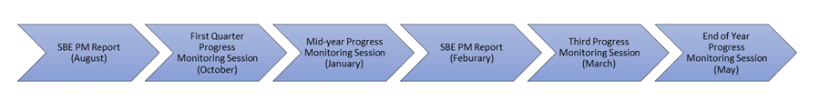
Follow Up from April AWG Meeting: Accountability Clock Progress Monitoring
State Board of Education Information Item:
Accountability Clock, Accountability Pathways Progress Monitoring Feedback
Presentation 3:39:40

Slide 12
TLCC Updates and Feedback

Slide 13
Upcoming with TLCC 2024
New vendor - Panorama Education
  Same instrument, questions, reporting plan, comparisons over time
  Opportunities for nationwide comparisons on constructs
  Off year administration
  Large experience base
  Professional development and learning tools, survey usage supports
Revisiting Ed Support Professional Questions (ESP), shortening ESP, Special Service Providers (SSP) questions
Revisiting Pandemic Impact and Wellbeing Questions from 2022
  Considerations for inclusion/exclusion for 2024
Proposal of sampling model of time-sensitive policy level questions
  Planning a summer convening of interested members of community (SBE, districts, community organizations, etc)

Slide 14
Break Out Groups for Discussion and Jamboard
Are pandemic/wellbeing questions still relevant
  Keep, embed, cut
What kind of things do you want to learn about from schools around the state right now, for example:
  Politics in your community
  Recruiting/Retaining Staff
  Educator/Staff Preparation
  External Staffing Challenges (healthcare, living expenses)
Notes:
Jamboard https://jamboard.google.com/d/1dJa7loGJkERbv88P3F-ghM_B-lF8ZRO7PJM1t_tmVjA/viewer?f=1
Questions
https://docs.google.com/document/d/16f2fOGngggG5VlqOAsky0twqBr2n2fLra7KScZ8Pq9E/edit

Slide 15

Break

Slide 16
UIP Pilot Template

Slide 17
Objectives
Share information about the process to date and focus for work
Provide specific feedback/discussion on the following topics:
  Current template changes: Reaction/considerations for changes made to the template for all schools/district for 2023/24
  Pilot Template: Reaction/considerations for the pilot template
  Future Enhancements: Recommendations for future improvements to the template

Slide 18

Pilot Progress- How did we get here?
2021- Convened a small working group with input from other stakeholder groups to develop key design features and pilot a google-based tool.
2022- Hired a developer to build a template within the online UIP platform; not able to launch with full functionality.
2023- Procured another developer and limiting pilot scope of the pilot.

Slide 19
Changes to the Template 2023-24 -All Schools/District
Assurances
  The department has identified several planning elements that can be addressed as assurances to reduce the narrative (data analysis activities, Stakeholder Input Process, Stakeholder engagement in progress monitoring, family notification)
  The district has responsibility for ensuring completion of activities associated with these expectations and may be asked to share artifacts as a part of a monitoring process.
  Responsive in template based on school context and identification
  All
Categories for Challenges, Root Causes and Strategies
  Qualitative Analysis, Improved reporting
Contacts and Context
  Display UIP contact information from Pipeline submission rather than input
  “Context Box” connected to future public reporting at CDE
Notes:
How should CDE be supporting schools and districts in meeting assurances

Slide 20
Pilot of New Template Format
Spring 2023
  Develop new template and evaluation plan
Summer 2023 - Fall 2023
  Small group to pilot template in UIP Online System
    Evaluation and Feedback on changes
Winter 2024
  Review of evaluation and potential modifications to the template statewide
Spring 2024
  Decision point for statewide availability/rollout

Slide 21
Goals of Template Change and Evaluation Focus
01
Adding specificity to collections to ensure users know what to fill out
Reorganize layout to align better with school and district planning processes
Ease of Use
02
Shorten and consolidate sections
Remove components not specified in rule or law
Completion Time Reduction
03
New look and feel to form
Improved final report to increase readability
Improved Visual and Public Reporting

Slide 22
UIP Template Evaluation Plan
30 - 50 Schools will use UIP Template Pilot for 2023-2024 plan
Evaluation Activities
Pre-Survey: Review of initial user pre-survey
Working session: Real time feedback on specific template changes
Support Requests: On demand technical support from CDE/Developers
Post-Survey: Review of post-completion user survey
SAC Survey: Gathering feedback on completed reports

Slide 23
Pilot Mock Ups
Demo
https://drive.google.com/drive/folders/1qn6iGrMFTp3_X8pmw4HdSZlzkp795G2d
Notes:
https://drive.google.com/drive/folders/1qn6iGrMFTp3_X8pmw4HdSZlzkp795G2d

Slide 24

Considerations for Future Enhancements
Final Public Plan, Additional Reports (Exec Summary, Customizable, etc.)
  How do you (and your schools) use the:
    Full Plan
    Executive Summary
    Data Exports
  What recommendations do you have to maximize reporting from the UIP online system?
Feedback to Schools on their UIP content
  What is helpful for providing feedback on school plans? (Current or aspiration)
    From district staff
    From CDE

Slide 25

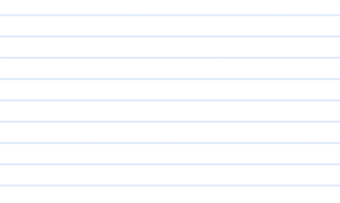

Breakout and Feedback
Please use the jamboard to provide specific feedback on the following topics:
  Current template changes: Reaction/considerations for changes made to the template for all schools/district for 2023/24
  Pilot Template: Reaction/considerations for the pilot template
  Future Enhancements: Recommendations for future improvements to the template
Group 1
Group 2
Group 3
Group 1
Notes:
https://jamboard.google.com/d/13uyQ8PNBunLsFlOYLdMWBf_6m5sOOumn_vNXZrtB8Kw/edit?usp=sharing

Slide 26
Non-Member Comments

Slide 27
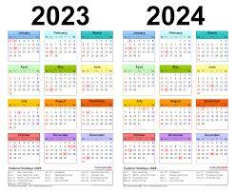
Preview for Next Year
Fall Meetings: Calendar invitations will be sent
Friday September 29, 2023
Friday November 3, 2023
Think about your interest in person/hybrid meetings
Survey will be sent out in summer asking about logistics and topics of interest

Slide 28
Thank you!

