Slide 1
Accountability Work Group
April 14, 2023

Slide 2

Welcome

Slide 3

Introductions
In the chat:
Name
Title
District/School/Organization/Affiliation
What are you reading? Have read? On your stack for “free time”?

Slide 4
Purpose of AWG
The Accountability Work Group (AWG) serves as an advisory group on policy implementation and CDE practice in support of federal and state accountability. This group will consider input from other stakeholders, when possible, in developing recommendations for policies and practices.

Slide 5

Agenda
Welcome and Overview
Updates
Discussion on Participation Descriptors
State Accountability Data Visualizations
  Breakout: End of Clock Sequence and Elements
Meeting Practices
This meeting is being recorded. Slides and the recording will be posted to the CDE website. Small group breakouts are not recorded at this time.
Please mute your sound if you are not speaking. Be on screen if tech allows.
Non‐members: add your Name/Affiliation to the chat box. All non‐AWG members should hold any comments until the end of the meeting to ensure we have sufficient time to address all meeting agenda items.

Slide 6
Second Half of Meeting
State Accountability
Data Visualizations
Information available from CDE
Tool demonstration and feedback
Address purpose and needs of reporting
Recording will continue
Small Group: End of Clock Sequence and Elements
Assumes background knowledge of State Board Direct Action
Feedback on specific sequence and tools
Report out will be shared, slides will be available

Slide 7
Updates

Slide 8
Updates
Legislative Updates
Task Force to Study K-12 Accountability System: https://leg.colorado.gov/bills/hb23-1241
2023 Resource Updates
Available now: On Track Growth Fact Sheet, Higher Bar Sub-Indicators Fact Sheet, & Student Biographical Data Review Process and Accountability Fact Sheet
Coming soon: Summary Accountability Changes, Anticipated Framework Changes, Participation and Accountability Guide, Accountability Handbook, …
UIP
UIP template and resource rollover: 2023-24 online template, updated Quality Criteria, UIP Handbook, District User Dashboard

Slide 9
Participation Descriptors

Slide 10
Goal for this Discussion
Gather advice on how to clarify the role and reporting of state assessment participation in accountability
Important Caveat: We are only at the discussion phase. Any recommendations will shared with CDE leadership and potentially the state board for next steps.
Discuss as a group:
  What is the role of participation in the frameworks?
  How do we balance reporting on accountability expectations and interpreting results?
  What is important about the way participation is displayed and gets flagged?
  What else are we missing that should be considered?

Slide 11
2022 Feedback on Participation
Some larger participation themes CDE heard from the field this fall:
Confusion between total participation and accountability participation rates - both in how they are calculated and how they impact ratings
Community members misinterpreted “Low Participation” descriptors or “Insufficient State Data” ratings to mean that the school/district was actively discouraging participation on state tests or that the results were invalid
90% total participation eligibility requirement for request to reconsider unfairly penalized schools/districts for opt-out rates that are outside of the school/district control

Slide 12

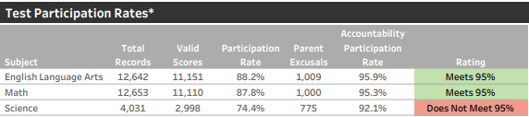
Current Participation Descriptors and Rates
Performance Framework Participation Descriptors
Meets Participation: Above the 95% total participation rate in two or more content areas. Does not impact the plan type.
Low Participation: Below the 95% total participation rate in two or more content areas. Provides context for interpreting representation of entire student population. Does not impact the plan type.
Decreased due to Participation: Below the 95% accountability participation rate in two or more content areas. Plan type decreased by one level.
Total participation: parent excusals are counted as non-participants (i.e., they are included in the denominator)
Accountability participation: parent excusals are excluded from the calculation
These ratings reflect whether accountability participation rates meet or exceed 95%.

Slide 13
Participation Policy and Rule | Impacts of Low Participation
CDE’s policy for the impact of low participation is based on State Board of Education Rule and the February 2015 State Board of Education motion that districts will not be penalized by a lowering of their accreditation rating should their student participation rates fall below 95 percent on the state assessments due to parental excusals.
State Board of Education rules (1 CCR 301-1 5.03) state that the department should apply the following criteria to determine accreditation ratings:
“The percentage of students enrolled in the District or Institute who are not tested on the Statewide Assessments”
“The Commissioner shall determine whether a District or Institute has failed to administer statewide assessment results in a standardized and secure manner so that resulting assessment scores are reflective of independent student performance and whether the failure was pervasive and egregious enough to warrant a change in the District’s or Institute’s Accreditation rating.”

Slide 14
Participation Policy and Rule | Insufficient State Data Ratings
Insufficient State Data (ISD) ratings are assigned when the state does not have enough data to assign a rating or plan type.
State Board of Education rules (1 CCR 301-1 5.01) state ISD will be assigned if a school or district’s performance framework “reflects scores from less than 25 percent of students in tested grades”.
Historically, districts/schools could request an ISD rating if they had less than 85% participation on state assessments. In 2023, CDE expects this condition to return to the request to reconsider process.

Slide 15
What could be some helpful changes for the framework?
Current Framework:
Sample Changes:
Total
Overall Participation Descriptor:
Low Participation
Images for discussion - not approved changes

Slide 16
Additional Resources
CDE 2022 Participation Data (XLSX) - State, district, and school-level test and accountability participation rates (2018-2022)
Board presentation - Participation- Content Assessments Part 1-Slides 8-25
Participation and Accountability Guide - This resource describes assessment participation requirements and the role of participation in both state and federal accountability

Slide 17

Discussion
Jamboard with designated CDE facilitator/note taker
Discussion Questions:
  What is the role of participation in the frameworks?
  How do we balance reporting on accountability expectations and interpreting results?
  What is important about the way participation is displayed and gets flagged?
  What else are we missing that should be considered?
Small group discussion then whole group share out to draft recommendations.
Notes:
Jamboard

Slide 18

Break

Slide 19
Breakout

Slide 20
End of Clock:
State Board Directed Action Progress Monitoring

Slide 21
Objectives
Provide context of current practices for end-of-clock State Board Directed Action and progress monitoring
Receive feedback on possible changes to State Board Directed Action progress monitoring specifically in the following areas: (1) progress monitoring activities, (2) reports to the State Board, and (3) use of and reporting of interim and local data

Slide 22
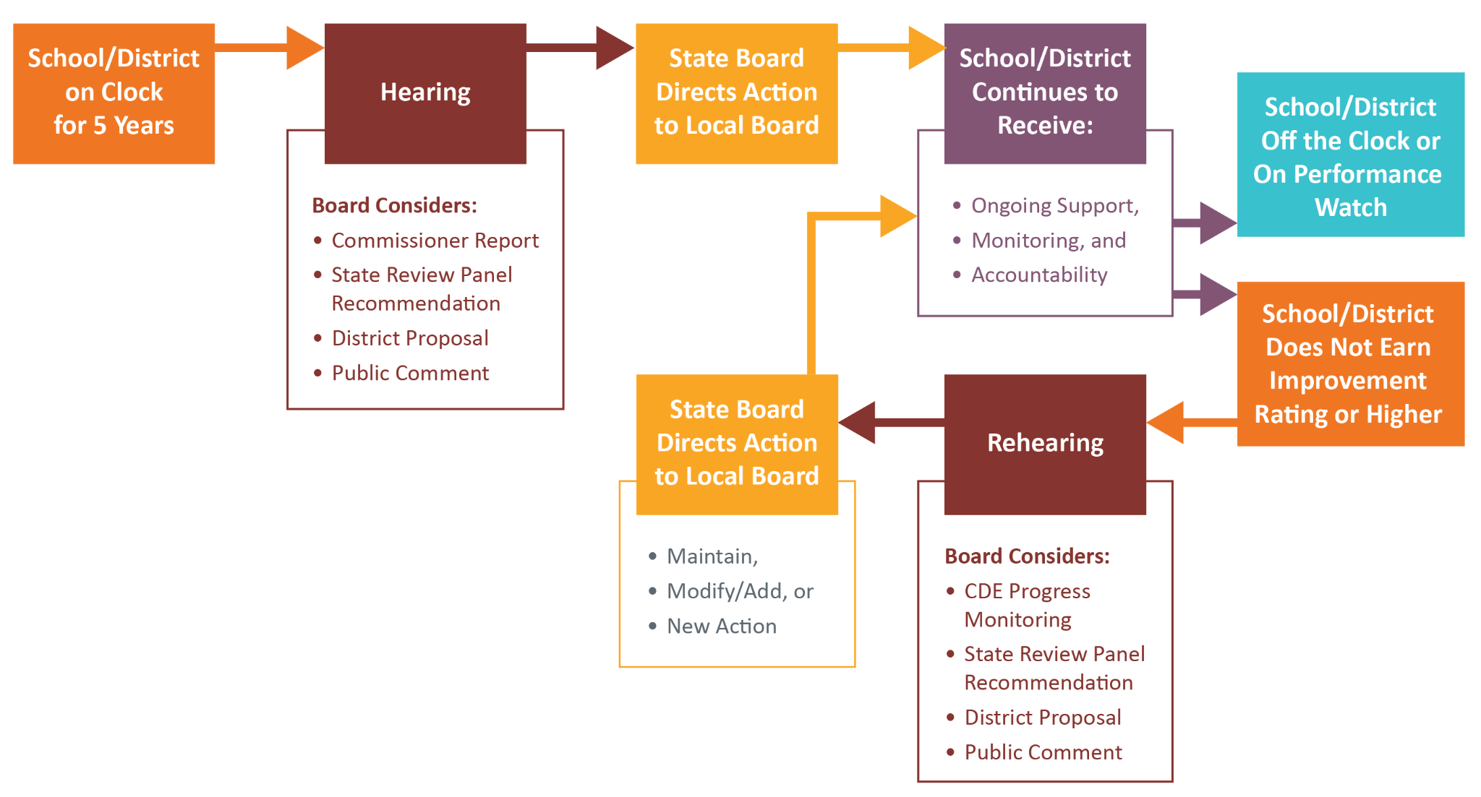
Accountability Clock Hearing Process Timeline

Slide 23
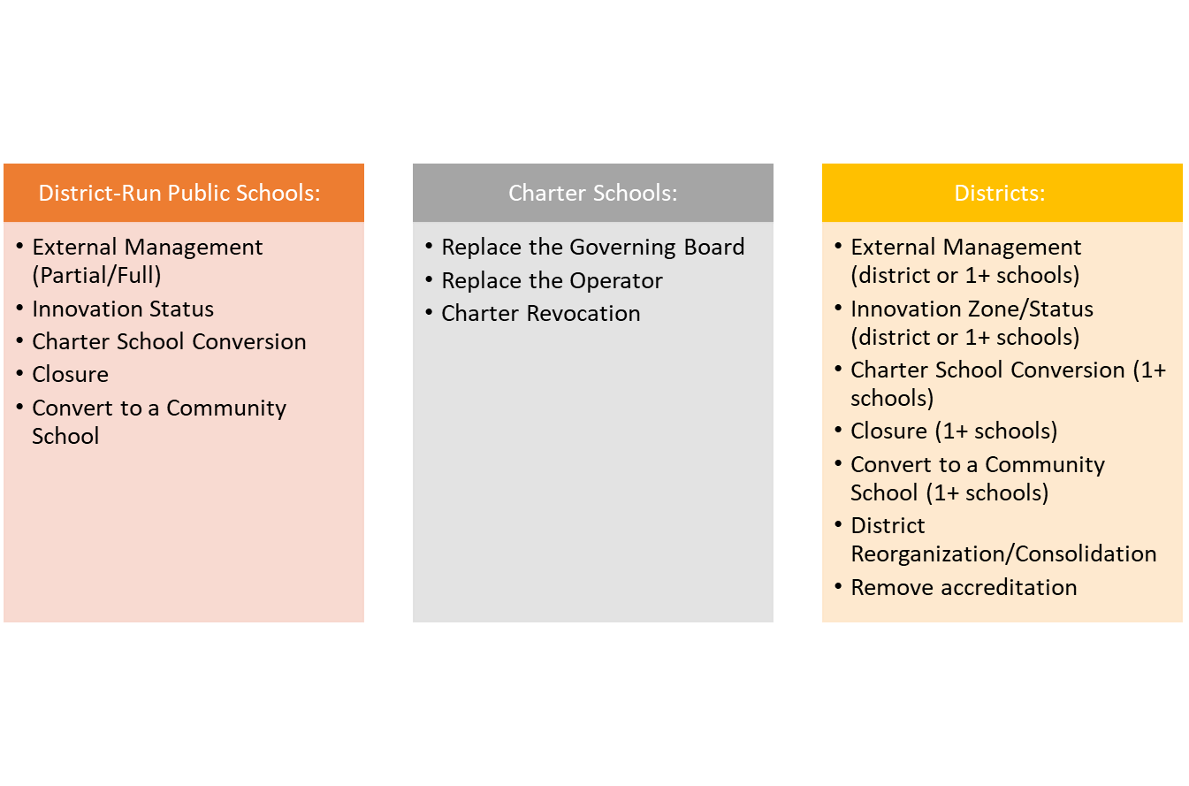
Pathway Options for Directed Action

Slide 24
Accountability Clock Hearing Process Timeline
CDE Progress Monitoring

Slide 25
Goal of CDE Progress Monitoring
Track progress throughout the term of the order (including while On Watch), including:
  Adherence to the board’s direction, as provided by the order, and the district’s pathway plan, and
  Overall improvement of school practices and interim outcomes, as measured by Turnaround Support Manager* (TSM) observations, district leadership or management partner reflections (if applicable), interim data, and annual SPF/DPFs.
Facilitate communication between district and school staff and the state (CDE and the State Board of Education) about the school/district.
* Turnaround Support Managers (TSMs) are CDE staff assigned to support the school/district through the pathways development process, any State Board hearings, and in progress monitoring and reporting to the State Board

Slide 26
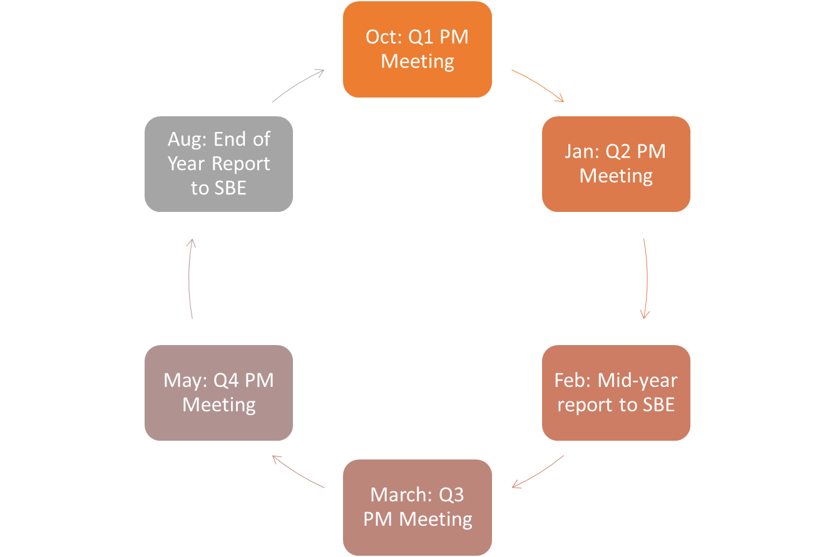
Current Progress Monitoring Overview
CDE assigns a Transformation Support Manager (TSM) to all late on clock schools & districts
TSM shepherds school/district through hearing process and leads progress monitoring
Other Possible Activities:
Presentations to local board*
Presentations to State Board*
Unannounced site visits*
Mid-Year Review (optional)
*If stated in board order

Slide 27
Progress Monitoring Feedback
Use this jamboard to capture your ideas
 | Progress Monitoring Activities | Progress Monitoring Reports | Use of Interim and Local Data
Goal of component | Monitor order implementation progress by: Reviewing interim academic and culture data and implementation benchmarks Observe implementation progress (culture, planning, training, etc.) Observe classroom instruction | Inform the state board on progress of sites with directed-action by providing biannual reports containing an overview of the work being done at each site and an assessment of progress by Department staff. Create a written record that can be referred to in future accountability hearings, if necessary. | During mid-year reports, use local interim data to provide a mid-year update on progress (when available), since state assessment data is not available. During end-of-year reports, use local data (when available) as a supplement to state assessment data to provide an end-of-year update on progress.
Current state | Progress Monitoring Plan Quarterly site visits Streamline with existing work as possible Sample Site Visit Agenda Pathway Plan Notes Template | Sample Mid-Year State Board Report Mid-Year Presentation Submit reports at mid-year (March) and end of year (September) Reports are submitted along with a presentation from CDE with opportunities for SBE members to ask questions of staff | Schools and districts with directed are not required to submit local data to CDE, but many sites do. Local data cannot supplant state data. The only assessment data that is aligned to state-standards are state assessments. Local assessments do not measure progress on state standards.
Questions for feedback | Do the progress monitoring activities and progress monitoring plan fit the intended goals? What are the strengths? What challenges do you see? | What do you think about the level of detail and type of reporting provided by CDE to the state board? What are the strengths? What challenges do you see? | How should local student achievement and growth data be included in progress monitoring and reporting to the State Board?

Slide 28
State Accountability
Data Visualizations

Slide 29
Objectives
Introduction: Purpose and intent of each of the dashboards
Demonstration: Diving into reports
Feedback: How to make these dashboards more useful
Alignment with purpose
Content
Timeline for release

Slide 30
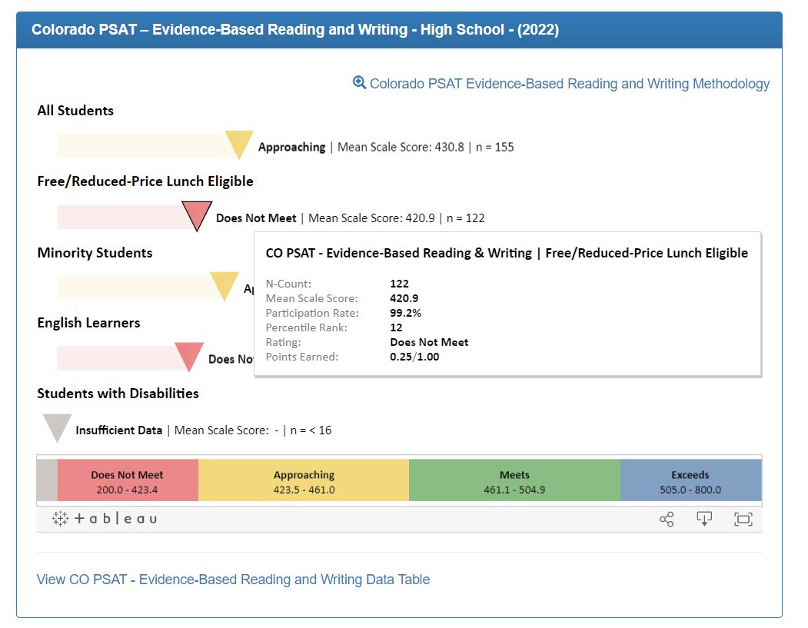
Online Framework
Level: Individual School and District
Content: Detailed results of normative comparison of school/district Achievement, Growth, and PWR data, for one year (or multi year average)
Primary Purpose: Explain how plan type was determined
Secondary Purpose: Respond to results in an improvement plan
Audience: School Leaders, District staff, Community
Format: Bar charts
Location: Schoolview

Slide 31
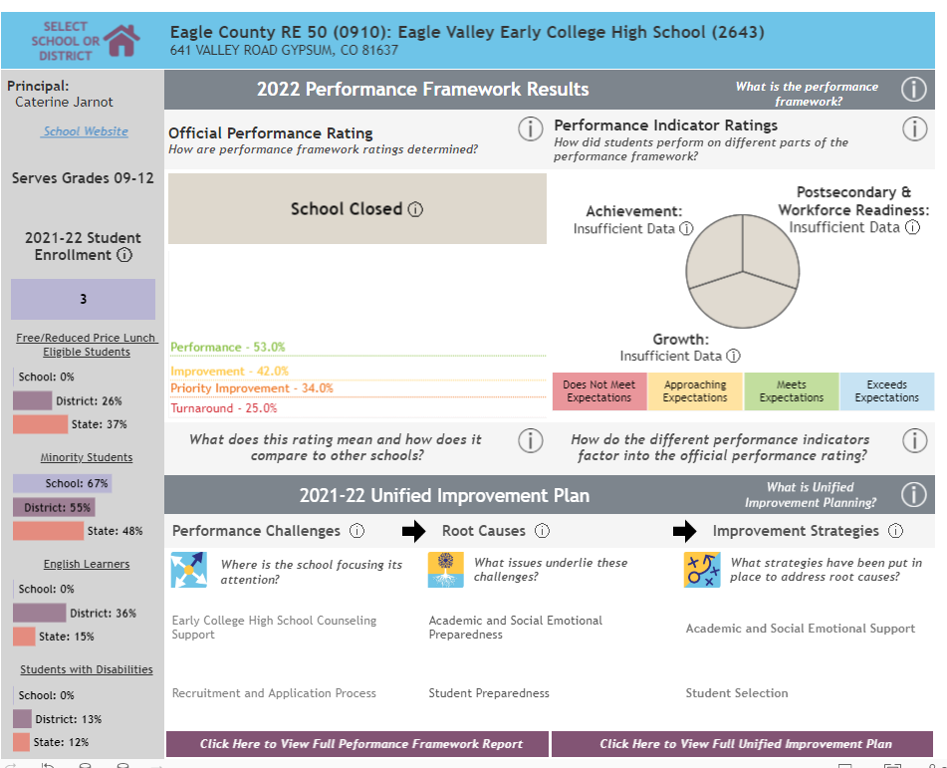
Performance Snapshot Dashboard
Level: Individual School and District
Content: High level results of Performance Framework and UIP for one year (or multi year), as well as explanatory information
Primary Purpose: Explain Performance Frameworks and demonstrate connection to improvement plan
Audience: Community
Format: Pie Charts, bar charts, text
Location: CDE reports website

Slide 32
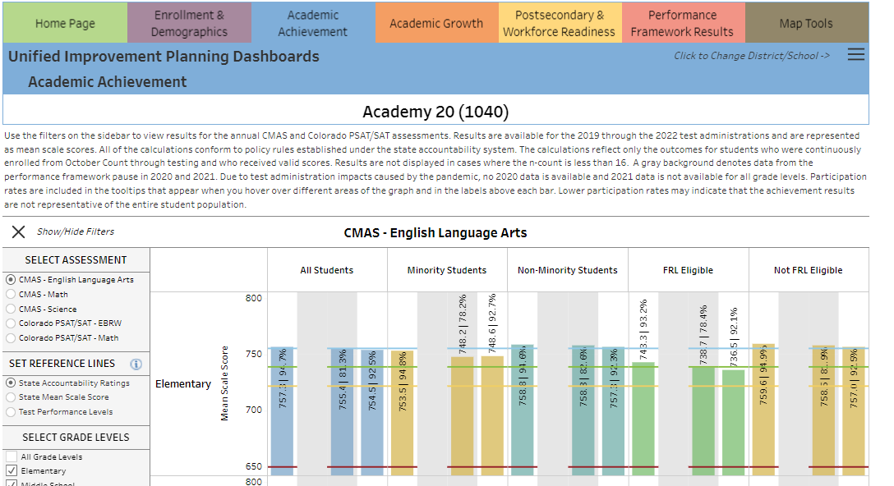
District and School Dashboard
Level: Individual School and District
Content: Detailed information on Enrollment and Demographics, Academic Achievement, Academic Growth, Post Secondary and Workforce data, and Performance Framework results over time/multi-year trends
Primary Purpose: Provide framework data, assessment data, graduation and dropout data for improvement planning
Secondary Purpose: Provide data generally on schools and districts
Audience: School and District leaders, community
Format: Bar charts, maps
Location: Embedded within UIP, CDE reports website

Slide 33
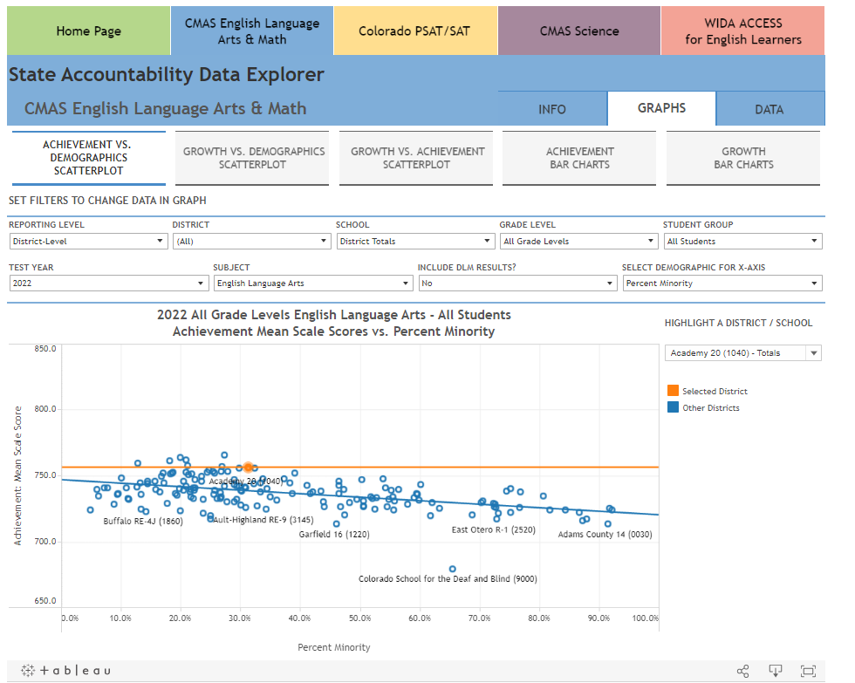
Data Explorer Tool Dashboard
Level: Multiple school and districts
Content: CMAS, PSAT/SAT, WIDA ACCESS data
Primary Purpose: Provide assessment data flat files (including to an N of 1 with LAM credentials)
Secondary Purpose: Provide school and district comparison information
Audience: District leaders
Format: Scatterplots, bar charts, flat files
Location: CDE reports website

Slide 34
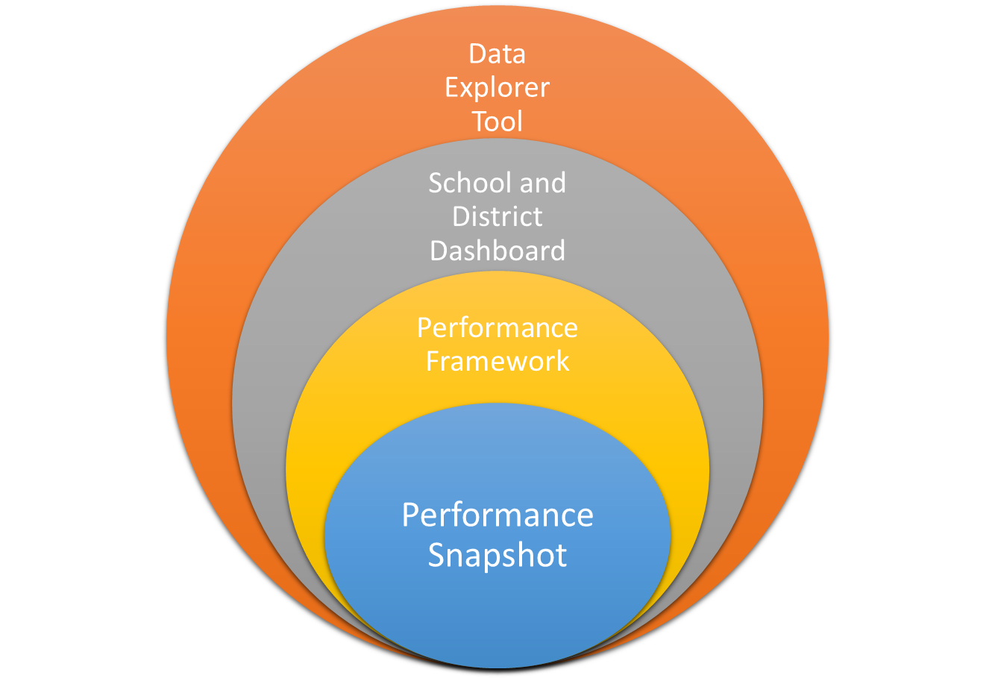
More data
Ability to make comparisons across schools and districts
Ability to look at school/district data trends across years
Ability to understand Identification
Ability to understand Accountability and Continuous Improvement
Less data

Slide 35
Discussion
What do you use reports at CDE for?
Do the current reports align with these intended purposes?
Are there any audiences or purposes we are missing?
Do the intended purposes meet your needs?
Does the data meet your needs? If so, why or why not?
Are the visuals functional to interpret results? Why or why not?

Slide 36
Additional Feedback
For any additional feedback on any of these dashboards, email wales_a@cde.state.co.us.

Slide 37
Non-Member Comments

Slide 38
Next Meeting
5/12/23
Tentative Topics: Pilot Template

