Slide 1
Accountability Work Group
March 10, 2023

Slide 2
Welcome

Slide 3
Introductions
In the chat:
Name, Title, District/School/Organization Affiliation, # of years as an AWG member
Include a highlight of your year
Welcome new members! Quick Introduction
Jinny Jensen, Greeley Schools- Director of Assessment and Evaluation
Brenda Dickhoner, Ready Colorado
Evie Hudak, A4PEP
Ted Johnson, Pueblo 60-Executive Director of Continuous Improvement and Innovation

Slide 4
Agenda
AWG Overview: Purpose, Norms, etc.
Update on 2023 Informational Framework Indicator and Sub-Indicators
Discussion on 2023 Accountability Data Release & Improvement Planning Timeline
Discussion on Future AWG Topics
Meeting Practices
This meeting is being recorded. Slides and the recording will be posted to the CDE website. Small group breakouts are not recorded at this time.
Please mute your sound if you are not speaking. Be on screen if tech allows.
Non‐members: add your Name/Affiliation to the chat box. All non‐AWG members should hold any comments until the end of the meeting to ensure we have sufficient time to address all meeting agenda items.

Slide 5
Purpose of AWG
The Accountability Work Group (AWG) serves as an advisory group to the department on policy setting, policy implementation and CDE practice in support of federal and state accountability.

Slide 6
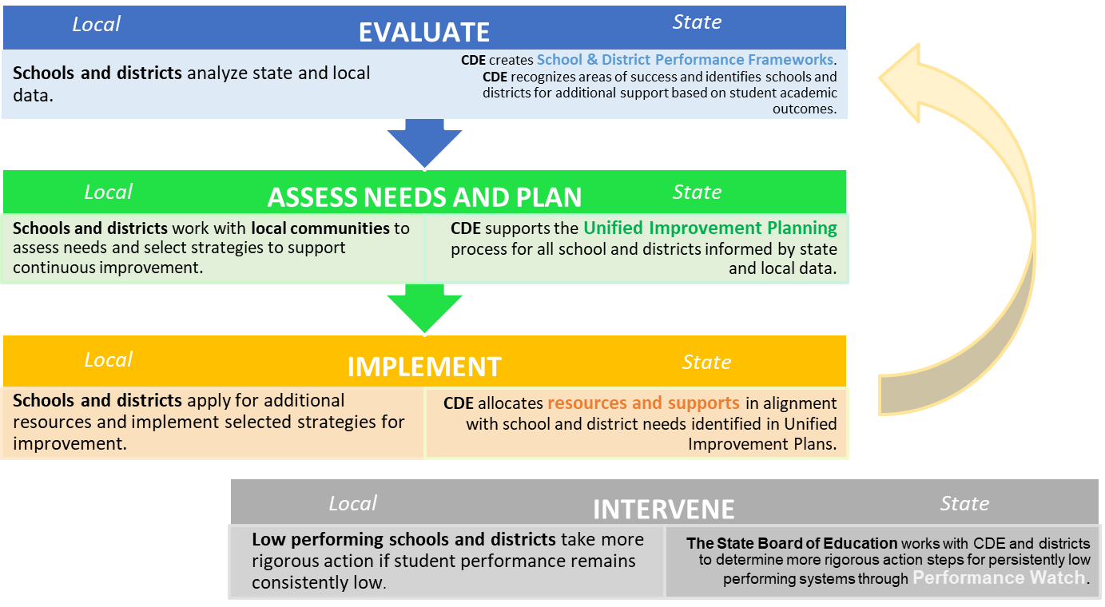
Definition: Accountability Theory of Action

Slide 7
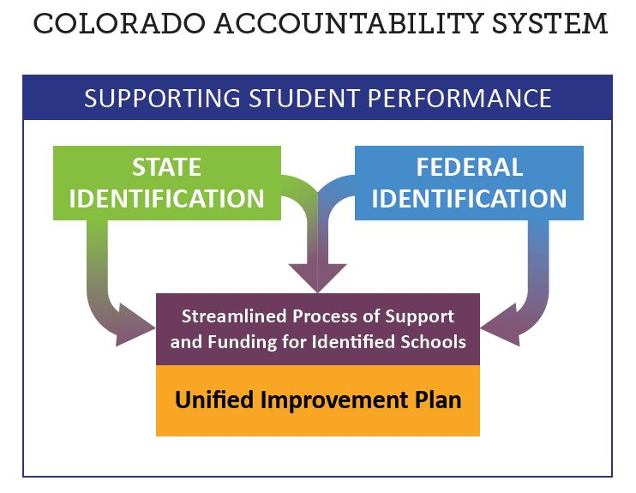
State and ESSA Accountability

Slide 8
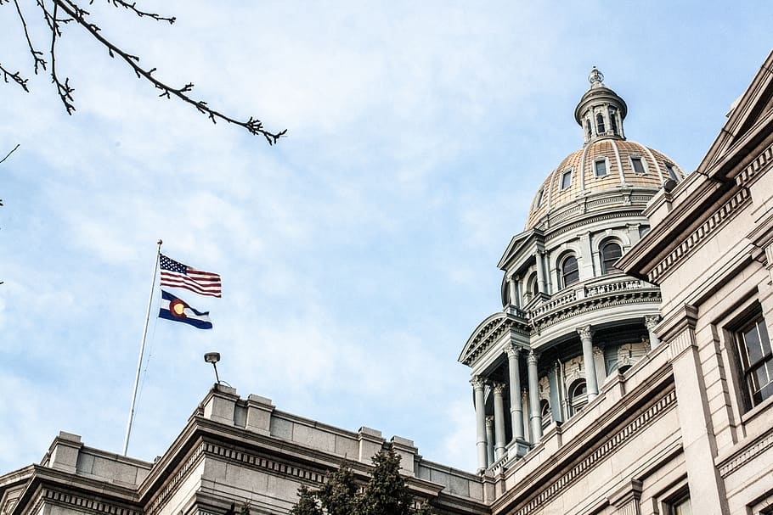
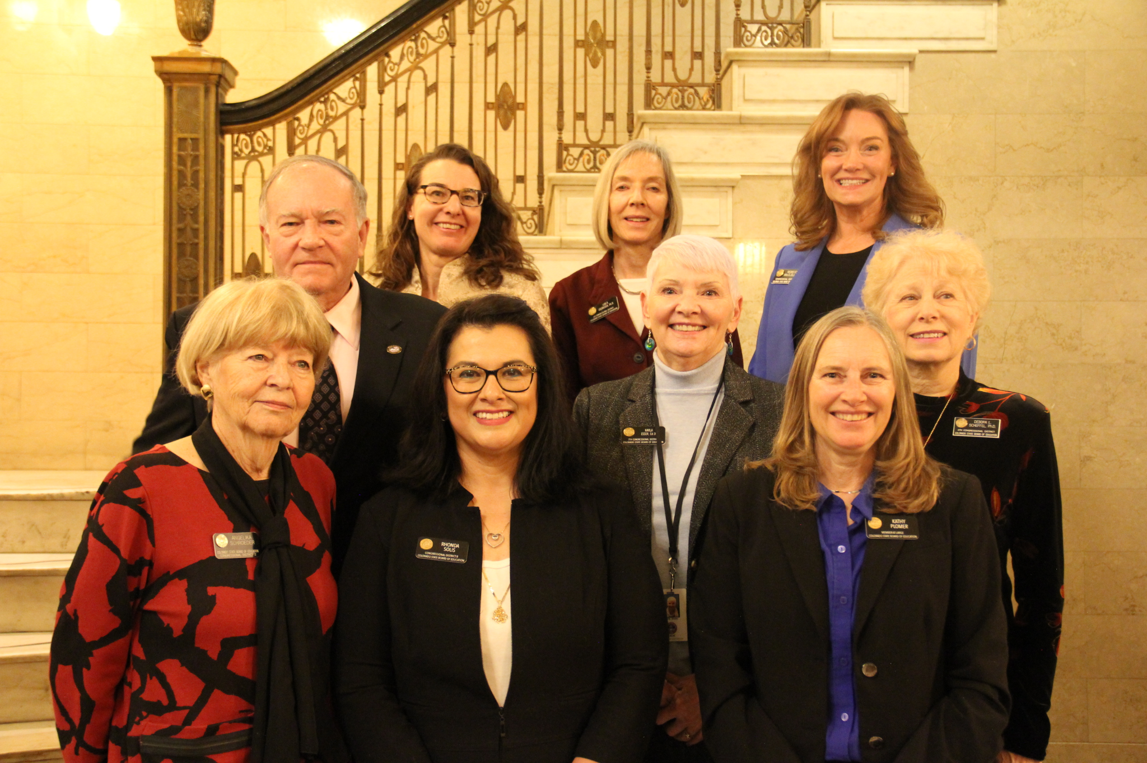
What do we mean by “policy”
Policy Development Structures | General Description | Examples in 2022 Accountability Processes
State Legislature & Governor | Legislature passes statute and Governor signs into law. | SB 22-137: Provides broader overview for adjustments to accountability
State Board of Education | Board provides additional detail on statute through rule process. | State Board Rules: Framework cut scores, request to reconsider process
CDE Documentation and Guidance | Department provides documentation, logistics and parameters for implementation. Guidance includes requirements and recommendations. | Documentation: Frameworks Calculation Guidebook Guidance: Request to Reconsider Guidance, UIP Handbook

Slide 9
Accountability Work Group
Guiding principles:
The group is representative of users of accountability policy (setting, level, role, etc.)
Recommendations from the group, to the degree possible, will inform CDE decision-making and influence policies and practices.
Perspectives from other stakeholder groups (e.g. TAP) and data sources will be considered in developing recommendations, as appropriate.
Norms:
Presume positive intent
Engage with the group to elevate perspectives of the constituency you represent- we WANT to hear multiple perspectives on these topics
Monitor air-time

Slide 10
On Track Growth Indicator & Postsecondary Workforce Readiness (PWR) Sub-Indicators

Slide 11
Goals for this Discussion
Provide additional background and context about the new On Track Growth indicator and Postsecondary Workforce Readiness (PWR) sub-indicators
Discuss as a group:
What key questions or considerations strike you?
What advice do you have for CDE as we begin implementation?
What is helpful now for resource development and training? Who is the appropriate audience for these resources/trainings?

Slide 12
On Track Growth | Background
Required by Colorado’s educational accountability law, the On Track Growth performance indicator addresses:
Catch Up: Whether students scoring below grade level are catching up to grade-level expectations within two years.
Keep Up: Whether students who are already meeting grade-level expectations are maintaining their performance for two years.
CDE and the Technical Advisory Panel (TAP) have been developing this measure since 2019, but implementation was paused due to the pandemic
Since CMAS growth is available across all typical grades and content areas in 2023, CDE is planning on calculating this measure for elementary and middle schools using Spring 2023 test results
On Track Growth will be provided to schools and districts for informational purposes in 2023 and for points in 2024, at the earliest
Throughout 2023, CDE, CADRE, and the TAP will investigate a methodology for high schools and districts

Slide 13
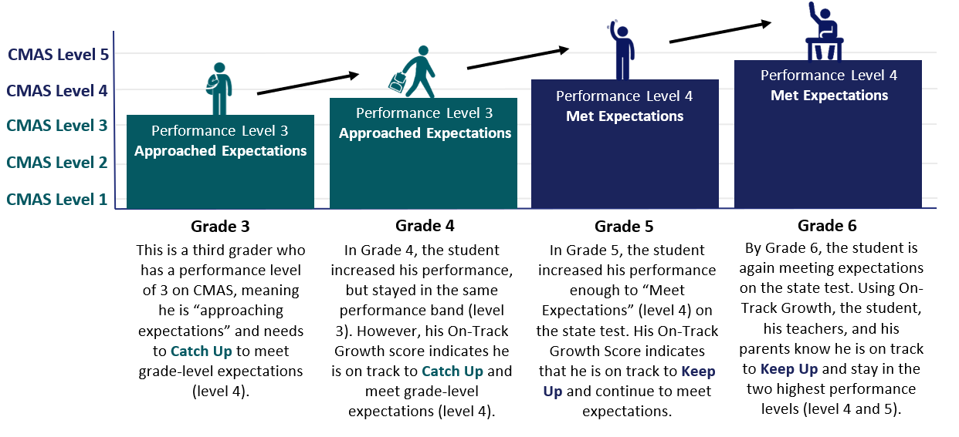
On Track Growth | Student Example

Slide 14
On Track Growth | Inclusion in the Framework
The performance indicator will include (as available):
Total percentage of students meeting their On Track targets
Percentage of students designated as Catch Up meeting their On Track targets
Percentage of students designated as Keep Up meeting their On Track targets
Disaggregation by student groups (e.g., English learners, minority, SPED, FRL)
On Track Growth will account for 10% of the total framework indicator points for elementary and middle schools
Elementary and Middle School Weighting
2016-2023
2024+
Growth
55%
Growth
60%
On Track 10%*
Achievement
40%
Achievement
35%
Notes:
The target equally pulls from both achievement and growth indicators—since it is a measure that uses each student’s achievement performance level and determines, based on their growth results from year-to-year, how long it will take for that student to either advance to the next performance level or maintain grade-level proficiency. This new measure is both an achievement and a growth measure and that is why On Track growth will pull from both.

Slide 15
PWR Sub-Indicators | Background
Data from the Graduation Guidelines Student Interchange File (reported as part of the End of Year data collection) is being used to build two new PWR sub-indicators for 2023 frameworks:
Higher Bar - ELA/Math: measures higher achievement levels (as defined by the state board) in English language arts (ELA) and math on certain graduation guidelines measures (including Accuplacer, ACT, ACT Work Keys, AP, ASVAB, CE, IB, SAT)
Higher Bar - Non-ELA/Non-Math: measures successful completion of AP, IB, and/or CE non-ELA, and non-math courses. This measure requires an AP exam score of 3 or higher, an IB exam score of 4 or higher, and a CE course grade of B or higher
For both sub-indicators:
Districts can choose which exam subjects and CE course offerings qualify as ELA/Math or non-ELA/Math
The calculation methodology (determined by TAP) is the unduplicated count of graduates that have met at least one measure divided by the number of graduates identified by the school/district (a graduate is counted in the numerator if a student meets the requirement at any time during grades 9 through 12)
Will be reported for informational purposes in 2023 high school frameworks and for points in 2024

Slide 16
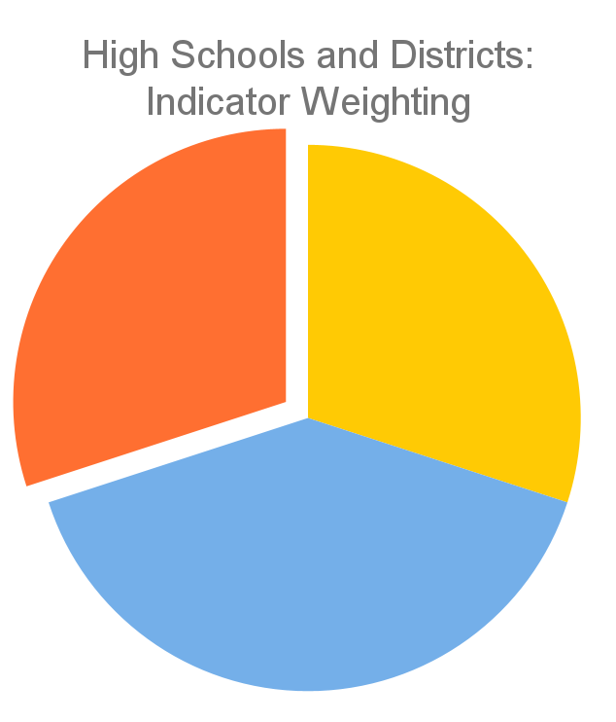
PWR Sub-Indicators | Inclusion in the Framework
Currently, the PWR indicator consists of five sub-indicators (detailed in the image on the right)
TAP and CDE are working on developing points for the two new PWR sub-indicators (Higher Bar ELA/Math and Higher Bar Non-ELA/Non-Math)
With the addition of these new sub-indicators, the PWR indicator will continue to contribute 30% of the points in determining the overall high school or district score
PWR 30%
Achievement
30%
Growth
40%
Current PWR Indicator: Points by Sub-Indicator & Level
SAT EBRW (8 points): Mean Scale Score [All Students (4) & Disaggregated (1 each)]
SAT Math (8 points): Mean Scale Score [All Students (4) & Disaggregated (1 each)]
Dropout (16 points): Rate [All Students (8) & Disaggregated (2 each)]
Matriculation (4 points): Rate [All Students (4)]
Graduation (16 points): Rate [All Students (8) & Disaggregated (2 each)]

Slide 17
Draft Timeline for Implementation
Growth
40%
2022: Grad, Dropout, Matriculation, Higher Bar, CMAS & P/SAT
2023: CMAS & P/SAT
Growth
60%
2023 Frameworks
Elementary and Middle Schools: On Track Growth provided for informational purposes
High Schools/Districts: PWR sub-indicators provided for informational purposes
Indicator Weights
Achievement
30%
Achievement
40%
PWR
30%
ES & MS
HS & Dist
2023: Grad, Dropout, Matriculation, Higher Bar, CMAS & P/SAT
2024: CMAS & P/SAT
2024 Frameworks
Elementary and Middle Schools: On Track Growth included for points
High Schools/Districts: PWR sub-indicators included for points, On Track Growth included for informational purposes
Growth
40%
Growth
55%
Indicator Weights
Achievement
30%
On Track 10%
Achievement
35%
PWR
30%
ES & MS
HS & Dist
2024: Grad, Dropout, Matriculation, Higher Bar, CMAS & P/SAT
2025: CMAS & P/SAT
2025 Frameworks
High Schools/Districts: On Track Growth included for points
Growth
55%
Growth
On Track
Indicator Weights
Achievement
On Track 10%
Achievement
35%
PWR
ES & MS
HS & Dist*
*Weighting has not been decided by TAP or approved by the state board

Slide 18
Additional Resources
Higher Bar Presentation (2/9/23): https://www.cde.state.co.us/accountability/tap
Higher Bar Fact Sheet: https://www.cde.state.co.us/accountability/higher-bar-fact-sheet-march-2022-final
On Track Growth Fact Sheet: Coming Soon
Next TAP Meeting: March 30th

Slide 19
Discussion
Jamboard (slides 1-3) with designated CDE facilitator/notetaker
Discussion Questions:
What key questions or considerations strike you?
What advice do you have for CDE as we begin implementation?
What is helpful now for resource development and training? Who is the appropriate audience for these resources/trainings?
Small group discussion then whole group share out
Notes:
Jamboard - 20 minute break out

Slide 20
Break

Slide 21
2023 Accountability Data Release & Improvement Planning Timeline

Slide 22
Goals for this Discussion
Provide a tentative timeline for data release and improvement planning
Discuss as a group:
How can CDE better support the planning (UIP) process prior to and during the release of accountability data?
Any feedback on data delivery (e.g., Syncplicity, District and School Dashboard in the UIP online system, Public Data Tools & Reports, Online Frameworks)?
What technical assistance or resources would be helpful? Any special implications for identified schools/districts?

Slide 23
Draft Guiding Principles for State Accountability Data Release
Release state data in a timely manner
Allow time for internal district communication before the data is released publicly
Ensure public data is transparent, accessible, and understandable
Support utility of state accountability data
Other principles to consider?

Slide 24
Tentative Data Release and Improvement Planning Timeline
June/ July
Aug
Sept
Nov/ Dec
Phase 1:
ACCESS Growth and
UIP Prioritization
Phase 2:
CMAS & P/SAT Growth and UIP Adjustments
Phase 3:
Preliminary Frameworks and UIP Finalization
Phase 4:
Final Frameworks and UIP Implementation
Private: Files are uploaded to Syncplicity
Private: Accountability Contacts receive email notification from CDE
Public: Announcement is posted to the Scoop
Same steps as Phase 1 for CMAS & P/SAT growth files
Private: District and School Dashboard (DISH) is updated in the UIP online system
Public: Growth / Accreditation / Accountability Webinars
Aug SBE meeting: Growth release
Same steps as Phase 1 for the preliminary framework PDFs
Private: DISH is updated in the UIP online system
Private: State and ESSA identification emails are sent
Public: dashboards and flat files are updated/posted on website
Nov SBE meeting: ratings are finalized for non-request to reconsider (R2R) schools/districts
Dec SBE meeting: ratings are finalized for R2R schools/districts
Public: dashboards, flat files, PDFs, and online frameworks are updated/posted on website
Data Release
Schools and districts reflect on the current state of their plan, conduct end of year analysis based on local data, and draft performance challenges, root causes, strategies, and benchmarks.
As state data is released, schools and districts can adjust their data analysis based on CMAS, P/SAT, & ACCESS growth data.
By September, schools and districts should confirm their draft plan with the rating and identification release, share with stakeholders, and build a detailed action plan. The plan should be finalized for the October due date.
By December, implementation of the UIP should be underway. For those who submitted a R2R, schools and districts have until January to adjust and submit their plan based on final framework ratings.
UIP Process

Slide 25
Homework: Resource Supports
Sample Accountability Resources from 2022:
District Accountability Handbook (PDF) - Outlines requirements and responsibilities for the state’s accountability process.
Priority Improvement and Turnaround Districts and Schools: A Supplement to the CDE District Accountability Handbook (PDF) - Details the requirements and responsibilities for those identified as Priority Improvement / Turnaround.
2022 Summary Change (DOC) - Accountability and UIP changes.
2022 Annotated Framework Report (PDF) - Annotated performance framework.
Participation and Accountability Guide (PDF) - Assessment participation requirements and the role of participation in both state and federal accountability.
Performance Watch Labels and Progression (DOC) - Performance watch process and associated requirements.
Parent Notification and Public Hearing Requirements Fact Sheet (DOC) - Requirements for notifying and engaging stakeholders.

Slide 26
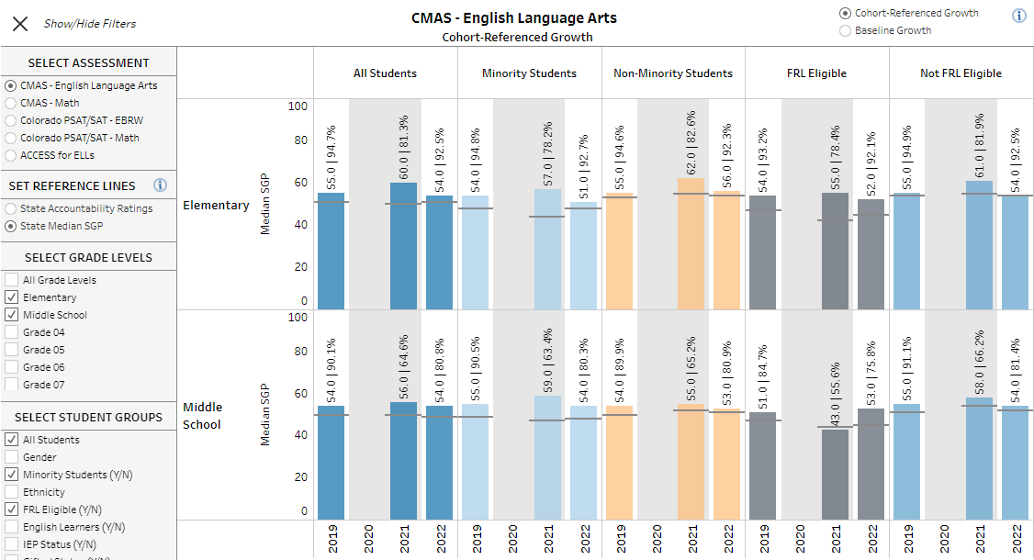
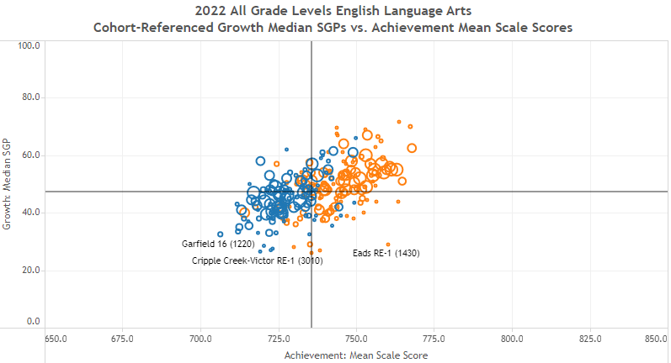
Homework: Performance Tools and Visualizations
District and School Dashboard
Data Explorer Tool
Includes updated enrollment, demographics, achievement, growth, and postsecondary visualizations to support improvement planning efforts.
Includes updated achievement, growth, and postsecondary metrics that can also be downloaded into Excel files for additional analysis.
Notes:
Google Doc Facilitator Notes

Slide 27
Homework:
Review resources and information about state accountability on our website
State Accountability resources: http://www.cde.state.co.us/accountability/stateaccountability
Framework flat files: http://www.cde.state.co.us/accountability/performanceframeworkresults
Online frameworks & improvement plans: https://www.cde.state.co.us/schoolview/frameworks/welcome
Data tools & reports: https://www.cde.state.co.us/accountability/schoolviewdataandresults
UIP resources: https://www.cde.state.co.us/uip

Slide 28
Discussion
Jamboard (slides 4-6) with designated CDE facilitator/note taker
Discussion Questions:
How can CDE better support the planning (UIP) process prior to and during the release of accountability data?
Any feedback on data delivery (e.g. Syncplicity, District and School Dashboard in the UIP online system, Public Data Tools & Reports, Online Frameworks)?
What technical assistance or resources would be helpful? Any special implications for identified schools/districts?
Small group discussion
Notes:
Jamboard - 10 minutes

Slide 29
Future AWG Topics

Slide 30
Potential Future AWG Topics
Jamboard (slide 7) with designated CDE facilitator/note taker
Discussion Questions:
We’ve already suggested
Participation Descriptors in Performance Frameworks
Performance Watch expectations and activities alignment
UIP Pilot Template
ESSA Identification
Accountability tools, resources and visualizations
Just in time policy discussions (its leg session!)
What other topics would you add for this group to discuss?
How would you prioritize these topics? Draw a star or check mark (pen tool) on your two highest priority topics.
Notes:
Jamboard

Slide 31
Non-Member Opportunity

